Slide 1
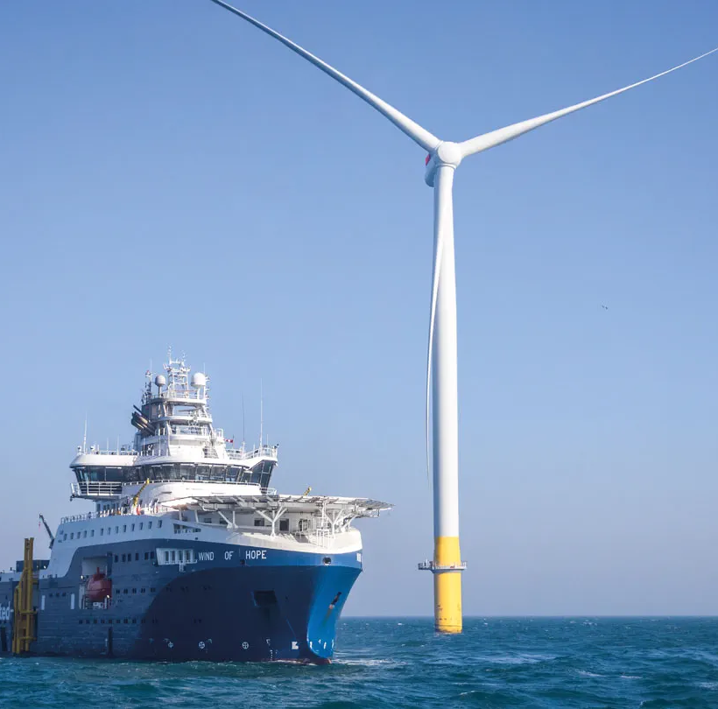
Wind Power
Plants
How a wind turbine
generates electricity
Electric Power Generation
Group A
Notes:
Presenter A 00:00–00:30
Good afternoon, everyone. Today we are going to explain how a wind power plant works. We will start with the turbine, then follow the electricity to the grid. I will cover the equipment and the main performance measures. My partner will explain grid support, environmental impacts, and a real offshore wind farm.
中文提示：用正常语速介绍主题与分工。不要在开场把后面所有知识点都念一遍。
R1: U.S. Department of Energy. How Do Wind Turbines Work?
https://www.energy.gov/cmei/systems/how-do-wind-turbines-work
Image source: https://cdn.orsted.com/-/media/www/images/corp/uk/expert-take/hornsea-2/56a-wind-of-hope-a2l.jpg?extension=webp&hash=E11C89B3CC7A6AAEE52EC3E9AC23F08A&mh=1440&mw=1440&rev=1b15ecc03bf34e4b83a154639c54c8c7

Slide 2
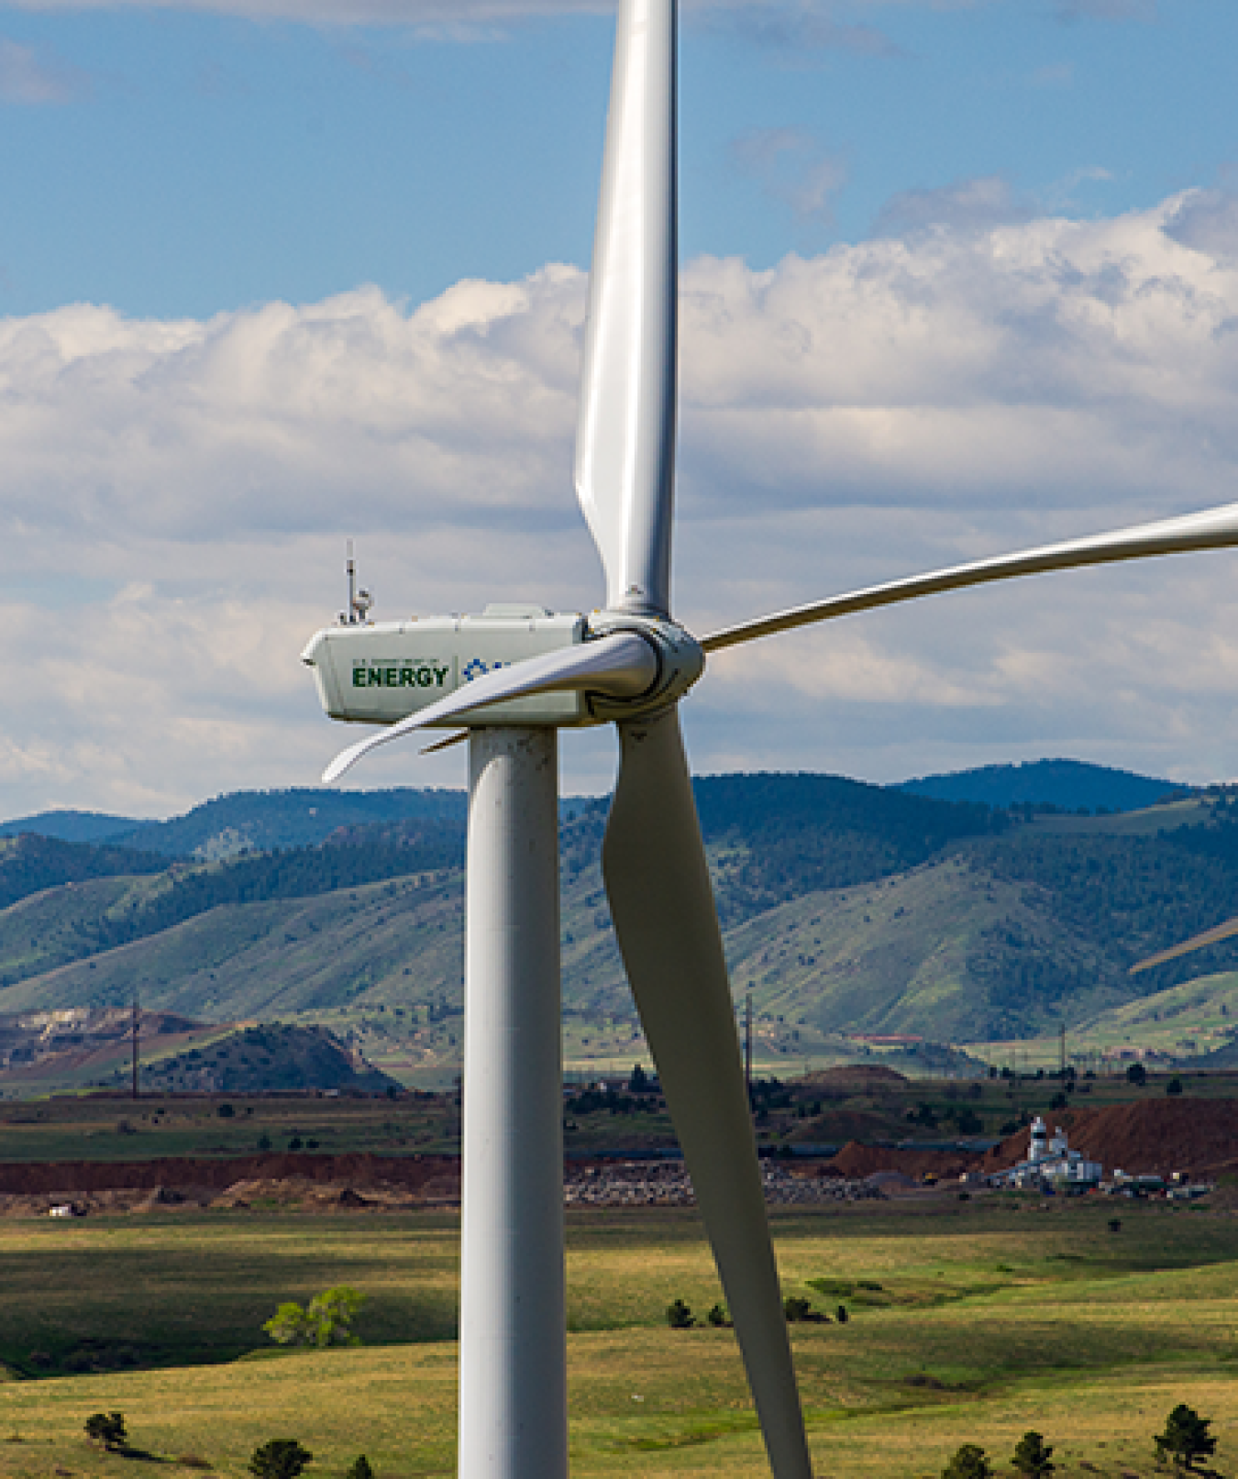
Wind as an energy source
Moving air carries kinetic energy.
The available energy changes with wind speed.
Image: U.S. Department of Energy
R1
02
Notes:
Presenter A 00:30–01:15
The energy comes from moving air. We can see a rotor placed high above the ground, where it can intercept that air flow. The turbine does not burn a fuel to generate electricity. But it also cannot choose when the wind will blow. Even at a good site, wind speed changes during the day and across the seasons. That is why a turbine's rated power alone cannot tell us how much electricity it will produce. We need to understand both the machine and the wind at its location.
中文提示：指着照片中的转子和塔架，解释能源来自空气运动。最后一句引出后面的功率与容量因子，不展开环境影响。
R1: U.S. Department of Energy. How Do Wind Turbines Work?
https://www.energy.gov/cmei/systems/how-do-wind-turbines-work
Image source: https://www.energy.gov/sites/default/files/styles/full_article_width/public/2019/08/f66/25897_CROPPED.png?itok=IgKTfBNx

Slide 3
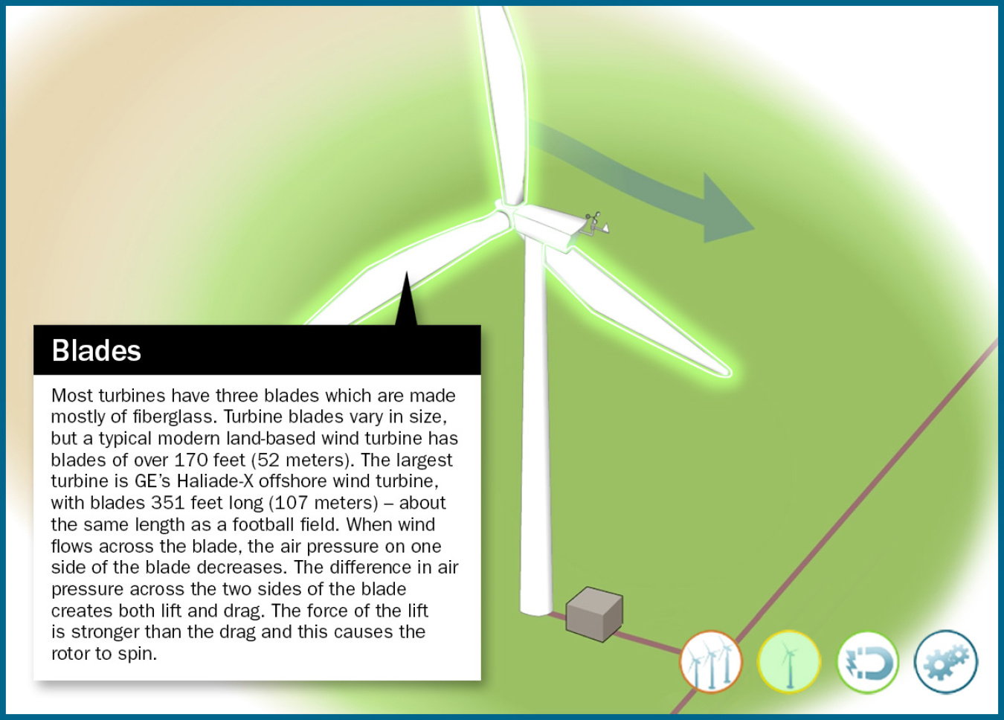
How blades turn the rotor
Each blade has an airfoil profile.
The tangential force produces rotor torque.
Image: U.S. Department of Energy
R1, R3
03
Notes:
Presenter A 01:15–02:15
A modern turbine blade works in a similar way to an aircraft wing. Its cross-section is an airfoil. As air flows around it, the blade experiences lift and drag. Part of the aerodynamic force acts in the direction of rotation. That component creates torque and turns the rotor. Look at where the blades join the hub. The blades and hub rotate together, transferring mechanical power into the machine. So we should picture an aerodynamic force producing rotation, rather than imagine the turbine as a flat surface that the wind simply pushes. The generator uses that rotation to produce electricity. We will look at it on the next slide.
中文提示：指叶片、轮毂，按“气流产生气动力，切向分量产生转矩”解释。插图只说明转子位置，不是升力矢量图。
R1: U.S. Department of Energy. How Do Wind Turbines Work?
https://www.energy.gov/cmei/systems/how-do-wind-turbines-work
R3: Burton et al. (2011). Wind Energy Handbook, 2nd edition
https://doi.org/10.1002/9781119992714
Image source: https://www.energy.gov/sites/default/files/styles/full_article_width/public/2021-07/wind-turbine-blades.jpg?itok=THlqet8U

Slide 4
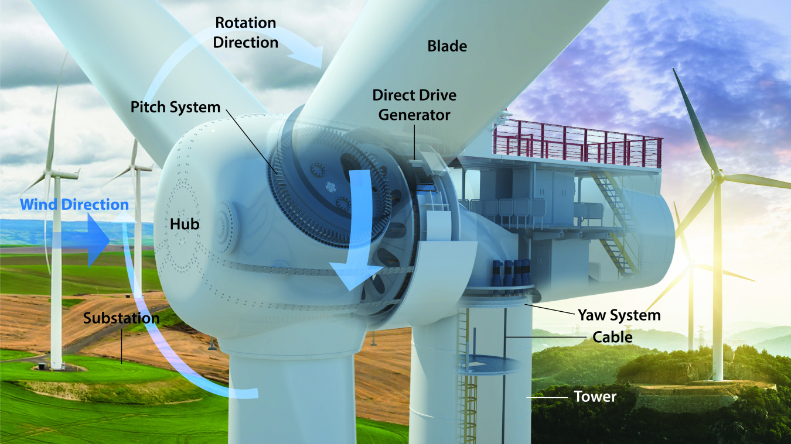
The generator inside the nacelle
Direct drive: the rotor turns the generator directly.
A geared design adds a gearbox between them.
Direct-drive illustration: Josh Bauer / NLR, via U.S. DOE
R1, R2, R10
04
Notes:
Presenter A 02:15–03:20
The housing behind the rotor is called the nacelle. This cutaway shows a direct-drive design. The rotor connects directly to a large generator, so there is no gearbox in this arrangement. The generator converts the shaft's mechanical power into electrical power through electromagnetic action. Another common design uses a gearbox between the rotor and the generator. The gearbox increases the rotational speed, allowing a different generator design. Both approaches do the same basic job, but their equipment and maintenance needs differ. The tower supports the nacelle and raises the rotor into the wind. A foundation carries the structural loads. For this slide, the point to remember is where the generator sits and how the rotor drives it.
中文提示：图是直驱结构，先指 Direct Drive Generator，再说明有齿轮箱机型是另一种设计。不要把图讲成所有风机统一结构。
R1: U.S. Department of Energy. How Do Wind Turbines Work?
https://www.energy.gov/cmei/systems/how-do-wind-turbines-work
R2: U.S. Department of Energy. Explore a Wind Turbine
https://www.energy.gov/cmei/systems/explore-wind-turbine-text-version
R10: U.S. Department of Energy. What Is Wind Energy?
https://www.energy.gov/cmei/systems/windexchange/what-wind-energy
Image source: https://www.energy.gov/sites/default/files/styles/full_article_width/public/2025-09/123838_Wind%20Turbine%20Cutaway_wText_4_4.jpg?itok=b3JPY3iH

Slide 5
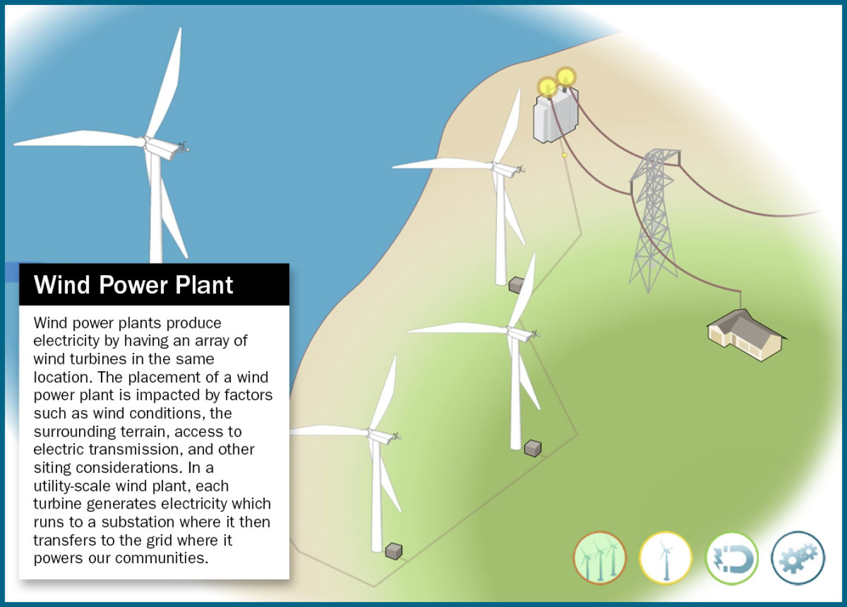
Collecting electricity from a wind farm
Each turbine feeds a collection network.
The substation combines output and raises voltage.
Image: U.S. Department of Energy
R2, R3
05
Notes:
Presenter A 03:20–04:20
One turbine is a generating unit. A wind farm connects many of these units through a collection network. In this illustration, follow the cables from the turbines toward the substation. Electricity from the individual machines comes together there, and transformers raise the voltage for the grid connection. Higher voltage reduces the current needed to transfer the same power, which helps reduce resistive losses. The plant also needs switchgear, protection, metering, and communication. The collection network is what lets separate turbines supply electricity through a shared connection. Offshore farms use the same basic idea, although their collection and export cables must operate in a marine environment.
中文提示：指图中的电缆、变电站与输电线路。讲清集电系统如何连接多台风机，不再复述机舱内部组成。
R2: U.S. Department of Energy. Explore a Wind Turbine
https://www.energy.gov/cmei/systems/explore-wind-turbine-text-version
R3: Burton et al. (2011). Wind Energy Handbook, 2nd edition
https://doi.org/10.1002/9781119992714
Image source: https://www.energy.gov/sites/default/files/styles/full_article_width/public/2021-07/wind-power-plant-main.jpg?itok=Sj3TZlTp

Slide 6
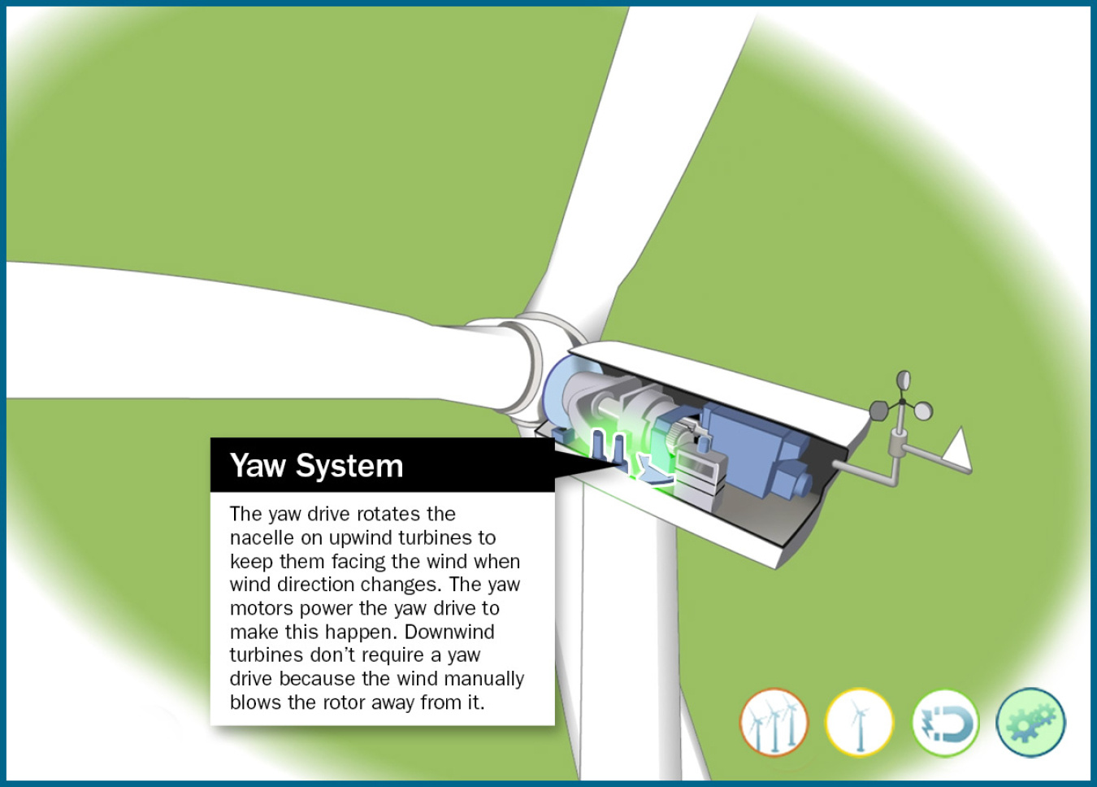
Yaw control
Yaw rotates the whole nacelle.
It keeps an upwind rotor facing the wind.
Image: U.S. Department of Energy
R2
06
Notes:
Presenter A 04:20–05:05
Wind direction changes as well as wind speed. Yaw control deals with that change in direction. A wind vane measures the direction, and yaw motors turn the nacelle around the top of the tower. Notice that the whole nacelle moves with the rotor. On a typical upwind turbine, this keeps the rotor facing the wind. If the rotor is poorly aligned, it captures less energy and may experience uneven loading. Yaw is usually a gradual adjustment. It changes the direction the turbine faces, rather than changing the angle of an individual blade.
中文提示：指机舱与塔顶之间的偏航机构。用“整台机舱转向”解释，避免把偏航与变桨混为一谈。
R2: U.S. Department of Energy. Explore a Wind Turbine
https://www.energy.gov/cmei/systems/explore-wind-turbine-text-version
Image source: https://www.energy.gov/sites/default/files/styles/full_article_width/public/2021-07/land-based--turbine-yaw-system.jpg?itok=iDJer7-0

Slide 7
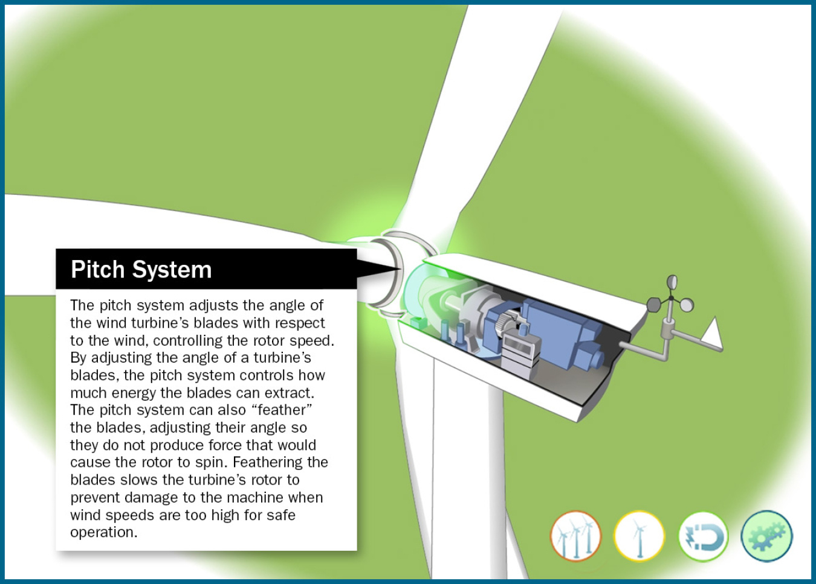
Pitch control
Pitch rotates each blade about its own axis.
It limits power and loads in strong winds.
Image: U.S. Department of Energy
R2, R3
07
Notes:
Presenter A 05:05–05:55
Pitch control changes the angle of each blade about its own long axis. Here, the adjustment happens where a blade connects to the hub. Changing that angle changes the aerodynamic force. When wind is strong enough for the turbine to reach rated power, the controller can adjust pitch to keep power and loads within safe limits. For a shutdown, it can turn the blades toward a feathered position, reducing the force that drives rotation. This explains why more wind does not always produce more electrical power. Below rated power, torque and speed control also help the turbine capture energy. On this page, though, we are focusing on the blade-angle adjustment.
中文提示：指叶根，说明变桨改变叶片绕自身长轴的角度。重点解释额定功率以上的限功率与保护作用。
R2: U.S. Department of Energy. Explore a Wind Turbine
https://www.energy.gov/cmei/systems/explore-wind-turbine-text-version
R3: Burton et al. (2011). Wind Energy Handbook, 2nd edition
https://doi.org/10.1002/9781119992714
Image source: https://www.energy.gov/sites/default/files/styles/full_article_width/public/2021-07/land-based--turbine-pitch-system.jpg?itok=Fef4z2cQ

Slide 8
Wind speed and electrical output
Electrical output / rated power
Pwind = ½ρAv³
1
Rated
Cut-out
Available wind power
increases with v³.
0.5
Output has a rated limit.
Cut-in
0
0
3
12
25
30
Wind speed (m/s)
Illustrative electrical-output curve: 3 / 12 / 25 m/s are teaching assumptions, not manufacturer specifications.
R2, R3
08
Notes:
Presenter A 05:55–07:00
The equation on the left describes power available in the wind. With the same air density and swept area, that power grows with wind speed cubed. The curve on the right shows a different quantity: electrical output divided by rated power. Below cut-in, output is zero. Between cut-in and rated speed, output rises. Above rated speed, pitch control limits output, producing the plateau. Beyond the illustrated high-wind limit, the turbine stops for protection. Three, twelve and twenty-five metres per second are teaching assumptions; actual thresholds and storm controls vary by turbine. So the cubic rule helps explain the resource, but it does not describe electrical output across the entire operating range.
中文提示：先指左侧可用风功率公式，再沿右侧电功率曲线讲启动、增长、额定平台和高风速停机。纵轴是实际电功率/额定功率；3、12、25 m/s只是教学假设，不是Hornsea 2的官方或实测阈值。
R2: U.S. Department of Energy. Explore a Wind Turbine
https://www.energy.gov/cmei/systems/explore-wind-turbine-text-version
R3: Burton et al. (2011). Wind Energy Handbook, 2nd edition
https://doi.org/10.1002/9781119992714

Slide 9
A wind-power calculation
Pe ≈ ½ρAv³ × Cp × η
Assumed inputs
Calculated power
D = 120 m v = 8 m/s
ρ = 1.225 kg/m³
Cp = 0.45 η = 0.94
A = π × 60² ≈ 11,310 m²
Incoming wind 3.55 MW
Rotor 1.60 MW
Electrical output 1.50 MW
Teaching example with assumed inputs. Values rounded.
R3
09
Notes:
Presenter A 07:00–08:05
Let's put numbers into the equation. Assume a rotor diameter of one hundred and twenty metres and a wind speed of eight metres per second. We also assume standard air density of one point two two five kilograms per cubic metre. The rotor sweeps a circular area with a radius of sixty metres. Substituting these values gives about three point five five megawatts in the incoming wind. The rotor captures only part of that power. With an assumed power coefficient of zero point four five, the rotor power is about one point six megawatts. Applying a downstream efficiency of zero point nine four gives about one point five megawatts of electrical output. This is a teaching calculation using assumed inputs, rather than a measured turbine result.
中文提示：按来流 3.55 MW、转子 1.60 MW、电气输出 1.50 MW 依次指读。尺寸、风速、Cp、η 都是假设值。
R3: Burton et al. (2011). Wind Energy Handbook, 2nd edition
https://doi.org/10.1002/9781119992714

Slide 10
The power coefficient Cp
Cp = rotor power / available wind power
59.3%
Air must still flow out
behind the rotor.
Ideal Betz limit
Downstream mechanical and electrical
losses are accounted for separately by η.
Cp ≤ 16/27 in the ideal actuator-disk model
R3
10
Notes:
Presenter A 08:05–08:55
The power coefficient, C p, tells us what fraction of the incoming wind power reaches the rotor as mechanical power. Why is there a limit? If a rotor removed all the energy, the air behind it would stop moving. Air still has to flow through and leave the rotor. In the ideal actuator-disk model, the highest possible power coefficient is sixteen over twenty-seven, or about fifty-nine point three percent. A real turbine also has aerodynamic losses. Then the drive train and electrical equipment introduce further losses after the rotor. In our previous example, C p described aerodynamic capture, while eta described the downstream conversion. Keeping those two stages separate makes the calculation easier to interpret.
中文提示：口播把 Cp 读作 C p。说明 Betz 上限是理想模型里的气动捕获上限，不能把它直接当整机电气效率。
R3: Burton et al. (2011). Wind Energy Handbook, 2nd edition
https://doi.org/10.1002/9781119992714

Slide 11
Capacity factor and annual energy
Capacity factor
Actual energy / (rated power × time)
A 35% capacity factor does not mean 65% of wind energy is wasted.
3 MW × 8,760 h × 0.35
≈ 9.20 GWh per year
Assumed 35% capacity factor in a non-leap year. Capacity factor measures output over time.
R3
11
Notes:
Presenter A 08:55–10:00
Capacity factor answers a different question: how much energy did the turbine produce over a period of time? We divide actual energy by the energy it would have produced at rated power throughout that period. For this example, take a three-megawatt turbine and assume a thirty-five percent annual capacity factor. Three megawatts times eight thousand seven hundred and sixty hours times zero point three five gives about nine point two gigawatt-hours in a non-leap year. A thirty-five percent capacity factor does not mean that sixty-five percent of wind energy is wasted. It measures energy over time, rather than conversion efficiency. It reflects wind conditions and factors such as downtime, wake losses, electrical losses, and curtailment. That completes the turbine and performance section. I will now hand over to my partner to explain the grid connection.
中文提示：按分子和分母解释容量因子；强调35%并不代表浪费了65%的风能。算例用非闰年的 8,760 小时。结尾完成 A 到 B 的交接。
R3: Burton et al. (2011). Wind Energy Handbook, 2nd edition
https://doi.org/10.1002/9781119992714

Slide 12
Frequency support from active power
Extra active power can help when frequency falls.
Sustained support needs available wind and headroom.
Short response can use finite rotor energy. Sustained support needs an ongoing energy source.
R3, R8, C3
12
Notes:
Presenter B 10:00–11:25
Thank you. I will begin with frequency support. As we discussed in class, frequency is closely related to the balance between generation and demand. If generation falls short, frequency tends to fall. A wind plant with suitable controls can increase active power to help, but the extra energy must come from somewhere. For a short response, a turbine can release some of the kinetic energy stored in its rotating parts. That response is finite, and the rotor must recover afterward. For sustained upward support, the plant needs available wind and room to increase output. In the example here, two megawatts are available, but the turbine is operating at one point six. That leaves zero point four megawatts of headroom. If it were already using all the available wind power, it could not simply hold a higher output indefinitely.
中文提示：指例子中的 1.6 MW 和剩余 0.4 MW。区分转子短时动能释放与持续有功备用，例子不是实测运行记录。
R3: Burton et al. (2011). Wind Energy Handbook, 2nd edition
https://doi.org/10.1002/9781119992714
R8: NREL (2014). Active Power Controls from Wind Power, NREL/TP-5D00-60574
https://www1.eere.energy.gov/wind/pdfs/60574.pdf
C3: Mehrjerdi. Course slides, Frequency Control, PDF pp. 12–13 and 24–29
Illustrative headroom example: 2.0 MW available, 1.6 MW scheduled, 0.4 MW held back.

Slide 13
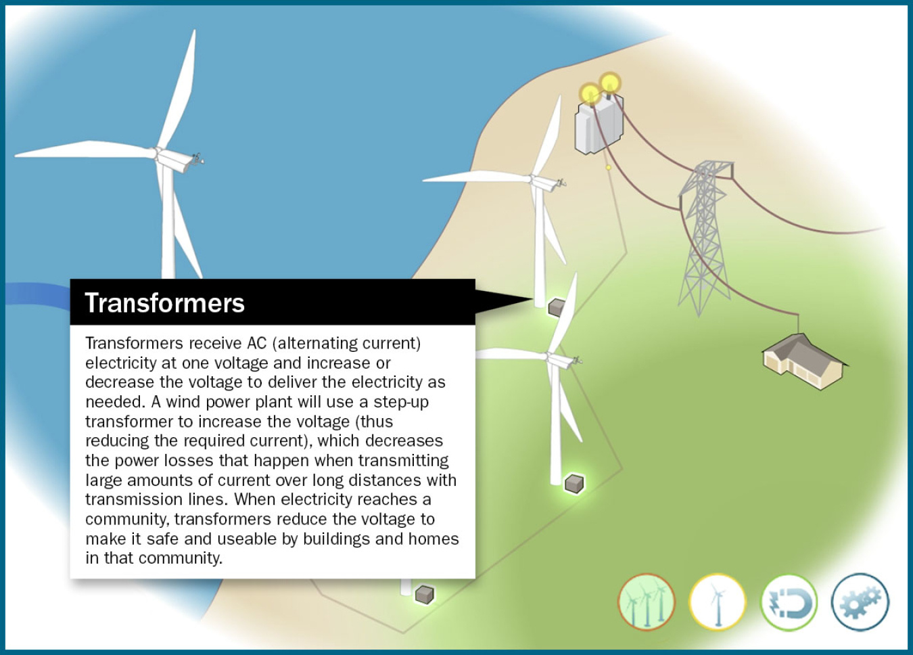
Voltage support from reactive power
The converter controls reactive current.
Plant control coordinates support at the grid connection.
Image: U.S. Department of Energy
R3, C2
13
Notes:
Presenter B 11:25–12:40
Voltage support involves reactive power. In our full-converter example, power electronics control the current supplied to the grid, including its reactive component. Plant-level control coordinates the turbines so that the shared grid connection follows a voltage or reactive-power target. The converter has current and thermal limits, so the available reactive support is bounded. Active and reactive power requirements also have to fit within the equipment's capability. This connects with the voltage-control topic in our course, but the equipment differs. A conventional synchronous generator's automatic voltage regulator acts on excitation. A full-converter turbine uses converter control. The illustration shows the plant's electrical connection, not a detailed control circuit. The useful distinction is that active-power support and reactive-power support have different jobs and different limits.
中文提示：重点讲变流器无功电流与风场协调。配图用于指出并网位置，不当作控制回路图。同步机 AVR 的详细比较留在备份页。
R3: Burton et al. (2011). Wind Energy Handbook, 2nd edition
https://doi.org/10.1002/9781119992714
C2: Mehrjerdi. Course slides, Voltage Control, PDF pp. 17–21 and 33
Image source: https://www.energy.gov/sites/default/files/styles/full_article_width/public/2021-07/wind-power-plant-transformer.jpg?itok=dQGGgljg

Slide 14
Life-cycle carbon emissions
Life-cycle emissions, g CO₂-eq/kWh
IPCC 2014 literature medians. Includes upstream and construction emissions.
The values describe a synthesis of studies, not measurements from every plant.
R5
14
Notes:
Presenter B 12:40–13:55
Now let's look at carbon emissions over the life cycle. Wind turbines do not burn fuel while producing electricity. They still require steel, concrete, manufacturing, installation, and maintenance. The chart includes these stages. It uses literature medians from the IPCC's 2014 assessment: eleven grams of carbon-dioxide equivalent per kilowatt-hour for onshore wind, four hundred and ninety for gas combined cycle, and eight hundred and twenty for pulverized coal. The gap is large, even though wind's number is above zero. These values come from a historical synthesis of studies, so they should not be treated as measurements for every plant or as a current project forecast. They help us compare the scale of life-cycle emissions under a common unit. Local environmental effects need a separate assessment, which is the next topic.
中文提示：指三根柱子，明确单位和 2014 文献中位数口径。不要称为零排放，也不要把它说成 2026 年实时数据。
R5: IPCC (2014). Annex III, Table A.III.2
https://www.ipcc.ch/site/assets/uploads/2018/02/ipcc_wg3_ar5_annex-iii.pdf

Slide 15
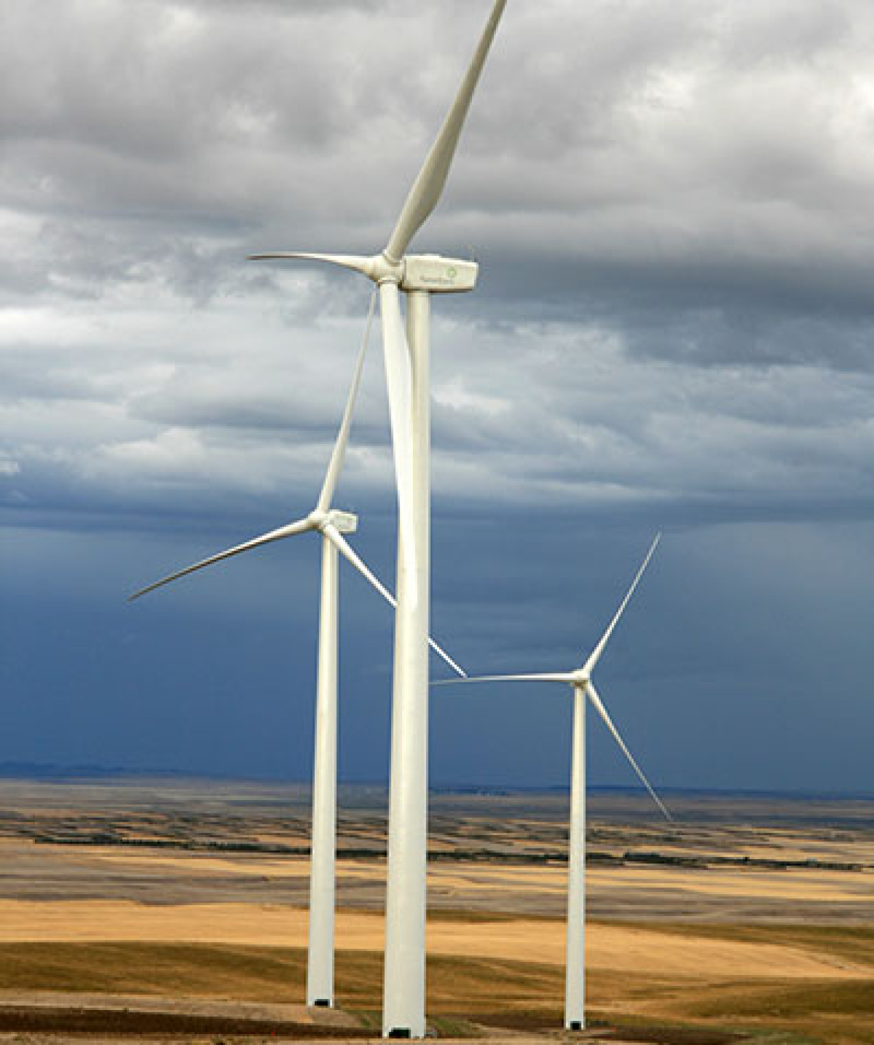
Siting and local impacts
Bird and bat activity can affect where turbines go.
Noise and visual effects matter to nearby residents.
Land between turbines can remain in use.
Image: U.S. Department of Energy
R7, R10
15
Notes:
Presenter B 13:55–15:00
A low carbon footprint does not settle the question of where to build a wind farm. Site selection has to consider birds, bats, habitats, and the people living nearby. Ecological surveys can identify sensitive areas, and monitoring can show when operating changes are needed. In some cases, targeted curtailment reduces risk to wildlife. Noise and visual effects also need to be considered with local communities. Look at the space between turbines in this photo. The total project area is much larger than the land directly occupied by foundations and access roads. Depending on the site, agriculture or other activities can continue between turbines. This is why land use should be described carefully rather than reduced to one area figure.
中文提示：用照片解释风场总范围与基础、道路的直接占地不同。当地生态、噪声和视觉影响都属于选址问题。
R7: Denholm et al. (2009). Land-Use Requirements of Modern Wind Power Plants, NREL/TP-6A2-45834
https://www.nrel.gov/docs/fy09osti/45834.pdf
R10: U.S. Department of Energy. What Is Wind Energy?
https://www.energy.gov/cmei/systems/windexchange/what-wind-energy
Image source: https://www.energy.gov/sites/default/files/styles/full_article_width/public/2019/08/f65/photo-utility-scale-16082-035a6f4113cac1389bcd8841b09aae02510b2a443b902ae64f7ff8162ba5ea30.jpg?itok=F7ecuByb

Slide 16
Global wind capacity
1,133 GW
Global installed wind capacity at the end of 2024
China has the largest national market.
The United States and Europe also have large fleets.
IRENA, Renewable Capacity Statistics 2025. Capacity is rated power, not annual energy.
R4
16
Notes:
Presenter B 15:00–15:55
To show the scale of deployment, we have kept a clearly dated benchmark. IRENA's 2025 report gives about one thousand one hundred and thirty-three gigawatts of installed wind capacity worldwide at the end of 2024. That is about one point one three terawatts. China has the largest national installed-capacity market, and the United States and Europe also have large wind fleets. Different regions develop onshore or offshore projects according to their resources and grid connections. Remember the unit here: gigawatts describe rated power. This number tells us the scale of the installed equipment, but annual generation would need an energy unit, such as terawatt-hours.
中文提示：数据明确写到 2024 年底，沿用原稿年份。把 GW 的额定功率含义讲清即可，不把它当发电量。
R4: IRENA (2025). Renewable Capacity Statistics 2025
https://www.irena.org/Publications/2025/Mar/Renewable-capacity-statistics-2025

Slide 17
China’s resource and demand locations
Location | Resource and delivery
Northern and western onshore sites | Strong resources can be far from major demand centres.
Eastern demand centres | Transmission must carry energy to consumers.
Coastal offshore sites | Closer to coastal demand, with marine engineering needs.
Limited transmission can force a wind farm to reduce output.
R3, R9
17
Notes:
Presenter B 15:55–16:55
China gives us a useful example of why the grid location matters. Many strong onshore resources are in northern and western areas, while major demand centres are elsewhere, including the east. A wind farm can therefore have a good wind resource but still need long-distance transmission to reach consumers. If the network cannot accept all the available output, some generation may be curtailed. Forecasting helps operators prepare for changes, while transmission and system flexibility help them use the energy. Coastal offshore development offers a different location option, though marine engineering brings its own challenges. For this regional example, the main lesson is the distance between a useful resource and the demand it needs to serve.
中文提示：用左右两栏说明资源所在地与负荷中心的关系。英国海缆照片不拿来冒充中国工程；本页用可编辑对照表。
R3: Burton et al. (2011). Wind Energy Handbook, 2nd edition
https://doi.org/10.1002/9781119992714
R9: IEA (2025). World Energy Investment 2025, China
https://www.iea.org/reports/world-energy-investment-2025/china

Slide 18
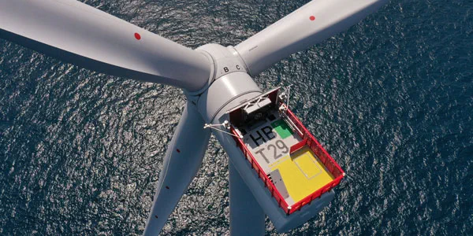
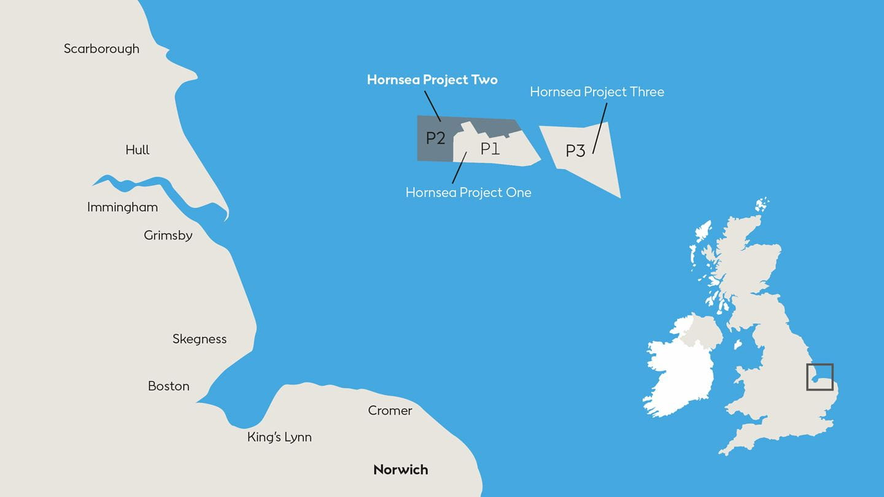
Hornsea 2 offshore wind farm
North Sea · Yorkshire coast
165 turbines × 8 MW
Collection network
→ substations → onshore grid
1,320 MW rated capacity
Fully operational in August 2022
Photo and location map: Ørsted
R6
18
Notes:
Presenter B 16:55–18:15
Hornsea Two is a real offshore wind farm in the North Sea, off the United Kingdom. The project became fully operational in August 2022. It has one hundred and sixty-five turbines, with a published rating of eight megawatts each. Multiplying those values gives one thousand three hundred and twenty megawatts, or about one point three gigawatts. The photo shows the turbine and the marine setting. On the official map, locate the shaded P2 area in the North Sea, off the Yorkshire coast. P1 and P3 identify the neighbouring projects, not Hornsea Two. At this scale, the plant needs an offshore collection network, substations, and export cables to bring electricity to shore. It also needs vessels and weather windows for maintenance. The project makes the earlier equipment and grid topics concrete: each rotor generates mechanical power, and the shared electrical infrastructure delivers the combined output. The one point three gigawatts remains a rated capacity, rather than a promise of constant generation.
中文提示：先指照片，再指右侧官方位置图上的P2区域，说明其位于约克郡海岸外的北海。P1/P3是相邻项目，不是本项目。然后沿新增文字讲集电网、变电站和陆上电网的送电路径。只保留已核对的投运时间、165 台与 8 MW，不使用“目前全球最大”。
R6: Ørsted. Hornsea 2 Offshore Wind Farm
https://orsted.co.uk/energy-solutions/offshore-wind/our-wind-farms/hornsea2
Image source: https://cdn.orsted.com/-/media/2022-activity-maps/hornsea2sgre84mwturbine.jpg?extension=webp&hash=4705F719FDF91946E70B400FC62C43AF&mh=1440&mw=1440&rev=23e97ca3f9c94109ae7b9b7db4b2cb72
Location map: https://cdn.orsted.com/-/media/www/images/corp/uk/hornsea-project-two/how2_map.jpg?hash=27FCE6711EB4F75CA5A0FBABB36ADF83&mh=1440&mw=1440&rev=4133b672a21c4c60a38199c6039f52d2

Slide 19
Wind in the generation mix
Technology | Supply characteristic | Main constraint
Wind | Low-carbon energy, no fuel purchase | Output follows the wind resource
Gas | Output adjustable within limits | Fuel supply, cost and emissions
Solar PV | Modular, low-carbon energy | Daylight and weather
Reservoir hydro | Flexible when water is available | Sites, water and ecology
During low wind, the system can use gas, hydro, storage or imports.
R1, R3, R5
19
Notes:
Presenter B 18:15–19:20
This table compares how different plants can supply power. Wind has no fuel purchase during generation and has low life-cycle emissions, but its available output changes with the weather. A gas plant can adjust output within its operating limits, although it needs fuel and produces emissions. Solar photovoltaic output depends on daylight and weather. Reservoir hydropower can adjust output when water and operating conditions allow, but sites and water availability are limited. So the technologies provide different combinations of energy and controllability. A power system has to meet demand in each hour, not just add up annual energy. Wind can make a substantial contribution, while flexible generation, interconnection, demand response, and sometimes storage help the system handle changing output.
中文提示：表格只比较供电特性和主要限制。水电特指水库式，避免暗示所有水电都可自由调度。
R1: U.S. Department of Energy. How Do Wind Turbines Work?
https://www.energy.gov/cmei/systems/how-do-wind-turbines-work
R3: Burton et al. (2011). Wind Energy Handbook, 2nd edition
https://doi.org/10.1002/9781119992714
R5: IPCC (2014). Annex III, Table A.III.2
https://www.ipcc.ch/site/assets/uploads/2018/02/ipcc_wg3_ar5_annex-iii.pdf

Slide 20
The output of a wind power plant
Hornsea 2 has a rated capacity of 1,320 MW.
Its actual output changes with wind conditions.
Thank you
R3
20
Notes:
Presenter B 19:20–20:00
We will finish with one point to keep in mind. Rated capacity tells us the size of a wind power plant. To understand what it actually delivers, we also need the wind resource, the energy produced over time, and the conditions at the grid connection. That is why our annual-energy example and our Hornsea Two capacity figure describe different things. Thank you for listening. We are happy to take your questions.
中文提示：只收束到“额定容量与实际交付不同”这一点。说完邀请提问，再按需要打开备份页。
R3: Burton et al. (2011). Wind Energy Handbook, 2nd edition
https://doi.org/10.1002/9781119992714

Slide 21
References for turbine technology
R1
U.S. Department of Energy. How Do Wind Turbines Work?
https://www.energy.gov/cmei/systems/how-do-wind-turbines-work
R2
U.S. Department of Energy. Explore a Wind Turbine
https://www.energy.gov/cmei/systems/explore-wind-turbine-text-version
R3
Burton et al. (2011). Wind Energy Handbook, 2nd edition
https://doi.org/10.1002/9781119992714
R10
U.S. Department of Energy. What Is Wind Energy?
https://www.energy.gov/cmei/systems/windexchange/what-wind-energy
R1, R2, R3, R10
21
Notes:
Reference or discussion slide
R1: U.S. Department of Energy. How Do Wind Turbines Work?
https://www.energy.gov/cmei/systems/how-do-wind-turbines-work
R2: U.S. Department of Energy. Explore a Wind Turbine
https://www.energy.gov/cmei/systems/explore-wind-turbine-text-version
R3: Burton et al. (2011). Wind Energy Handbook, 2nd edition
https://doi.org/10.1002/9781119992714
R10: U.S. Department of Energy. What Is Wind Energy?
https://www.energy.gov/cmei/systems/windexchange/what-wind-energy

Slide 22
References for deployment and impacts
R4
IRENA (2025). Renewable Capacity Statistics 2025
https://www.irena.org/Publications/2025/Mar/Renewable-capacity-statistics-2025
R5
IPCC (2014). Annex III, Table A.III.2
https://www.ipcc.ch/site/assets/uploads/2018/02/ipcc_wg3_ar5_annex-iii.pdf
R6
Ørsted. Hornsea 2 Offshore Wind Farm
https://orsted.co.uk/energy-solutions/offshore-wind/our-wind-farms/hornsea2
R7
Denholm et al. (2009). Land-Use Requirements of Modern Wind Power Plants, NREL/TP-6A2-45834
https://www.nrel.gov/docs/fy09osti/45834.pdf
R9
IEA (2025). World Energy Investment 2025, China
https://www.iea.org/reports/world-energy-investment-2025/china
R4, R5, R6, R7, R9
22
Notes:
Reference or discussion slide
R4: IRENA (2025). Renewable Capacity Statistics 2025
https://www.irena.org/Publications/2025/Mar/Renewable-capacity-statistics-2025
R5: IPCC (2014). Annex III, Table A.III.2
https://www.ipcc.ch/site/assets/uploads/2018/02/ipcc_wg3_ar5_annex-iii.pdf
R6: Ørsted. Hornsea 2 Offshore Wind Farm
https://orsted.co.uk/energy-solutions/offshore-wind/our-wind-farms/hornsea2
R7: Denholm et al. (2009). Land-Use Requirements of Modern Wind Power Plants, NREL/TP-6A2-45834
https://www.nrel.gov/docs/fy09osti/45834.pdf
R9: IEA (2025). World Energy Investment 2025, China
https://www.iea.org/reports/world-energy-investment-2025/china

Slide 23
References for grid support
R8
NREL (2014). Active Power Controls from Wind Power, NREL/TP-5D00-60574
https://www1.eere.energy.gov/wind/pdfs/60574.pdf
C1
Mehrjerdi. Course slides, Introduction, PDF pp. 17–19 and 27
C2
Mehrjerdi. Course slides, Voltage Control, PDF pp. 17–21 and 33
C3
Mehrjerdi. Course slides, Frequency Control, PDF pp. 12–13 and 24–29
R8, C1, C2, C3
23
Notes:
Reference or discussion slide
R8: NREL (2014). Active Power Controls from Wind Power, NREL/TP-5D00-60574
https://www1.eere.energy.gov/wind/pdfs/60574.pdf
C1: Mehrjerdi. Course slides, Introduction, PDF pp. 17–19 and 27
C2: Mehrjerdi. Course slides, Voltage Control, PDF pp. 17–21 and 33
C3: Mehrjerdi. Course slides, Frequency Control, PDF pp. 12–13 and 24–29

Slide 24
Why electrical output stops rising
Electrical output / rated power
1
Rated
Cut-out
0.5
Cut-in
0
0
3
12
25
30
Wind speed (m/s)
Teaching thresholds: cut-in 3, rated 12, cut-out 25 m/s. Actual turbines and storm-control strategies vary.
R2, R3
24
Notes:
Reference or discussion slide
The cubic relationship describes available wind power under fixed assumptions. Turbine controls limit electrical output once rated power is reached, and protection may stop the turbine in very high winds. The chart assumes cut-in at 3 m/s, rated operation at 12 m/s and shutdown at 25 m/s. These are teaching values, not Hornsea 2 specifications; actual thresholds and storm-control strategies vary by turbine.
中文提示：仅在回答风速立方关系为何不能一直套用时打开。
R2: U.S. Department of Energy. Explore a Wind Turbine
https://www.energy.gov/cmei/systems/explore-wind-turbine-text-version
R3: Burton et al. (2011). Wind Energy Handbook, 2nd edition
https://doi.org/10.1002/9781119992714

Slide 25
Generator and converter architectures
Discussion
Full converter: all generator power passes through the converter.
DFIG: a partial converter connects to the rotor circuit.
Synchronous-machine AVR: excitation regulates terminal voltage.
R2, R3, C2
25
Notes:
Reference or discussion slide
Wind turbines use different electrical architectures. In a full-converter design, all generator power passes through the converter. A doubly fed induction generator uses a partial converter on the rotor circuit. An excitation-based AVR describes a conventional synchronous-machine control, so we should identify the architecture before describing its voltage control.
中文提示：先判断听众问的是哪一种架构，再解释。不要把全功率变流器结论推广到全部风机。
R2: U.S. Department of Energy. Explore a Wind Turbine
https://www.energy.gov/cmei/systems/explore-wind-turbine-text-version
R3: Burton et al. (2011). Wind Energy Handbook, 2nd edition
https://doi.org/10.1002/9781119992714
C2: Mehrjerdi. Course slides, Voltage Control, PDF pp. 17–21 and 33

Slide 26
Does a wind farm need its own battery?
Discussion
A dedicated battery is not required for every wind farm.
The grid can combine storage with other forms of flexibility.
R3, R9
26
Notes:
Reference or discussion slide
A dedicated battery is not required at every wind farm. Variability can also be managed through interconnection, flexible generation, forecasting, and demand response. A battery may be useful, but the decision depends on the grid need and the project's economics.
中文提示：回答储能问题时，先说明系统层面的灵活性选择，再谈具体项目是否需要储能。
R3: Burton et al. (2011). Wind Energy Handbook, 2nd edition
https://doi.org/10.1002/9781119992714
R9: IEA (2025). World Energy Investment 2025, China
https://www.iea.org/reports/world-energy-investment-2025/china

