Slide 1
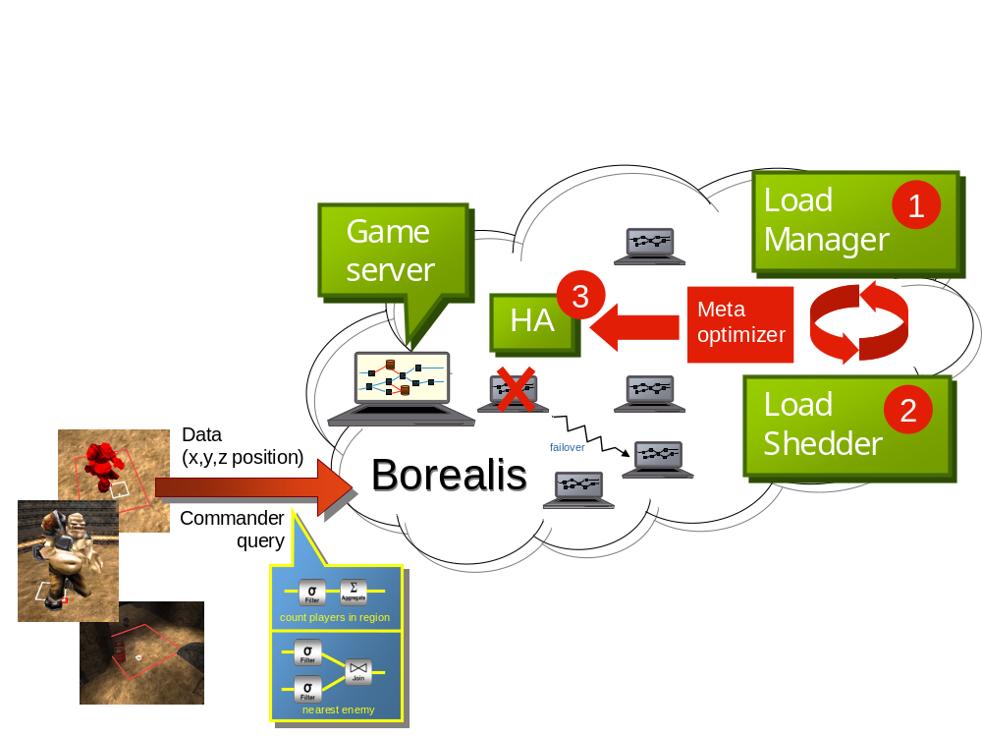
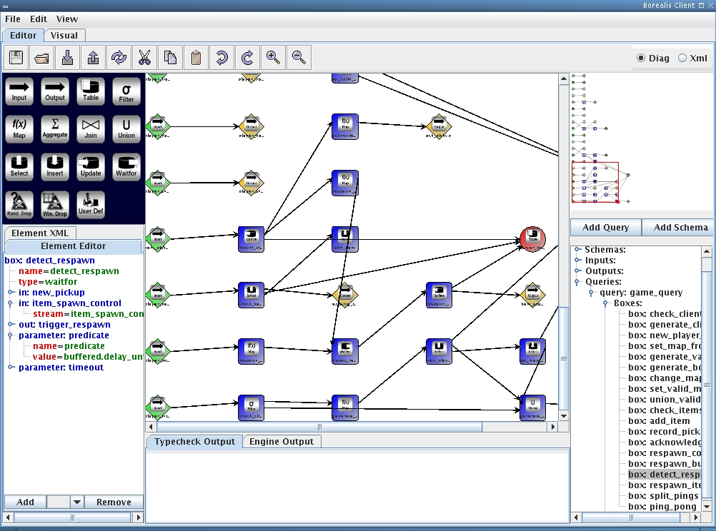
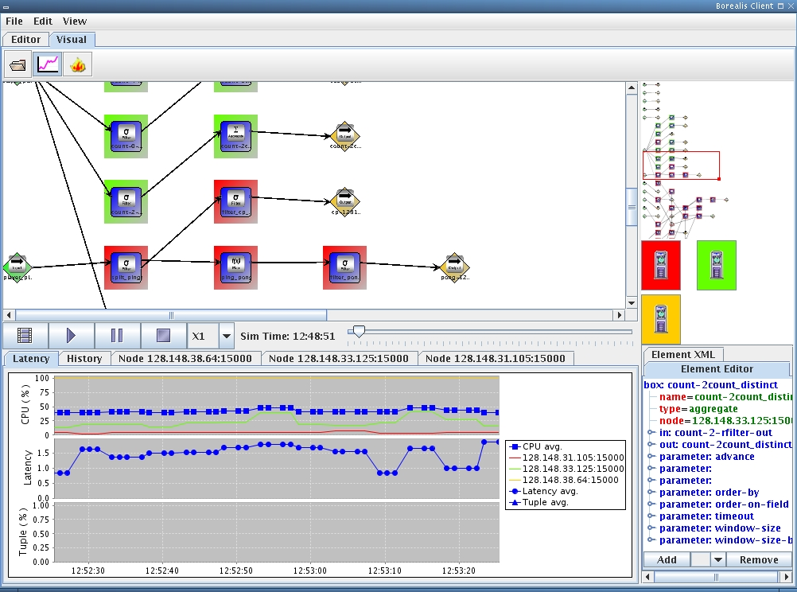

Borealis-powered Cube Multiplayer Game Commander
Y. Ahmad, B. Berg, U. Çetintemel, M. Humphrey, J. Hwang, A. Jhingran, O. Papaemmanouil, A. Rasin, N. Tatbul, W. Xing, Y. Xing, S. Zdonik
Graphical network editor
Visualizer
Query Grammar
value := region | item | player
rel_value := friend | enemy | value
aggregate := count | min | max | sum
query := contains region
  | distance value rel_value
  | aggregate query
Cube game

