Slide 1
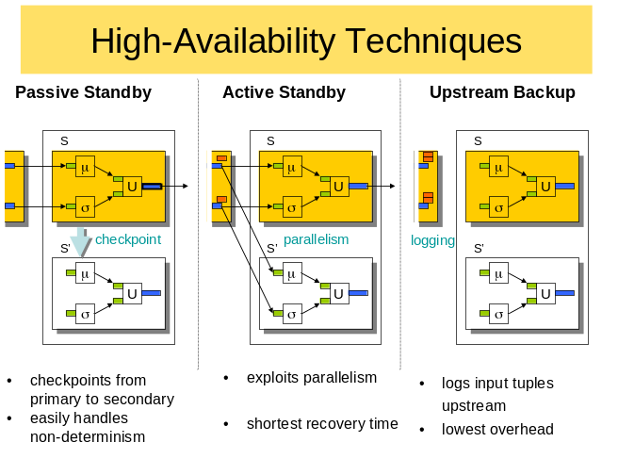
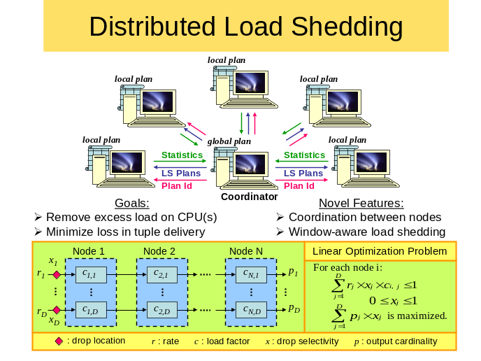
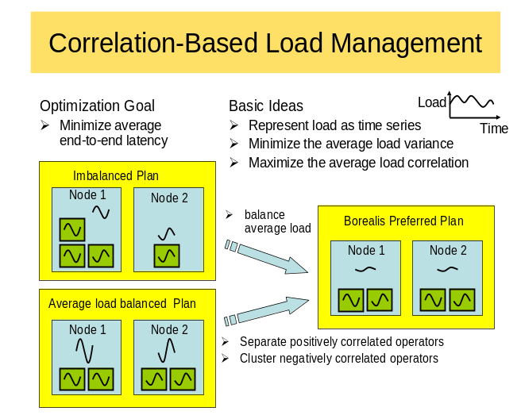
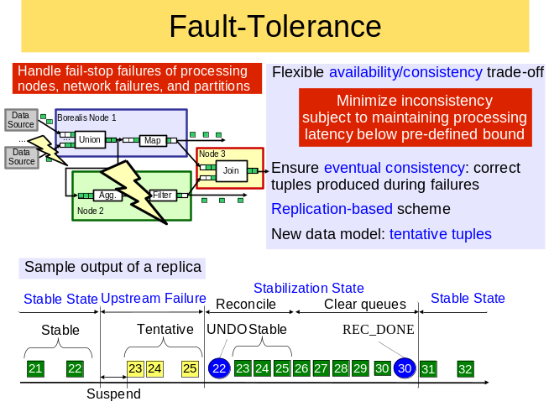
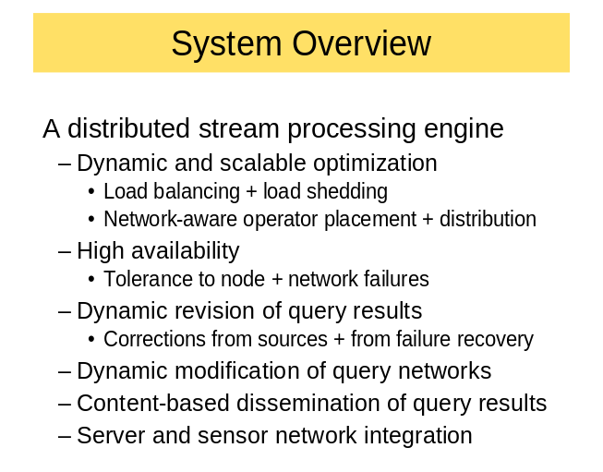
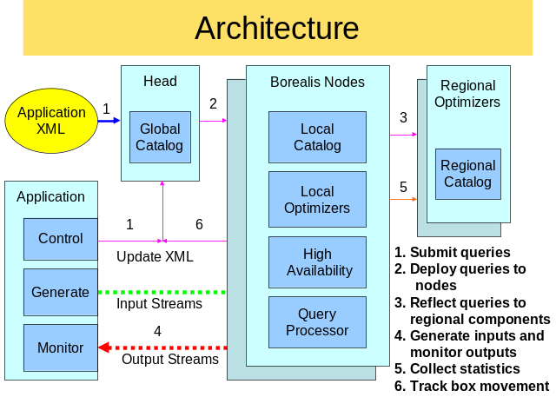



Distributed Operation in the Borealis Stream Processing Engine
D. Abadi, Y. Ahmad, H. Balakrishnan, M. Balazinska, B. Berg, U. Çetintemel, M. Cherniack, J. Hwang, W. Lindner, A. Maskey,
O. Papaemmanouil, A. Rasin, E. Ryvkina, M. Stonebraker, N. Tatbul, Y. Xing, S. Zdonik
http://nms.lcs.mit.edu/projects/borealis/

