Slide 1
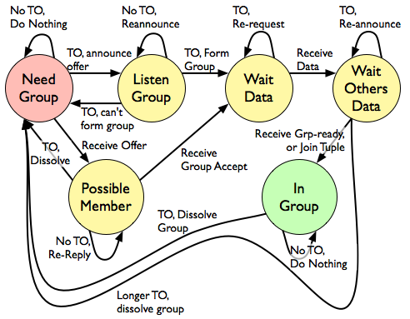
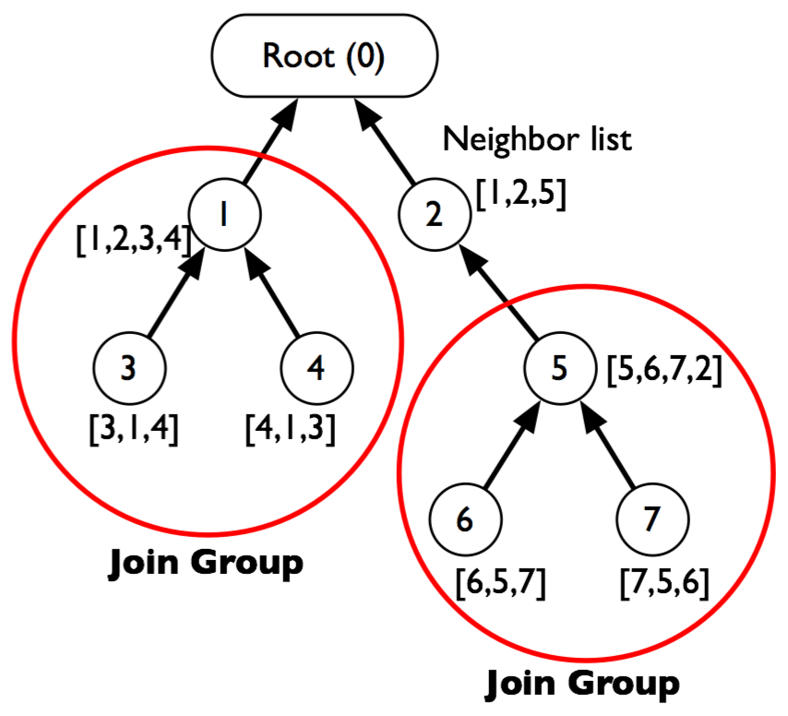
Robust, Efficient Filtering and Event Detection in Sensor Networks (REED)
Daniel Abadi and Samuel Madden
Motivation
Sensor networks are memory and bandwidth limited
Want to save bandwidth by performing as much filtering as possible in-network to avoid transmitting unnecessary data
Complex predicates can be represented as a static table and can be applied using a join of sensor data with this table
But memory limitations prohibit performing static joins with large static tables in network
Cricket Mote Properties
Attribute | Value
Processor | 7Mhz Atmega 128
Radio | 38.6 Kbps CC1020
RAM | 4KB
Flash | 512KB
Active Battery Cons | ~15mA
Sleep Battery Cons | ~10µA
Solution: Store Table in Groups
Step 1:
Form Group
A node begins by announcing it wants to make a group and listens for possible members’ responses
  After waiting period, node checks to see if a group with sufficient aggregate storage can be formed
  If so, group members are alerted and horizontal partitions of static table are requested from root
Sensor Nodes
Group Formation FSA
Step 2:
Filter Locally and Join
Send summary of static table to every node as bloom filter
If bloom filter indicates that a produced tuple has the potential to join, send tuple to rest of group and have each node perform join and send results up routing tree
Tuple That Might Join
Join Table Partition Stored Locally
So send to group

