Slide 1
Viability of HTML5 video as a replacement for plug-in based approaches of delivering video content to user agents
David Hulme
Kirk Martinez (Supervisor)

Slide 2
Introduction
Internet video traffic is growing
Many devices and platforms should be supported
Historically achieved using third party plug-ins
HTML5 enables videos to be embedded directly into web pages
However, to be adopted it must support the features already offered by traditional approaches

Slide 3
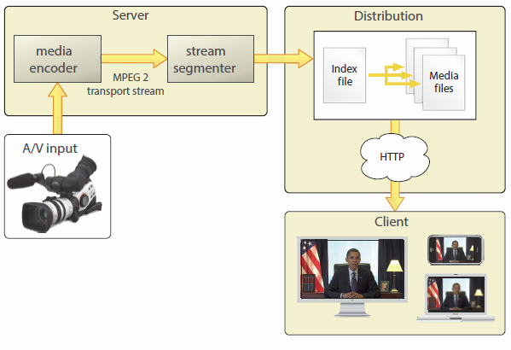
Streaming Video
On-demand media and live media are supported by both plug-in and HTML5 video approaches
Live streaming over HTTP architecture
Adapted from http://files.andrewsblog.org/http_live_streaming.pdf

Slide 4
Content Protection
Limiting access to streams
DRM technologies can be used to prevent playback
HTML5 does not specify a DRM system
Encrypted Media Extensions (EME) will provide a common API to interact with DRM systems

Slide 5
Performance
More mobile devices will be used to play video
Such devices are less powerful and it is important that watching HTML5 video is efficient
Conflicting research into performance differences between Flash and HTML5 video
Varies between browsers

Slide 6
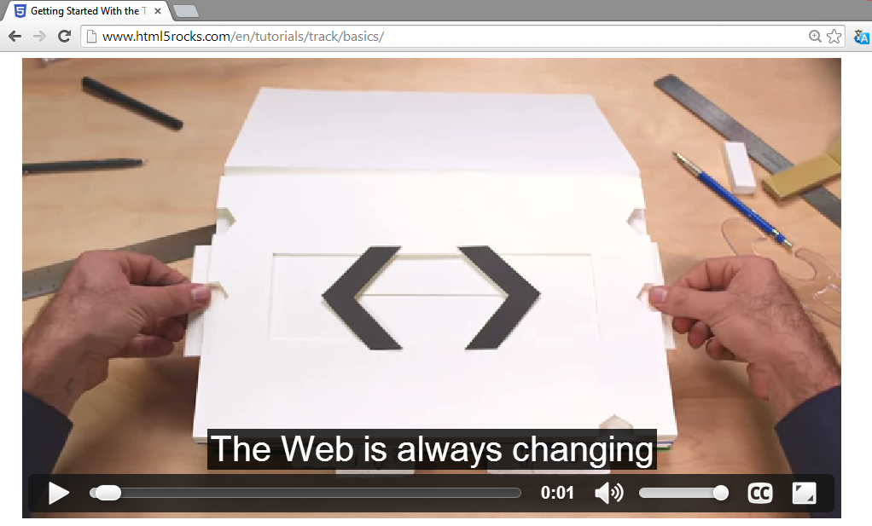
Accessibility
HTML5 video uses the <track> tag to add subtitle tracks

Slide 7
Conclusion
HTML5 video is a viable replacement for plug-in based approaches, albeit with some work still to do
Plug-in based approaches are more mature and offer a better experience on desktop web browsers
HTML5 standardisation efforts must continue
The use of HTML5 video by content providers, such as YouTube, should drive adoption

