Slide 1
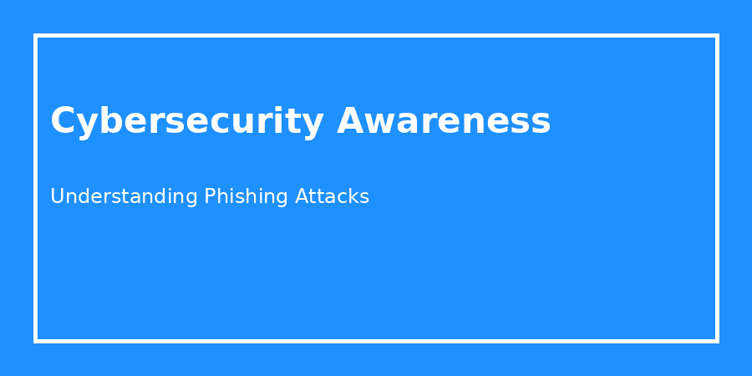
Cybersecurity Awareness Session
Understanding Phishing Attacks & Social Engineering
Presented by: Dhulwan Ratnayaka
University Cybersecurity Awareness Activity

Slide 2
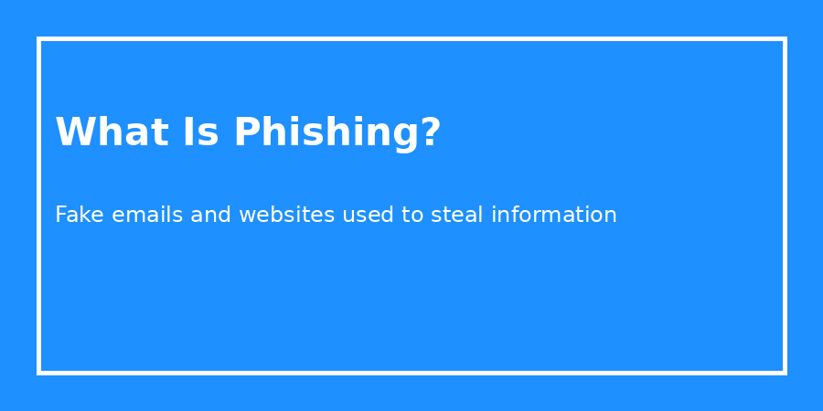
What Is Phishing?
Phishing is a cyberattack where attackers pretend to be trusted organisations.
Attackers attempt to steal passwords, banking details, or personal data.
One of the most common cyber threats affecting internet users.

Slide 3
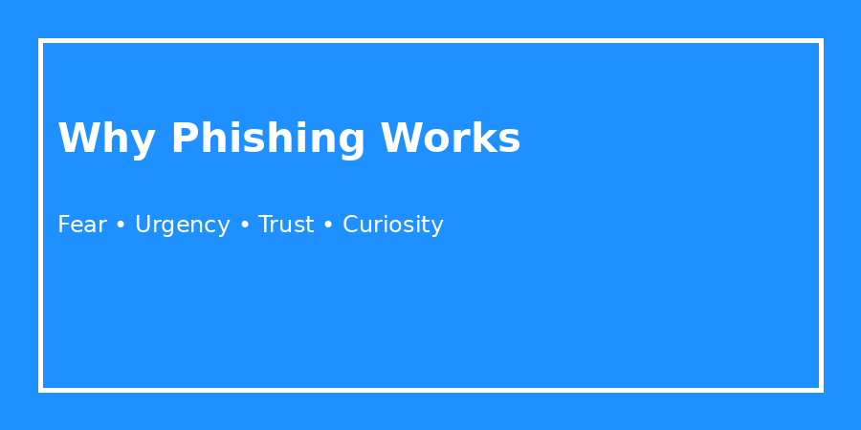
Why Phishing Is Effective
Attackers manipulate human psychology rather than technical systems.
Common emotional triggers include fear, urgency, trust, and curiosity.

Slide 4
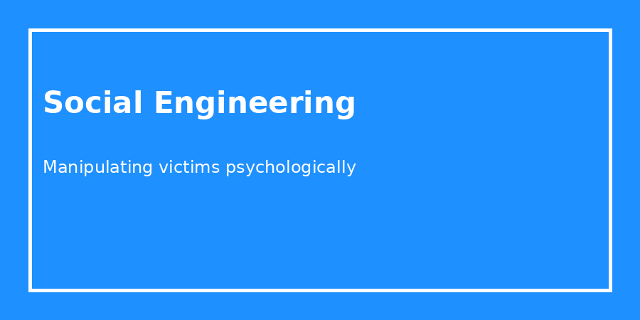
Social Engineering Techniques
Urgency: “Your account will be suspended today.”
Authority: Pretending to be banks or government agencies.
Fear: Threatening penalties or account loss.
Curiosity: Fake prizes or package notifications.

Slide 5
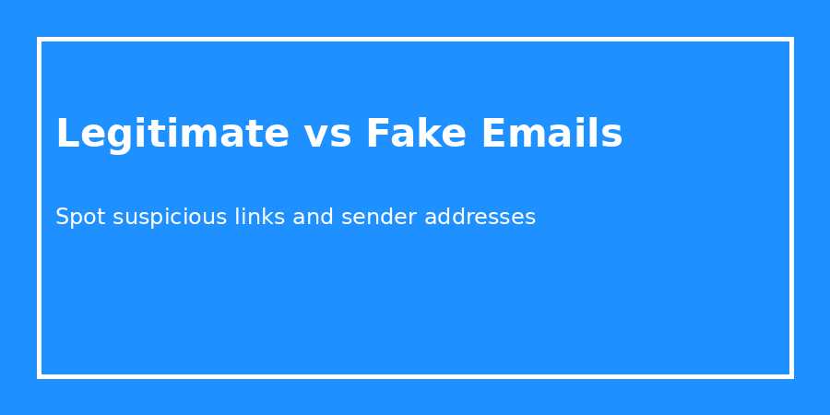
Legitimate vs Phishing Emails
Legitimate emails usually contain professional language and secure links.
Phishing emails often include spelling mistakes and suspicious URLs.
Never provide passwords or verification codes through email.

Slide 6

Spot the Red Flags
Check sender addresses carefully.
Hover over links before clicking.
Watch for urgent or threatening messages.
Avoid clicking unknown attachments.

Slide 7
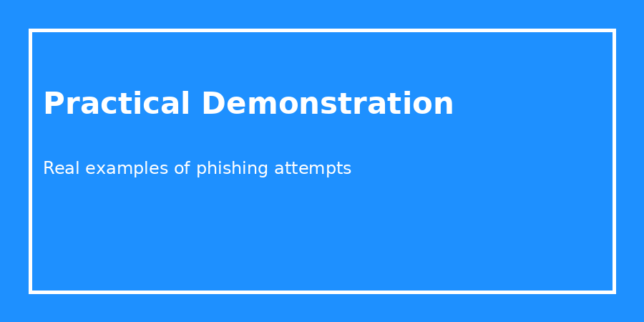
Practical Demonstration
Demonstrated side-by-side examples of phishing and legitimate emails.
Explained fake login pages and suspicious URL structures.
Highlighted how attackers trick users into clicking malicious links.

Slide 8
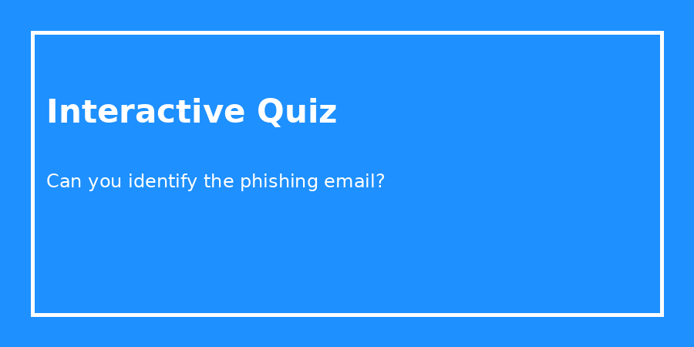
Interactive Quiz Activity
Participants reviewed five example emails.
4 out of 5 phishing emails were correctly identified.
Participants discussed why one message appeared convincing.

Slide 9
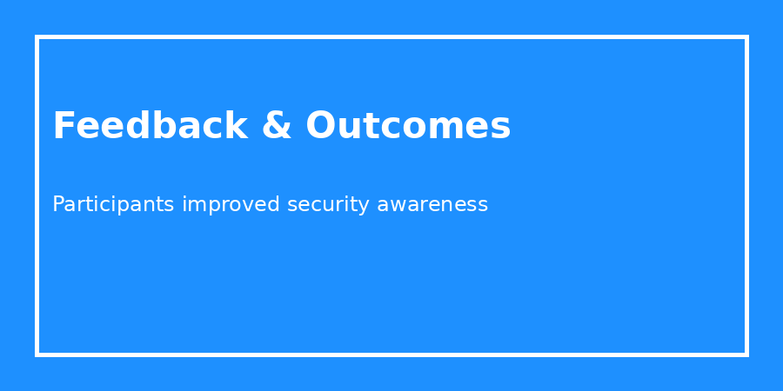
Feedback & Outcomes
Participants became more cautious with unexpected emails.
Some planned to change reused passwords.
Others enabled two-factor authentication (2FA).

Slide 10
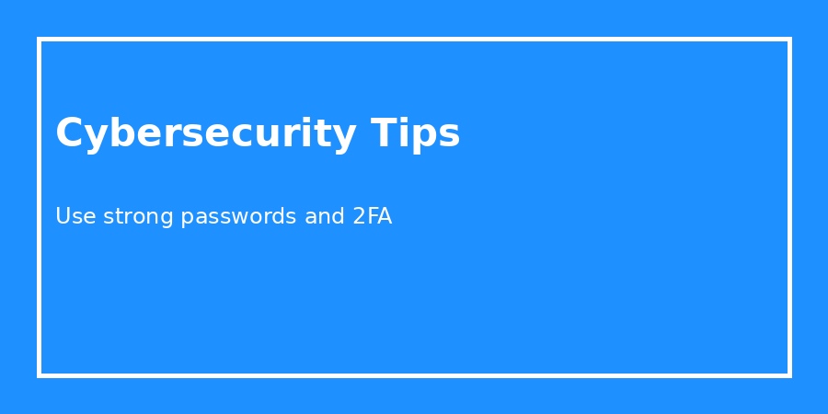
Key Cybersecurity Tips
Use strong unique passwords.
Enable two-factor authentication.
Verify suspicious emails before responding.
Keep devices and software updated.

Slide 11

Conclusion
Cybersecurity awareness is important for everyone.
Understanding phishing reduces the risk of cybercrime.
Thank You! Questions?

