Slide 1
Technical Seminar AT3
Machine Learning – ITA0605
Decision Tree Learning
Name : Dhuneshwarran V
Reg.no: 192324169

Slide 2
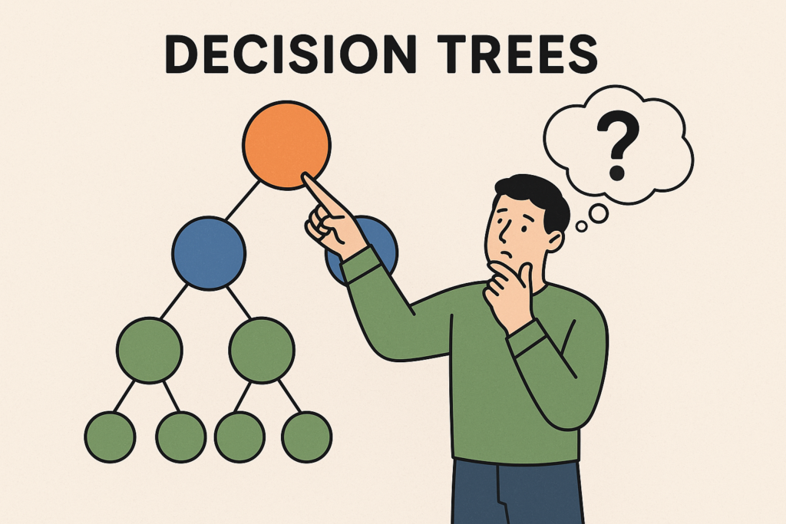
Decision Tree Learning:
Supervised machine learning technique.
Used for classification and prediction.
Divides data based on different conditions.
Uses a tree-like structure.
Continues splitting until a final prediction is reached.

Slide 3
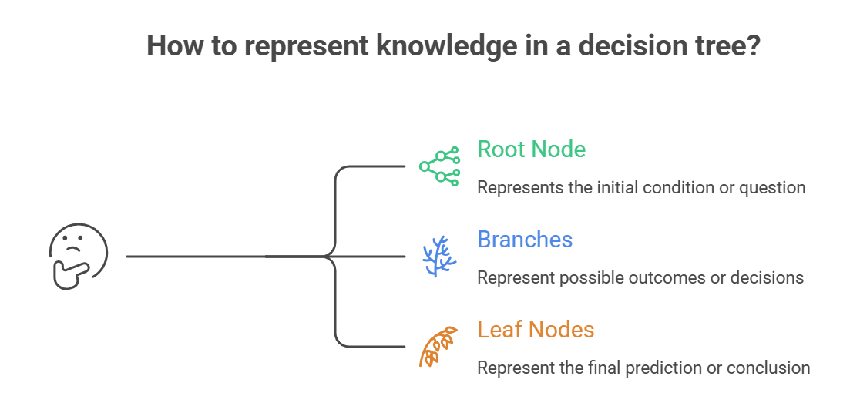
2. Knowledge Representation
A decision tree represents learned knowledge in a simple tree structure.
Root Node – represents the first and most important condition.
Internal/Decision Node – represents another test or condition.
Branches – represent possible outcomes of a condition.
Leaf Nodes – represent the final prediction or class.
A path from root to leaf can be represented as an IF–THEN rule.
This representation makes decision trees easy for humans to understand.
It also helps explain why a particular prediction was made.
Example: IF Marks > 50 AND Attendance > 75% → Pass

Slide 4
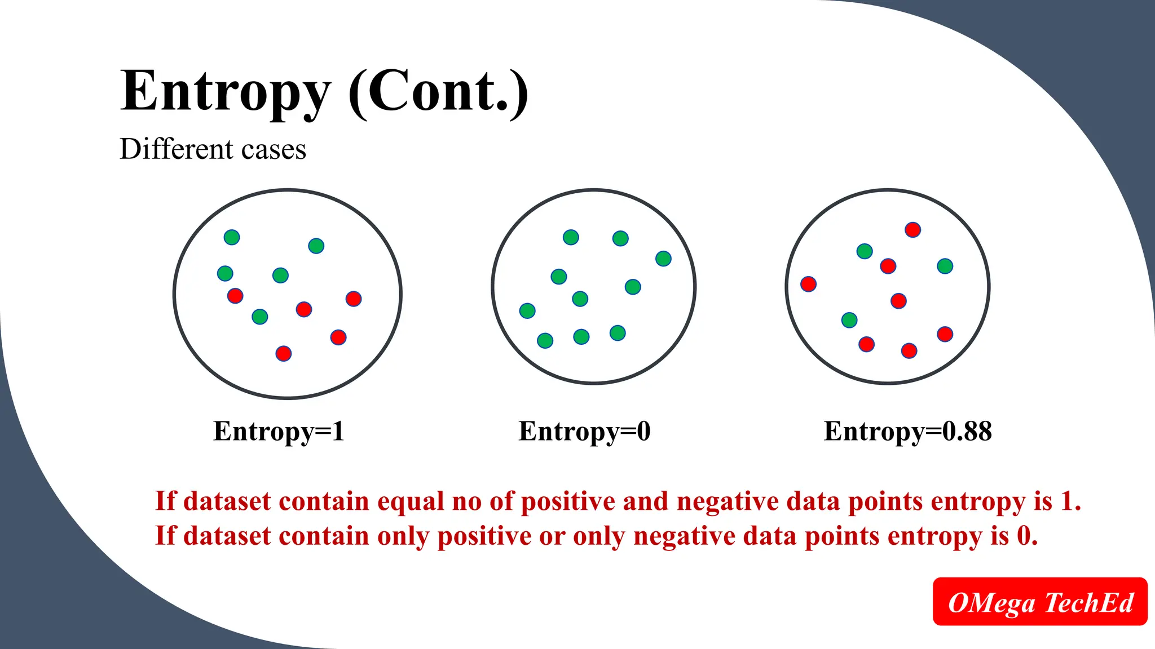
3. Entropy
Entropy measures the uncertainty or impurity present in a dataset.
It helps determine how mixed the classes are.
Low entropy means the data is mostly from one class.
High entropy means different classes are mixed together.
A completely pure group has very low or zero entropy.
Decision trees try to create splits that reduce entropy.
Entropy is commonly used when selecting features in algorithms such as ID3.

Slide 5
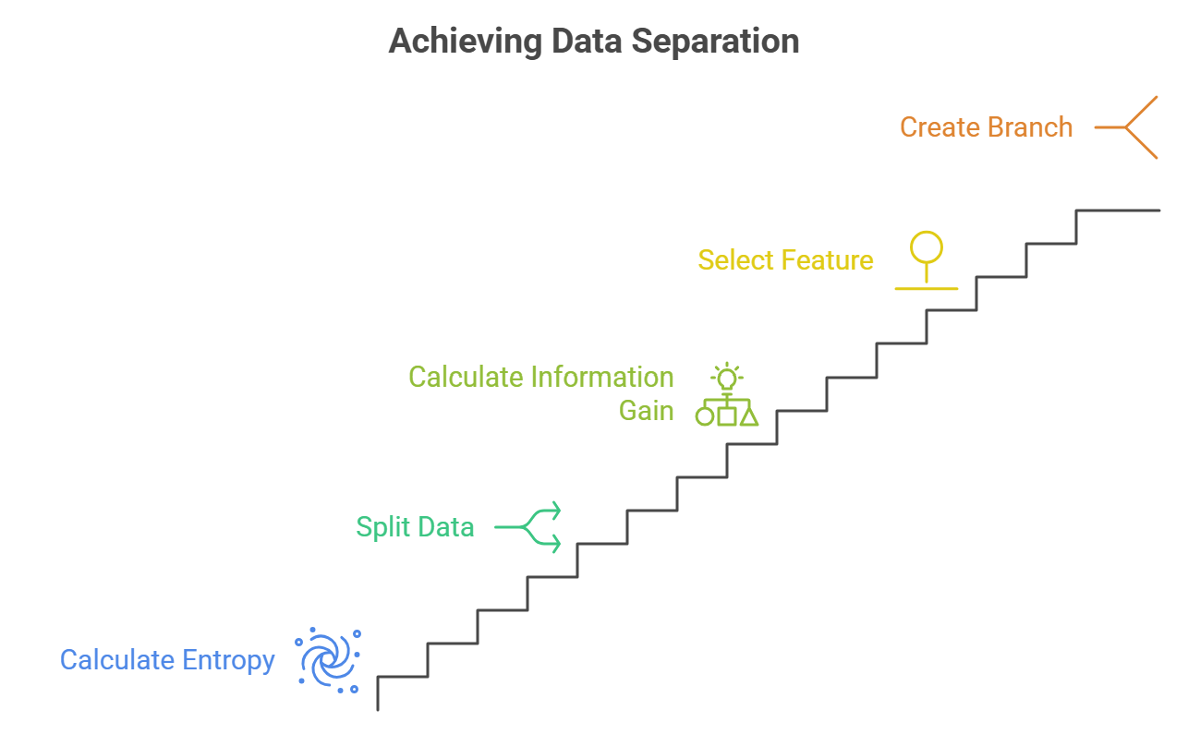
4. Information Gain
Information Gain measures the reduction in entropy after splitting data.
It helps identify which feature should be used for a split.
Different features can produce different Information Gain values.
A feature with higher Information Gain generally provides a better split.
It helps separate the classes more effectively.
The selected feature becomes a decision node in the tree.
The process is repeated to construct the remaining branches.

Slide 6
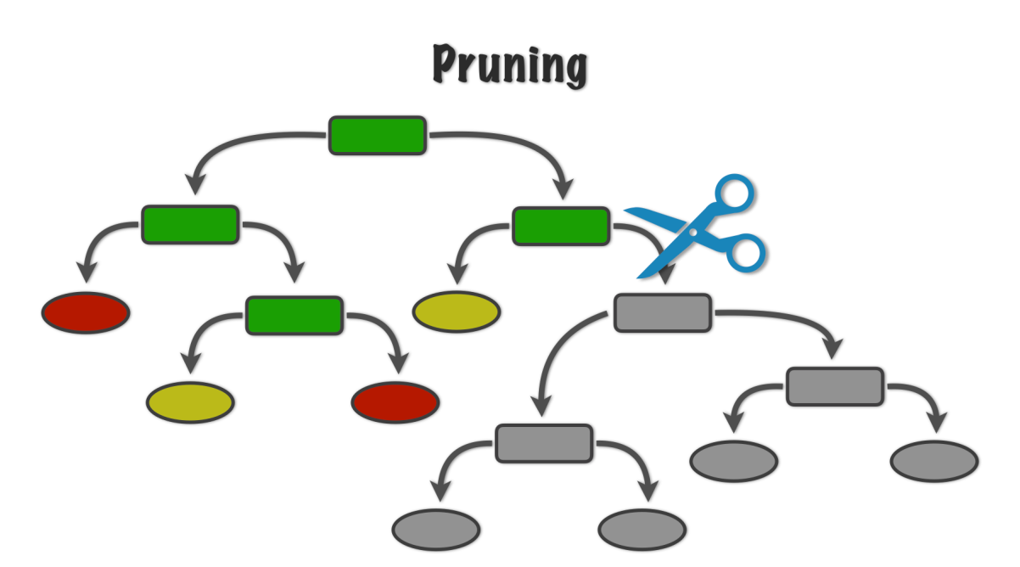
5. Tree Pruning
Tree Pruning means removing unnecessary branches from a decision tree.
A very large decision tree may learn unnecessary details from training data.
This can lead to overfitting.
Pruning reduces the overall complexity of the model.
It produces a smaller and simpler tree.
A simpler tree is usually easier to understand and interpret.
Pruning can improve the model's ability to work with unseen data.
Two common approaches are pre-pruning and post-pruning.

Slide 7
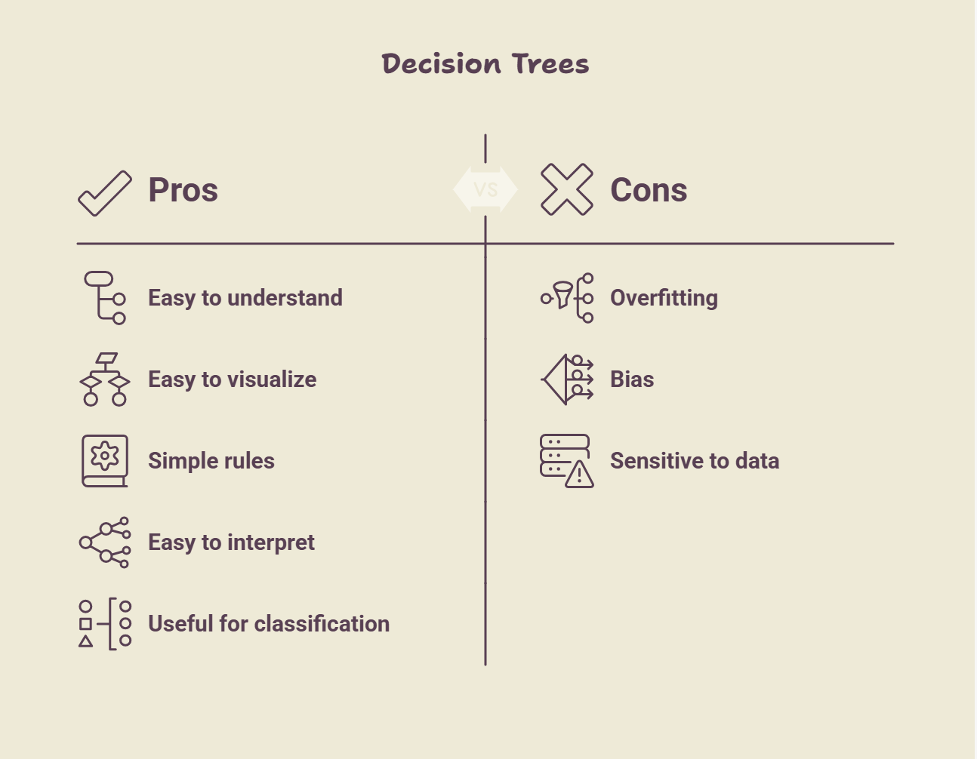
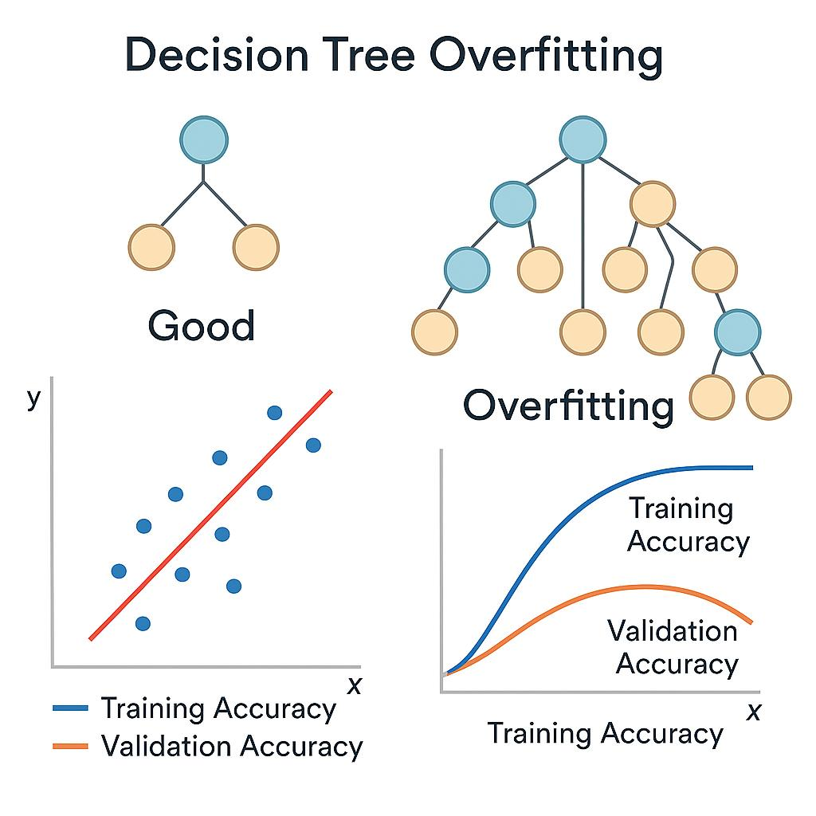
6. Pros and Cons of Decision Trees

Slide 8
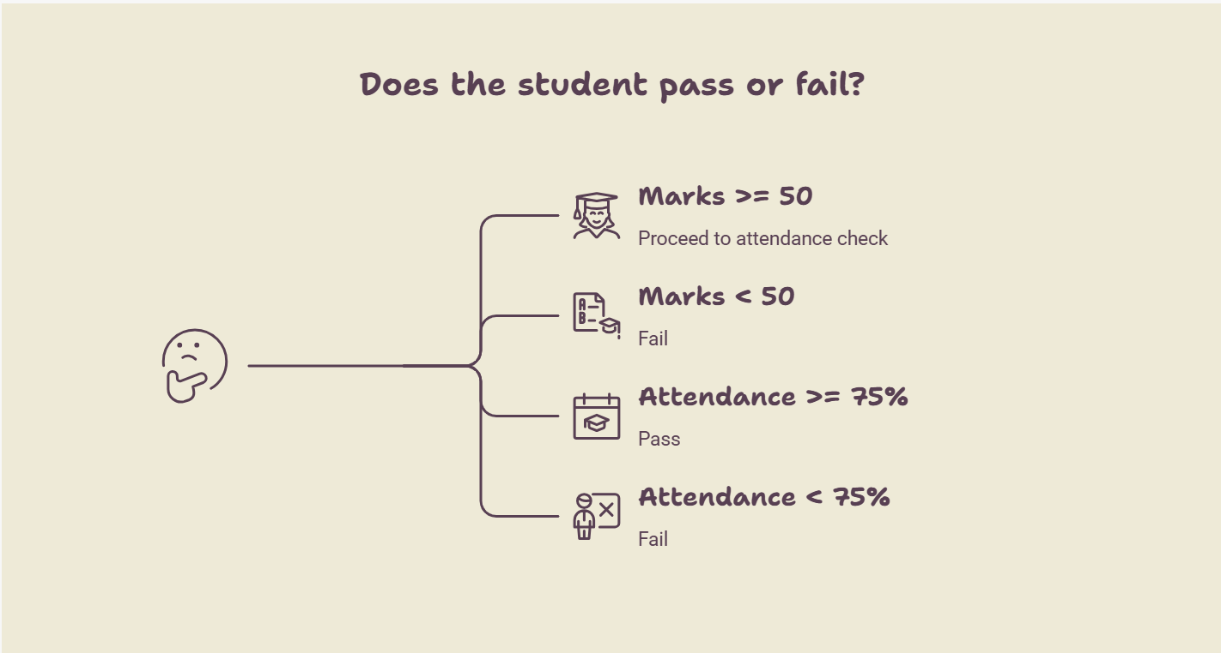
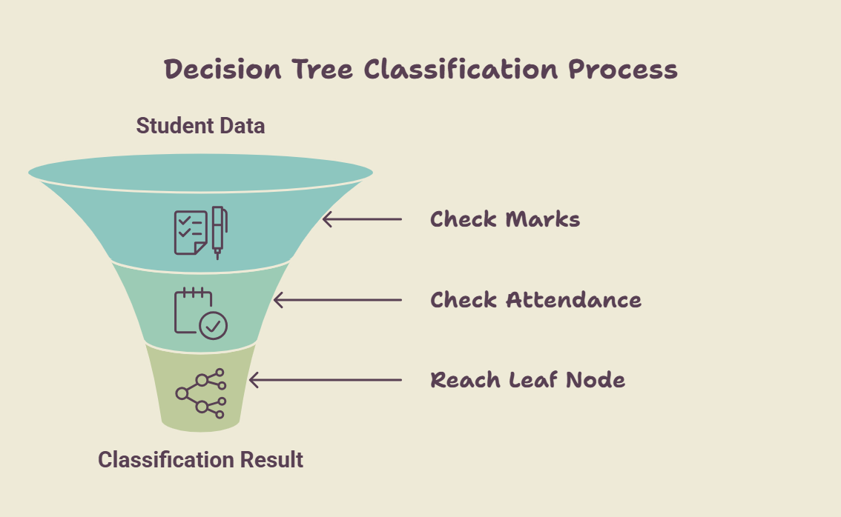
7. Classification

Slide 9
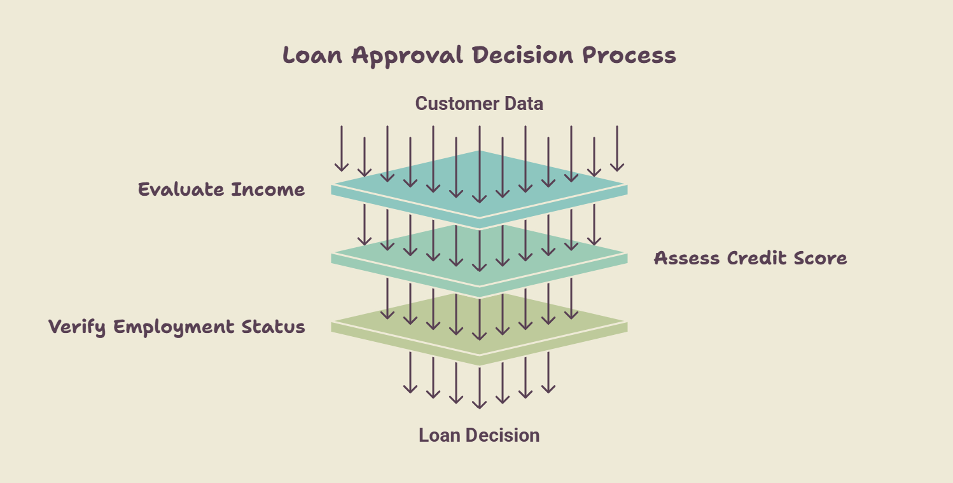
9. Decision-Making

Slide 10
Thankyou!

