Slide 1

Development of an Unbeatable Tic Tac Toe using
Search Algorithm
CSC 425 -Artificial Intelligence
Team Members: Bijay Dhungana,Aryan Kafle

Slide 2


Introduction & Context
Context & Objectives
Project Scope
•
Context: Tic-Tac-Toe is a zero-sum, perfect information game, making it the "Hello World" of Game AI.
•
Heuristic AI: Rule-based baseline.
•
Minimax: Mathematical perfection.
•
Goal: Develop an agent that evolves from "Smart" to "Perfect".
•
Alpha-Beta: Optimization for speed.
•
Key Metric: Achieve a 0% Loss Rate against any opponent.
•
MCTS: Scalability for larger grids (e.g., 4x4, 5x5).

Slide 3








Methodology: The Evolutionary Path
1. Heuristic
2. Minimax
3. Alpha-Beta
4. MCTS
Rule-based priority system. Fast but fallible.
Recursive backtracking search. Unbeatable.
Pruning branches to optimize Minimax speed.
Monte Carlo simulations for scalable complexity.

Slide 4

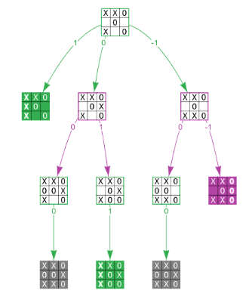
Approach 1: Heuristic AI (Baseline)
Rule-Based Logic
The agent follows a strict hierarchy of static rules to decide the next move. It doesn't "think" ahead, it just reacts.
•
1. Win: Take winning move immediately.
•
2. Block: Stop opponent from winning.
•
3. Center: Take the center (most valuable).
•
4. Corner: Take a corner.
Drawback: Easily trapped by "forks" where the opponent creates two winning threats simultaneously.

Slide 5
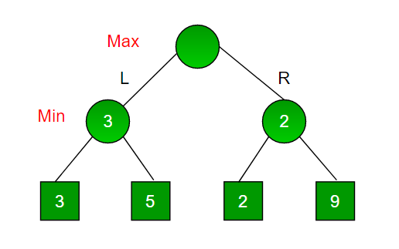
Approach 2: Minimax Algorithm
Perfect Optimal Play
Minimax treats the game as a tree of all possible future states. It recursively explores every path to the end.
•
Maximizer (AI): Tries to get the highest score (+10).
•
Minimizer (Opponent): Tries to get the lowest score (-10).
•
Zero-Sum: A win for one is a loss for the other.
Cons: Computationally expensive. explores ~550,000 nodes for a full 3x3 game.

Slide 6
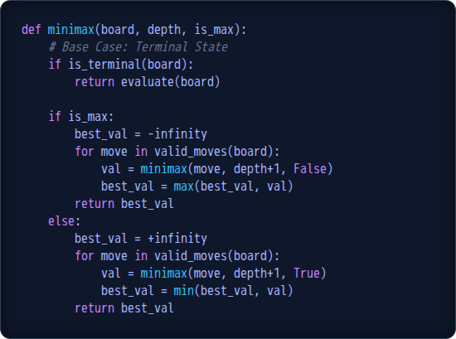
Minimax Logic Implementation
Recursive Structure
The core function calls itself until a terminal state (Win/Loss/Draw) is reached.
•
Base Case: Return +10, -10, or 0.
•
Recursive Step:
○
If AI's turn: Pick Max of children.
○
If Opponent's turn: Pick Min of children.

Slide 7
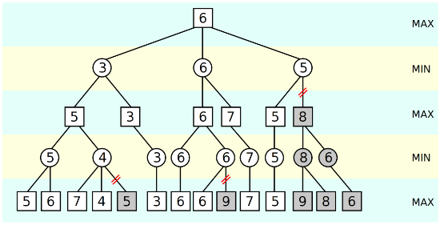
Approach 3: Alpha-Beta Pruning
Optimizing the Search
We don't need to evaluate every branch. If we find a move that is "worse" than a move we already found, we can stop searching that branch.
•
Alpha: The best value Max can guarantee so far.
•
Beta: The best value Min can guarantee so far.
•
Pruning: If beta <= alpha, we cut off the branch.
Result: Reduces search space by >96% (from 500k to ~2k nodes) while maintaining mathematical perfection.

Slide 8
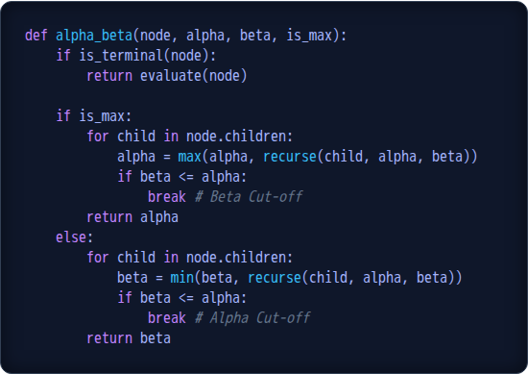
Alpha-Beta Implementation
The Pruning Logic
The logic is identical to Minimax, with the addition of two parameters: alpha and beta.
•
Cut-off: The `break` statement is where the efficiency happens. It stops the `for` loop early.
•
Propagation: Alpha and Beta values are passed down the recursion tree to inform child nodes of the bounds.

Slide 9
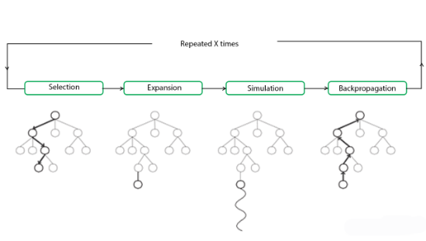
Approach 4: MCTS (Scalability)
Monte Carlo Tree Search
For larger boards (4x4, 5x5), the search tree grows exponentially, making Minimax impossible. MCTS solves this via probability.
•
Selection: Pick a promising node.
•
Expansion: Add a new child state.
•
Simulation: Play random moves to the end.
•
Backpropagation: Update the node with the Win/Loss result.
Converges to the optimal move without traversing the full tree.

Slide 10
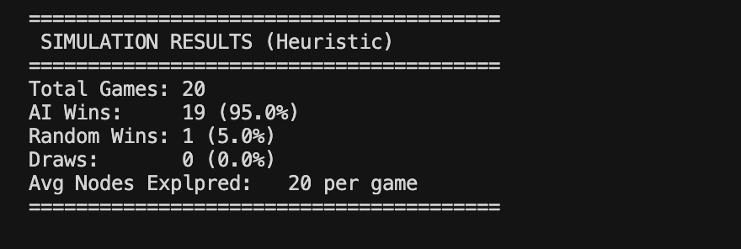
Result (Heuristic Approach)
We simulated 20 games and following was the result:

Slide 11

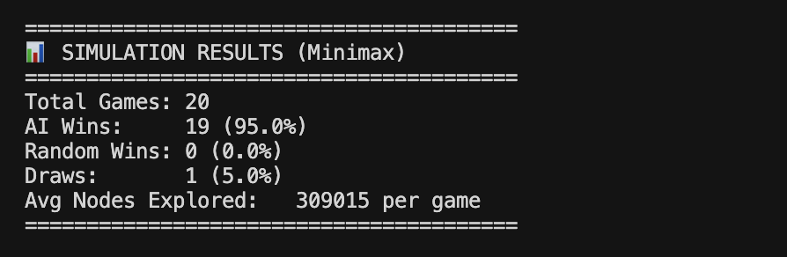
Result(Minimax Algorithm)
We simulated 20 games and following was the result:

Slide 12
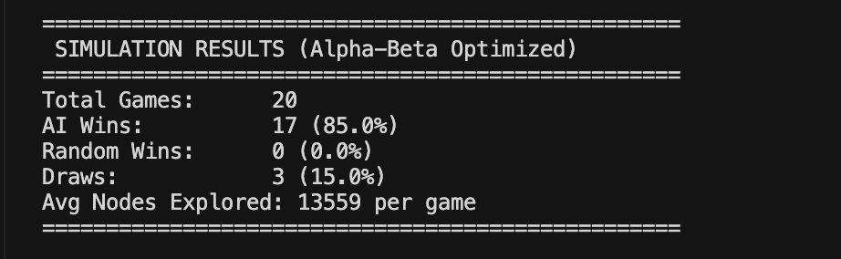
Result (Alpha Beta Pruning)
We simulated 20 games and following was the result:

Slide 13
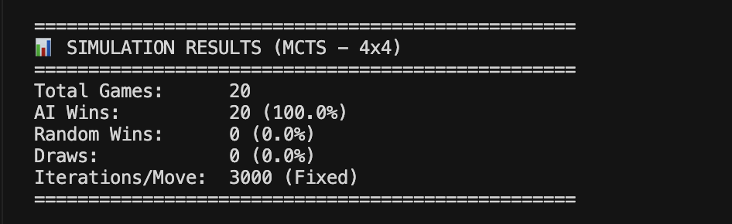
Result (MCTS Approach)
Upon further increasing the board size to 4x4 ,We simulated 20 games on 4x4 board and following was the result:

Slide 14
Efficiency Calculation
Method Used | AI Wins | Draw | Random Wins | Avg Nodes Explored
Heuristic | 19/20 (95%) | 0 | 1(5%) | 20
Minimax | 19/20 (95%) | 1 | 0 | 309,105
Alpha-Beta | 17/20 (85%) | 3 | 0 | 13,559
MCTS | 20/20 (100%) | 0 | 0 | ~(3000 iterations/move)

Slide 15
Key Observations
Heuristic Approach
Wins 95% of games but also 1 human win.
Uses a very shallow search, making it fast but less reliable.
Can make human-like mistakes due to heuristic limitations.
Minimax (Full Search)
Wins 95% of games with 1 draw, no losses.
Explores the most nodes, making it accurate but expensive.
Very accurate but computationally expensive.
Alpha-Beta Pruning
Wins 85% of games with 3 draws and no losses.
Searches far fewer nodes than Minimax due to effective pruning.
Provides a strong balance of speed and decision quality.
MCTS
Achieves 100% wins using fixed 3000 simulations per move.
Extremely strong for large or complex state spaces.
Most consistent and strongest performer among all methods.

Slide 16
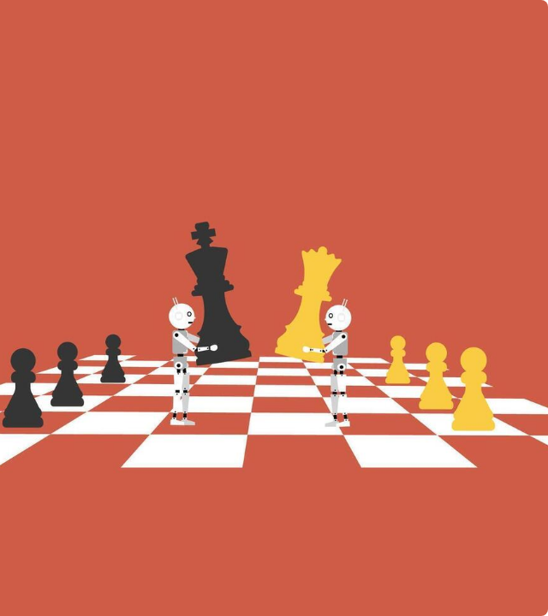
Conclusion
Summary
We successfully evolved our agent from a simple rule-follower to a mathematically perfect entity using Alpha-Beta pruning.
Implications
While Minimax solves 3x3 completely, the exponential growth of game trees makes it not viable for complex games without pruning.
Future Work
Implementing MCTS allows us to scale this "Unbeatable" concept to Super Tic-Tac-Toe, Chess, and Go.

Slide 17

Q & A
Thank you for your attention.
Code available at: https://github.com/dhunganab2/Tictactoe

