Slide 1
StreamCab
Real-Time Taxi Fare Intelligence
Kafka · Spark Structured Streaming · XGBoost
Bibek Dhungana, Xiaodi Shao, Raivath Mallela April 24, 2026
Big Data Application

Slide 2
Agenda
Overview — problem statement and system architecture
Data — source, collection, schema, and metadata
Process — end-to-end pipeline inputs and outputs
Results — dashboard, model quality, and insights
Takeaways — what worked and what was hard

Slide 3
Overview

Slide 4
Problem Statement
NYC taxi demand and pricing shift rapidly by zone and time.
Static batch reports lag behind operational decisions.
No live view of which zones are surging right now.
Tip prediction from historical patterns alone is too slow.
Goal: Build a full streaming analytics and prediction stack — ingestion to live dashboard — that runs reproducibly on a single machine.

Slide 5
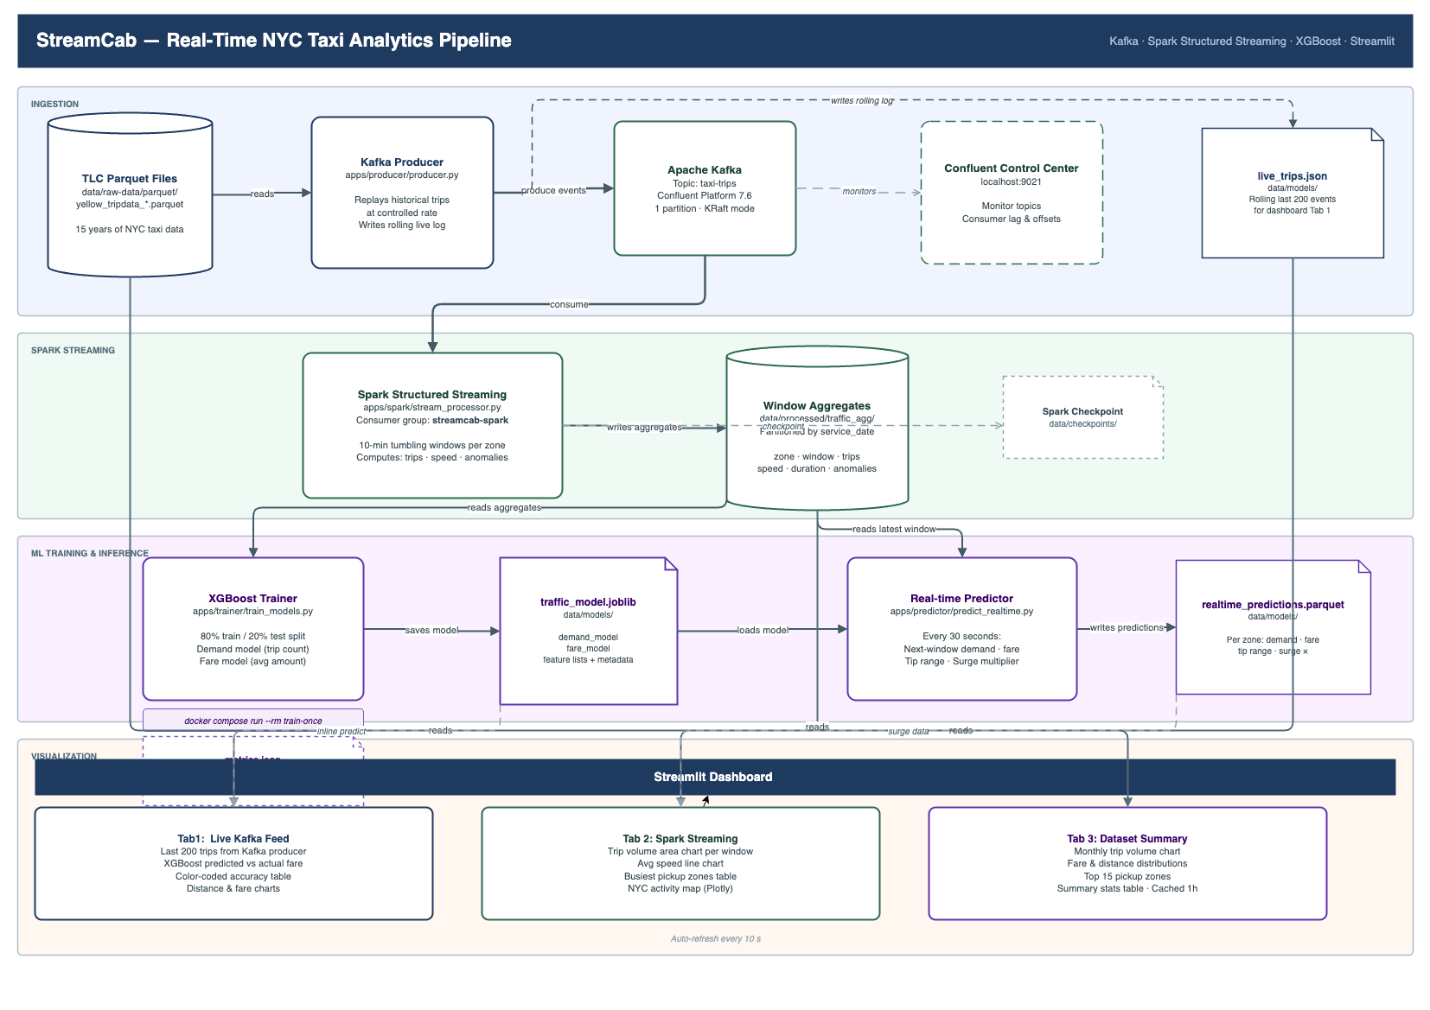
System Architecture
Parquet → Kafka → Spark → PostgreSQL → Predictor → Dashboard

Slide 6
Architecture Components
Producer + Kafka: replay trips as a live event stream
Consumer: write raw events to
live_trips
Spark: 10-min windowed zone aggregates
PostgreSQL: live trips, aggregates, predictions
Trainer: XGBoost on historical aggregates
Predictor: periodic inference every 30 s
Dashboard: live KPIs, map, zone rankings

Slide 7
Data

Slide 8
Data Source and Collection
Source: NYC TLC Yellow Taxi Trip Records — public monthly Parquet files
nyc.gov/site/tlc/about/tlc-trip-record-data.page
Collection workflow
Data Size: 152GB CSV and 24GB parquet
Tentative Rows: 1642819405 Around 1.6 billion
Download monthly parquet files via project script (retry + back-off).
Store under /data/raw-data/parquet/.
Producer replays rows to Kafka as pseudo-live events.
Scale: 2010–2025 supported; default pull 2022-01 → 2024-12; quick-start uses 2022-01 → 2022-03 for fast local iteration.
Reference data: TLC zone centroid CSV for spatial zone mapping.

Slide 9
Schema and Metadata
Raw event fields
pickup_datetime, dropoff_datetime
passenger_count, trip_distance
pu_location_id, do_location_id
total_amount
Windowed aggregate fields
window_start, window_end
pu_location_id, trip_count
avg_trip_distance, avg_duration_min
avg_speed_mph, avg_total_amount
Coordinates snapped to nearest zone centroid via BallTree (≈100 m precision).

Slide 10
Data Quality Rules
Rows are retained only when they satisfy all bounds:
Field
Accepted range
Duration Trip distance Average speed
Fare / total amount Pickup zone
1–180 min
0.2–100 mi
1–80 mph
$0–$500
valid ID or mappable lat/lon
Conservative filtering reduces outlier influence and improves model stability.

Slide 11
Process

Slide 12
End-to-End Processing Pipeline
Ingest — read parquet, normalize timestamps and zone IDs.
Stream — replay rows to Kafka at configurable rate.
Aggregate — Spark applies quality filters; computes 10-min window stats per zone.
Persist — consumer writes window stats to a table.
Train — XGBoost reads aggregates in small batches.
Predict — predictor scores real-time windows.
Visualize — Streamlit renders KPIs, zone rankings, and map.

Slide 13
Inputs and Outputs
Inputs
Historical Parquet trip files
Zone centroid CSV
Intermediates
Kafka topic
taxi-trips
traffic_agg table
Spark checkpoints
Final outputs
traffic_model
.joblib
metrics.json
predictions table
Live dashboard

Slide 14
Model Training Configuration
Target: tip_amount
Features:
location_id, hour
day_of_week
trip_distance, duration_min
speed_mph, trip_count
XGBoost settings:
max_depth=5, lr=0.05
80/20 temporal train-test split
Strategy: 500K-row parquet mini batches;

Slide 15
Results

Slide 16
Model Performance
Model | MAE ($) | MAPE (%)
Baseline (zone-hour mean) | 1.99 | 15.43
XGBoost (test) | 0.49 | 3.42
75% reduction in MAE over the baseline. XGBoost captures nonlinear interactions between demand, speed, duration, and time that a simple mean cannot represent.

Slide 17
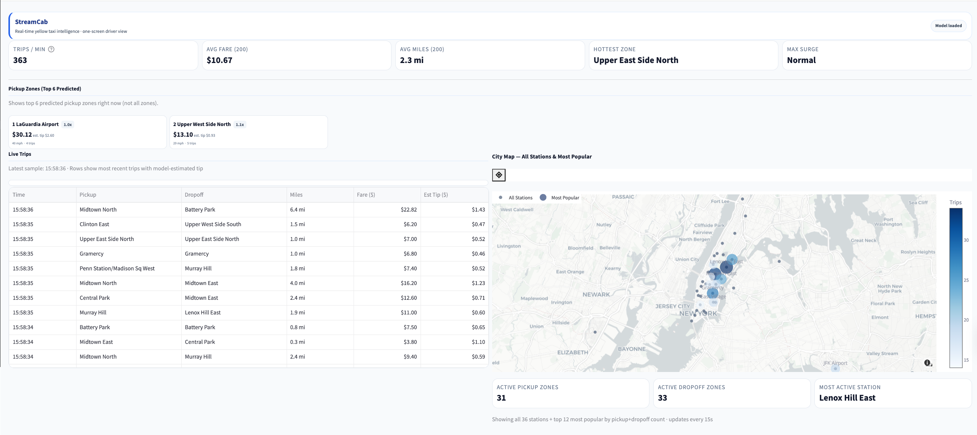
Dashboard and Analytics Outputs
Live KPIs · zone rankings with surge badges · NYC map · rolling trip table

Slide 18
Key Takeaways

Slide 19
What Worked and What Was Hard
Worked well
Reproducible one-command startup with Docker Compose.
Spark windowed aggregates as stable, interpretable features.
Strong prediction accuracy with XGBoost even with 10% training data.
Most difficult
XGboost performance drop when we train in all data. May be
over-fitting. (Pytorch might be easy)
Network communication across docker container and volume mounts.
Schema changes and inconsistent data. LC format changes (lat/lon vs. zone IDs).
Difficult to restart training on failures. Spark checkpoints helps
but difficult.
13 / 15

Slide 20
Additional References
Youtube links: https://youtu.be/lEEw0fPl7UM
Code Links: https://github.com/dhunganabibek/StreamCab
Data source:
www.nyc.gov/site/tlc/about/tlc-trip-record-data.page

Slide 21
Questions?
Thank you.

