Slide 1

Florida Prospers
Looking Back
Looking Forward

Slide 2
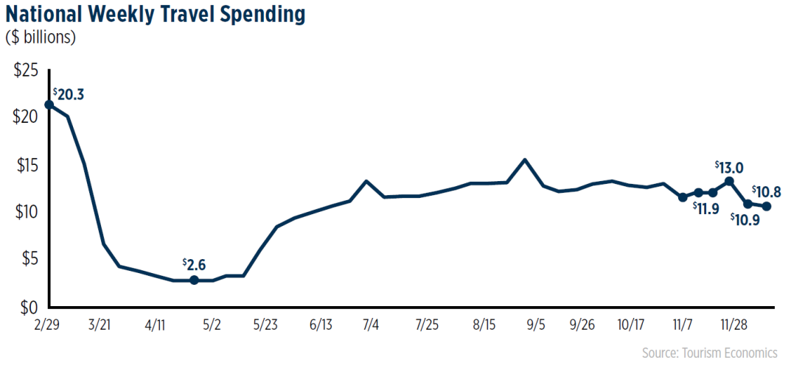
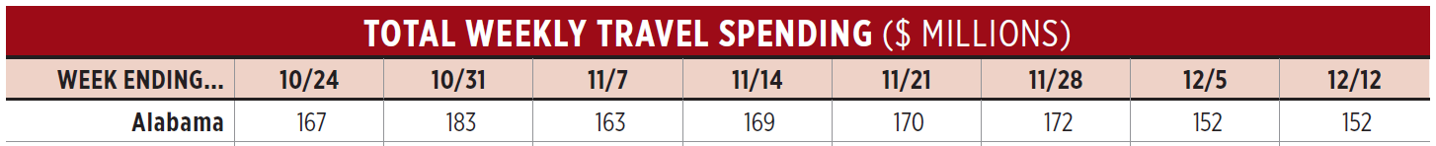
In looking at the data from the U.S. Travel Association, we can see that when the lockdown was in full gear, the travel and tourism industry was operating at approximately 10% of normal.
There has been a lot of recovery made. Obviously, there still needs to be care taken, so it will be some time before a full recovery is made. Florida, for example, is down 43% (or $857 million) in mid-December 2020 compared to the same time in 2019.

Slide 3
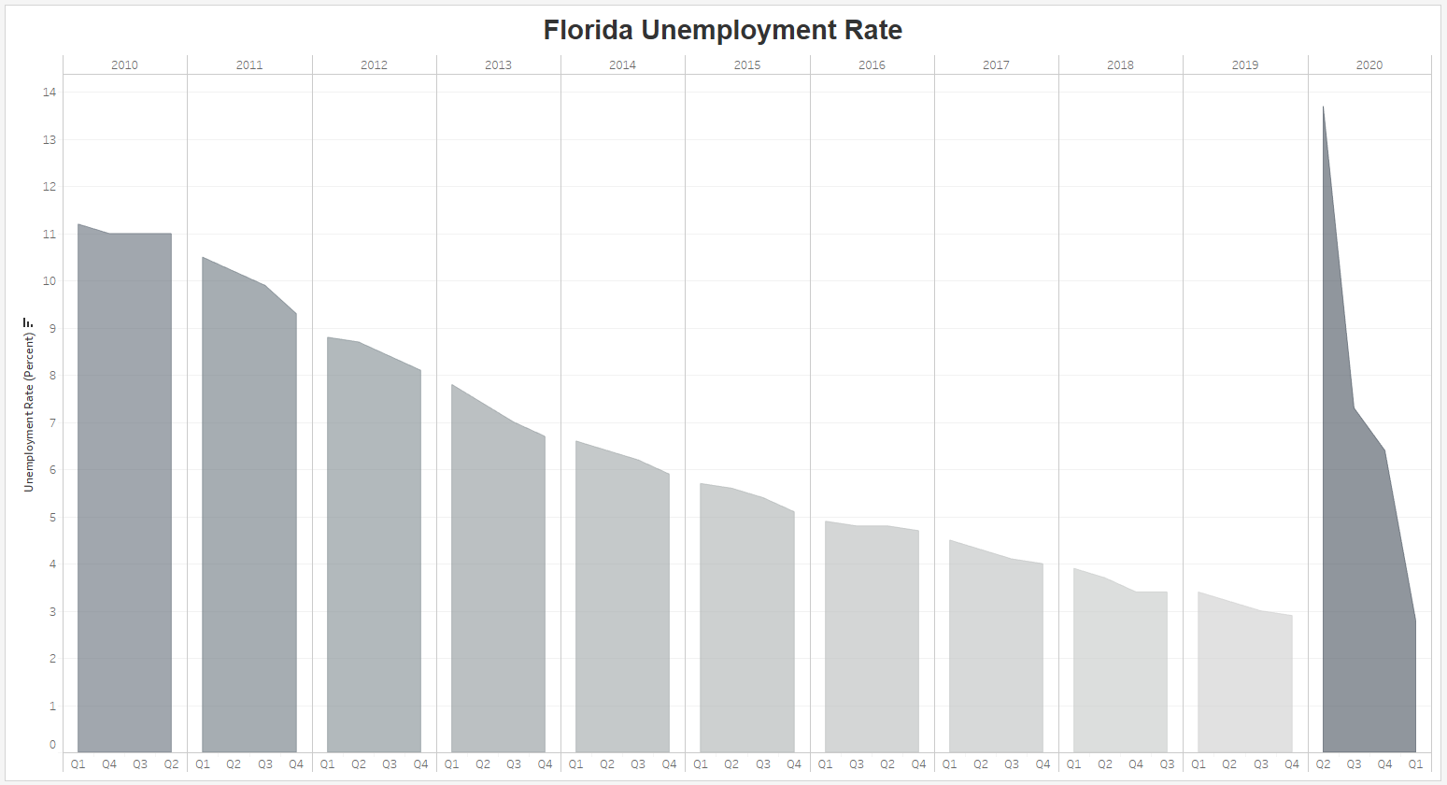
We have a responsibility to our employees and visitors. After the spike (almost 14%) in unemployment early in the year when shutdowns were undertaken by most of the country, Florida has had a great recovery. We’re just about back to pre-pandemic levels (6.4% in mid-December) of employment in Florida. This keeps people in their homes and food on the table.

Slide 4
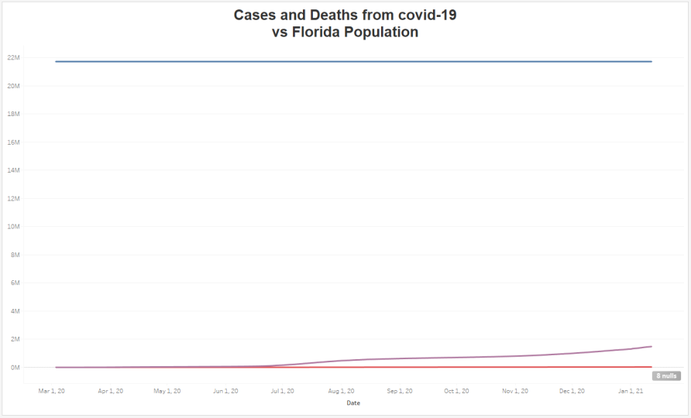

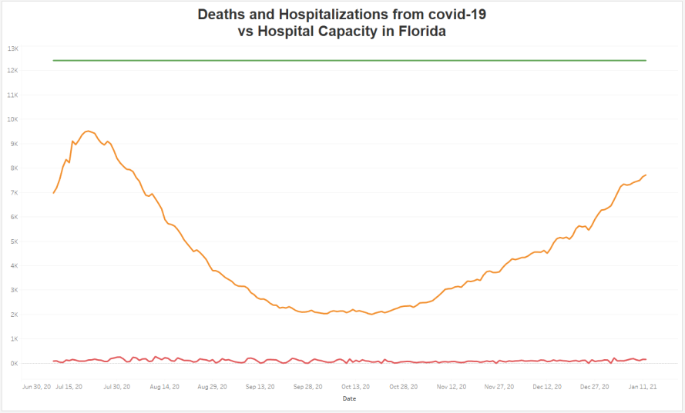

Overall, Florida has done a great job of keeping the rate of deaths low. Although there has been an uptick in the number of cases since the state reopened a lot of businesses, we have not seen a spike in deaths. Best of all, we have never come close to overwhelming our hospitals.
The steps we have implemented (cleaning, masks, and social distancing) as we reopen have had the hoped-for positive effect. We will continue to practice these for as long as they are necessary.

Slide 5
References
CDC. (2021). United States COVID-19 Cases and Deaths by State over Time. Retreived from
https://data.cdc.gov/Case-Surveillance/United-States-COVID-19-Cases-and-Deaths-by-State-
o/9mfq-cb36 20 January 2021.
FRED, Federal Reserve Bank of St. Louis. (2020)., U.S. Bureau of Labor Statistics, Unemployment Rate in Florida
[FLUR]. Retrieved from; https://fred.stlouisfed.org/series/FLUR, 24 January 24 2021.
U.S. Travel Association. (2020). Weekly Coronavirus Impact on Travel Expenditures in the U.S., December 17,
2020 Update. Retrieved from
https://www.ustravel.org/sites/default/files/media_root/document/Coronavirus_WeeklyImpacts_
12.17.20.pdf

