Slide 1
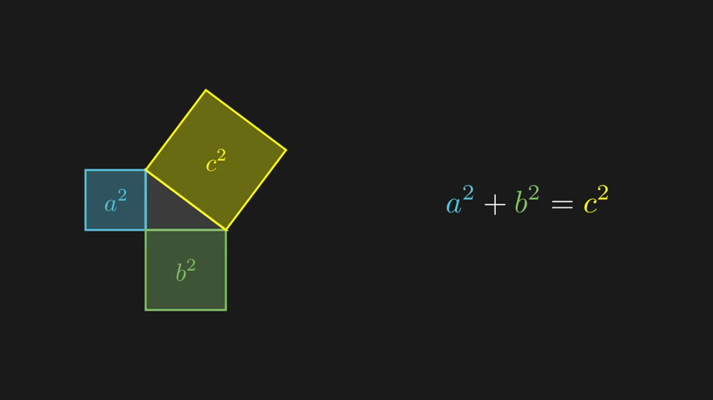
MANImation Studio
From one sentence to a narrated, 3Blue1Brown-style lesson video
Multi-agent AI system · Dhup Thumbadiya
A frame generated by the system: Pythagorean proof
Notes:
Introduce the project in one breath: you type one sentence describing a math, physics or computer-science idea, and the system produces a narrated animation in the style of the 3Blue1Brown YouTube channel, together with the code that draws it. The image on the right is an actual frame the system produced.

Slide 2
Good animations teach fast, but they are slow to make
A moving picture can explain in seconds what a page of text cannot: a tangent line sliding along a curve, a grid bending under a matrix, a search narrowing down an array.
Tools like Manim make these animations possible, but only for people who can program them. Most teachers never get past that barrier.
1
Write the animation as Python code
Manim, LaTeX, coordinates, timing
2
Render, find mistakes, fix by hand
every error means reading tracebacks
3
Record narration and sync it
Every change to the idea sends you back to step 1.
re-record whenever the animation changes
Notes:
Start with the motivation. Visual explanations are powerful, which is why channels like 3Blue1Brown are so popular. But behind every one of those animations is a programmer: the animation is written as code, rendered, debugged and synchronised with narration. That is the barrier we wanted to remove for teachers.

Slide 3
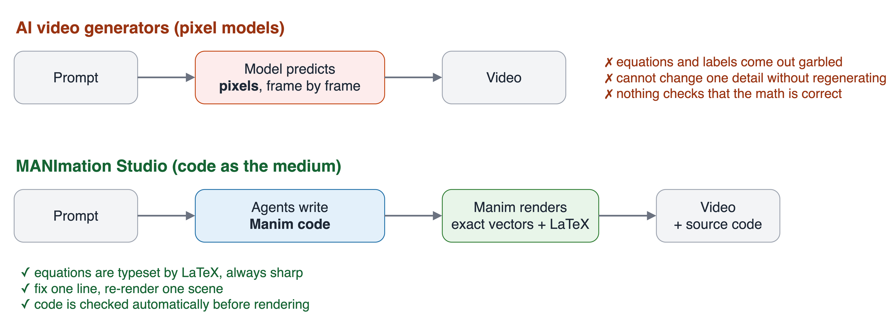
Why not just ask an AI video generator?
Our choice: the AI writes code, and a real math engine draws every frame: exact, checkable, editable.
Notes:
Text-to-video models like Sora or Veo predict pixels. They are impressive for scenery, but for teaching they fail exactly where it matters: equations come out garbled, labels drift, and nothing checks that the math is right. You also cannot fix one detail without regenerating the whole clip. So instead of asking AI to draw pixels, we ask it to write code for Manim, the engine 3Blue1Brown uses. LaTeX typesets the equations, so they are always exact, and because the output is code, we can check it automatically and fix single lines.

Slide 4
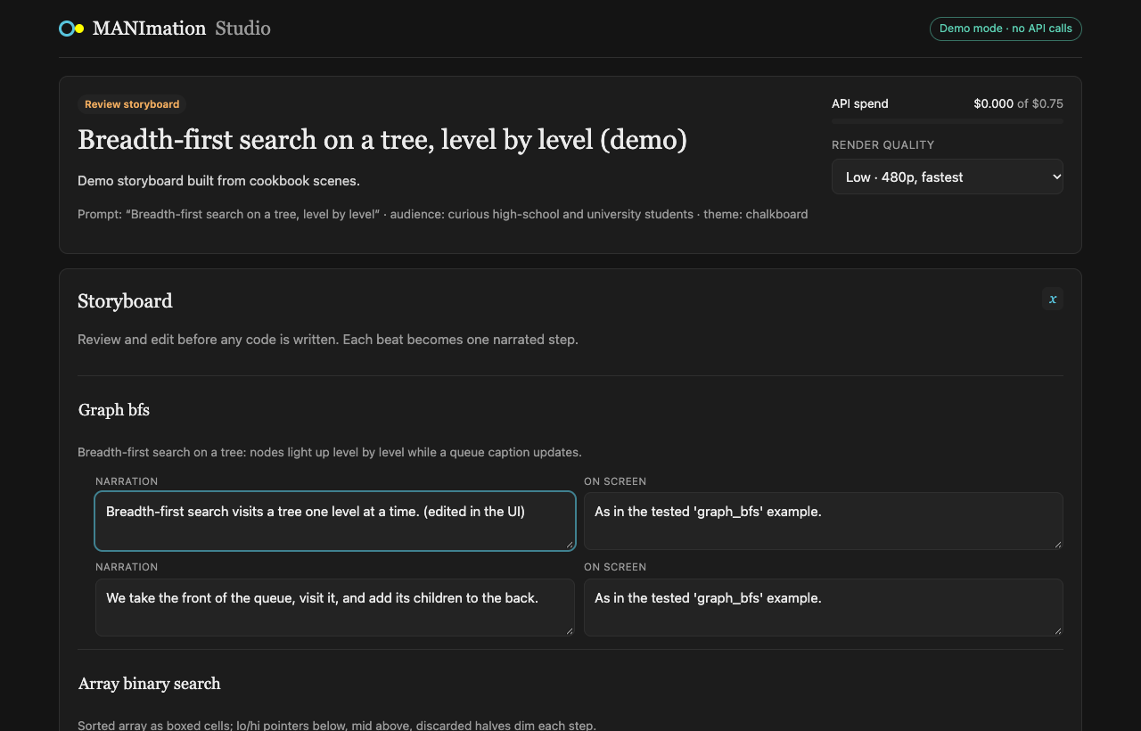
Our idea: describe it, review it, get the video
1
Describe
Type one sentence and choose a color theme, the audience and a budget.
2
Review
Read the storyboard the AI planned and edit any narration or visual before code is written.
3
Receive
Watch and download the narrated video, plus the Manim code for every scene.
The storyboard review screen of the web app
Notes:
This is the whole user experience in three steps. The important design choice is step two: the teacher stays in control. The AI proposes a storyboard, scene by scene and beat by beat, and the teacher can correct it before any code is written, which is also the cheapest moment to change your mind. The screenshot is the real review screen of our web app, built with React and FastAPI.

Slide 5
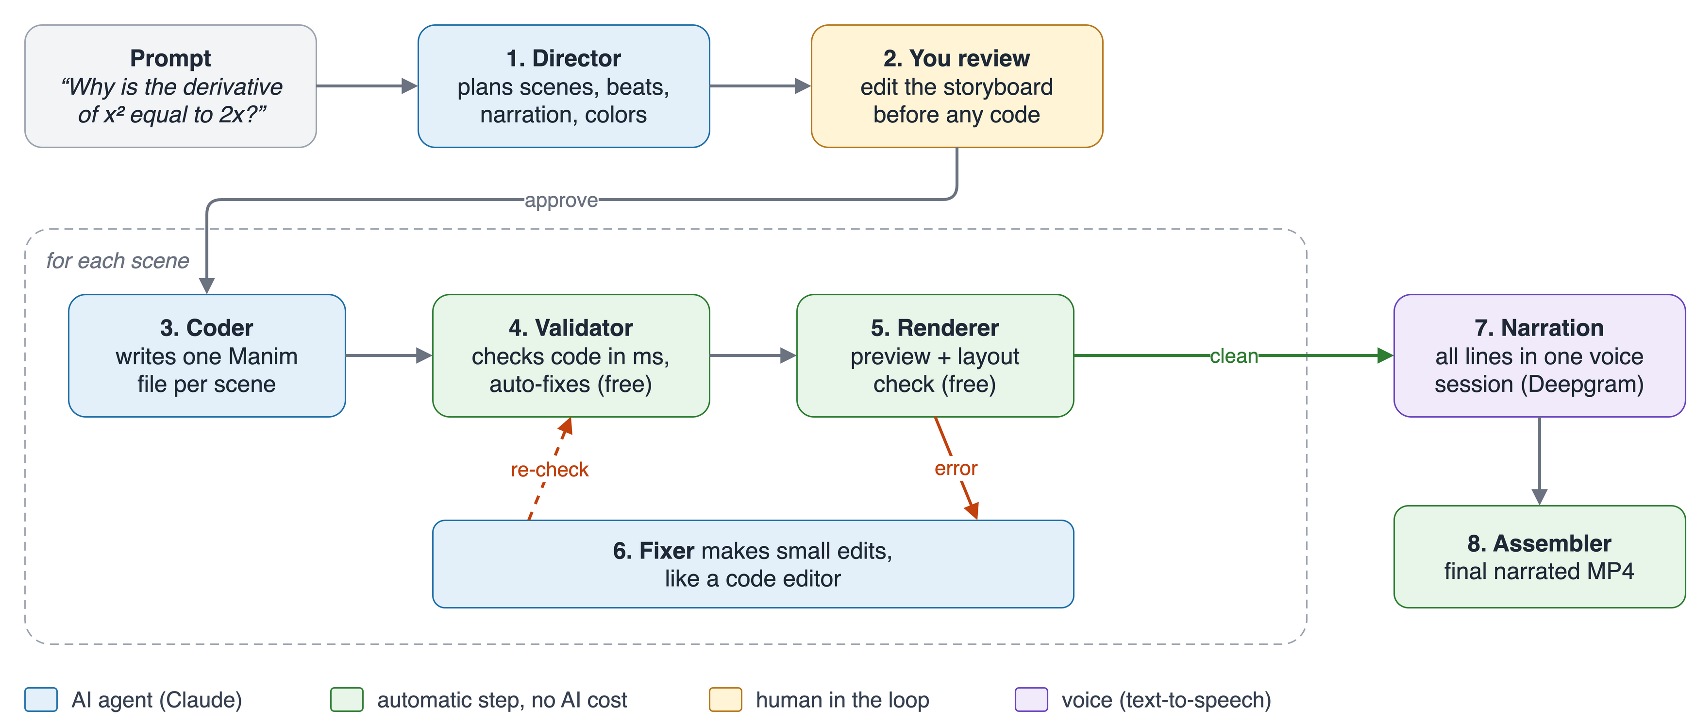
How it works: a team of specialised agents
Each agent does one job well. Blue steps use the AI; green steps are automatic and cost nothing.
Notes:
Walk through the diagram left to right. The Director plans the lesson. The teacher approves it. Then, for every scene, the Coder writes one Manim file; the Validator checks it in milliseconds; the Renderer draws a quick preview and measures the layout. If anything is wrong, the Fixer repairs it and the loop runs again. Once every scene is clean, the narration is recorded in a single voice session and the Assembler joins the scenes into the final video. Point out the colours: only the blue boxes cost money.

Slide 6
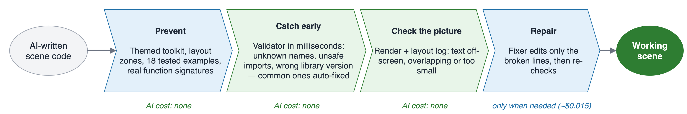
Making AI-written code reliable
Language models are fluent but not exact: they invent function names and place text on top of other text. We surround the AI with four layers that prevent, catch, check and repair those mistakes.
18
85
0
tested example scenes the AI learns from
automated tests on every part of the system
layout problems across all example scenes
Notes:
This slide answers the question: why can an AI produce accurate results here when it usually cannot? Because we never trust the first draft. First we prevent mistakes: the AI writes against our own small toolkit with fixed screen zones and colour roles, and sees tested examples and the real function signatures. Then a validator catches bad code in milliseconds and auto-fixes common errors, for free. Then the renderer measures the picture: is text off-screen, overlapping or too small? Only if something is still wrong do we pay for the Fixer.

Slide 7
Fix, don't rewrite: repairs work like a code editor
When a scene fails, most systems ask the AI to write the whole file again: expensive, slow, and it can break parts that already worked. Our Fixer opens the file, edits only the broken lines, and re-checks, just like a developer in an editor.
1
AI call
Before: the title shows a literal caret
1 edit
title = title_card("How steep is y = x^2?")
the rest of the file untouched
After: one edit, real math typesetting
title = Tex(r"How steep is $y = x^2$?", font_size=44)
place_in_zone(title, "TOP")
$0.015
total cost of the repair
A real repair from our test run
Notes:
Here is a real repair from our testing. The AI had written a title with math inside a plain-text object, so the video showed a literal caret: y = x^2. Our validator flagged it before rendering. The Fixer made one edit, swapping in LaTeX typesetting, and the next render came back clean. One AI call, 239 output tokens, one and a half cents, and everything else in the file stayed exactly as it was. Regenerating the scene would have cost more and risked breaking parts that already worked.

Slide 8
What a video costs, and how long it takes
$0.073
~1.5 min
68 s
complete 2-scene narrated video, real run
from prompt to finished video
of narrated animation produced
How we keep it cheap
A cost-efficient model by default, with a hard budget per video
Shared instructions cached, so later scenes cost less
Free checks run before any paid AI call
Repairs are small edits, never full rewrites
Every step saved, so resuming never pays twice
Notes:
These are measured numbers from a real run with Claude, not estimates. A complete two-scene video with narration cost about seven cents, and it took about a minute and a half from typing the prompt to the finished file: 18 seconds to plan, about half a minute to code and preview both scenes, and the rest for the final render. The chart shows where the money goes: writing the scenes is the largest part. By hand, the same video needs someone who can program Manim and LaTeX, and every change means editing code yourself. The list on the right is how we keep costs low: a budget cap, caching, free checks first, edit-only repairs, and checkpoints so nothing is paid for twice.

Slide 9
One consistent voice across the whole video
Our first version recorded every narration line separately, and listeners noticed the voice shifting between scenes. Now the whole script is spoken in one continuous voice session, then split per scene.
3× steadier
pitch spread fell from 18.7 Hz to 6.0 Hz
< 0.05 s
difference between audio and video length
Voice: Deepgram Flux TTS, “Priya” (Indian English)
Notes:
A detail that matters for real lessons. Our first version generated each narration line with a separate request, and the voice changed tone slightly between lines; in a video it sounds like a different speaker each scene. We measured the pitch of each line: with separate requests it jumped by up to 57 hertz. Now the whole script is spoken in one continuous session and split afterwards, and the spread fell from 18.7 to 6.0 hertz, about three times steadier. We also fixed a subtle sync bug, so audio and video now match within five hundredths of a second.

Slide 10
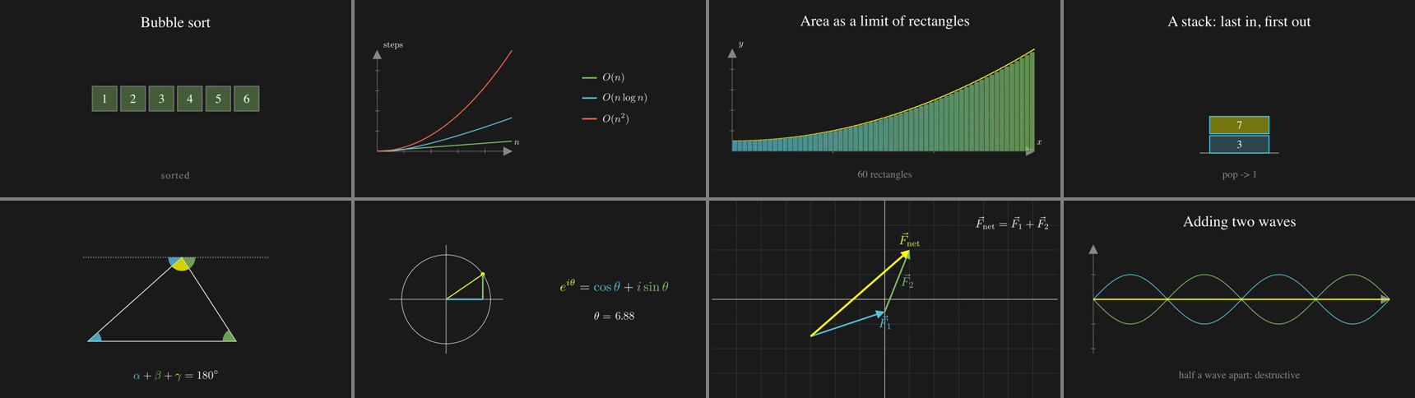
What it makes today, and what comes next
Frames from scenes the system renders: algorithms, calculus, physics, geometry, linear algebra
Working today
Next
Full web app: create, review, live progress, request changes
Narrated video in four themes, plus the source code
Runs offline in demo mode and in one Docker container
Visual critic: an AI that reviews rendered frames
Larger evaluation on 15 math, physics and CS topics
Slide-clip mode for lecture slides; more voices and languages
Notes:
Close by showing range: these frames are from scenes the system renders, covering algorithms, calculus, physics, geometry and linear algebra. Today the complete web application works end to end, produces narrated video in four colour themes, and runs offline in a demo mode or in a single Docker container. Next we want an AI critic that looks at rendered frames, a larger evaluation across fifteen topics, and a slide-clip mode so teachers can drop short animations straight into lectures. Then offer a live demo.

