Slide 1



Planning for College
Lydia Ciummo
Ryan Svendson
David Hutsell

Slide 2



agenda
Summary/Goals
Source of Data
Approach
Results
Conclusion

Slide 3


Summary/ goals
Our goal was to give parents insight into future cost of tuition and to give them the power to know how much they would need to invest to pay for college but also if they weren’t able to save that amount they would know how much of a loan to apply for.

Slide 4
Summary/ goals
We were able to forecast the median price for all Public and Private colleges with Tuition ,room and board, and other fees. Plus we used a high and low risk ETF to show the power of investing and compounding their investment. This would be useful for financial advisor.

Slide 5


Questions to be answered
How much has the price of university changed over the past 60 years after accounting for inflation?
How much can we expect the price to increase each year?
What is the average difference in price between public and private university?
With an initial investment of 10,000 dollars, how much can a family expect to have saved after 10 years for each portfolio? How does that compare to the predicted cost of university after 10 years?
Is one portfolio better than another in the given scenario?

Slide 6

Source of Data
Click to add photo
Tuition CSV
ALPACA

Slide 7
Source of Data
Tuition csv
Alpaca​
NCES.ed.gov for tuition satistics
Broke down Public, Private, and All Institutions into different Dataframes
Used ALPACA API to get historical data for SPY and AGG ETF for investment sources
Used this data to help with financial advice on how much to invest.

Slide 8
Approach/ difficulties
Difficulties we ran into were breaking down the CSV. There was a lot of data and which data do we use. Also, since we used the free Alpaca API we could only get 7 years of SPY and AGG ETF history. Other small coding walls but as a team we figured it out.

Slide 9
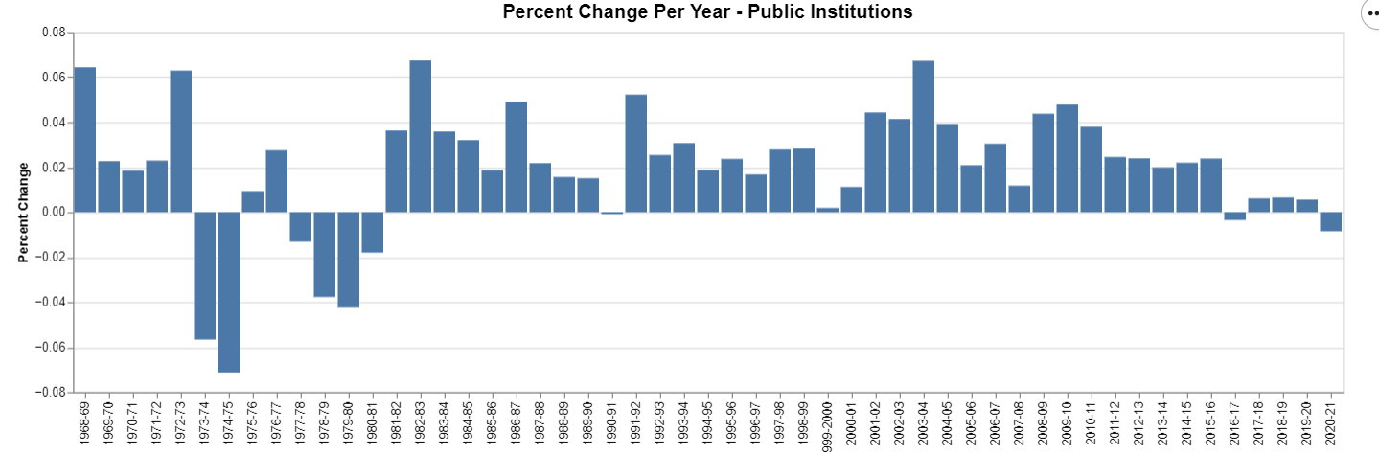
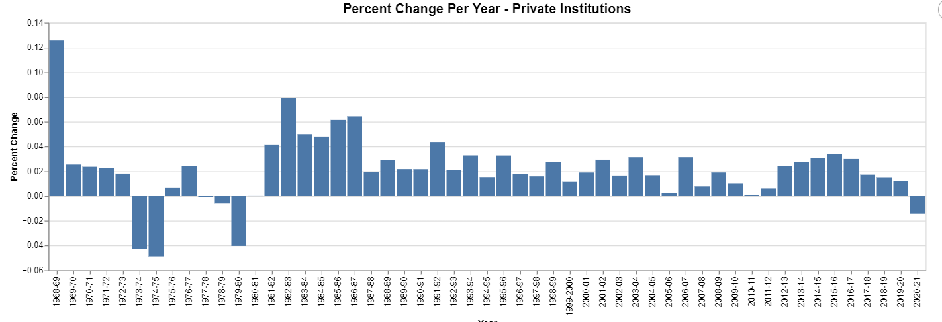
Average university cost by year

Slide 10

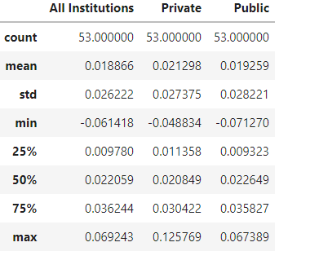
Assuming this 2 percent increase and using the most recent pricing data as a starting point, we can use the Future Value formula to calculate a price estimate over a certain number of years.

Slide 11

Main question to answer was: With an initial investment of 10,000 dollars, how much can a family expect to have saved after 10 years for each portfolio? How does that compare to the predicted cost of university after 10 years?¶

Slide 12
Simulated Returns 3 savings portfolio v cost per year predicted

Slide 13
In our simulations, the higher-risk portfolio appears to have performed better than the other two, even in the lower-bound prediction, although the difference was minimal. Since we only evaluated ETFs, which are less risky overall than investing in individual stocks, it seems that the increased level of risk for our higher-risk portfolio did not hurt its performance enough to decrease its attractiveness as an investment option.

Slide 14
Future Versions
Tuition Cost per state
More ETFS
Charts
Break down cost of tuition per state for all institutions ​
Add a couple more ETFs to the portfolio do give more diversity and options to the clients
​Have more interactive charts to show difference between high risk and low risk investments and the price of college in different states

Slide 15




Meet the team
Takuma Hayashi​
Mirjam Nilsson​
Flora Berggren​
Rajesh Santoshi​
President
Chief Executive Officer
Chief Operations Officer
VP Marketing

Slide 16








Meet the team
Takuma Hayashi
Mirjam Nilsson​
Flora Berggren​
Rajesh Santoshi​
President
Chief Executive Officer
Chief Operations Officer
VP Marketing
Graham Barnes
Rowan Murphy
Elizabeth Moore
Robin Kline
VP Product
SEO Strategist
Product Designer
Content Developer

Slide 17
Plan for product launch
1
Planning
4
Strategy
Synergize scalable e-commerce
Foster holistically superior methodologies
2
Marketing
5
Design
Disseminate standardized metrics
Coordinate e-business applications
3
Launch
Deploy strategic networks with compelling e-business needs

Slide 18
Timeline
Sep 20XX
Synergize scalable
e-commerce
Nov 20XX
Disseminate standardized metrics
Jan 20XX
Coordinate e-business applications
Mar 20XX
May 20XX
Foster holistically superior methodologies
Deploy strategic networks with compelling
e-business needs

Slide 19

count | 53.000000 | 53.000000 | 53.000000
mean | 0.018866 | 0.021298 | 0.019259
std | 0.026222 | 0.027375 | 0.028221
min | -0.061418 | -0.048834 | -0.071270
25% | 0.009780 | 0.011358 | 0.009323
50% | 0.022059 | 0.020849 | 0.022649
75% | 0.036244 | 0.030422 | 0.035827
max | 0.069243 | 0.125769 | 0.067389

