Slide 1
We Are Models
Notes:
On Human Pursuit
We’ve all played around with biological models, or financial models, or cooking models – so it’s clear that we use models in our work. Well, by the end of this presentation, you will see that we don’t just use models in our work – they are our work, and furthermore, they are our lives. We are models.

Slide 2
The First Modelers
Modern Models
Limits
Push the Limits
Models & Life
What is a
model?
Notes:
I will not define a model right away. Instead, I will show you how we have used models in the past, work on models in the present and how we seek to improve models in the future. Then, we can define a model inductively and see what it means in our life. So while we explore the depths of models, keep in mind the question: what is a model?

Slide 3
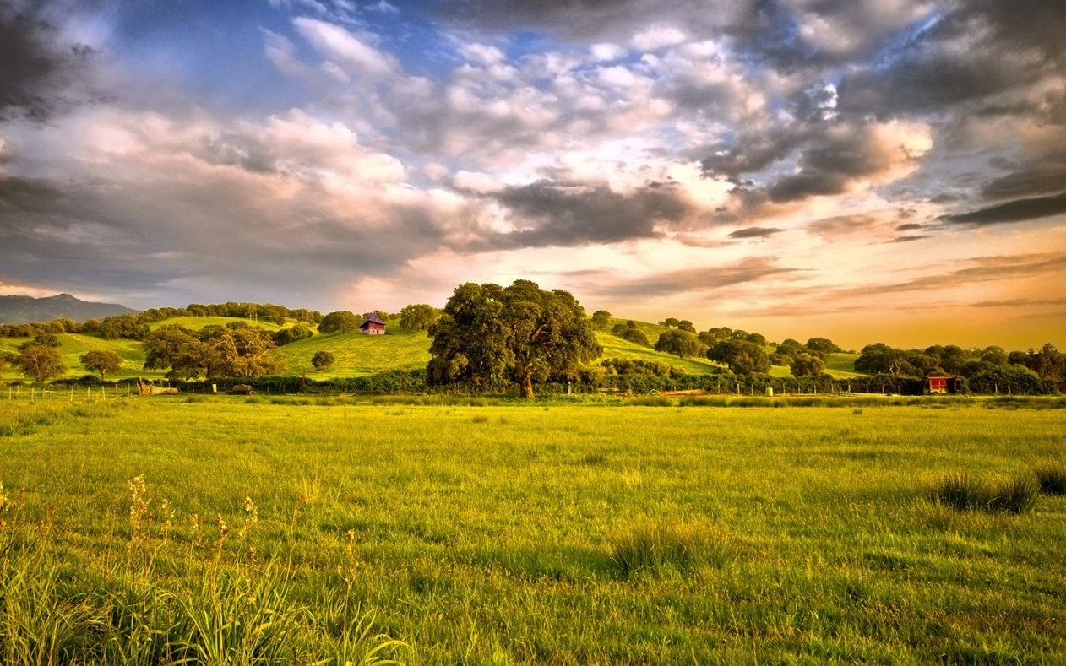
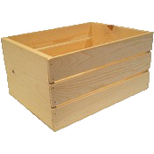

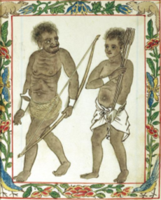

The First Modelers
Goal: Food!
Where will deer be given current conditions?
What conditions will make deer most likely move under the trap?
If I make a noise, will deer move under the trap?
Prediction
Explanation
Intervention
Inference Queries
?
??
!!
Notes:
Let’s think about one of the primary goals of the hunter-gatherers– to obtain FOOD. One way we can do it is hunting *this* deer. To better hunt the deer, we ask…
Suppose we build a trap. Now we would ask… #2
But, even if we can figure these conditions out, it would be nice to be able to DO something to increase the chance that deer move under the trap. So we can ask… #3
NOW if we can answer all 3 of these questions well enough, we may succeed in trapping the deer and satisfying our goal to obtain food.
Well… let’s think about these questions a bit more. We can classify each question
The first is a question of prediction. The hunter-gatherers want to know the likelihood of a future state, given the state of the world right now and in the past.
The second is a question of explanation. What are the most likely states that explain the occurrence of a given state?
The third is a question of intervention. If we do some action, forcing part of the current world state to some value, will we achieve a desired effect?
Now, just as the hunter-gatherers made these 3 types of queries 1000s of years ago, we make the same queries today in pursuit of our own goals. But there’s a big question: what when our models fail? We can’t predict the position of the deer perfectly, we can’t explain what will cause the deer to move under the trap easily, and our interventions, making the noise, don’t always accomplish our intended goals, trapping the deer. So what are we to do

Slide 4
Modern Models
Physics
Prediction: What is the path of an electron?
Explanation: What causes gravity?
Intervention: If we build a rocket and ignite it, will it launch into orbit?
Finance
What will the value of Apple be in 3 months?
What circumstances led to the 2008 crash?
If the Federal Reserve repurchases treasury bonds, will inflation decrease?
Music
How will it sound if a violin plays A, a Flute plays B, a Cello plays C, …
What leads an audience to most appreciate a sound? [psychology]
If we change the increase a tune’s time signature, will it appear faster?
Love, History, Biology, Mathematics, Engineering, Health, …….
Notes:
circumstances led to the Big Bang?

Slide 5
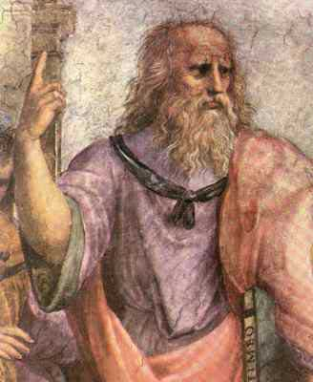

Limits
“What are the limits of our models?”
“How do we acquire knowledge?”
→ Epistemology
Rationalists
Empiricists
Thinking
Senses
Knowledge ← Logic
Knowledge ← Environment
Compute Everything → Know Everything
Observe Everything → Know Everything
Leibniz: God-Machine
Infinite processing
Infinite memory
Infinite bandwidth
Push our Limits ➔ Approach the God Machine
Notes:
Predictions provide a check on our imaginations

Slide 6
Push the Limits
Push bandwidth (I/O)
Take in more data
Telescopes, microscopes, Geiger counters, Internet, …
Increase data’s relevant information content
Filtering tools, Search Engines
Push Memory (RAM, Storage)
Summarize and condense (Hash)
Library catalog system, Internet
Push Computation (Processor)
New ways of thinking → Theories
Graphical, Symbolic, Numerical, Audial, …
Statistics in Physics → Classical to Probabilistic Model of Atom
Increase thinking efficiency
Stand on the shoulders of giants
Notes:
Clothes shopping – can only afford $30 on new pants. Filter out everything above – like a low pass filter -> DSP
Use others’ results without expending their lifetime of effort

Slide 7

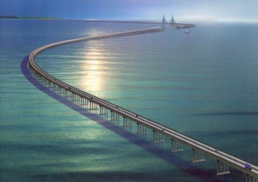
Taking Models to the Next Level
Accuracy & Precision ↗
Assumptions ↘
Computability ↗
Compatibility w/ other models ↗ (Unification)
Simplicity ↗ (Language)
The Bottom Line:
Within limitations, make most likely inferences
Scientists: expand knowledge via ↗ models
Engineering: leverage all knowledge & Solve problems
Notes:
Yes, we cannot perfectly predict, explain & intervene given the limits of our models, but with the capabilities we do have, we can deliver the most likely explanations, predictions& interventions.

Slide 8
For what purpose?
Advance humanity toward your future vision.
Your meaning of life
FUN! Enjoy everything
Creation process, outcome, comraderie
Notes:
Always learn more & pass on the knowledge

Slide 9
On Failure
God messed up our models
Notes:
Moving a bit further in time, many of the ancient humans asked the same questions: what do we do when our models—the results of all our work and thinking—fail?
The first answer

Slide 10

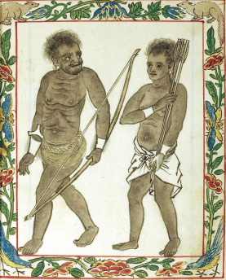
Failure…
Goal: Food!
When will it rain?
Where are the deer given it’s raining?
Make the herds move somewhere via noise?
~7000 BCE
Explanation
Prediction
Intervention
!!

Slide 11
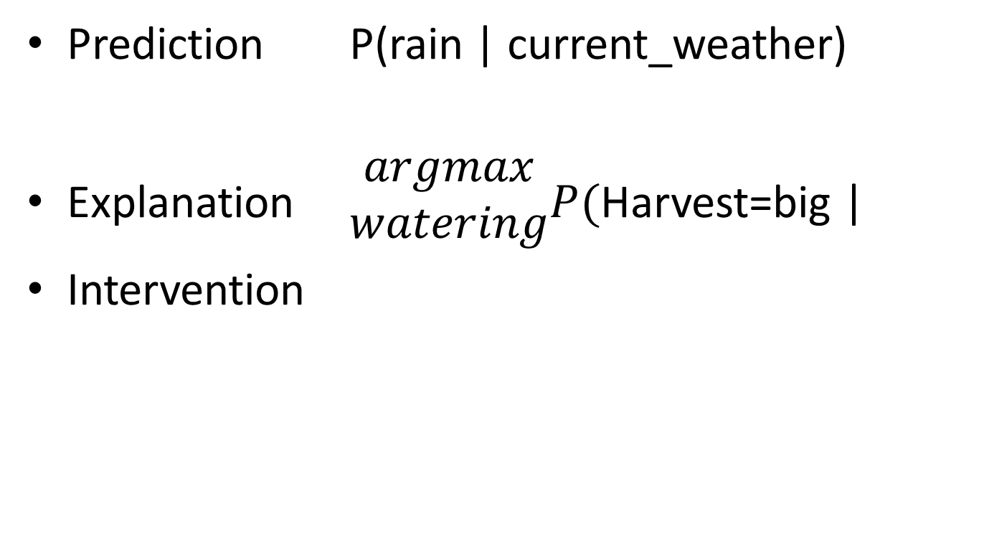
Prediction P(rain | current_weather)
Explanation $\begin{matrix}argmax \\ watering\end{matrix}P($Harvest=big |
Intervention
Combine with Feedback ➔ Learning

