Slide 1
Models: Prediction, Explanation, Intervention
Notes:
On Human Pursuit

Slide 2
Success
Failure
Limits
Our Best Shot
What is a
model?
Notes:
I will not define a model right away. Instead, I will show you how we have used models in the past, work on models in the present and how we seek to improve models in the future. Then, we can define a model inductively and see what it means in our life. So while we explore the depths of models, keep in mind the question: what is a model?

Slide 3
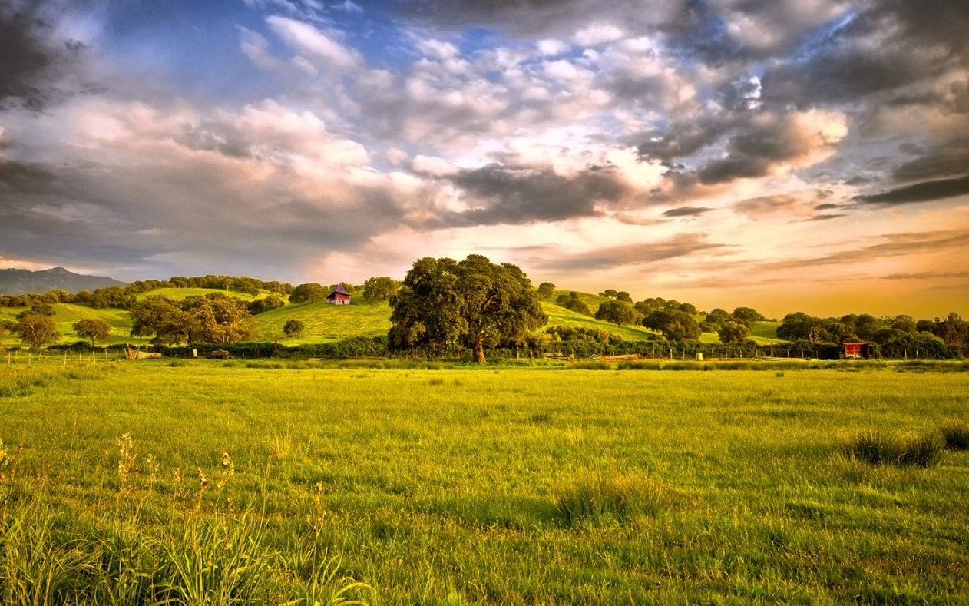
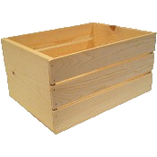

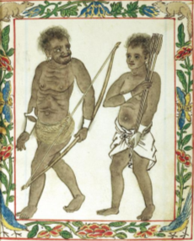

The First Modelers
Goal: Food!
Where will the deer be given current conditions?
What conditions will make the deer most likely move under the trap?
If I make a noise, will the deer move under the trap?
Prediction
Explanation
Intervention
Inference Queries
?
??
!!
Notes:
Let’s think about one of the primary goals of the hunter-gatherers– to obtain FOOD. One way we can do it is hunting *this* deer. To better hunt the deer, we ask…
Suppose we build a trap. Now we would ask… #2
But, even if we can figure these conditions out, it would be nice to be able to DO something to increase the chance that the deer moves under the trap. So we can ask… #3
NOW if we can answer all 3 of these questions well enough, we may succeed in trapping the deer and satisfying our goal to obtain food.
Well… let’s think about these questions a bit more. We can classify each question
The first is a question of prediction. The hunter-gatheres ask about a ……………………
Now, just as the hunter-gatherers made these 3 types of queries 1000s of years ago, we make the same queries today in pursuit of our own goals. But there’s a big question: what when our models fail? We can’t predict the position of the deer perfectly, we can’t explain what will cause the deer to move under the trap easily, and our interventions, making the noise, don’t always accomplish our intended goals, trapping the deer.

Slide 4
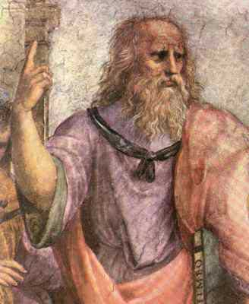

Limits
“What are the limits of our models?”
“How do we acquire knowledge?”
Epistemology
Rationalists
Empiricists
Thinking
Senses
Knowledge ← Logic
Knowledge ← Environment
Compute Everything → Know Everything
Observe Everything → Know Everything
Leibniz: God-Machine
Infinite processing
Infinite memory
Infinite bandwidth
Push the limits ➔ Approach the God Machine

Slide 8
On Failure
God messed up our models
Notes:
Moving a bit further in time, many of the ancient humans asked the same questions: what do we do when our models—the results of all our work and thinking—fail?
The first answer

Slide 9

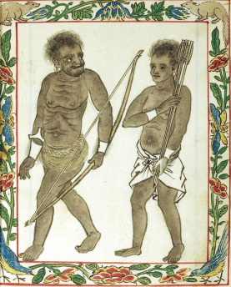
Failure…
Goal: Food!
When will it rain?
Where are the deer given it’s raining?
Make the herds move somewhere via noise?
~7000 BCE
Explanation
Prediction
Intervention
!!

Slide 10
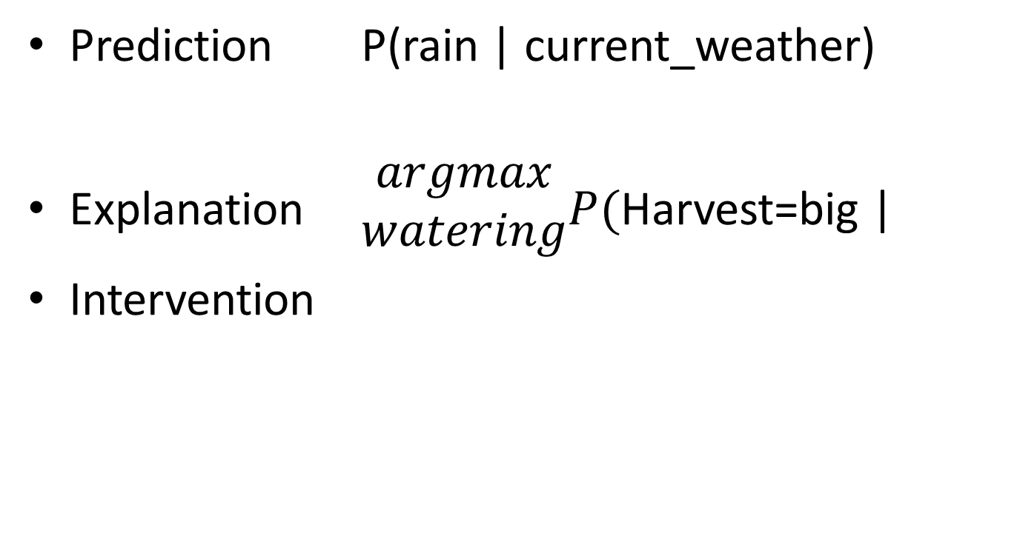
Prediction P(rain | current_weather)
Explanation $\begin{matrix}argmax \\ watering\end{matrix}P($Harvest=big |
Intervention

