Slide 1

We Are Modelers, Pressing Our Models
The First Modelers
Human Limits
Ultimate Limits
Pushing Limits
Why? Models & Life
What is a
model?
Notes:
You call yourselves scientists. You call yourselves engineers. You say you use the scientific method to solve problems and make progress in the world. But what are you really doing?
I will not define a model right away. Instead, I will show you how we have used models in the past, work on models in the present and how we seek to improve models in the future. Then, we can define a model inductively and see what it means in our life. So while we explore the depths of models, keep in mind the question: what is a model?

Slide 2
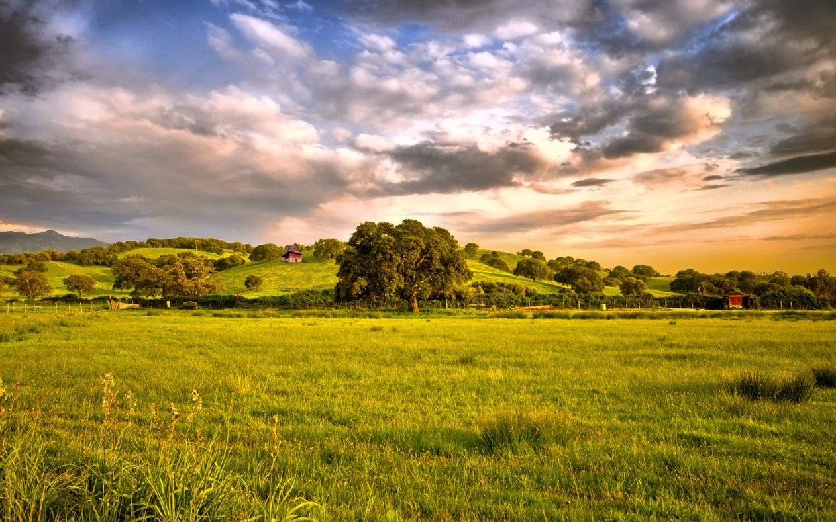
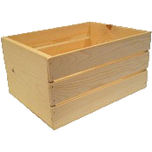

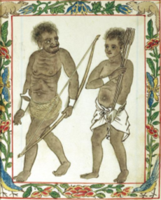

The First Modelers
Goal: Food!
Where will deer be given current conditions?
What conditions will make deer most likely move under the trap?
If I make a noise, will deer move under the trap?
Prediction
Explanation
Intervention
Inference Queries
Computable!
?
??
!!
Notes:
Let’s think about one of the primary goals of the hunter-gatherers– to obtain FOOD. One way we can do it is hunting *this* deer. To better hunt the deer, we ask…
Suppose we build a trap. Now we would ask… #2
But, even if we can figure these conditions out, it would be nice to be able to DO something to increase the chance that deer move under the trap. So we can ask… #3
NOW if we can answer all 3 of these questions well enough, we may succeed in trapping the deer and satisfying our goal to obtain food.
Well… let’s think about these questions a bit more. We can classify each question:
The first is a question of prediction. The hunter-gatherers want to know the likelihood of a future state, given the state of the world right now and in the past.
The second is a question of explanation. What are the most likely states that explain the occurrence of a given state?
The third is a question of intervention. If we do some action, forcing part of the current world state to some value, will we achieve a desired effect?
In general, we call these three questions inference queries, and they make up all our daily activities.
Can I predict the stock market so that I invest in the best funds?
Can I explain why I want to eat a cookie?
Can I intervene to get the best grade in a class? And so on.
Notice that all these queries can be written in the language of mathematics. This implies that these queries are computable. Keep that in mind, and I will return to that point shortly.
Now, just as the hunter-gatherers made these 3 types of queries 1000s of years ago, we make the same queries today in pursuit of our own goals. But there’s a big question: what when our models fail? We can’t predict the position of the deer perfectly, we can’t explain what will cause the deer to move under the trap easily, and our interventions, making the noise, don’t always accomplish our intended goals, trapping the deer. So what are we to do?

Slide 3
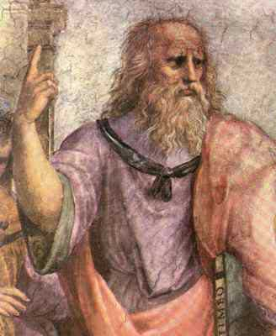

Limits
God?
“What are the limits of our models?”
“How do we acquire knowledge?”
→ Epistemology
Rationalists
Empiricists
Thinking
Senses
Knowledge ← Logic
Knowledge ← Environment
Compute Everything → Know Everything
Observe Everything → Know Everything
God-Machine?
∞ processing
∞ memory
∞ bandwidth
Can we reach the God Machine?
Notes:
Well, it turns out we’re not the only ones asking that question. For a long time, humans wondered how their models could fail and came up with a clear answer: God!
A few thousand years after the hunter-gatherers, philosophers began thinking about the limits of our models, and they started by asking…
and then it took the form of…
In other words, philosophers started investigating *epistemology
Now for you history buffs, you might remember that epistemology split into two camps. One camp is called the *rationalists, who proposed that we acquire all our knowledge through logic and reasoning. They said that if we think really hard, we can discover all the knowledge of the universe.
On the other extreme, another group of philosophers said “what!? You rationalists just think
If we can both COMPUTE and OBSERVE then we can create the GOD MACHINE
Predictions provide a check on our imaginations

Slide 4



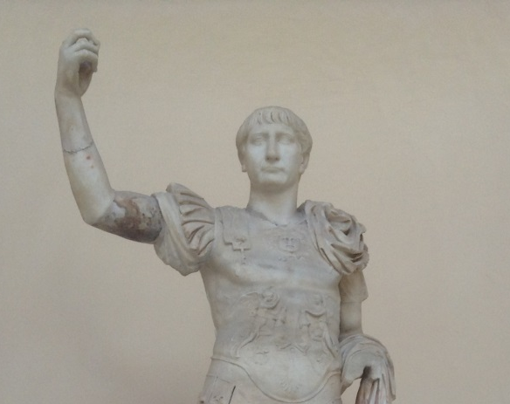
Reality Check: Hard Limits
Heisenberg
Thermodynamics
Gödel Incompleteness
Physical Measurements
Physical Manipulation
Knowledge
lim
lim
lim
But we can get closer!
Perfection
Notes:
D’s stance: You will never know everything because there are limits on what you can measure.
G’s counter: Your uncertainty is on a really small scale
D’s response: Yea, but think about chaotic systems. A small deviation in initial inputs to a chaotic system, even on the scale of 10^-30, leads to total divergence. Your models will never be correct.
G’s Stance: Actually, we can model physical uncertainty with probability and randomness. By incorporating probability into our models, we can use machine learning to create models that capture reality with minimal error.
D’s Response: You risk overfitting the data and mistake randomness with supposed order. You also need HUGE sets of data to have a decent model. Think of the Bayesian error rate: you will never achieve an error smaller than the minimum Bayesian Error Rate when engaging in any kind of machine learning.
G’s stance: Ok, but you will never be correct either. Your logical systems will never be complete without risking inconsistency. And if you desire total consistency, then your system will be incomplete.
D’s stance: Well, we’re both fucked. I can’t ever gain complete and consistent knowledge, and you can’t ever take perfect data observations from the environment. And we both cannot make perfect manipulations due to the laws of thermodynamics– no matter how much we try to intervene, we cannot make energy flow from low to high without applying work. We can’t make perpetual motion machines!

Slide 5
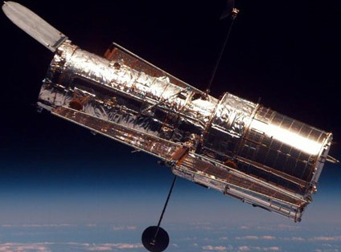

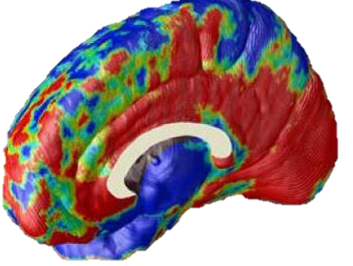


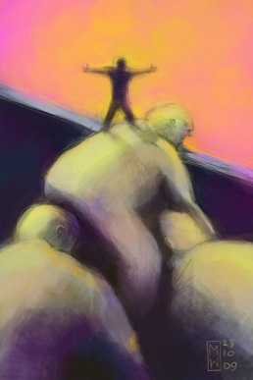
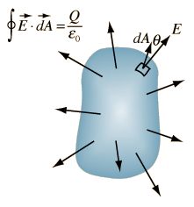
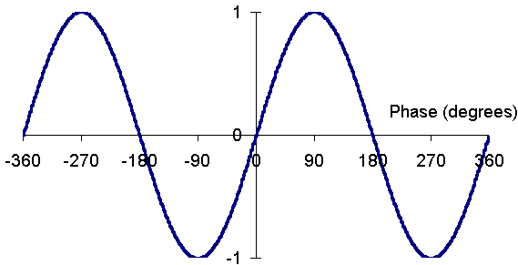
Push the Limits
Push bandwidth (I/O)
More Data, More Relevant Data
Push Memory (RAM, Storage)
Summarize and condense (Hash)
Push Computation (Processor)
New ways of thinking → Theories
Classical to Probabilistic
Increase thinking efficiency
123
xyz
Notes:
Stand on the shoulders of giants
Clothes shopping – can only afford $30 on new pants. Filter out everything above – like a low pass filter -> DSP
Use others’ results without expending their lifetime of effort

Slide 6


Taking Models to the Next Level
Accuracy & Precision ↗
Assumptions ↘
Minimize error
Compatibility w/ other models ↗ (Unification)
Computability ↗
Simplicity ↗ (Language)
The Bottom Line:
Within limitations, make most likely inferences
Scientists: expand knowledge via ↗ models
Engineering: leverage all knowledge & Solve problems
Notes:
Yes, we cannot perfectly predict, explain & intervene given the limits of our models, but with the capabilities we do have, we can deliver the most likely explanations, predictions & interventions.

Slide 7
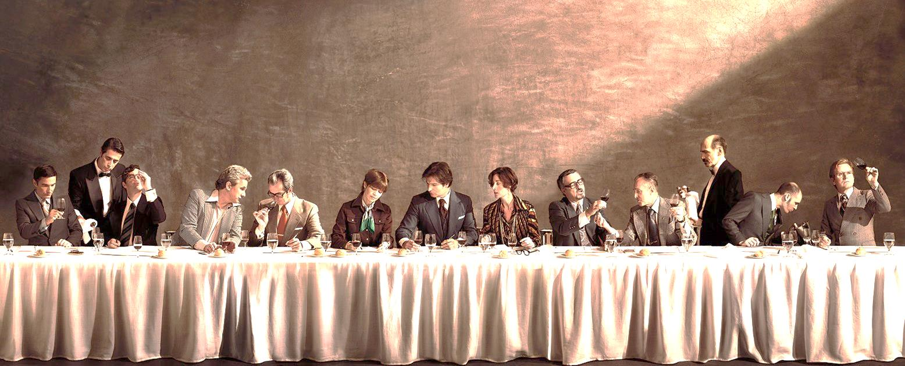
For what purpose?
Advance humanity toward your future vision
Your meaning of life
Fun! Enjoy everything…
Creation process, outcome, camaraderie
Notes:
Always learn more & pass on the knowledge

Slide 8
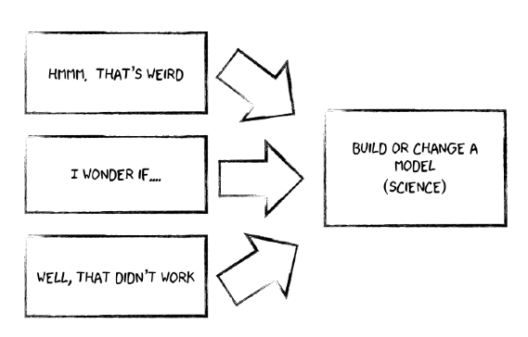
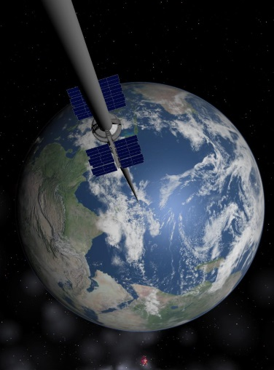
Advance humanity toward your future vision
Your meaning of life
Fun! Enjoy everything…
Creation process, outcome, camaraderie
Better…
Predictions
Explanations
Interventions
Approach our limits and prosper!
Notes:
So… what should you take away from tonight?
First, recognize your goals: through what better predictions, explanations and interventions are you trying to change the world? If you understand your goals and how to improve models to meet them, you will understand what your role in the world.
Second, recognize there are fundamental limits. BUT DO NOT DESPAIR! Though we can’t ever hit the limits, we can approach them, and by doing so move humanity to greater place than today.
We move to push the limits, and in doing so we create real progress in the world. And we do it for those two grand goals:
to move the world toward our vision, and to take utter joy in the whole process while doing so.
We have limits
Can we hit the God Machine?
No we can't
But we can get closer
And make real progress in the world
And this is why we do it

Slide 10
Backup!

Slide 11
Modern Models
Physics
Prediction: What is the path of an electron?
Explanation: What causes gravity?
Intervention: If we build a rocket and ignite it, will it launch into orbit?
Finance
What will the value of Apple be in 3 months?
What circumstances led to the 2008 crash?
If the Federal Reserve repurchases treasury bonds, will inflation decrease?
Music
How will it sound if a violin plays A, a Flute plays B, a Cello plays C, …
What leads an audience to most appreciate a sound? [psychology]
If we change the increase a tune’s time signature, will it appear faster?
Love, History, Biology, Mathematics, Engineering, Health, …….
Notes:
circumstances led to the Big Bang?

Slide 12
On Failure
God messed up our models
Notes:
Moving a bit further in time, many of the ancient humans asked the same questions: what do we do when our models—the results of all our work and thinking—fail?
The first answer

Slide 13

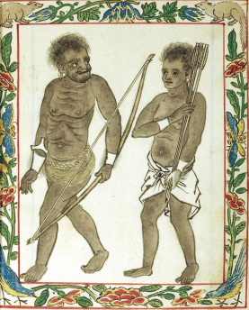
Failure…
Goal: Food!
When will it rain?
Where are the deer given it’s raining?
Make the herds move somewhere via noise?
~7000 BCE
Explanation
Prediction
Intervention
!!

Slide 14
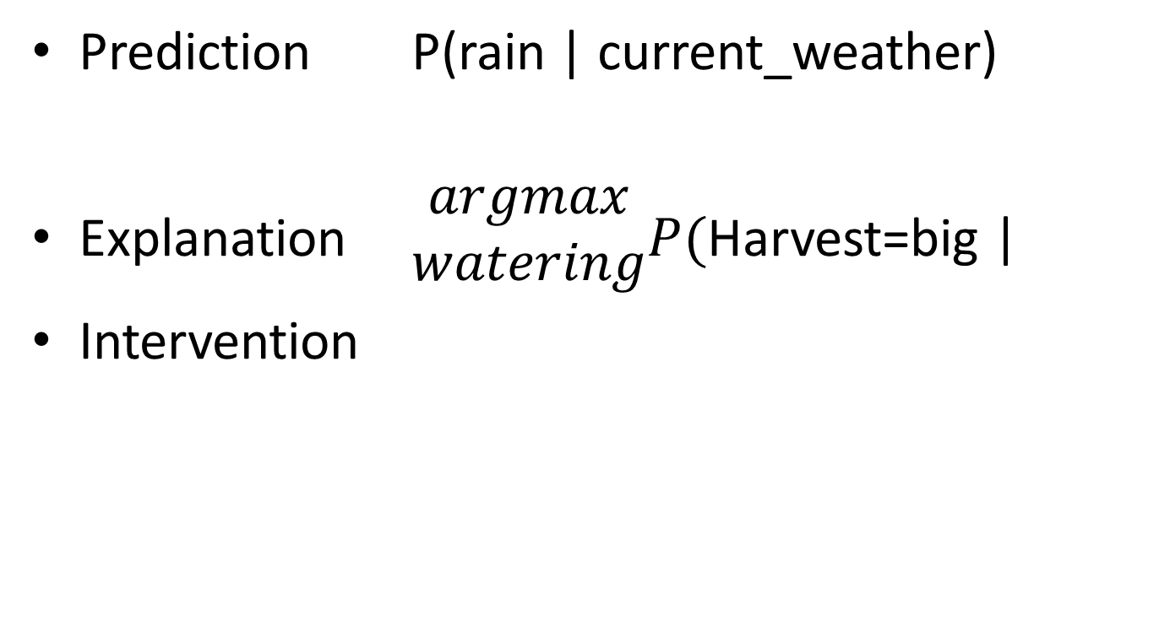
Prediction P(rain | current_weather)
Explanation $\begin{matrix}argmax \\ watering\end{matrix}P($Harvest=big |
Intervention
Combine with Feedback ➔ Learning

Slide 15
Push bandwidth (I/O)
Take in more data
Telescopes, microscopes, Geiger counters, Internet, …
Increase data’s relevant information content
Filtering tools, Search Engines
Push Memory (RAM, Storage)
Summarize and condense (Hash)
Library catalog system, Internet
Push Computation (Processor)
New ways of thinking → Theories
Graphical, Symbolic, Numerical, Audial, …
Statistics in Physics → Classical to Probabilistic Model of Atom
Increase thinking efficiency
Stand on the shoulders of giants
We’ll never get perfect models
But we can get closer!
Push our Limits ➔ Approach the God Machine

