Slide 1

Bounding Ramsey Numbers
by Optimization
Dylan Hutchison
Margaret Vulih
Example photos

Slide 2

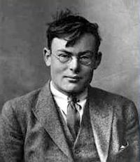
Background
Named after Frank P. Ramsey. Inspiration/Bio: ___
Popularized by Erdos and Szercik
Applications: ___
Frank P. Ramsey

Slide 3
Ramsey Number:
Graph Interpretation
R(p,q)
is the smallest integer such that:
(function N x N → N)
Every graph G with |G| > R(p,q) nodes has, no matter how you arrange the edges,
EITHER a complete (clique) subgraph H  G of size |H|=p
OR an independent set subgraph H  G of size |H|=q
Notes:
Interested in the general case? Ask after the presentation!

Slide 4
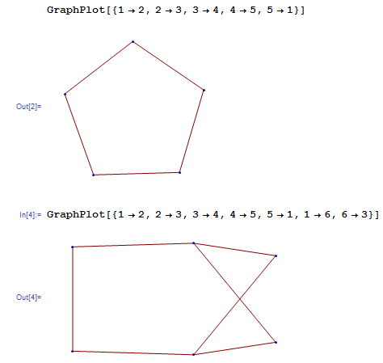
Example: R(3,3)=6
5 nodes:
May have no 3-clique
or 3-indep subgraph
6 nodes:
We are guaranteed
Either 3-clique
or 3-indep subgraph

Slide 5
Known Ramsey #s and Bounds
p, q | 1 | 2 | 3 | 4 | 5 | 6 | 7 | 8 | 9 | 10
1 | 1 | 1 | 1 | 1 | 1 | 1 | 1 | 1 | 1 | 1
2 | 1 | 2 | 3 | 4 | 5 | 6 | 7 | 8 | 9 | 10
3 | 1 | 3 | 6 | 9 | 14 | 18 | 23 | 28 | 36 | 40-43
4 | 1 | 4 | 9 | 18 | 25 | 35-41 | 49-61 | 56-84 | 73-115 | 92-149
5 | 1 | 5 | 14 | 25 | 43-49 | 58-87 | 80-143 | 101-216 | 125-316 | 143-442
6 | 1 | 6 | 18 | 35-41 | 58-87 | 102-165 | 113-298 | 127-495 | 169-780 | 179-1171
7 | 1 | 7 | 23 | 49-61 | 80-143 | 113-298 | 205-540 | 216-1031 | 233-1713 | 298-2826
8 | 1 | 8 | 28 | 56-84 | 101-216 | 127-495 | 216-1031 | 282-1870 | 317-3583 | 317-6090
9 | 1 | 9 | 36 | 73-115 | 125-316 | 169-780 | 233-1713 | 317-3583 | 565-6588 | 580-12677
10 | 1 | 10 | 40-43 | 92-149 | 143-442 | 179-1171 | 289-2826 | 317-6090 | 580-12677 | 798-23556
Source: http://documents.kenyon.edu/math/BuschurKSenEx2011.pdf

Slide 6
Methods we tried
Establish an upper bound through a recursive approach.
  R(m,n) ≤ [R(m,n-1)]² /R(m,n-2); n > 7
  For m = 3, error compared to established upper bounds is less than 10%
  Fails for R(3,9)
  For select other Ramsey Numbers the result falls within established ranges.

Slide 7
Our Plan to find R(4,4)
Initialize Ramsey number to r = 4
Initialize iteration number i = 0
Randomly generate a graph with i vertexes.
  If there exists a graph with either 4 edges or 4 independent vertexes,
  Then, r = r+ 1, i = 0
  Else, i=i +1
  Return to Step 3 if i <25.
Print r

Slide 8
Results
Used C++
We found that R(4,4) =
Our error from the established number was __%

Slide 9
Summary
There is no other method besides brute force to prove a Ramsey Number.
The mathematical equations published about finding Ramsey Numbers still need to be proved using brute force numerical techniques.
We used a Random Search method to generate the graphs for inspection.

Slide 10
Questions?

Slide 13
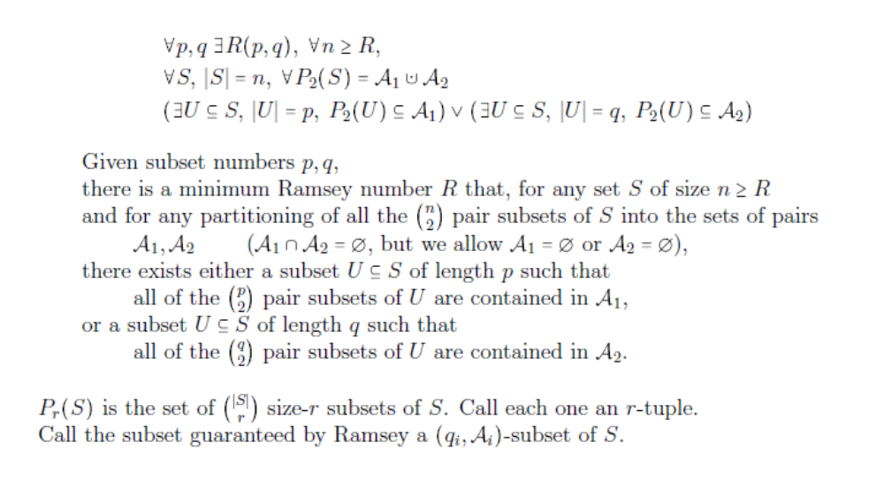
Set Interpretation

Slide 14
Backup
Graph G = (V,E)
V = Vertices/Nodes
E = Edges

