Slide 1

Bounding Ramsey Numbers by Search & Optimization
Dylan Hutchison
Margaret Vulih
10 December 2013
Example photos

Slide 2

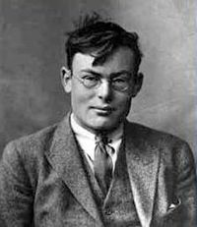
Background
Named after Frank P. Ramsey. Inspiration/Bio: A British mathematician who published the paper On a problem of Formal Logic in 1928 that became the basis of Ramsey Theory.
Popularized by Erdos and Szekeres in the paper Happy Ending Problem [1935]
Frank P. Ramsey
http://en.wikipedia.org/wiki/File:Frank_Plumpton_Ramsey.JPG

Slide 3
Applications
Graphs and Social Networks
In a group of n people, if n >= R(p,q), then there is either
a subcollection of p people who are pairwise all friends OR
a subcollection of q people who are pairwise all not friends.
Convex Geometry
With n points in general position (no 3 points collinear), if n >= R(5,m; r=4),
there MUST BE a subcollection of m points that compose a convex m-gon.
Information Theory with Dual Cores
Goal: Find the maximum number of codes that can be transmitted down a channel without error → when 2 codes can be confused for one another.
Nodes = codes, edges = pairs of codes confused when transmitted
Given n codes, find
Notes:
Ask me about the convex proof

Slide 4
Ramsey Number: Graph Interpretation
R(p,q)
(function N x N → N)
is the smallest integer such that:
Every graph G with |G| > R(p,q) nodes has, no matter how you arrange the edges,
EITHER a complete (clique) subgraph H  G of size |H|=p
OR an independent set subgraph H  G of size |H|=q
“Guaranteed order amidst large enough chaos”
Notes:
Interested in the general case? Ask after the presentation!

Slide 5
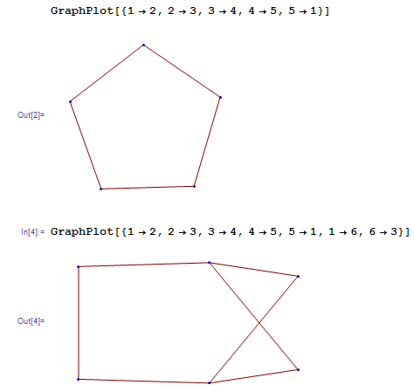
Example: R(3,3)=6
5 nodes:
May have no 3-clique
or 3-indep subgraph
6 nodes:
We are guaranteed
Either 3-clique
or 3-indep subgraph

Slide 6
Known Ramsey #’s and Bounds
p, q | 1 | 2 | 3 | 4 | 5 | 6 | 7 | 8 | 9 | 10
1 | 1 | 1 | 1 | 1 | 1 | 1 | 1 | 1 | 1 | 1
2 | 1 | 2 | 3 | 4 | 5 | 6 | 7 | 8 | 9 | 10
3 | 1 | 3 | 6 | 9 | 14 | 18 | 23 | 28 | 36 | 40-43
4 | 1 | 4 | 9 | 18 | 25 | 35-41 | 49-61 | 56-84 | 73-115 | 92-149
5 | 1 | 5 | 14 | 25 | 43-49 | 58-87 | 80-143 | 101-216 | 125-316 | 143-442
6 | 1 | 6 | 18 | 35-41 | 58-87 | 102-165 | 113-298 | 127-495 | 169-780 | 179-1171
7 | 1 | 7 | 23 | 49-61 | 80-143 | 113-298 | 205-540 | 216-1031 | 233-1713 | 298-2826
8 | 1 | 8 | 28 | 56-84 | 101-216 | 127-495 | 216-1031 | 282-1870 | 317-3583 | 317-6090
9 | 1 | 9 | 36 | 73-115 | 125-316 | 169-780 | 233-1713 | 317-3583 | 565-6588 | 580-12677
10 | 1 | 10 | 40-43 | 92-149 | 143-442 | 179-1171 | 289-2826 | 317-6090 | 580-12677 | 798-23556
Source: http://documents.kenyon.edu/math/BuschurKSenEx2011.pdf

Slide 8
R(q,q) Search using C++

Slide 9
R(4,4) Search using Matlab
While <=10 bad graphs
Generate a subgraph
If it is not duplicate subgraph
Check if it is a bad graph
If there are more bad graphs that iterations of the while loop than iterate r.
End
Print out final r

Slide 10

Optimization Form
Minimize the totals number of nodes n that guarantees a complete subgraph or an independent subgraph.

Slide 11
Results
Using C++
We found R(3,3) = 6
True number is 6
Using Matlab
We found R(4,4) > 16~17 (randomness)
True number is 18

Slide 12
Summary
No analytical solutions for Large Ramsey Numbers
Use brute force numerical techniques.
We systematically searched through all graphs of size n to bound the Ramsey number R(q,q)
Partial results on random search through graphs size n
If n < R(q,q), random search can find a new lower bound
If n >= R(q,q), random search fails – still need to enumerate all graphs for upper bound
Active research area – new Ramsey # = new paper

Slide 15
Set Interpretation

Slide 16
Backup
Graph G = (V,E)
V = Vertices/Nodes
E = Edges

