Slide 1

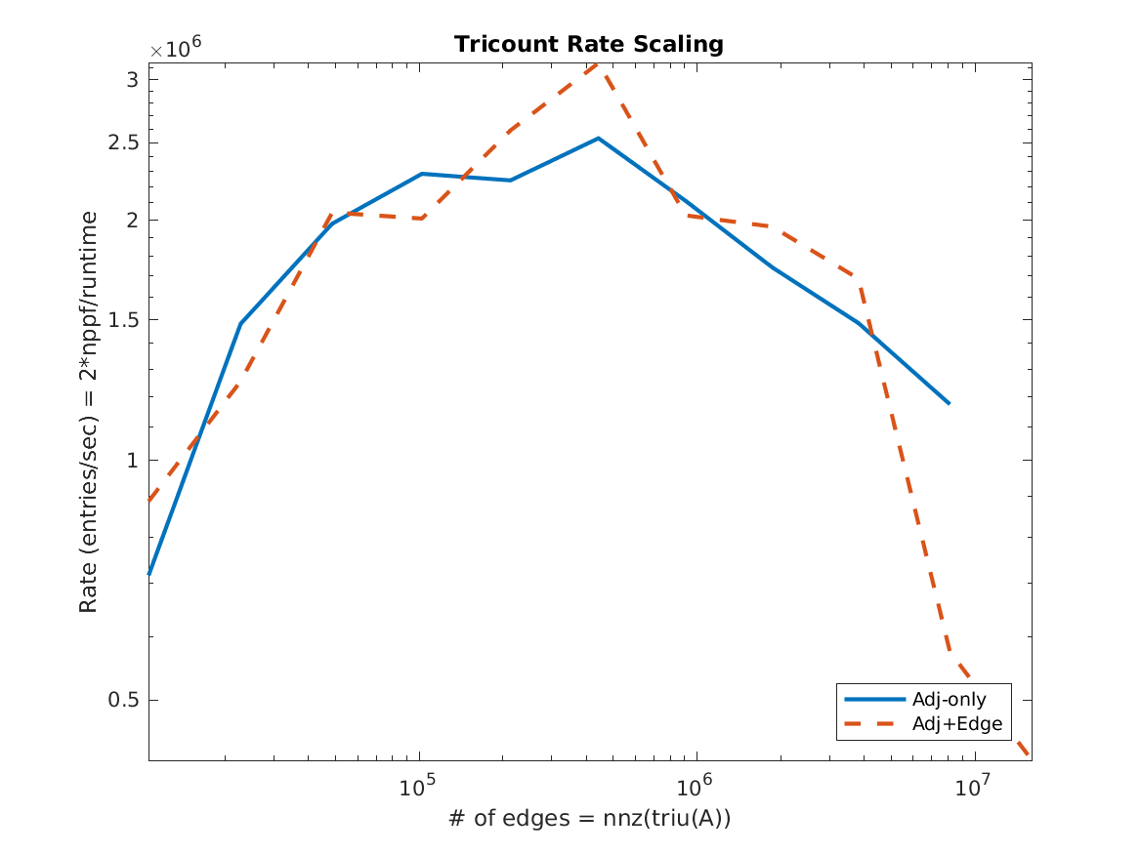
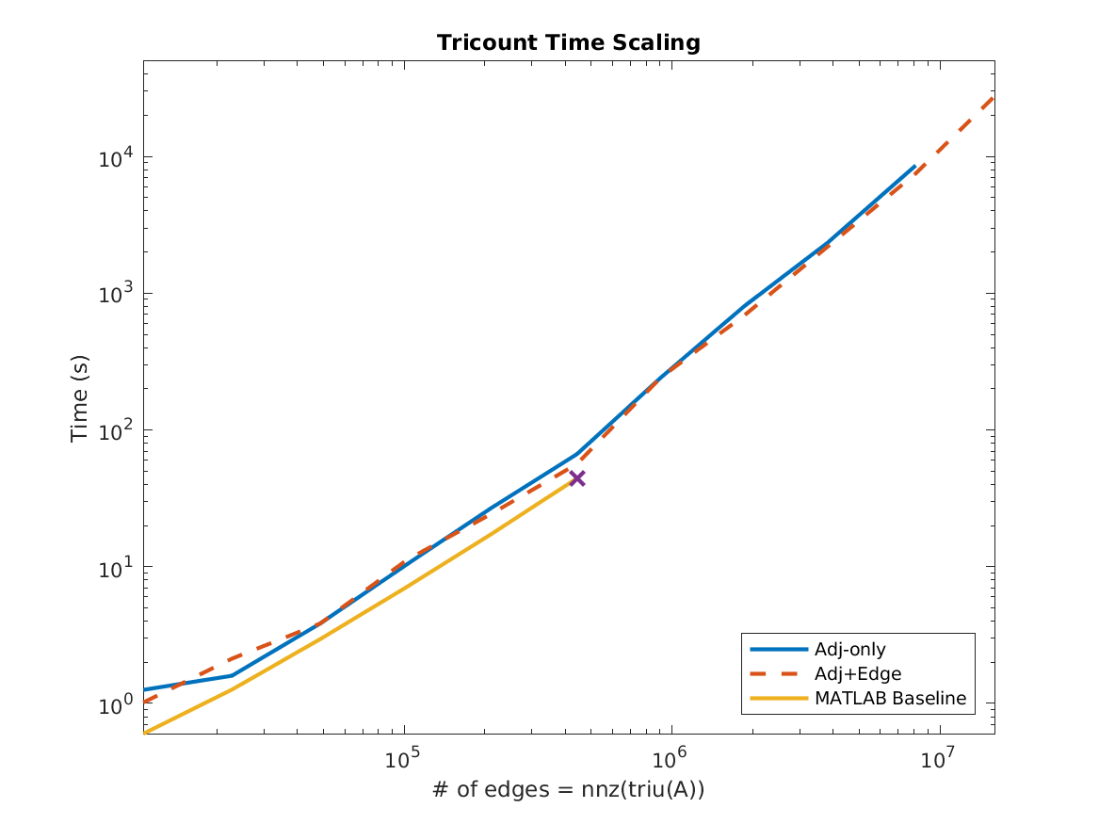

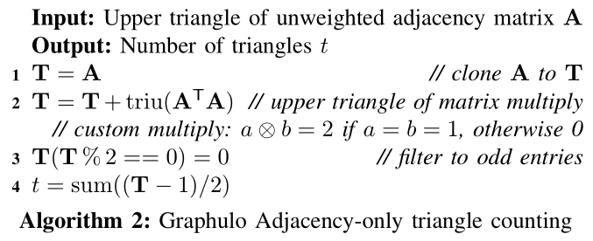
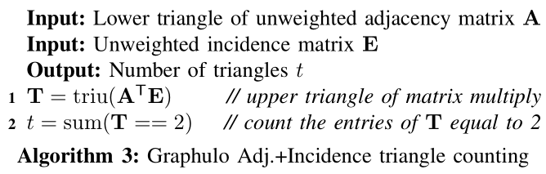



Distributed Triangle Counting in the Graphulo Matrix Math Library
Dylan Hutchison, University of Washington, dhutchis@cs.washington.edu
Triangle Counting Experiment on Power Law Graphs
Experiment Details
Question: How do the two triangle counting implementations compare in performance?
Baseline: Single-node in-memory MATLAB implementation
m3.xlarge Amazon nodes, each 15 GB mem, 4 vCPU, 2x40 GB SSD
8 workers, 3 coordinators, 1 monitor
Graph500 power law matrix generator, 2¹⁰ to 2²⁰ rows, 16 nonzeros/row
An open source library to orchestrate server-side graph processing in the Apache Accumulo database
Graphulo uses server-side iterators (a la BigTable) to compute the GraphBLAS kernels on database tables:
Matrix Multiply Element-wise Multiply
Matrix Reduce Element-wise Add
Apply function Matrix Assignment
Matrix Extraction (Row/Column filtering)
Advantages of in-database computation include
Data Locality (Graphulo brings compute to data)
Infrastructure Reuse (no sharing hardware between systems)
Accumulo Features (Accumulo as a Big Index, Distributed Execution)
Past Work
Showed Graphulo faster than single-node in-memory LA packages on MxM (HPEC '15)
Confirmed results for more complex I/O-bound, single-pass graph analytics (IPDPS '15, HPEC '16)
Verified Graphulo scales with Accumulo as cluster size increases (HPEC '16)
Implemented GraphBLAS, Jaccard, k-Truss; showed Graphulo is best for I/O-bound, single-pass analytics (HPEC ’16)
Built LaraDB atop Graphulo; compared to MapReduce on MxM (BeyondMR ’17)
Discussion
MATLAB Baseline exceeds memory after scale 15 (520k edges); Baseline performs faster while it fits in memory
Similar performance for both Graphulo algorithms
Phase transition between scale 15 and 16 (520k and 1.05M edges)
Scale ≤ 15 – Reduction step is bottleneck
Scale ≥ 16 – Matrix multiply step is bottleneck
Peak processing rate achieved at the phase transition point
Data skew (from power law graphs) limits performance
Poor load balancing; one machine receives a disproportionately large workload
Permuting rows and columns helps; however, some machine must receive the “super-node”—the highest degree row
Proposal: A hybrid algorithm to address skew
Handle high-degree rows separately with an inner-product matrix multiply
Handle low-degree rows with an outer-product matrix multiply
Static Graph Challenge
Finding the k-Truss subgraph
Implemented in HPEC ’16
Triangle Counting
This poster
Example 3-truss consisting of 2 triangles
Future Work
Two Triangle Counting Algorithms
Measure how well a hybrid algorithm addresses data skew
Explore the “export to an external system” strategy, as used in polystores such as Myria and BigDAWG
Benchmark on real-world data, which likely has less skew
Address programmability barriers to graph algorithms via code generation

