Slide 1
From NoSQL Accumulo
to NewSQL Graphulo:
Design and Utility of Graph Algorithms
inside a BigTable Database
Dylan Hutchison Jeremy Kepner
Vijay Gadepally Bill Howe
Notes:
Hello folks! I hope you enjoyed Tim Weale's talk 20 minute ago on Graphulo scale-up matrix multiply experiments.
In case you missed Tim's talk, I will quickly review some background here and then present new material.
20 minutes earlier Tim gave you a proper introduction to the Apache Accumulo database and the Graphulo project to implement the GraphBLAS matrix math kernels inside the Accumulo database.
He showed you experiments that test how well Graphulo matrix multiply scales with the Accumulo database on a cluster, both for large matrix multiplication and for subgraph extraction.

Slide 2
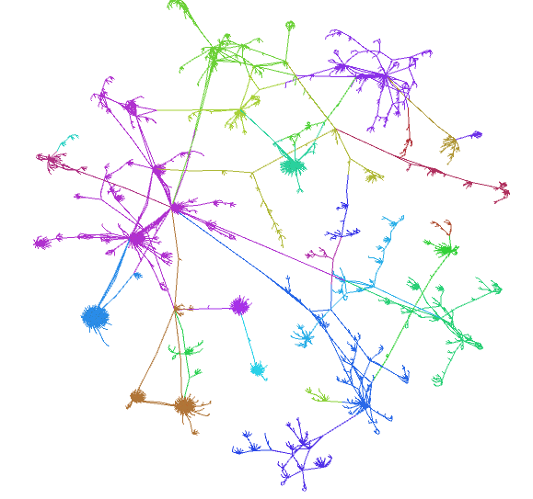

Computation ➔ Databases

Slide 3
Computation ➔ Databases
Graph Algorithms ➔ BigTable

Slide 4

Computation ➔ Databases
Graph Algorithms ➔ BigTable
GraphBLAS ➔
Notes:
Apache Accumulo sorted, distributed key-value store
The Graphulo project enables the GraphBLAS kernels to run inside the Accumulo database

Slide 5
Why push Compute into Accumulo?
Data Locality
Save communication
Reuse infrastructure
One less system to adopt and maintain
Database features for free
Indexed access
Distributed execution
if the computation aligns with the DB’s access path

Slide 6
How to do matrix computation in Accumulo?
Applications
Jaccard coefficients
k-Truss subgraph
When is this a good idea?
Spoiler: Compare Memory and I/O
Notes:
In this talk, we’re going to address two questions.
First, we show how we can implement the remaining GraphBLAS operations inside Accumulo.
Second, we ask: when is it a good idea to run the GraphBLAS operations inside Accumulo?
We will derive answers by examining the performance of two graph algorithms: Jaccard and k-Truss.

Slide 7

Adjacency Matrix Schema
Key |  |  |  |  | Value
Row | Column |  |  | Timestamp
 | Family | Qualifier | Visibility
(Row, Column Qualifier, Value) = (v₁, v₂, weight) [Transpose: (v₂, v₁, weight)]
Adjacency Table
row :colq ->val 1 :1 [] -> 141 1 :10 [] -> 12 1 :101 [] -> 9 1 :105 [] -> 3 1 :11 [] -> 9 1 :110 [] -> 3 1 :111 [] -> 3 1 :113 [] -> 12 10 :1 [] -> 18 10 :109 [] -> 2
$$\begin{matrix} 1 & 10 & ⋯\end{matrix}$$
$$\begin{matrix}1 \\ \begin{aligned}10 \\ ⋮\end{aligned}\end{matrix}\left[\begin{matrix}141 & 12 & ⋯ \\ 18 & & ⋮ \\ ⋮ & ⋯ & ⋱\end{matrix}\right]$$
Other schemas supported:
Graph as Incidence Matrix
Graph as Single Table with degrees
Notes:
Let's start by showing how we represent a graph or matrix in Accumulo. In this work we use the adjacency matrix.
For each edge we store the starting vertex as the Accumulo row, the ending vertex as the Accumulo column qualifier, and the edge weight as the Accumulo value.
We may also store a transpose table where the row and column qualifier are switched.

Slide 8
Adjacency Matrix Schema
Key |  |  |  |  | Value
Row | Column |  |  | Timestamp
 | Family | Qualifier | Visibility
(Row, Column Qualifier, Value) = (v₁, v₂, weight) [Transpose: (v₂, v₁, weight)]
Degree table: store vertex degrees separately
Adjacency Table
row :colq ->val 1 :1 [] -> 141 1 :10 [] -> 12 1 :101 [] -> 9 1 :105 [] -> 3 1 :11 [] -> 9 1 :110 [] -> 3 1 :111 [] -> 3 1 :113 [] -> 12 10 :1 [] -> 18 10 :109 [] -> 2
Degree Table
1 :in [] -> 1084
1 :out [] -> 1027
10 :in [] -> 118
10 :out [] -> 94
100 :in [] -> 8
100 :out [] -> 10
$$\begin{matrix} 1 & 10 & ⋯\end{matrix}$$
$$\begin{matrix}1 \\ \begin{aligned}10 \\ ⋮\end{aligned}\end{matrix}\left[\begin{matrix}141 & 12 & ⋯ \\ 18 & & ⋮ \\ ⋮ & ⋯ & ⋱\end{matrix}\right]$$
Other schemas supported:
Graph as Incidence Matrix
Graph as Single Table with degrees
Notes:
For some algorithms, specifically the Jaccard algorithm, we also store a degree table, which holds the in-degree and out-degree of each vertex.
It is easy to maintain the degree table since it is simply the sum of the adjacency table (or its transpose) along rows.

Slide 9
Accumulo Scan Iterator Pipeline
In-Memory Map
Client
HDFS
RFile
RFile
…
Notes:
Now let's review Accumulo's dataflow, when a client scans an Accumulo table.
Data originates from Accumulo's in-memory map, for recently accessed data, or from sorted RFiles stored on disk in HDFS.

Slide 10
Accumulo Scan Iterator Pipeline
In-Memory Map
Merge
Client
HDFS
RFile
RFile
…
Notes:
Accumulo merges data from these sources together

Slide 11
Accumulo Scan Iterator Pipeline
User-defined SortedKeyValueIterators
In-Memory Map
Merge
Iterator 1
Iterator 2
Client
HDFS
RFile
RFile
…
Notes:
and sends them through a pipeline of user-defined iterators before sending them to the client.
These iterators are commonly used as filters, sums and simple transforms.

Slide 12
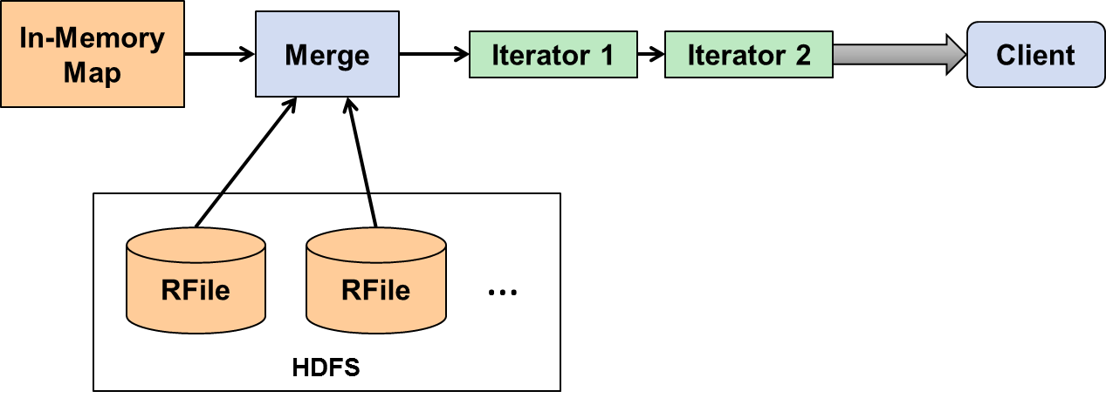
Accumulo BatchScan Iterator Pipeline
Tablet 1
Client
Tablet 2
Tablet 3
Notes:
Scaling up, when a table grows large enough that it can be split into sections called tablets, different tablet servers can process each tablet in parallel, running the same pipeline on different segments of data.
Here’s the question for us: how might we leverage the iterator infrastructure to perform the more complicated GraphBLAS matrix operations?

Slide 13
Graphulo addition to Iterator Pipeline
Scanner
Client
Use client-side Scanners and BatchWriters inside server-side iterators
BatchWriter
Table
Notes:
The key architectural insight is that inside these iterators we can open up Accumulo Scanners that read from another table
as well as Accumulo BatchWriters that write to another table.
Just like before, the reading and writing distributes with Accumulo across all its tablet servers.

Slide 14
Graphulo MxM: A^{T} (⊕.⊗) B
A^{T}
Client
Scanner
B
TwoTableIterator
RemoteWriteIterator
BatchWriter
C
Notes:
Let’s see how this enables matrix multiplication:

Slide 15
Graphulo MxM: A^{T} (⊕.⊗) B
A^{T}
(c₁, r₁, v₁)
Client
Scanner
(r₂, c₂, v₂)
B
TwoTableIterator
RemoteWriteIterator
BatchWriter
C
Notes:
As a reminder, here are the entries streaming from the source table.

Slide 16
Graphulo MxM: A^{T} (⊕.⊗) B
A^{T}
(c₁, r₁, v₁)
Client
Scanner
(r₂, c₂, v₂)
B
TwoTableIterator
RemoteWriteIterator
Align
c₁ = r₂
BatchWriter
(r₁, c₂, v₁ ⊗ v₂)
C
Notes:
The TwoTableIterator here aligns the entries along the Accumulo row, which matches the column of the first table and the row of the second table,
multiplies the corresponding values, and sends them to the result table C with a BatchWriter

Slide 17
Graphulo MxM: A^{T} (⊕.⊗) B
A^{T}
(c₁, r₁, v₁)
Client
Scanner
(r₂, c₂, v₂)
B
TwoTableIterator
RemoteWriteIterator
Align
c₁ = r₂
BatchWriter
(r₁, c₂, v₁ ⊗ v₂)
C
⊕
Notes:
A summing iterator on table C sums the partial products from the multiplication

Slide 18
Graphulo Client Functions
long TableMult(String ATtable, String Btable, String Ctable)
long SpEWiseX(String Atable, String Btable, String Ctable)
long SpEWiseSum(String Atable, String Btable, String Ctable)
…
Simple API abstracts the iterator pipeline
Notes:
Graphulo presents matrix multiply as well as the other GraphBLAS operations as simple Java library calls,
when standard arithmetic plus and times are used and no other options are needed

Slide 19
Graphulo Client Functions
long TwoTable(
String ATtable, String Btable, String Ctable, String CTtable,
int BScanIteratorPriority, TwoTableIterator.DOTMODE dotmode,
Map<String, String> optsTT, IteratorSetting plusOp,
String rowFilter, String colFilterAT, String colFilterB,
boolean emitNoMatchA, boolean emitNoMatchB,
List<IteratorSetting> iteratorsBeforeA,
List<IteratorSetting> iteratorsBeforeB,
List<IteratorSetting> iteratorsAfterTwoTable,
Reducer reducer, Map<String, String> reducerOpts,
int numEntriesCheckpoint, Authorizations ATauthorizations, Authorizations Bauthorizations, int batchWriterThreads
)
Full control
when you need it
Notes:
When more advanced or custom functionality is needed, such as multiplying along the min.+ semiring
or when fusing kernels together to run at the same time, you can call the full Graphulo TwoTable API.
Don't be afraid of all the parameters; most accept -1 or null as default values.

Slide 20
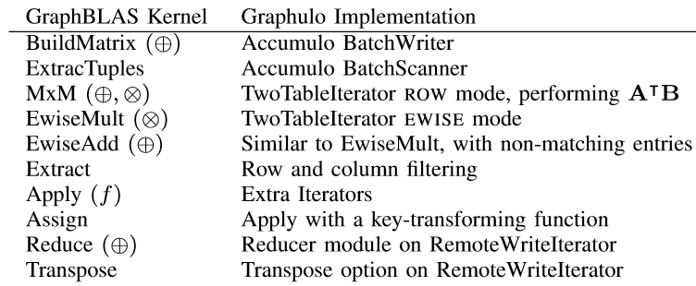
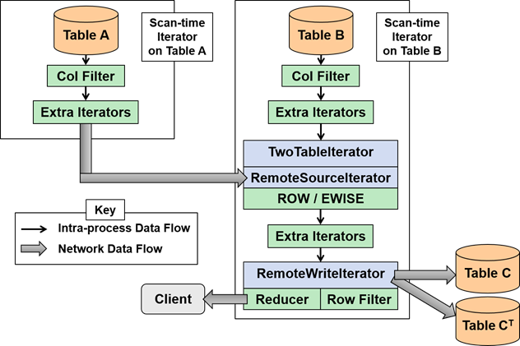
Graphulo’s TwoTable Pipeline
Notes:
You can think of TwoTable as filling in this iterator template. Different parts of the template are filled in based on the arguments to TwoTable.

Slide 21
Applications and Performance
Notes:
Okay– now that you have seen how to do matrix processing inside the Accumulo database, let's move onto applications.

Slide 22
Applications and Performance
Algorithms: Jaccard and k-Truss
Comparison to main-memory alternatives
Sparse: D4M Matlab library
Dense: MTJ Java library
Node: 16GB RAM, 8 i7 cores, Accumulo 1.8.0
Data: Unpermuted power law graph generator
2^{SCALE} nodes, 16 edges/node
Accumulo Threads: 1-2 tablets
Read from Accumulo
A
D4M / MTJ
Compute in memory
R
Write to Accumulo
Notes:
We're going to cover two applications—to compute the Jaccard coefficients, and to form the k-Truss subgraph.
We implemented each application in Graphulo as well as in two main-memory external systems: the D4M sparse matrix library, and the MTJ dense matrix library.
Both alternatives pull data from Accumulo, compute the result in-memory, and push the result back to Accumulo.
We ran the performance experiment on a single-node Accumulo database with one or two tablets, to control Accumulo's parallelism.
Why compare to main-memory systems, I hear you ask? We had a particular use case in mind: cued analytics, or analytics that run on a subgraph.
Databases excel at selecting subgraphs since they build indexes over the data. On the other hand, these subgraphs may fit into memory, which makes computing on them perfect for main-memory systems.
We will explore the tradeoff between these two benefits further.

Slide 23
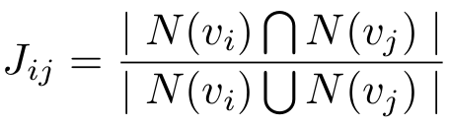
Alg 1: Jaccard Coefficients
Neighborhood overlap of two vertices
Vertex similarity measure
long Jaccard(String Aorig, String ADeg, String Rfinal)
Graphulo: Linear algebra graph kernels for NoSQL databases, Gadepally et al, IEEE IPDPSW 2015
Notes:
Jaccard coefficients are used in many contexts such as social networks for measuring vertex similarity—
how many neighbors two vertices have in common, divided by the union of neighbors

Slide 24
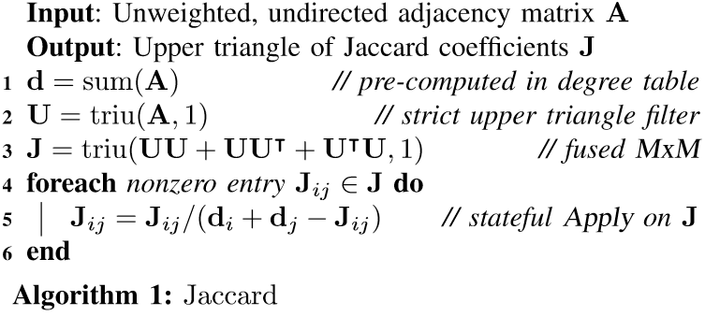
Alg 1: Jaccard Coefficients
Fusion:
A single Graphulo TwoTable pass!
Notes:
What I want you to takeaway from this algorithm is that the whole thing can be executed as a single TwoTable call.
We did this by fusing together three matrix multiplications and a few filters to run inside the same iterator pipeline.
If time permits, I'm happy to talk further about the implementation during the Q&A, or you can refer to the diagrams in our paper.

Slide 25
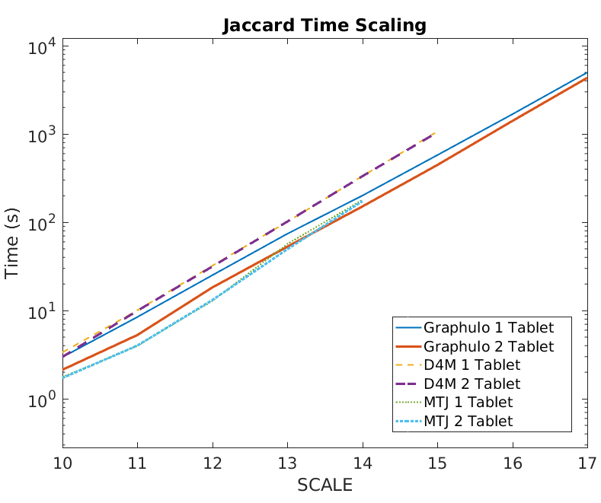
Jaccard Performance
Problem size = 2^ nodes
Notes:
Here's a performance breakdown. The x-axis is data size on a log scale: it controls the number of nodes in the input graph. The y-axis is processing time on a log scale, so lower is better.
The solid lines plot Graphulo's runtime; the dotted and dashed lines show the main-memory systems' performance.
You can see that Graphulo runs on par with the main-memory systems, and once the SCALE is sufficiently large, Graphulo both the sparse and dense libraries.
Of course, if the SCALE is large enough that D4M and MTJ run out of memory, then Graphulo is the only option.

Slide 26
Alg 2: k-Truss Subgraph
A graph is a k-Truss if each edge is part of at least k-2 triangles
May be the empty graph
Indicates a graph’s "core community"
Example 3-truss
long kTrussAdj(String Aorig, String Rfinal, int k)

Slide 27
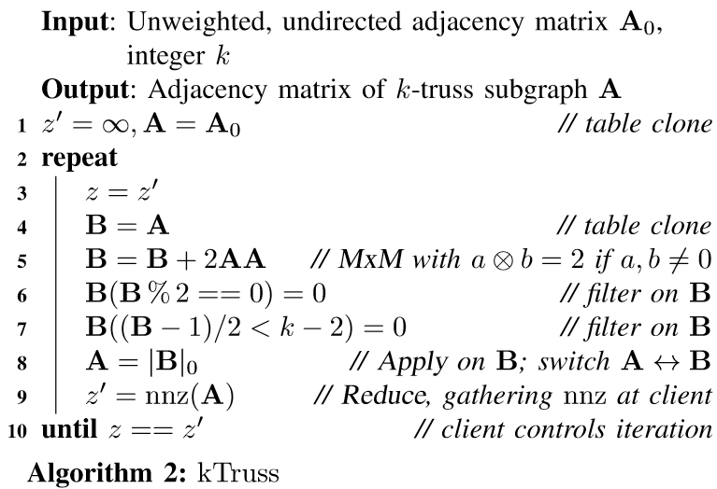
Alg 2: k-Truss Subgraph
Iterations of Graphulo TwoTables
Notes:
The takeaway here is that, in contrast with Jaccard, k-Truss runs iterations of matrix operations.
Each iteration removes edges that are part of fewer than k-2 triangles, repeating until the graph converges.

Slide 28
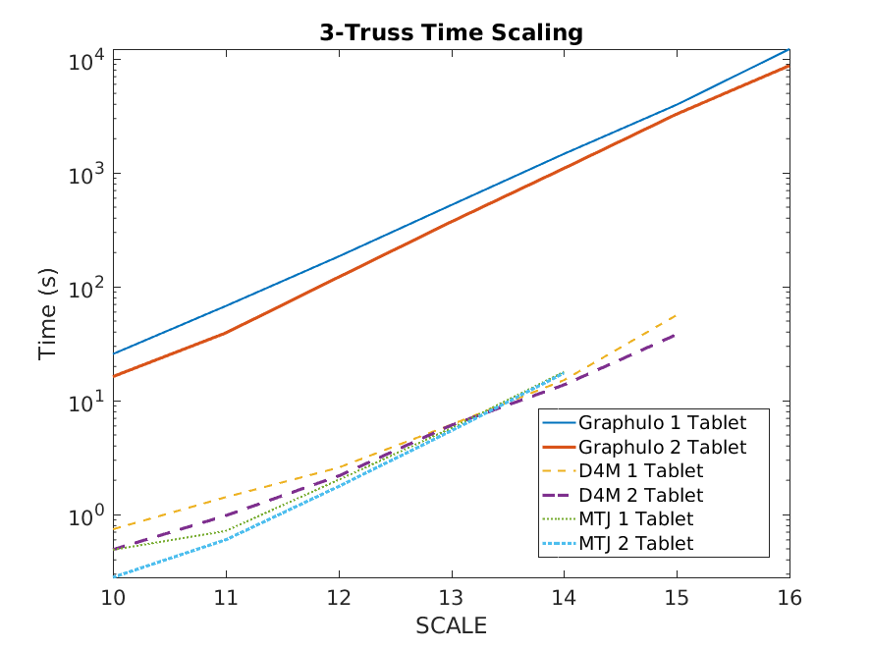
3-Truss Performance
Problem size = 2^ nodes
Notes:
As you may have guessed, iterations are not so good for Graphulo. The main-memory alternatives perform significantly better than Graphulo.
Let's examine why.

Slide 29
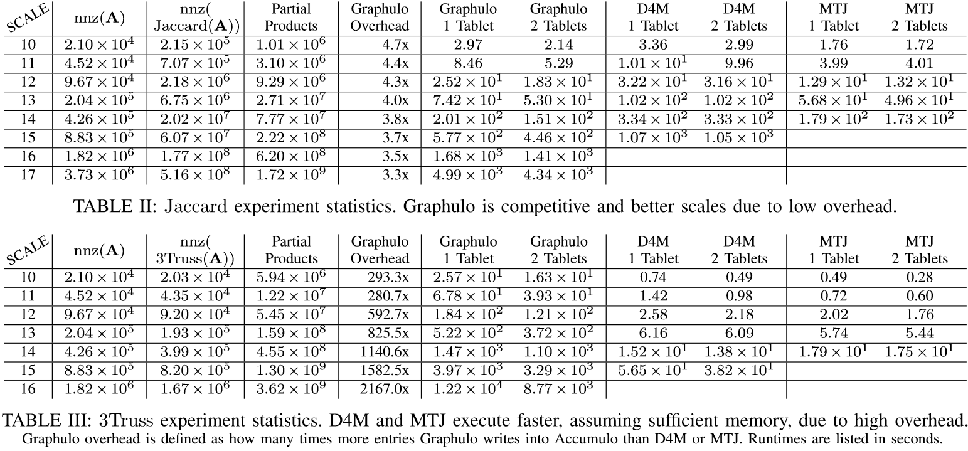
Performance Diff
Graphulo Overhead: How many more entries Graphulo writes to Accumulo than the main-memory systems
Notes:
Here are tables of counts and timings for the performance experiments. In blue you can read the Graphulo overhead.
This overhead is how many times more entries Graphulo writes to the database than the main-memory alternatives do.
For Jaccard you can see the overhead is low, at 3-4x and decreasing with matrix size. Such a low overhead makes it worthwhile to run Jaccard inside the Accumulo database since we avoid communicating data outside the Accumulo cluster.
The source of the overhead is that Graphulo uses the outer product matrix multiply implementation, which means that Graphulo sums partial products after writing them to the database.
The main-memory systems can pre-sum the partial produces, since they hold their results in memory.
For k-Truss you can see the overhead is high, at 300-2200x and increasing with matrix size. Such a high overhead makes it worthwhile to run k-Truss in an external main-memory system, assuming sufficient memory.
The primary source of the k-Truss overhead is the intermediary table writes---Graphulo writes out the intermediary matrices to Accumulo at the end of each iteration. The main-memory systems don't need to do that because they can cache they intermediary matrices in memory.
2 iterations for 3-truss.
State-parallel: iteration or communication

Slide 30
Performance Diff
(Overhead is due to Graphulo writing all partial products whereas main-memory systems pre-sum)
Comparable I/O;
savings in communication outweighs I/O overhead
Graphulo Overhead: How many more entries Graphulo writes to Accumulo than the main-memory systems
Notes:
Here are tables of counts and timings for the performance experiments. In blue you can read the Graphulo overhead.
This overhead is how many times more entries Graphulo writes to the database than the main-memory alternatives do.
For Jaccard you can see the overhead is low, at 3-4x and decreasing with matrix size. Such a low overhead makes it worthwhile to run Jaccard inside the Accumulo database since we avoid communicating data outside the Accumulo cluster.
The source of the overhead is that Graphulo uses the outer product matrix multiply implementation, which means that Graphulo sums partial products after writing them to the database.
The main-memory systems can pre-sum the partial produces, since they hold their results in memory.
For k-Truss you can see the overhead is high, at 300-2200x and increasing with matrix size. Such a high overhead makes it worthwhile to run k-Truss in an external main-memory system, assuming sufficient memory.
The primary source of the k-Truss overhead is the intermediary table writes---Graphulo writes out the intermediary matrices to Accumulo at the end of each iteration. The main-memory systems don't need to do that because they can cache they intermediary matrices in memory.
2 iterations for 3-truss.
State-parallel: iteration or communication

Slide 31
Performance Diff
(Overhead is due to Graphulo writing all partial products whereas main-memory systems pre-sum)
Comparable I/O;
savings in communication outweighs I/O overhead
Vastly different I/O;
main-memory systems cache temporary tables whereas Graphulo writes all to Accumulo
Graphulo Overhead: How many more entries Graphulo writes to Accumulo than the main-memory systems
Notes:
Here are tables of counts and timings for the performance experiments. In blue you can read the Graphulo overhead.
This overhead is how many times more entries Graphulo writes to the database than the main-memory alternatives do.
For Jaccard you can see the overhead is low, at 3-4x and decreasing with matrix size. Such a low overhead makes it worthwhile to run Jaccard inside the Accumulo database since we avoid communicating data outside the Accumulo cluster.
The source of the overhead is that Graphulo uses the outer product matrix multiply implementation, which means that Graphulo sums partial products after writing them to the database.
The main-memory systems can pre-sum the partial produces, since they hold their results in memory.
For k-Truss you can see the overhead is high, at 300-2200x and increasing with matrix size. Such a high overhead makes it worthwhile to run k-Truss in an external main-memory system, assuming sufficient memory.
The primary source of the k-Truss overhead is the intermediary table writes---Graphulo writes out the intermediary matrices to Accumulo at the end of each iteration. The main-memory systems don't need to do that because they can cache they intermediary matrices in memory.
2 iterations for 3-truss.
State-parallel: iteration or communication

Slide 32
http://graphulo.mit.edu
How to do matrix math in Accumulo?
The TwoTable iterator pipeline
Jaccard & k-Truss
When to do matrix math in Accumulo?
Memory requirements
Compare in-database I/O vs. alternatives
Future Work: Multi-Node, expand to Relational Algebra, use an Optimizer to choose the best plan
Contact: Dylan Hutchison
dhutchis@cs.washington.edu

Slide 33
Backup

Slide 34
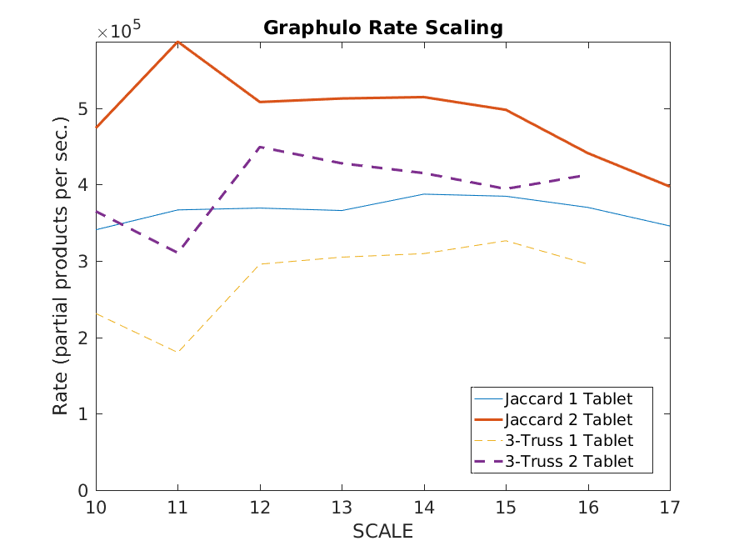
Overall Graphulo Performance
Problem size = 2^ nodes
Notes:
Record single-node is 400k/s. Jaccard uses fusion: 3 MxMs (over the upper triangle) at the cost of one MxM I/O. Also SSD.

Slide 35
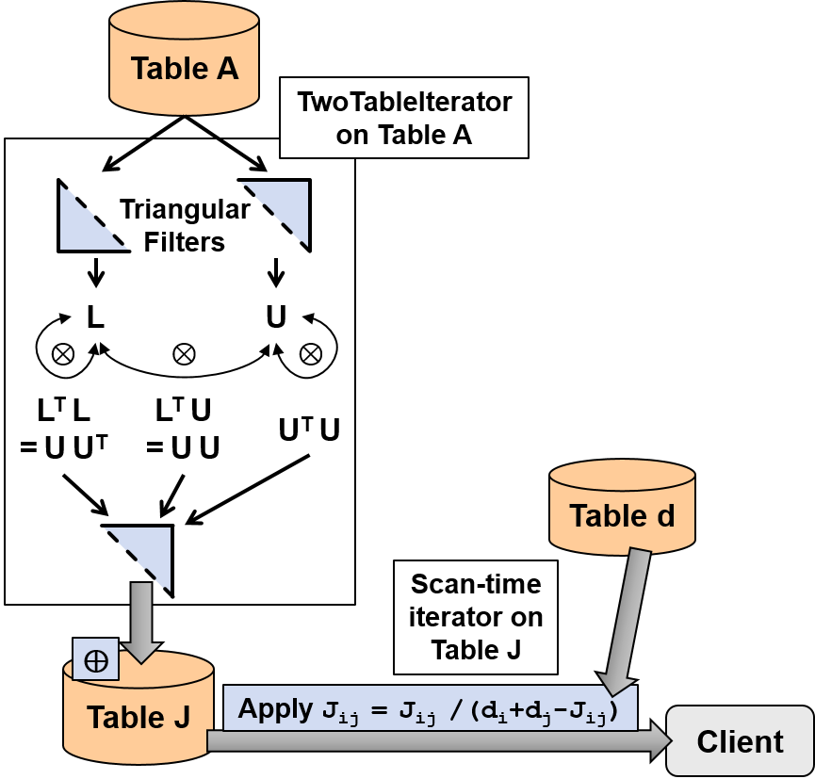
Alg 1: Jaccard Coefficients
Fusion:
A single Graphulo TwoTable pass!

Slide 36
Alg 2: k-Truss Subgraph
A
deepCopy()
TableMult
⊗2
B % 2 = 1 && (B - 1) / 2 ≥ k-2
B
nnz
Client
Iterations of Graphulo TwoTables

Slide 37

Background on Accumulo
Key |  |  |  |  | Value
Row | Column |  |  | Timestamp
 | Family | Qualifier | Visibility
Best for:
Large, de-normalized tables; no schema necessary
Unlimited columns; un-interpreted values; everything is a byte[]
TBs to PBs of data; robust horizontal scaling
Hadoop HDFS / Java ecosystem
Cell-level visibility
Row store by default
Scan over rows for O(log n) lookup & sorted order
Use Transpose Tables for column indexing¹
Iterator processing framework
¹D4M 2.0 Schema: A General Purpose High Performance Schema for the Accumulo Database, Kepner et al, IEEE HPEC 2013
Notes:
Locality groups on column families work if you know what the columns are in advance

Slide 38
GraphBLAS Operations

