Slide 1
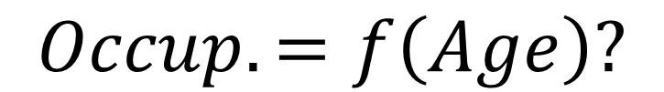
Structural Clustering
Analysts’ Step 1 Approach to New Data
Dylan Hutchison <dhutchis@stevens.edu> and the Microsoft Research Tabular Team
Vision: Enable data analysts to run Probabilistic Machine Learning in Excel
Background: Tabular – an Excel-based DSL
data analysts use to write generative models
for probabilistic inference.
Problem: High entry barrier for data analysts to write generative models.
Need expert domain knowledge, heavy time investment.
Solution Idea: Suggest a default model
based on a dataset’s structure and statistics.
Extends Singh and Graepel’s InfernoDB in Tabular.
Evaluation: Compare model accuracy and fit with InfernoDB & other models.
Demonstrate value to data analysts via case studies.
Tabular: A Schema-Driven
Probabilistic Programming Language
A. Gordon, T. Graepel, N. Rolland, C. Russo et al POPL 2014
Automated Probabilistic Modelling for Relational Data
S. Singh, T. Graepel CIKM 2013
MovieLens Example
<http://grouplens.org/datasets/movielens>
Application: Predicting users’ ratings,
Suggesting movies to users
Pipeline
1) Statistical Analysis
Sparse
Full
CSVs
2) Functional Analysis
$$Occup.=f\left(Age\right)?$$
Users
3) Structural Analysis
Foreign
Links
User | Age | Gender | Occupation
1 | 24 | M | technician
2 | 53 | F | lawyer
3 | 23 | M | writer
4 | 24 | M | technician
Users
k | upto(Ku) | latent | CDiscrete(N=Ku)
Occupation | upto(Nocc) | output | CDiscrete(N=Nocc)[k]
Age | real | output | CPoisson(alpha=5.0,beta=5.0)[k]
Gender | bool | output | CBernoulli()[k]
Ratings
Movies
k | upto(Km) | latent | CDiscrete(N=Km)
Action | bool | output | CBernoulli()[k]
Adventure | bool | output | CBernoulli()[k]
Animation | bool | output | CBernoulli()[k]
User | Movie | Rating
196 | 242 | 3
186 | 302 | 3
22 | 377 | 1
244 | 51 | 2
Generative
Cluster Model
Ratings
User | link(T_User) | input
Movie | link(T_Movie) | input
k | upto(Kr) | latent | CDiscrete(N=Kr)[User.k][Movie.k]
Rating | upto(5) | output | CBinomial(N=5)[k]
Movies
Genres
Movie | Title | Action | Adventure | Animation
1 | Toy Story (1995) | 0 | 0 | 1
2 | GoldenEye (1995) | 1 | 1 | 0
3 | Four Rooms (1995) | 0 | 0 | 0
4 | Get Shorty (1995) | 1 | 0 | 0
User Cluster
Movie
Cluster
Age
Rating
Cluster
Gender
Genres
Occupation
Rating

Slide 2
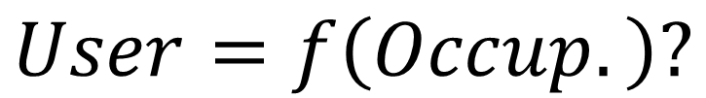
Structural Clustering
Analysts’ Step 1 Approach to New Data
Dylan Hutchison <dhutchis@stevens.edu> and the Microsoft Research Tabular Team
Vision: Enable data analysts to run Probabilistic Machine Learning in Excel
Background: Tabular – an Excel-based DSL
data analysts use to write generative models
for probabilistic inference.
Tabular: A Schema-Driven
Probabilistic Programming Language
A. Gordon, T. Graepel, N. Rolland, C. Russo et al POPL 2014
Problem: High entry barrier for data analysts to write generative models.
Need expert domain knowledge, heavy time investment.
Solution Idea: Suggest a default model
based on a dataset’s structure and statistics.
Extends Singh and Graepel’s InfernoDB construct in Tabular.
Automated Probabilistic Modelling for Relational Data
S. Singh, T. Graepel CIKM 2013
Evaluation: Compare model accuracy and fit with InfernoDB & other models.
Demonstrate value to data analysts via case studies.
MovieLens Example:
http://grouplens.org/datasets/movielens/
Application: Predicting users’ ratings,
Suggesting movies to users
Pipeline:
1) Statistical Analysis
Sparse
Full
CSVs
2) Functional Analysis
$$User=f\left(Occup.\right)?$$
Users
3) Structural Analysis
Foreign
Links
User | Age | Gender | Occupation
1 | 24 | M | technician
2 | 53 | F | lawyer
3 | 23 | M | writer
4 | 24 | M | technician
Users
k | upto(Ku) | latent | CDiscrete(N=Ku)
Occupation | upto(Nocc) | output | CDiscrete(N=Nocc)[k]
Age | real | output | CPoisson(alpha=5.0,beta=5.0)[k]
Gender | bool | output | CBernoulli()[k]
Movies
k | upto(Km) | latent | CDiscrete(N=Km)
Action | bool | output | CBernoulli()[k]
Adventure | bool | output | CBernoulli()[k]
Animation | bool | output | CBernoulli()[k]
Ratings
Generative
Cluster Model
User | Movie | Rating
196 | 242 | 3
186 | 302 | 3
22 | 377 | 1
244 | 51 | 2
Ratings
User | link(T_User) | input
Movie | link(T_Movie) | input
k | upto(Kr) | latent | CDiscrete(N=Kr)[User.k][Movie.k]
Rating | upto(5) | output | CBinomial(N=5)[k]
Movies
Genres
Movie | Title | Action | Adventure | Animation
1 | Toy Story (1995) | 0 | 0 | 1
2 | GoldenEye (1995) | 1 | 1 | 0
3 | Four Rooms (1995) | 0 | 0 | 0
4 | Get Shorty (1995) | 1 | 0 | 0
User Cluster
Movie
Cluster
Age
Rating
Cluster
Gender
Genres
Occupation
Rating

Slide 3
Structural Clustering
Analysts’ Step 1 Approach to New Data
Vision: Enable data analysts to run Probabilistic Machine Learning in Excel
Background: Tabular – an Excel-based DSL
data analysts use to write generative models
for probabilistic inference.
Tabular: A Schema-Driven
Probabilistic Programming Language
A. Gordon, T. Graepel, N. Rolland, C. Russo et al POPL 2014
Problem: High entry barrier for data analysts to write generative models.
Need expert domain knowledge, heavy time investment.
Solution idea: Given a dataset, suggest a default model
based on its structure and statistics.
Extends Singh and Graepel’s InfernoDB construct in Tabular.
Automated Probabilistic Modelling for Relational Data
S. Singh, T. Graepel CIKM 2013
Evaluation: Compare model accuracy and fit with InfernoDB & other models.
Demonstrate value to data analysts via case studies.
MovieLens Example:
http://grouplens.org/datasets/movielens/
Application: Predicting users’ ratings,
Suggesting movies to users
T_User
Occupation | link(T_Occupation) | input
k | upto(Ku) | latent | CDiscrete(N=Ku)[Occupation.k]
Age | real | output | CPoisson(alpha=5.0,beta=5.0)[k]
Gender | bool | output | CBernoulli()[k]
Users
T_Movie
k | upto(Km) | latent | CDiscrete(N=Km)
Action | bool | output | CBernoulli()[k]
Adventure | bool | output | CBernoulli()[k]
Animation | bool | output | CBernoulli()[k]
User | Age | Gender | Occupation
1 | 24 | M | technician
2 | 53 | F | lawyer
3 | 23 | M | writer
4 | 24 | M | technician
Ratings
User | link(T_User) | input
Movie | link(T_Movie) | input
k | upto(Kr) | latent | CDiscrete(N=Kr)[User.k][Movie.k]
Rating | upto(5) | output | CDiscrete(N=5)[k]
Ratings
User | Movie | Rating
196 | 242 | 3
186 | 302 | 3
22 | 377 | 1
244 | 51 | 2
User Cluster
Movie
Cluster
Movies
Genres
Movie | Title | Action | Adventure | Animation
1 | Toy Story (1995) | 0 | 0 | 1
2 | GoldenEye (1995) | 1 | 1 | 0
3 | Four Rooms (1995) | 0 | 0 | 0
4 | Get Shorty (1995) | 1 | 0 | 0
Age
Rating
Cluster
Gender
Genres
Occupation
Rating
D. Hutchison, A. Gordon and the Microsoft Research Team

Slide 4
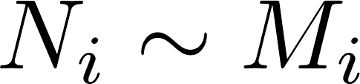
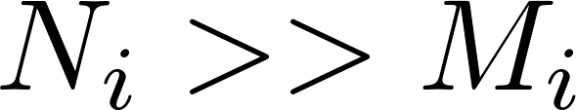
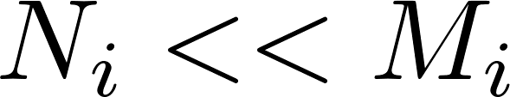
What is a dataset?
Past Work
What is a generative model?
Big Data Dimensional Analysis
V. Gadepally, J. Kepner
Submitted to IEEE HPEC 2014
DDA
Idea: Use the structure of a dataset
as the basis for a cluster model.
Identity
Rows ≈ 1-1 with Colvals?
→ Row ≡ ColEntity; same info content
Organizational
Many more Rows than Colvals?
→ Use Colvals to cluster Rows
Authoritative
Many more Colvals than Rows?
→ Use Rows to cluster Colvals
Structure Learning
The Discovery of Structural Form
C. Kemp, J. Tenenbaum
PNAS 2008 105 (31) 10687-10692
Proposes a universal structure learning algorithm that infers the form of a dataset.
Structural Clustering differs by choosing a specific form—clustering—based on a dataset’s statistics.
Too many datasets and too little expert knowledge?
Try Structural Clustering – a default generative model
inferred from data’s structure and first-order statistics
Notes:
http://www.pnas.org/content/105/31/10687.full

Slide 5
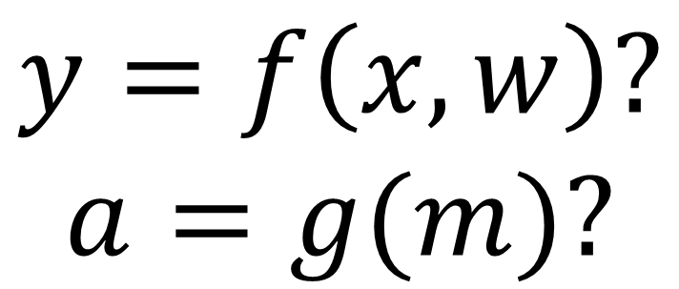
Statistical Analysis
Generative Cluster Model
Sparse
Full
CSVs
Functional Analysis
$$y=f\left(x,w\right)?$$
$$a=g(m)?$$

