Slide 1
Accelerating Bioinformatics with Big Data Technologies
Dylan Hutchison Group 110 Computing and Analytics 6 August 2012
Notes:
Hi there. My name is Dylan Hutchison, and today I would like to extend the pleasure of presenting my summer work in distributed and parallel computing. I did a lot of work in the field in general, but let’s zoom in on the crux application of my summer’s work, and that is in bioinformatics.

Slide 2
Outline
Introduction
Approach
Results
Summary
Notes:
Outline slide

Slide 3

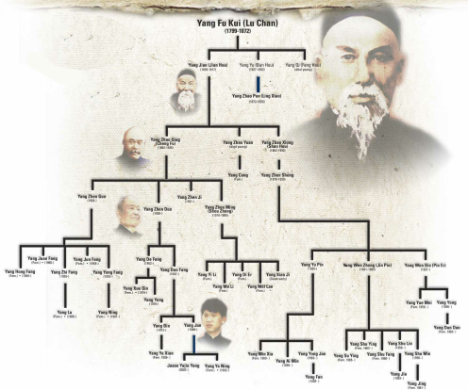
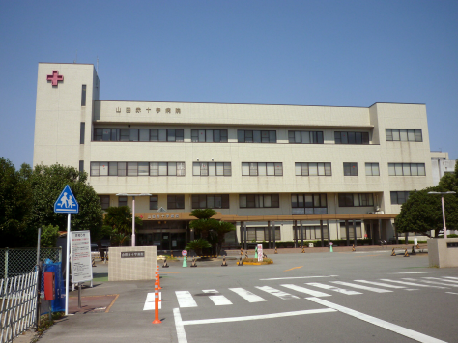
DNA Sequence Matching
Goal
Quickly compare two sets of DNA
Applications
Identification
Mixture Analysis
Kinship Analysis
Ancestry Analysis
Uses: disease outbreaks, criminal investigations, personal medical services, …
Challenge: sequence matching takes a long time, can we make it faster?
Notes:
Police investigation unit – crime scene – catch the perpetrator faster
Doctor – patient with contagious and disturbing symptoms, but unknown malady – save life or rule out contaminated/unreliable sample
Need for speed. FAST-A algorithm and NCBI’s (National Center for Biotechnology Information) BLAST
So the goal of my project is to obtain the best matches of a sample against a ton of reference DNA sequences faster, delivering invaluable preliminary information. Then, we can take the top results for each sample and do detailed comparisons and alignments using FAST-A or BLAST, which will now run quickly since the reference sequence size we’re comparing against is so much smaller.

Slide 4
Outline
Introduction
Approach
Results
Summary
Notes:
Outline slide

Slide 5


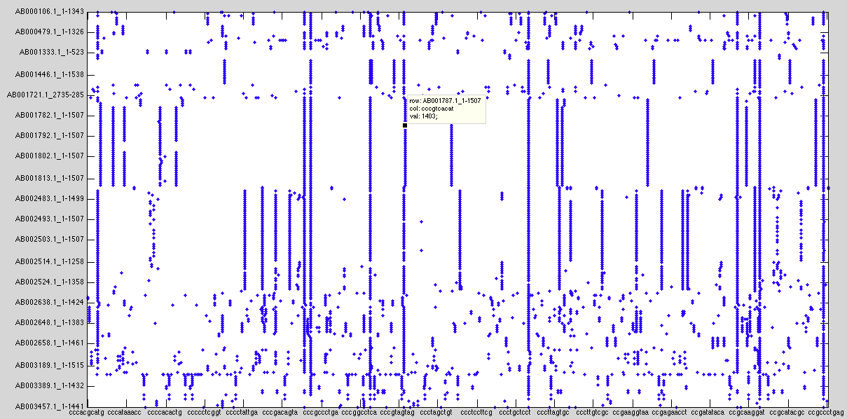
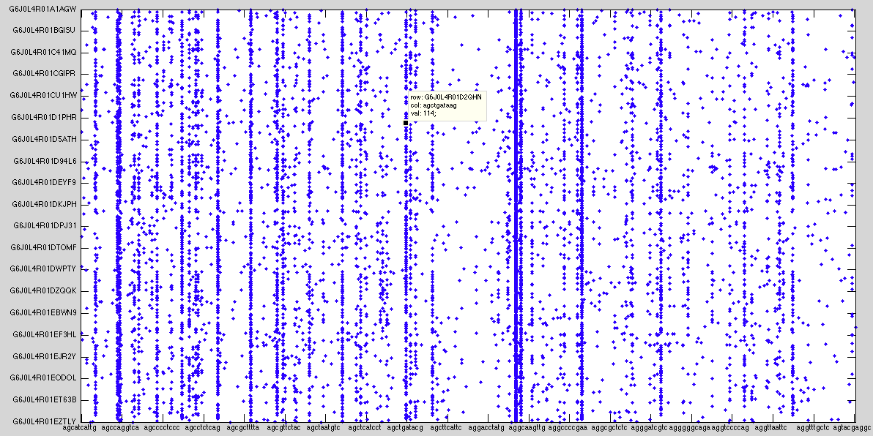
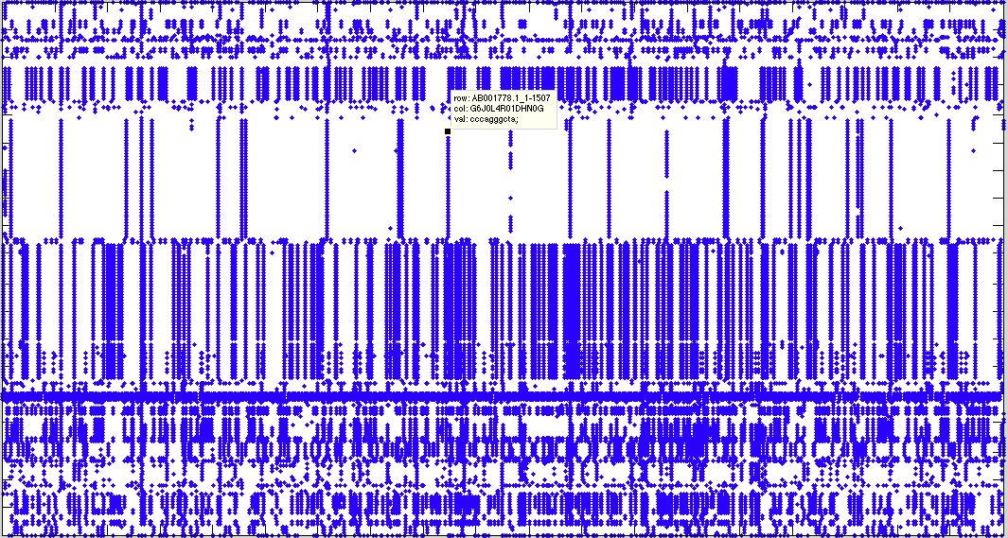
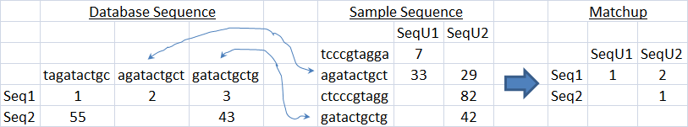
Sequence Matching ⬄ Sparse Matrix Multiply in D4M
RNA Reference Set
Collected Sample
reference
bacteria
unknown
bacteria
A₁
A₁ A₂'
A₂
reference
sequence ID
unknown
sequence ID
reference
sequence ID
sequence word (10mer)
sequence word (10mer)
unknown sequence ID
Notes:
Finding common base sequences can be performed with a single matrix multiply in D4M.
substring-substring comparison problem
Sparse matrix – break into words

Slide 6

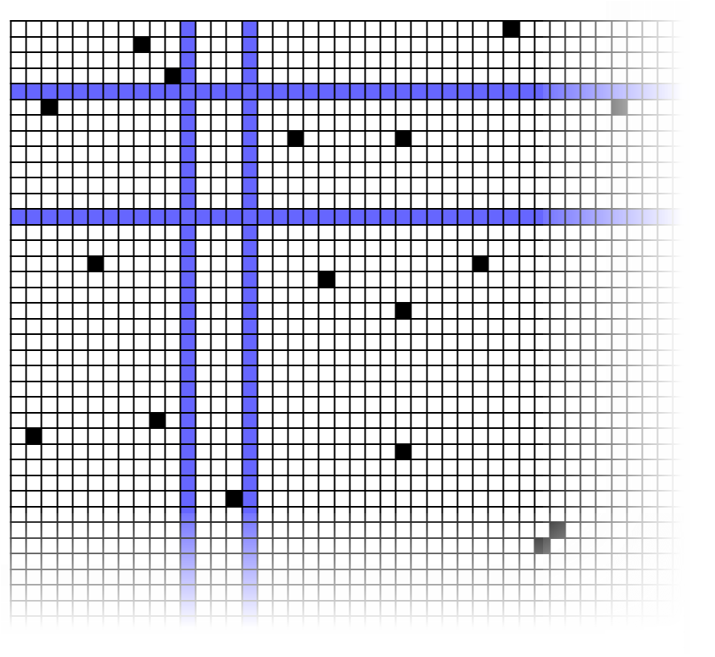
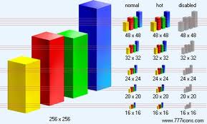
D4M Stores Giant Sparse Matrices in Accumulo Triple Store Database
Triple Store
Distributed Database
D4M
Dynamic
Distributed
Dimensional
Data
Model
Associative Arrays
Numerical Computing Environment
A
B
C
Query:
T(:,ggaatctgcc)
E
D
A D4M query returns a sparse matrix or graph from a triple store…
Triple store are high performance distributed databases for heterogeneous data
Database Advantage
Store word frequency
Only compare against the most frequent words
…for statistical signal processing or graph analysis in Matlab
Notes:
D4M (Dynamic Distributed Dimensional Data Model) provides a uniform way to view and manipulate complex data.
use D4M to store and operate on sparse matrices efficiently and integrate with a DB too
Scale of data to store – GBs, PBs
DB advantage: selectively query rarest, most useful sequences

Slide 7
Sequence Processing Pipeline
Table Splits
Accumulator
Reference
Pre-processing
Row
Seq. ID
Accumulo DB
Seq. Data
Seq. Frequency
Main Computation
Fasta
C Parser
Col
Seq.
Matlab
to Assoc
Matlab D4M Comparison
Top
Matches
Val
Position
Sample
.mat
Post-processing
Matlab Header Parser
Accumulo DB
Header Data
Matlab Match Linker
C Parser
Generate n-mer words from
Fasta DNA data in D4M format
Preprocess & filter the sequences
Ignore bad, common sequences
Break output files into manageable chunks, say 5MB
Generate reverse complement sequences
Break up big sequences into subsequences to preserve locality
Top Taxonomic Matches
If no match to a particular species, can we narrow the sample down to a family?
Notes:
reduce the time by using a DB with multiple tablet servers and ingesting the data into the DB in parallel, up to the capacity of the network medium we have to transmit the data over and the very limits of the hardware itself
One-time step
DB advantage: selectively query rarest, most useful sequences
post-processing steps we take to generate more useful information from our comparison. The Fasta format includes taxonomic data with each sequence. By pairing that data with the top results over here, we can output the top matching groups and families for samples that have no overwhelming match to a single species

Slide 8
D4M Contributions: Table Splits
Initial inserts bottleneck on one tablet server until it fills up and splits
Performance booster: pre-split table among several tablet servers for instant parallel insertion
Use advanced knowledge of row data patterns to choose splits
Created functions to set, merge and query table splits
No Splitting
Table Splits
Inserter
Inserter
Tablet Server
Tablet Server
Inserter
Inserter
Inserter
Inserter
Tablet Server
Tablet Server
Inserter
Inserter

Slide 9
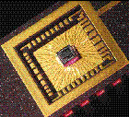
D4M Contributions: Accumulator Columns
Introduced Accumulo’s combiner to D4M
Example: Document word counting
Row ID = Document ID
Column = Word
Value = Count
Insert (Doc1, ‘bird’, 2) → DB has (Doc1, ‘bird’, 2)
Insert (Doc1, ‘bird’, 3) → DB has (Doc1, ‘bird’, 5)
Works with any commutative operation
Addition, maximum, minimum, etc.
Very handy for D4M users
Database Accumulator
Inserter
 | Col
Row | SUM
Inserter
Inserter
Notes:
Accumulator pun
Automatically sum insertions to a particular row and column.

Slide 10
Outline
Introduction
Approach
Results
Summary
Notes:
Outline slide

Slide 11
D4M Performance: Table Splits
pMatlab + tic & toc
Each inserter inserts ~2¹⁸ rows of ~8 bytes each 8 times = 16 MB/inserter
- Ran in exclusive mode – one inserter process per node
Conclusion: Pre-Splitting tables appropriately can double ingest rates at higher Np in multinode database environments
Notes:
Exclusive mode ensures maximum usage of network and minimizes other jobs’ impact on runs

Slide 12
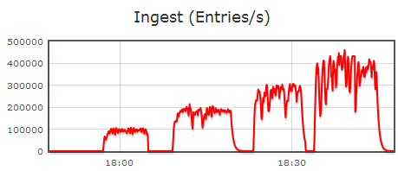
Sample to Human Performance
4.5 GB human Fasta file
C Parser took 25 minutes
101 GB of row, col files
Ingest Time: Reduced 50 hours to 10 hours
Long pre-processing;
Fast query comparison!
Np = 2
Np = 4
Np = 16
Np = 8
8 Tablet Server Accumulo Instance
Notes:
Processing: Took 70 secs for 559MB viruses – scales to 10 mins predicted on human
Processing: BLAST Time: 17.75 hours
22MB Sample808

Slide 13
Leveraging “Big Data” Technologies for High Speed Sequence Matching
D4M
100x smaller
BLAST
100x faster
D4M +
Triple Store
High performance triple store database trades computations for lookups
Used Apache Accumulo database to accelerate comparison by 100x
Used Lincoln D4M software to reduce code size by 100x
Notes:
code time
D4M+DB: 603 70
D4M: 549 8400
BLAST: 862296 5820
DB advantage: selectively query rarest, most useful sequences

Slide 14

Summary
New Approach to DNA Matching
D4M: Sparse Matrix Multiplication + Database Integration
Speed over depth – excellent first-stage tool
Promising pending results – estimate big speedup over BLAST
Scalable: Performance scales with database/query size and number/power of processors
Need faster results? Add more/better COTS machines
Techniques applicable to more bioinformatics problems
Protein comparison, SNP analysis, the meaning of life (almost)
Big Thanks to Jeremy Kepner and Darrell Ricke of Group 110, 48!
Notes:
COTS = Commercial off the Shelf machines

Slide 15
Backup Slides

Slide 16
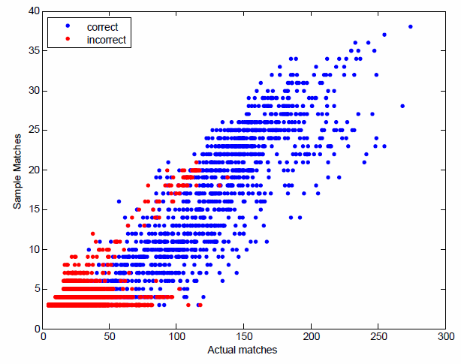
Further Speedup: Only need the rare sequences!
Can eliminate 10mers occurring in the reference DB > 100 times (95% of all 10mers) and still correctly match top results
Implication: Significantly smaller # of entries to scan Reduced database size and search space
0.1
# of matches in 99.5%
reduced reference DB
CDF of Seq.
95% of sequences occur more than 100 times in virus data
# of matches in full reference DB
Sequence Occurrence in Reference DB
Notes:
Small red region – believe these sequences match on repetitive regions

Slide 17


Parallel and Distributed Computing
General Development: Improving D4M
What is D4M? Why is it useful?
Link to Accumulo database
Some Contributions:
Accumulator Columns
Table Splits
Performance Testing Results
Specific Application: DNA Matching
Background on Bioinformatics
The DNA Matching Problem
D4M Solution – Matrices and Assoc Arrays
Complete Pipeline
Optimization
Performance & Results
What’s next?

Slide 18
D4M for Dummies
Dynamic Distributed Dimensional Data For Matlab
Associative Array
Sparse matrix – memory efficient
Easily distributed across multiple machines with pMatlab
Linkable with Accumulo Database for Big Data
Remote computation – Bring the processing to the data
1-to-1 correspondence between database queries & linear algebra
Easier, cleaner implementation than SQL queries
Doubly Index-able Triple Store
O(log n) search time on row and column
Lincoln Lab development
Currently used in text and cyber analytics
➔ System architecture for rapidly analyzing very large problems ⬅
Assoc Array Example
(ACR56360.1,,GGBKTAO01A0YYP,) 5
(ACR56360.1,,GGBKTAO02CAGWF,) 1 (ADK12630.1,,GGBKTAO02CAGWF,) 3
(ADY69164.1,,GGBKTAO01A0YYP,) 128
GGBKTAO01A0YYP, GGBKTAO02CAGWF,
ACR56360.1, 5, 1,
ADK12630.1, 3,
ADY69164.1, 128,

Slide 19
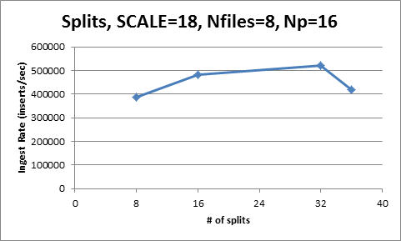
D4M Performance: Why 35 splits?
Goal: Split at points such that we get an even distribution of data among tablets (load balancing)
Challenge: Random power law data
Solution:
Split “string space”
00000000 to 99999999
More splits = less error as Accumulo will put sparse tablets on the same tablet server (bottom graph)

Slide 20
D4M Performance: Insert Block Size
Same setup as before, now varying the insert block size.
Conclusion: little correlation between insert block size and ingest rate
Notes:
How many bytes do we send to the DB at a time?

Slide 21
D4M Performance: Table Splits & Insert Block Size
Without Splits
With 35 Splits
Clear table splitting performance boost across insert block size
Notes:
Same scale on y-axis
Emphasizes boost from table splitting

Slide 22

Parallel and Distributed Computing
General Development: Improving D4M
What is D4M? Why is it useful?
Link to Accumulo database
Some Contributions:
Accumulator Columns
Table Splits
Performance Testing Results
Specific Application: DNA Matching
Background on Bioinformatics
DNA Matching Problem
D4M Solution – Matrices and Assoc Arrays
Complete Pipeline
Optimization
Performance & Results
What’s next?

Slide 23
DNA Matching
Worked with Darell Ricke of Group 48 -Bioengineering Systems and Technologies
Applications
Identification
Mixture Analysis
Kinship Analysis
Ancestry Analysis
Uses: disease outbreak analysis, criminal investigations, personal services, …

Slide 24
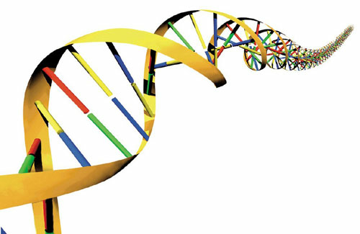
DNA Matching with D4M
Goal: match a DNA sample against a DB of DNA
Sequence: tagatactgctgcctcccgtagga
Split: tagatactgc
agatactgct
(chunksize 10) gatactgctg
Substring comparison problem!
Count # of matches of each sequence chunk
Count forward, backward w/ base complement
Highest count = highest match chance
Difficulty: 10GB DNA Fasta file → 260 GB of different sequence data. Need efficient comparison!
Notes:
Sliding view of sequence. Larger chunksize = fewer spurious matches but more missed close matches

Slide 25
Associative Array Approach
Matlab Array of Triples
(sequence ID, sequence, position in sequence)
(G6J0L4R01AUYU3, tagatactgc, 1)
(G6J0L4R01AUYU3, agatactgct, 2) …
Take transpose for fast column lookup.
Multiply to match: A * B’
Also stored: matchup positions, row & column matchup totals

Slide 26
C Fasta Parser
Primary Goal: Generate n-mer words from Fasta data in format Matlab can easily read into an Assoc array
Goal #2: Preprocess & Filter the sequences
Ignore bad, common sequences
Too few unique bases
Unknown bases at end
Break output files into manageable chunks, say 5MB
Generate reverse sequences
Break up big sequences into subsequences to preserve locality
Matches must occur somewhat close together
Ex. Break after 10,000 base pairs with overlap of 200

Slide 27
Parsing & DB Ingest Optimization
Parameters to optimize
Input file size
Too big = won’t fit in memory
Too small = too many files
~5MB file size good
Ingest chunk size – amt. of data sent to DB at once
~500k worked ok
Weird Problem: Assoc construct time increases with file #
Fixed after adjusting above parameters
Input file size | 4.82E+09
File part size | 5.00E+07
# of file parts | 878
chunksize | 10
ingest chunksize | 1.00E+06
TTF | 69.38 | hrs
MB/sec | 0.0193
Input file size | 4.82E+09
File part size | 6.20E+06
# of file parts | 7894
chunksize | 10
ingest chunksize | 1.00E+05
TTF | 50.74 | hrs
MB/sec | 0.0264
Much better!

Slide 28
File Size Optimization
Some virus sequences are really big → big, outlier output files
Huge, nonlinear jump in Assoc construction time
Solution: break DNA in middle of a sequence
chunksize | 10
# of file splits: | 770
# of sequences | 384663
Input file size: | 5.85E+08 | Total size
Row avg file size: | 6.32E+06 | 4.87E+09
Col average file size: | 6.38E+06 | 4.92E+09
Val average file size: |  | 0.00E+00
TOTAL output file size |  | 9.78E+09
Output/Input Size | 16.72
TTF | 13126.2 | sec
 | 3.64618 | hrs
MB/sec | 0.0446
Notes:
Modified fasta parser

Slide 29
Pipeline Performance
586 MB Virus data, 23 MB Sample data

Slide 30
It’s the rare ones!
Can eliminate 10mers occurring in the reference DB > 100 times (95% of all 10mers) and still correctly match top results
Implication: Significantly smaller # of entries to scan Can reduce database size and search space
0.1
# of Sequences
95% of sequences occur more than 100 times in virus data
Sequence Occurrence in Reference DB

Slide 31
Conclusion
Do you have a ton of data to process?
Are you limited by time or memory?
contact Group 110 and the D4M team!
Somewhere mention the technique applies to protein sequences too

Slide 32
Backup!

Slide 33
Index the data in a DB! Fast lookup, comparison
Parse big .fa Fasta file → all sequence chunks in D4M-friendly format – .row, .col, .val files
Ingest data into DB
Parse sample .fa Fasta file → .row, .col, .val
Load sample data & compare against data in DB

Slide 34
Overview
Upgrading D4M support for Accumulo
Accumulator / combiner columns
Table Splits
Deleting Triples
Performance Testing
D4M Bioinformatics Application
Background & Approach
Optimization & Quirks
Performance & Results

Slide 35


Accumulo Background
Triple Store DB:
Cell-level access control
Distributed, Open Source, Java
Uses Hadoop File System and Zookeeper Node Mgmt.
D4M Background
Dynamic Distributed Dimensional Data
Lincoln Lab development
Matlab Software Package
Linear Algebra & Graph Theory support
Associative Array
Usage: Text and cyber analytics
Lincoln Labs PLSA Cloud Knowledge Service uses Accumulo
Notes:
PLSA = Probabilistic Latent Semantic Analysis

Slide 36
Performance Testing Intro
The hallmark of parallel and distributed computing
pMatlab – Parallel Matlab
Divide work to many nodes using distributed arrays
Lincoln Laboratory product
Multiple nodes insert vast quantities of data into Accumulo instance
Matlab timing functions: tic toc
Measure ingest rate in inserts/sec
Rigorously vary parameter, measure times
Notes:
Much like a chemistry experiment

Slide 37
Build Sequence Processing Pipeline
Reference
Row
Seq. ID
Accumulo DB
Seq. Data
Seq. Frequency
Fasta
C Parser
Col
Seq.
Matlab
to Assoc
Matlab D4M Comparison
Top
Matches
Val
Position
.mat
Sample
Matlab Header Parser
Accumulo DB
Header Data
Matlab Match Linker
Comparison
Also
Top Taxonomic Matches
If no match to a particular species, can we narrow the sample down to a family?

