Slide 1
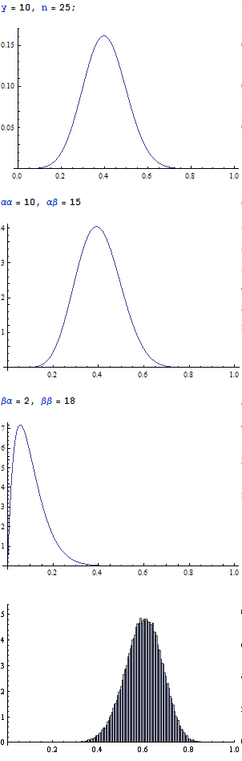
Uncertain? Represent your belief with…
SOPD
Second-Order
Probability Distributions
Raw
Evidence
on P(s)
Propagation in Bayesian Networks
More general than interval, possibility and belief functions
Useful for risk analysis and uncertain evidence
Tractable with Monte Carlo simulation
False
negative
rate α
S
False
positive
rate β
H
E
Adjusted
belief
of P(s)
Dylan Hutchison – dhutchis@stevens.edu

