Slide 1
Causal Inference under Uncertainty via Adjustments and SOPDs
Dylan Hutchison and Samantha Kleinberg
Stevens Institute of Technology

Slide 2
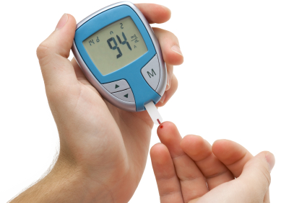
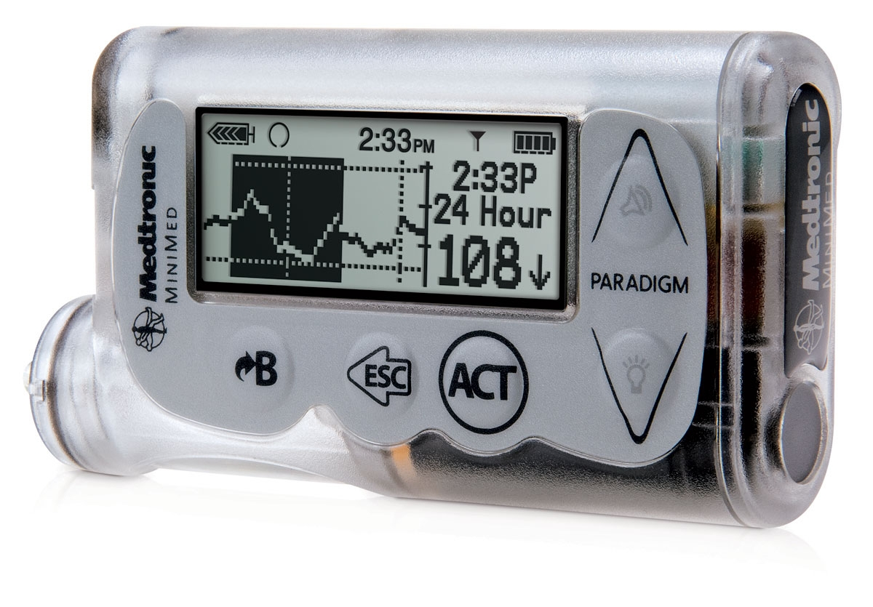
Notes:
Biomedical Informatics. 347M diabetics in the world*
Make decisions: how should a patient manage their glucose?
Orange juice / Insulin / Nothing? Pasta? Exercise?
Causes uncertain, but more than that, data uncertain too. Ex. Fingersticks -> CGM
People with diabetes need to make decisions throughout the day about whether to give insulin to lower their blood glucose, or consume carbohydrates to raise it. This is a challenging problem given all the factors that influence glucose, not all of which are known to the patient (and many of which affect people differently and in seemingly unpredictable ways).
Minimed: http://www.diabetesproductsource.com/product/minimed-paradigm-real-time-revel-insulin-pump
Fingerstick:http://www.tellushealth.com/blog/glucometer-to-monitor-blood-glucose-level-for-diabetes-patients/
*World Health Organization. http://www.who.int/mediacentre/factsheets/fs312/en/

Slide 3
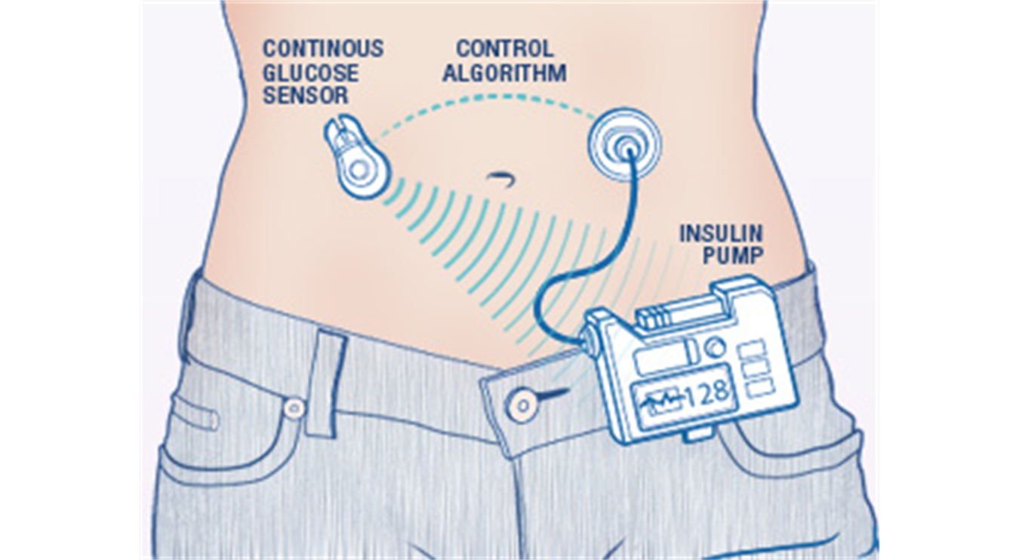
Notes:
Data uncertainty all the more important when machines move to
Artificial pancreas: tries to link CGM/pump, but it’s missing info on activity and nutrition, which have a big impact on BG. Figure from http://discoverysedge.mayo.edu/artificial-pancreas/
Instead: aim to use bodyworn sensors to collect data, link this with CGM/pump, and give predictions on BG and insulin needs.
Incorrect predictions can lead to severe consequences (an insulin overdose can lead to coma or even death), so we need to be sure that our predictions are stable and that we intervene on variable that can produce the effects of interest (and are not merely associated with them)

Slide 4
Notes:
Why is this problem hard? On top of not truly understanding all of the factors that interact to impact blood glucose, we have to find these and patients must make decisions with highly uncertain data.

Slide 5
Incorrect Data
Notes:
Why is this problem hard? On top of not truly understanding all of the factors that interact to impact blood glucose, we have to find these and patients must make decisions with highly uncertain data.

Slide 6
Incorrect Data
Incomplete Data
Notes:
Why is this problem hard? On top of not truly understanding all of the factors that interact to impact blood glucose, we have to find these and patients must make decisions with highly uncertain data.

Slide 7
Incorrect Data
Incomplete Data
Outdated Data
Notes:
Distinguish variable vs. observation-specific uncertainty

Slide 8

What’s missing?
Computable
Causal
Inference
Uncertainty
Representation
Intervals
Granger VAR
Belief Functions
Temporal Logic
Base Weights
DBNs
Notes:
Incorporate observation-specific beliefs in causal inference
Computable ➔ We want to incorporate uncertainty in causal inference methods we can feasibly use on real data, not just create theoretical models of uncertainty adjustment!
Highlight state of the art: Just highlight current inadequacies (no major detail) in uncertainty & causal inference
What’s lacking? Why isn’t the problem solved?
We need causal inference methods that incorporate our entire belief state. That means assigning belief distributions to each value of a parameter. Current methods are too coarse-grained; most common belief representation is intervals <- lack detail. (todo: back up that fact with a reference)
Challenge: use finer-grained belief representation—distributions—and maintain computational feasibility at scale.
Premise: SOPD belief representation is scalable because the SOPDs maintain accuracy even when approximated.
Todo: become familiar with other methods’ take on the tradeoff between assumptions and efficiency
Better adjust for uncertainty, but don’t sacrifice Correctness or Efficiency!

Slide 9
Approach
Assign uncertain values less weight
Inaccurate Data – assign less weight
Missing Data – impute with less weight
Outdated Data – weigh with decay factor
Notes:
Main idea / desiderata
Weigh uncertain values less in both belief formation/updating and causal inference.
Combining type level information with a specific token variable instance.
Belief information vs. confidence information → center vs. spread
Use example: read a glucose measurement: 150. Yields evidence on the actual BG level– it may be high == center. Certainty in whether the measurement itself reflects reality == spread.
Missing data: distinguish
data missing by design (such as different sampling frequencies) from data missing for other reasons
recoverable data from non-recoverable data -- recoverable data is defined to be data OAR (observed at random) such that it is independent of other variables' values
from Cismondi, Fialho et al (2013).

Slide 10
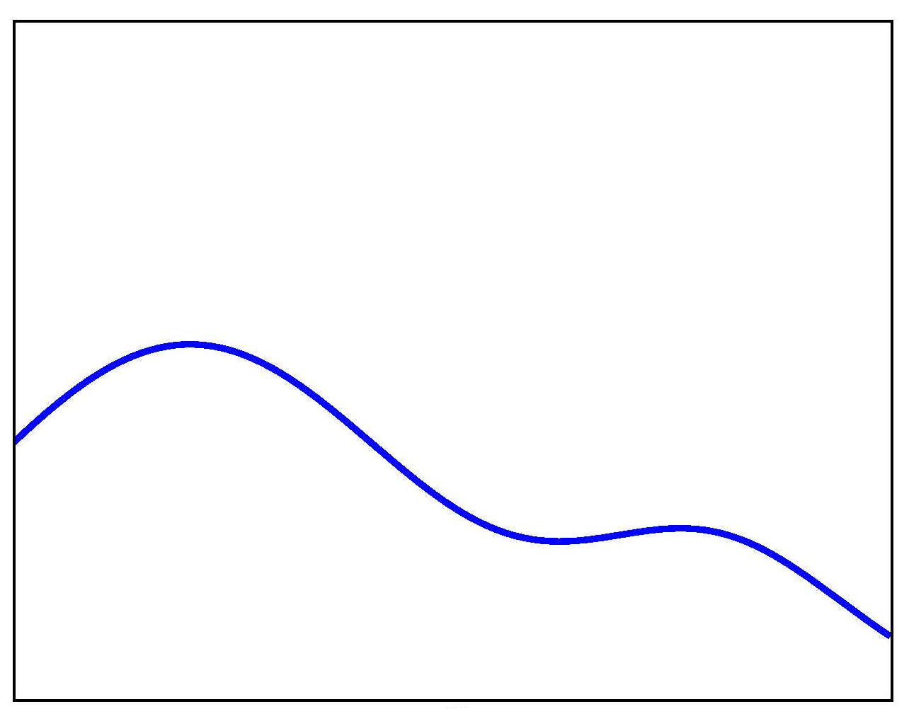
Second Order Probability Distribution
Center = belief
= most likely value
Spread = certainty

Slide 11
(center, spread)
Notes:
Here’s one way we incorporate confidence info. Each data point has a confidence level, taken as 1 without any additional info.
It’s the relative confidence ratios that count, since we use them as weights in taking weighted averages (see causal inference slide later)
First couple points from CGM and BodyMedia SenseWear Activity Monitor have less confidence due to calibration / running average initialization.
We can do this any time we have metadata—information on relative evidence confidence–at the type or token level.

Slide 12
Discretization
How do we partition continuous data into discrete events?
→ {too low, normal, too high} ?
Strict partitioning leads to inconsistencies
Time | Glucose
8:00 | 130
Notes:
{cancer, no cancer}
A bit about form of data, why discretization useful, why strict boundaries are problematic
Try fuzzy partitioning!

Slide 13
Uncertainty in discretization
Notes:
Usual approach, 70-120 normal, outside of that too high or too low. But with device error, strict partitions don’t make sense, etc etc.
Perhaps mention (MAYBE 1 line of text/eq here) that now when calculating probabilities based on frequencies, we can now weight by probability of being mapped to particular states.

Slide 14
SOPD Adjustment
Notes:
: [' Prior', ' Data', ' Poste']
Means: [' 0.22 ', ' 0.50 ', ' 0.42 ']
Varia: [' 0.02 ', ' 0.08 ', ' 0.08 ']

Slide 15
Causal inference, without uncertainty
Complex, temporal relationships
Assess average difference cause makes to probability of effect
Kleinberg, S. (2013) Causality, Probability, and Time.

Slide 16
Adding uncertainty
Notes:
NOTE: should be more about giving a feel for what happens when we add in c/s. Just showing how we augment the equation in the more general case.
still omitting time indices…

Slide 17
Carb-heavy meal (c), vigorous exercise (e), blood glucose (g)
Notes:
Example of accounting for uncertainty in discretization alone and the impact it has. Using nice example from abstract.
Explain figures. Included distributions just as a reminder.

Slide 18
What’s the effect of exercise on glucose?
Calculate:

Slide 19
What’s the effect of exercise on glucose?
Calculate:
Strict discretization:

Slide 20
What’s the effect of exercise on glucose?
Calculate:
Strict discretization:
Probabilistic discretization:

Slide 21
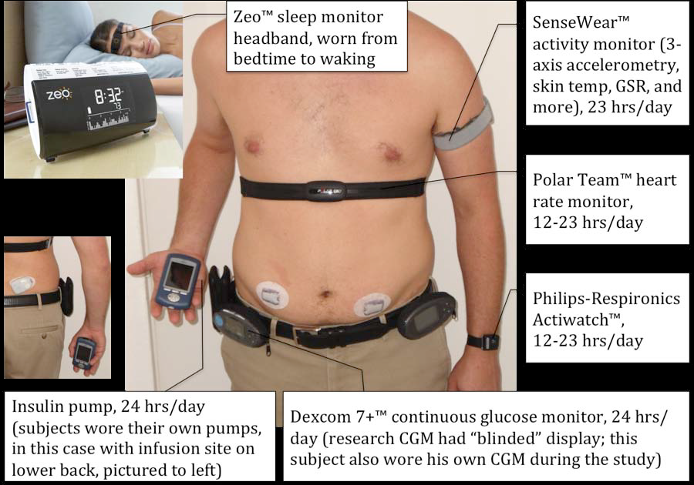
Experiment
Cohort: 17 subjects with T1DM
Sensor data (collected for >72 hours)
Glucose values
Insulin dosage
Activity
Sleep stage
Heart rate
Temperature
Data from N. Heintzman at UCSD
Notes:
Diabetes Management Integrated Technology Research Initiative
http://dial.ucsd.edu/what-we-do.php

Slide 22
Results
Effect occurs over 5-80 minutes, peaking 15-40 minutes
Not found with strict discretization
Supported by medical studies (Marliss and Vranic, 2002; Riddell and Perkins, 2006)
Notes:
(at short timescales that glucose, unsurprisingly, tends to stay at its current state)
We compared results using uncertain discretization of glucose values to those with traditional discretization (where values in [70,120] are considered normal). Using the proposed method, we were able to identify very vigorous exercise as a significant potential cause of hyperglycemia, with this effect occurring from 5-80 minutes after activity and peaking between 15-40 minutes. This response has been previously identified in individuals with T1DM, and thus gives us confidence in the methodology and the sensor data quality, as we could identify the relationship with a relatively small sample. On the other hand, this relationship was not identified in the data discretized according to the traditional range, demonstrating that incorporating uncertainty can lower false negative rates.

Slide 23
Conclusions
Better representation of uncertainty
Captures more prior knowledge
Uncertainty in causal inference
Computationally feasible
Increased power
Realistic discretization
Notes:
Yes, it's not the full SOPD distribution, but the standard deviation of the SOPD already captures much more information on uncertainty than, say, an interval or at worst, a single point.
we have ideas for how to do so, but we need to actually do try them on real data
Implement adjustment for missing, outdated data
Capture more of the SOPD beyond standard deviation
Formally prove SOPD robustness to approximation

Slide 25
Conclusions
Better capture uncertainty → Better causal inference
While keeping computational feasibility
Use SOPDs in causal inference
Incorporate prior knowledge into (center, spread)
Future work
Implement adjustment for missing, outdated data
Capture more of the SOPD beyond standard deviation
Formally prove SOPD robustness to approximation
Notes:
Yes, it's not the full SOPD distribution, but the standard deviation of the SOPD already captures much more information on uncertainty than, say, an interval or at worst, a single point.
we have ideas for how to do so, but we need to actually do try them on real data

