Slide 1
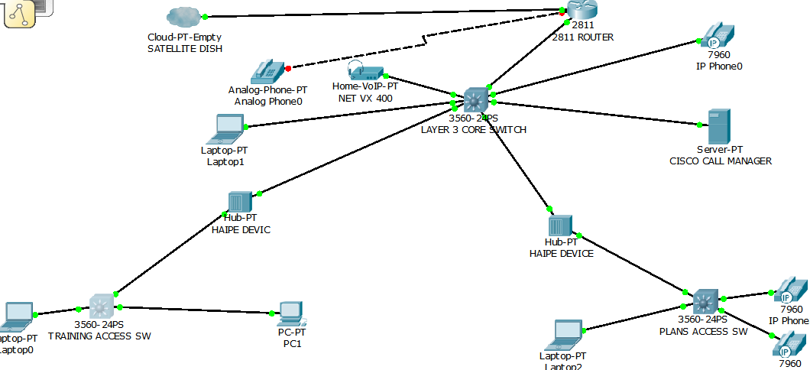
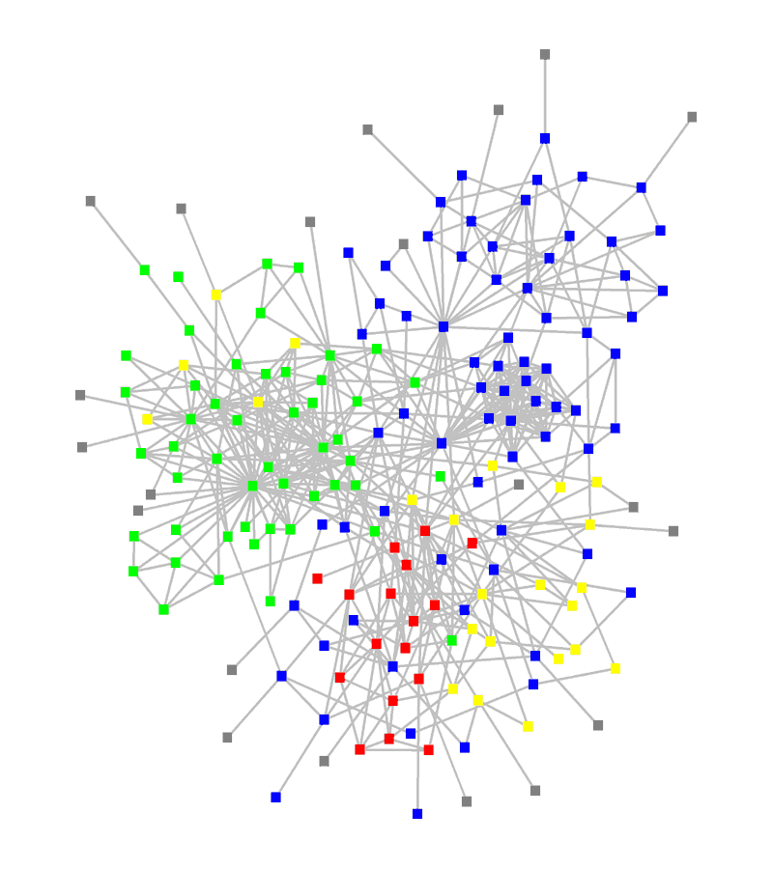

Network Anomaly Detection
Dylan Hutchison
Advisor: Levi Lloyd
Summer 2013
SAND #2013-5904C

Slide 2
Data Sources
Application Level
Email Attachments
HTTP Traffic
Known Spam Lists
DNS Lookups
Netflow Data
ARP Requests
Low Level
Notes:
Many data sources; we’ll just focus on 1

Slide 3
DNS Mess
09:40:49.523901 IP 146.246.89.59.43817 > 205.251.194.163.53: 8717% [1au] NS? reclameaqui.com.br. (47) 09:40:49.524052 IP 146.246.89.59.37645 > 205.251.197.14.53: 8799% [1au] NS? reclameaqui.com.br. (47) 09:40:49.524418 IP6 2001:df0:dc::251:32.53 > 2620:106:6000:331e::59.38155: 35232*- 2/6/1 SOA, RRSIG (524) 09:40:49.524803 IP 146.246.89.59.42453 > 205.251.192.120.53: 3701% [1au] NS? reclameaqui.com.br. (47) 09:40:49.525731 IP 205.251.199.170.53 > 146.246.89.59.45523: 40535*- 4/0/1 NS ns-120.awsdns-15.com., NS ns-1294.awsdns-33.org., NS ns-1962.awsdns-53.co.uk., NS ns-675.awsdns-20.net. (187) 09:40:49.525877 IP6 2001:df0:dc::251:36.53 > 2620:106:6000:331e::59.59596: 58042*- 2/6/11 SOA, RRSIG (744) 09:40:49.527042 IP6 2001:df0:dc::251:13.53 > 2620:106:6000:331e::59.40500: 19058*- 2/6/11 SOA, RRSIG (744) 09:40:49.527094 IP 205.251.194.163.53 > 146.246.89.59.43817: 8717*- 4/0/1 NS ns-120.awsdns-15.com., NS ns-1294.awsdns-33.org., NS ns-1962.awsdns-53.co.uk., NS ns-675.awsdns-20.net. (187) 09:40:49.534614 IP 205.251.197.14.53 > 146.246.89.59.37645: 8799*- 4/0/1 NS ns-120.awsdns-15.com., NS ns-1294.awsdns-33.org., NS ns-1962.awsdns-53.co.uk., NS ns-675.awsdns-20.net. (187) 09:40:49.539351 IP6 2620:106:6000:331e::59.42768 > 2001:503:231d::2:30.53: 52790% [1au] DS? lotteryamerica.com. (47) 09:40:49.540326 IP 146.246.89.59.59237 > 192.42.93.30.53: 15068% [1au] DS? lotteryamerica.com. (47) 09:40:49.541343 IP6 2620:106:6000:331e::59.60140 > 2001:503:a83e::2:30.53: 3527% [1au] DS? lotteryamerica.com. (47) 09:40:49.542138 IP 146.246.89.59.43179 > 192.52.178.30.53: 13750% [1au] DS? lotteryamerica.com. (47) 09:40:49.542206 IP6 2001:1398:276:0:200:7:5:7.53 > 2620:106:6000:331e::59.45523: Flags [.], ack 47, win 45, options [nop,nop,TS val 2491795726 ecr 2700282080], length 0 09:40:49.542809 IP 146.246.89.59.42072 > 192.43.172.30.53: 64559% [1au] DS? lotteryamerica.com. (47) 09:40:49.543202 IP6 2001:503:231d::2:30.53 > 2620:106:6000:331e::59.42768: 52790*- 0/6/1 (771) 09:40:49.543274 IP6 2620:106:6000:331e::59.45523 > 2001:1398:276:0:200:7:5:7.53: Flags [.], ack 1956, win 144, options [nop,nop,TS val 2700282116 ecr 2491795726], length 0 09:40:49.543465 IP6 2620:106:6000:331e::59.45523 > 2001:1398:276:0:200:7:5:7.53: Flags [F.], seq 47, ack 1956, win 144, options [nop,nop,TS val 2700282116 ecr 2491795726], length 0 09:40:49.546606 IP6 2001:503:a83e::2:30.53 > 2620:106:6000:331e::59.60140: 3527*- 0/6/1 (771) 09:40:49.547034 IP 199.249.125.1.53 > 146.246.89.59.38065: 22912*- 1/8/1 SOA (282) 09:40:49.553096 IP6 2001:500:27::1.53 > 2620:106:6000:331e::59.46877: 27148*- 1/8/13 SOA (546) 09:40:49.566116 IP 146.246.89.59.41701 > 156.154.101.23.53: 8406% [1au] Type32769? level3.net.dlv.isc.org. (51) 09:40:49.567357 IP6 2620:106:6000:331e::59.34899 > 2001:500:2c::254.53: 39040% [1au] Type32769? level3.net.dlv.isc.org. (51) 09:40:49.567882 IP 146.246.89.59.60446 > 199.6.0.29.53: 18033% [1au] Type32769? level3.net.dlv.isc.org. (51) 09:40:49.569837 IP 156.154.101.23.53 > 146.246.89.59.41701: 8406 NXDomain*- 0/6/1 (733) 09:40:49.572120 IP 159.142.148.200.53 > 146.246.89.59.41101: 41885*- 6/0/1 DNSKEY, DNSKEY, DNSKEY, DNSKEY, RRSIG, RRSIG (1358) 09:40:49.572538 IP 159.142.119.252.53 > 146.246.89.59.38638: 14839*- 6/0/1 DNSKEY, DNSKEY, DNSKEY, DNSKEY, RRSIG, RRSIG (1358) 09:40:49.575056 IP6 2620:106:6000:331e::59.33409 > 2001:4f8:0:2::20.53: 37502% [1au] Type32769? level3.net.dlv.isc.org. (51) 09:40:49.575357 IP 146.246.89.59.43826 > 199.254.63.254.53: 43985% [1au] Type32769? level3.net.dlv.isc.org. (51) 09:40:49.576288 IP 159.142.148.210.53 > 146.246.89.59.40733: 33133*- 6/0/1 DNSKEY, DNSKEY, DNSKEY, DNSKEY, RRSIG, RRSIG (1358) 09:40:49.576568 IP6 2620:106:6000:331e::59.35027 > 2001:502:2eda::23.53: 28899% [1au] Type32769? level3.net.dlv.isc.org. (51) 09:40:49.578070 IP6 2001:4f8:0:2::20.53 > 2620:106:6000:331e::59.33409: 37502 NXDomain*- 0/6/1 (733) 09:40:49.579163 IP 146.246.89.59.56194 > 156.154.100.23.53: 49607% [1au] Type32769? level3.net.dlv.isc.org. (51) 09:40:49.579207 IP 146.246.89.59.43061 > 149.20.64.4.53: 42101% [1au] Type32769? level3.net.dlv.isc.org. (51) 09:40:49.580110 IP 209.225.2.109.53 > 146.246.89.59.49049: 32208*- 6/0/1 DNSKEY, DNSKEY, DNSKEY, DNSKEY, RRSIG, RRSIG (1358) 09:40:49.580330 IP 159.142.152.60.53 > 146.246.89.59.41501: 32606*- 6/0/1 DNSKEY, DNSKEY, DNSKEY, DNSKEY, RRSIG, RRSIG (1358) 09:40:49.582607 IP 156.154.100.23.53 > 146.246.89.59.56194: 49607 NXDomain*- 0/6/1 (733) 09:40:49.582660 IP 149.20.64.4.53 > 146.246.89.59.43061: 42101 NXDomain*- 0/6/1 (733) 09:40:49.583442 IP 216.117.110.142.53 > 146.246.89.59.56059: 57525*- 1/4/5 SOA (237) 09:40:49.583597 IP 209.242.100.13.53 > 146.246.89.59.57931: 41854*- 1/4/5 SOA (237) 09:40:49.584393 IP 216.117.110.143.53 > 146.246.89.59.45210: 49075*- 1/4/5 SOA (237) 09:40:49.585155 IP 205.251.192.120.53 > 146.246.89.59.42453: 3701*- 4/0/1 NS ns-120.awsdns-15.com., NS ns-1294.awsdns-33.org., NS ns-1962.awsdns-53.co.uk., NS ns-675.awsdns-20.net. (187) 09:40:49.588617 IP 146.246.89.59.56040 > 199.6.1.29.53: 30589% [1au] Type32769? level3.net.dlv.isc.org. (51) 09:40:49.589478 IP6 2620:106:6000:331e::59.53863 > 2001:502:ad09::23.53: 43517% [1au] Type32769? level3.net.dlv.isc.org. (51) 09:40:49.589496 IP6 2620:106:6000:331e::59.43505 > 2001:500:60::29.53: 5146% [1au] Type32769? level3.net.dlv.isc.org. (51) 09:40:49.589947 IP6 2620:0:150:140d::11.53 > 2620:106:6000:331e::59.55037: 49317*- 6/0/1 DNSKEY, DNSKEY, DNSKEY, DNSKEY, RRSIG, RRSIG (1358) 09:40:49.593374 IP 159.142.90.245.53 > 146.246.89.59.60414: 40741*- 6/0/1 DNSKEY, DNSKEY, DNSKEY, DNSKEY, RRSIG, RRSIG (1358) 09:40:49.594001 IP 192.42.93.30.53 > 146.246.89.59.59237: 15068*- 0/6/1 (771) 09:40:49.596341 IP6 2001:500:2c::254.53 > 2620:106:6000:331e::59.34899: 39040 NXDomain*- 0/6/1 (733) 09:40:49.608359 IP 192.43.172.30.53 > 146.246.89.59.42072: 64559*- 0/6/1 (771) 09:40:49.609207 IP6 2620:0:150:300c::11.53 > 2620:106:6000:331e::59.50477: 34103*- 6/0/1 DNSKEY, DNSKEY, DNSKEY, DNSKEY, RRSIG, RRSIG (1358) 09:40:49.623072 IP 199.6.0.29.53 > 146.246.89.59.60446: 18033 NXDomain*- 0/6/1 (733)
Notes:
But the data is a mess. How can we use it for anomaly detection?

Slide 4
DNS Mess
Request
09:40:49.523901 IP 146.246.89.59.43817 > 205.251.194.163.53: 8717% [1au] NS? reclameaqui.com.br. (47) 09:40:49.524052 IP 146.246.89.59.37645 > 205.251.197.14.53: 8799% [1au] NS? reclameaqui.com.br. (47) 09:40:49.524418 IP6 2001:df0:dc::251:32.53 > 2620:106:6000:331e::59.38155: 35232*- 2/6/1 SOA, RRSIG (524) 09:40:49.524803 IP 146.246.89.59.42453 > 205.251.192.120.53: 3701% [1au] NS? reclameaqui.com.br. (47) 09:40:49.525731 IP 205.251.199.170.53 > 146.246.89.59.45523: 40535*- 4/0/1 NS ns-120.awsdns-15.com., NS ns-1294.awsdns-33.org., NS ns-1962.awsdns-53.co.uk., NS ns-675.awsdns-20.net. (187) 09:40:49.525877 IP6 2001:df0:dc::251:36.53 > 2620:106:6000:331e::59.59596: 58042*- 2/6/11 SOA, RRSIG (744) 09:40:49.527042 IP6 2001:df0:dc::251:13.53 > 2620:106:6000:331e::59.40500: 19058*- 2/6/11 SOA, RRSIG (744) 09:40:49.527094 IP 205.251.194.163.53 > 146.246.89.59.43817: 8717*- 4/0/1 NS ns-120.awsdns-15.com., NS ns-1294.awsdns-33.org., NS ns-1962.awsdns-53.co.uk., NS ns-675.awsdns-20.net. (187) 09:40:49.534614 IP 205.251.197.14.53 > 146.246.89.59.37645: 8799*- 4/0/1 NS ns-120.awsdns-15.com., NS ns-1294.awsdns-33.org., NS ns-1962.awsdns-53.co.uk., NS ns-675.awsdns-20.net. (187) 09:40:49.539351 IP6 2620:106:6000:331e::59.42768 > 2001:503:231d::2:30.53: 52790% [1au] DS? lotteryamerica.com. (47) 09:40:49.540326 IP 146.246.89.59.59237 > 192.42.93.30.53: 15068% [1au] DS? lotteryamerica.com. (47) 09:40:49.541343 IP6 2620:106:6000:331e::59.60140 > 2001:503:a83e::2:30.53: 3527% [1au] DS? lotteryamerica.com. (47) 09:40:49.542138 IP 146.246.89.59.43179 > 192.52.178.30.53: 13750% [1au] DS? lotteryamerica.com. (47) 09:40:49.542206 IP6 2001:1398:276:0:200:7:5:7.53 > 2620:106:6000:331e::59.45523: Flags [.], ack 47, win 45, options [nop,nop,TS val 2491795726 ecr 2700282080], length 0 09:40:49.542809 IP 146.246.89.59.42072 > 192.43.172.30.53: 64559% [1au] DS? lotteryamerica.com. (47) 09:40:49.543202 IP6 2001:503:231d::2:30.53 > 2620:106:6000:331e::59.42768: 52790*- 0/6/1 (771) 09:40:49.543274 IP6 2620:106:6000:331e::59.45523 > 2001:1398:276:0:200:7:5:7.53: Flags [.], ack 1956, win 144, options [nop,nop,TS val 2700282116 ecr 2491795726], length 0 09:40:49.543465 IP6 2620:106:6000:331e::59.45523 > 2001:1398:276:0:200:7:5:7.53: Flags [F.], seq 47, ack 1956, win 144, options [nop,nop,TS val 2700282116 ecr 2491795726], length 0 09:40:49.546606 IP6 2001:503:a83e::2:30.53 > 2620:106:6000:331e::59.60140: 3527*- 0/6/1 (771) 09:40:49.547034 IP 199.249.125.1.53 > 146.246.89.59.38065: 22912*- 1/8/1 SOA (282) 09:40:49.553096 IP6 2001:500:27::1.53 > 2620:106:6000:331e::59.46877: 27148*- 1/8/13 SOA (546) 09:40:49.566116 IP 146.246.89.59.41701 > 156.154.101.23.53: 8406% [1au] Type32769? level3.net.dlv.isc.org. (51) 09:40:49.567357 IP6 2620:106:6000:331e::59.34899 > 2001:500:2c::254.53: 39040% [1au] Type32769? level3.net.dlv.isc.org. (51) 09:40:49.567882 IP 146.246.89.59.60446 > 199.6.0.29.53: 18033% [1au] Type32769? level3.net.dlv.isc.org. (51) 09:40:49.569837 IP 156.154.101.23.53 > 146.246.89.59.41701: 8406 NXDomain*- 0/6/1 (733) 09:40:49.572120 IP 159.142.148.200.53 > 146.246.89.59.41101: 41885*- 6/0/1 DNSKEY, DNSKEY, DNSKEY, DNSKEY, RRSIG, RRSIG (1358) 09:40:49.572538 IP 159.142.119.252.53 > 146.246.89.59.38638: 14839*- 6/0/1 DNSKEY, DNSKEY, DNSKEY, DNSKEY, RRSIG, RRSIG (1358) 09:40:49.575056 IP6 2620:106:6000:331e::59.33409 > 2001:4f8:0:2::20.53: 37502% [1au] Type32769? level3.net.dlv.isc.org. (51) 09:40:49.575357 IP 146.246.89.59.43826 > 199.254.63.254.53: 43985% [1au] Type32769? level3.net.dlv.isc.org. (51) 09:40:49.576288 IP 159.142.148.210.53 > 146.246.89.59.40733: 33133*- 6/0/1 DNSKEY, DNSKEY, DNSKEY, DNSKEY, RRSIG, RRSIG (1358) 09:40:49.576568 IP6 2620:106:6000:331e::59.35027 > 2001:502:2eda::23.53: 28899% [1au] Type32769? level3.net.dlv.isc.org. (51) 09:40:49.578070 IP6 2001:4f8:0:2::20.53 > 2620:106:6000:331e::59.33409: 37502 NXDomain*- 0/6/1 (733) 09:40:49.579163 IP 146.246.89.59.56194 > 156.154.100.23.53: 49607% [1au] Type32769? level3.net.dlv.isc.org. (51) 09:40:49.579207 IP 146.246.89.59.43061 > 149.20.64.4.53: 42101% [1au] Type32769? level3.net.dlv.isc.org. (51) 09:40:49.580110 IP 209.225.2.109.53 > 146.246.89.59.49049: 32208*- 6/0/1 DNSKEY, DNSKEY, DNSKEY, DNSKEY, RRSIG, RRSIG (1358) 09:40:49.580330 IP 159.142.152.60.53 > 146.246.89.59.41501: 32606*- 6/0/1 DNSKEY, DNSKEY, DNSKEY, DNSKEY, RRSIG, RRSIG (1358) 09:40:49.582607 IP 156.154.100.23.53 > 146.246.89.59.56194: 49607 NXDomain*- 0/6/1 (733) 09:40:49.582660 IP 149.20.64.4.53 > 146.246.89.59.43061: 42101 NXDomain*- 0/6/1 (733) 09:40:49.583442 IP 216.117.110.142.53 > 146.246.89.59.56059: 57525*- 1/4/5 SOA (237) 09:40:49.583597 IP 209.242.100.13.53 > 146.246.89.59.57931: 41854*- 1/4/5 SOA (237) 09:40:49.584393 IP 216.117.110.143.53 > 146.246.89.59.45210: 49075*- 1/4/5 SOA (237) 09:40:49.585155 IP 205.251.192.120.53 > 146.246.89.59.42453: 3701*- 4/0/1 NS ns-120.awsdns-15.com., NS ns-1294.awsdns-33.org., NS ns-1962.awsdns-53.co.uk., NS ns-675.awsdns-20.net. (187) 09:40:49.588617 IP 146.246.89.59.56040 > 199.6.1.29.53: 30589% [1au] Type32769? level3.net.dlv.isc.org. (51) 09:40:49.589478 IP6 2620:106:6000:331e::59.53863 > 2001:502:ad09::23.53: 43517% [1au] Type32769? level3.net.dlv.isc.org. (51) 09:40:49.589496 IP6 2620:106:6000:331e::59.43505 > 2001:500:60::29.53: 5146% [1au] Type32769? level3.net.dlv.isc.org. (51) 09:40:49.589947 IP6 2620:0:150:140d::11.53 > 2620:106:6000:331e::59.55037: 49317*- 6/0/1 DNSKEY, DNSKEY, DNSKEY, DNSKEY, RRSIG, RRSIG (1358) 09:40:49.593374 IP 159.142.90.245.53 > 146.246.89.59.60414: 40741*- 6/0/1 DNSKEY, DNSKEY, DNSKEY, DNSKEY, RRSIG, RRSIG (1358) 09:40:49.594001 IP 192.42.93.30.53 > 146.246.89.59.59237: 15068*- 0/6/1 (771) 09:40:49.596341 IP6 2001:500:2c::254.53 > 2620:106:6000:331e::59.34899: 39040 NXDomain*- 0/6/1 (733) 09:40:49.608359 IP 192.43.172.30.53 > 146.246.89.59.42072: 64559*- 0/6/1 (771) 09:40:49.609207 IP6 2620:0:150:300c::11.53 > 2620:106:6000:331e::59.50477: 34103*- 6/0/1 DNSKEY, DNSKEY, DNSKEY, DNSKEY, RRSIG, RRSIG (1358) 09:40:49.623072 IP 199.6.0.29.53 > 146.246.89.59.60446: 18033 NXDomain*- 0/6/1 (733)
Response
Notes:
Identify useful features
NS (2) lookup, 4 answers, 1 authority (ans/add/auth), DNS ID 8717, request length 47, response length 187
DS is A (1) lookup
TTL, IP vs. IP6
1 A, 28 AAAA, TTL, SOA Start of Authority

Slide 5
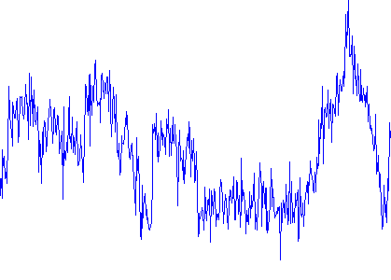
DNS Mess
09:40:49.523901 IP 146.246.89.59.43817 > 205.251.194.163.53: 8717% [1au] NS? reclameaqui.com.br. (47) 09:40:49.524052 IP 146.246.89.59.37645 > 205.251.197.14.53: 8799% [1au] NS? reclameaqui.com.br. (47) 09:40:49.524418 IP6 2001:df0:dc::251:32.53 > 2620:106:6000:331e::59.38155: 35232*- 2/6/1 SOA, RRSIG (524) 09:40:49.524803 IP 146.246.89.59.42453 > 205.251.192.120.53: 3701% [1au] NS? reclameaqui.com.br. (47) 09:40:49.525731 IP 205.251.199.170.53 > 146.246.89.59.45523: 40535*- 4/0/1 NS ns-120.awsdns-15.com., NS ns-1294.awsdns-33.org., NS ns-1962.awsdns-53.co.uk., NS ns-675.awsdns-20.net. (187) 09:40:49.525877 IP6 2001:df0:dc::251:36.53 > 2620:106:6000:331e::59.59596: 58042*- 2/6/11 SOA, RRSIG (744) 09:40:49.527042 IP6 2001:df0:dc::251:13.53 > 2620:106:6000:331e::59.40500: 19058*- 2/6/11 SOA, RRSIG (744) 09:40:49.527094 IP 205.251.194.163.53 > 146.246.89.59.43817: 8717*- 4/0/1 NS ns-120.awsdns-15.com., NS ns-1294.awsdns-33.org., NS ns-1962.awsdns-53.co.uk., NS ns-675.awsdns-20.net. (187) 09:40:49.534614 IP 205.251.197.14.53 > 146.246.89.59.37645: 8799*- 4/0/1 NS ns-120.awsdns-15.com., NS ns-1294.awsdns-33.org., NS ns-1962.awsdns-53.co.uk., NS ns-675.awsdns-20.net. (187) 09:40:49.539351 IP6 2620:106:6000:331e::59.42768 > 2001:503:231d::2:30.53: 52790% [1au] DS? lotteryamerica.com. (47) 09:40:49.540326 IP 146.246.89.59.59237 > 192.42.93.30.53: 15068% [1au] DS? lotteryamerica.com. (47) 09:40:49.541343 IP6 2620:106:6000:331e::59.60140 > 2001:503:a83e::2:30.53: 3527% [1au] DS? lotteryamerica.com. (47) 09:40:49.542138 IP 146.246.89.59.43179 > 192.52.178.30.53: 13750% [1au] DS? lotteryamerica.com. (47) 09:40:49.542206 IP6 2001:1398:276:0:200:7:5:7.53 > 2620:106:6000:331e::59.45523: Flags [.], ack 47, win 45, options [nop,nop,TS val 2491795726 ecr 2700282080], length 0 09:40:49.542809 IP 146.246.89.59.42072 > 192.43.172.30.53: 64559% [1au] DS? lotteryamerica.com. (47) 09:40:49.543202 IP6 2001:503:231d::2:30.53 > 2620:106:6000:331e::59.42768: 52790*- 0/6/1 (771) 09:40:49.543274 IP6 2620:106:6000:331e::59.45523 > 2001:1398:276:0:200:7:5:7.53: Flags [.], ack 1956, win 144, options [nop,nop,TS val 2700282116 ecr 2491795726], length 0 09:40:49.543465 IP6 2620:106:6000:331e::59.45523 > 2001:1398:276:0:200:7:5:7.53: Flags [F.], seq 47, ack 1956, win 144, options [nop,nop,TS val 2700282116 ecr 2491795726], length 0 09:40:49.546606 IP6 2001:503:a83e::2:30.53 > 2620:106:6000:331e::59.60140: 3527*- 0/6/1 (771) 09:40:49.547034 IP 199.249.125.1.53 > 146.246.89.59.38065: 22912*- 1/8/1 SOA (282) 09:40:49.553096 IP6 2001:500:27::1.53 > 2620:106:6000:331e::59.46877: 27148*- 1/8/13 SOA (546) 09:40:49.566116 IP 146.246.89.59.41701 > 156.154.101.23.53: 8406% [1au] Type32769? level3.net.dlv.isc.org. (51) 09:40:49.567357 IP6 2620:106:6000:331e::59.34899 > 2001:500:2c::254.53: 39040% [1au] Type32769? level3.net.dlv.isc.org. (51) 09:40:49.567882 IP 146.246.89.59.60446 > 199.6.0.29.53: 18033% [1au] Type32769? level3.net.dlv.isc.org. (51) 09:40:49.569837 IP 156.154.101.23.53 > 146.246.89.59.41701: 8406 NXDomain*- 0/6/1 (733) 09:40:49.572120 IP 159.142.148.200.53 > 146.246.89.59.41101: 41885*- 6/0/1 DNSKEY, DNSKEY, DNSKEY, DNSKEY, RRSIG, RRSIG (1358) 09:40:49.572538 IP 159.142.119.252.53 > 146.246.89.59.38638: 14839*- 6/0/1 DNSKEY, DNSKEY, DNSKEY, DNSKEY, RRSIG, RRSIG (1358) 09:40:49.575056 IP6 2620:106:6000:331e::59.33409 > 2001:4f8:0:2::20.53: 37502% [1au] Type32769? level3.net.dlv.isc.org. (51) 09:40:49.575357 IP 146.246.89.59.43826 > 199.254.63.254.53: 43985% [1au] Type32769? level3.net.dlv.isc.org. (51) 09:40:49.576288 IP 159.142.148.210.53 > 146.246.89.59.40733: 33133*- 6/0/1 DNSKEY, DNSKEY, DNSKEY, DNSKEY, RRSIG, RRSIG (1358) 09:40:49.576568 IP6 2620:106:6000:331e::59.35027 > 2001:502:2eda::23.53: 28899% [1au] Type32769? level3.net.dlv.isc.org. (51) 09:40:49.578070 IP6 2001:4f8:0:2::20.53 > 2620:106:6000:331e::59.33409: 37502 NXDomain*- 0/6/1 (733) 09:40:49.579163 IP 146.246.89.59.56194 > 156.154.100.23.53: 49607% [1au] Type32769? level3.net.dlv.isc.org. (51) 09:40:49.579207 IP 146.246.89.59.43061 > 149.20.64.4.53: 42101% [1au] Type32769? level3.net.dlv.isc.org. (51) 09:40:49.580110 IP 209.225.2.109.53 > 146.246.89.59.49049: 32208*- 6/0/1 DNSKEY, DNSKEY, DNSKEY, DNSKEY, RRSIG, RRSIG (1358) 09:40:49.580330 IP 159.142.152.60.53 > 146.246.89.59.41501: 32606*- 6/0/1 DNSKEY, DNSKEY, DNSKEY, DNSKEY, RRSIG, RRSIG (1358) 09:40:49.582607 IP 156.154.100.23.53 > 146.246.89.59.56194: 49607 NXDomain*- 0/6/1 (733) 09:40:49.582660 IP 149.20.64.4.53 > 146.246.89.59.43061: 42101 NXDomain*- 0/6/1 (733) 09:40:49.583442 IP 216.117.110.142.53 > 146.246.89.59.56059: 57525*- 1/4/5 SOA (237) 09:40:49.583597 IP 209.242.100.13.53 > 146.246.89.59.57931: 41854*- 1/4/5 SOA (237) 09:40:49.584393 IP 216.117.110.143.53 > 146.246.89.59.45210: 49075*- 1/4/5 SOA (237) 09:40:49.585155 IP 205.251.192.120.53 > 146.246.89.59.42453: 3701*- 4/0/1 NS ns-120.awsdns-15.com., NS ns-1294.awsdns-33.org., NS ns-1962.awsdns-53.co.uk., NS ns-675.awsdns-20.net. (187) 09:40:49.588617 IP 146.246.89.59.56040 > 199.6.1.29.53: 30589% [1au] Type32769? level3.net.dlv.isc.org. (51) 09:40:49.589478 IP6 2620:106:6000:331e::59.53863 > 2001:502:ad09::23.53: 43517% [1au] Type32769? level3.net.dlv.isc.org. (51) 09:40:49.589496 IP6 2620:106:6000:331e::59.43505 > 2001:500:60::29.53: 5146% [1au] Type32769? level3.net.dlv.isc.org. (51) 09:40:49.589947 IP6 2620:0:150:140d::11.53 > 2620:106:6000:331e::59.55037: 49317*- 6/0/1 DNSKEY, DNSKEY, DNSKEY, DNSKEY, RRSIG, RRSIG (1358) 09:40:49.593374 IP 159.142.90.245.53 > 146.246.89.59.60414: 40741*- 6/0/1 DNSKEY, DNSKEY, DNSKEY, DNSKEY, RRSIG, RRSIG (1358) 09:40:49.594001 IP 192.42.93.30.53 > 146.246.89.59.59237: 15068*- 0/6/1 (771) 09:40:49.596341 IP6 2001:500:2c::254.53 > 2620:106:6000:331e::59.34899: 39040 NXDomain*- 0/6/1 (733) 09:40:49.608359 IP 192.43.172.30.53 > 146.246.89.59.42072: 64559*- 0/6/1 (771) 09:40:49.609207 IP6 2620:0:150:300c::11.53 > 2620:106:6000:331e::59.50477: 34103*- 6/0/1 DNSKEY, DNSKEY, DNSKEY, DNSKEY, RRSIG, RRSIG (1358) 09:40:49.623072 IP 199.6.0.29.53 > 146.246.89.59.60446: 18033 NXDomain*- 0/6/1 (733)
Goal: Find signal of malicious IPs/Domains
Strip Noise & Add Structure
Notes:
1 A, 28 AAAA, TTL, SOA Start of Authority

Slide 6
DNS Data: Parsing
09:40:49.523901 IP 146.246.89.59.43817 > 205.251.194.163.53: 8717% [1au] NS? reclameaqui.com.br. (47) 09:40:49.524052 IP 146.246.89.59.37645 > 205.251.197.14.53: 8799% [1au] NS? reclameaqui.com.br. (47) 09:40:49.524418 IP6 2001:df0:dc::251:32.53 > 2620:106:6000:331e::59.38155: 35232*- 2/6/1 SOA, RRSIG (524) 09:40:49.524803 IP 146.246.89.59.42453 > 205.251.192.120.53: 3701% [1au] NS? reclameaqui.com.br. (47) 09:40:49.525731 IP 205.251.199.170.53 > 146.246.89.59.45523: 40535*- 4/0/1 NS ns-120.awsdns-15.com., NS ns-1294.awsdns-33.org., NS ns-1962.awsdns-53.co.uk., NS ns-675.awsdns-20.net. (187) 09:40:49.525877 IP6 2001:df0:dc::251:36.53 > 2620:106:6000:331e::59.59596: 58042*- 2/6/11 SOA, RRSIG (744) 09:40:49.527042 IP6 2001:df0:dc::251:13.53 > 2620:106:6000:331e::59.40500: 19058*- 2/6/11 SOA, RRSIG (744) 09:40:49.527094 IP 205.251.194.163.53 > 146.246.89.59.43817: 8717*- 4/0/1 NS ns-120.awsdns-15.com., NS ns-1294.awsdns-33.org., NS ns-1962.awsdns-53.co.uk., NS ns-675.awsdns-20.net. (187) 09:40:49.534614 IP 205.251.197.14.53 > 146.246.89.59.37645: 8799*- 4/0/1 NS ns-120.awsdns-15.com., NS ns-1294.awsdns-33.org., NS ns-1962.awsdns-53.co.uk., NS ns-675.awsdns-20.net. (187) 09:40:49.539351 IP6 2620:106:6000:331e::59.42768 > 2001:503:231d::2:30.53: 52790% [1au] DS? lotteryamerica.com. (47) 09:40:49.540326 IP 146.246.89.59.59237 > 192.42.93.30.53: 15068% [1au] DS? lotteryamerica.com. (47) 09:40:49.541343 IP6 2620:106:6000:331e::59.60140 > 2001:503:a83e::2:30.53: 3527% [1au] DS? lotteryamerica.com. (47) 09:40:49.542138 IP 146.246.89.59.43179 > 192.52.178.30.53: 13750% [1au] DS? lotteryamerica.com. (47) 09:40:49.542206 IP6 2001:1398:276:0:200:7:5:7.53 > 2620:106:6000:331e::59.45523: Flags [.], ack 47, win 45, options [nop,nop,TS val 2491795726 ecr 2700282080], length 0 09:40:49.542809 IP 146.246.89.59.42072 > 192.43.172.30.53: 64559% [1au] DS? lotteryamerica.com. (47) 09:40:49.543202 IP6 2001:503:231d::2:30.53 > 2620:106:6000:331e::59.42768: 52790*- 0/6/1 (771) 09:40:49.543274 IP6 2620:106:6000:331e::59.45523 > 2001:1398:276:0:200:7:5:7.53: Flags [.], ack 1956, win 144, options [nop,nop,TS val 2700282116 ecr 2491795726], length 0 09:40:49.543465 IP6 2620:106:6000:331e::59.45523 > 2001:1398:276:0:200:7:5:7.53: Flags [F.], seq 47, ack 1956, win 144, options [nop,nop,TS val 2700282116 ecr 2491795726], length 0 09:40:49.546606 IP6 2001:503:a83e::2:30.53 > 2620:106:6000:331e::59.60140: 3527*- 0/6/1 (771) 09:40:49.547034 IP 199.249.125.1.53 > 146.246.89.59.38065: 22912*- 1/8/1 SOA (282)
1. Strip noise
2. Structure
Query
Row Col
Answer
Row Col
Authority
Row Col
Additional
Row Col
Domain
Row Col

Slide 7
DNS Data: Table Ingest
Query
Row Col
Answer
Row Col
Authority
Row Col
Authority
Row Col
Domain
Row Col
Full
Scan Algorithms
Selective Query Algorithms
Accumulo
files
on HDFS
Deg
Data
DataT
ANALYTICS

Slide 8
Accumulo Schema
Exploded
Schema
src_ip|192.168.1.36
Qhost|.com.yahoo
Qhost|.com.google
src_ip|10.0.2.8
Qhost|.ly.bit
lookup_hash|001
lookup_hash|002
lookup_hash|003
1 | 1 | 0 | 0 | 1
0 | 1 | 1 | 0 | 0
1 | 0 | 0 | 1 | 0
Indexing Across all Variables
Server-Side Computation
Automatic Degree Counts (separate table)
➔ Flexible Analytics
Notes:
Hadoop is in common use, but why Accumulo? And why strucutre the data the way we did?

Slide 9

Queries
What are the 4 most frequently returned answers? What were the original requests?
Find all lookups with TTLs < 10
Find 10 domains with most unique associated IPs
For IPv4, IPv6, both
Find top 10 queried domains on May 1, 9:10 – 9:19am

Slide 10

Future Work
Flexibility first, to identify features
Expert Analysis
Machine Learning
Efficiency next, specializing on key features
Run on real data!
Features

Slide 11
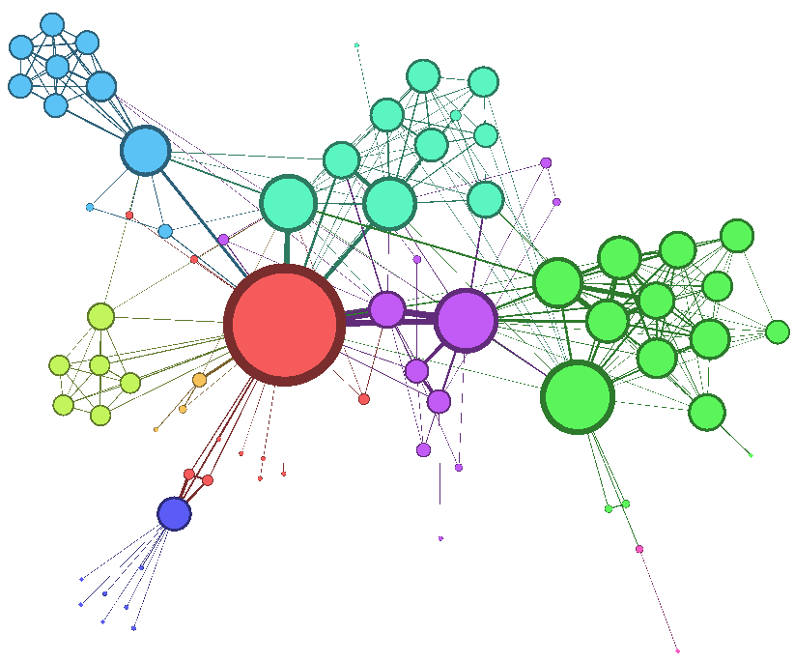
New angle: Visualization
http://gephi.org/
http://graphstream-project.org/

