Slide 1
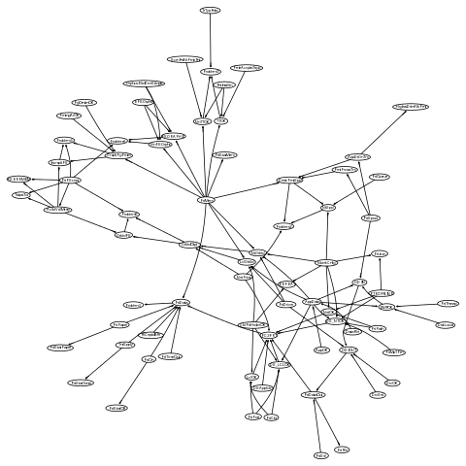
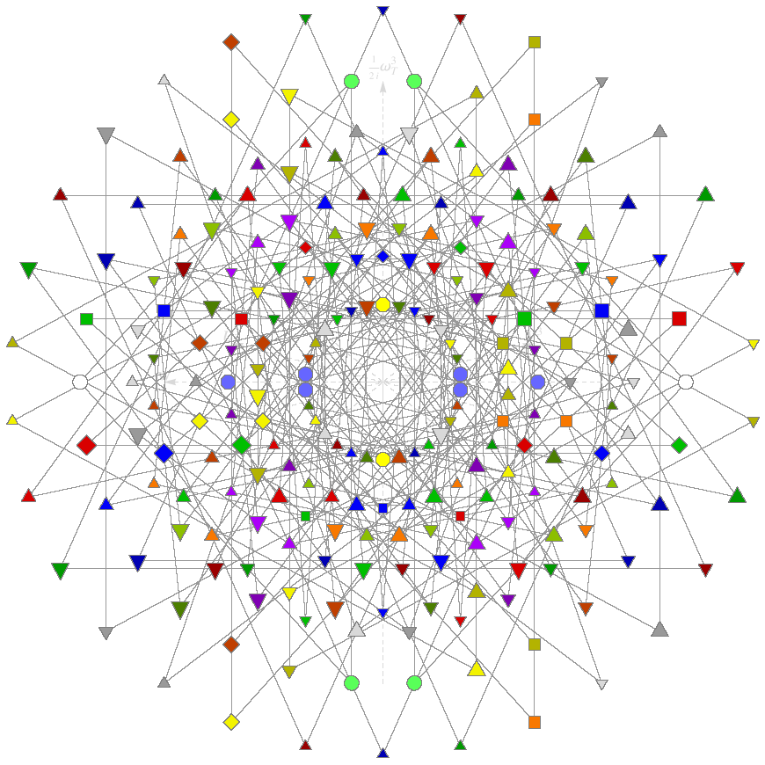
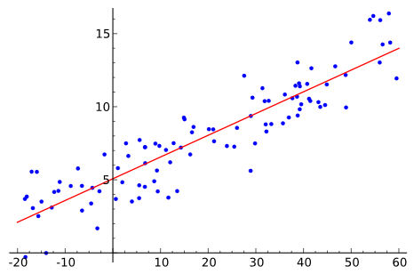
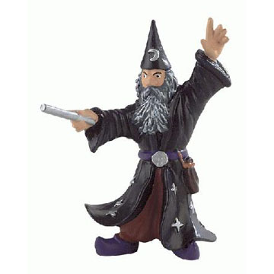
ModelWizard Interactive Model Construction for Tabular
Dylan Hutchison
Advisors Andy Gordon and Claudio Russo
15 August 2014
Notes:
Put on your data scientist hats. Today, we will learn the structure behind your favourite dataset, hand-in-hand with the ModelWizard!

Slide 2
Wild_Propagate | redord_ID_ | Genus | Species | On_CITES | Country | conserve_concern | conserve_priority | price_USD
P | 1 | Adenia | cladosepala | FALSE | ND | H | H | 8.29
P | 2 | Adenia | cladosepala | FALSE | ND | H | H | 71.82
P | 3 | Adenia | cladosepala | FALSE | DE | H | H | 4.56
P | 4 | Adenia | cladosepala | FALSE | ND | H | H | 17.89
P | 5 | Adenia | cladosepala | FALSE | CZ | H | H | 1
P | 6 | Adenia | cladosepala | FALSE | USA | H | H | 38
P | 7 | Adenia | cladosepala | FALSE | CYPRUS | H | H | 7.58
P | 8 | Adenia | cladosepala | FALSE | ND | H | H | 17.85
P | 9 | Adenia | cladosepala | FALSE | CZ | H | H | 1
P | 10 | Adenia | cladosepala | FALSE | DE | H | H | 7.58
P | 11 | Adenia | cladosepala | FALSE | UK | H | H | 37.13
P | 12 | Adenia | cladosepala | FALSE | DE | H | H | 7.15
P | 13 | Adenia | cladosepala | FALSE | CYPRUS | H | H | 7.57
P | 14 | Adenia | cladosepala | FALSE | DE | H | H | 7.15
P | 15 | Adenia | cladosepala | FALSE | ND | H | H | 17.82
P | 16 | Adenia | cladosepala | FALSE | CZ | H | H | 1
P | 17 | Adenia | cladosepala | FALSE | USA | H | H | 38
P | 18 | Adenia | cladosepala | FALSE | DE | H | H | 4.54
P | 19 | Adenia | cladosepala | FALSE | USA | H | H | 9.95
P | 20 | Adenia | cladosepala | FALSE | GE | H | H | 1.37
T_conserve_priority
ID | int | input
conserve_priority | string | input | pk
T_conserve_concern
ID | int | input
conserve_concern | string | input | pk
T_Wild_Propagate
ID | int | input
Wild_Propagate | string | input | pk
T_Species
ID | int | input
Species | string | input | pk
T_On_CITES
ID | int | input
On_CITES | string | input | pk
T_Genus
ID | int | input
Genus | string | input | pk
T_Country
ID | int | input
Country | string | input | pk
T_Genus_Species | Visible Uniques Table
ID | int | input
Genus | link(T_Genus) | input | pk
Species | link(T_Species) | input | pk
conserve_priority | link(T_conserve_priority) | output | CDiscrete(N=SizeOf(T_conserve_priority))
conserve_concern | link(T_conserve_concern) | output | CDiscrete(N=SizeOf(T_conserve_concern))
On_CITES | link(T_On_CITES) | output | CDiscrete(N=SizeOf(T_On_CITES))
tmain
ID | int | input
Wild_Propagate | link(T_Wild_Propagate) | output | CDiscrete(N=SizeOf(T_Wild_Propagate))
Genus_Species | link(T_Genus_Species) | output | CDiscrete(N=SizeOf(T_Genus_Species))[Wild_Propagate]
Country | link(T_Country) | output | CDiscrete(N=SizeOf(T_Country))[Wild_Propagate]
Genus | link(T_Genus) | output | Genus_Species.Genus
On_CITES | link(T_On_CITES) | output | Genus_Species.On_CITES
Species | link(T_Species) | output | Genus_Species.Species
conserve_concern | link(T_conserve_concern) | output | Genus_Species.conserve_concern
conserve_priority | link(T_conserve_priority) | output | Genus_Species.conserve_priority
price_USD | real | output | CGaussian(MeanMean=45.53844295,MeanPrec=0.0001470609862)[Wild_Propagate]
tmain
ID | int | input
Country | string | input
Genus | string | input
On_CITES | bool | input
Species | string | input
Wild_Propagate | string | input
conserve_concern | string | input
conserve_priority | string | input
price_USD | real | input
redord_ID_ | int | input
W.TypeInfer "tmain" ""
W.ExactInfer "tmain" ["Genus"; "Species"]
W.NaiveBayes "tmain" "Wild_Propagate"
["conserve_priority"; "conserve_concern"; "On_CITES"]
|> List.map (W.Model "T_Genus_Species")
ID | Wild_Propagate | Genus | Species | On_CITES | Country | conserve_concern | conserve_priority | price_USD | Genus_Species | ID | conserve_priority |  | ID | conserve_concern |  | ID | Wild_Propagate |  | ID | Species |  | ID | On_CITES |  | ID | Genus |  | ID | Country |  | ID | Genus | Species | conserve_priority | conserve_concern | On_CITES
0 | 3 |  |  |  | 12 |  |  | 9.08 | 16 | 0 | H |  | 0 | H |  | 0 | P |  | 0 | abbreviata |  | 0 | FALSE |  | 0 | Adenia |  | 0 | AFRICA |  | 0 | 0 | 3 | 0 | 0 | 0
1 | 3 |  |  |  | 4 |  |  | 1.2 | 17 | 1 | H-M |  | 1 | H-M |  | 1 | U |  | 1 | aprevalii |  | 1 | TRUE |  | 1 | Commiphora |  | 1 | AFRICA ZA |  | 1 | 0 | 6 | 4 | 5 | 0
2 | 3 |  |  |  | 12 |  |  | 33.42 | 17 | 2 | L |  | 2 | L |  | 2 | W |  | 2 | borealis |  |  |  |  | 2 | Cyphostemma |  | 2 | AUSTRALIA |  | 2 | 0 | 8 | 0 | 0 | 0
3 | 2 |  |  |  | 16 |  |  | 80 | 24 | 3 | M |  | 3 | M |  | 3 | W-P |  | 3 | cladosepala |  |  |  |  | 3 | Operculicarya |  | 3 | CYPRUS |  | 3 | 0 | 9 | 0 | 0 | 1
4 | 2 |  |  |  | 16 |  |  | 35 | 21 | 4 | U |  | 4 | M-H |  |  |  |  | 4 | cornigera |  |  |  |  | 4 | Uncarina |  | 4 | CZ |  | 4 | 0 | 16 | 0 | 0 | 0
5 | 2 |  |  |  | 7 |  |  | 93.57 | 18 |  |  |  | 5 | U |  |  |  |  | 5 | decaryi |  |  |  |  |  |  |  | 5 | DE |  | 5 | 0 | 19 | 0 | 0 | 0
6 | 2 |  |  |  | 6 |  |  | 123.85 | 21 |  |  |  |  |  |  |  |  |  | 6 | ecirrosa |  |  |  |  |  |  |  | 6 | ES |  | 6 | 0 | 21 | 0 | 0 | 1
7 | 2 |  |  |  | 5 |  |  | 3.85 | 33 |  |  |  |  |  |  |  |  |  | 7 | elephantophus |  |  |  |  |  |  |  | 7 | FR |  | 7 | 0 | 25 | 3 | 3 | 0
8 | 2 |  |  |  | 15 |  |  | 4.63 | 27 |  |  |  |  |  |  |  |  |  | 8 | epigea |  |  |  |  |  |  |  | 8 | GE |  | 8 | 0 | 31 | 1 | 1 | 1
9 | 2 |  |  |  | 13 |  |  | 53.67 | 21 |  |  |  |  |  |  |  |  |  | 9 | firingavalensis |  |  |  |  |  |  |  | 9 | HUNGARY |  | 9 | 1 | 1 | 1 | 1 | 0
10 | 2 |  |  |  | 5 |  |  | 40.6 | 33 |  |  |  |  |  |  |  |  |  | 10 | grandidieri |  |  |  |  |  |  |  | 10 | INDIA |  | 10 | 1 | 11 | 1 | 0 | 0
11 | 0 |  |  |  | 16 |  |  | 75 | 3 |  |  |  |  |  |  |  |  |  | 11 | guillauminii |  |  |  |  |  |  |  | 11 | IT |  | 11 | 1 | 13 | 1 | 0 | 0
12 | 3 |  |  |  | 5 |  |  | 4.54 | 16 |  |  |  |  |  |  |  |  |  | 12 | hirsutissima |  |  |  |  |  |  |  | 12 | ND |  | 12 | 1 | 20 | 1 | 0 | 0
13 | 2 |  |  |  | 12 |  |  | 50.36 | 21 |  |  |  |  |  |  |  |  |  | 13 | humbertii |  |  |  |  |  |  |  | 13 | REUNION |  | 13 | 1 | 22 | 1 | 0 | 0
14 | 2 |  |  |  | 7 |  |  | 38.53 | 33 |  |  |  |  |  |  |  |  |  | 14 | hyphaenoides |  |  |  |  |  |  |  | 14 | THAILAND |  | 14 | 1 | 29 | 2 | 3 | 0
15 | 2 |  |  |  | 12 |  |  | 462.39 | 21 |  |  |  |  |  |  |  |  |  | 15 | ihlenfeldtiana |  |  |  |  |  |  |  | 15 | UK |  | 15 | 2 | 4 | 4 | 5 | 0
16 | 3 |  |  |  | 15 |  |  | 5.89 | 16 |  |  |  |  |  |  |  |  |  | 16 | isaloensis |  |  |  |  |  |  |  | 16 | USA |  | 16 | 2 | 7 | 0 | 0 | 1
17 | 3 |  |  |  | 4 |  |  | 8.97 | 16 |  |  |  |  |  |  |  |  |  | 17 | laza |  |  |  |  |  |  |  | 17 | ZA |  | 17 | 2 | 17 | 0 | 4 | 1
18 | 2 |  |  |  | 5 |  |  | 14.44 | 21 |  |  |  |  |  |  |  |  |  | 18 | leptocarpa |  |  |  |  |  |  |  |  |  |  | 18 | 2 | 23 | 0 | 0 | 0
19 | 3 |  |  |  | 4 |  |  | 29.87 | 17 |  |  |  |  |  |  |  |  |  | 19 | monadelpha |  |  |  |  |  |  |  |  |  |  | 19 | 2 | 27 | 3 | 0 | 0
20 | 2 |  |  |  | 16 |  |  | 10.99 | 24 |  |  |  |  |  |  |  |  |  | 20 | monstruosa |  |  |  |  |  |  |  |  |  |  | 20 | 3 | 2 | 0 | 0 | 0
ID | Wild_Propagate | Genus | Species | On_CITES | Country | conserve_concern | conserve_priority | price_USD | Genus_Species | ID | conserve_priority |  | ID | conserve_concern |  | ID | Wild_Propagate |  | ID | Species |  | ID | On_CITES |  | ID | Genus |  | ID | Country |  | ID | Genus | Species | conserve_priority | conserve_concern | On_CITES
0 | 3 |  |  |  | 12 |  |  | 9.08 | 16 | 0 | H |  | 0 | H |  | 0 | P |  | 0 | abbreviata |  | 0 | FALSE |  | 0 | Adenia |  | 0 | AFRICA |  | 0 | 0 | 3 | 0 | 0 | 0
1 | 3 |  |  |  | 4 |  |  | 1.2 | 17 | 1 | H-M |  | 1 | H-M |  | 1 | U |  | 1 | aprevalii |  | 1 | TRUE |  | 1 | Commiphora |  | 1 | AFRICA ZA |  | 1 | 0 | 6 | 4 | 5 | 0
2 | 3 |  |  |  | 12 |  |  | 33.42 | 17 | 2 | L |  | 2 | L |  | 2 | W |  | 2 | borealis |  |  |  |  | 2 | Cyphostemma |  | 2 | AUSTRALIA |  | 2 | 0 | 8 | 0 | 0 | 0
3 | 2 |  |  |  | 16 |  |  | 80 | 24 | 3 | M |  | 3 | M |  | 3 | W-P |  | 3 | cladosepala |  |  |  |  | 3 | Operculicarya |  | 3 | CYPRUS |  | 3 | 0 | 9 | 0 | 0 | 1
4 | 2 |  |  |  | 16 |  |  | 35 | 21 | 4 | U |  | 4 | M-H |  |  |  |  | 4 | cornigera |  |  |  |  | 4 | Uncarina |  | 4 | CZ |  | 4 | 0 | 16 | 0 | 0 | 0
5 | 2 |  |  |  | 7 |  |  | 93.57 | 18 |  |  |  | 5 | U |  |  |  |  | 5 | decaryi |  |  |  |  |  |  |  | 5 | DE |  | 5 | 0 | 19 | 0 | 0 | 0
6 | 2 |  |  |  | 6 |  |  | 123.85 | 21 |  |  |  |  |  |  |  |  |  | 6 | ecirrosa |  |  |  |  |  |  |  | 6 | ES |  | 6 | 0 | 21 | 0 | 0 | 1
7 | 2 |  |  |  | 5 |  |  | 3.85 | 33 |  |  |  |  |  |  |  |  |  | 7 | elephantophus |  |  |  |  |  |  |  | 7 | FR |  | 7 | 0 | 25 | 3 | 3 | 0

Slide 3
Tabular: Probabilistic Models on Schemas
①
Get Data into Excel, clean data with tools like Power Query
Add in query-by-missing-value rows
Write a Tabular Model
Compile to Infer.NET and profit!
②
③
Players
Skill | real | latent | GaussianFromMeanAndPrecision(25.0,0.01)
Matches
Player1 | link(Players) | input
Player2 | link(Players) | input
Perf1 | real | latent | GaussianFromMeanAndPrecision(Player1.Skill,0.01)
Perf2 | real | latent | GaussianFromMeanAndPrecision(Player2.Skill,0.01)
Win1 | bool | output | Perf1 > Perf2
④
③
Player | Name |  | Match | Player1 | Player2 | Win1
0 | Alice |  | 0 | 0 | 1 | FALSE
1 | Bob |  | 1 | 1 | 2 | FALSE
2 | Cynthia |  | 2 | 0 | 2
①
②
④
Log Evidence | Players |  |  | Matches
-1.56 | Player | Skill |  | Match | Perf1 | Perf2 | Win1
 | 0 | Gaussian(20.25, 82.28) |  | 0 | Gaussian(15.49, 129.1) | Gaussian(29.75, 123.6) | Bernoulli(0)
 | 1 | Gaussian(25, 70.66) |  | 1 | Gaussian(20.25, 123.6) | Gaussian(34.51, 129.1) | Bernoulli(0)
 | 2 | Gaussian(29.75, 82.28) |  | 2 | Gaussian(20.25, 182.3) | Gaussian(29.75, 182.3) | Bernoulli(0.3092)
Infer.NET

Slide 4
Tabular: Probabilistic Models on Schemas
③: Easier than writing Infer.NET
but still hard for Data Scientists.
Which models make sense?
Which perform best?
①
Get Data into Excel, clean data with tools like Power Query
Add in query-by-missing-value rows
Write a Tabular Model
Compile to Infer.NET and profit!
②
③
Players
Skill | real | latent | GaussianFromMeanAndPrecision(25.0,0.01)
Matches
Player1 | link(Players) | input
Player2 | link(Players) | input
Perf1 | real | latent | GaussianFromMeanAndPrecision(Player1.Skill,0.01)
Perf2 | real | latent | GaussianFromMeanAndPrecision(Player2.Skill,0.01)
Win1 | bool | output | Perf1 > Perf2
④
③
Player | Name |  | Match | Player1 | Player2 | Win1
0 | Alice |  | 0 | 0 | 1 | FALSE
1 | Bob |  | 1 | 1 | 2 | FALSE
2 | Cynthia |  | 2 | 0 | 2
①
②
④
Log Evidence | Players |  |  | Matches
-1.56 | Player | Skill |  | Match | Perf1 | Perf2 | Win1
 | 0 | Gaussian(20.25, 82.28) |  | 0 | Gaussian(15.49, 129.1) | Gaussian(29.75, 123.6) | Bernoulli(0)
 | 1 | Gaussian(25, 70.66) |  | 1 | Gaussian(20.25, 123.6) | Gaussian(34.51, 129.1) | Bernoulli(0)
 | 2 | Gaussian(29.75, 82.28) |  | 2 | Gaussian(20.25, 182.3) | Gaussian(29.75, 182.3) | Bernoulli(0.3092)
Infer.NET

Slide 5
Ex1: Clouds, Rain, Sprinklers, WetGrass
cloudy | sprinkler | rain | wetGrass
TRUE | FALSE |  | FALSE
FALSE | FALSE | TRUE | TRUE
FALSE | TRUE | FALSE | FALSE
FALSE | TRUE | FALSE | FALSE
TRUE | FALSE | FALSE | FALSE
TRUE | TRUE | TRUE | TRUE
FALSE | FALSE | FALSE | FALSE
4 Boolean Variables
Space of Models = Bayesian Networks
Let “➔” mean “governs the distribution behind”
Rain ➔ WetGrass?
Sprinklers ➔ Rain??
Use ModelWizard to explore & compare
Classic model, taken from Kevin Murphey 1998. Data generated by sampling an Infer.NET program.
Notes:
Each row is a set of observations on a given date.
Demo ModelWizard ==> do Inference with Tabular
Model everything independently
Model Rain ➔ WetGrass – better model
Model Sprinklers ➔ Rain – worse model

Slide 6
tmain
ID | int | input
cloudy | string | input
rain | string | input
sprinkler | string | input
wetGrass | string | input
T_wetGrass
ID | int | input
wetGrass | string | input | pk
T_sprinkler
ID | int | input
sprinkler | string | input | pk
T_rain
ID | int | input
rain | string | input | pk
T_cloudy
ID | int | input
cloudy | string | input | pk
tmain
ID | int | input
cloudy | link(T_cloudy) | input
rain | link(T_rain) | input
sprinkler | link(T_sprinkler) | input
wetGrass | link(T_wetGrass) | input
TypeInfer
2. Model
tmain
ID | int | input
cloudy | link(T_cloudy) | output | CDiscrete(N=SizeOf(T_cloudy))
rain | link(T_rain) | output | CDiscrete(N=SizeOf(T_rain))
sprinkler | link(T_sprinkler) | output | CDiscrete(N=SizeOf(T_sprinkler))
wetGrass | link(T_wetGrass) | output | CDiscrete(N=SizeOf(T_wetGrass))
3. Approx
tmain
ID | int | input
cloudy | link(T_cloudy) | output | CDiscrete(N=SizeOf(T_cloudy))
rain | link(T_rain) | output | CDiscrete(N=SizeOf(T_rain))[cloudy]
sprinkler | link(T_sprinkler) | output | CDiscrete(N=SizeOf(T_sprinkler))[cloudy]
wetGrass | link(T_wetGrass) | output | CDiscrete(N=SizeOf(T_wetGrass))[sprinkler][rain]

Slide 7
Model Improvement: Predicting Cloudy
Log Evidence
-2661.41
All-Independent Model
Final Model
Log Evidence
-1963.57
 |  | Truth
 |  | 0 | 1
Predict | 0 | 19.6 | 27.4
 | 1 | 78.2 | 74.8
 |  | Truth
 |  | 0 | 1
Predict | 0 | 87.6 ↑ | 28.6
 | 1 | 10.2 ↓ | 73.6
Cloudy
Sprinkler
Rain
Cloudy
WetGrass
1000 rows of data
5-fold cross-validation
20% data held out
= 200 test predictions average per fold
Sprinkler
Rain
cloudy | link(T_cloudy) | output | CDiscrete(N=SizeOf(T_cloudy))
rain | link(T_rain) | output | CDiscrete(N=SizeOf(T_rain))
sprinkler | link(T_sprinkler) | output | CDiscrete(N=SizeOf(T_sprinkler))
wetGrass | link(T_wetGrass) | output | CDiscrete(N=SizeOf(T_wetGrass))
WetGrass
cloudy | link(T_cloudy) | output | CDiscrete(N=SizeOf(T_cloudy))
rain | link(T_rain) | output | CDiscrete(N=SizeOf(T_rain))[cloudy]
sprinkler | link(T_sprinkler) | output | CDiscrete(N=SizeOf(T_sprinkler))[cloudy]
wetGrass | link(T_wetGrass) | output | CDiscrete(N=SizeOf(T_wetGrass))[sprinkler][rain]
Notes:
Confusion matrix entries sum to 200 – for 20% of 1000 rows of data in the test set.

Slide 8
Ex2: Naive Bayes Classifier: Gender
Gender
ID | gender | height | weight | footsize
0 | 1 | 6 | 180 | 12
1 | 1 | 5.92 | 190 | 11
2 | 1 | 5.58 | 170 | 12
3 |  | 5.92 | 165 | 10
4 | 0 | 5 | 100 | 6
5 | 0 | 5.5 | 150 | 8
6 | 0 | 5.42 | 130 | 7
7 |  | 5.75 | 150 | 9
Height
Weight
Footsize
Data from Wikipedia Naive Bayes example

Slide 9
tmain
ID | int | input
footsize | int | input
gender | int | input
height | real | input
weight | int | input
NaiveBayes tmain (+)
ReorderColumns tmain
Type tmain gender Nominal
Model tmain gender
Model tmain footsize
Model tmain height
Model tmain weight
Approx tmain gender footsize
Approx tmain gender height
Approx tmain gender weight
EstimateHyper tmain (+)
EstimateHyper tmain weight
EstimateHyper tmain height
EstimateHyper tmain footsize
NaiveBayes
T_gender
ID | int | input
gender | string | input | pk
tmain
ID | int | input
gender | link(T_gender) | output | CDiscrete(N=SizeOf(T_gender))
footsize | real | output | CGaussian(MeanMean=9.375,MeanPrec=0.01667)[gender]
height | real | output | CGaussian(MeanMean=5.63625,MeanPrec=0.1)[gender]
weight | real | output | CGaussian(MeanMean=154.375,MeanPrec=0.00111)[gender]
Notes:
Power Commands!

Slide 10
Ex3: Exact Functional Dependencies: Plant Sales in Madagascar
Genus | Species | On_CITES | Country | conserve_concern | conserve_priority | price_USD
Adenia | olaboensis | TRUE | ND | H | H | 22
Adenia | olaboensis | TRUE | DE | H | H | 5.91
Adenia | olaboensis | TRUE | CZ | H | H | 8.96
Adenia | perrieri | FALSE | FR | M | M | 16.51
Adenia | perrieri | FALSE | ND | M | M | 17.81
Adenia | perrieri | FALSE | ND | M | M | 17.81
Thanks to Matt Smith for the dataset!

Slide 11
tmain
ID | int | input
Country | string | input
Genus | string | input
On_CITES | bool | input
Species | string | input
Wild_Propagate | string | input
conserve_concern | string | input
conserve_priority | string | input
price_USD | real | input
T_conserve_priority
ID | int | input
conserve_priority | string | input | pk
T_conserve_concern
ID | int | input
conserve_concern | string | input | pk
T_Wild_Propagate
ID | int | input
Wild_Propagate | string | input | pk
T_Species
ID | int | input
Species | string | input | pk
T_On_CITES
ID | int | input
On_CITES | string | input | pk
T_Genus
ID | int | input
Genus | string | input | pk
T_Country
ID | int | input
Country | string | input | pk
tmain
ID | int | input
Country | link(T_Country) | input
Genus | link(T_Genus) | input
On_CITES | link(T_On_CITES) | input
Species | link(T_Species) | input
Wild_Propagate | link(T_Wild_Propagate) | input
conserve_concern | link(T_conserve_concern) | input
conserve_priority | link(T_conserve_priority) | input
price_USD | real | input
TypeInfer tmain
2. ExactInfer [Genus,Species]
T_Genus_Species | Visible Uniques Table
ID | int | input
Genus | link(T_Genus) | input | pk
Species | link(T_Species) | input | pk
conserve_priority | link(T_conserve_priority) | input
conserve_concern | link(T_conserve_concern) | input
On_CITES | link(T_On_CITES) | input
tmain
ID | int | input
Genus_Species | link(T_Genus_Species) | output | CDiscrete(N=SizeOf(T_Genus_Species))
Country | link(T_Country) | input
Genus | link(T_Genus) | output | Genus_Species.Genus
On_CITES | link(T_On_CITES) | output | Genus_Species.On_CITES
Species | link(T_Species) | output | Genus_Species.Species
Wild_Propagate | link(T_Wild_Propagate) | input
conserve_concern | link(T_conserve_concern) | output | Genus_Species.conserve_concern
conserve_priority | link(T_conserve_priority) | output | Genus_Species.conserve_priority
price_USD | real | input
Columns exactly determined by (Genus, Species)

Slide 12
NaiveBayes tmain
Model T_Genus_Species ...
T_Genus_Species | Visible Uniques Table
ID | int | input
Genus | link(T_Genus) | input | pk
Species | link(T_Species) | input | pk
conserve_priority | link(T_conserve_priority) | output | CDiscrete(N=SizeOf(T_conserve_priority))
conserve_concern | link(T_conserve_concern) | output | CDiscrete(N=SizeOf(T_conserve_concern))
On_CITES | link(T_On_CITES) | output | CDiscrete(N=SizeOf(T_On_CITES))
tmain
ID | int | input
Wild_Propagate | link(T_Wild_Propagate) | output | CDiscrete(N=SizeOf(T_Wild_Propagate))
Genus_Species | link(T_Genus_Species) | output | CDiscrete(N=SizeOf(T_Genus_Species))[Wild_Propagate]
Country | link(T_Country) | output | CDiscrete(N=SizeOf(T_Country))[Wild_Propagate]
Genus | link(T_Genus) | output | Genus_Species.Genus
On_CITES | link(T_On_CITES) | output | Genus_Species.On_CITES
Species | link(T_Species) | output | Genus_Species.Species
conserve_concern | link(T_conserve_concern) | output | Genus_Species.conserve_concern
conserve_priority | link(T_conserve_priority) | output | Genus_Species.conserve_priority
price_USD | real | output | CGaussian(MeanMean=45.5384,MeanPrec=0.00014706)[Wild_Propagate]
T_Genus_Species | Visible Uniques Table
ID | int | input
Genus | link(T_Genus) | input | pk
Species | link(T_Species) | input | pk
conserve_priority | link(T_conserve_priority) | input
conserve_concern | link(T_conserve_concern) | input
On_CITES | link(T_On_CITES) | input
tmain
ID | int | input
Wild_Propagate | link(T_Wild_Propagate) | output | CDiscrete(N=SizeOf(T_Wild_Propagate))
Genus_Species | link(T_Genus_Species) | output | CDiscrete(N=SizeOf(T_Genus_Species))[Wild_Propagate]
Country | link(T_Country) | output | CDiscrete(N=SizeOf(T_Country))[Wild_Propagate]
Genus | link(T_Genus) | output | Genus_Species.Genus
On_CITES | link(T_On_CITES) | output | Genus_Species.On_CITES
Species | link(T_Species) | output | Genus_Species.Species
conserve_concern | link(T_conserve_concern) | output | Genus_Species.conserve_concern
conserve_priority | link(T_conserve_priority) | output | Genus_Species.conserve_priority
price_USD | real | output | CGaussian(MeanMean=45.5384,MeanPrec=0.00014706)[Wild_Propagate]

Slide 13
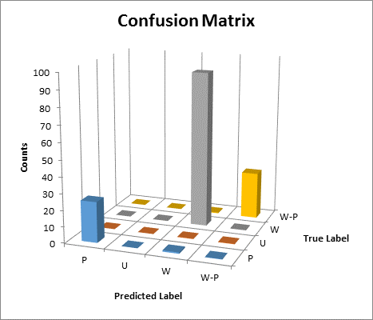
Better Models by Capturing Exact FDs
Without EFDs
With EFDs
Class Labels
P = Propagate
W = Wild
U = Unknown
W-P = Unknown
748 rows of data
5-fold cross-validation
20% data held out
= 149.6 test predictions average per fold

Slide 14

type State = Schema * Data
type Operation = State -> State option
Primitive Operations
Compound Operations
Type
Model
Approx
JoinDomain
Exact
TypeInfer
EstimateHyper
NaiveBayes
ExactInfer
Later...
Regression
Clustering
Time
Matrix Factorization
Notes:
Misc. Operations: Undo, Delete, Comment, ...
TYPES: room for constraints: Real >=0, <=5
continuous -> discrete = regression
continuous -> continuous = oh no! Try polynomial regression.
Clustering – latent variables indexing a distribution
Matrix Factorization – latent trait vectors
Naive Bayes Classifier – Class determines feature distr.
Regression – Features determine class
Tables of unique values – explicit discrete domains

Slide 15
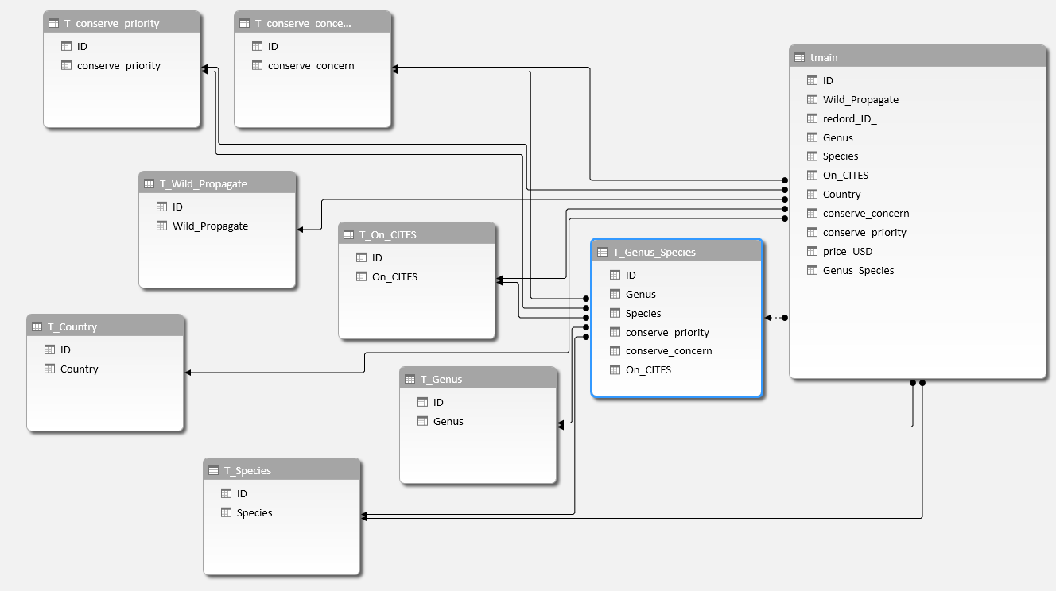
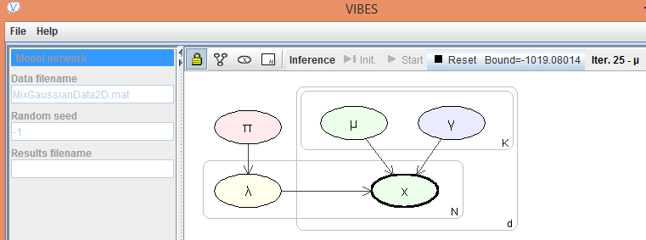
Future: ModelWizard GUI
Related to 2002 VIBES graphical model builder by John Winn
Integration with existing tools
Excel Data Model, Factor Graph view
➔ Default models within reach of Data Scientists
Notes:
Command-line interface not F# dependent, could be driven by Python or R or your favourite language
our initial implementation eagerly applies operations to the actual dataset in memory; to scale, we could instead apply the transformations eagerly to the schema, but lazily to the actual data.

Slide 16
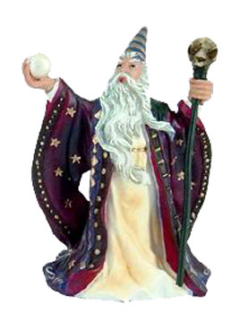
ModelWizard Interactive Model Construction
Data
Approx!
New abstraction to simultaneously refine...
Model
 | Your Expertise
+ | Automation & Search
+ | Default Models
= | Discovery ✓
ExactInfer!
State = Schema * Data
PrimOp = State -> State option
Notes:
Relational Data
Probabilistic Model

Slide 17
Backup

Slide 18
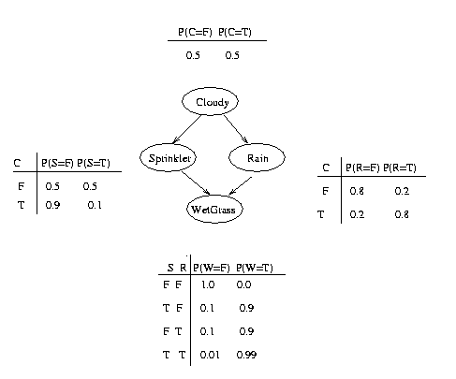
Bayesian Network: Inferred Parameters
Full model: Conditional Distributions
All-independent model: Marginal Distributions
cloudy_V | Dirichlet(490 512) | 0.51
rain_V_0 | Dirichlet(390 101) | 0.21
rain_V_1 | Dirichlet(100.6 412) | 0.80
sprinkler_V_0 | Dirichlet(239 252) | 0.51
sprinkler_V_1 | Dirichlet(460 53) | 0.10
wetGrass_V_0_0 | Dirichlet(278.7 1) | 0.00
wetGrass_V_1_0 | Dirichlet(25 188) | 0.88
wetGrass_V_0_1 | Dirichlet(53.34 368) | 0.87
wetGrass_V_1_1 | Dirichlet(1 93) | 0.99
cloudy_V | Dirichlet(490 512) | 0.51
rain_V | Dirichlet(489 512) | 0.51
sprinkler_V | Dirichlet(698 304) | 0.30
wetGrass_V | Dirichlet(355 647) | 0.65

Slide 19
type State = Schema * Data
type Operation = PrimOp | CompoundOp
type PrimOp = State -> State option
type CompoundOp = State -> Operation list
type Program = Operation list
Primitive Operations
Compound Operations
Type
Model
Approx
JoinDomain
Exact
TypeInfer
EstimateHyper
NaiveBayes
ExactInfer
Later...
Regression
Clustering
Matrix Factorization
Notes:
TYPES: room for constraints: Real >=0, <=5
continuous -> discrete = regression
continuous -> continuous = oh no! Try polynomial regression.
Clustering – latent variables indexing a distribution
Matrix Factorization – latent trait vectors
Naive Bayes Classifier – Class determines feature distr.
Regression – Features determine class
Tables of unique values – explicit discrete domains

