Slide 1
EVALUATE THE MALIGNANCY OF PULMONARY NODULES USING 3-D DEEP LEAKY NOISY-OR NETWORK
COMPUTER VISION AND DEEP LEARNING
 Final Project 
IEEE Transactions on Neural Networks and Learning Systems 2019
Fangzhou Liao*, Ming Liang*, Zhe Li*, Xiaolin Hu* and Sen Song*.
*Tsinghua University
Keywords: 3-D Convolutional Neural Network (CNN), Deep Learning,
Nodule Malignancy Evaluation, Noisy-OR model, Pulmonary Nodule Detection.
Group Number: 01
Group Members: Le Phong Phu P78087029
Nguyen Vu Le Minh P76087099
Tran Thi Ai P76087081
Nguyen Thanh Binh P76087015
Nguyen Duc Nhat Quang P76077078
Notes:
Hello everyone, today, I am going to present Faster R-CNN, a fast and high-accuracy of region based detection algorithm.

Slide 2
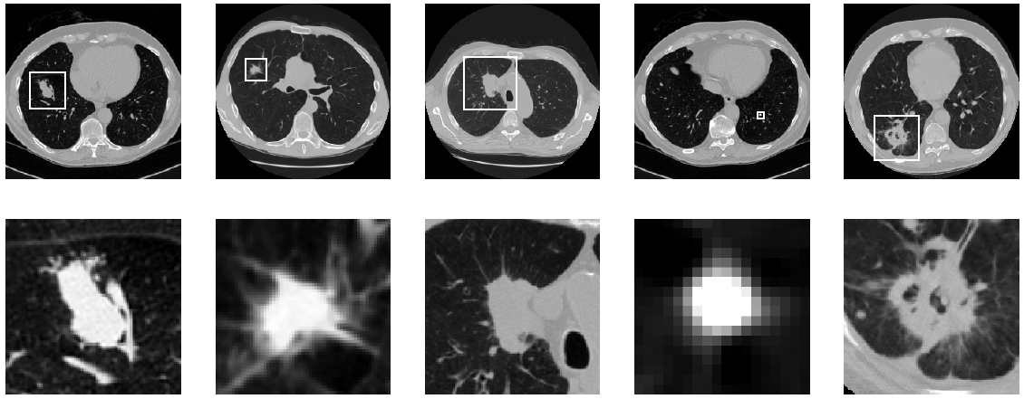
1. Introduction
Motivation:
Lung Cancer is the most common and deadly malignant cancers. The best solution for lung cancer is early diagnosis and timely treatment.
Doctors can evaluate the malignancy of nodules based on their morphology, but the accuracy highly depends on experience and time.
B) Objective:
Propose a computer-aided diagnosis (CAD) using 3D Deep Neural Network to quickly scan nodule.
The network consists two modules:
1) 3D region proposal network (RPN) for nodule detection.
2) A leaky noise-OR gate to obtain the probability of lung cancer for the subject.
C) Contribution:
Propose the first volumetric one-stage end-to-end CNN for 3-D object detection.
Integrate the noisy-OR gate into neural networks to solve the Multiple Instance Learning (MIL) task in Computer-aided diagnosis (CAD).
Fig 1. DSB dataset. (top) Whole slice with nodule. (bottom) Zoomed-in nodules. Lung Computed Tomography (CT) image and Nodule, covered by Bounding Boxes. Nodule has distinctive shape: The bronchus and vessels are continuous pipe systems, thick at the root and thin at the branch; Nodule are usually spherical and isolated.

Slide 3
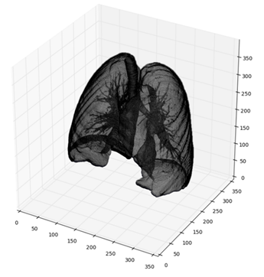
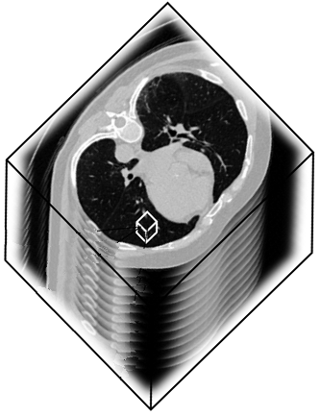
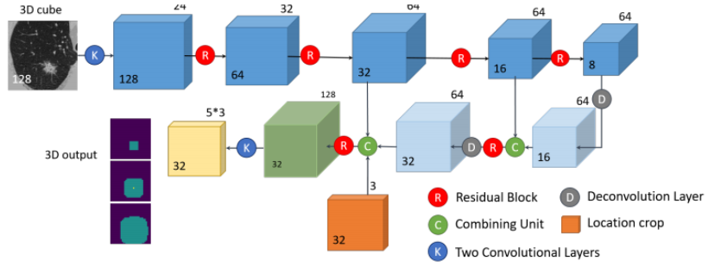
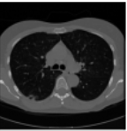
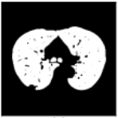
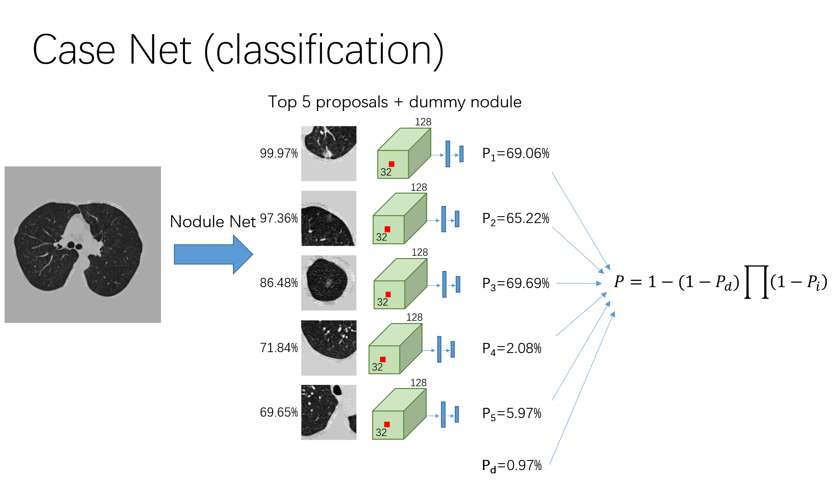

1. Introduction
D) Global Framework:
1.2 2D Slice from 3D Image:
2. 3-D CNN for Nodule Detection
Detect the Bounding Box containing Nodule on 2D Image
Model: ResNet18
3D
3D
2D
Slice down
2D
3D
128x128
128x128
512x512
1.2 2D Slide Pre-processing:
Convert by Hourfield Unit (a).
Mask extraction (b).
Convex Hull and Dilation (c).
Intensity Normalization (d).
1.2 2D Patch Extraction from Slice:
3. Cancer Classification
Classify if the defect is malignant
(a)
(b)
2D
128x128
(c)
(d)
Notes:
This is overview of Faster r-CNN
[H1] This is the picture that demonstrates the unified network after merging RPN and Fast R-CNN. You can see, 2 modules use the same feature map extracted from 1 convolutional network.
[H2]
Intuitively, Faster RCNN composed of main 2 modules after feature extraction process. The first module is Region proposal network that proposes regions, and the second module is the Fast R-CNN that uses the proposed regions to detect the objects.
The entire system is a single and unified network for object detection.
[H3]
The faster r-cnn can be demonstrated like this:
Data preparation. We rescale image so that the shorter side equals 600 pixels.
Feature extraction. Employ a pre-trained deep CNN, such as VGG, to extract feature map from image.
Region proposal network. It is composed of 2 small conv network that detect the regions which might contain objects in the feature maps.
Region of Interest pooling layer. We use this layer to crops and resizes the proposed regions into fixed size.
And classifier layer. The new feature maps of each region are then used for classification and finer bounding box regression through three fully connected layers.

Slide 4
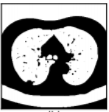
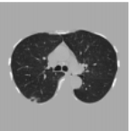
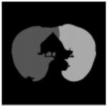
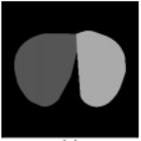
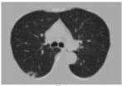
2. Pre-processing:
1. Convert into Hourfield Unit:
2. Mask extraction: Extract the mask of lung and ignores all other tissues.
Filter the tissues:
2-D image is filtered with a Gaussian filter (s = 1 pixel)
Binarized threshold = -600
Remove 2-D connected components < 30 mm2 or having eccentricity > 0.99
Calculate all 3-D connected components in the resulting binary 3-D matrix.
Keep 3-D components not touching the matrix corner and having a volume between 0.68 and 7.5L.
Remove other distracting components:
(Because the lung is always at the center point of image) Calculate the minimum distance from it to the image center (MinDist) and its area.
Select all slices whose area > 6,000 mm2.
Remove component having MinDist > 62mm.
Union remaining components
3. Convex Hull and Dilation:
3. Intensity Normalization:
Separate lung into left and right parts:
Eroded iteratively until it’s broken.
Dilated back to original image
Keep nodules attached to the outer wall inside the mask.
Compute Convex Hull (CH).
Replace 2-D slices with CH.
Dilation:
Dilated the resultant masks ten voxels to get surrounding space.
Union the masks.
Transform images from HU to UINT8.
Clip the raw data matrix [-1200, 600].
Linear transform to [0, 255].
Multiply with the obtained full mask.
Fill outside the mask with 170
The space generated by dilation = 170 (if value >210).
Clip the luminance of bone
Crop in all 3 dimensions so that the margin to every side is 10 pixels.
Notes:
The RPN:
The input of RPN is: the images and their feature maps.
The output would be region proposals and their objectness scores. At the last shared layer of initial CNN, a 3x3 sliding window moves across the feature map and maps it to a lower dimension vector (256-d ZF; 512-d VGG, with RELU). (The position of the sliding window provides localization information with reference to the image.)
Let’s take a look at how RPN work:
1) This is sliding window, a sliding window run across the feature maps and will be map with a feature vector.
2) A pre-defined number of anchors are generated at the position of sliding window on the image, which is re-projected from feature map. So we have anchors.
3) At the position of a sliding window, each anchor will be classified and regressed into proposal regions if it possibly contains object based on the feature vectors.
Let’s go to detail.
) Sliding window and low feature vector extraction:
Slide a window (size nxn, ex: n=3) over the convolutional feature map
Map window to a lower-dimensional feature vector (512-d VGG).
The vectors contain the location information on original image. (an receptive field of 228 pixels for VGG)
This process works as a 3x3-kernel convolution with 512 output feature maps
For example: we have 512 60x40 feature maps. Each sliding window run on a feature map (we can assume its size is 3x3x512 when running all feature maps at a time)
We move this sliding window (the yellow area) across the feature maps with stride 1 and using padding 1.
Each position of feature map, we can get a feature vector sized 1 x1x512.
Because using stride 1, we can have 2400 vectors in total.
Each vector contains the location information on original iamge.
Anchor generation:
Anchors:
What are anchors? they are Pre-defined reference boxes that may contain objects in the image. Each set of anchors has multi scales and ratios and has the characteristic of translation invariant. (it means we use the same set of anchors at every location)
How it work? Firstly, we re-project the center of sliding window back to the image. At that position. K anchor boxes are generated. K mean number of maximum possible proposals for each location.
In our case: k = 9 anchors are formed from 3 scales: 128, 256, 512 and 3 ratios: 1:1, 1:2, 2:1
1 sliding window we have 9 anchors. There are totally 60x40x9 = 21600 anchors.
It is recommended that we ignore all cross-boundary anchors. It mean anchors have a part outside the range of image.
We now have 6000 anchors to the next step.
3) Feeding data into Sibling networks:
The data including 2400 vectos and 6000 anchors are fed into the sibling networks:
1) A 1x1-filter regression network (reg). outputs 4 coordinates representing the bounding box of the region.
2) A 1x1-filter classification network (cls). outputs the “objectness” score for that region. (object or no object)
To have more understand let see my picture.
K anchor at a position of sliding window and their corresponding feature vector are fed into 2 sibling networks.
Each anchor will have 2 outputs in classification and 4 outputs in regression. Therefore, k anchors create 2k outputs in classification and 4k outputs in regression.
So how regression and classification work: 1. regression: the object is to compute offsets from anchor boxes using the linear regression method.
X,y now represent center of box; w,h are width and height.
We now have 3 kinds of box: regressed box : notation; anchor box: notation a; and GT box: notation star.
the parameters of box can be regressed using these functions.
In these function i: index of an anchor in a mini-batch.
t_{i}: vector represents 4 parameter of the predicted box.
t_{i}*: the ground-truth box associated with a positive anchor.
After that, we can compute the loss value. In this function: R is robust function (smooth L1)

Slide 5
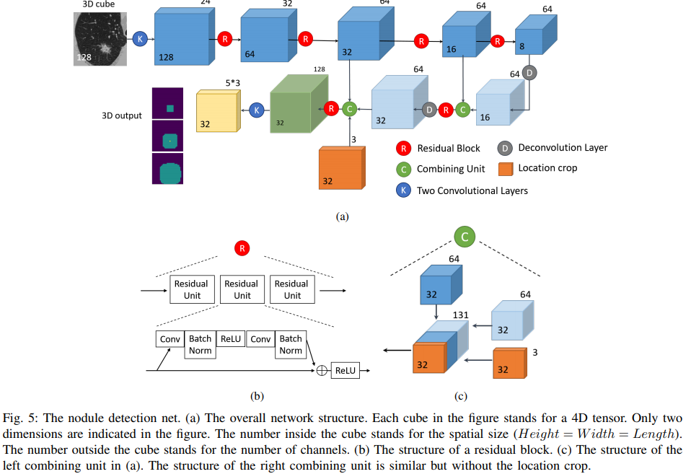
3. Deep Learning Architecture: 3-D CNN For Nodule Detection
Notes:
The RPN:
The input of RPN is: the images and their feature maps.
The output would be region proposals and their objectness scores. At the last shared layer of initial CNN, a 3x3 sliding window moves across the feature map and maps it to a lower dimension vector (256-d ZF; 512-d VGG, with RELU). (The position of the sliding window provides localization information with reference to the image.)
Let’s take a look at how RPN work:
1) This is sliding window, a sliding window run across the feature maps and will be map with a feature vector.
2) A pre-defined number of anchors are generated at the position of sliding window on the image, which is re-projected from feature map. So we have anchors.
3) At the position of a sliding window, each anchor will be classified and regressed into proposal regions if it possibly contains object based on the feature vectors.
Let’s go to detail.
) Sliding window and low feature vector extraction:
Slide a window (size nxn, ex: n=3) over the convolutional feature map
Map window to a lower-dimensional feature vector (512-d VGG).
The vectors contain the location information on original image. (an receptive field of 228 pixels for VGG)
This process works as a 3x3-kernel convolution with 512 output feature maps
For example: we have 512 60x40 feature maps. Each sliding window run on a feature map (we can assume its size is 3x3x512 when running all feature maps at a time)
We move this sliding window (the yellow area) across the feature maps with stride 1 and using padding 1.
Each position of feature map, we can get a feature vector sized 1 x1x512.
Because using stride 1, we can have 2400 vectors in total.
Each vector contains the location information on original iamge.
Anchor generation:
Anchors:
What are anchors? they are Pre-defined reference boxes that may contain objects in the image. Each set of anchors has multi scales and ratios and has the characteristic of translation invariant. (it means we use the same set of anchors at every location)
How it work? Firstly, we re-project the center of sliding window back to the image. At that position. K anchor boxes are generated. K mean number of maximum possible proposals for each location.
In our case: k = 9 anchors are formed from 3 scales: 128, 256, 512 and 3 ratios: 1:1, 1:2, 2:1
1 sliding window we have 9 anchors. There are totally 60x40x9 = 21600 anchors.
It is recommended that we ignore all cross-boundary anchors. It mean anchors have a part outside the range of image.
We now have 6000 anchors to the next step.
3) Feeding data into Sibling networks:
The data including 2400 vectos and 6000 anchors are fed into the sibling networks:
1) A 1x1-filter regression network (reg). outputs 4 coordinates representing the bounding box of the region.
2) A 1x1-filter classification network (cls). outputs the “objectness” score for that region. (object or no object)
To have more understand let see my picture.
K anchor at a position of sliding window and their corresponding feature vector are fed into 2 sibling networks.
Each anchor will have 2 outputs in classification and 4 outputs in regression. Therefore, k anchors create 2k outputs in classification and 4k outputs in regression.
So how regression and classification work: 1. regression: the object is to compute offsets from anchor boxes using the linear regression method.
X,y now represent center of box; w,h are width and height.
We now have 3 kinds of box: regressed box : notation; anchor box: notation a; and GT box: notation star.
the parameters of box can be regressed using these functions.
In these function i: index of an anchor in a mini-batch.
t_{i}: vector represents 4 parameter of the predicted box.
t_{i}*: the ground-truth box associated with a positive anchor.
After that, we can compute the loss value. In this function: R is robust function (smooth L1)

Slide 6
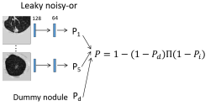
3. Deep Learning Architecture: Malignant Nodule Classification
Notes:
The RPN:
The input of RPN is: the images and their feature maps.
The output would be region proposals and their objectness scores. At the last shared layer of initial CNN, a 3x3 sliding window moves across the feature map and maps it to a lower dimension vector (256-d ZF; 512-d VGG, with RELU). (The position of the sliding window provides localization information with reference to the image.)
Let’s take a look at how RPN work:
1) This is sliding window, a sliding window run across the feature maps and will be map with a feature vector.
2) A pre-defined number of anchors are generated at the position of sliding window on the image, which is re-projected from feature map. So we have anchors.
3) At the position of a sliding window, each anchor will be classified and regressed into proposal regions if it possibly contains object based on the feature vectors.
Let’s go to detail.
) Sliding window and low feature vector extraction:
Slide a window (size nxn, ex: n=3) over the convolutional feature map
Map window to a lower-dimensional feature vector (512-d VGG).
The vectors contain the location information on original image. (an receptive field of 228 pixels for VGG)
This process works as a 3x3-kernel convolution with 512 output feature maps
For example: we have 512 60x40 feature maps. Each sliding window run on a feature map (we can assume its size is 3x3x512 when running all feature maps at a time)
We move this sliding window (the yellow area) across the feature maps with stride 1 and using padding 1.
Each position of feature map, we can get a feature vector sized 1 x1x512.
Because using stride 1, we can have 2400 vectors in total.
Each vector contains the location information on original iamge.
Anchor generation:
Anchors:
What are anchors? they are Pre-defined reference boxes that may contain objects in the image. Each set of anchors has multi scales and ratios and has the characteristic of translation invariant. (it means we use the same set of anchors at every location)
How it work? Firstly, we re-project the center of sliding window back to the image. At that position. K anchor boxes are generated. K mean number of maximum possible proposals for each location.
In our case: k = 9 anchors are formed from 3 scales: 128, 256, 512 and 3 ratios: 1:1, 1:2, 2:1
1 sliding window we have 9 anchors. There are totally 60x40x9 = 21600 anchors.
It is recommended that we ignore all cross-boundary anchors. It mean anchors have a part outside the range of image.
We now have 6000 anchors to the next step.
3) Feeding data into Sibling networks:
The data including 2400 vectos and 6000 anchors are fed into the sibling networks:
1) A 1x1-filter regression network (reg). outputs 4 coordinates representing the bounding box of the region.
2) A 1x1-filter classification network (cls). outputs the “objectness” score for that region. (object or no object)
To have more understand let see my picture.
K anchor at a position of sliding window and their corresponding feature vector are fed into 2 sibling networks.
Each anchor will have 2 outputs in classification and 4 outputs in regression. Therefore, k anchors create 2k outputs in classification and 4k outputs in regression.
So how regression and classification work: 1. regression: the object is to compute offsets from anchor boxes using the linear regression method.
X,y now represent center of box; w,h are width and height.
We now have 3 kinds of box: regressed box : notation; anchor box: notation a; and GT box: notation star.
the parameters of box can be regressed using these functions.
In these function i: index of an anchor in a mini-batch.
t_{i}: vector represents 4 parameter of the predicted box.
t_{i}*: the ground-truth box associated with a positive anchor.
After that, we can compute the loss value. In this function: R is robust function (smooth L1)

Slide 7
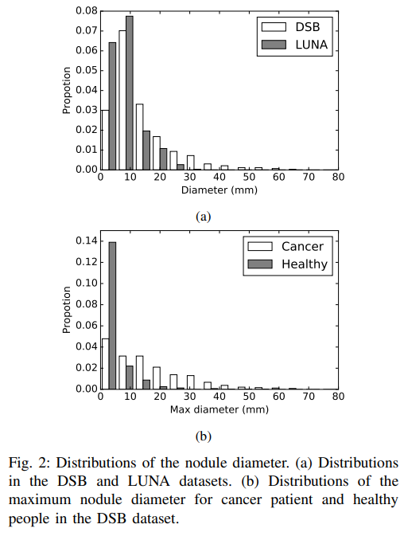
4.1 Experimental Result – Data Collection
Name Dataset | Train | Valid | Test | Total
LUNA 16 | 600 patients | 144 patients | 144 patients | 1,186 nodules / 888 patients
Data Science Bowl (DSB) 2017 | 754 nodules / 1,397 persons (Cases) | 78 nodules / 198 persons (Cases) (7 tiny nodules will be removed) | 506 persons(Cases) | 2,102 persons
Different size:
LUNA: Contains very small annotated nodules (irrelevant to cancer, size < 6 mm).
DSB: Contains very big nodules (size > 40 mm).
Average nodule diameter:
LUNA: 8.31 mm.
DSB: 13.68 mm.
Contribution:
Remove small nodule in LUNA (< 6 mm, not dangerous).
Manually label big nodule in DSB. (next stage will alleviates the demand for highly reliable nodule labels).

Slide 8
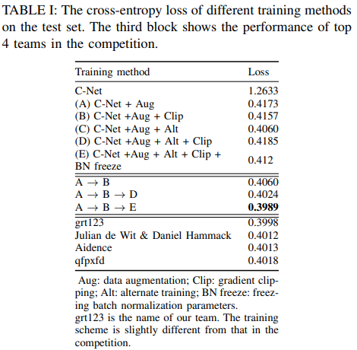
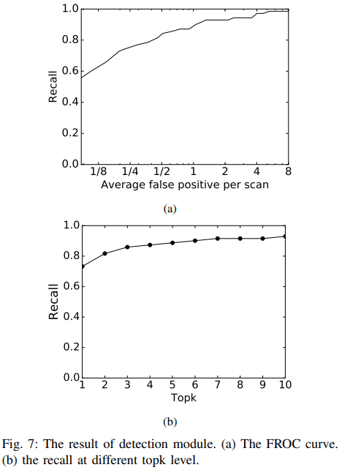
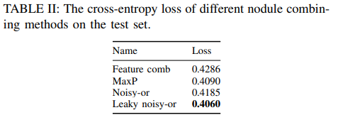
4.2 Experimental Result – Results
Nodule Detection
Case Classification

Slide 9
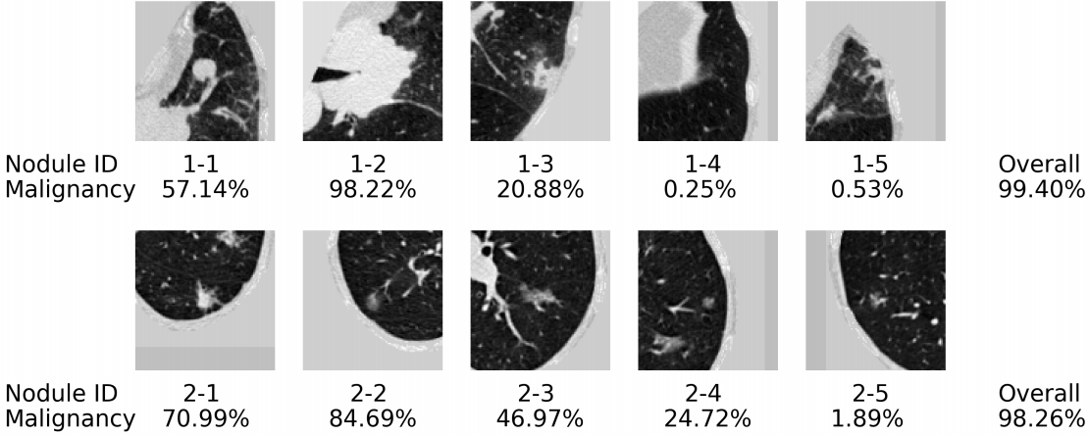
4.2 Experimental Result – True Positive Examples
Nodule has distinctive shape:
The bronchus and vessels are continuous pipe systems, thick at the root and thin at the branch;
Nodule are usually spherical and isolated.

Slide 10
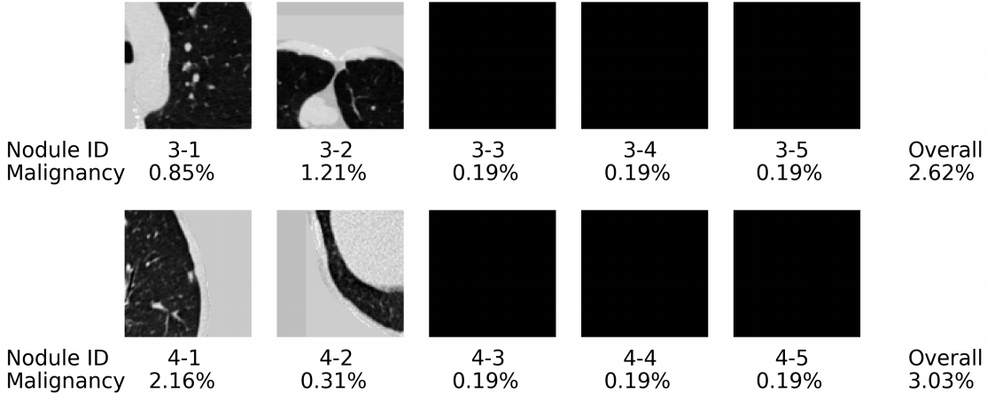
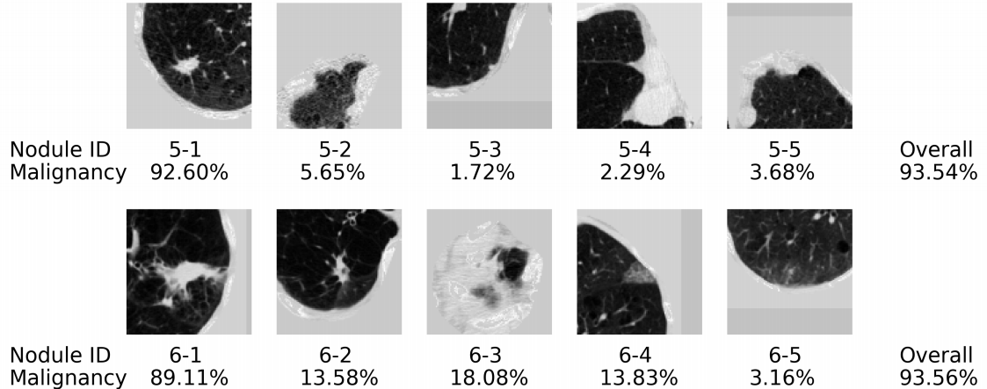
4.3 Experimental Result – False Positive Examples
Noisy Information:
There are some tissues acted as a nodule.
Model could not work well on Gray Images.

Slide 11
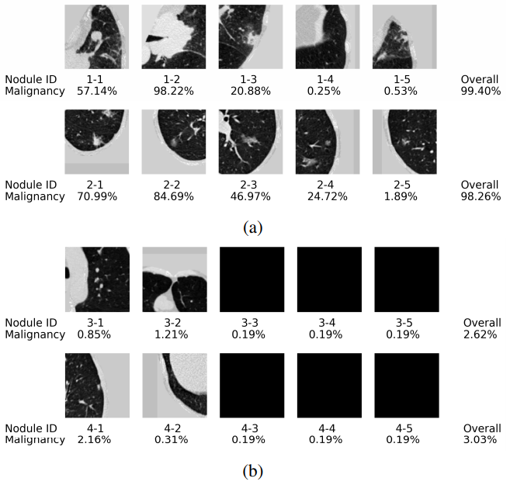
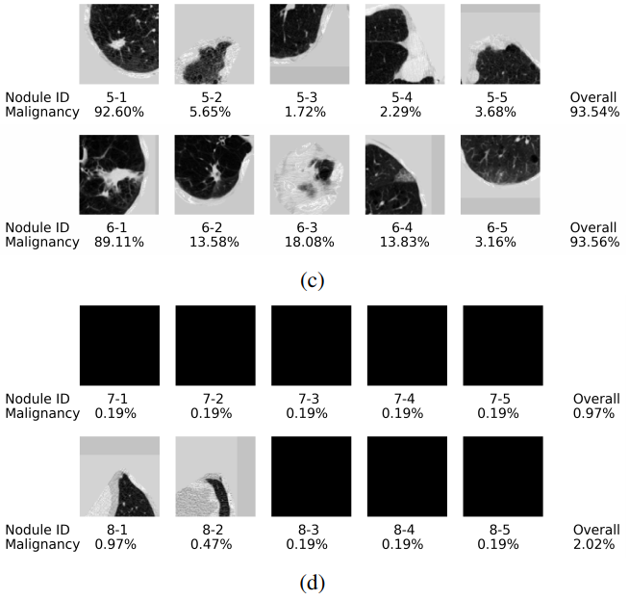
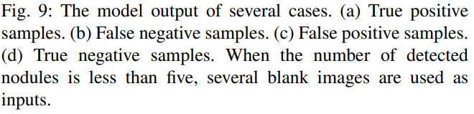
4.3 Experimental Result

Slide 12
5. Conclusion
This paper focus on:
Detect the Nodule of Lung using 3D-CNN Neural Network:
The network consists two modules 3D region proposal network (RPN) for nodule detection.
Malignant Nodule Classification:
Integrate the noisy-OR gate into neural networks to solve the Multiple Instance Learning (MIL) task in Computer-aided diagnosis (CAD).

Slide 13
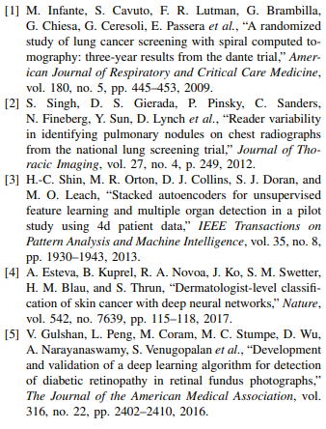
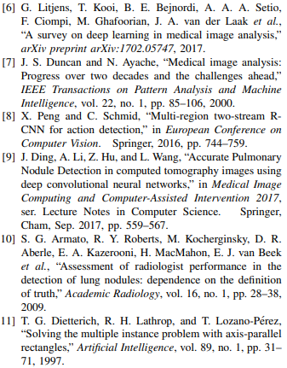
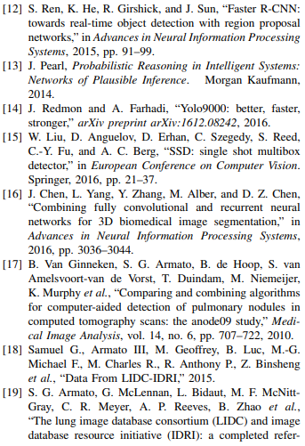
6. References

