Slide 1
Simulink – RGA Experimental Method

Slide 2
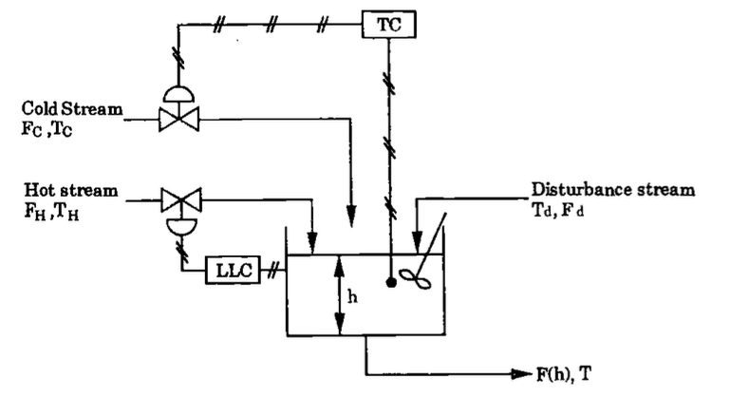
RGA Analysis for Level and Temperature Control
Objective: Experimentally calculate the Relative Gain Array (RGA) for the mixed tank level and temperature control.
Use the RGA to determine the optimal pairing.

Slide 3

Review
The parameters of the RGA are given by:
Where $Δy_{1m}=Open Loop Final Steady State Value$ and $Δy_{1}^{∗}=Closed Loop Final Steady State Value$

Slide 4
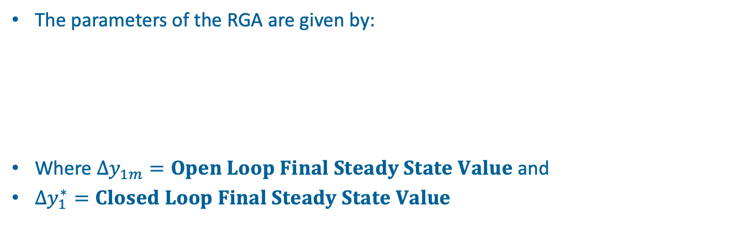
Review
The parameters of the RGA are given by:
Where $Δy_{1m}=Open Loop Final Steady State Value$ and
$Δy_{1}^{∗}=Closed Loop Final Steady State Value$

Slide 6
-
m₁
y_{d1}
+
ε₁
+
g_{c1}
g₁₁
y₁
+
Experiment 2
With Loop 2 closed
g₁₂
Δy_{1r}
g₂₁
+
y_{d2}
ε₂
+
+
y₂
g_{c2}
g₂₂
-
m₂

Slide 7
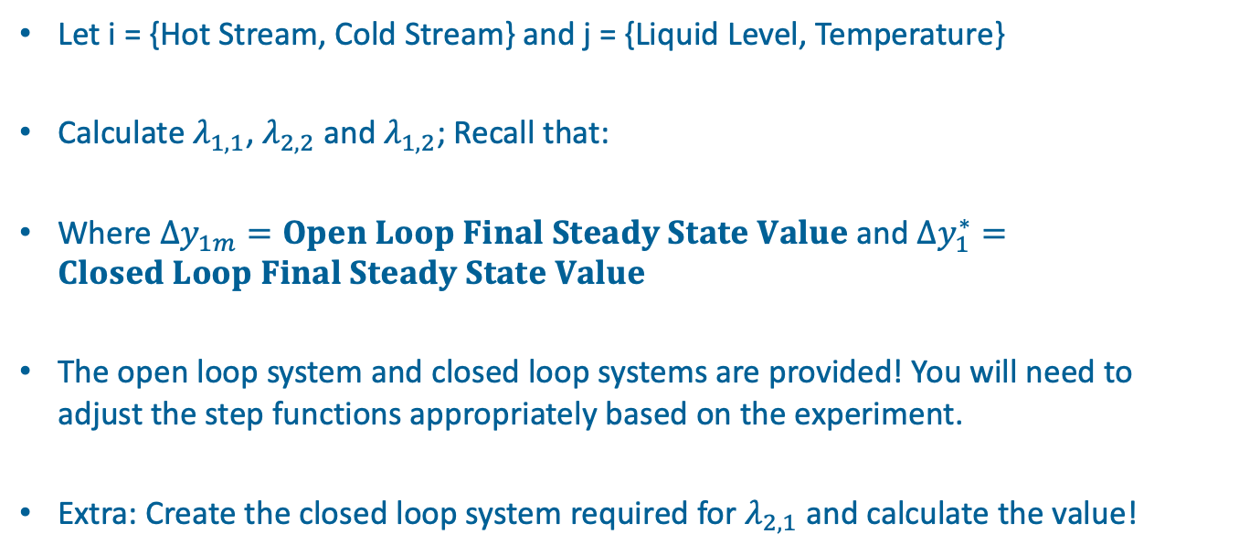
Experiment
Let i = {Hot Stream, Cold Stream} and j = {Liquid Level, Temperature}
Calculate $λ_{1,1}$, $λ_{2,2}$ and $λ_{1,2}$; Recall that:
Where $Δy_{1m}=Open Loop Final Steady State Value$ and $Δy_{1}^{∗}=Closed Loop Final Steady State Value$
The open loop system and closed loop systems are provided! You will need to adjust the step functions appropriately based on the experiment.
Extra: Create the closed loop system required for $λ_{2,1}$ and calculate the value!

Slide 8
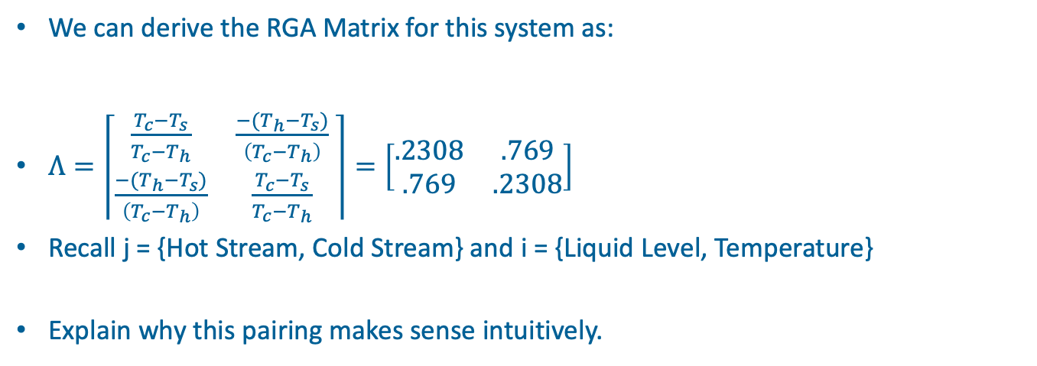
RGA Analysis
We can derive the RGA Matrix for this system as:
$Λ=\left\lceil \begin{matrix}\frac{T_{c}−T_{s}}{T_{c}−T_{h}} & \frac{−(T_{h}−T_{s})}{\left(T_{c}−T_{h}\right)} \\ \frac{−(T_{h}−T_{s})}{\left(T_{c}−T_{h}\right)} & \frac{T_{c}−T_{s}}{T_{c}−T_{h}}\end{matrix} \right\rceil =\left[\begin{matrix}.2308 & .769 \\ .769 & .2308\end{matrix}\right]$
Recall j = {Hot Stream, Cold Stream} and i = {Liquid Level, Temperature}
Explain why this pairing makes sense intuitively.
Ts = 40, Th = 90, Tc = 25

Slide 9
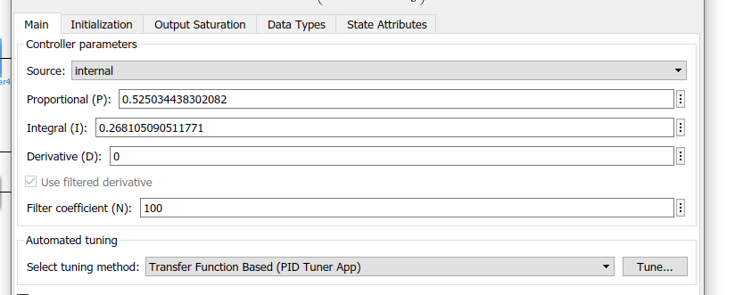
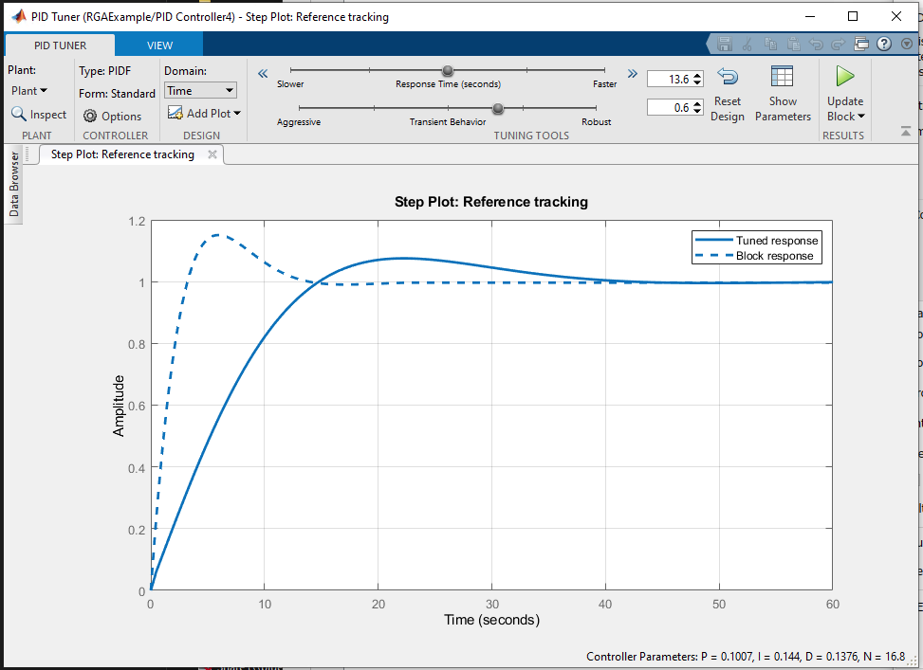
Combining Both Controllers
- Make a copy of closed-loop model 3. Add an additional PID controller to close the second uncontrolled loop.
Use the PID autotuning tool to generate a PI controller.
Generate a step response for time t = 5 for the hot or cold stream and at t = 10 for the other stream.

