Slide 1
Simulink – Simple MIMO Example

Slide 2
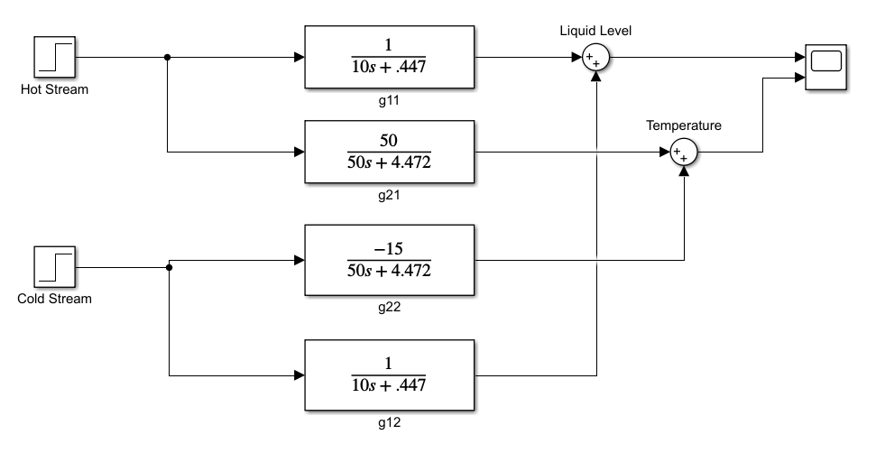
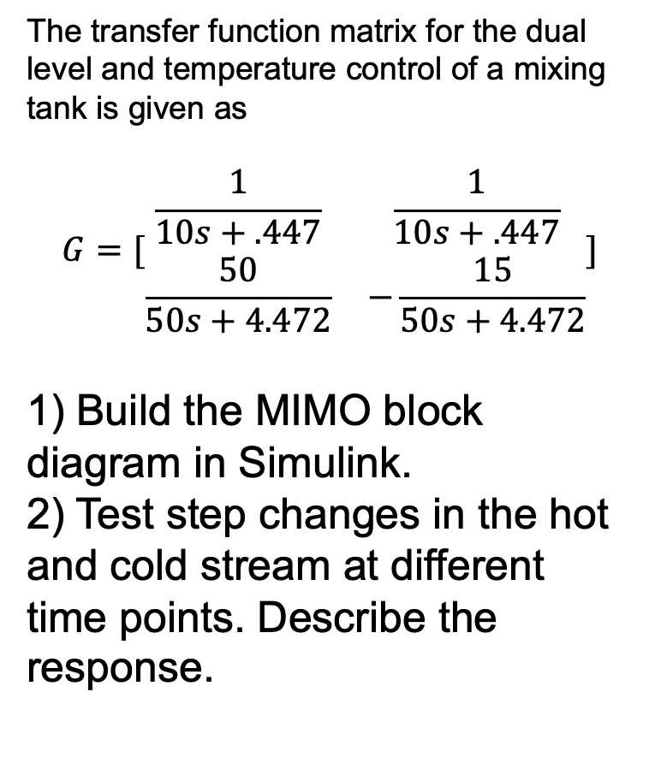
MIMO Example – Level and T Control for Mixing Tank
The transfer function matrix for the dual level and temperature control of a mixing tank is given as
$$G=[\begin{matrix}\frac{1}{10s+.447} & \frac{1}{10s+.447} \\ \frac{50}{50s+4.472} & −\frac{15}{50s+4.472}\end{matrix}]$$
1) Build the MIMO block diagram in Simulink.
2) Test step changes in the hot and cold stream at different time points. Describe the response.
Ref: Example 20.5 in the textbook for
Ac = 10, hs = 5, K = 4, Ts = 40, Th = 90, Tc = 25

Slide 3
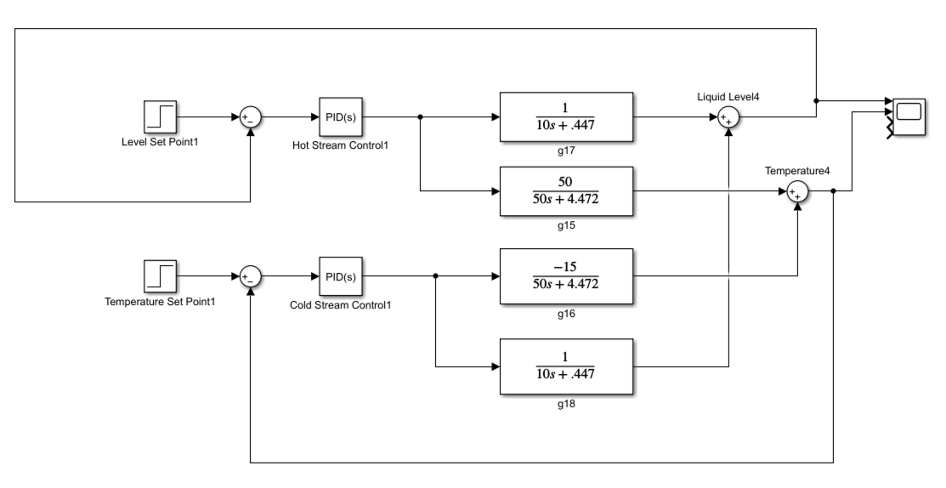
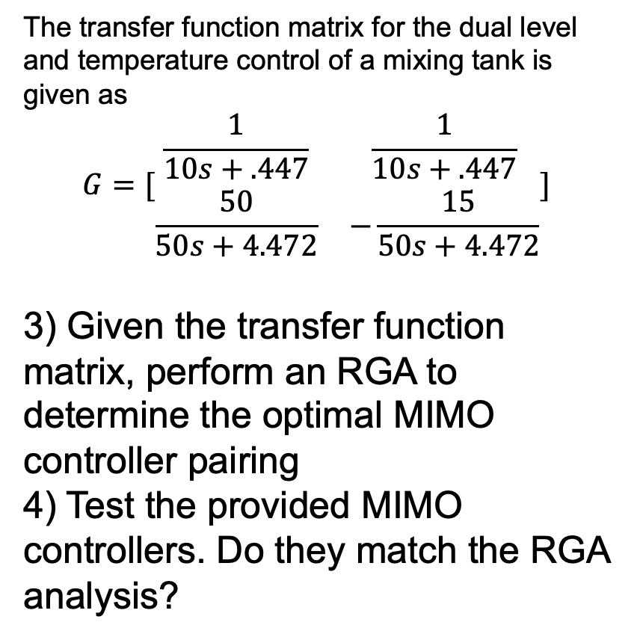
MIMO Example – Level and T Control for Mixing Tank
The transfer function matrix for the dual level and temperature control of a mixing tank is given as
$$G=[\begin{matrix}\frac{1}{10s+.447} & \frac{1}{10s+.447} \\ \frac{50}{50s+4.472} & −\frac{15}{50s+4.472}\end{matrix}]$$
3) Given the transfer function matrix, perform an RGA to determine the optimal MIMO controller pairing
4) Test the provided MIMO controllers. Do they match the RGA analysis?
Ref: Example 20.5 in the textbook for
Ac = 10, hs = 5, K = 4, Ts = 40, Th = 90, Tc = 25

