Slide 1

Exploratory Data Analysis
G2M insight for Cab Investment firm
20th August 2022

Slide 2

Agenda
Executive Summary
Problem Statement
Approach
EDA
EDA Summary
Recommendations

Slide 3
Executive Summary
Objective:
Perform market analysis and develop actionable insights for XYZ firm to make the right investment choice from Yellow Cab and Pink Cab company.
Solution:
Cab industry is service-oriented industry which is driven by customers.
There are basically some criteria to check for investing in cab industry which are discussed below:
Profit analysis: Profit analysis of a firm is the topmost criteria if we are looking to invest in a company.
Number of rides analysis: Total transactions also define profits and popularity of the company.
Customer analysis: As this industry is customer service driven, we need to focus on customers preferences towards the companies.
Geographic location analysis: Geographic location plays an important role for the development of any industry.
Holiday Analysis: Customer preferences and profit earned during holidays are compared.

Slide 4
Problem Statement & Approach
Problem Statement:
Perform market analysis and develop actionable insights for XYZ firm to make the right investment choice from Yellow Cab and Pink Cab company.
Approach:
The solution approach is divided into several steps mentioned below:
Data gathering and cleaning
Explanatory Data Analysis(EDA)
Data Visualization
Recommended Solutions

Slide 5
DATA EXPLORATION
Data exploration is the foremost step towards analysis. Below are the list of datasets which are analyzed:
Cab_Data.csv – this file includes details of transaction for 2 cab companies
Customer_ID.csv – this is a mapping table that contains a unique identifier which links the customer’s demographic details
Transaction_ID.csv – this is a mapping table that contains transaction to customer mapping and payment mode
City.csv – this file contains list of US cities, their population and number of cab users
US_Holiday_Dates.csv – This file contains list of US holidays and respective Dates between 2004 to 2020.
Assumptions:
‘City’ files contains ‘Users’ feature which is assumed to be the total number of Cab users in respective cities.
Profit is calculated based on Price_charged and Cost_of_Trip features from ‘Cab_Data’ File.
All visuals are represented in the color respective of name of company. Ex. Yellow cab is represented as Yellow color and so.

Slide 6
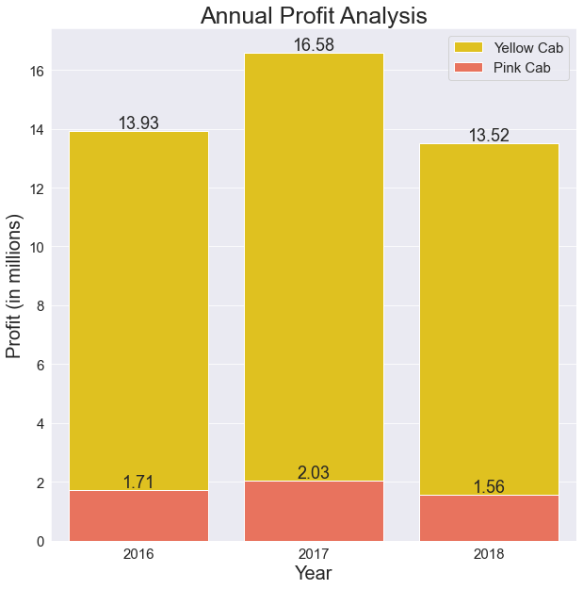
Profit Analysis It is performed based on below criteria: -- Annual Profit -- Profit per Kilometers of rides -- Profit per ride -- Quarterly Profit Yellow Cab wins the battle for the profit analysis.

Slide 7
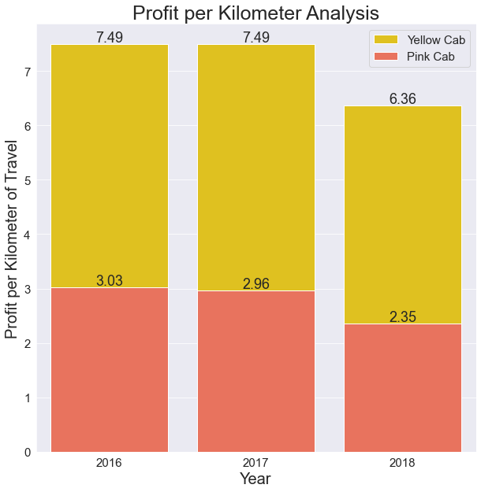
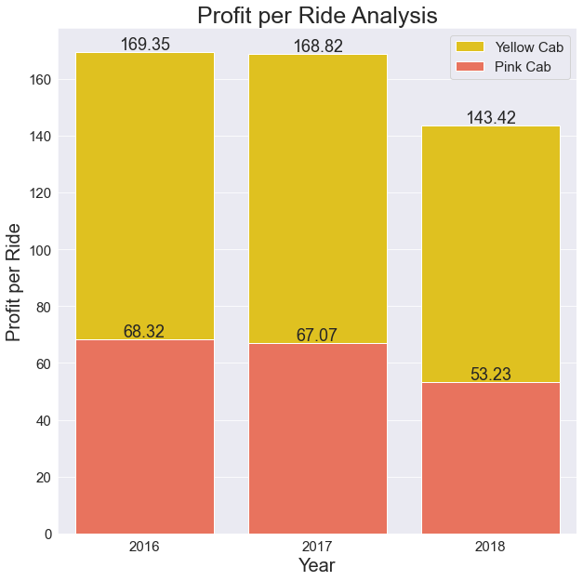
Profit Analysis

Slide 8
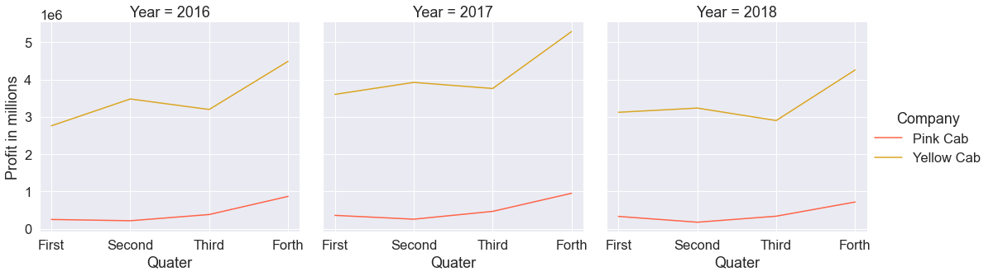
Profit Analysis
Quarterly profit analysis is most important factor to analyze growth of the company in a year. Here, Yellow cab is gaining more profit each year with same pattern of growth.

Slide 9
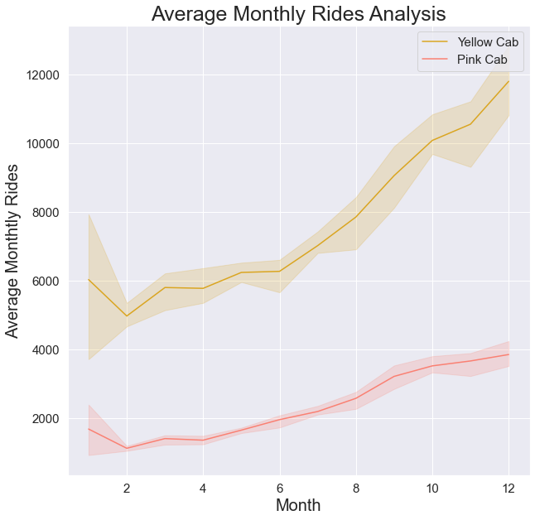
Number of Rides Analysis Rides analysis is performed considering following criteria: -- Average monthly rides analysis -- Average Daily rides analysis Yellow Cab is having nearly three times more rides as compared to Pink cab which shows its popularity.

Slide 10
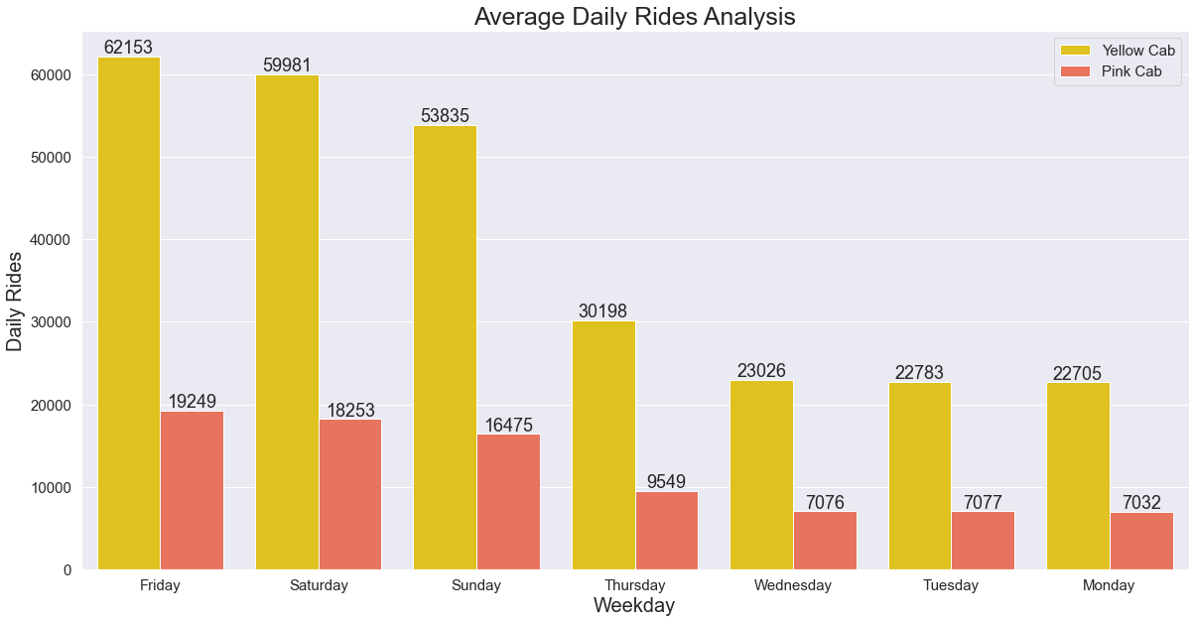
Number of Rides Analysis

Slide 11
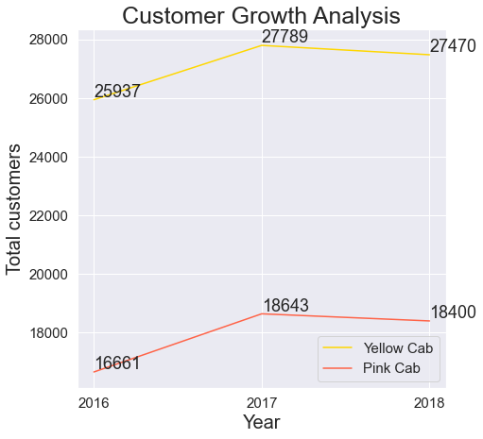
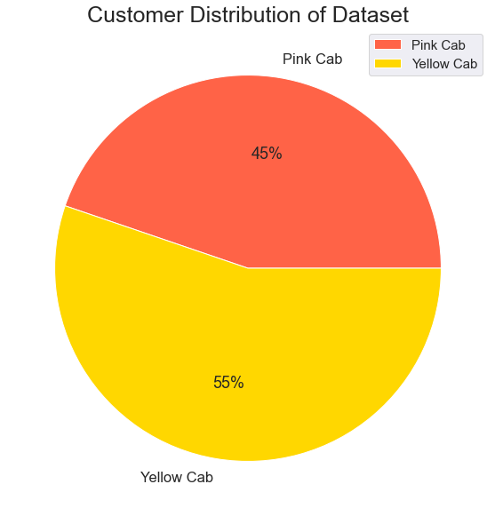
Customer Analysis
Customer analysis is done based on below:
Customer distribution between two companies
Customer Growth Analysis
Yellow cab has 10% more customer base.

Slide 12
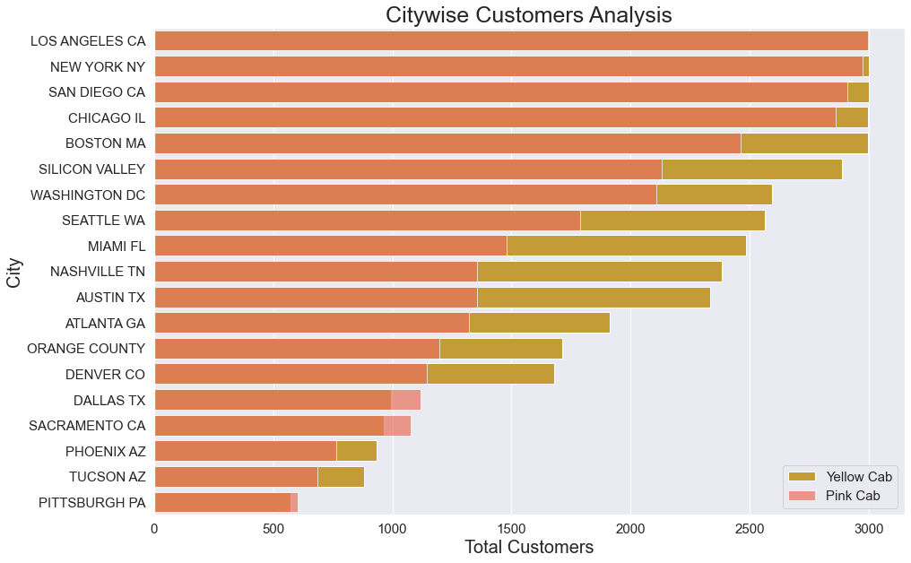
Customer Analysis
Out of 19 cities, yellow cab is popular among the 15 cities when we calculate the total customer reach city wise.

Slide 13
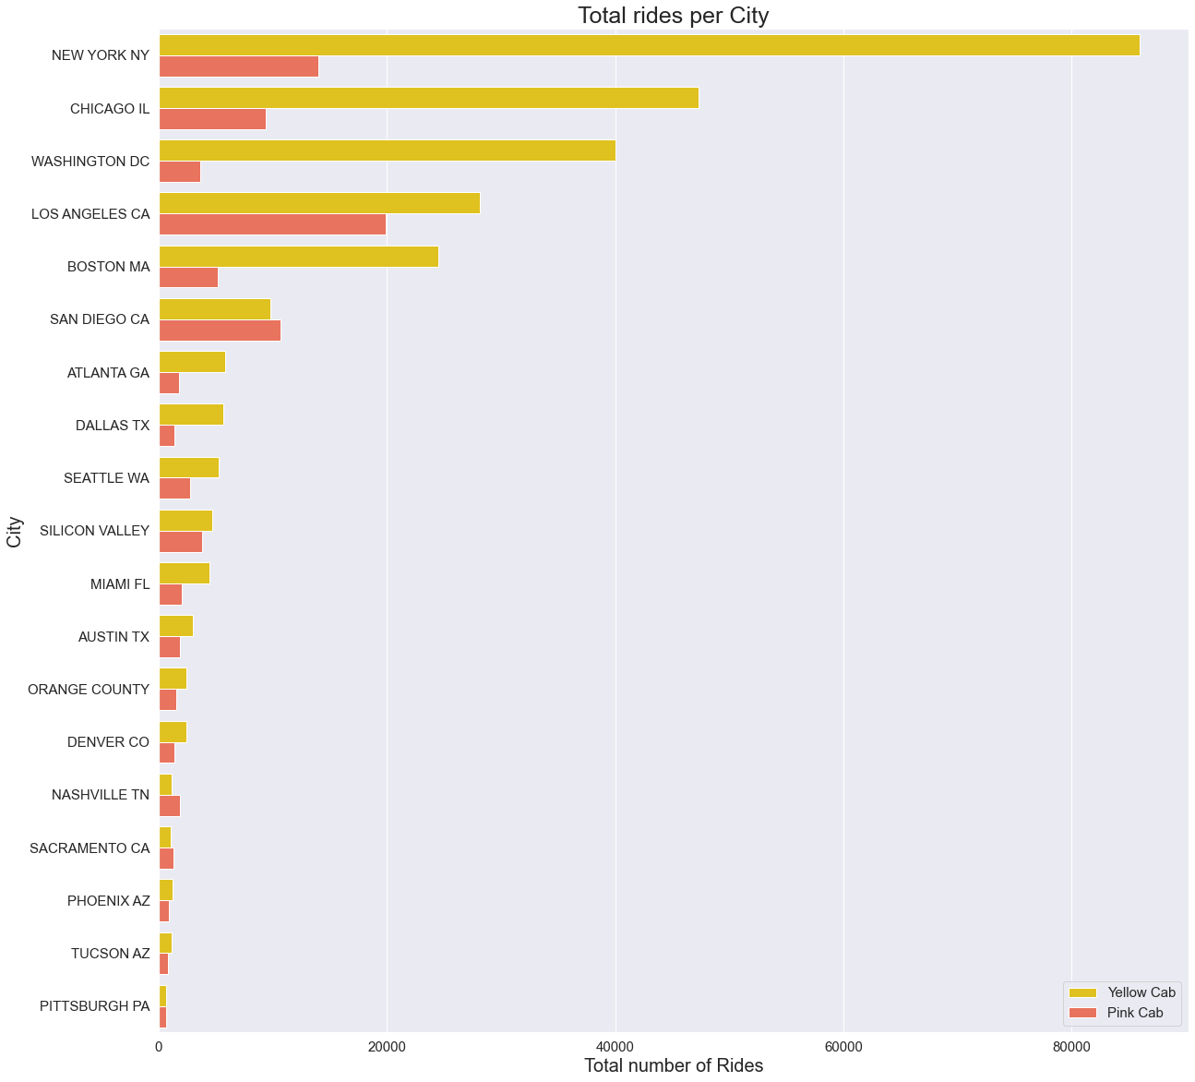
Geographic location Analysis Out of 19 cities, yellow cab is performing well in 15 cities by catching more number of rides.

Slide 14
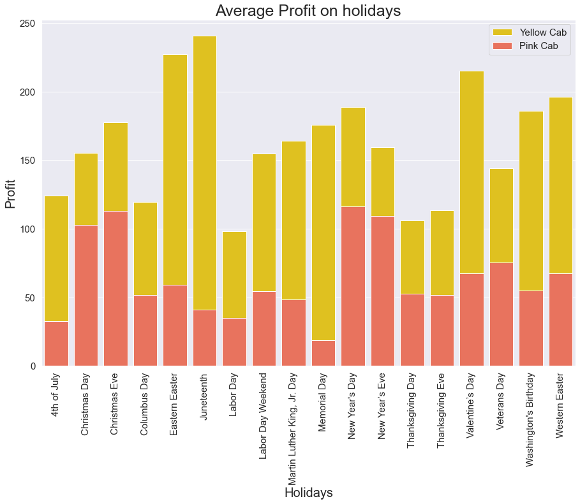
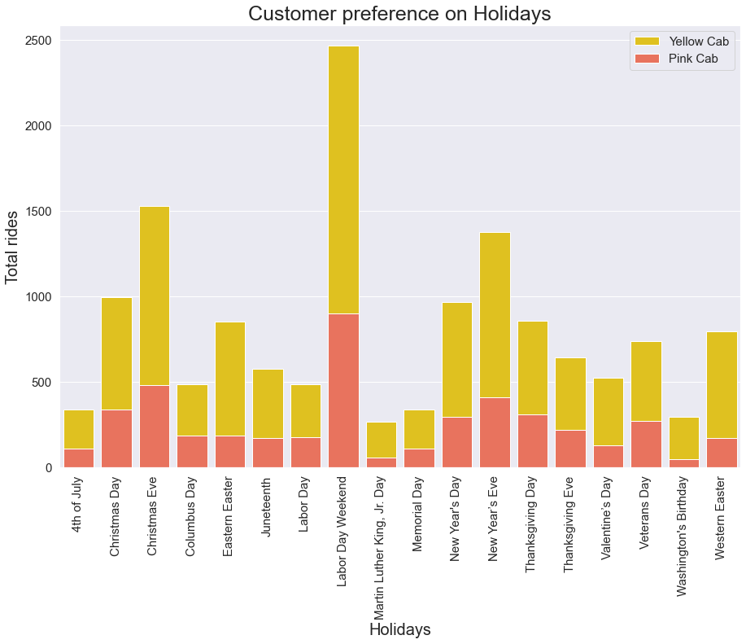
Holiday Analysis
In terms of profit and rides on holidays, we can see that yellow cab is popular choice for rides so that profit earned is also higher.

Slide 15
EDA Summary
We have discussed total 5 criteria for analysis as mentioned. Moreover, the summary of the EDA approach and its key insights are discussed below:
1. Profit Analysis: In this analysis, we compared annual profit, quarterly profit, per Kilometer profit, per ride profit and result states that Yellow Cab is doing great with 8 times more profit than Pink cab.
2. Number of rides Analysis: In this analysis, we compared average monthly rides, average daily rides which shows that Yellow Cab is popular more.
3. Customer Analysis: In this analysis, we compared customer reach and percentage of reach of total cab users and result states that Yellow Cab has more customers than Pink cab.
4. Geographic Location Analysis: In this analysis, we compared citywide total rides and customer reach. The outcome is that Yellow Cab is doing great with 16 cities out of 19.
5. Holiday Analysis: In this analysis, we compared profit and rides on holidays for both the companies which comes to a decision that Yellow Cab is more popular than Pink cab on holidays as well.
As per EDA, rightful and profitable investment choice is “Yellow Cab”.

Slide 16
Thank You !!!

