Slide 1


Professor: Andreas Gausrab
Date: 13th August 2023
Alberta a place to stay: ETL Process
During this presentation, we will explain the steps we took to convert and import data from multiple sources while maintaining a high level of quality.
Algonquin College
Course Number: CST_0022_10
Database Systems Admin and Mgmt

Slide 2

Meet Our Team
Dhruv Gadhiya - 041089597
Het Patel - 041089597
Vidhi Tripathi -041057189
Saiyam Shah - 041080364

Slide 3
What is ETL?
1
2
3
Extract
Transform
Load
A variety of sources were used to gather data, including web-based, CSV files, and SQL databases.
A number of transformations were performed on the extracted data, including cleaning, filtering, and aggregating.
Finally, the altered data is put into one or more designated databases or data repositories.

Slide 4
Tools & Techniques
Python
SQL Server Management Studio
Identify dimensions, conduct statistical analyses, and determine data types within the Excel spreadsheet using data exploration. Scripting is also used to extract standardized data from the initial source.
Data loading into the database is simplified with SQL Server Management Studio.

Slide 5
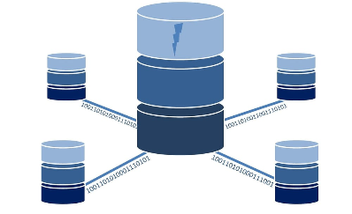
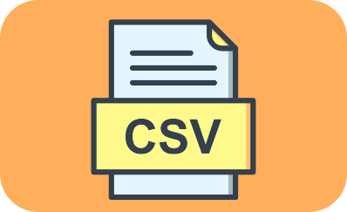

Data Sources
Open Database of Address
CSV Files
SQL Databases
CSV files were used to process structured data.
Different SQL databases were used to extract data.
An open database of addresses (ODA), provided by Statistics Canada under the Open Government License-Canada, is a collection of open address point data.

Slide 6
Understanding the Data
The data is sourced from Statistics Canada's Open Database of Address (ODA) under the Open Government License-Canada.
The ODA contains approximately 10 million records, gathered from open government portals of municipal, regional, and provincial sources.
The ODA was created by harmonizing datasets from various open data portals, aiming for uniformity due to the lack of a standardization system in the original sources.
Key variables in the ODA include Source Index, ODA Index, Group Index, Civic Number, Street type, Street direction, Unit, Full Address, Postal Code, City, Processed City, Standardized street name, type, and direction, Census subdivision name, and unique identifiers for provinces/territories.
The focus is on Alberta, with a dataset having 1777428 rows and 22 columns.
Data types in the dataset are mainly objects, with some columns (latitude, longitude, postal code) as floats, and others (group_id, csdname, pruid) as integers.
The primary objective is to find the street ID while using a normalized column for the city name.

Slide 7
Data Transformations
1
Cleaning
We removed duplicates, corrected errors.
2
Filtering
We filtered out irrelevant data using various criteria.
3
Aggregation
We summarized and combined data to gain insights.

Slide 8
Data Loading
Target Database Type:
Sql Server Management Studio
Load Speed:
1,000 records per second
Time Taken to convert into normalize form:
28 Hours

Slide 9
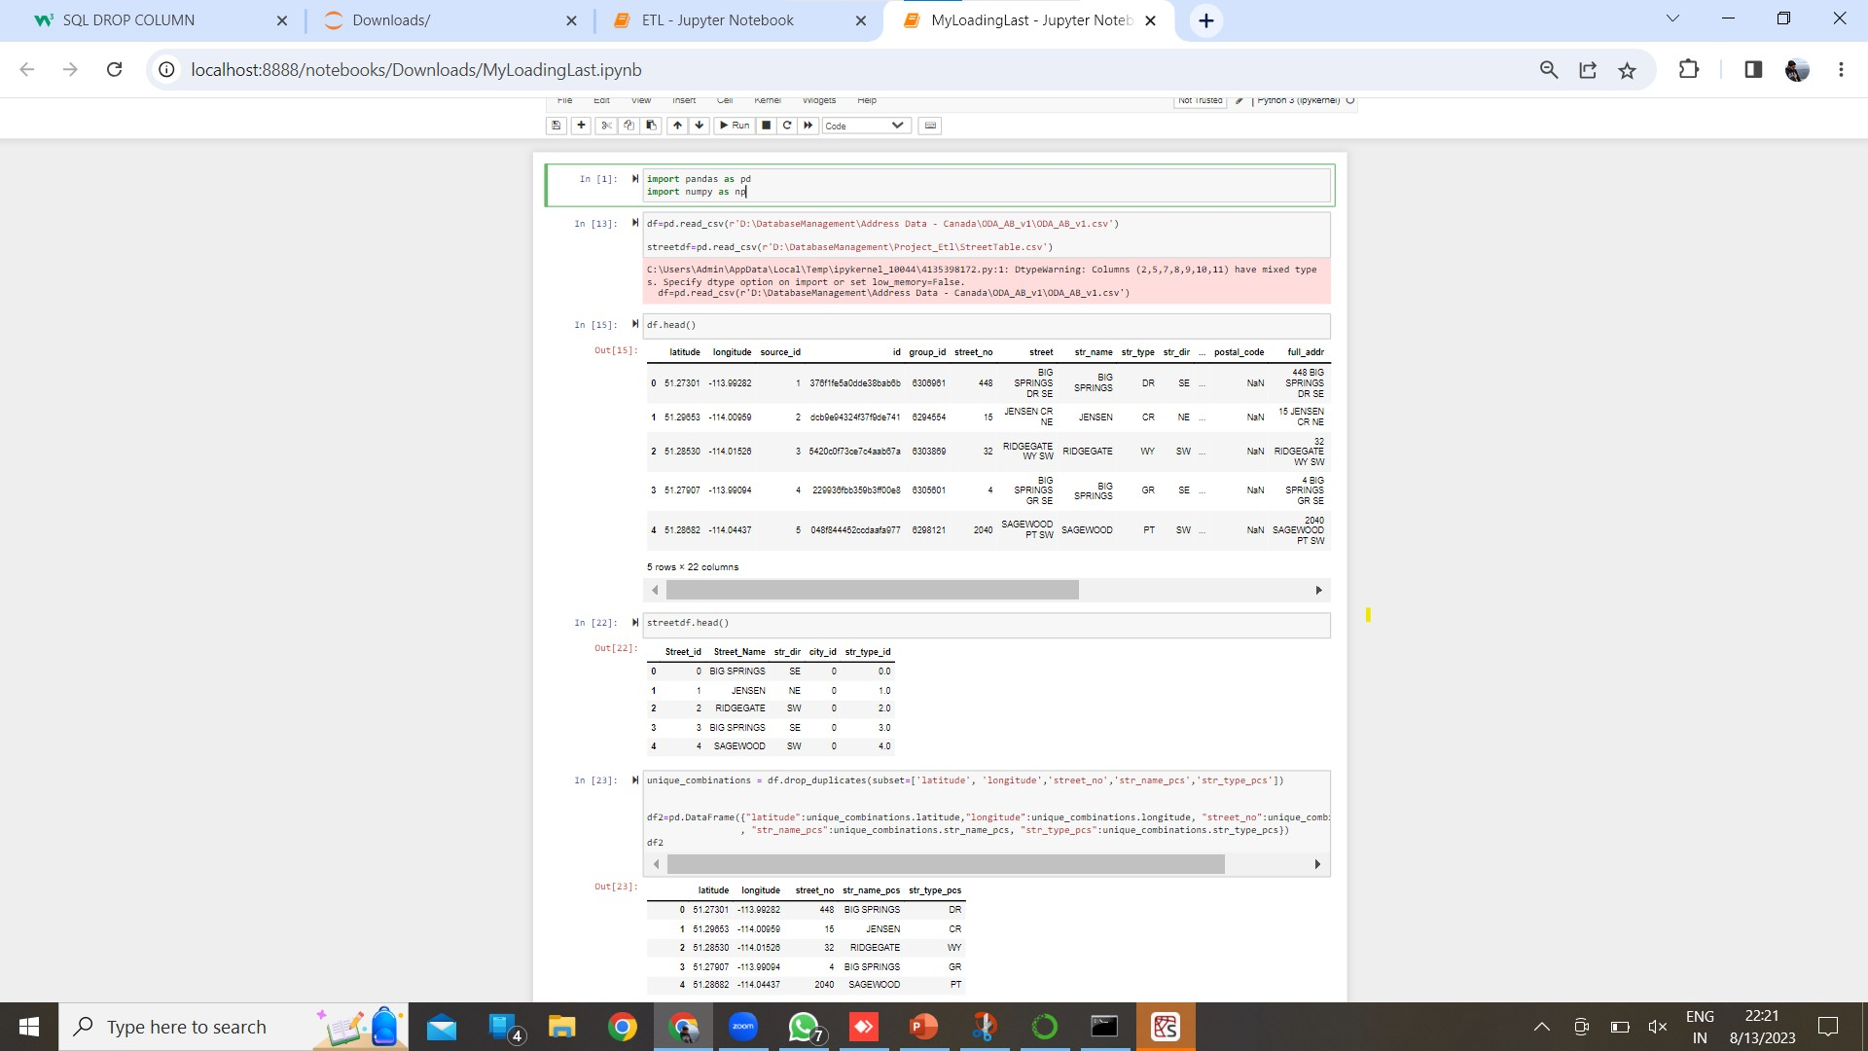
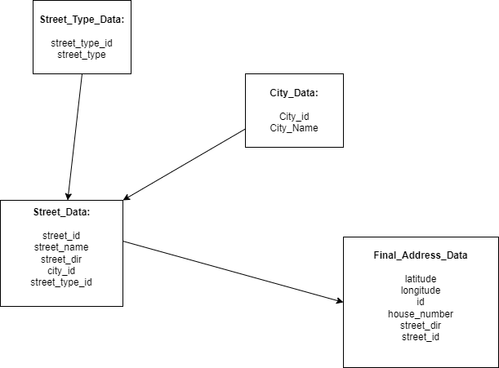
Data Script

Slide 10
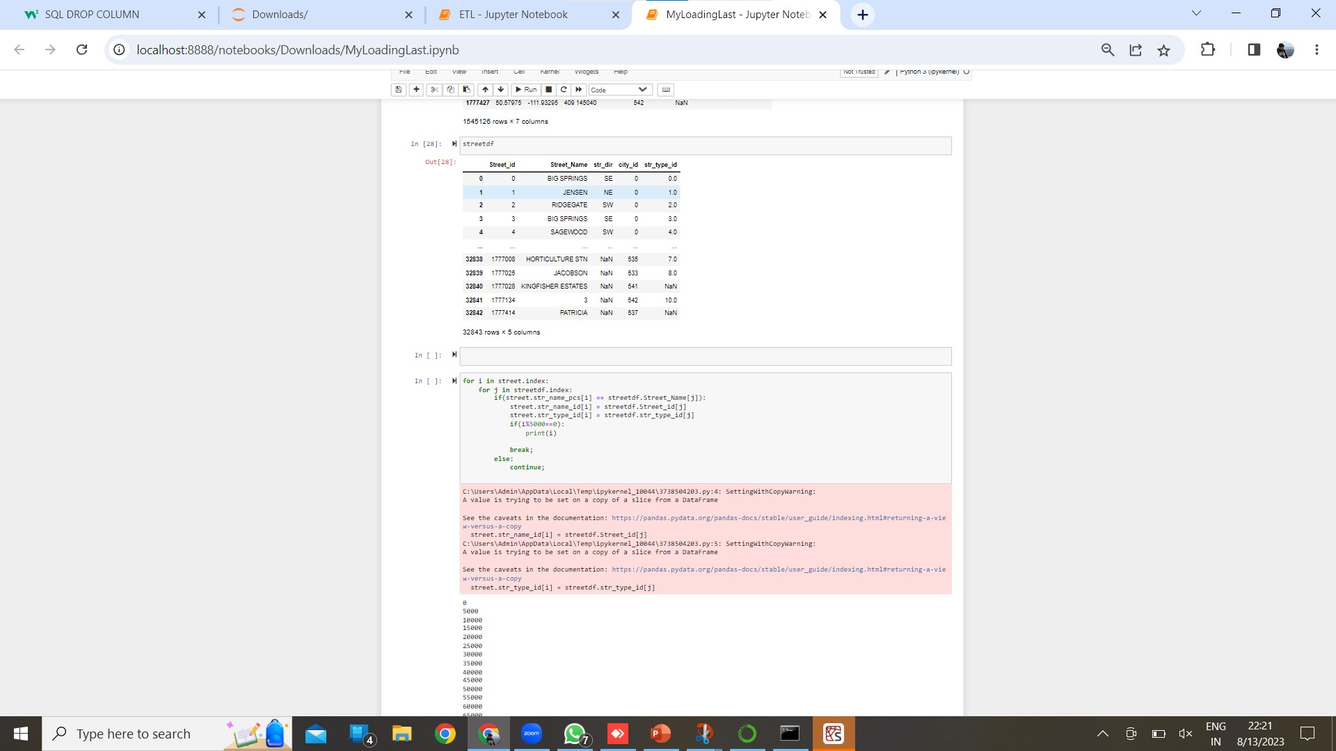
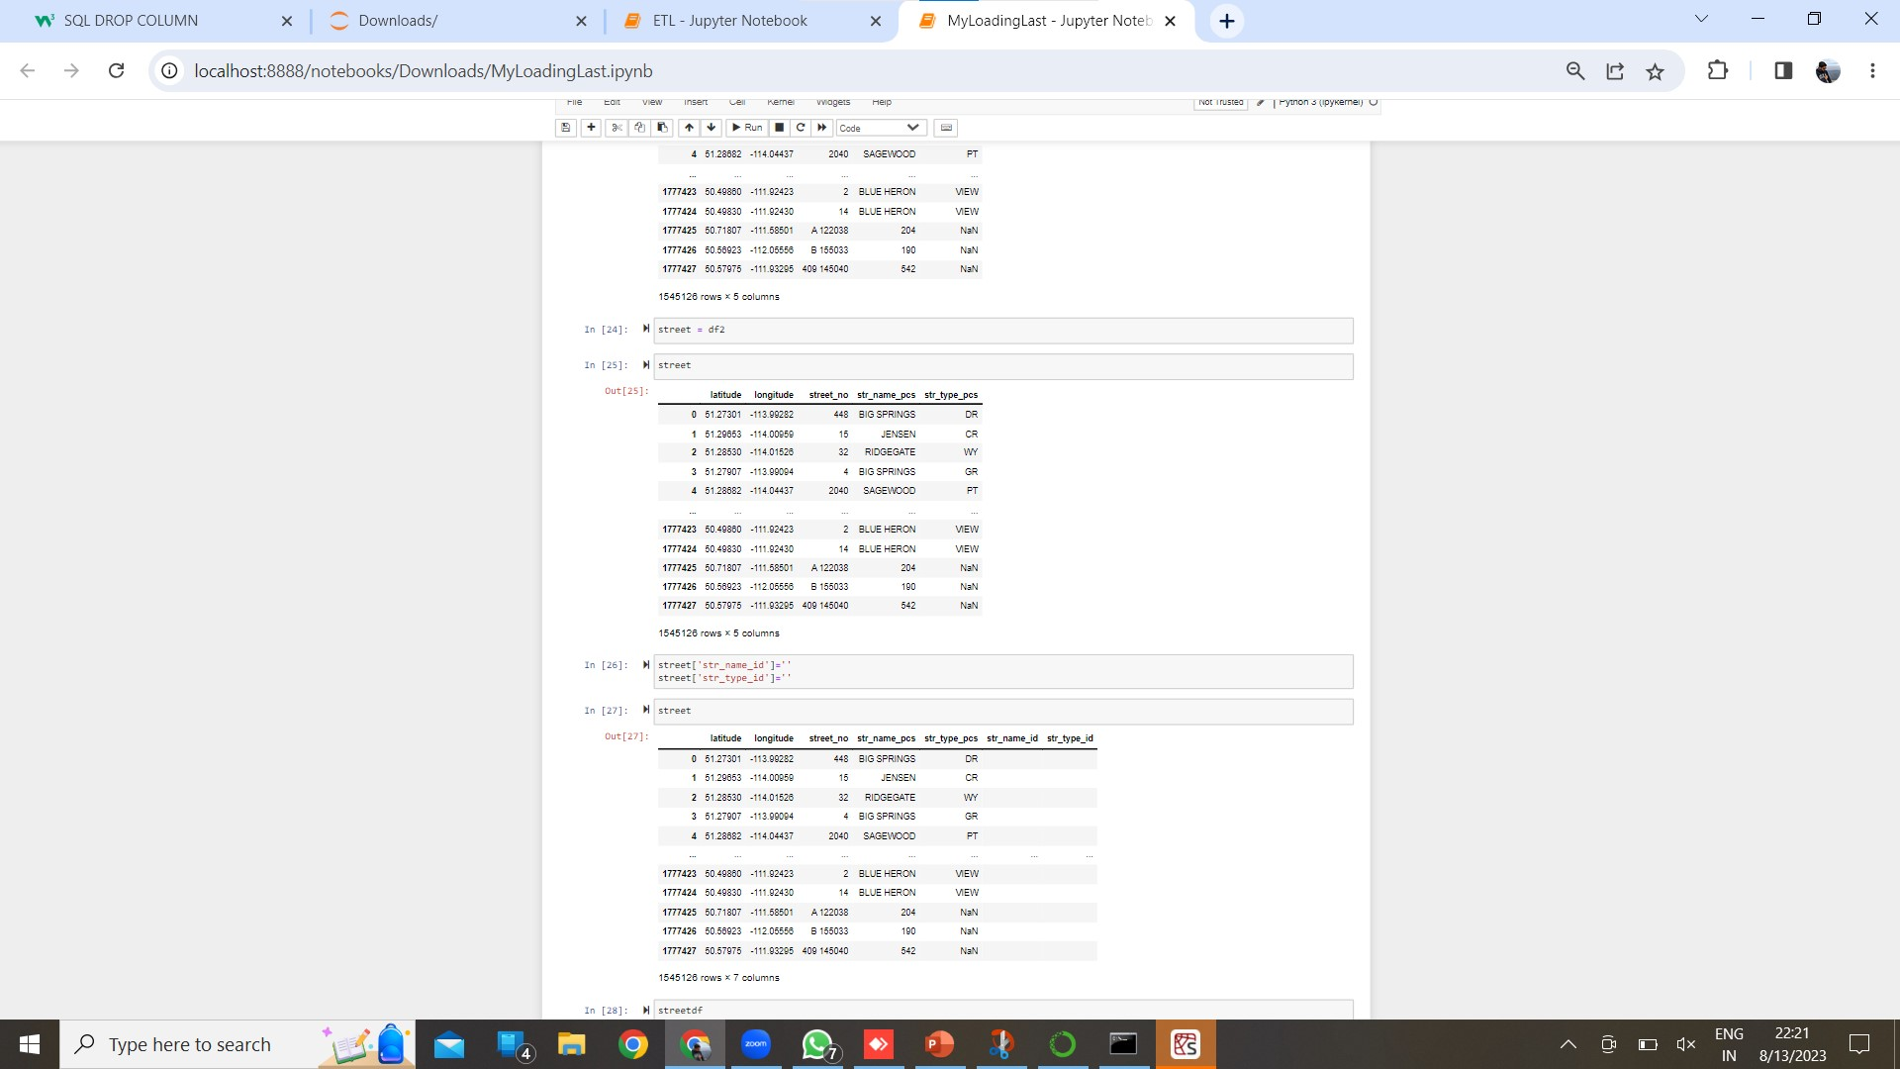
Data Script

Slide 11
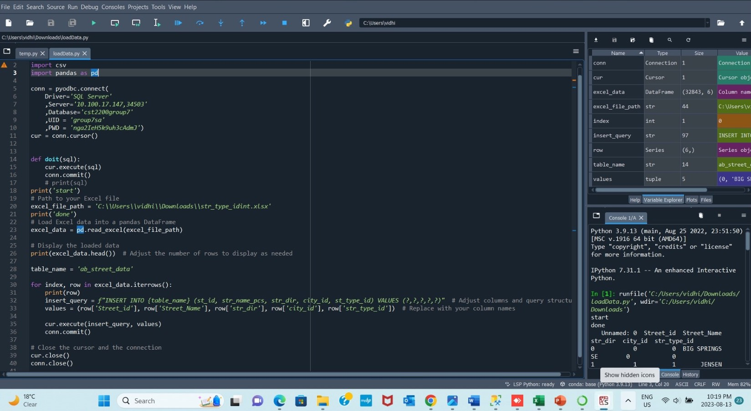
Data Loading Script

Slide 12
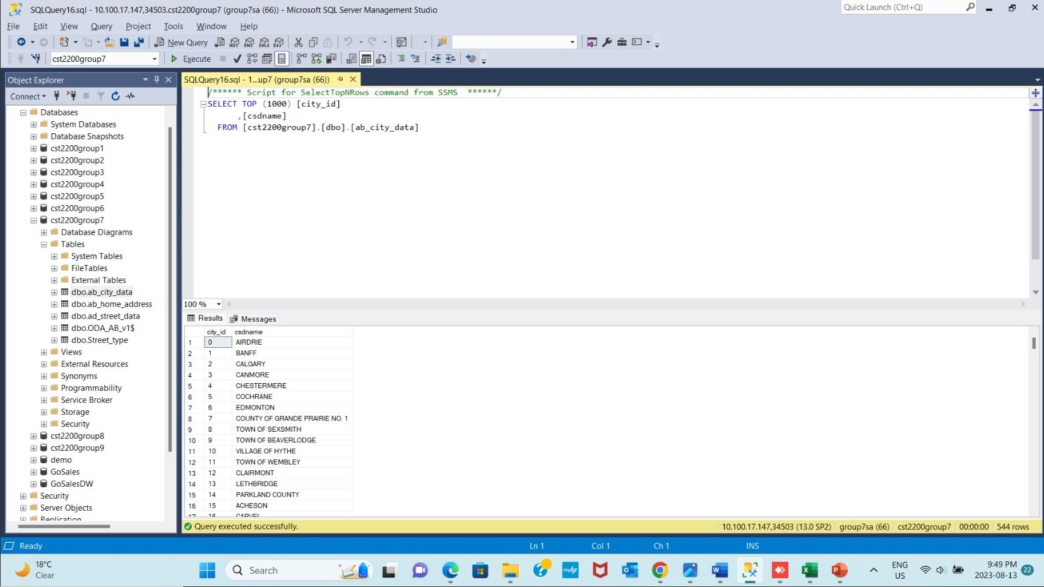
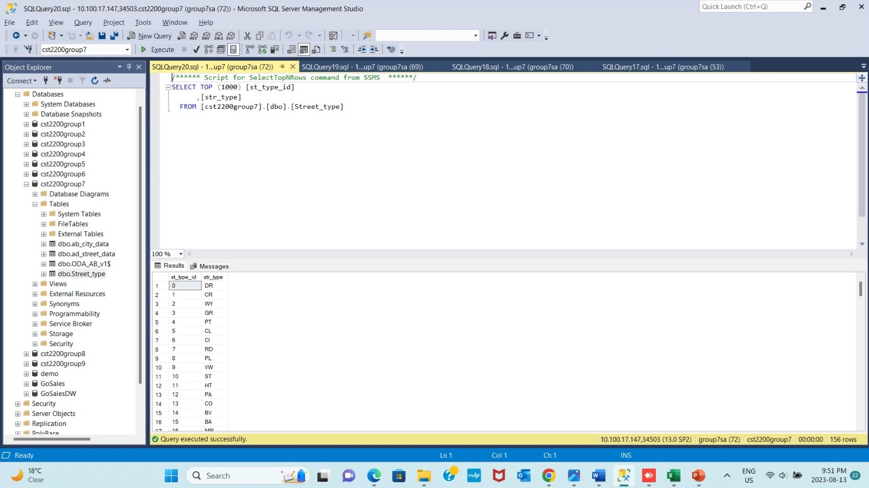
Final Output

Slide 13
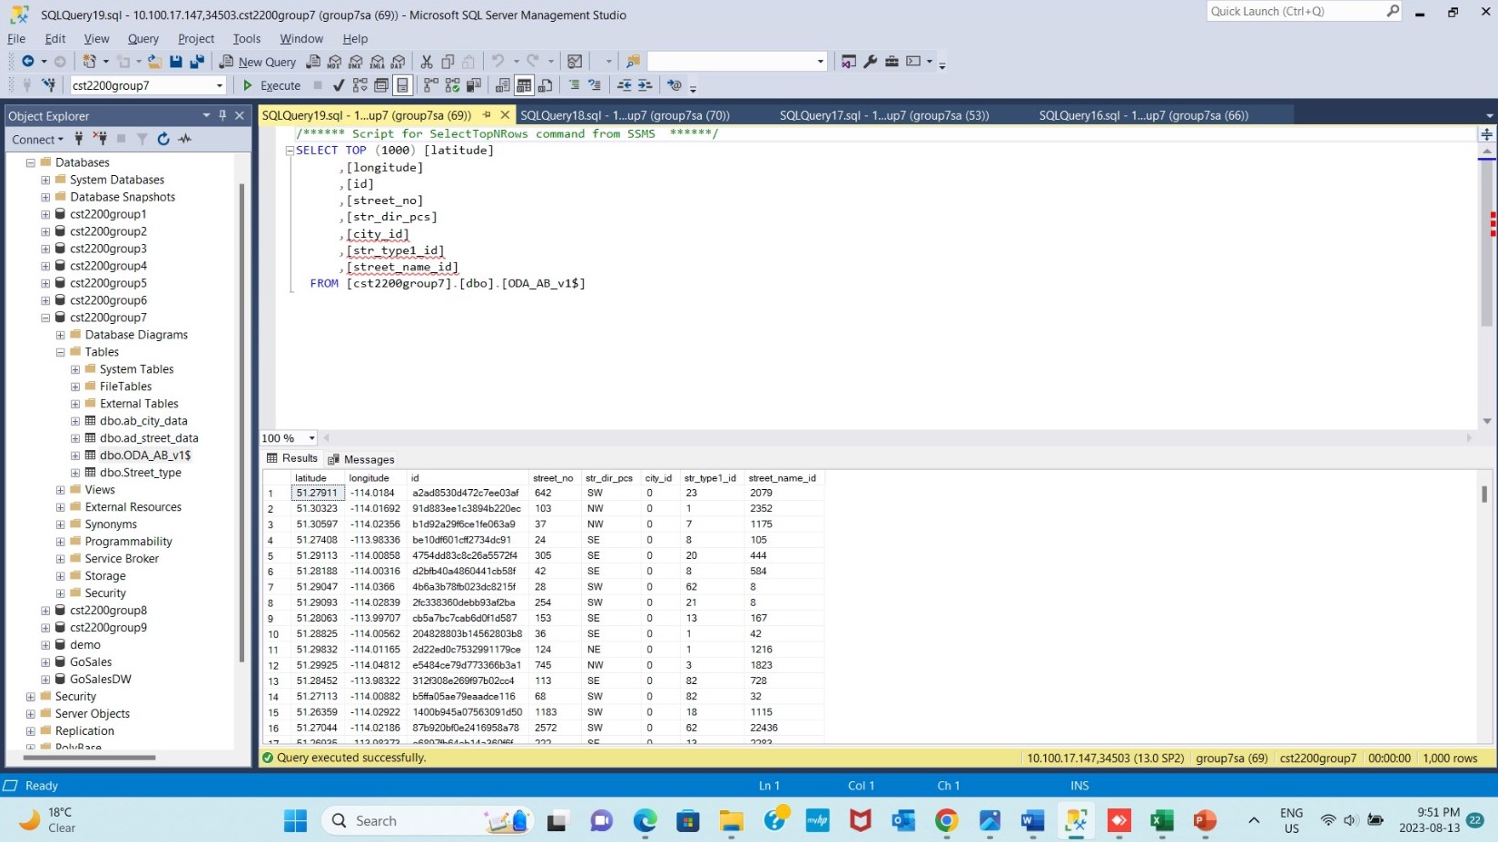
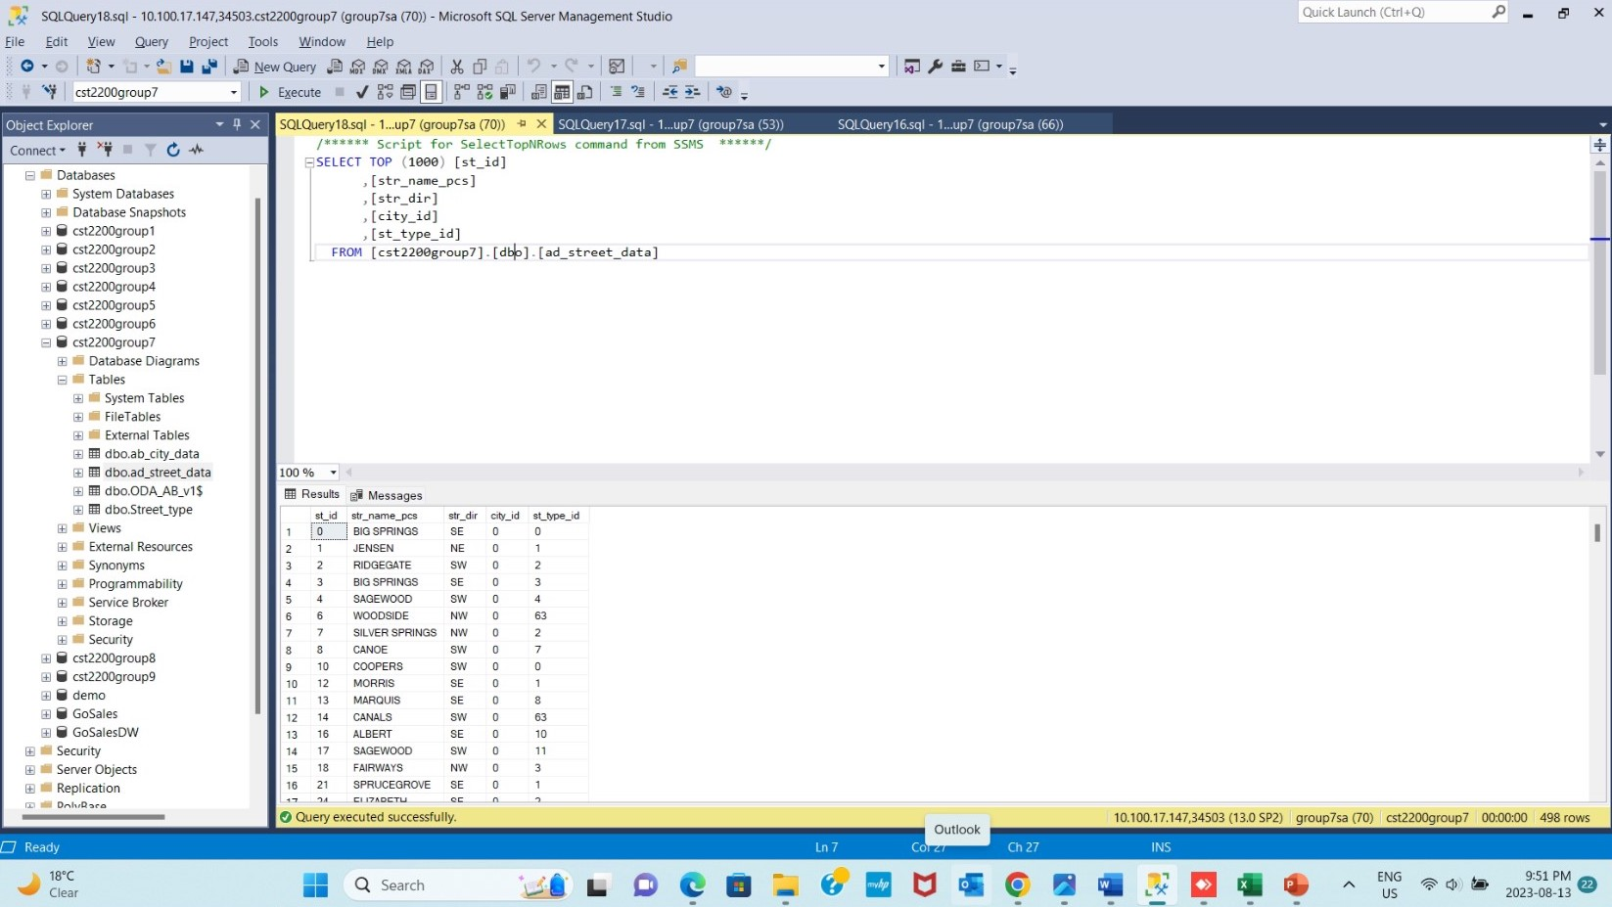
Final Output

Slide 14

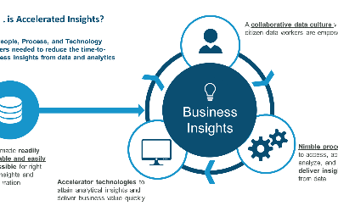

What we learned?
Lesson 1
Lesson 2
Lesson 3
Consistent data cleaning techniques are the foundation of an effective ETL process.
Data transformations can reveal insights and deliver business value.
Time Management for loading the data efficiently.

Slide 15
Conclusion
Success!
Benefits
Recommendations
Our ETL process achieved high data accuracy and consistency.
Improved decision making
Use industry-standard ETL tools
Faster reporting
Data insights
Implement automated testing
Invest in data profiling and data quality management

Slide 16
Thank You!

