Slide 1
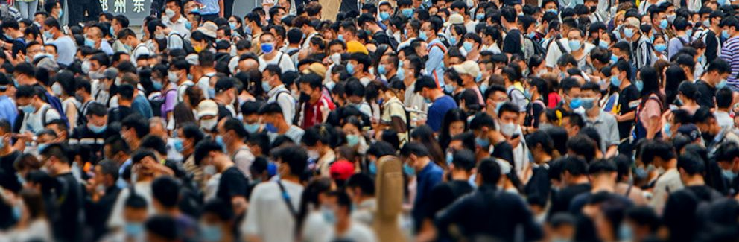
Growth of world population and prediction
Team 3
Dhruv Gadhiya (041094397)
Antriksha Goswami (041085017)
Gabriel Ntoweng (041099292)
Jay Patel (041085500)

Slide 2
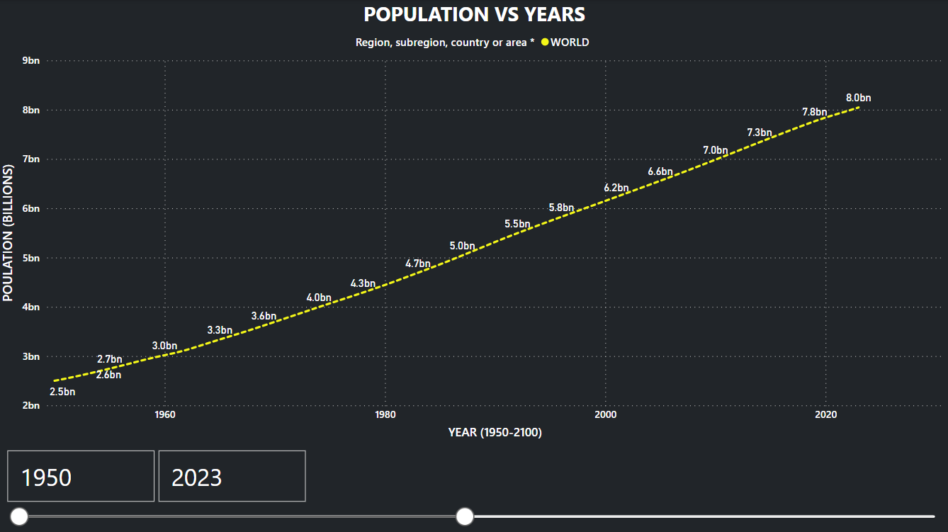
World Population so far...
In 1820 there were about 1 billion humans living on earth. In 2016 there were 7.33 billion. Today we are close to 8 billion. ​ ​ According to recent estimates, today's population is about to 6.5% of the total number of people ever born.​ ​​

Slide 3
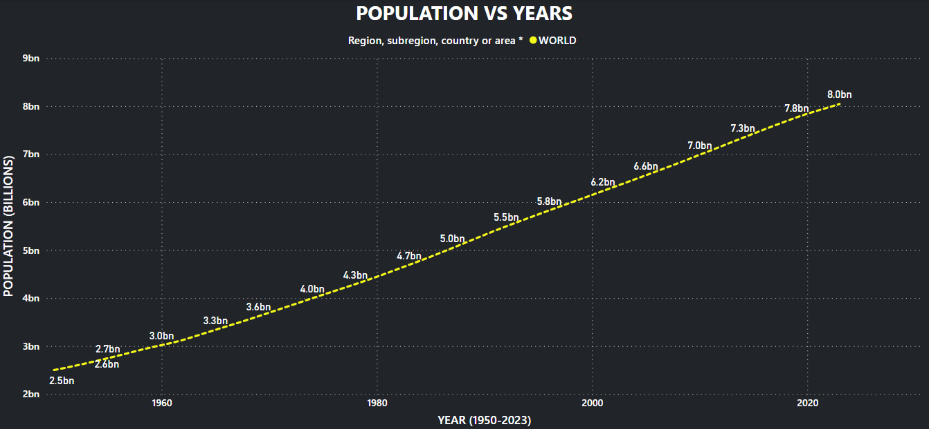
Population From 1950 to 2023

Slide 4


Why Population Is Continuously Increasing ?
Advancement in Medical :
Medical advancements have played an important role in population growth by improving health outcomes, reducing mortality rates, increasing life expectancy, and improving reproductive health outcomes.
​Literacy Rate:
Literacy can play an important role in population growth by increasing awareness of family planning, improving health outcomes, and contributing to economic development.

Slide 5
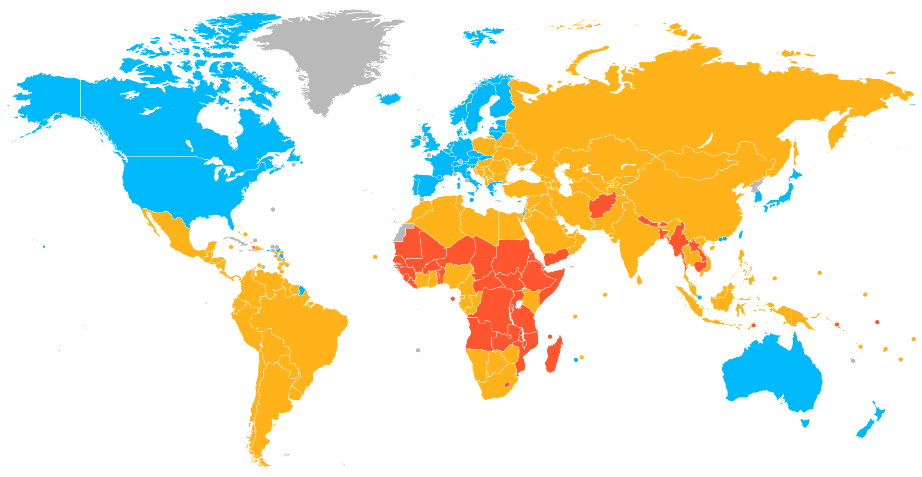
What You Think ?
Development Of The Country Plays An Important Role In Population Growth Rate Of That Individual Country ?

Slide 6
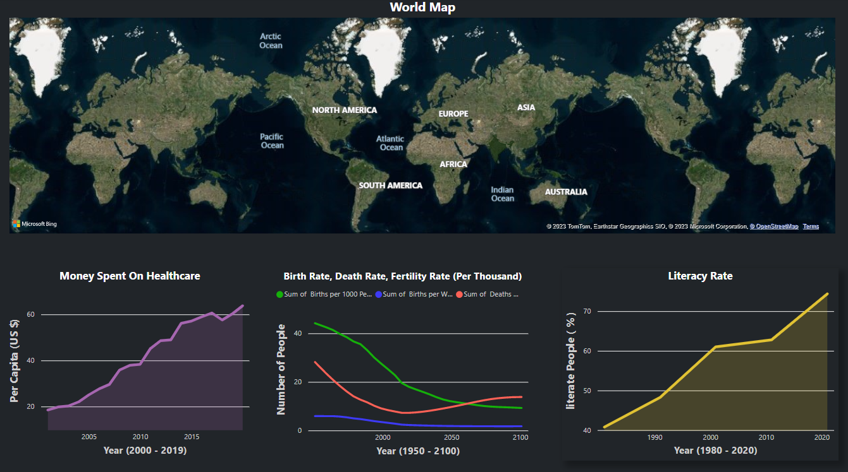
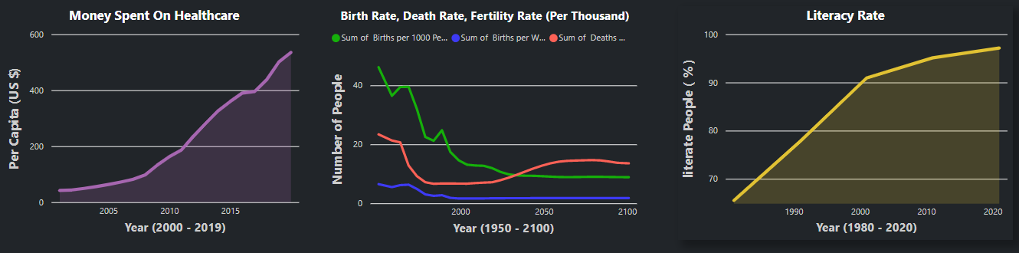
2 Most Populated
Countries
Example of India
1980:
Fertility Rate : 5
Literacy Rate : 41%
2000:
Fertility Rate : 3
Literacy Rate : 61%
I
N
D
I
A
Example of China
1980:
Fertility Rate : 3
Literacy Rate : 65%
2000:
Fertility Rate : 1.5
Literacy Rate : 91%
C
H
I
N
A

Slide 7

Sex Ratio
Sex ratio is defined as the number of males per 100 females.​

Slide 8
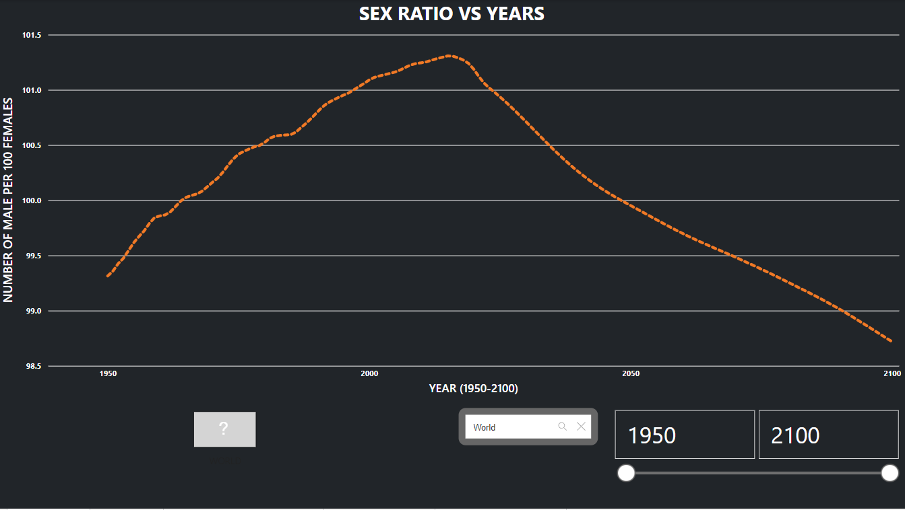
How Sex Ratio Fluctuated over the time period​ Sex ratio is a demographic measure that refers to the ratio of males to females in each population.​ The data depicted in the graph indicates that Sex Ratio had a fluctuation from 1950 to 2000.​ From 2000 to around 2025 Sex Ratio is highest of all time ​ It is projected that till 2100 it will gradually decrease.​

Slide 9

Births and Deaths

Slide 10
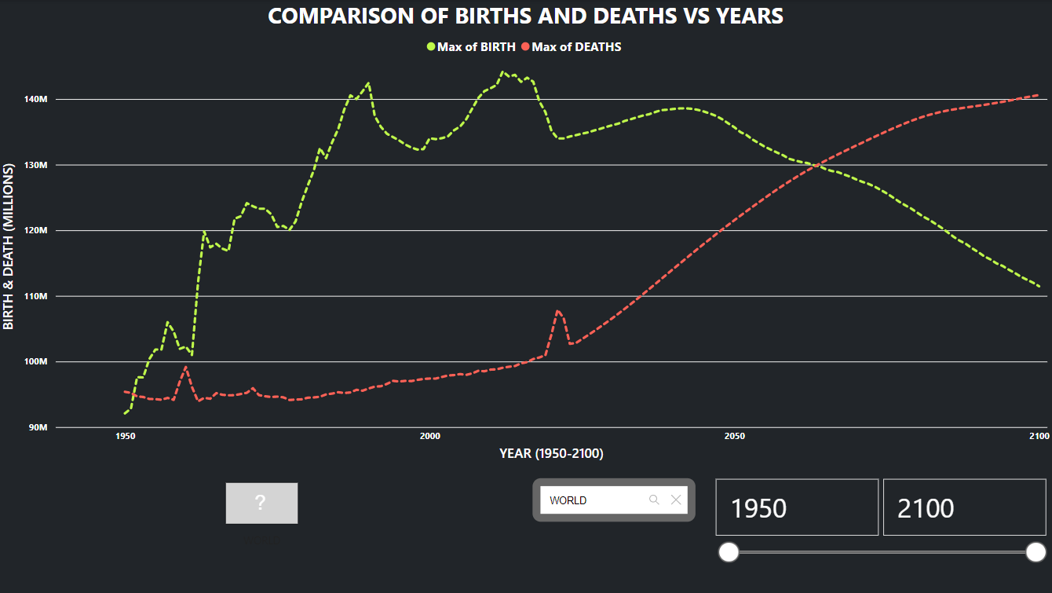
Comparison of Births and Deaths (1950-2100)​
Birth and deaths are two important factors that are directly related to population growth. ​
As depicted in the graph from 1950 births continued to increase with many ups and down until the present likewise, deaths were also gradually rising for the same period. ​
It was predicted that around 2070 the deaths and births will have the same ratio. ​
After that deaths will be higher than births.​

Slide 11
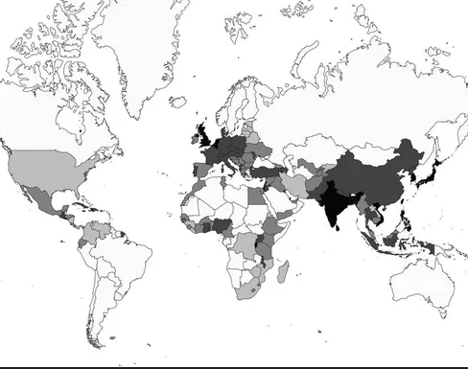
Density ​
Density refers to The Number of People Per Unit Area​

Slide 12
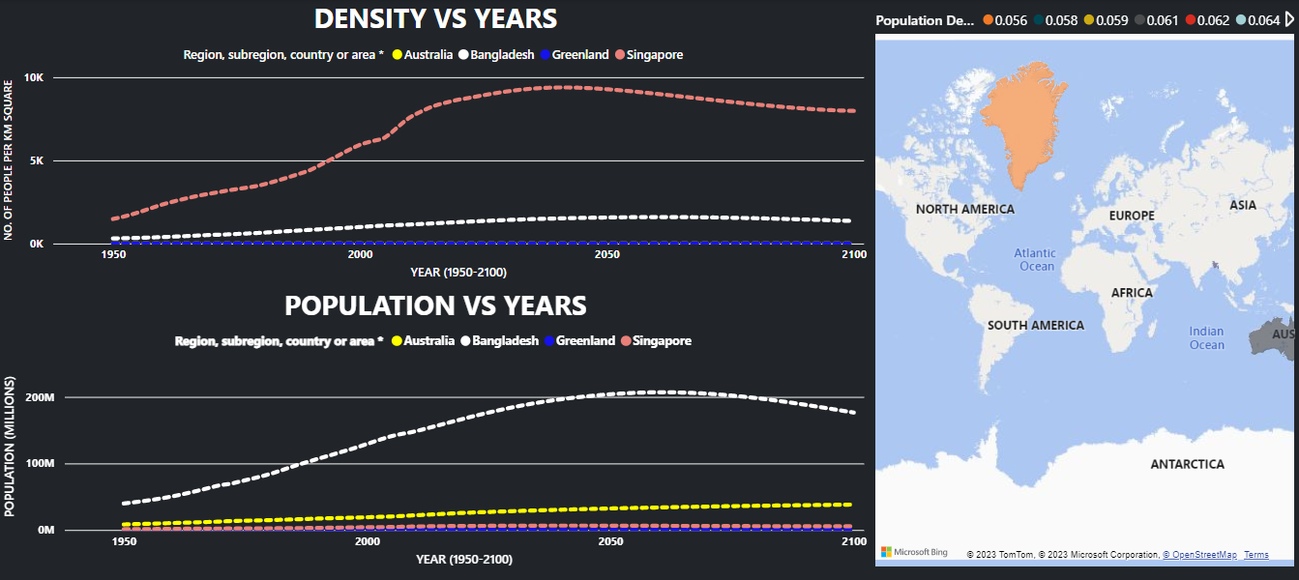
Density comparison of two most dense and least dense country​: The given graph illustrates the top 2 country which are most dense vs least dense country between 1950 to present and give projection till 2100 also shows the population among these countries​ Singapore has the highest density compared to the other 3 countries, but Bangladesh has the highest population amongst these given countries.​ ​

Slide 13



Which Parameters Help To Predict The Population ?
Fertility Rate: Average number of live births per woman during her reproductive years .
Life Expectancy: Average number of years that a person is expected to live.
Migration Rate: Number of people moving into or out of a specific geographic area ​

Slide 14
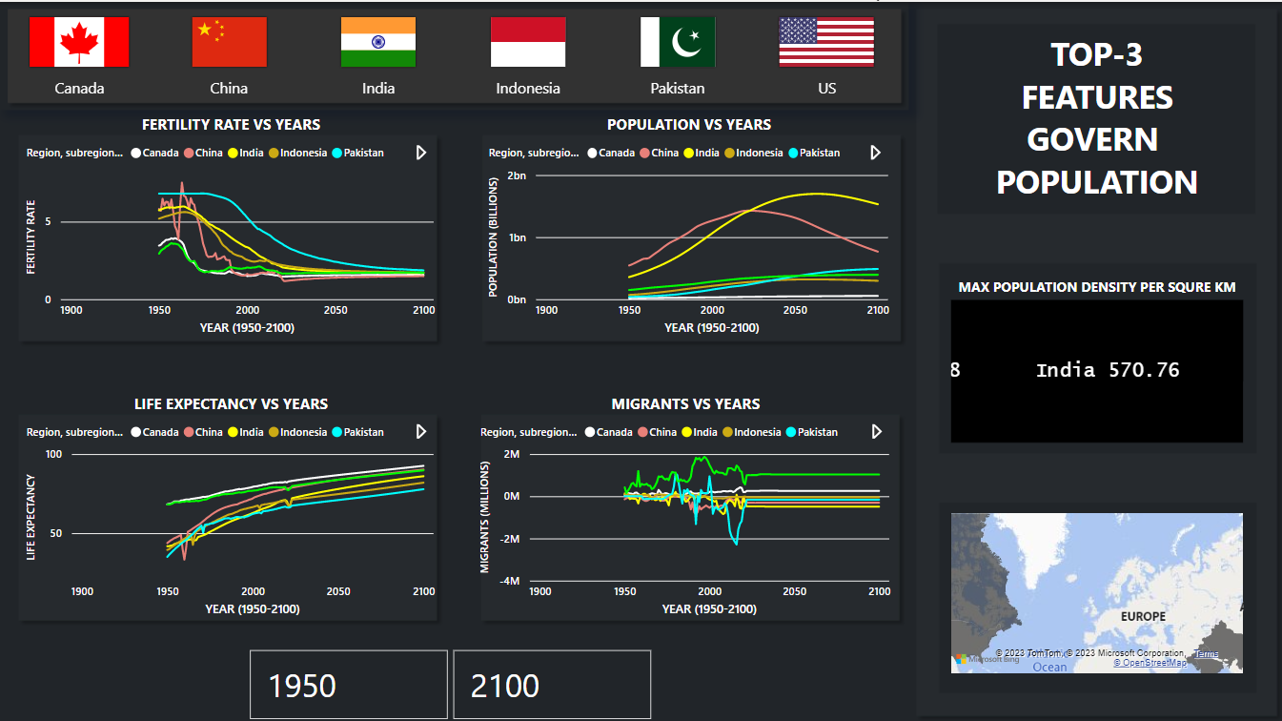

Slide 15
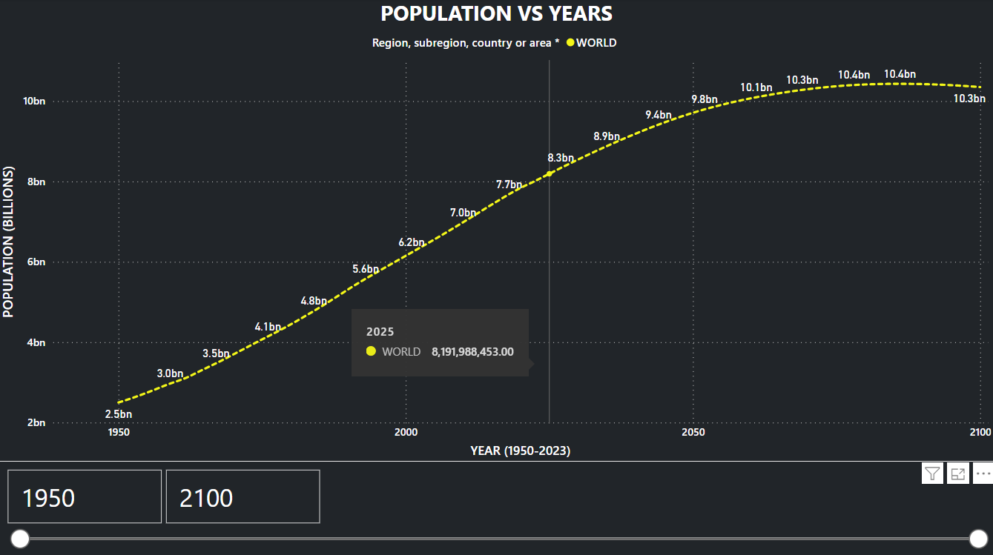
Population Prediction

Slide 16

References
https://www.macrotrends.net/​
Our World in Data​
https://www.un.org/en/

Slide 17


Slide 18

Thank You For Your Attention.

