Slide 1
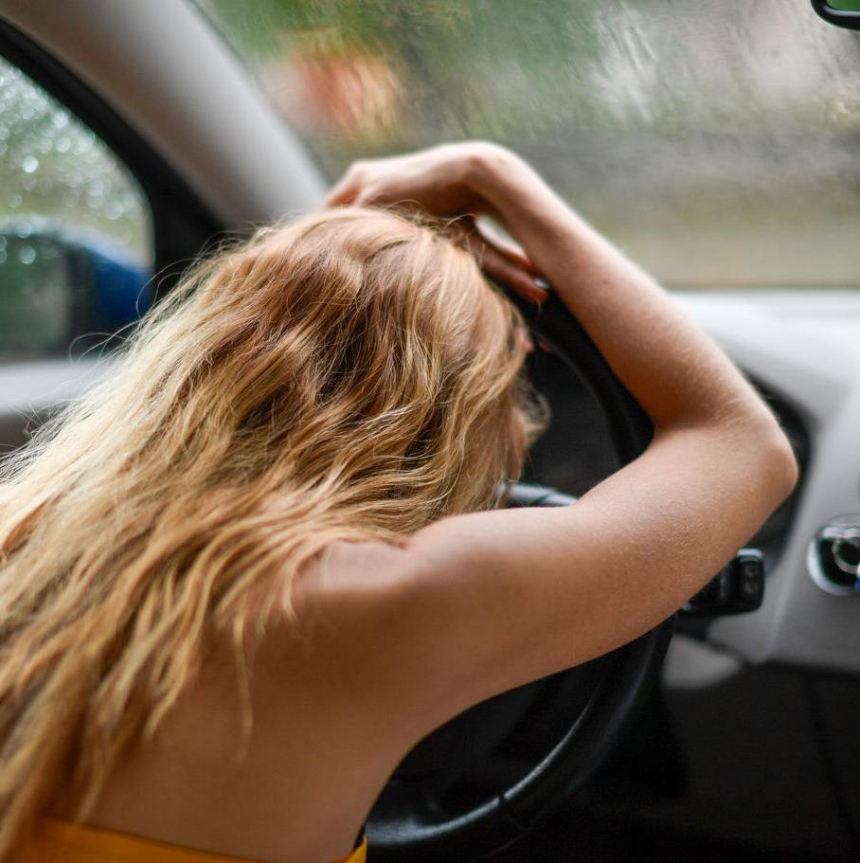
Drishti
Driver drowsiness
monitoring
Temporal fusion of eye closure
and yawning
Avani Bhuva Dhvani Tandel
Krishhma Vira Srishtee Varule
MBATECH Computer Engineering
MPSTME, Mumbai
Illustrative photograph
01
Notes:
Good morning everyone. Today, we are presenting Drishti, our driver drowsiness monitoring project. Our team includes Avani Bhuva, Dhvani Tandel, Krishhma Vira, and Srishtee Varule. The project studies how eye closure and yawning can contribute to warning decisions over time. Our current contribution is a temporal decision engine, supported by controlled software checks.
Sources: Corrected Drishti research paper; temporal_engine.py; verify_engine.py.
Photo: Margo Evardson, Pexels. https://www.pexels.com/photo/woman-resting-on-steering-wheel-in-car-35801682/ . The image does not establish impairment or vehicle motion.

Slide 2
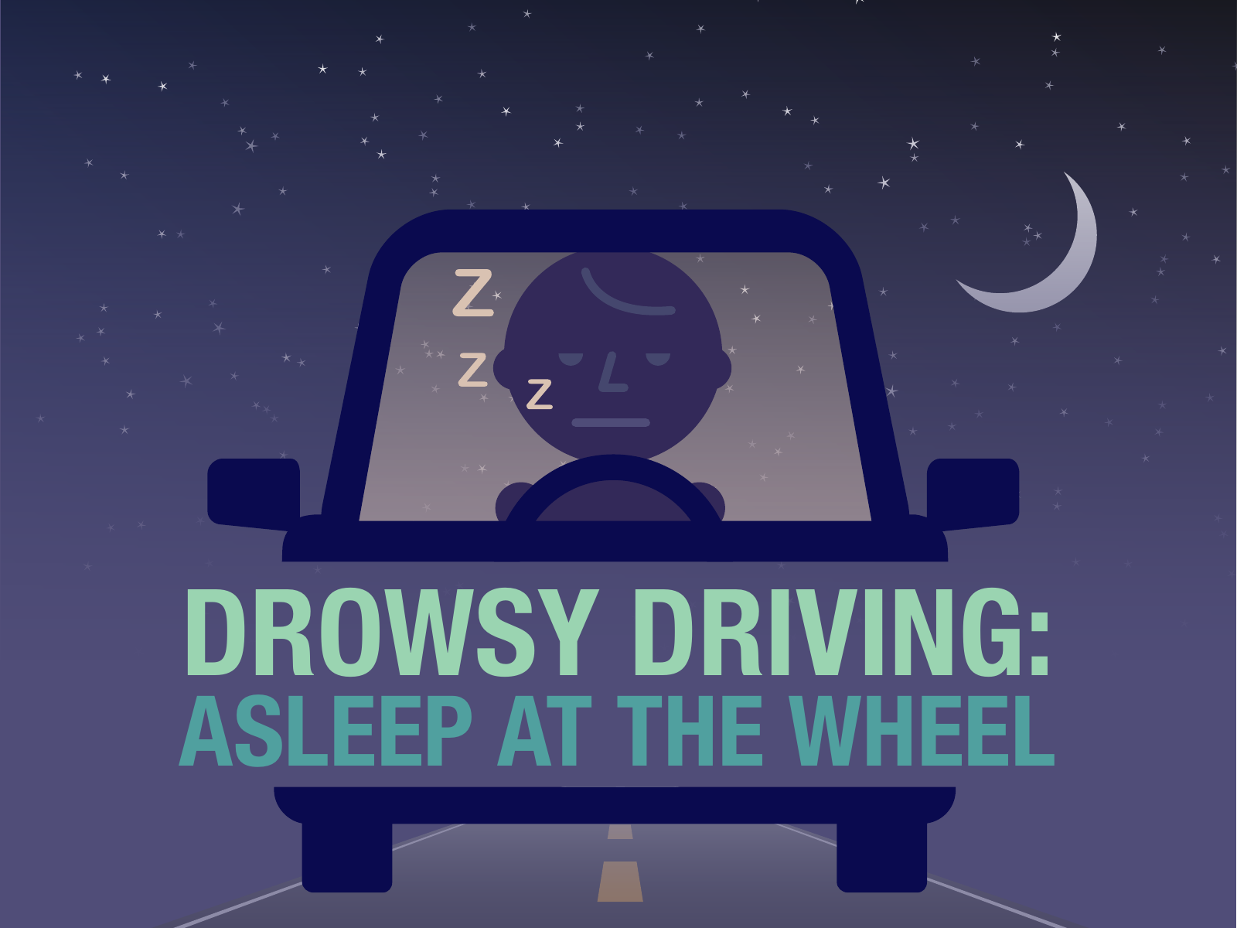
Why timing matters
A blink is brief
A sustained eye closure needs a different warning response.
Mouth opening is ambiguous
Duration and recent events help distinguish brief motion from a yawn.
Drishti retains time and recent history.
CDC educational illustration
02
Notes:
A single image cannot reliably explain a driver's condition. Closed eyes may indicate a normal blink, while a longer closure may require attention. Similarly, an open mouth could mean talking or yawning. Drishti therefore examines how long a cue continues and what has happened recently. This temporal context helps the engine distinguish brief movements from sustained or repeated behavior.
Sources: Corrected Drishti research paper; temporal_engine.py; verify_engine.py.
CDC educational poster: https://stacks.cdc.gov/view/cdc/154522 . Public-domain header excerpt.

Slide 3
Research context
Eye geometry
EAR supports landmark-based blink analysis.
Temporal behavior
PERCLOS research motivates observation over time.
Evaluation resources
YawDD supports yawn analysis. UTA-RLDD provides drowsiness labels.
Different labels and protocols require separate evaluation.
03
Notes:
Our paper draws on eye aspect ratio methods, physiological PERCLOS research, and datasets such as YawDD and UTA-RLDD. These sources examine different tasks, including blink recognition, yawning, and drowsiness classification. Their results cannot directly establish our system's accuracy. The research comparison helps us identify suitable evaluation resources and the need to calibrate thresholds across different people.
Sources: Corrected Drishti research paper; temporal_engine.py; verify_engine.py.
Paper references [1], [2], [3], [8]. Full research comparison appears on appendix slides 9-11. Published performance figures belong to the cited authors and do not measure Drishti.

Slide 4
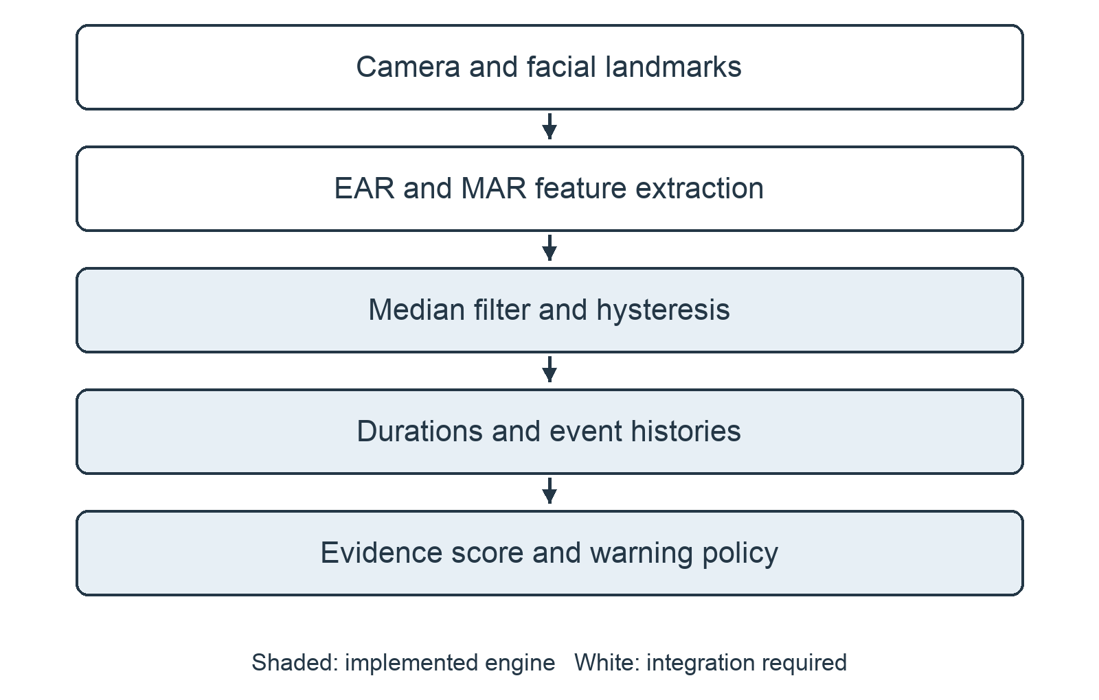
System pipeline
Input
Eye aspect ratio and mouth aspect ratio
Implemented component
Filtering, event histories, evidence score and warning rules
Camera, landmark extraction and warning delivery require integration.
04
Notes:
The intended system begins with a camera and facial landmarks. A feature extraction stage would calculate eye and mouth aspect ratios, called E-A-R and M-A-R. The implemented engine receives those two numbers. It filters recent observations, tracks events, and calculates a warning state. Camera acquisition, landmark extraction, and warning delivery still require integration, so the verified component is the temporal engine shown here.
Sources: Corrected Drishti research paper; temporal_engine.py; verify_engine.py.
Pipeline figure from the corrected paper, based on the implemented TemporalEngine interface. White blocks show integration requirements.

Slide 5
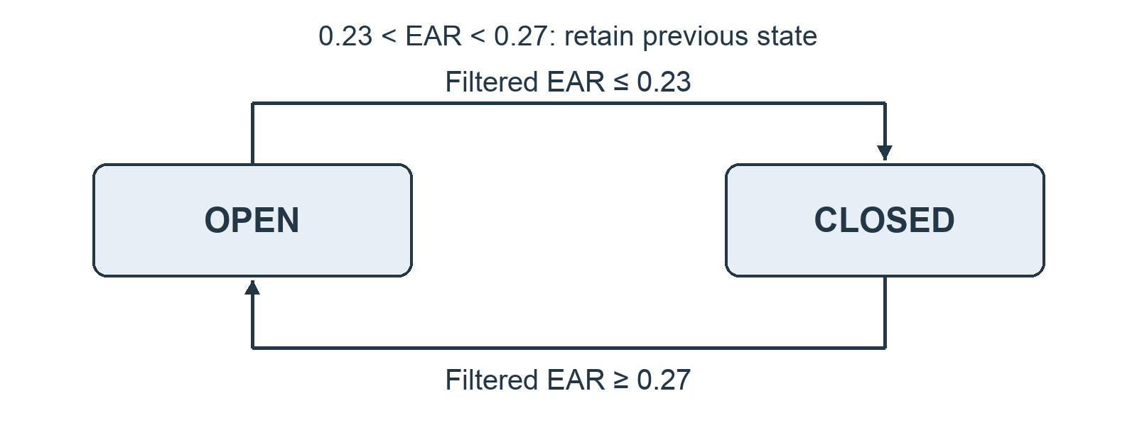
Eye and mouth cues
Eye state
Close at EAR ≤ 0.23
Reopen at EAR ≥ 0.27
Yawn confirmation
MAR ≥ 0.42 for at least 0.65 s
End at MAR ≤ 0.28
Median filtering uses up to seven recent observations.
05
Notes:
The engine uses a median filter over up to seven observations to reduce isolated fluctuations. For eye state, it uses two thresholds. Eyes close when filtered E-A-R reaches zero point two three or lower, and reopen at zero point two seven or higher. Between them, the previous state remains unchanged. This behavior is called hysteresis. A yawn requires sufficiently large mouth opening to continue for at least zero point six five seconds.
Sources: Corrected Drishti research paper; temporal_engine.py; verify_engine.py.
Thresholds are engineering choices in temporal_engine.py. They require calibration and participant-level validation.

Slide 6
Warning policy
ALERT
No higher warning rule applies
FATIGUED
At least two recent yawns or score ≥ 30, when higher rules do not apply
DROWSY
Closure ≥ 1.5 s, or another drowsy rule
CRITICAL
Closure ≥ 3.0 s, or closure ≥ 2.0 s with at least two recent yawns
A smoothed 0-100 evidence score supports the policy.
06
Notes:
The engine combines current closure duration with recent yawns and a rolling closed-eye sample ratio. It produces four operational states: alert, fatigued, drowsy, and critical. Sustained closure reaches the drowsy rule at one point five seconds and the critical rule at three seconds. Other combinations can also trigger warnings. A smoothed evidence score supports these decisions, but it is not a probability of drowsiness or a clinical diagnosis.
Sources: Corrected Drishti research paper; temporal_engine.py; verify_engine.py.
The slide highlights major duration and fatigue rules. Additional DROWSY rules use the closed-eye sample ratio, long closures and score, as specified in Section IV of the paper. The score is not a calibrated probability. Status selection prioritizes CRITICAL, then DROWSY, then FATIGUED.

Slide 7
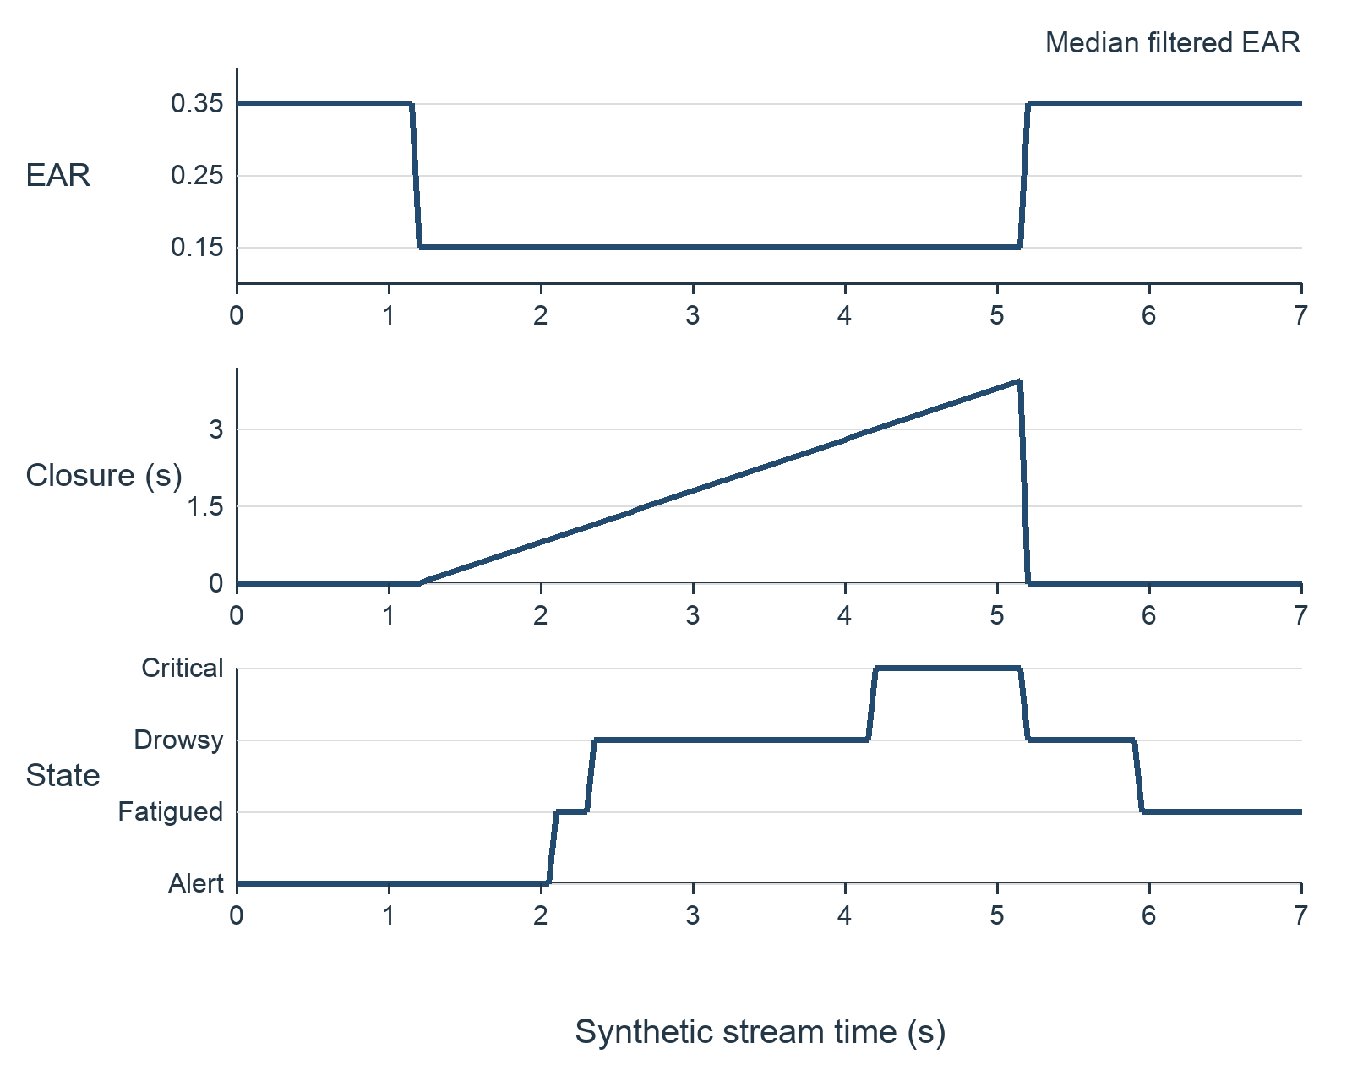
Functional verification
8 of 8
synthetic scenarios passed
their specified assertions
Controlled clock
20 updates per second
Selected software checks. Real-driver detection accuracy remains unmeasured.
07
Notes:
We checked eight deterministic scenarios using synthetic inputs and a controlled clock. All eight passed their specified assertions. They cover baseline behavior, hysteresis, blink counting, sustained closure, brief mouth opening, repeated yawns, event expiry, and startup behavior. The graph shows one synthetic closure and reopening sequence. It demonstrates filtering delay and changes in warning state. These results verify selected software behavior. They do not establish detection accuracy on real drivers.
Sources: Corrected Drishti research paper; temporal_engine.py; verify_engine.py.
Synthetic trace from the unmodified temporal engine. Raw EAR is 0.15 from 1.05 through 5.00 s and 0.35 otherwise, MAR is 0.15, sampled at 20 Hz using a patched clock. Eight checks: baseline, hysteresis, blink, sustained closure, brief mouth opening, two yawns, yawn expiry and cold start.

Slide 8
Next evaluation
An explainable temporal
decision engine
Integrate the camera and landmark front end.
Evaluate independently labeled recordings with different test subjects.
Measure false warnings, missed events, detection delay and latency.
08
Notes:
Our next step is to integrate the camera front end and evaluate with independently labeled recordings. Calibration and testing should use different subjects. We should measure missed events, false warnings per hour, detection delay, and processing latency. Drishti currently provides an explainable temporal decision policy. Real-world validation will determine how effectively that policy supports driver monitoring. Thank you. We welcome your questions.
Sources: Corrected Drishti research paper; temporal_engine.py; verify_engine.py.
Evaluation plan in Sections VI-VIII of the corrected paper. Dataset-level discrimination, operational warning performance and latency remain future measurements.

Slide 9
Appendix Research comparison 1 of 3
Reference no. | Dataset used | Methodology / algorithm used | Performance parameters | Research gap / disadvantages
[1] | Controlled ocular measurement and psychomotor-vigilance study | Physiological PERCLOS validation | Relationship with alertness and vigilance; no project accuracy | The project needs calibrated eyelid-closure measurement before claiming equivalence.
[2] | ZJU and Eyeblink8 video sequences | Facial landmarks, eye aspect ratio, short temporal window and support vector machine | Blink detection; not a four-state drowsiness benchmark | Blink recognition alone does not establish fatigue or warning validity.
[3] | YawDD in-car video sets | Dataset of normal mouth activity, speech or singing, and yawning | 322 videos in one camera setup; 29 in the other; dataset descriptors | Yawning labels do not by themselves establish physiological drowsiness.
Published results belong to the cited studies. They do not measure Drishti.
09
Notes:
Appendix for questions. Complete original research comparison, continued across slides 9-11.
[1] Federal Highway Administration, “PERCLOS: A valid psychophysiological measure of alertness as assessed by psychomotor vigilance,” TechBrief FHWA-MCRT-98-006, Oct. 1998, doi: 10.21949/1502740.
[2] T. Soukupová and J. Čech, “Real-time eye blink detection using facial landmarks,” in Proc. 21st Computer Vision Winter Workshop, Rimske Toplice, Slovenia, Feb. 2016. [Online]. Available: https://vision.fe.uni-lj.si/cvww2016/proceedings/papers/05.pdf
[3] S. Abtahi, M. Omidyeganeh, S. Shirmohammadi, and B. Hariri, “YawDD: A yawning detection dataset,” in Proc. 5th ACM Multimedia Systems Conf., Singapore, 2014, pp. 24–28, doi: 10.1145/2557642.2563678.
[4] National Highway Traffic Safety Administration, “Drowsy driving,” Accessed: Oct. 16, 2026. [Online]. Available: https://www.nhtsa.gov/risky-driving/drowsy-driving
[5] Centers for Disease Control and Prevention, “Drowsy driving: Asleep at the wheel,” educational poster, CDC Stacks, Nov. 30, 2022. Accessed: Oct. 16, 2026. [Online]. Available: https://stacks.cdc.gov/view/cdc/154522
[6] M. Evardson, “Woman resting on steering wheel in car,” photograph, Pexels. Accessed: Oct. 16, 2026. [Online]. Available: https://www.pexels.com/photo/woman-resting-on-steering-wheel-in-car-35801682/
[7] J. Lyu, Z. Yuan, and D. Chen, “Long-term multi-granularity deep framework for driver drowsiness detection,” 2018, arXiv:1801.02325, doi: 10.48550/arXiv.1801.02325.
[8] R. Ghoddoosian, M. Galib, and V. Athitsos, “A realistic dataset and baseline temporal model for early drowsiness detection,” in Proc. IEEE/CVF Conf. Computer Vision and Pattern Recognition Workshops (CVPRW), 2019, pp. 178–187, doi: 10.1109/CVPRW.2019.00027.
[9] C. Dewi, R.-C. Chen, X. Jiang, and H. Yu, “Adjusting eye aspect ratio for strong eye blink detection based on facial landmarks,” PeerJ Comput. Sci., vol. 8, Art. no. e943, 2022, doi: 10.7717/peerj-cs.943.
[10] A. Mujtaba, G. Radchenko, M. Masana, and R. Prodan, “YawDD+: Frame-level annotations for accurate yawn prediction,” arXiv:2512.11446, ver. 3, May 2026, doi: 10.48550/arXiv.2512.11446.

Slide 10
Appendix Research comparison 2 of 3
Reference no. | Dataset used | Methodology / algorithm used | Performance parameters | Research gap / disadvantages
[7] | NTHU-DDD; additional FI-DDD dataset | Multi-granularity convolutional features and long short-term memory | Authors report 90.05% accuracy and approximately 37 frames/s on NTHU-DDD evaluation set | Hardware and protocol differ from this project; model and inference cost require measurement.
[8] | UTA-RLDD: 60 subjects, approximately 30 h | Blink features with hierarchical multiscale long short-term memory | Three video states: alert, low vigilant, drowsy; classification benchmark | Its three labels do not directly validate this engine’s four warning states.
Published results belong to the cited studies. They do not measure Drishti.
10
Notes:
Appendix for questions. Complete original research comparison, continued across slides 9-11.
[1] Federal Highway Administration, “PERCLOS: A valid psychophysiological measure of alertness as assessed by psychomotor vigilance,” TechBrief FHWA-MCRT-98-006, Oct. 1998, doi: 10.21949/1502740.
[2] T. Soukupová and J. Čech, “Real-time eye blink detection using facial landmarks,” in Proc. 21st Computer Vision Winter Workshop, Rimske Toplice, Slovenia, Feb. 2016. [Online]. Available: https://vision.fe.uni-lj.si/cvww2016/proceedings/papers/05.pdf
[3] S. Abtahi, M. Omidyeganeh, S. Shirmohammadi, and B. Hariri, “YawDD: A yawning detection dataset,” in Proc. 5th ACM Multimedia Systems Conf., Singapore, 2014, pp. 24–28, doi: 10.1145/2557642.2563678.
[4] National Highway Traffic Safety Administration, “Drowsy driving,” Accessed: Oct. 16, 2026. [Online]. Available: https://www.nhtsa.gov/risky-driving/drowsy-driving
[5] Centers for Disease Control and Prevention, “Drowsy driving: Asleep at the wheel,” educational poster, CDC Stacks, Nov. 30, 2022. Accessed: Oct. 16, 2026. [Online]. Available: https://stacks.cdc.gov/view/cdc/154522
[6] M. Evardson, “Woman resting on steering wheel in car,” photograph, Pexels. Accessed: Oct. 16, 2026. [Online]. Available: https://www.pexels.com/photo/woman-resting-on-steering-wheel-in-car-35801682/
[7] J. Lyu, Z. Yuan, and D. Chen, “Long-term multi-granularity deep framework for driver drowsiness detection,” 2018, arXiv:1801.02325, doi: 10.48550/arXiv.1801.02325.
[8] R. Ghoddoosian, M. Galib, and V. Athitsos, “A realistic dataset and baseline temporal model for early drowsiness detection,” in Proc. IEEE/CVF Conf. Computer Vision and Pattern Recognition Workshops (CVPRW), 2019, pp. 178–187, doi: 10.1109/CVPRW.2019.00027.
[9] C. Dewi, R.-C. Chen, X. Jiang, and H. Yu, “Adjusting eye aspect ratio for strong eye blink detection based on facial landmarks,” PeerJ Comput. Sci., vol. 8, Art. no. e943, 2022, doi: 10.7717/peerj-cs.943.
[10] A. Mujtaba, G. Radchenko, M. Masana, and R. Prodan, “YawDD+: Frame-level annotations for accurate yawn prediction,” arXiv:2512.11446, ver. 3, May 2026, doi: 10.48550/arXiv.2512.11446.

Slide 11
Appendix Research comparison 3 of 3
Reference no. | Dataset used | Methodology / algorithm used | Performance parameters | Research gap / disadvantages
[9] | Talking Face, Eyeblink8, Eye Video S1 | Modified eye aspect ratio for blink detection | Blink-detection evaluation across datasets | User-dependent eye geometry motivates threshold calibration; blink labels remain distinct from drowsiness.
[10] | YawDD+ frame annotations derived from YawDD | Human-verified temporal labeling; MNasNet and YOLOv11 models | v3 authors report 99.34% classification accuracy and 95.69% detection mAP | Yawn classification and object-detection metrics cannot be transferred to drowsiness classification.
Published results belong to the cited studies. They do not measure Drishti.
11
Notes:
Appendix for questions. Complete original research comparison, continued across slides 9-11.
[1] Federal Highway Administration, “PERCLOS: A valid psychophysiological measure of alertness as assessed by psychomotor vigilance,” TechBrief FHWA-MCRT-98-006, Oct. 1998, doi: 10.21949/1502740.
[2] T. Soukupová and J. Čech, “Real-time eye blink detection using facial landmarks,” in Proc. 21st Computer Vision Winter Workshop, Rimske Toplice, Slovenia, Feb. 2016. [Online]. Available: https://vision.fe.uni-lj.si/cvww2016/proceedings/papers/05.pdf
[3] S. Abtahi, M. Omidyeganeh, S. Shirmohammadi, and B. Hariri, “YawDD: A yawning detection dataset,” in Proc. 5th ACM Multimedia Systems Conf., Singapore, 2014, pp. 24–28, doi: 10.1145/2557642.2563678.
[4] National Highway Traffic Safety Administration, “Drowsy driving,” Accessed: Oct. 16, 2026. [Online]. Available: https://www.nhtsa.gov/risky-driving/drowsy-driving
[5] Centers for Disease Control and Prevention, “Drowsy driving: Asleep at the wheel,” educational poster, CDC Stacks, Nov. 30, 2022. Accessed: Oct. 16, 2026. [Online]. Available: https://stacks.cdc.gov/view/cdc/154522
[6] M. Evardson, “Woman resting on steering wheel in car,” photograph, Pexels. Accessed: Oct. 16, 2026. [Online]. Available: https://www.pexels.com/photo/woman-resting-on-steering-wheel-in-car-35801682/
[7] J. Lyu, Z. Yuan, and D. Chen, “Long-term multi-granularity deep framework for driver drowsiness detection,” 2018, arXiv:1801.02325, doi: 10.48550/arXiv.1801.02325.
[8] R. Ghoddoosian, M. Galib, and V. Athitsos, “A realistic dataset and baseline temporal model for early drowsiness detection,” in Proc. IEEE/CVF Conf. Computer Vision and Pattern Recognition Workshops (CVPRW), 2019, pp. 178–187, doi: 10.1109/CVPRW.2019.00027.
[9] C. Dewi, R.-C. Chen, X. Jiang, and H. Yu, “Adjusting eye aspect ratio for strong eye blink detection based on facial landmarks,” PeerJ Comput. Sci., vol. 8, Art. no. e943, 2022, doi: 10.7717/peerj-cs.943.
[10] A. Mujtaba, G. Radchenko, M. Masana, and R. Prodan, “YawDD+: Frame-level annotations for accurate yawn prediction,” arXiv:2512.11446, ver. 3, May 2026, doi: 10.48550/arXiv.2512.11446.

Slide 12
References
[1] FHWA. PERCLOS validation. 1998.
[6] Evardson. Resting at the wheel. Pexels.
[2] Soukupová and Čech. Eye blink detection. 2016.
[7] Lyu et al. Multi-granularity framework. 2018.
[3] Abtahi et al. YawDD. 2014.
[8] Ghoddoosian et al. UTA-RLDD. 2019.
[4] NHTSA. Drowsy driving.
[9] Dewi et al. Adjusted EAR. 2022.
[5] CDC. Drowsy driving poster. 2022.
[10] Mujtaba et al. YawDD+. Version 3, 2026.
Full citations and image credits appear in the speaker notes.
12
Notes:
[1] Federal Highway Administration, “PERCLOS: A valid psychophysiological measure of alertness as assessed by psychomotor vigilance,” TechBrief FHWA-MCRT-98-006, Oct. 1998, doi: 10.21949/1502740.
[2] T. Soukupová and J. Čech, “Real-time eye blink detection using facial landmarks,” in Proc. 21st Computer Vision Winter Workshop, Rimske Toplice, Slovenia, Feb. 2016. [Online]. Available: https://vision.fe.uni-lj.si/cvww2016/proceedings/papers/05.pdf
[3] S. Abtahi, M. Omidyeganeh, S. Shirmohammadi, and B. Hariri, “YawDD: A yawning detection dataset,” in Proc. 5th ACM Multimedia Systems Conf., Singapore, 2014, pp. 24–28, doi: 10.1145/2557642.2563678.
[4] National Highway Traffic Safety Administration, “Drowsy driving,” Accessed: Oct. 16, 2026. [Online]. Available: https://www.nhtsa.gov/risky-driving/drowsy-driving
[5] Centers for Disease Control and Prevention, “Drowsy driving: Asleep at the wheel,” educational poster, CDC Stacks, Nov. 30, 2022. Accessed: Oct. 16, 2026. [Online]. Available: https://stacks.cdc.gov/view/cdc/154522
[6] M. Evardson, “Woman resting on steering wheel in car,” photograph, Pexels. Accessed: Oct. 16, 2026. [Online]. Available: https://www.pexels.com/photo/woman-resting-on-steering-wheel-in-car-35801682/
[7] J. Lyu, Z. Yuan, and D. Chen, “Long-term multi-granularity deep framework for driver drowsiness detection,” 2018, arXiv:1801.02325, doi: 10.48550/arXiv.1801.02325.
[8] R. Ghoddoosian, M. Galib, and V. Athitsos, “A realistic dataset and baseline temporal model for early drowsiness detection,” in Proc. IEEE/CVF Conf. Computer Vision and Pattern Recognition Workshops (CVPRW), 2019, pp. 178–187, doi: 10.1109/CVPRW.2019.00027.
[9] C. Dewi, R.-C. Chen, X. Jiang, and H. Yu, “Adjusting eye aspect ratio for strong eye blink detection based on facial landmarks,” PeerJ Comput. Sci., vol. 8, Art. no. e943, 2022, doi: 10.7717/peerj-cs.943.
[10] A. Mujtaba, G. Radchenko, M. Masana, and R. Prodan, “YawDD+: Frame-level annotations for accurate yawn prediction,” arXiv:2512.11446, ver. 3, May 2026, doi: 10.48550/arXiv.2512.11446.

