Slide 1


HS2911
Social Media and Mental Health
This module introduces students to the connection between social media and mental health from multiple perspectives: computer-mediated communication, clinical psychiatry, and socio-cultural studies
Presented by Kokil Jaidka & Cyrus Ho

Slide 2

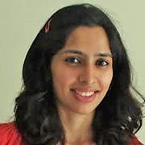
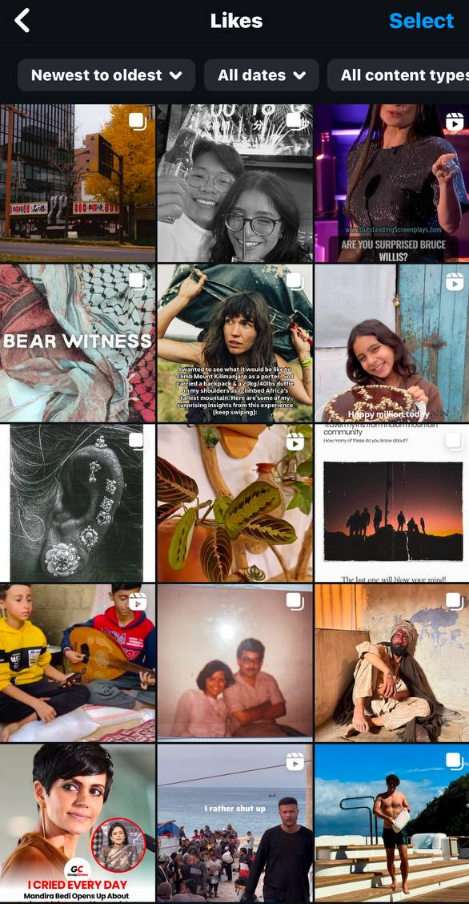
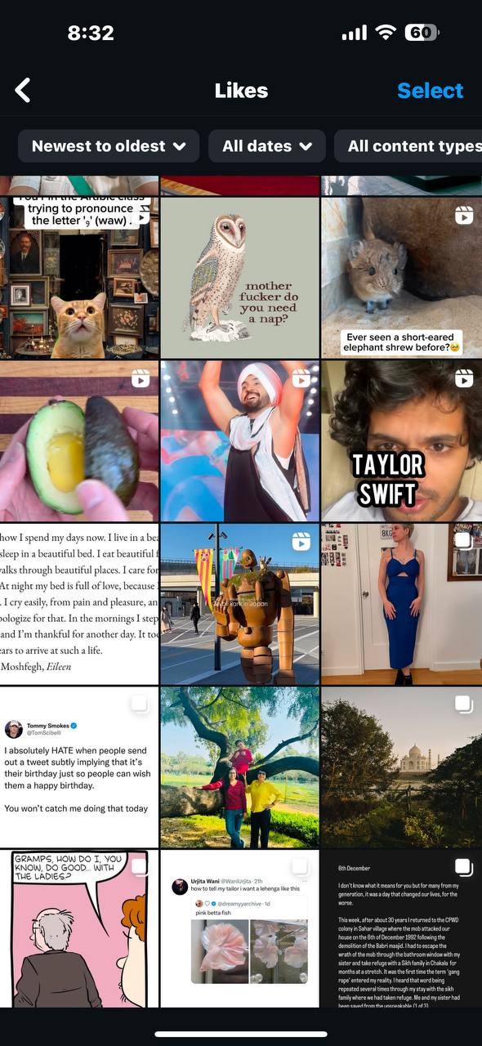
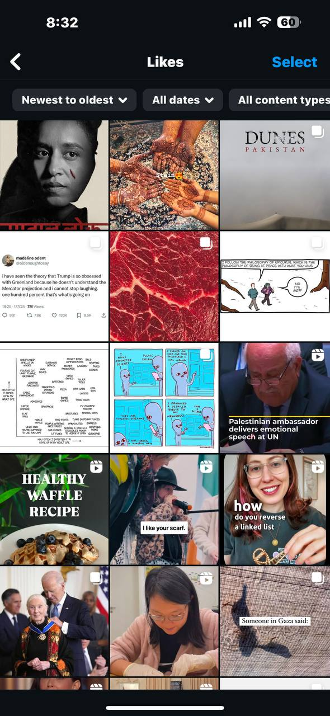
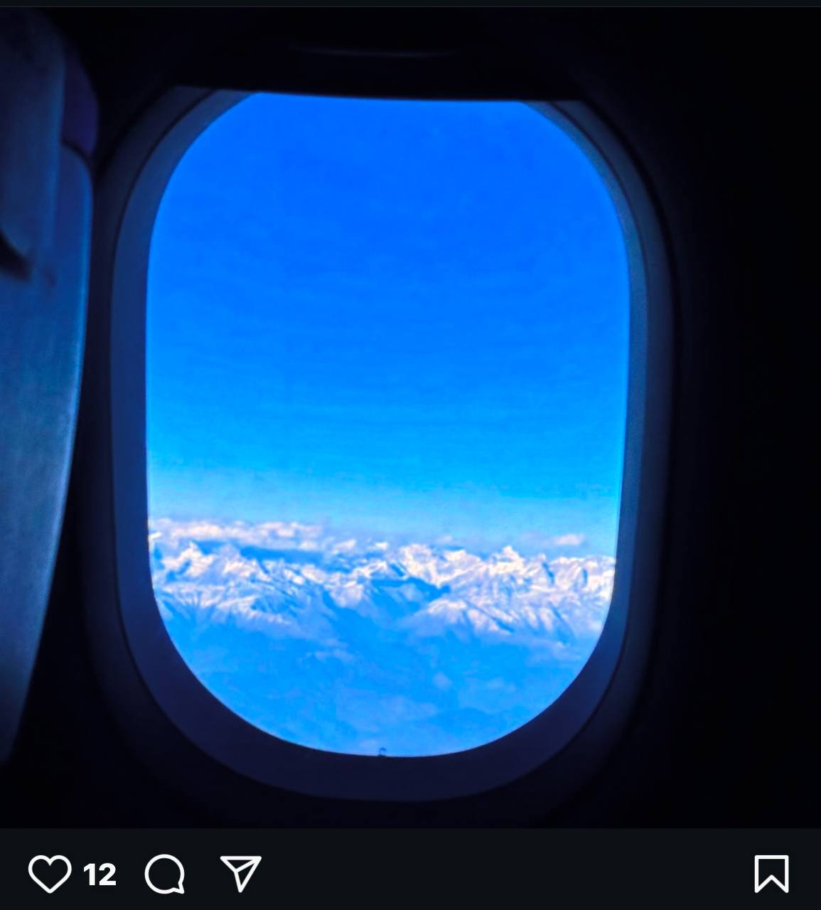
Who we are
Dr. Kokil Jaidka
  Social Media, Online behavior & Language (SMOL) project
Department of Communications and New Media
jaidka@nus.edu.sg

Slide 3
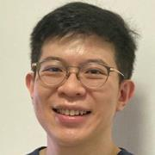
Who we are
Dr. Cyrus Ho
Assistant Professor and Senior Consultant Psychiatrist
Department of Psychological Medicine, NUS/NUH
pcmhsh@nus.edu.sg
Clinical and Research Interest: Mood disorders, Interface between Medicine and Psychiatry, Public Mental Health

Slide 4
Who we are
Xia Xin
    Department of Communications and New Media
    xiaxin@u.nus.edu

Slide 5
Who we are
Zhang Siyu
    Department of Communications and New Media
    zhangsiyu@u.nus.edu

Slide 6
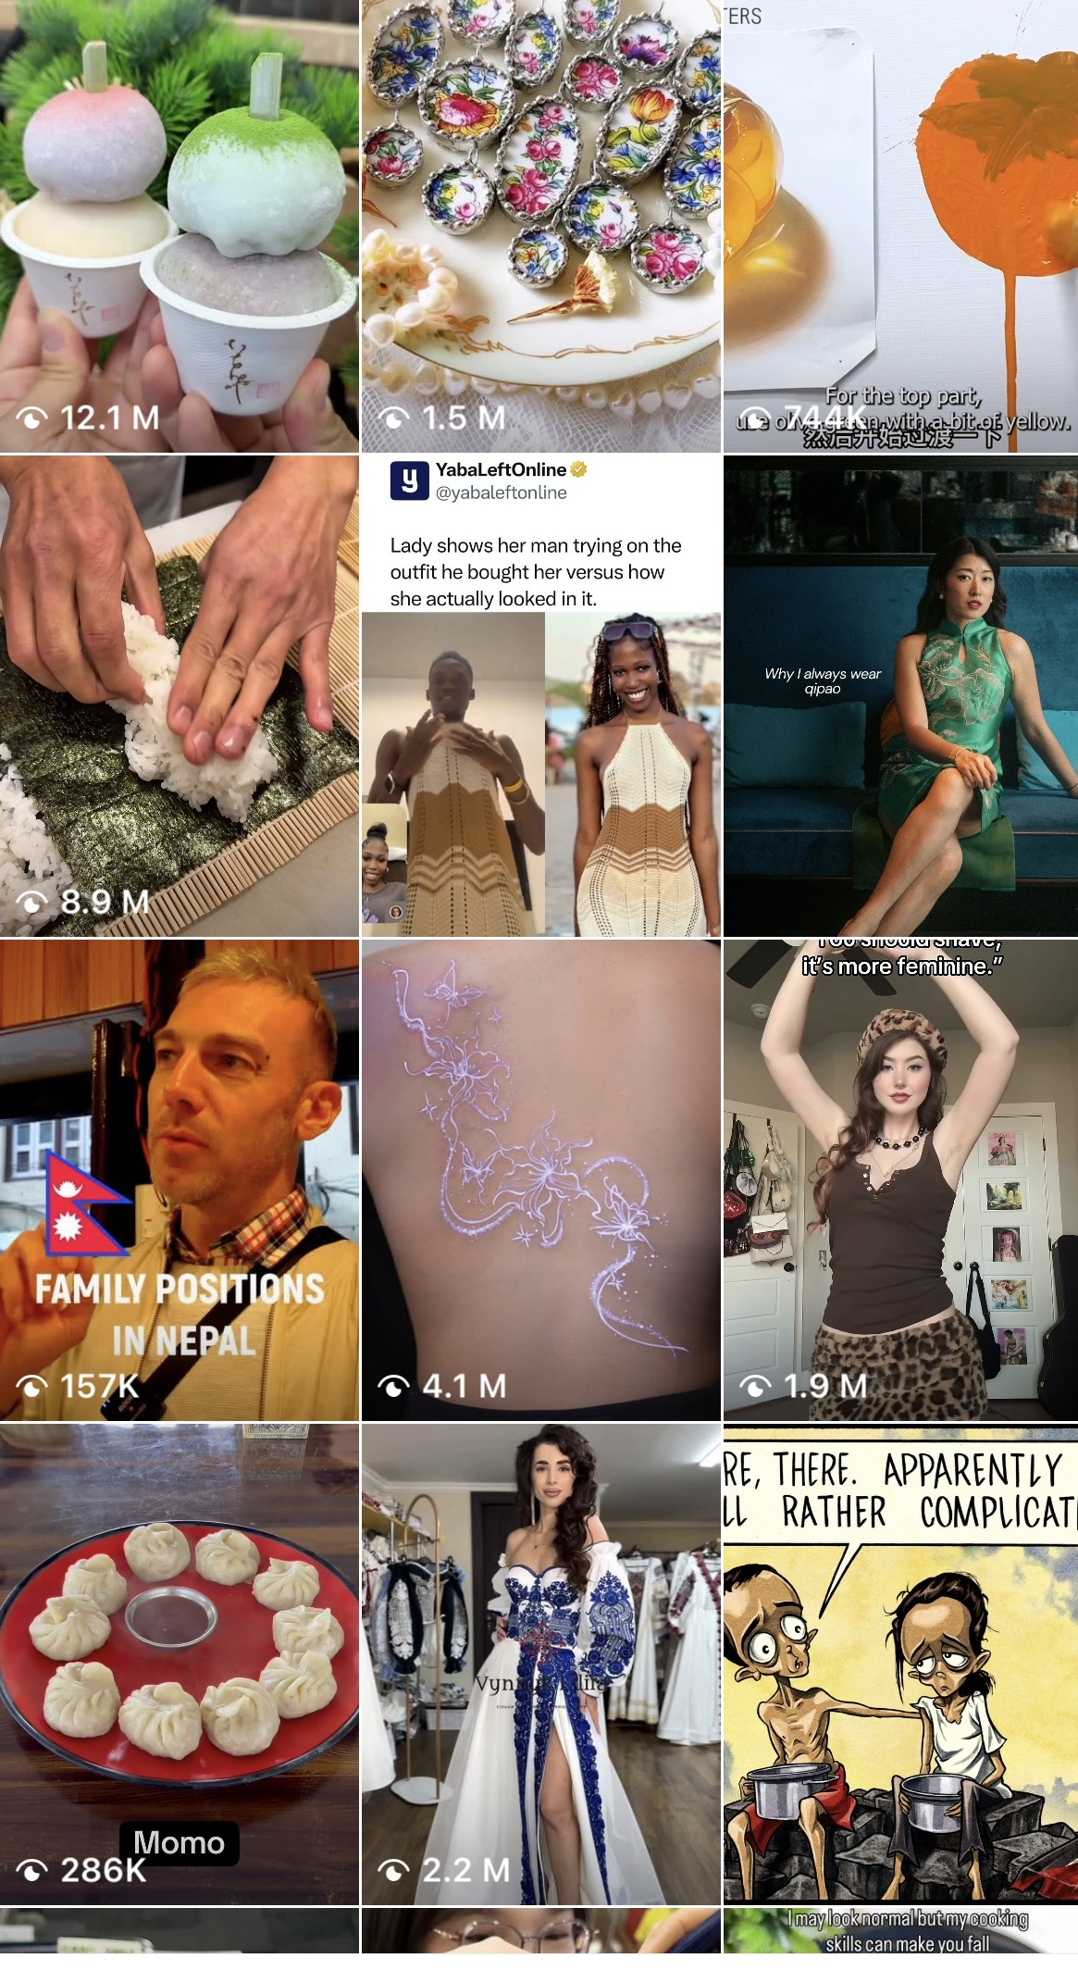
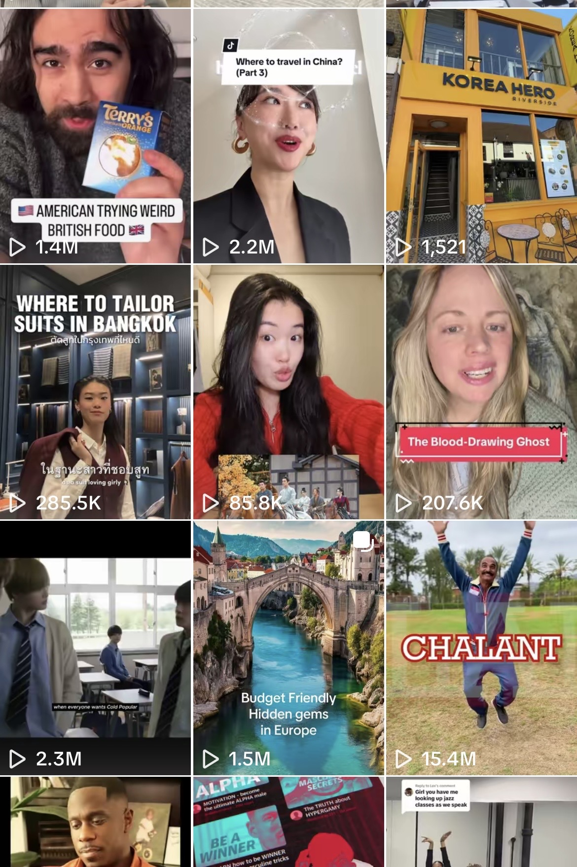

Who we are
Arpana Rai
Department of Communications and New Media
arpana.rai@nus.edu.sg

Slide 7
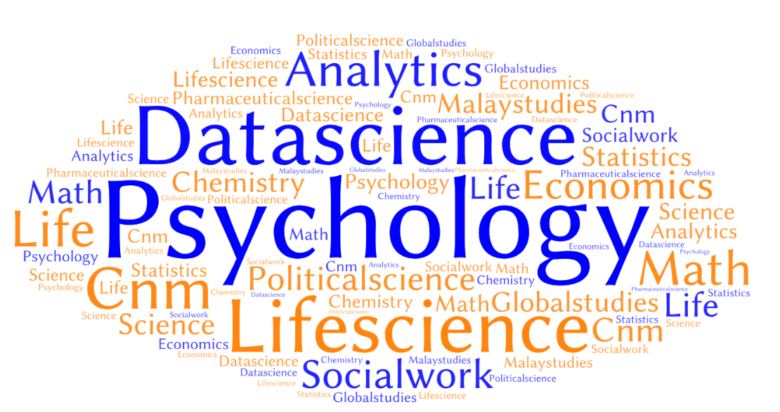
Who are you?
You can still fill up our pre-survey quiz (check Announcements)

Slide 8
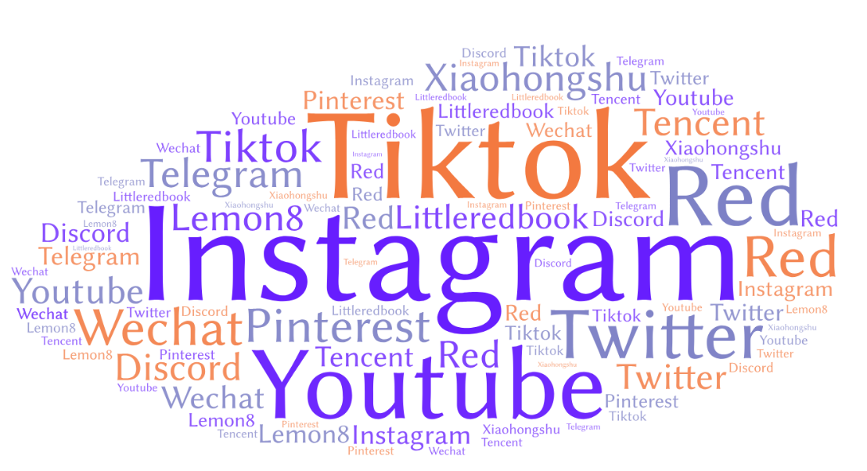
Where are you?

Slide 9
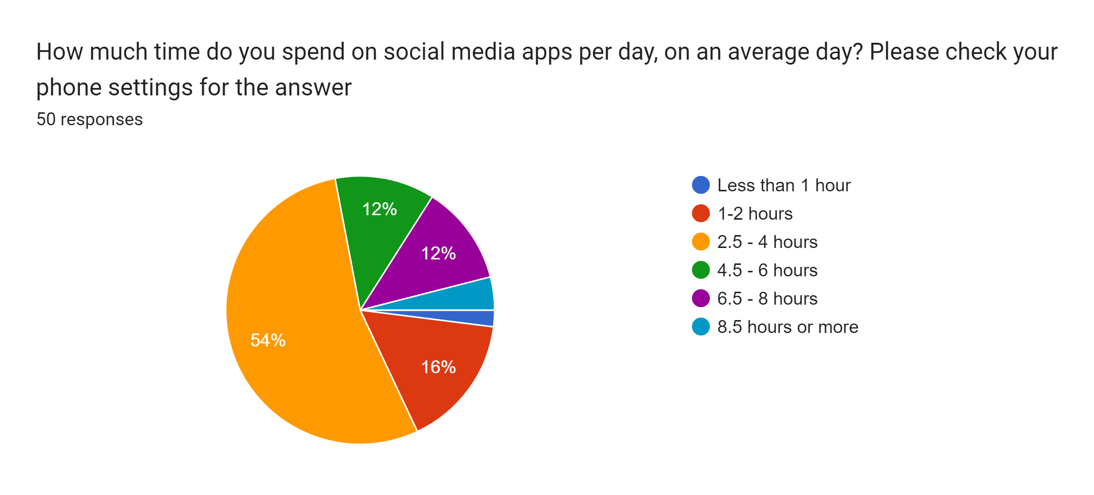
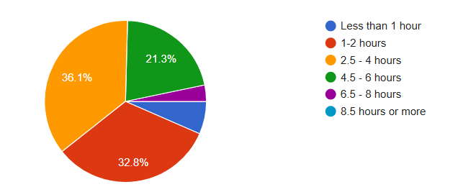
What do you do there?

Slide 10
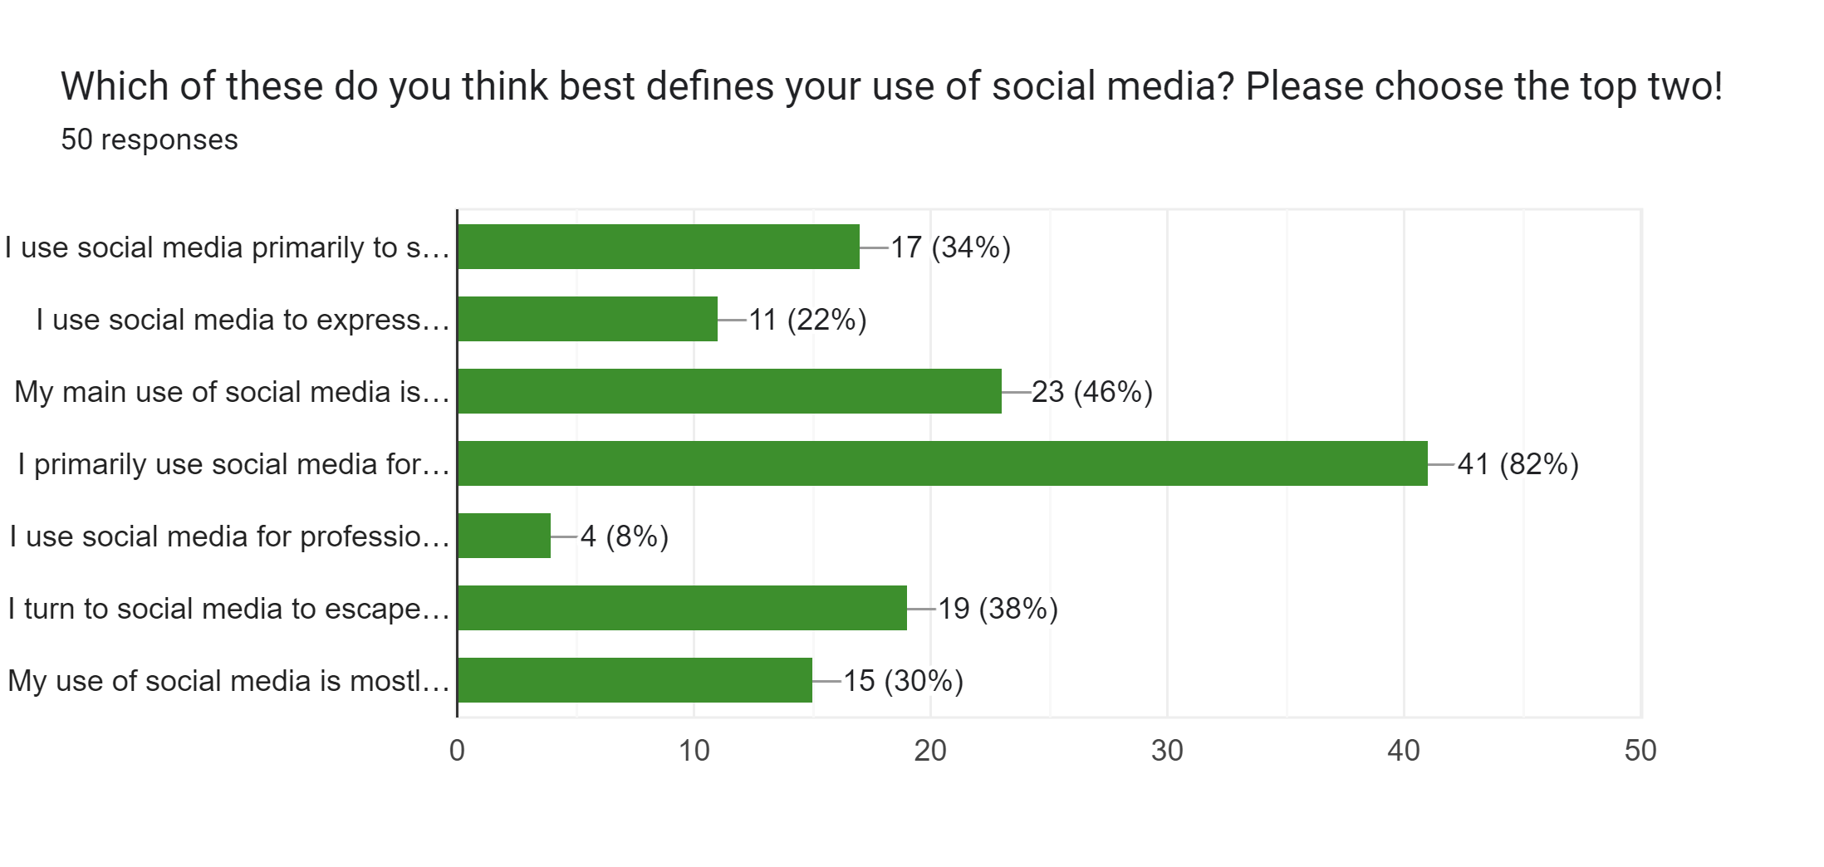
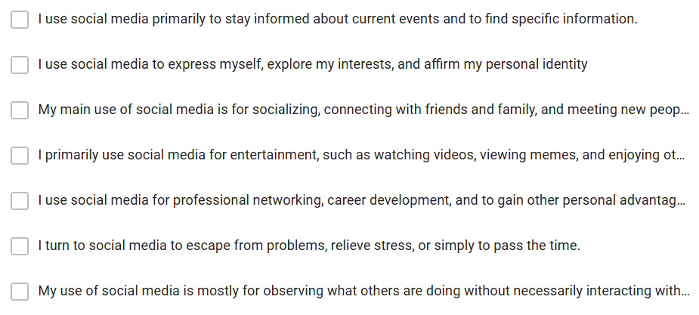
What do you do there?

Slide 11
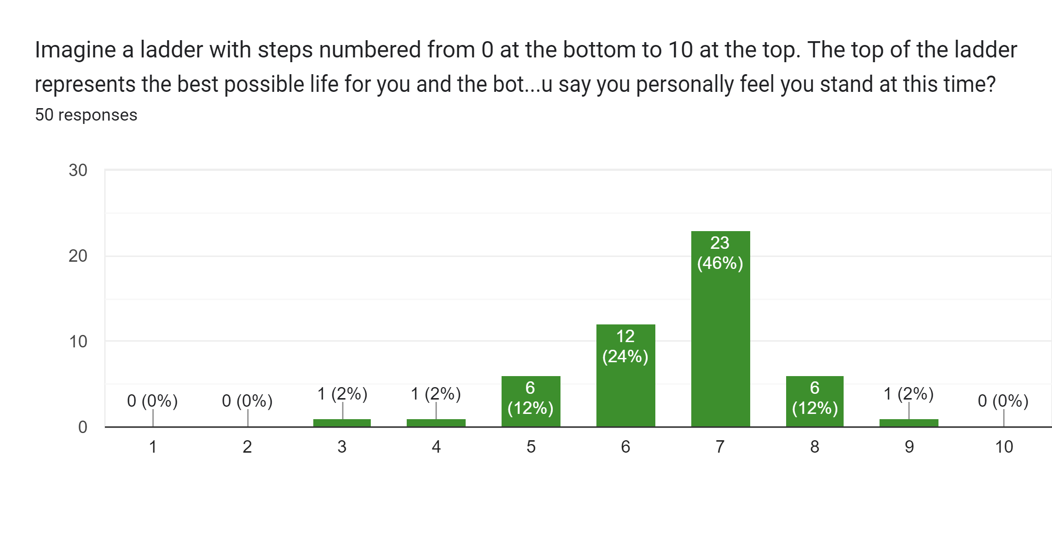
How do you feel?

Slide 12
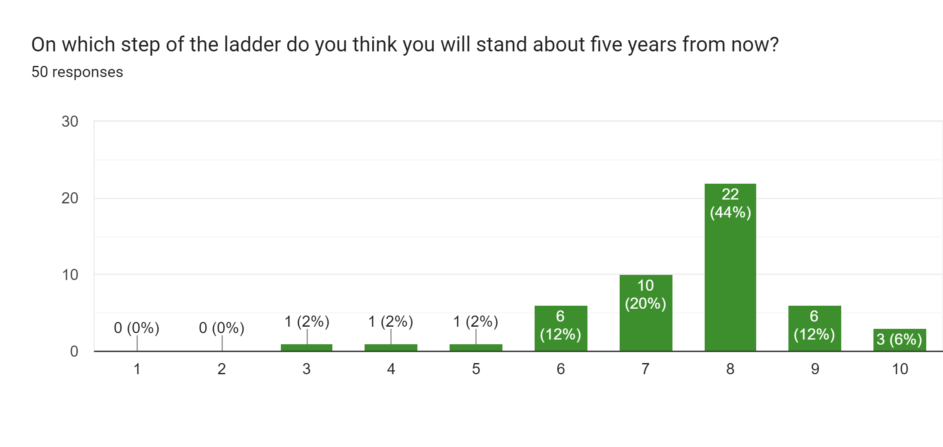
How do you feel?

Slide 13
Learning outcomes
The importance of mental health, barriers to help-seeking, and strategies to improve mental health.
Gain an understanding of seminal work in social media and mental health from three disciplinary perspectives (computer-mediated communication, clinical psychiatry, and socio-cultural studies).
Ability to put into practice the concepts from different perspectives towards social media’s relationship with mental health.
Learn to collaborate and communicate effectively in groups comprising members from different disciplinary background.
Engage in detailed in-class and outside-classroom forum discussion and critique of case studies related to the topics.
https://canvas.nus.edu.sg/courses/86726/files/folder/General%20Information

Slide 14
Burning questions:
What is this course like?
Relatable, real-world content — "the topic is very relatable and applicable in real life"
Engaging lectures with lots of examples, videos, and Slido interaction
Well-scaffolded assessments — tutorials build toward the presentation, practice questions build toward the quiz
Manageable, well-spaced workload — "relatively chill course with moderate workload"
Recorded lectures
Covers a wide range of topics, including less-discussed ones like queerness, race, and women on social media
Ends on a hopeful note — "Prof Kokil ended off the course with ways to personally cope with all the heavy issues... not all bleak“
One student's full review: "Nothing :D keep this course!"

Slide 15
Five-star reviews
"I liked that this was an interesting inter–disciplinary course that blends in communication and media studies and psychology"
"Nothing :D keep this course!"
"Very informative teaching, gives very positive vibes :D Teaches well!"
"great teacher"
"– chill"
"patience“
"Her anecdotes during the lectures are also very humanising and fun to listen to!"
"Love how no–nonsense she is"
"she is also caring towards students' wellbeing!"
"I liked the group project and individual assignment and how they encouraged us to think beyond."

Slide 16
One-star reviews
"most useless module i've taken?" — the question mark gives us hope
"That it was a OTOT thing." — filed under 'what I liked,' we'll take it
"sometimes the content is boring but I dont think its their fault, just not my interest" — honesty appreciated
"kinda hard" — in full, that was the entire review
"a little dry :/"
"didnt like the fact that there was a hidden final (the quiz). took the module cuz i thought theres no finals" — oh nooo, jumpscare!
"having to attend compulsory lectures" — ok ok we fixed this, don’t come
"Maybe stop treating us like primary school students... the volume of the lecture hall becomes higher than the sound of a feather dropping" — poetry, honestly
"quiz in week 13" — oh noooo, jumpscare!

Slide 17
Burning questions:
What will you likely find difficult?
Theory-heavy stretches early on — "only got truly interesting for me in the last 1–2 lectures," so hang in there
Juggling the psych and comms sides — some felt like they were "taking two different modules at times“, “there were some bio content which I did not expect”
Group project ramps up in the second half of the semester, so it can feel fast
The final quiz is closed book and lands in Week 13, alongside other modules' deadlines
Lots of weekly readings
Lecture attendance is graded (changed to in-lecture quizzes)
presentation slots differ across groups (will change it this sem)

Slide 18
Let’s set expectations
Start the group project early — the timeline between proposal and presentation is tight
Read assignment briefs carefully and ask questions early — instructions live in a few different places
The final quiz is closed-book and in Week 13 — it’s similar to the practice quizzes, so doing those pays off
Group work is a substantial chunk of the grade (~30%) — choose to be a good teammate
There's a course-linked research study component — you'll hear more about what participation involves
Lecture hall etiquette matters — the prof "does not tolerate disrespect," which fans consider a feature

Slide 19
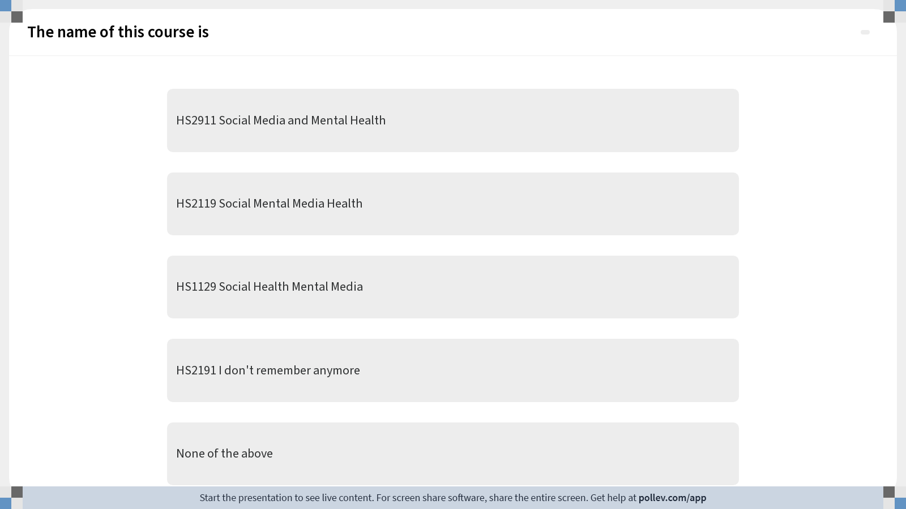
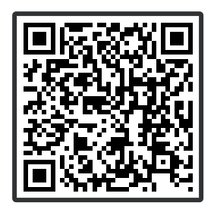
Testing PollEverywhere integration

Slide 20
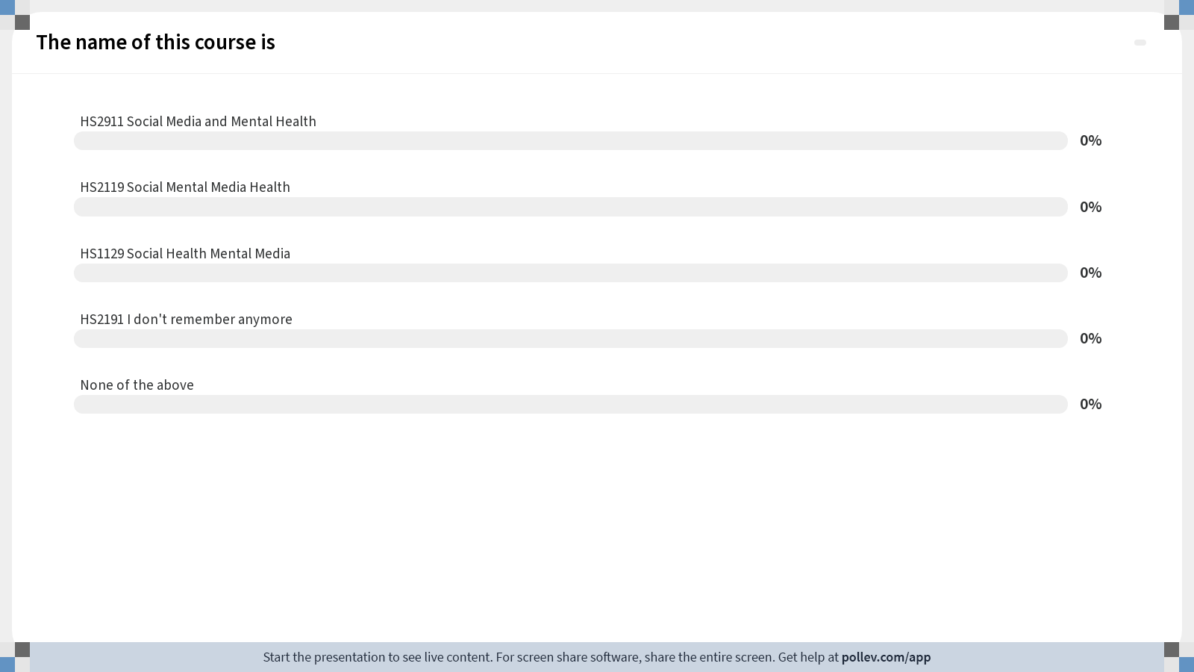
Poll Everywhere multiple choice poll chart screen
Activity Title: The name of this course is
Slide 24
Notes:
Do not modify the notes in this section to avoid tampering with the Poll Everywhere activity.
More info at polleverywhere.com/support
The name of this course is
https://www.polleverywhere.com/multiple_choice_polls/QfqboFmZva5vJMiFUu9ej?display_state=chart&activity_state=closed&state=closed&flow=Engagement&onscreen=persist

Slide 21
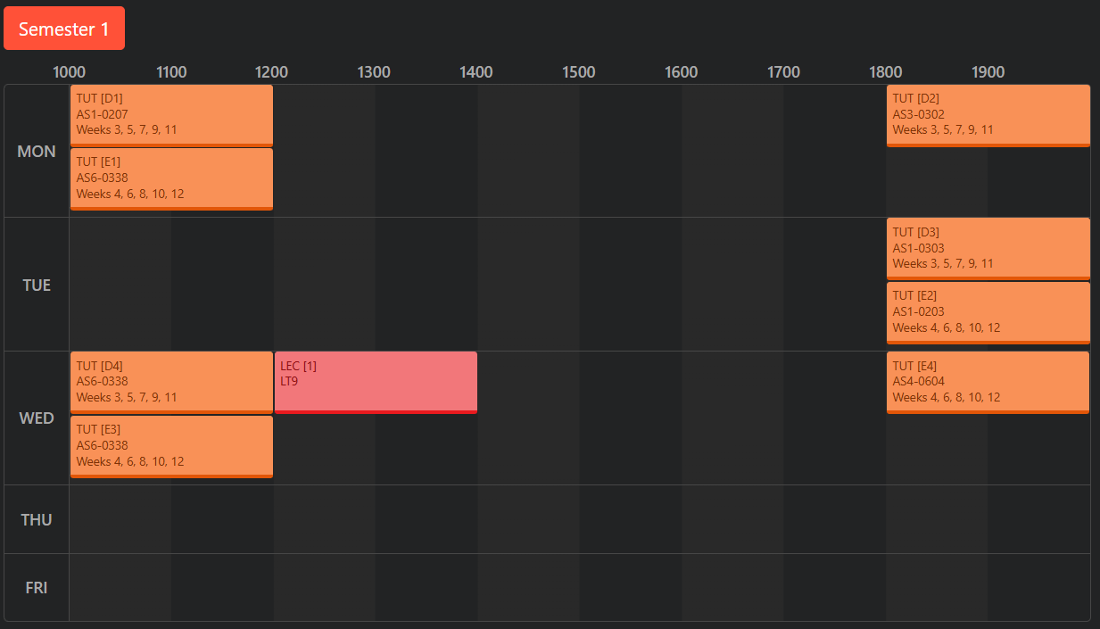
Find us on NUSMODS
https://nusmods.com/courses/HS2911/social-media-and-mental-health

Slide 22
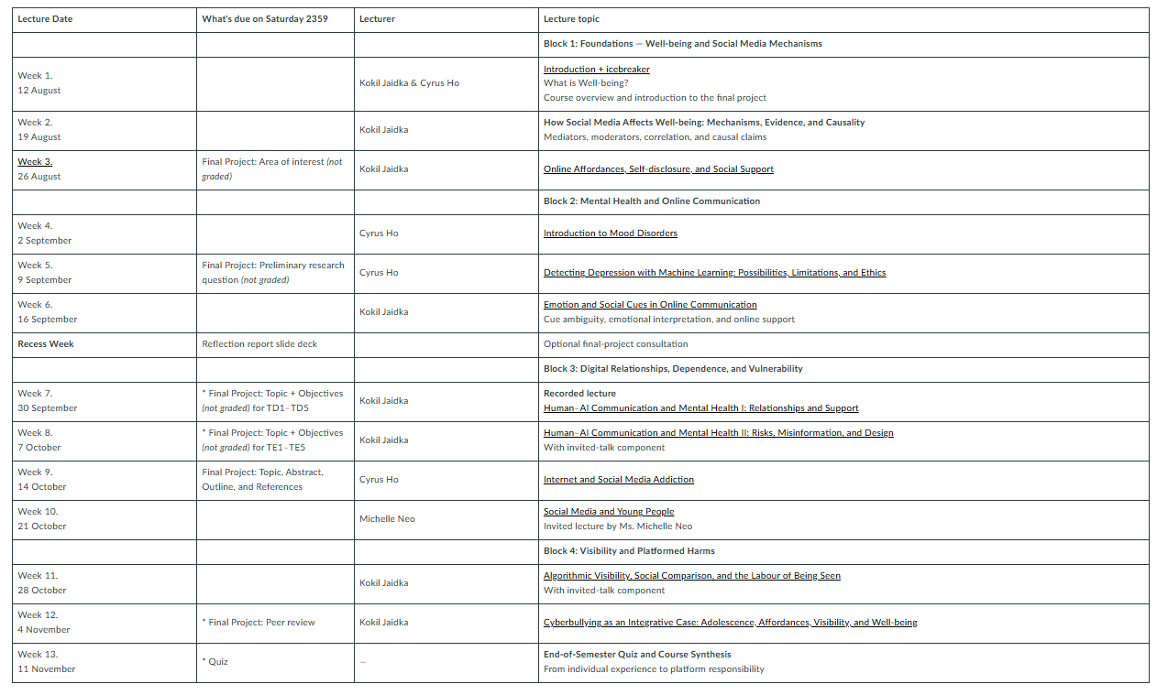
https://canvas.nus.edu.sg/courses/86726/wiki
Find us on Canvas
Pages
Assignments
Files
https://canvas.nus.edu.sg/courses/94598/pages

Slide 23
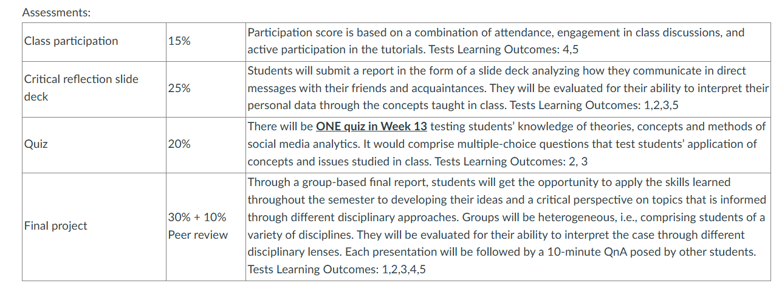
https://canvas.nus.edu.sg/courses/86726/wiki
Assessments
Click on “Pages” and scroll down
https://canvas.nus.edu.sg/courses/94598/pages

Slide 24
Assessments
Class participation (15%)
Quiz (20%)
In-lecture quizzes & QnA +
Q&A in group presentations (CA)
1 multiple choice quiz (Week 13)
1
2
3
4
Reflection slide deck (25%)
Final project (40%)
One slide deck about personal communication styles (Tutorial 2, Week 7)
One group presentation of a case study backed by a literature review (no written report) (Week 7, 9, last tutorial)

Slide 25
Important Dates
Recess Week Saturday
Week 13
Reflection slide deck
Quiz
1
2
3
4
5
Week 7 Saturday
Week 9 Saturday
Last tutorial
Final project topic + abstract
Presentations
Presentation outline
list of references

Slide 26
4 Content Blocks
2. Mental Health and
Online Communication
1. Concepts
Core psychological and communication concepts that help us understand mood disorders, online interactions, and how people navigate digital environments.
How individuals experience social media in daily life—self-disclosure, stress, non-verbal cues online, and how machine-learning tools detect symptoms in digital traces.
3
3. Digital Relationships
4. Visibility and Platform Harms
Broader harms that emerge at scale, including online misinformation, cognitive effects, incivility, cyberbullying, and risks faced by
Platform-level forces shaping behaviour—addiction, visibility, algorithmic influence, countervisuality, and the role of bots and automated agents.

Slide 27
Psychology concepts (Week 4, 5, 9, 10)
Mood disorders 😔
Machine Learning &
Mental Health Signals 🤖🔍
Youth Mental Health
in Digital Spaces 🧠✨
Social media can interact with symptoms of depression and anxiety. People experiencing low mood may be more sensitive to online comparison, rejection, or negative feedback. At the same time, digital platforms can offer distraction, routine, or community support.
Language and behaviour on social media contain patterns—such as tone, posting frequency, or engagement style—that machine-learning models use to detect signs of depression.
Developmental psychology explains why young people may experience stronger emotional effects online.
Addiction, Compulsive Use
& Design Features 🔄
Design elements such as notifications, infinite scroll, and algorithmic rewards can reinforce habitual use. Compulsive checking may disrupt sleep, increase stress, and interfere with work or school.
Notes:
Social media can intensify negative affect through comparison or rejection, but it can also provide distraction, routine, or support. Understanding mood disorders helps explain why social media affects individuals differently. ML methods show how online traces reflect psychological functioning, while raising important questions about privacy, fairness, and responsible mental-health inference.

Slide 28
Communication concepts (the others)
Misinformation &
Cognitive Effects 🧠⚠️
Online Discourse, Incivility
& Cyberbullying 🚨
Online Communication
Affordances
& Non-Verbal Cues 👀 💬
Exposure to inaccurate or distorted content affects how people perceive risks, threats, and social groups. Misinformation can heighten confusion, mistrust, and emotional distress. Understanding how cognitive biases operate in digital environments helps explain why misinformation spreads and why it affects mental wellbeing.
Digital platforms can amplify harshness, conflict, and targeted aggression, which undermine feelings of safety and belonging and increase stress and anxiety, especially among adolescents.
Social media platforms shape what people can do—what they can post, how they can interact, and how visible their messages are. These affordances influence emotional expression, conflict, and support-seeking, all of which affect mental health. They determine whether communication feels intimate, stressful, or overwhelming.
Algorithmic Visibility & Bots 🤖✨
Algorithms decide what content users see and which voices are amplified, influencing mood, attention, and perception. Bots can distort conversations, spread harmful content, and create misleading social cues. These dynamics affect trust, belonging, and emotional wellbeing.
Notes:
Social media can intensify negative affect through comparison or rejection, but it can also provide distraction, routine, or support. Understanding mood disorders helps explain why social media affects individuals differently. ML methods show how online traces reflect psychological functioning, while raising important questions about privacy, fairness, and responsible mental-health inference.

Slide 29
Burning questions: Course Logistics
Will lectures be recorded?
Yes. With Kokil Jaidka’s permission, you can also join on Zoom
Will the course be bell-curved?
It will be graded the same way all NUS undergrad courses are graded..
Is the workload heavy?
The workload is moderate and steady. Tasks are spaced out and support materials will be provided early.

Slide 30
Burning questions: Assessments
What are quizzes like?
They are applied. Questions focus on concepts discussed in class, not on memorising entire readings.
How hard is the reflection slide deck?
The deck is guided. You will receive examples and a template, and a clear rubric, and you may draw from any week’s concepts.
I’m worried about scoring well..
Assessment is designed to reward clarity, effort, and understanding.The rRubrics are transparent and we will show strong past examples.
Can I choose how deeply to explore a topic?
Yes. Reflection tasks allow flexibility: it’s better to focus deeply on one angle.

Slide 31
Burning questions: Content & Understanding
What research frameworks are used in interdisciplinary work on social media & mental health?
We draw from psychology, communication, HCI, and data science, integrating concepts through case studies and applied examples.
How will non-psychology students be supported?
We introduce all psychological concepts from the ground up.
Each topic includes plain-language explanations + examples + guided discussion.
Is the content very technical?
All topics (e.g., machine learning) are taught at a conceptual level, with no coding and no advanced statistics required.

Slide 32
Burning questions:
Group Work & Participation
What if I’m introverted or shy?
Participation includes small-group activities and written tasks—not just speaking aloud. You do not need to dominate discussion to do well.
I’m concerned about random group assignment.
Groups are balanced for diversity of skills. Clear roles, check-ins, peer reviews, and rubrics help ensure fairness and smooth collaboration.

Slide 33
Burning questions:
General Concerns
What if the course isn’t what I expected?
Week 1–2 are designed to show the big picture. From there we move step-by-step with structured slides, examples, and guided practice.
Will the module be stressful or abstract?
We care about application through real-world examples and provide weekly concept recaps. You will always know what to focus on.
Will it get boring?
Blocks includes interactive activities, guest talks, and real case examples to keep things dynamic.

Slide 34
Managing Social Media Use
to Promote Mental Health
Mindful Use
Practice mindfulness when using social media. Pause and take a break when social media use ceases to be part of recreation.
Content Filters
Use in-built content filters on any apps to limit unwanted or negative interactions and curate feeds that are inspiring.
Positive Interactions
Connect with people who post engaging, positive content on social media. Reach out if you need help or support.
Breaks
Take regular breaks from social media, limiting usage to a few sessions a day, if possible. Use some of the free time to work on your hobbies or to exercise.

Slide 35
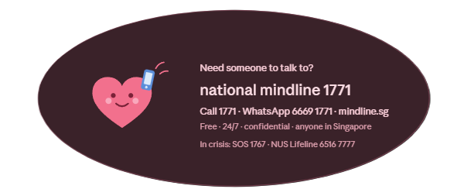
Take care of yourselves

Slide 36
QnA

