Slide 1

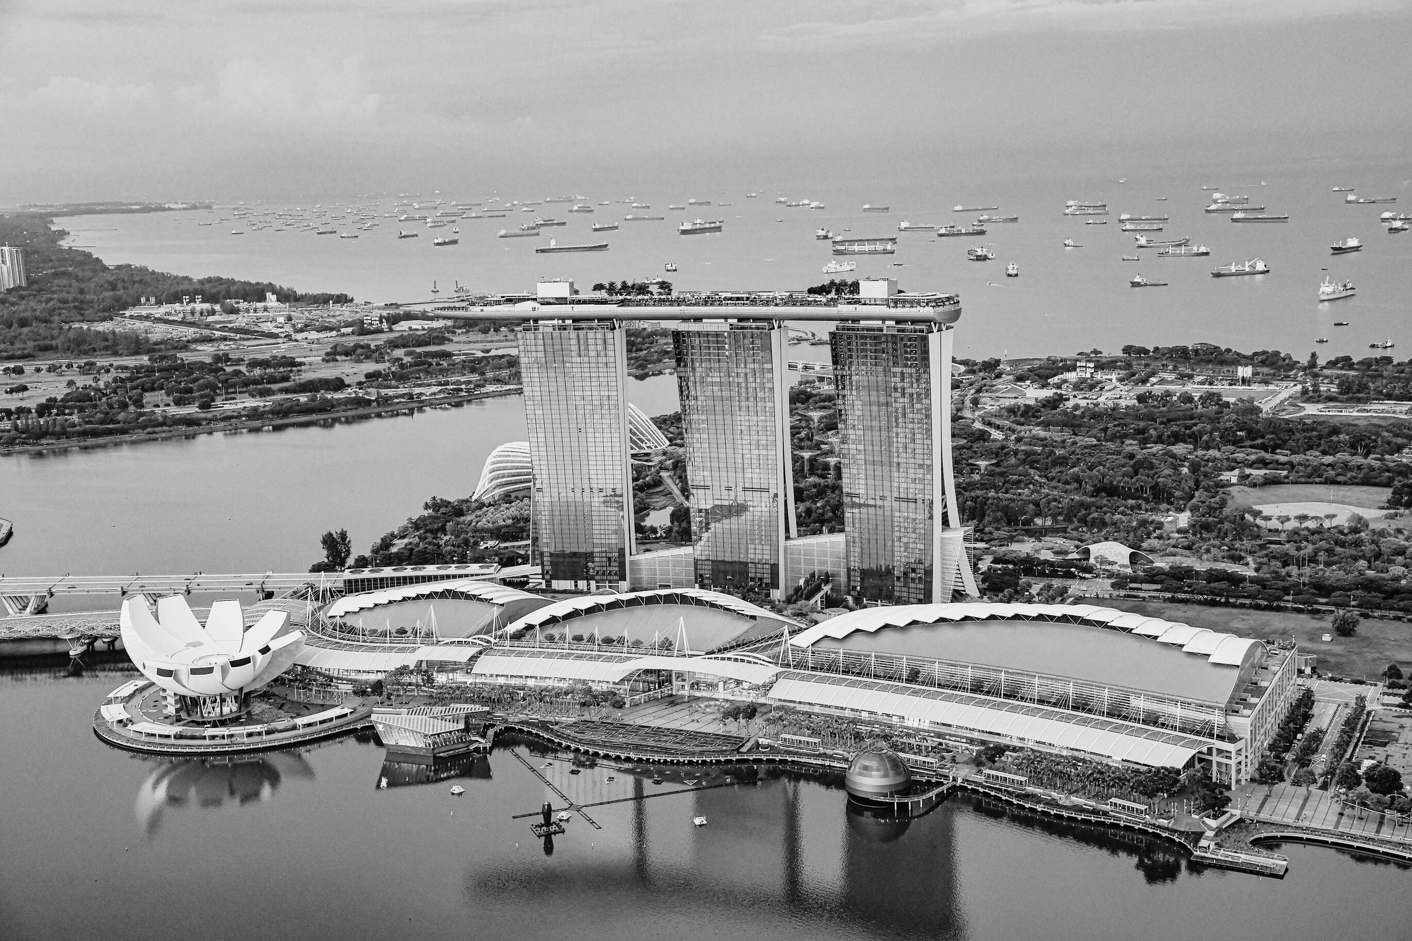



SOCIAL MEDIA &
WELL-BEING
FROM TAYLOR SWIFT INSIGHTS TO NATIONAL GUIDELINES

Slide 2



DEFINING WELL-BEING
PLEASURE AND ENJOYMENT
"Hedonic happiness" or subjective well-being
A. MOODS AND EMOTIONS
B. SATISFACTION
Are you experiencing positive moods and emotions? Negative moods and emotions?
How satisfied are you with your life? With work? Family?
(Affective)
(Cognitive or evaluative)

Slide 3
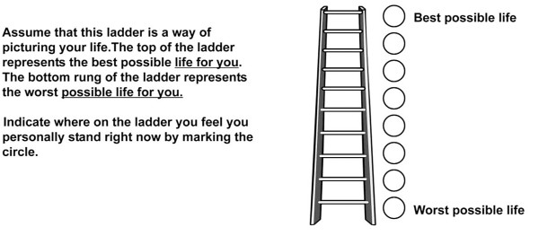
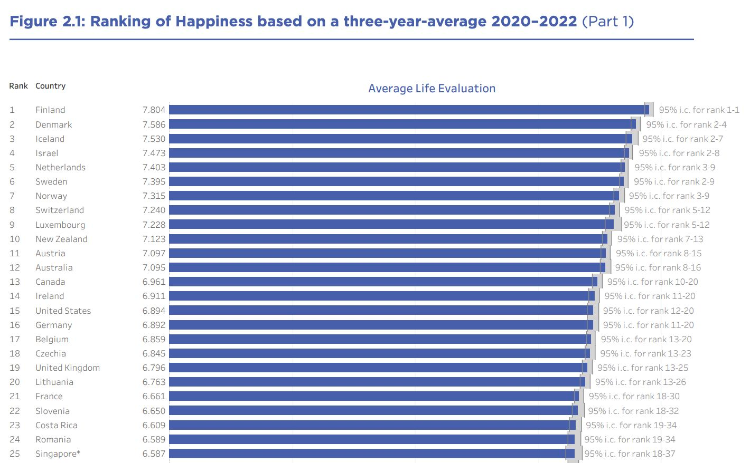
DEFINING WELL-BEING
WORLD HAPPINESS REPORT: LIFE SATISFACTION (CANTRIL LADDER)
#1: Finland (7.8)
#25: Singapore (6.6)

Slide 4

DEFINING WELL-BEING
PLEASURE AND ENJOYMENT
"Hedonic happiness" or subjective well-being
A. MOODS AND EMOTIONS
B. SATISFACTION
Are you experiencing positive moods and emotions? Negative moods and emotions?
How satisfied are you with your life? With work? Family?
(Affective)
(Cognitive or evaluative)
MEANING AND PURPOSE
"Eudaimonic happiness"
Being your 'true self': knowing who you are, enjoying and being engaged in activities, pursuing excellence, having purpose

Slide 5

DEFINING WELL-BEING
PLEASURE AND ENJOYMENT
"Hedonic happiness" or subjective well-being
A. MOODS AND EMOTIONS
B. SATISFACTION
Are you experiencing positive moods and emotions? Negative moods and emotions?
How satisfied are you with your life? With work? Family?
(Affective)
(Cognitive or evaluative)
MEANING AND PURPOSE
MENTAL HEALTH
"Eudaimonic happiness"
Depression, anxiety, stress
Being your 'true self': knowing who you are, enjoying and being engaged in activities, pursuing excellence, having purpose

Slide 6
VOTE: SOCIAL MEDIA’S IMPACT ON WELL-BEING?
PLEASURE AND ENJOYMENT
"Hedonic happiness" or subjective well-being
A. MOODS AND EMOTIONS
B. SATISFACTION
Are you experiencing positive moods and emotions? Negative moods and emotions?
How satisfied are you with your life? With work? Family?
(Affective)
(Cognitive or evaluative)
MEANING AND PURPOSE
MENTAL HEALTH
"Eudaimonic happiness"
Depression, anxiety, stress
Being your 'true self': knowing who you are, enjoying and being engaged in activities, pursuing excellence, having purpose

Slide 7
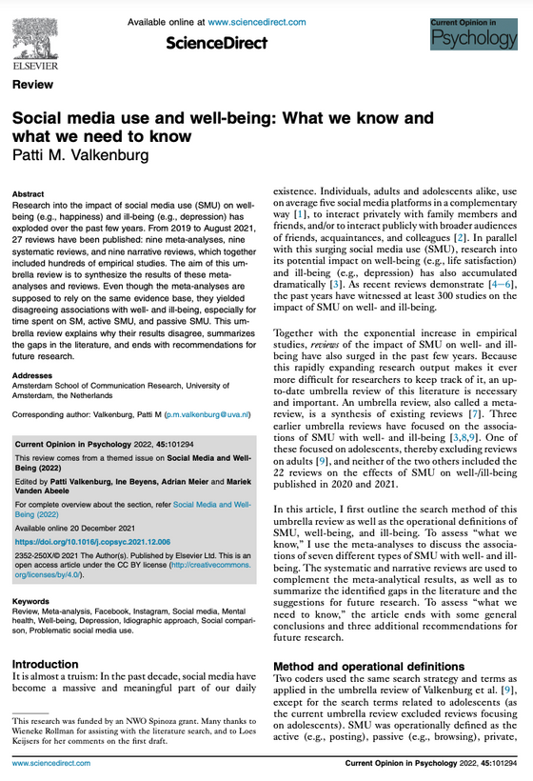
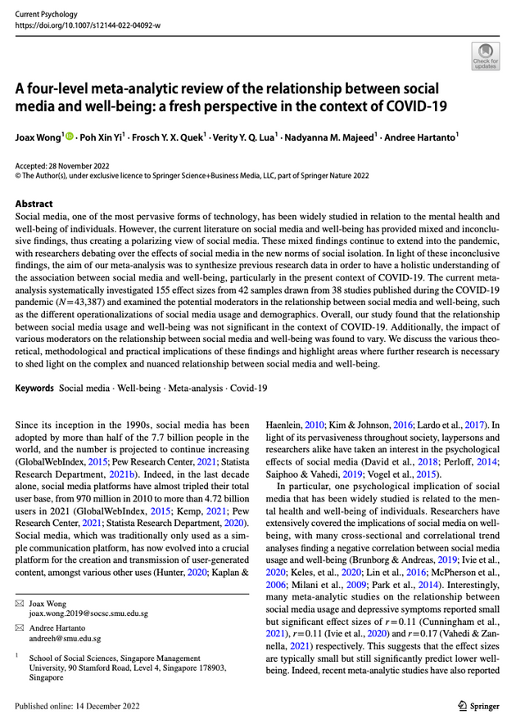
WHAT WE KNOW SO FAR
To date, around 20 meta-analyses & systematic reviews
>300 studies, largely correlational
Defining ‘social media’
  Time spent on social media (overall, passive vs. active)
  Frequency of social media usage
  Size of social media network
  Problematic social media usage (resulting in neglect to life activities)
  Social comparison from social media

Slide 8
LIMITED EVIDENCE OF IMPACT
Problematic, comparison: small negative association
General use: marginal / non-significant
PLEASURE AND ENJOYMENT
"Hedonic happiness" or subjective well-being
A. MOODS AND EMOTIONS
B. SATISFACTION
Are you experiencing positive moods and emotions? Negative moods and emotions?
How satisfied are you with your life? With work? Family?
(Affective)
(Cognitive or evaluative)
MEANING AND PURPOSE
MENTAL HEALTH
"Eudaimonic happiness"
Depression, anxiety, stress
Being your 'true self': knowing who you are, enjoying and being engaged in activities, pursuing excellence, having purpose
Small negative association

Slide 9

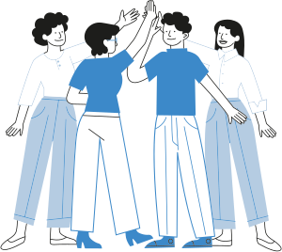

HOW TO PROGRESS BEYOND 300 STUDIES
FOCUS ON CONTENT
DON’T ASSUME EVERYONE’S THE SAME
CAUSE & EFFECT
What are people doing on social media?
Move beyond correlations

Slide 10
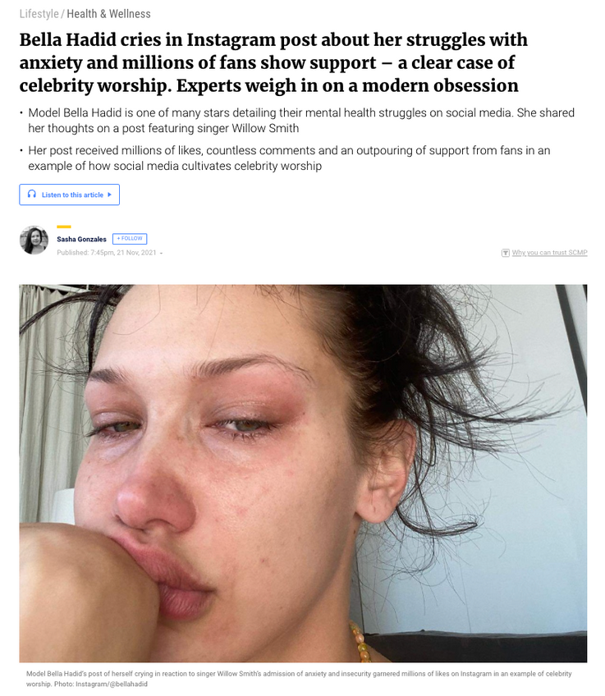
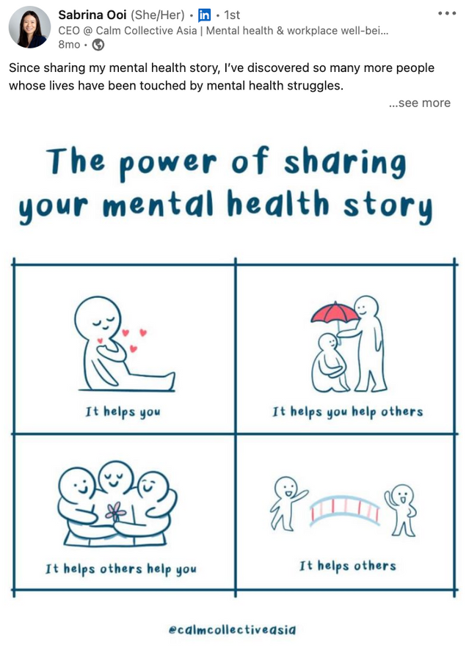
CASE STUDY: FOCUS ON CONTENT
HOW DOES MENTAL HEALTH CONTENT ON SOCIAL MEDIA INFLUENCE WELL-BEING?

Slide 11
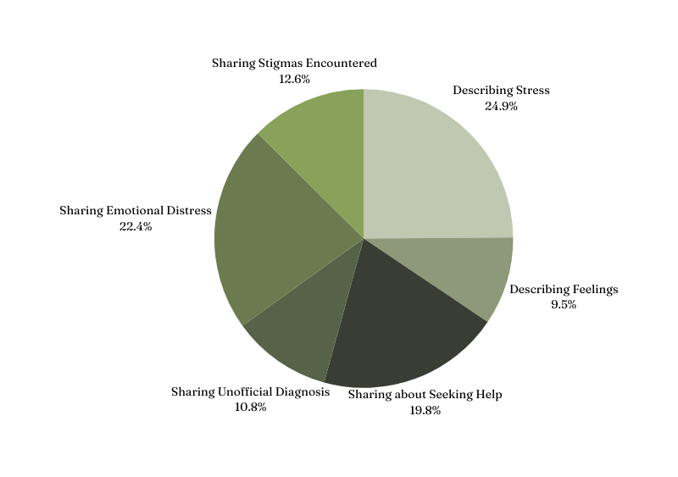
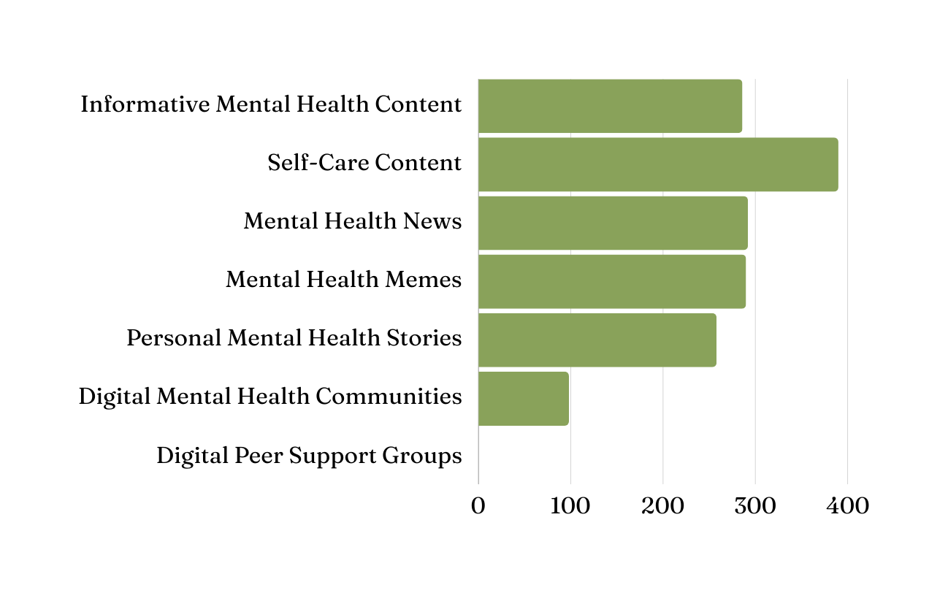
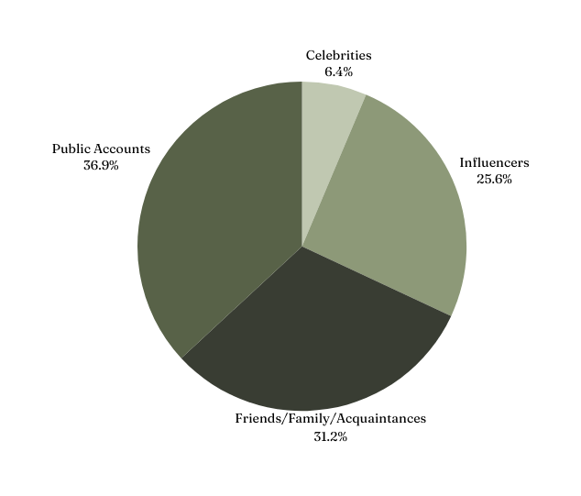
SURVEY OF 503 YOUTHS (18-34)
Nearly 3 in 5 posts relate to feelings
Most respondents have encountered mental health content
Posts come from multiple sources
(Erdembileg, in preparation)

Slide 12
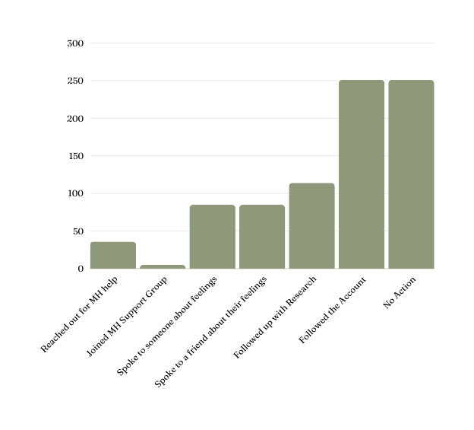
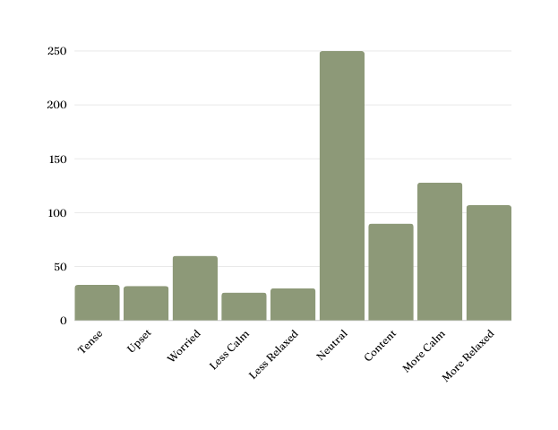
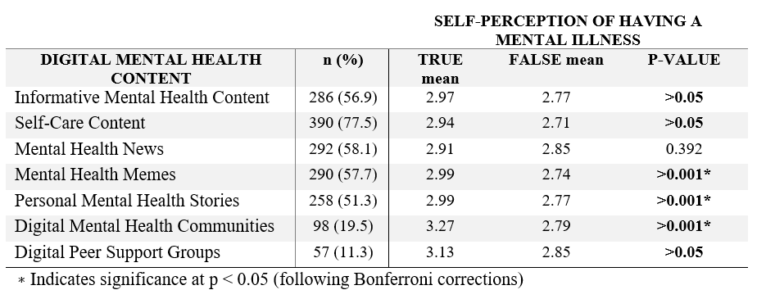
IMPACT ON WELL-BEING & BEHAVIOR
For most youths, seeing these posts makes them feel better / no different
1 in 2 take no action or simply follow the account

Slide 13
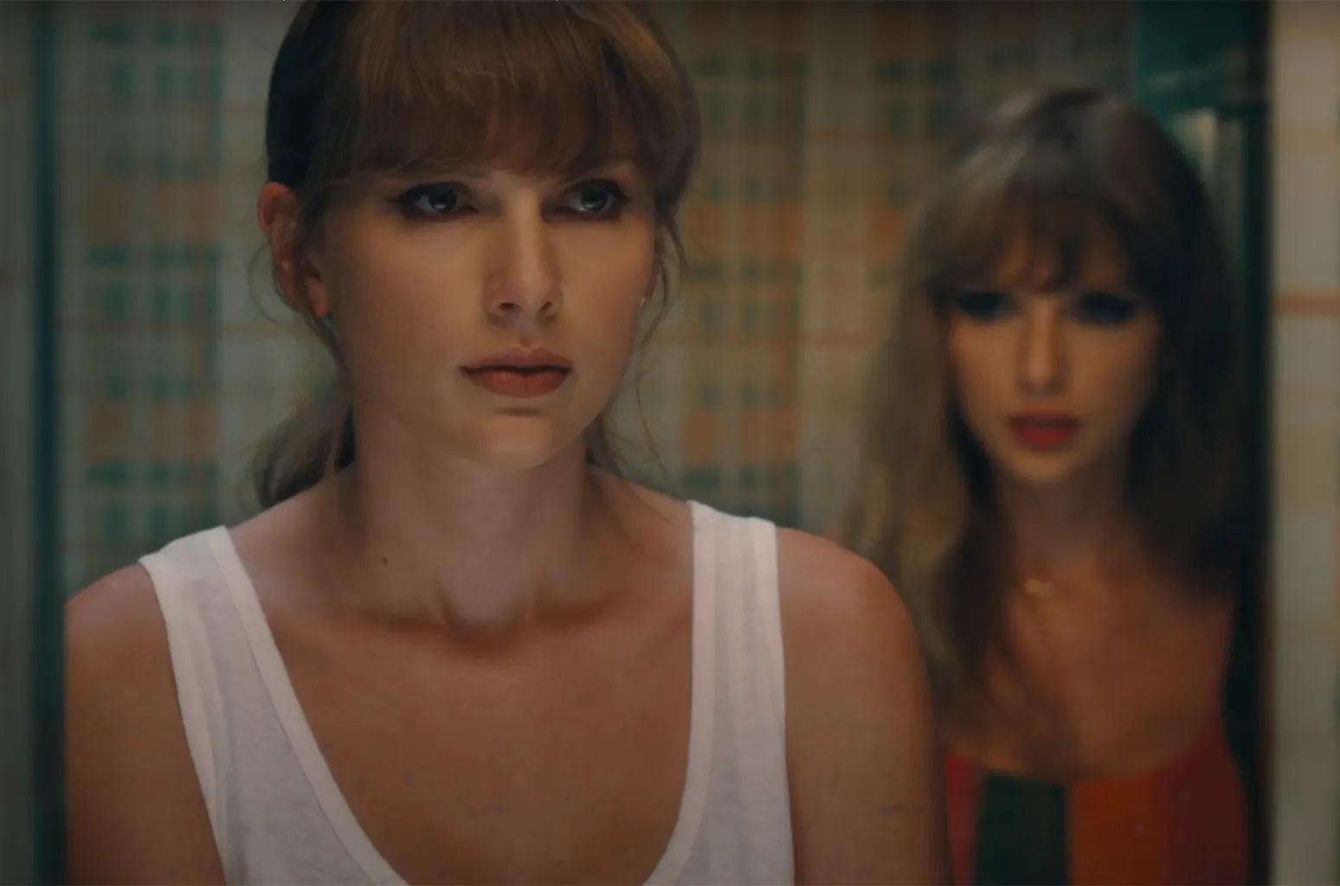
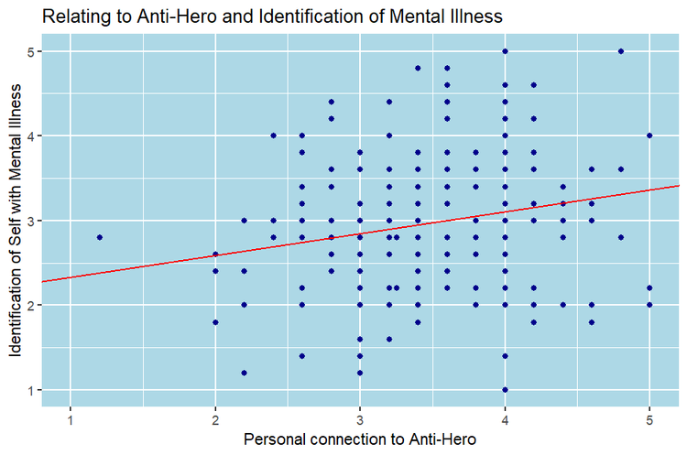
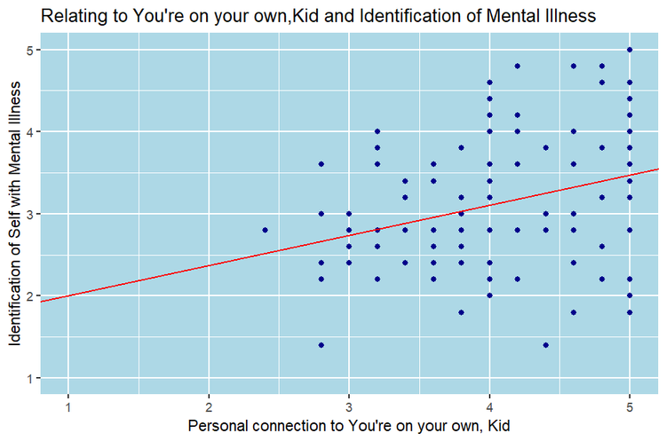
ANALOGOUS IMPACT: TAYLOR SWIFT SONGS
When my depression works the graveyard shift
All of the people
I've ghosted stand there in the room
It's me, hi, I'm the problem, it's me
At tea time, everybody agrees

Slide 14
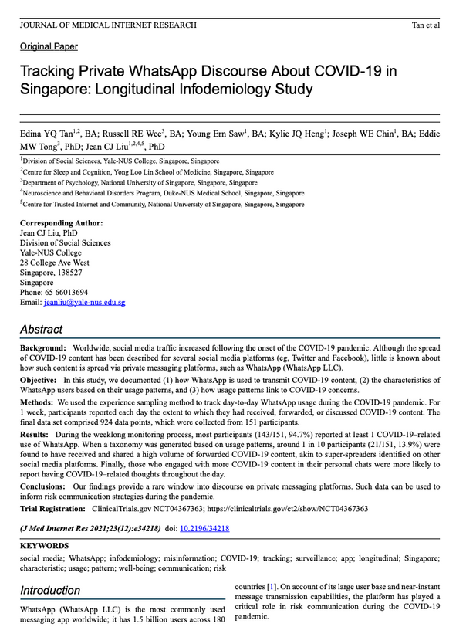
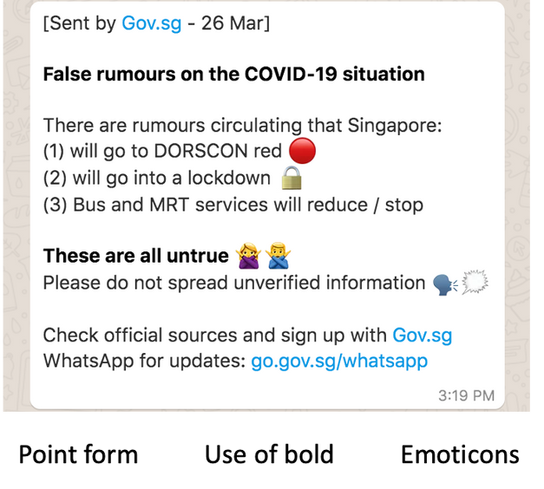
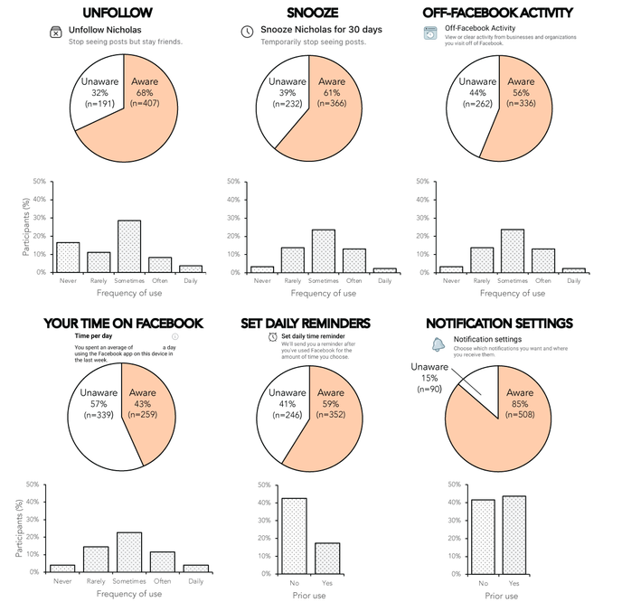
OTHER CASE STUDIES: FOCUS ON CONTENT
Do WhatsApp usage patterns predict fears and thoughts?
(Tan et al. 2021: 1150 respondents in Singapore and India)
Does subscription to an official WhatsApp channel predict depression, anxiety & stress?
(Liu & Tong, 2020: 1145 adults)
Does use of Facebook‘s well-being features predict depression, anxiety & stress?
(Barsova et al., 2022: 600 youths)

Slide 15

CASE STUDY: CAUSE & EFFECT
HOW DOES SOMEONE ELSE’S SOCIAL MEDIA USE IMPACT YOUR WELL-BEING?

Slide 16
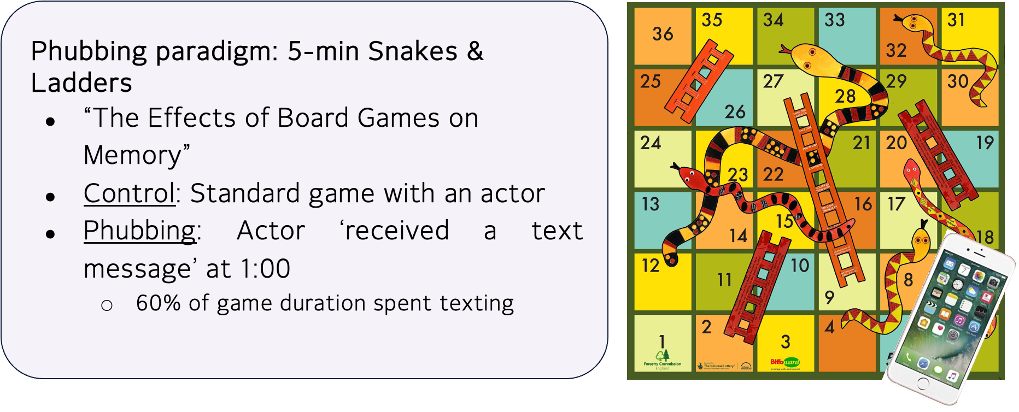
6 EXPERIMENTS ON ‘PHUBBING’

Slide 17
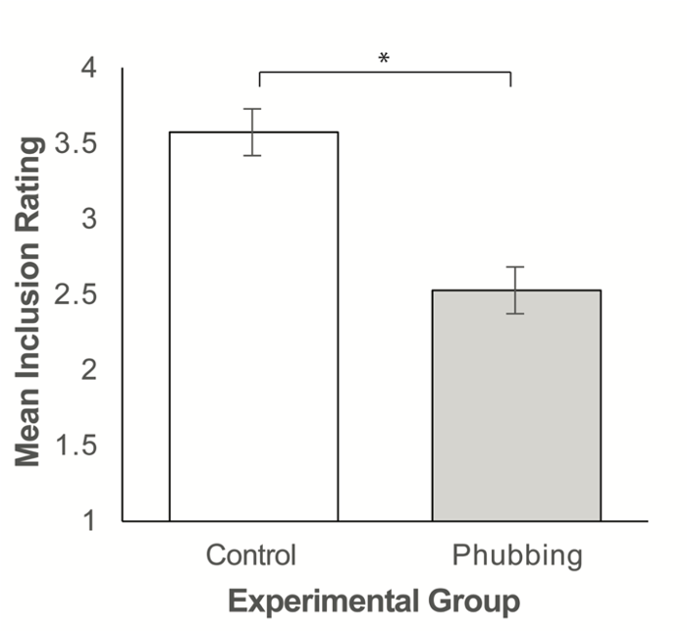
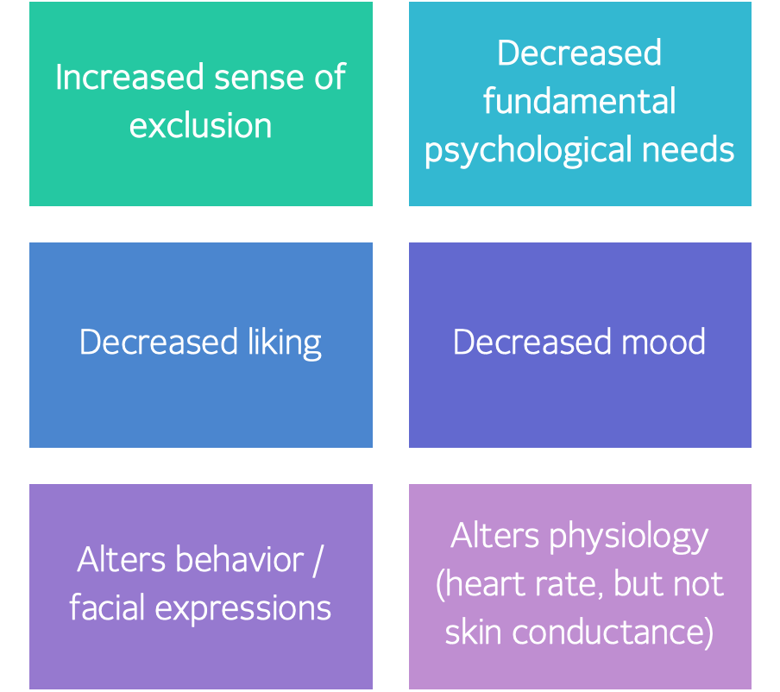
‘PHUBBING’ FEELS LIKE OSTRACISM

Slide 18


SUMMARY OF RESEARCH
OVER 300 STUDIES
  Correlation of general social media usage & well-being metric
  Modest impact when we focus on negative social media usage & on poor mental health
STRONGER ACTIONABLE INSIGHTS
  Focus on specific social media usage (e.g. type of content, use of feaatures)
  Focus on causal designs (e.g., phubbing experiments)

Slide 19
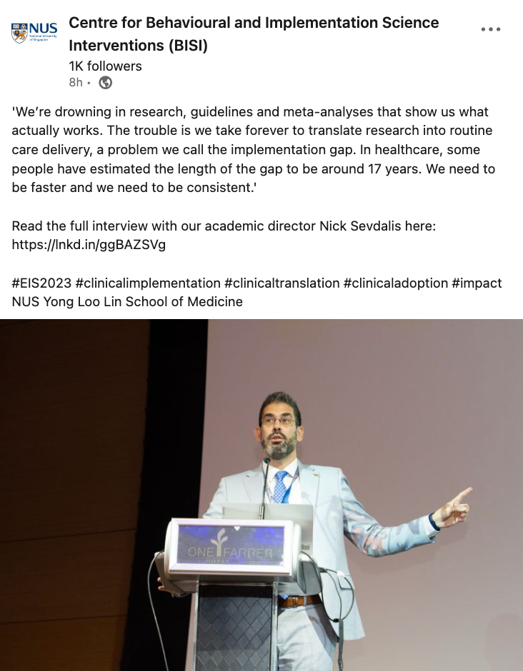

TRANSLATION: WHAT HAPPENS NEXT?
We’re drowning in research, guidelines and meta-analyses that show us what actually works.
The trouble is we take forever to translate research into routine care delivery, a problem we call the implementation gap.
In healthcare, some people have estimated the length of the gap to be around 17 years.

Slide 20
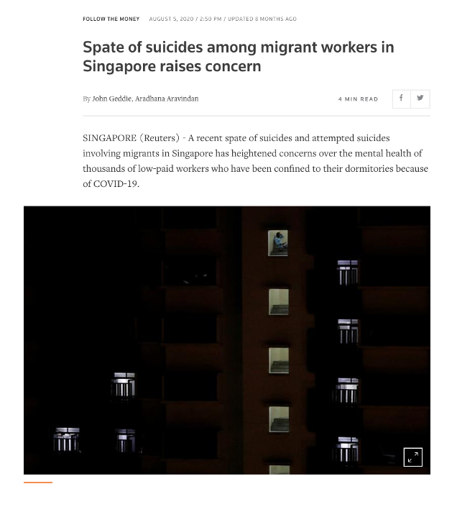
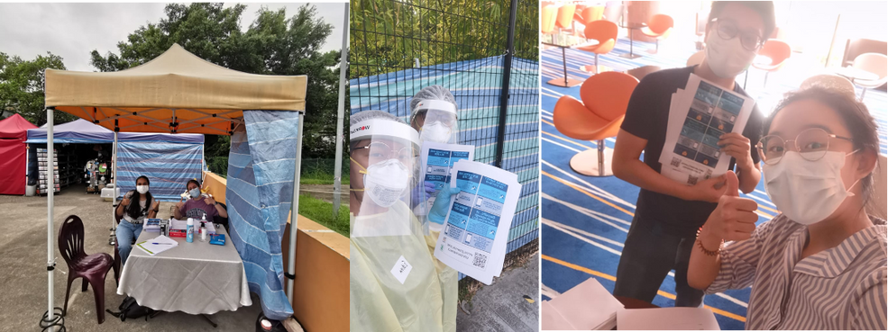
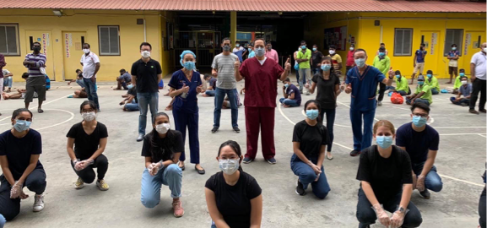
CASE STUDY: STARTING CONVERSATIONS
WHAT CIRCUMSTANCES & SOCIAL MEDIA USAGE PATTERNS PREDICT
MIGRANT WORKERS’ MENTAL HEALTH?

Slide 21
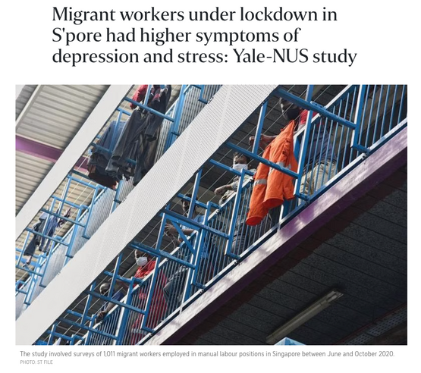
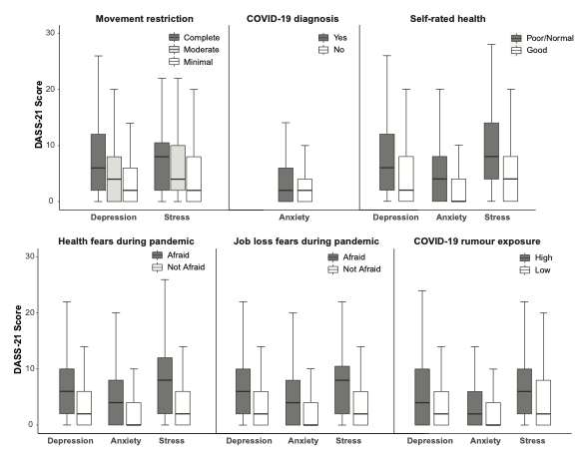
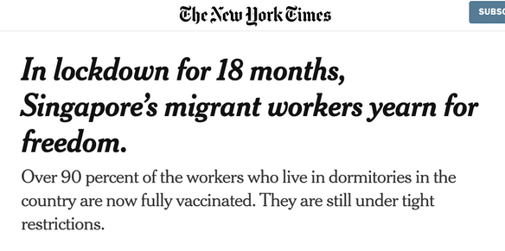
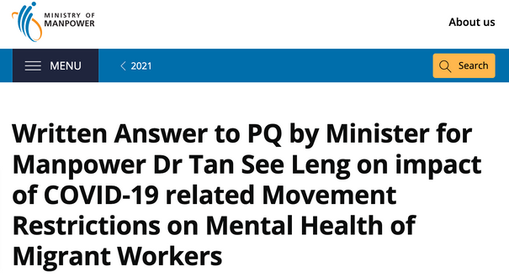
PUBLISHERS, NEWSROOMS, & PARLIAMENT
Pandemic-related activities, perception of situation & rumours
(Saw et al. 2021: 1011 migrant workers)

Slide 22


CASE STUDIES: SHAPING POLICIES
Practical guidelines with imperfect evidence

Slide 23
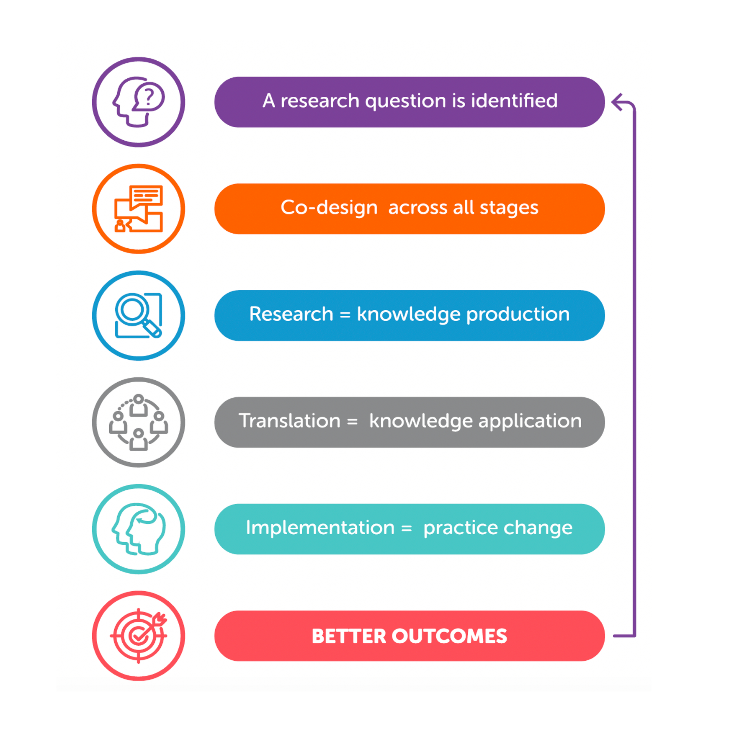
SUMMARY: RESEARCH-PRACTICE CYCLE
Give away research:
  Public forums
  Media
  Academic conferences
Strong partnerships:
  Researchers
  Policy-makers
  Stakeholders & practitioners: Youths, schools, parents, educators, healthcare
  Industry: Social media companies
Source: https://insideoutinstitute.org.au/blog/the-research-practice-cycle-what-is-it-and-why-is-it-important

Slide 24

TAKING A STEP BACK:
WHAT INFLUENCES WELL-BEING
☺☺
Genetics, personality (extraversion, conscientiousness), life events (childbirth), marital quality, financial satisfaction, meaning in life, self-compassion, successful goal pursuit
Increased well-being
Personality (openness to experience, agreeableness), creativity, life events (marriage), academic achievement, education level, autonomy, entrepreneurship, economic status, receiving cash transfers, physical activity, nature connectedness, quantity & quality of social network, helping behaviors, character strength interventions, kindness based meditation, mindfulness, forgiveness, imagining positive future scenarios
☺
0°C
Decreased
well-being
☹
Life events (divorce, reemployment, retirement), materialism, use of the internet, use of social networking sites, exposure to materialistic cues (e.g. luxury advertisements)
☹☹
Personality (neuroticism), life events (bereavement, unemployment), loneliness, imagining negative future scenarios

Slide 25
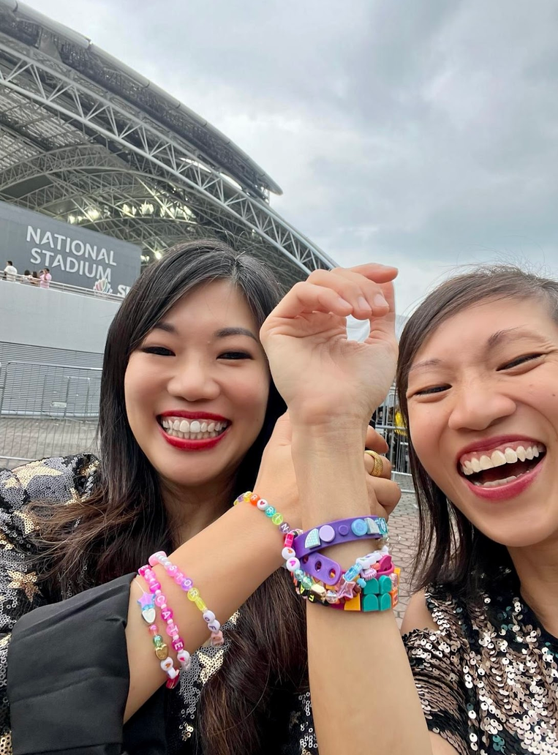
FOR WELL-BEING, PURSUE ‘SOCIAL’ WITHIN & BEYOND SOCIAL MEDIA
“SO MAKE THE FRIENDSHIP BRACELETS”

