Slide 1


HS2911 Week 2
Self-Disclosure on Social Media
Dr. Kokil Jaidka
Department of Communications & New Media National University of Singapore

Slide 2
Recap: Social Media & Well-Being (Dr Jean Liu)

Slide 3

DEFINING WELL-BEING
PLEASURE AND ENJOYMENT
"Hedonic happiness" or subjective well-being
A. MOODS AND EMOTIONS
B. SATISFACTION
Are you experiencing positive moods and emotions? Negative moods and emotions?
How satisfied are you with your life? With work? Family?
(Affective)
(Cognitive or evaluative)
MEANING AND PURPOSE
MENTAL HEALTH
"Eudaimonic happiness"
Depression, anxiety, stress
Being your 'true self': knowing who you are, enjoying and being engaged in activities, pursuing excellence, having purpose

Slide 4
What We Know So Far
~20 meta-analyses, 300+ studies, mostly correlational
General social media use: marginal / non-significant association with well-being
Problematic use & social comparison: small negative association
How to Progress Beyond 300 Studies
Focus on content — what are people actually doing on social media?
Don’t assume everyone’s the same
Move beyond correlation — chase cause & effect

Slide 5
Case Study: Focus on Content
How does mental-health content on social media influence well-being?
Survey of 503 youths: most have encountered MH content; ~3 in 5 posts relate to feelings
For most youths, seeing these posts made them feel better or no different
1 in 2 took no action, or simply followed the account

Slide 6
The Bigger Picture
Social media is one modest factor among many shaping well-being
Genetics, personality, life events, relationships, meaning, self-compassion often matter more
Research-practice cycle: findings take time to reach guidelines (the ‘implementation gap’)

Slide 7
Today's Bridge: From Well-Being to Self-Disclosure
Dr Liu’s takeaway: pursue ‘social’ within and beyond social media
Today we zoom into one specific online behavior: self-disclosure
Self-disclosure is a concrete example of ‘focus on content’ — what people share, and why it matters for stress and well-being

Slide 8
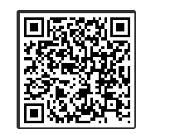

What do you think is your parent's/guardian's biggest source of happiness?

Slide 9
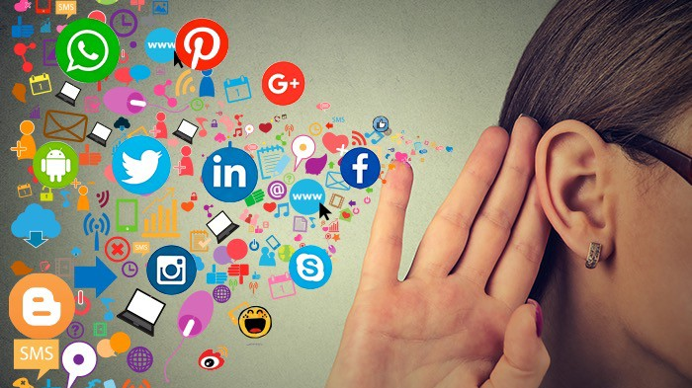

Slide 10
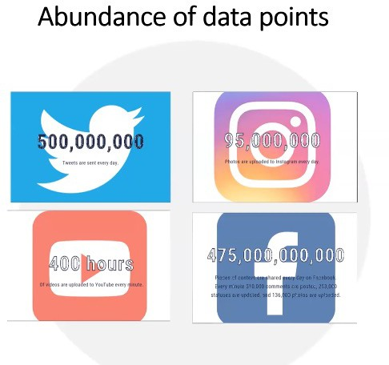

Slide 11
Social Media are:
Digital platforms that facilitate the creation, sharing, and exchange of user-generated content, as well as the fostering of online communities and interactions among users.
These platforms allow individuals, groups, and organizations to communicate, collaborate, and build relationships in real-time or asynchronously.

Slide 12
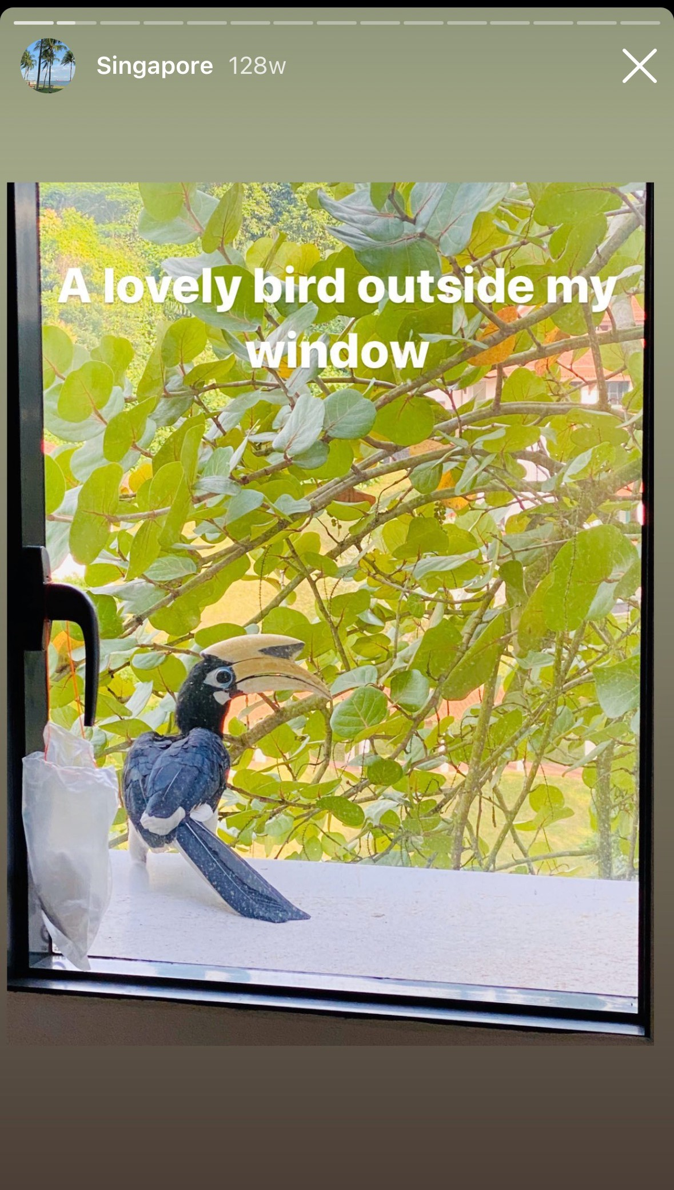

Slide 13
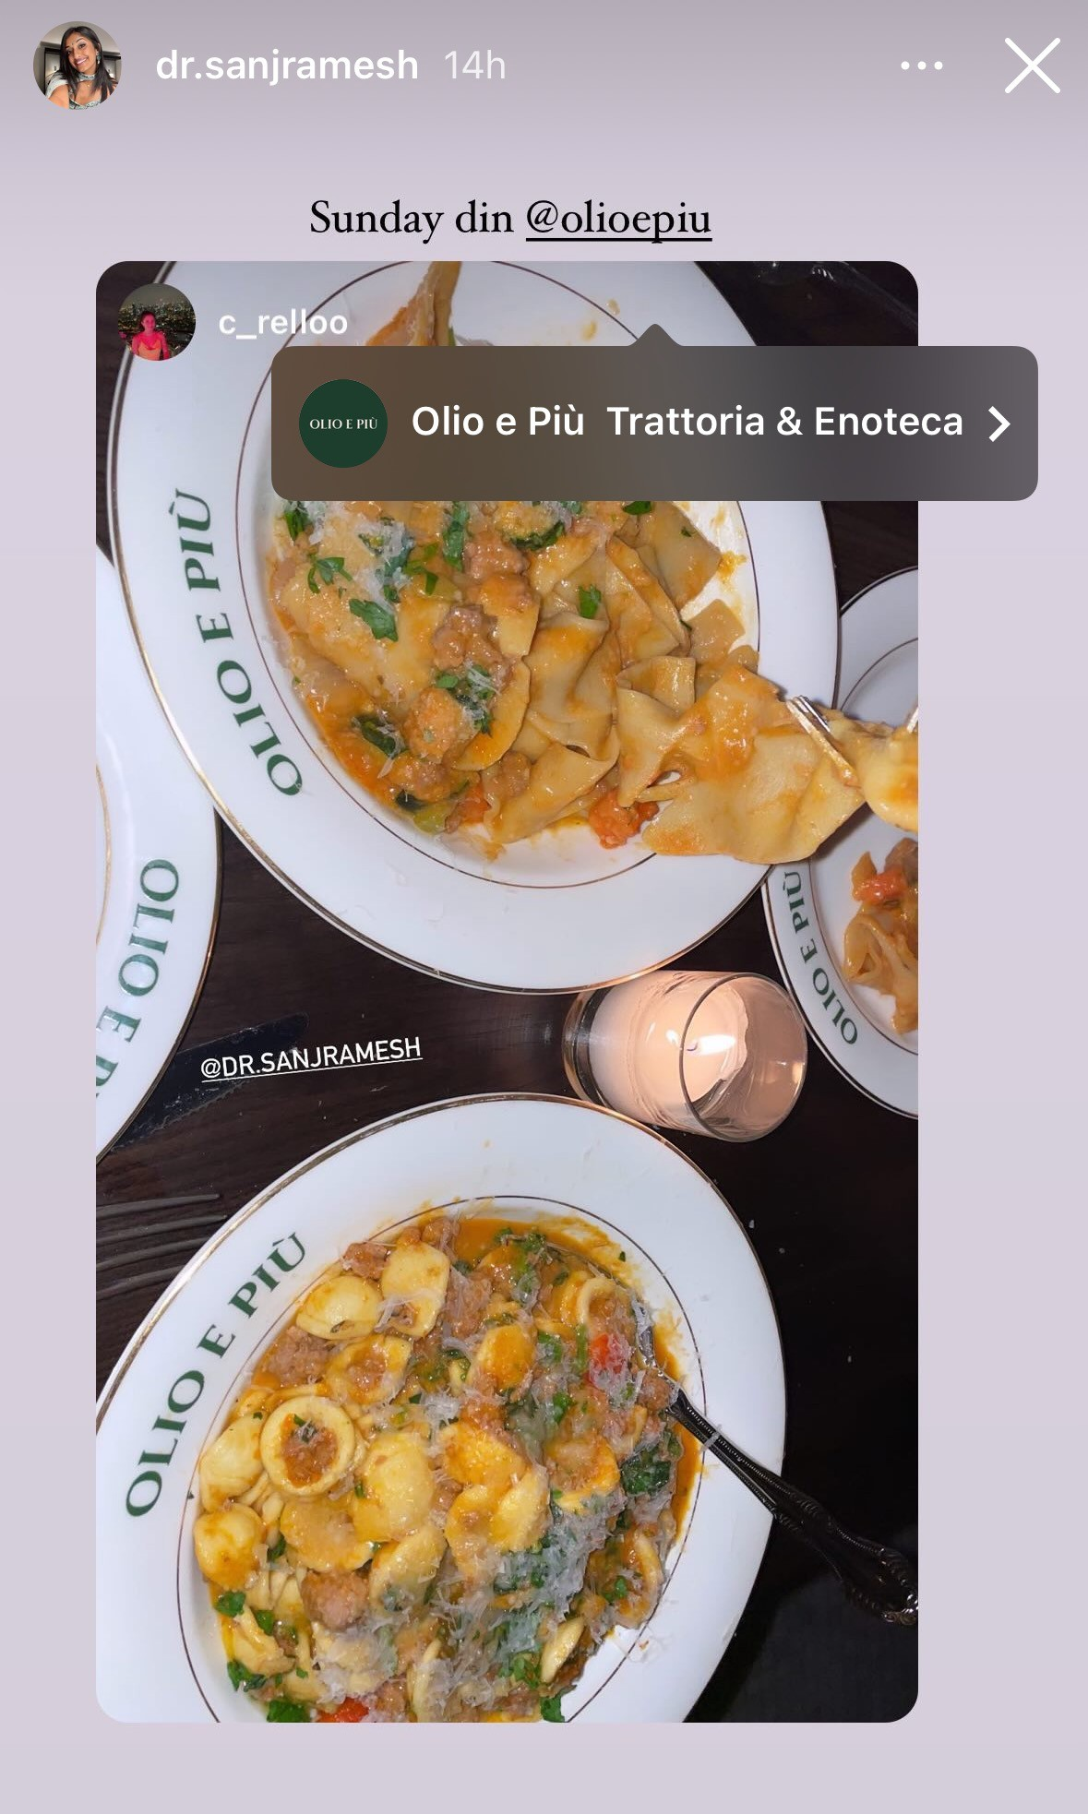

Slide 14
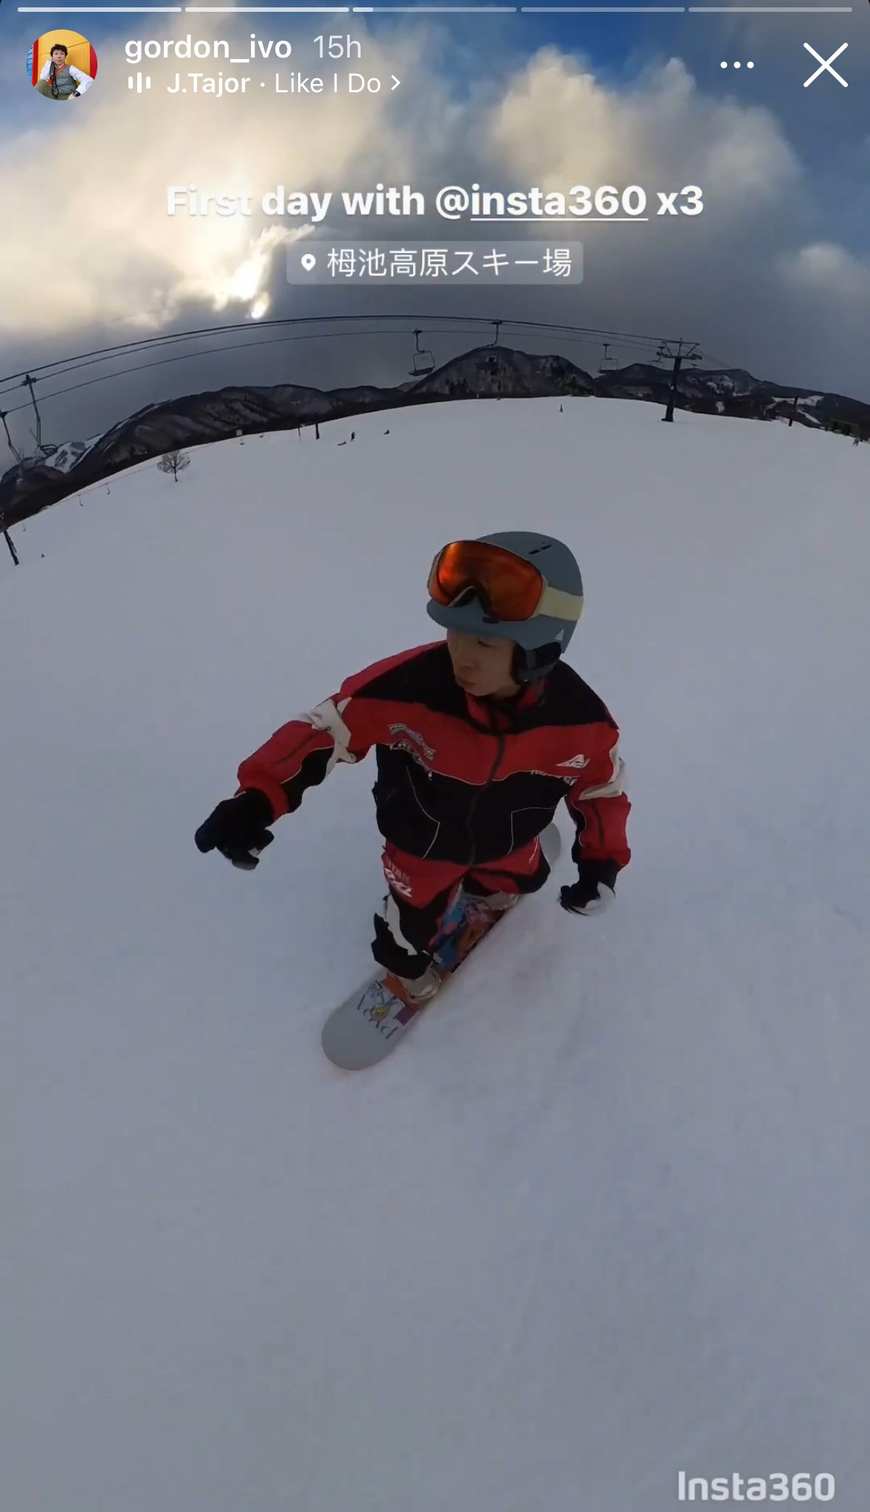

Slide 15
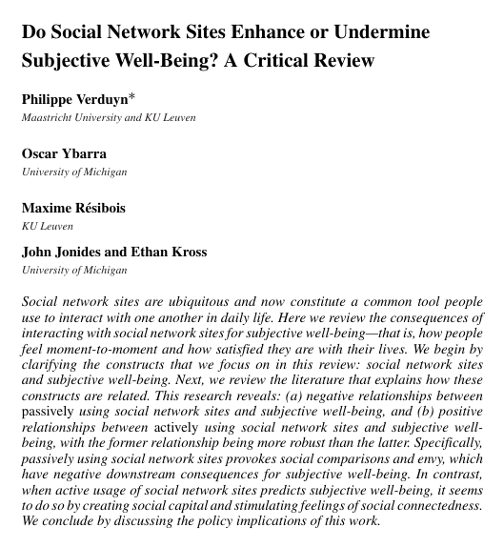
Verduyn, P., Ybarra, O., Résibois, M., Jonides, J., & Kross, E. (2017). Do social network sites enhance or undermine subjective well‐being? A critical review. Social Issues and Policy Review, 11(1), 274-302.

Slide 16
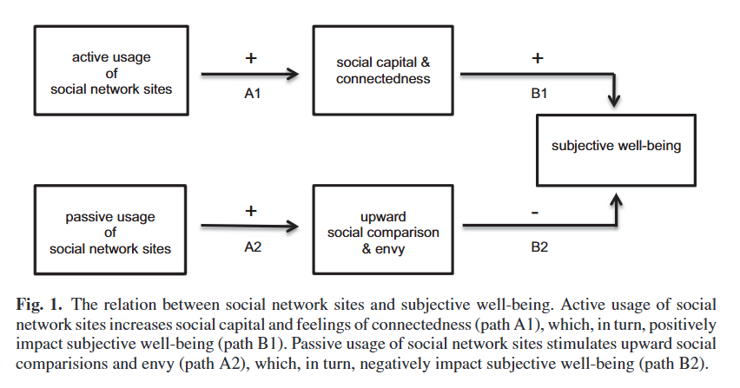
Verduyn, P., Ybarra, O., Résibois, M., Jonides, J., & Kross, E. (2017). Do social network sites enhance or undermine subjective well‐being? A critical review. Social Issues and Policy Review, 11(1), 274-302.

Slide 17
Self-Disclosure
The act of revealing personal information (e.g., thoughts, feelings, experiences) to others (Jourard, 1971)
Self-disclosure fosters intimacy (Altman & Taylor, 1973)
Self-disclosure is therapeutic (Pennebaker, 1997)

Slide 18
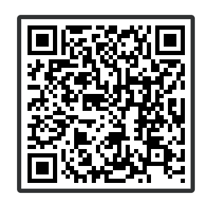
When you self-disclose on social media, what do you usually share?

Slide 19
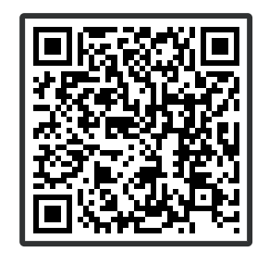
Who were you imagining would see your self-disclosure posts?

Slide 20
Factors influencing online disclosure
Background
The Theory of Situational Privacy and Self-Disclosure (Masur, 2018)
Personal factors
Interpersonal factors
External factors
The Functional Model of Self-disclosure on SNS (Bazarova & Choi, 2014)
Goals and motivations
Channel differences
Disclosure Decision-Making Framework
(Andalibi & Forte, 2018)
Self goals
Audience
Networks
Platforms
Temporality
Stigma
The Extended Privacy Calculus Model
(Dienlin & Metzger, 2016)
Perceived benefits
Privacy concerns
Self-efficacy

Slide 21
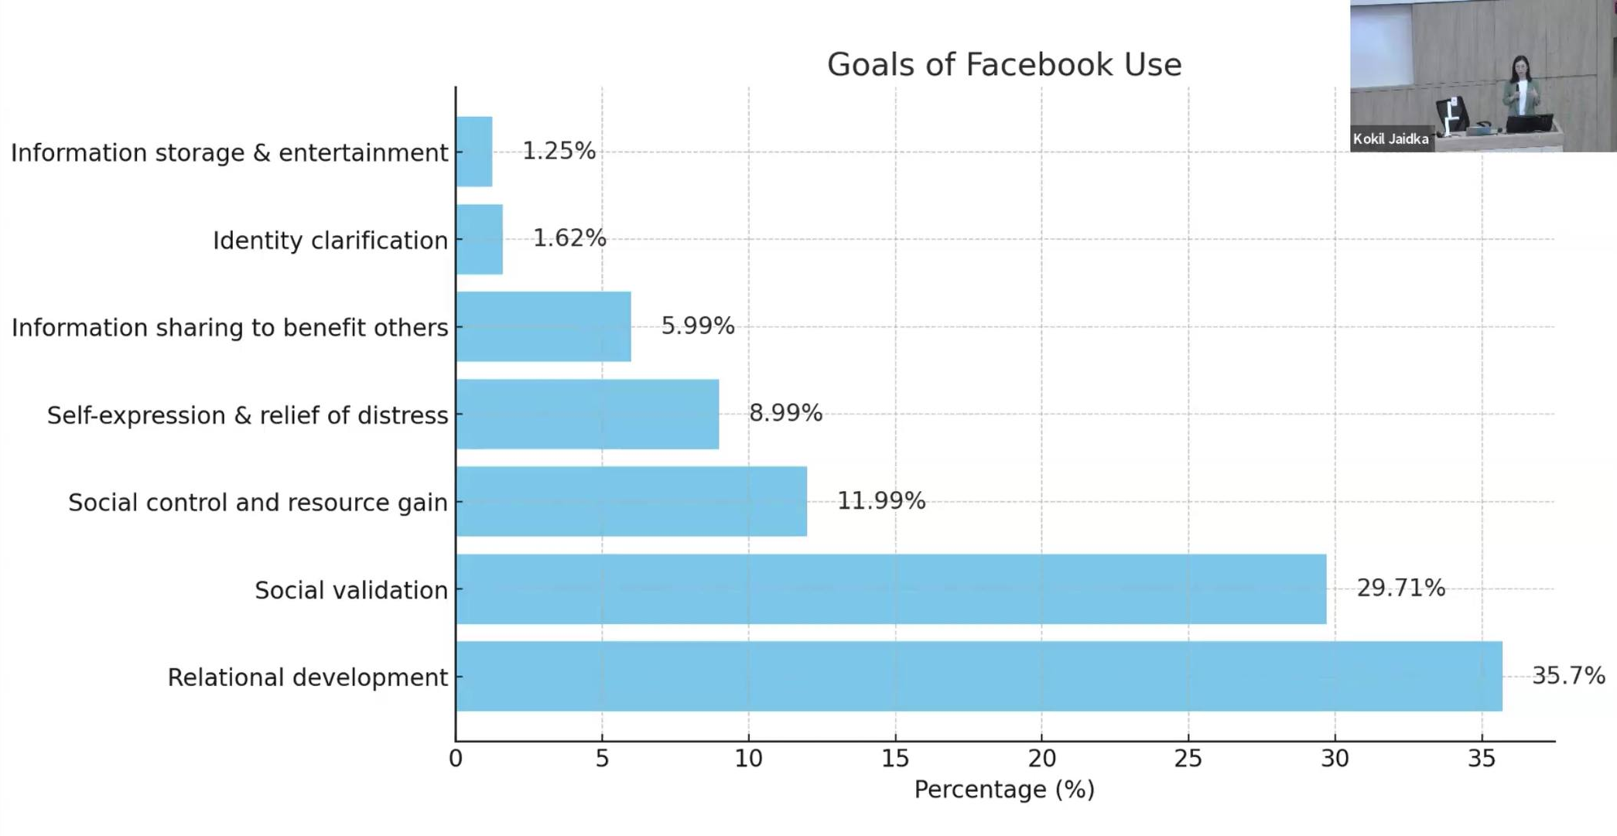
Goals of Social Media Use
Bazarova, N. N., & Choi, Y. H. (2014). Self-disclosure in social media: Extending the functional approach to disclosure motivations and characteristics on social network sites. Journal of communication, 64(4), 635-657.

Slide 22
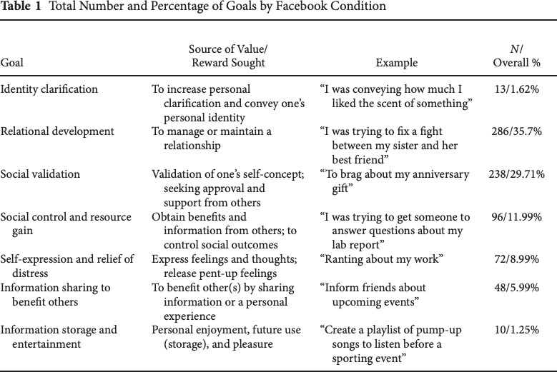

Slide 23
External Stress (Situational personal factor)
External Stressors
Self-Disclosure on Social Media
Zhang, R. (2017). The stress-buffering effect of self-disclosure on Facebook. Computers in Human Behavior, 75, 527–537.

Slide 24
External Stress (Situational personal factor)
External Stressors
Depression Symptoms
Self-Disclosure on Social Media
Zhang, R. (2017). The stress-buffering effect of self-disclosure on Facebook. Computers in Human Behavior, 75, 527–537.

Slide 25
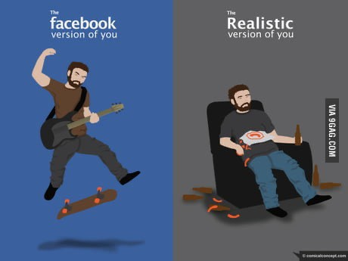
Audiences (Interpersonal factor)
Self-presentation (Goffman, 1978)
Context collapse (boyd)
Imagined audience (Litt, 2014)

Slide 26
Positivity norm in social media interactions
(Reinecke & Trepte, 2014; Waterloo et al., 2018)

Slide 27
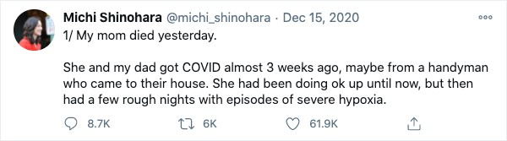
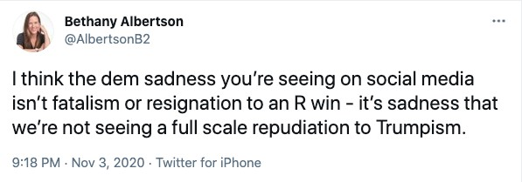

Slide 28
Distress Disclosure
Distress disclosure (Coates & Winston, 1987)
The open expression of negative thoughts, feelings, or emotions
Tradeoffs of distress disclosure
Distress disclosure on social media
Algorithmic detection of at-risk individuals

Slide 29
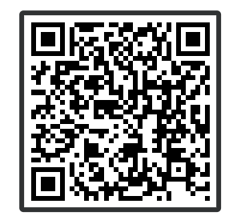

Have you ever shared negative thoughts, feelings, or emotions on social media?

Slide 30
Research Questions
How do people make decisions about whether and how to share negative emotions on social media?

Slide 31
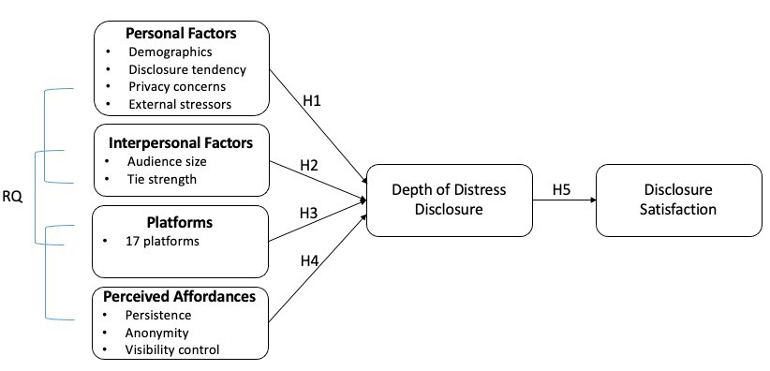
Conceptual Framework & Hypotheses

Slide 32





















Methods
Online surveys via Qualtrics online panels
May 2020
470 respondents (Adults, US residents, social media users)
Nationally representative sample
2%
Wh ite
65+
₁ 3 2%
%
%
7
%
2%
African American Asian
45-64
14%
45%
53%
25-44
American Indian Native Hawaiian Mo re than
one rac₂e₆
18-24
71%
0%
10%
20%
30%
40%

Slide 33

Measures
Study 1
Depth of distress disclosure
Details of event
Personal feelings
Personal thoughts
Audiences
Audience size
Relational closeness
01
04
Disclosure satisfaction
Satisfied with the response
Satisfied with the outcome
Social media platforms for distress disclosure
17 platforms (dummy variables)
02
05
Perceived affordances
Anonymity
Persistence
Visibility control
Personal factors
Demographics
Privacy concerns
General disclosure tendency
COVID-related stressors
03
06
27

Slide 34
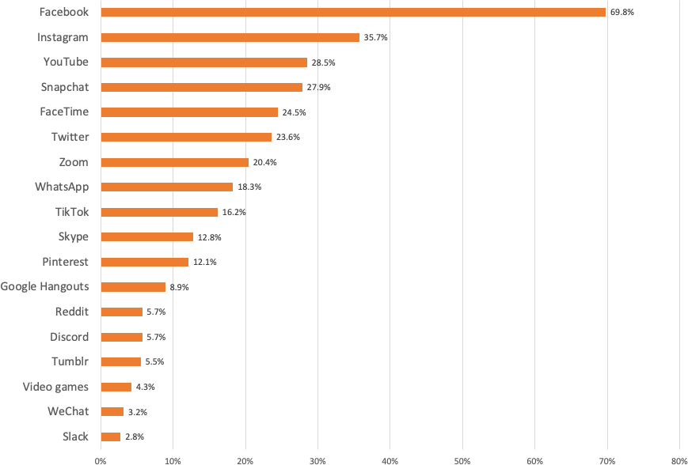
Study 1
Platforms for Distress Disclosure

Slide 35
Measures
Study 1
Perceived Affordances
Anonymity
  This platform/feature can make me anonymous to the person I am communicating with.
  The platform/feature allows people to remain anonymous or unidentifiable if they want to.
  When using this platform/feature, I can take on another identity if I want to.
Persistence
  This platform/feature keeps a record of communication that I can go back and look at.
  I can retrieve past messages in this platform/feature.
  Communication in this platform/feature exists long after the initial interaction is finished.
Visibility control
  This platform/feature allows me to control who can see my communication.
  I can specify who can or cannot see my communication via this platform/feature.
  I can make my communication easily seen by certain people via this platform/feature.
29

Slide 36
Results
Study 1
Persistence
.24***
Perceived affordances, but not specific platforms, predict disclosure depth
People share more distress with stronger ties
People who are more vocal about their feelings and men share more distress on social media
Technological factors
Anonymity
.15**
Visibility Control
.13**
Depth of Distress Disclosure
.17***
Interpersonal factors
Relational Closeness
.21***
Disclosure Tendency
.18***
Personal factors
Gender (Male)
Adjusted R² =0.47
30

Slide 37
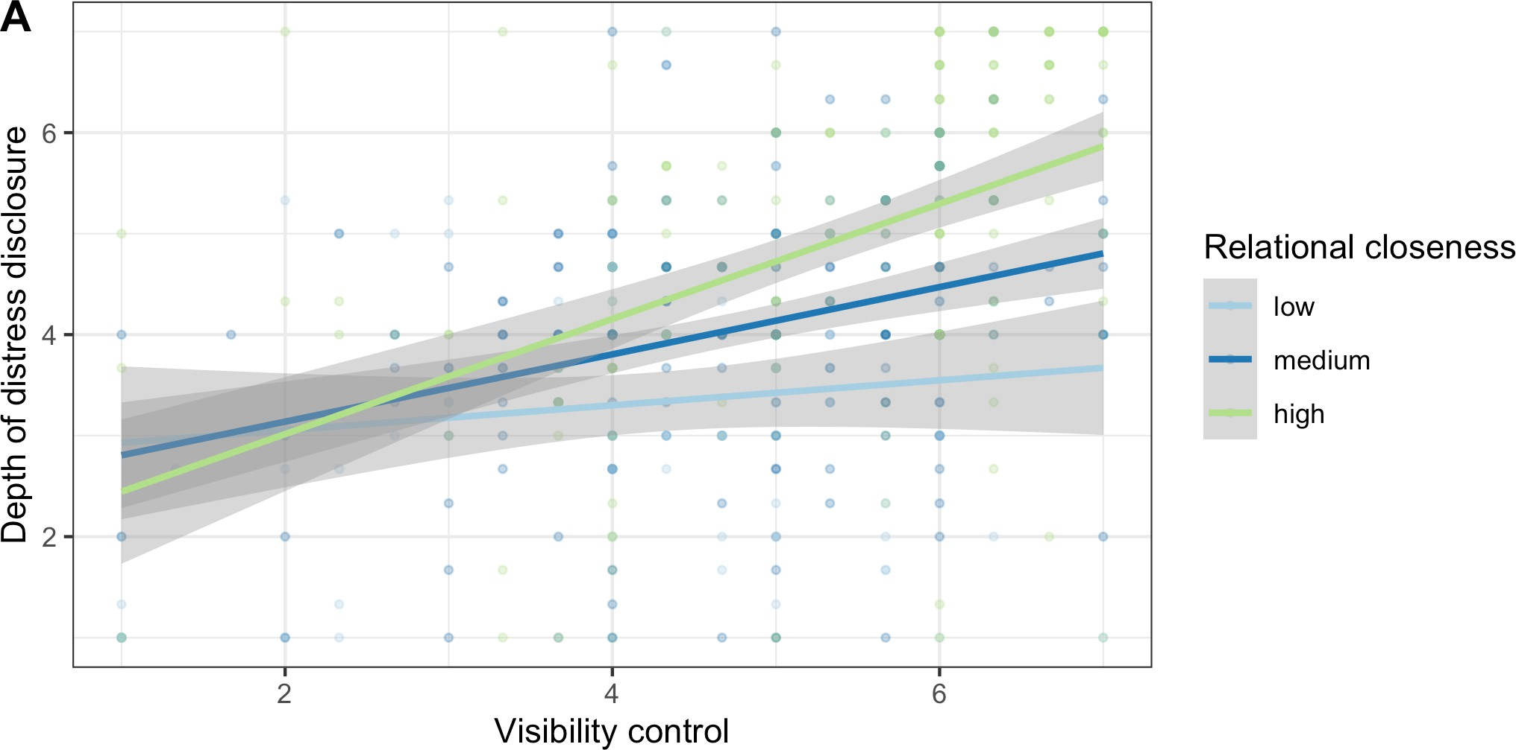
Interaction Effect
Study 1
Relational closeness moderates the relationship between perceived visibility control and disclosure depth

Slide 38
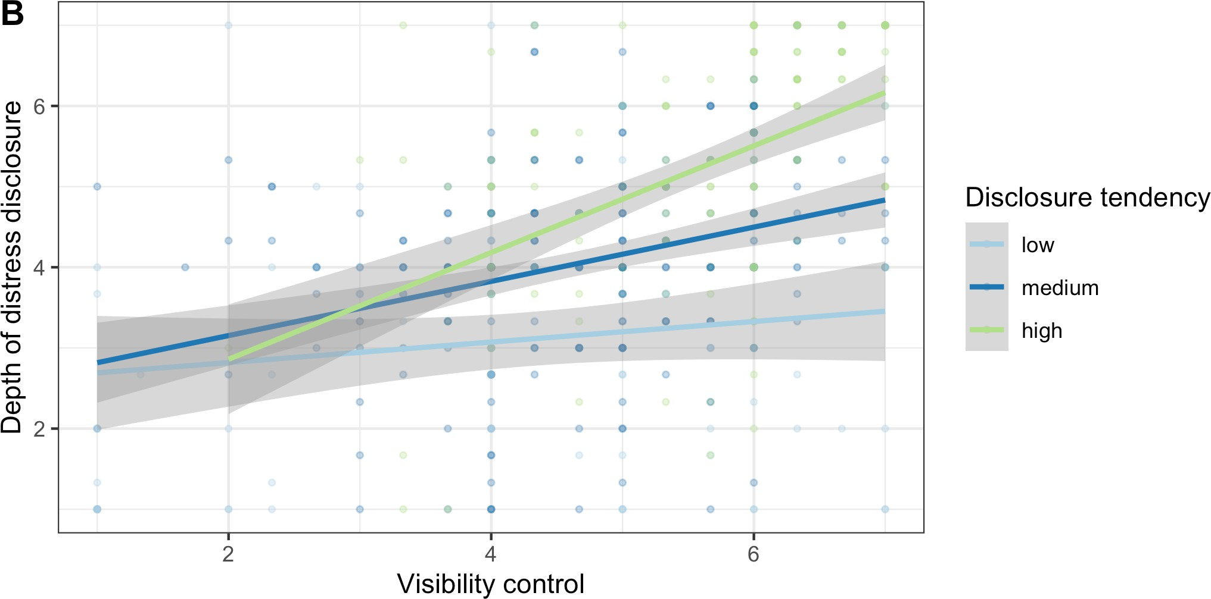
Interaction Effect
Study 1
Disclosure tendency moderates the relationship between perceived visibility control and disclosure depth

Slide 39
Results
Study 1
Persistence
.24***
.13*
Anonymity
.15**
Depth of Distress Disclosure
.13*
Disclosure Satisfaction
Visibility Control
.13**
.17***
Relational Closeness
.34***

Slide 40


Discussion
Study 1
Uncovered the relative strength and interplay of factors influencing online expressions of negative emotions
Emphasized the importance of understanding affordances in terms of user perception
  Varied disclosure behavior within one platform, depending on the channel and the account
  E.g., Finsta (a.k.a., fake Instagram) vs. Rinsta
  Synthesize findings across studies, platforms, and time periods; build durable theories

Slide 41
Discussion
Study 1
Highlighted users’ need for anonymity and privacy in distress disclosure
  Consistent with prior work on sensitive, stigmatized disclosure (Andalibi et al., 2018; Devito et al., 2018)
  Design features that support anonymity, visibility control, and content persistence are beneficial

Slide 42
Summary of Findings
Personal Factors
Demographics
Disclosure tendency
Mood and emotion
Interpersonal Factors
Audience
Relational closeness
Self-Disclosure on Social Media
Technological Factors
Sociocultural Factors
Platforms
Affordances
Social norms
Power dynamics
An integrated model of self-disclosure on social media

Slide 43

Thank you!
QnA

