Slide 1
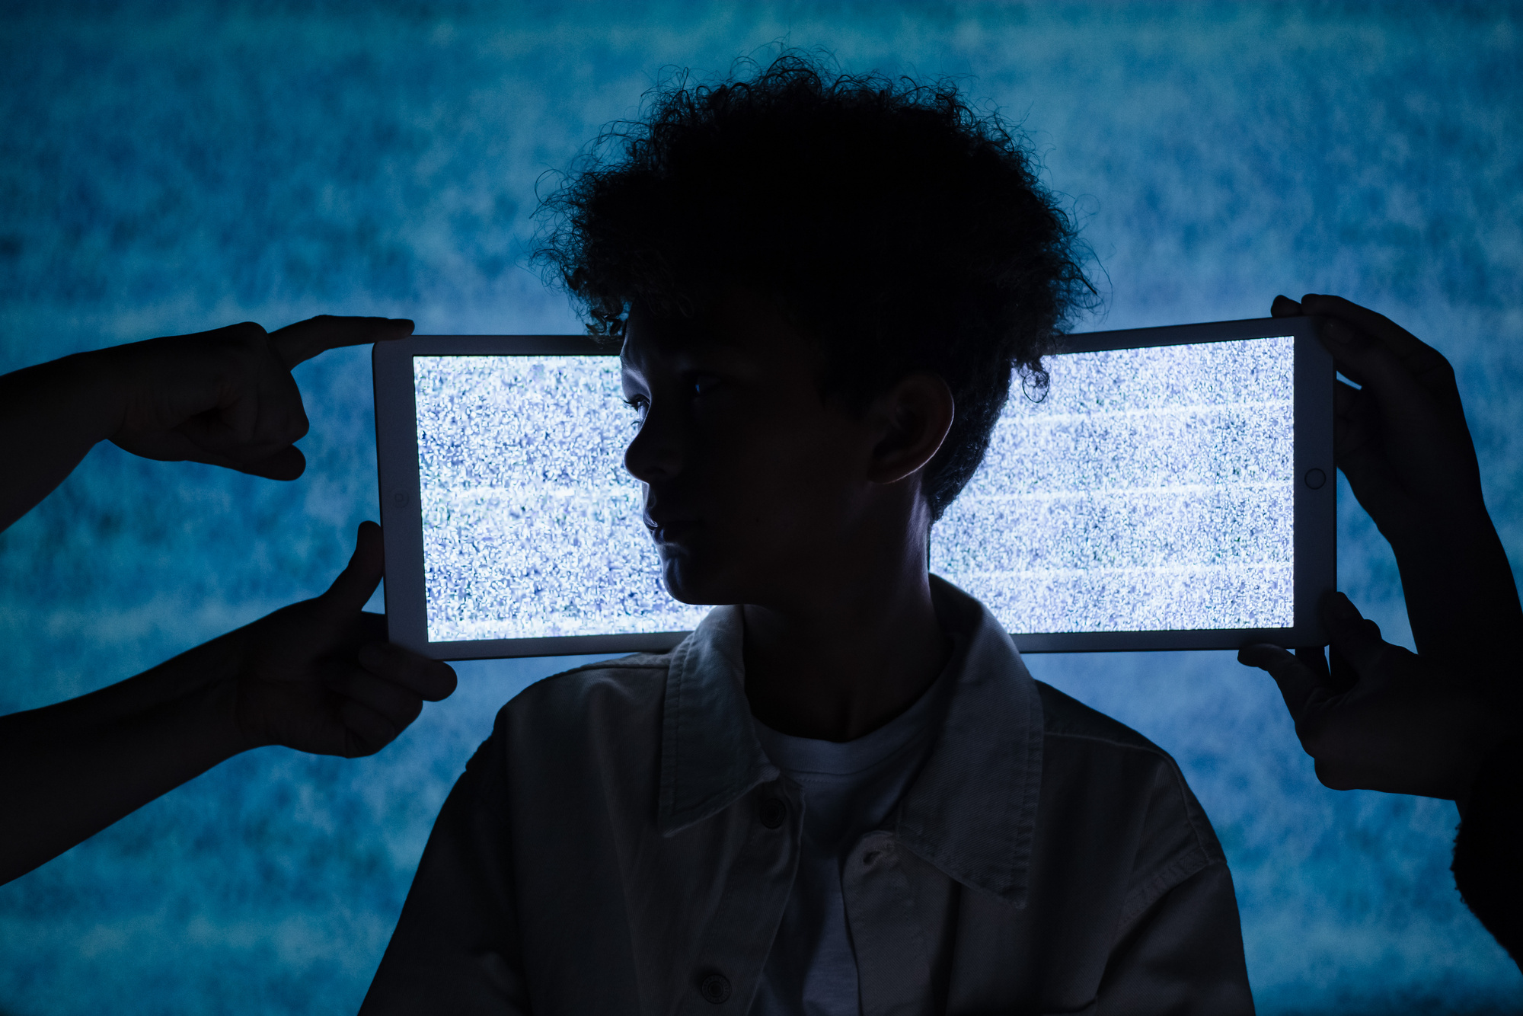
Online communication affordances
Week 03
HS2911 Social Media and Mental Health

Slide 2
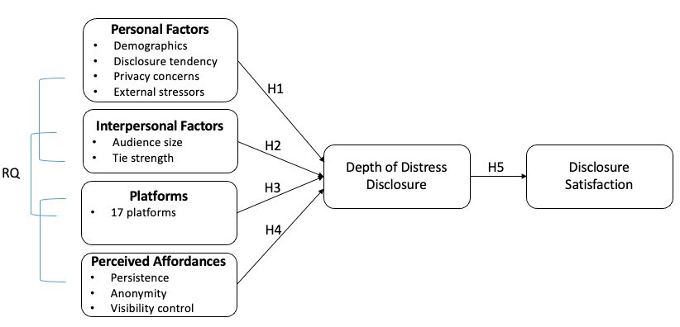
Recap
Conceptual Framework & Hypotheses

Slide 3





















Methods
Online surveys via Qualtrics online panels
May 2020
470 respondents (Adults, US residents, social media users)
Nationally representative sample
2%
Wh ite
65+
₁ 3 2%
%
%
7
%
2%
African American Asian
45-64
14%
45%
53%
25-44
American Indian Native Hawaiian Mo re than
one rac₂e₆
18-24
71%
0%
10%
20%
30%
40%

Slide 4

Measures
Study 1
Depth of distress disclosure
Details of event
Personal feelings
Personal thoughts
Audiences
Audience size
Relational closeness
01
04
Disclosure satisfaction
Satisfied with the response
Satisfied with the outcome
Social media platforms for distress disclosure
17 platforms (dummy variables)
02
05
Perceived affordances
Anonymity
Persistence
Visibility control
Personal factors
Demographics
Privacy concerns
General disclosure tendency
COVID-related stressors
03
06
27

Slide 5
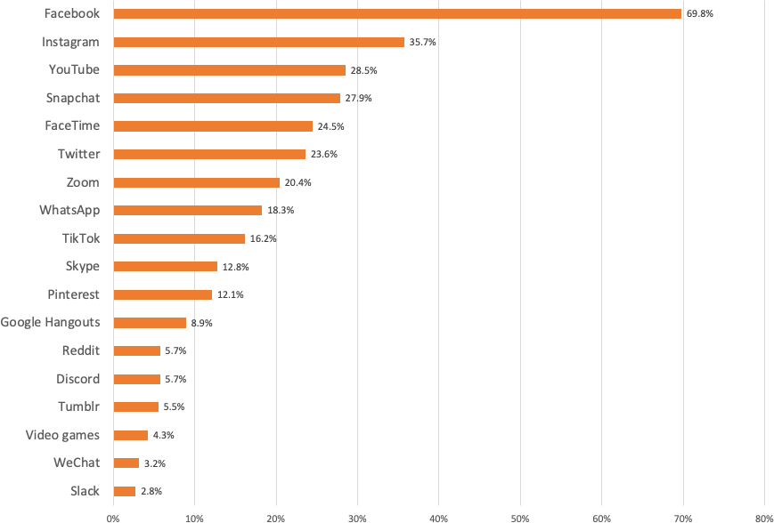
Study 1
Platforms for Distress Disclosure

Slide 6
Results
Study 1
Persistence
.24***
Perceived affordances, but not specific platforms, predict disclosure depth
People share more distress with stronger ties
People who are more vocal about their feelings and men share more distress on social media
Technological factors
Anonymity
.15**
Visibility Control
.13**
Depth of Distress Disclosure
.17***
Interpersonal factors
Relational Closeness
.21***
Disclosure Tendency
.18***
Personal factors
Gender (Male)
Adjusted R² =0.47
30

Slide 7
Measures
Study 1
Perceived Affordances
Anonymity
  This platform/feature can make me anonymous to the person I am communicating with.
  The platform/feature allows people to remain anonymous or unidentifiable if they want to.
  When using this platform/feature, I can take on another identity if I want to.
Persistence
  This platform/feature keeps a record of communication that I can go back and look at.
  I can retrieve past messages in this platform/feature.
  Communication in this platform/feature exists long after the initial interaction is finished.
Visibility control
  This platform/feature allows me to control who can see my communication.
  I can specify who can or cannot see my communication via this platform/feature.
  I can make my communication easily seen by certain people via this platform/feature.
29

Slide 8
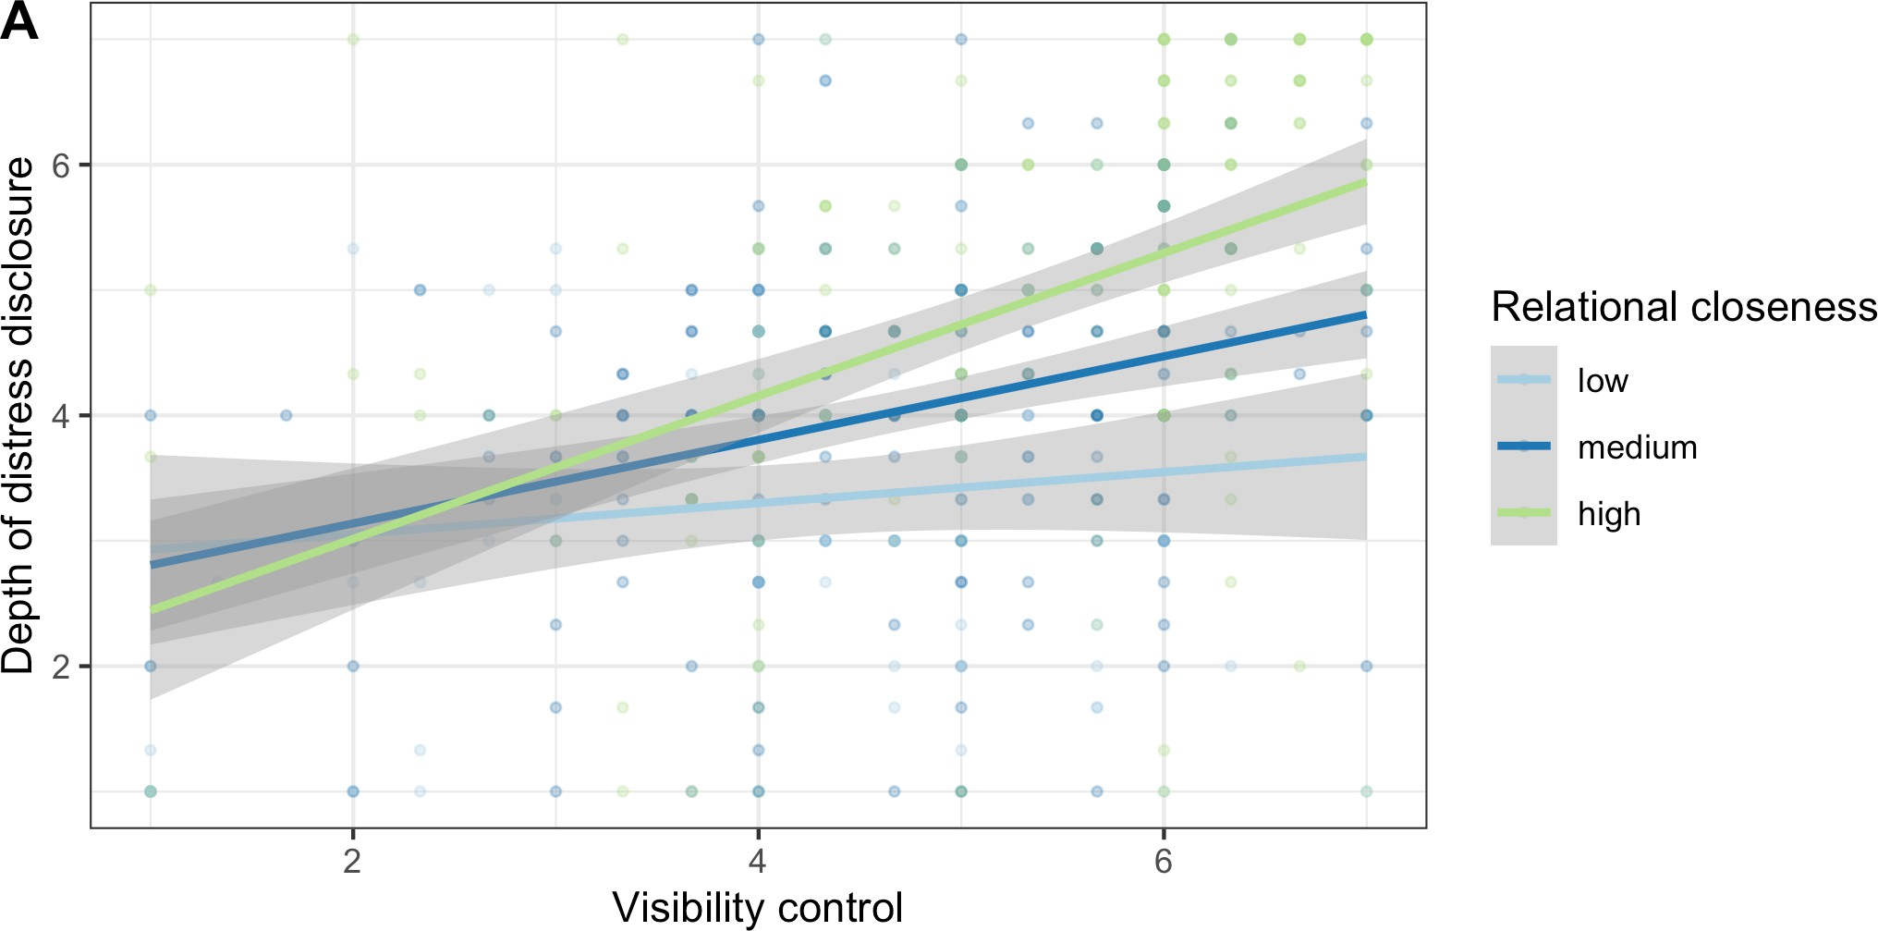
Interaction Effect
Study 1
Relational closeness moderates the relationship between perceived visibility control and disclosure depth

Slide 9
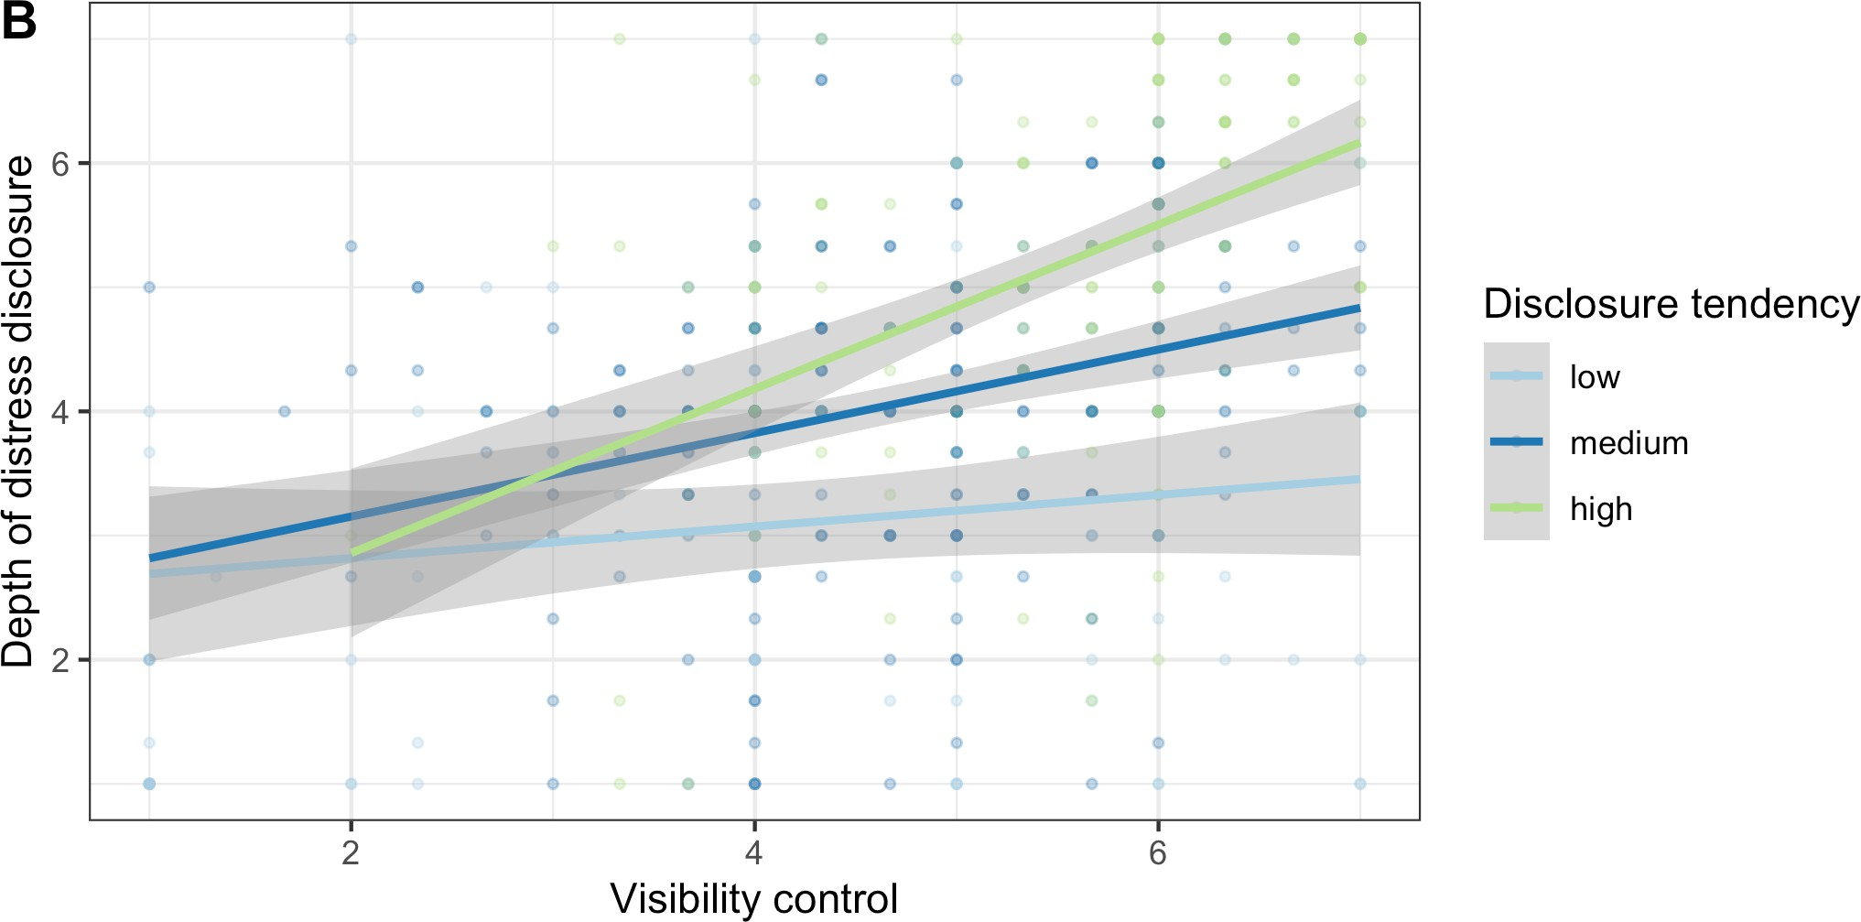
Interaction Effect
Study 1
Disclosure tendency moderates the relationship between perceived visibility control and disclosure depth

Slide 10
Results
Study 1
Persistence
.24***
.13*
Anonymity
.15**
Depth of Distress Disclosure
.13*
Disclosure Satisfaction
Visibility Control
.13**
.17***
Relational Closeness
.34***

Slide 11


Discussion
Study 1
Uncovered the relative strength and interplay of factors influencing online expressions of negative emotions
Emphasized the importance of understanding affordances in terms of user perception
  Varied disclosure behavior within one platform, depending on the channel and the account
  E.g., Finsta (a.k.a., fake Instagram) vs. Rinsta
  Synthesize findings across studies, platforms, and time periods; build durable theories

Slide 12
Discussion
Study 1
Highlighted users’ need for anonymity and privacy in distress disclosure
  Consistent with prior work on sensitive, stigmatized disclosure (Andalibi et al., 2018; Devito et al., 2018)
  Design features that support anonymity, visibility control, and content persistence are beneficial

Slide 13
Summary of Findings
Personal Factors
Demographics
Disclosure tendency
Mood and emotion
Interpersonal Factors
Audience
Relational closeness
Self-Disclosure on Social Media
Technological Factors
Sociocultural Factors
Platforms
Affordances
Social norms
Power dynamics
An integrated model of self-disclosure on social media

Slide 14
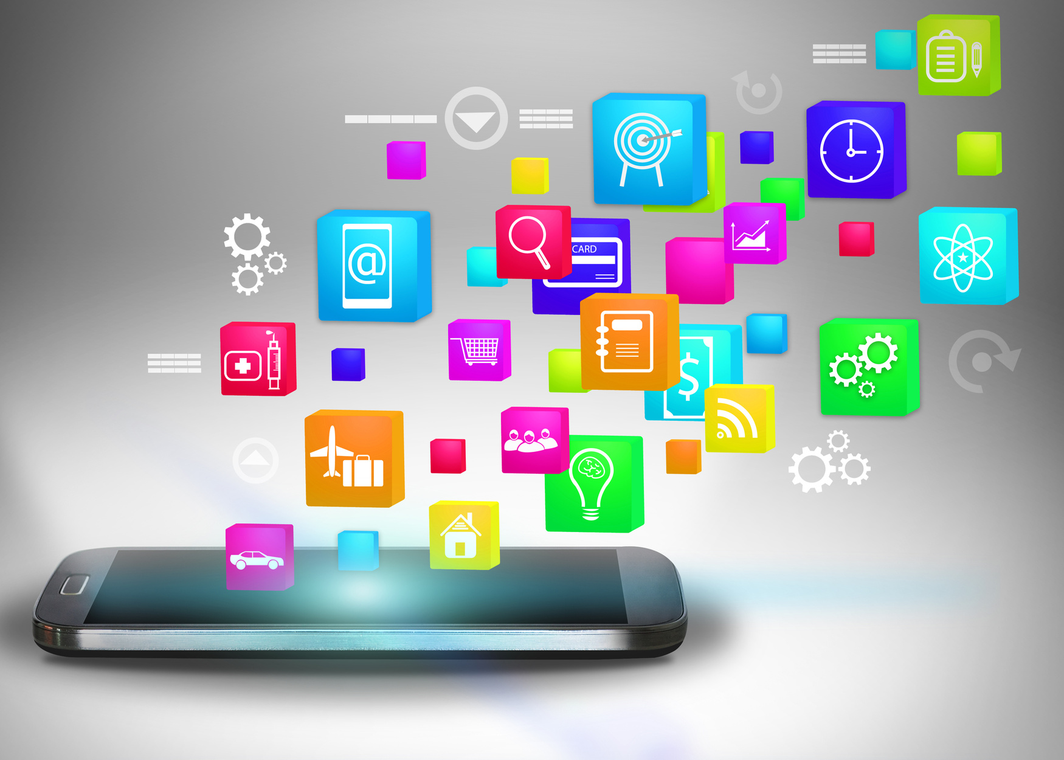
This week
Last week, ‘anonymity,’ ‘persistence,’ and ‘visibility control’ were just survey items
Today we learn where these concepts come from — and the general theory that explains why they matter
An affordance isn't a feature of an app. It's what the app makes possible, for a given person, in a given context.

Slide 15
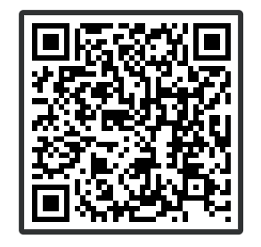
What’s one thing social media makes easy that’s hard to do offline?

Slide 16
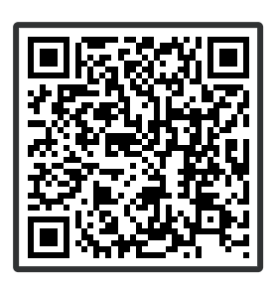
What’s easy to do IRL but so hard to do on social media?

Slide 17
Lecture Outline
1
Social media affordances shape self presentation
2
Interplay between online and offline identities
3
Importance of self presentation from three perspectives

Slide 18
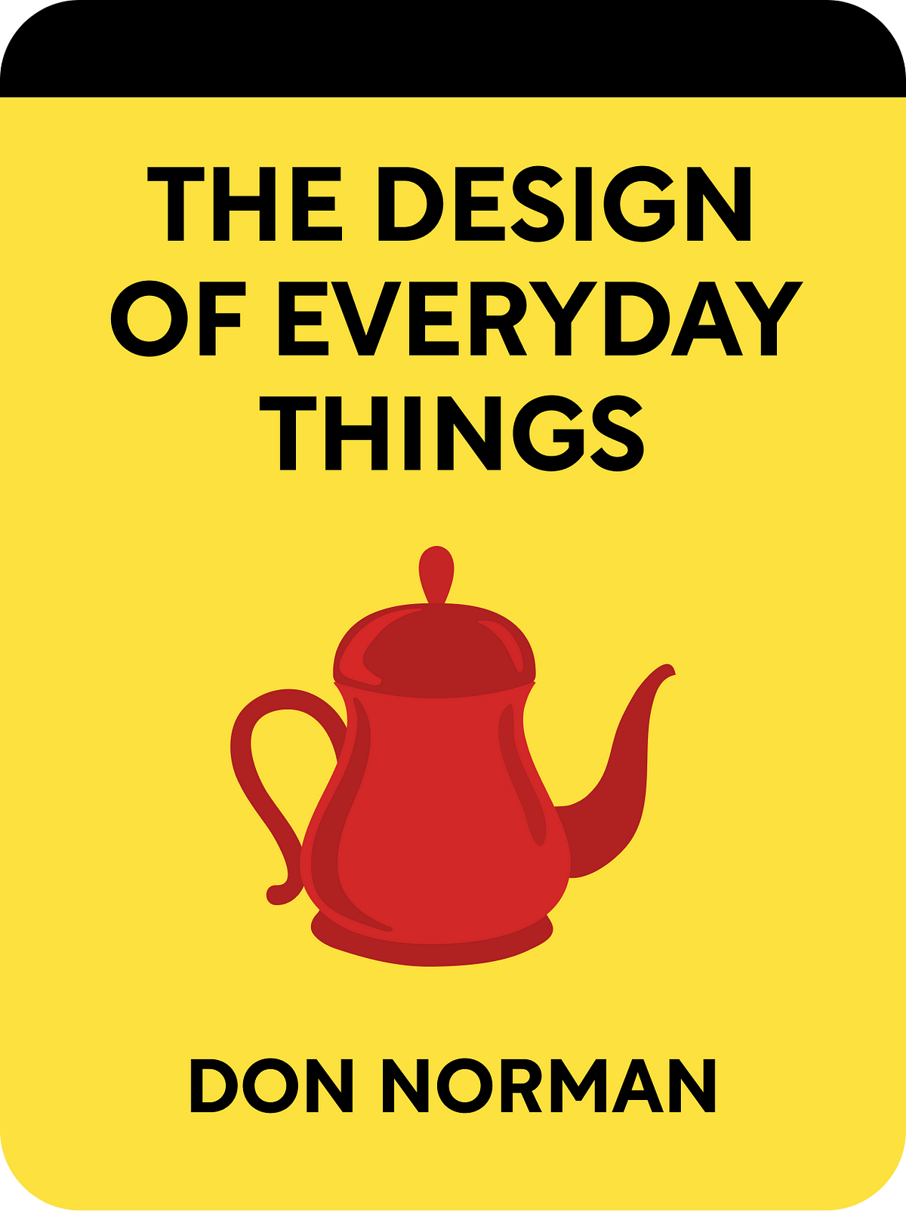
Main Glossary Terms
1
Social Media Affordances
“Perceived actual or imagined properties of social media, emerging through the relation of technological, social, and contextual, that enable and constrain specific uses of the platforms.”
Real affordances
Perceived affordances
User-environment relationship
Affordances in design
(Ronzhyn et al., 2022)
Notes:
Affordance Theory is a concept originating from ecological psychology, introduced by James J. Gibson in 1977. It refers to the potential actions or uses that an object, environment, or system offers to an individual based on their capabilities and perception. Affordances are not just properties of the object itself but exist in the interaction between the object and the user.
Key Concepts in Affordance Theory
Real Affordances:
These are the actual, objective functionalities or possibilities an object provides based on its physical or structural properties.
For example, a chair affords sitting because it is sturdy and shaped to support a person’s weight.
Perceived Affordances:
These are the affordances users perceive an object to have, which may or may not align with its real affordances.
For instance, a flat-screen display might be perceived as a touchscreen even if it is not.
User-Environment Relationship:
Affordances are context-dependent and arise from the relationship between the object and the capabilities of the user. For example, a rock may afford climbing to a human but not to an ant.
Affordances in Design:
Donald Norman popularized the term in The Design of Everyday Things (1988), focusing on how designers can make affordances visible to guide user behavior effectively.
In this context, perceived affordances become critical to usability. For example, a door handle's design might signal whether to push or pull.

Slide 19

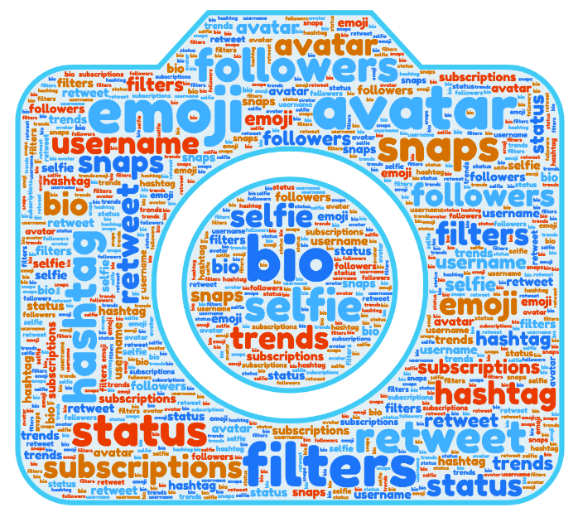
Affordances
How interactive organism-environment features index the behaviors an organism may perform (Gibson, 1979): Action possibilities provided by social media platforms that shape user behavior and organizational responses.
Whether the user perceives that some actions are possible (or in the case of perceived non-affordances, not possible) (Norman, 1988)
Gibson is primarily interested in how we perceive the environment while Norman has more interest in manipulating or designing the environment so that utility can be perceived easily
Zhao, Y., Liu, J., Tang, J., & Zhu, Q. (2013, March). Conceptualizing perceived affordances in social media interaction design. In Aslib Proceedings (Vol. 65, No. 3, pp. 289-303). Emerald Group Publishing Limited.
Persistence

Slide 20

Main Glossary Terms
1
Social Media Affordances
“Perceived actual or imagined properties of social media, emerging through the relation of technological, social, and contextual, that enable and constrain specific uses of the platforms.”
(Ronzhyn et al., 2022)
2
Self-Presentation/Impression Management
“Processes by which individuals attempt to control how they are perceived by others and influence others to respond to them in desired ways, by conveying particular impressions of their abilities, attitudes, motives, status, emotional reactions, and other personal characteristics.”
(Leary, 2001)

Slide 21
Main Glossary Terms
1
Social Media Affordances
“Perceived actual or imagined properties of social media, emerging through the relation of technological, social, and contextual, that enable and constrain specific uses of the platforms.”
(Ronzhyn et al., 2022)
Asynchronicity
Visibility
Editability
Persistence (Ephemerality)
Association
Treem, J. W., & Leonardi, P. M. (2013). Social media use in organizations: Exploring the affordances of visibility, editability, persistence, and association. Annals of the International Communication Association, 36(1), 143-189.

Slide 22
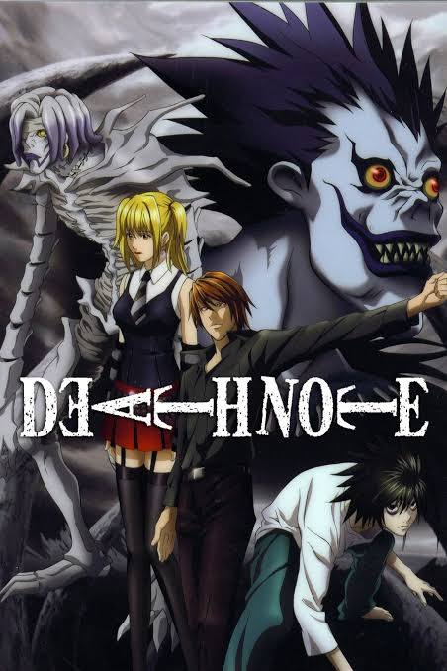
A study of Death Note
1
Real abilities of the notebook
Killing ability, ownership transfer, memory connection, Shinigami control
Real affordances are defined explicitly through the rules provided by the Shinigami
Notes:
Killing Ability: Writing a person's name in the notebook while visualizing their face leads to their death, with the cause and timing being customizable based on the details written.Ownership Transfer: The notebook allows transfer of ownership, enabling others to use it under the same rules.Memory Connection: Users lose their memories of the Death Note upon relinquishing ownership, a real affordance tied to its supernatural nature.Shinigami Control: The notebook grants the user the ability to interact with and learn from its associated Shinigami, including deals like the "Shinigami Eyes."

Slide 23
A study of Death Note
1
Real abilities of the notebook
Killing ability, ownership transfer, memory connection, Shinigami control
Real affordances are defined explicitly through the rules provided by the Shinigami
2
Perceived abilities of the notebook
Unlimited power, moral justice, indestructibility, infallibility
Action abilities that Light and others perceive the Notebook to have
Notes:
"real affordances" are tied to the notebook's supernatural rules, while "perceived affordances" emerge from character assumptions and societal interpretations.
Unlimited Power: Early in the story, Light and others perceive the notebook as granting its user omnipotence, when in reality, it has limits (e.g., rules about plausibility in cause of death or the inability to affect events beyond direct death causation).Moral Justice: Light perceives the Death Note as a tool for moral correction, believing it affords him the role of "God of the New World." This perception overlooks the fact that the notebook's real affordances are neutral and amoral.Indestructibility: Some characters perceive the notebook as indestructible due to its mysterious origins, even though this is never explicitly confirmed as a real affordance.Infallibility: Many characters assume the notebook’s actions are foolproof. However, real affordances reveal scenarios where its usage can fail (e.g., writing a name with insufficient knowledge of the person's identity).

Slide 24
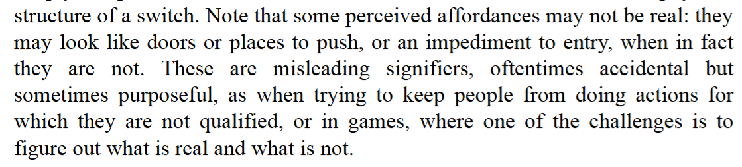
A study of Death Note
(Norman, 1988)
1
Light’s early experiments
2
Police’s misinterpretations about an omniscient Kira
Notes:
the distinction between real and perceived affordances plays into the series' themes of power, morality, and hubris. This also reflects human interaction with technology or tools in real life—where assumptions often shape behavior more than objective functionalities.

Slide 25
Affordances
Affordances are not technology features or functionalities
Affordances are relational, perceptional, and contextual
Affordances can enable and constrain behaviour and action
Treem, J. W., & Leonardi, P. M. (2013). Social media use in organizations: Exploring the affordances of visibility, editability, persistence, and association. Annals of the International Communication Association, 36(1), 143-189.

Slide 26
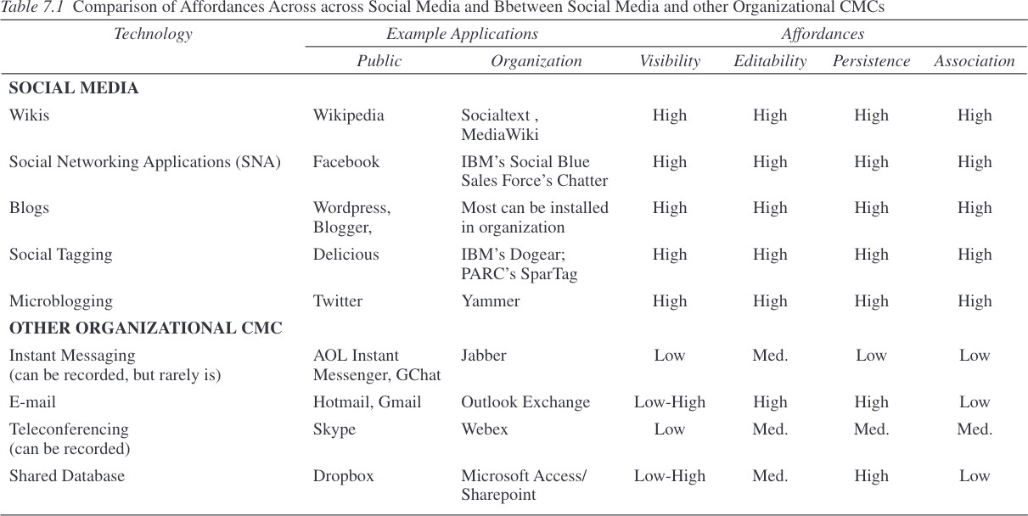
Treem, J. W., & Leonardi, P. M. (2013). Social media use in organizations: Exploring the affordances of visibility, editability, persistence, and association. Annals of the International Communication Association, 36(1), 143-189.

Slide 27
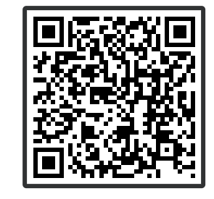
In your opinion, which affordance is likely to make people feel more powerful and why?
Visibility
Association
Persistence
Editability

Slide 28
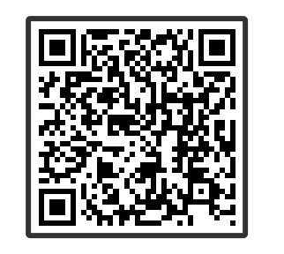
In your opinion, which affordance is likely to make people insecure and why?
Visibility
Association
Persistence
Editability

Slide 29
Visibility
1
Work behavior
2
Metaknowledge
3
Organizational activity streams
Treem, J. W., & Leonardi, P. M. (2013). Social media use in organizations: Exploring the affordances of visibility, editability, persistence, and association. Annals of the International Communication Association, 36(1), 143-189.

Slide 30
Persistence
1
Sustaining knowledge over time
2
Creating robust form of communication
3
Growing content
Treem, J. W., & Leonardi, P. M. (2013). Social media use in organizations: Exploring the affordances of visibility, editability, persistence, and association. Annals of the International Communication Association, 36(1), 143-189.

Slide 31
Editability
1
Regulating personal expression
2
Targeting content
3
Improving information quality
Treem, J. W., & Leonardi, P. M. (2013). Social media use in organizations: Exploring the affordances of visibility, editability, persistence, and association. Annals of the International Communication Association, 36(1), 143-189.

Slide 32
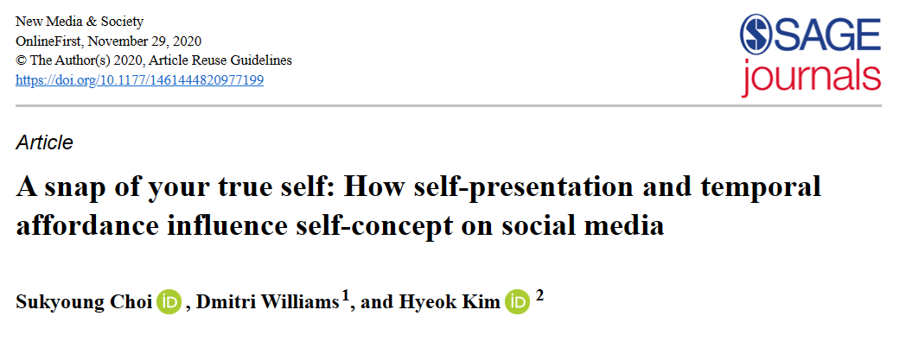
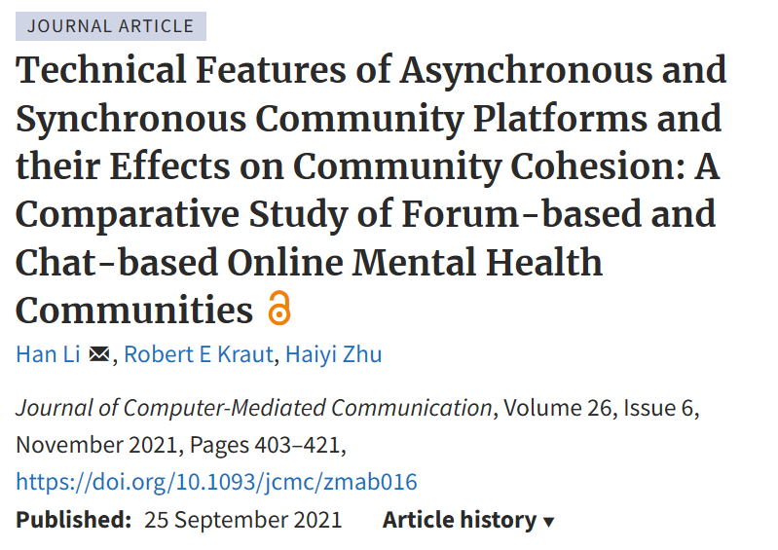
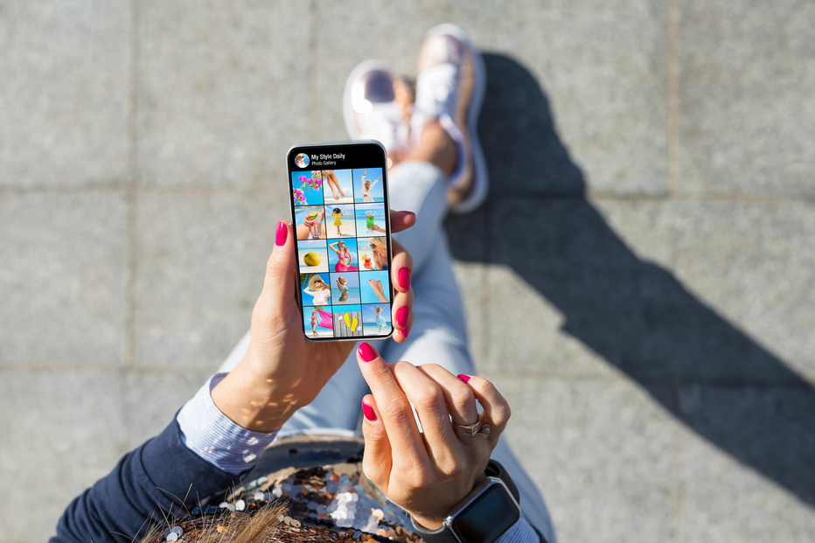
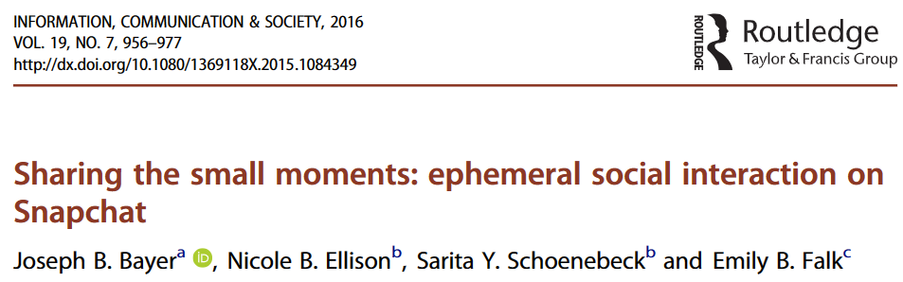
Temporal affordances of persistence & editability
(Treem & Leonardi, 2013; Baym, 2010)
Ephemerality
Asynchronicity
- Snaps/Stories
- Disappearing Messages
- Drafts/Edits
- Delete/Hide/Archive
https://doi.org/10.1177/1461444820977199
http://dx.doi.org/10.1080/1369118X.2015.1084349
https://doi.org/10.1093/jcmc/zmab016
Notes:
Starting with the concept of persistence, we consider how the digital content we create can endure over time. Sakyouny Chio et al., in their article in New Media & Society, examine how this persistence of self-presentation on social media platforms affects our self-concept. When our posts and images remain accessible indefinitely, they can create a permanent digital footprint that contributes to an enduring online identity.
However, not all digital interactions are meant to last forever, which brings us to ephemerality. The ability to share moments that are transient in nature, such as snaps, stories, or disappearing messages, provides a different dimension to how we express ourselves. Joseph B. Bayer and colleagues, in their work published in Information, Communication & Society, explore these small, ephemeral interactions. They argue that sharing fleeting moments can foster intimacy and immediacy in ways that permanent posts cannot.
Next, we look at the affordance of editability through asynchronicity. The ability to draft, edit, or even delete our digital content allows us to curate our online presence carefully. Asynchronicity gives us the time to reflect on our self-presentation before making it public. This control over our digital narrative is a powerful tool for crafting our desired identity.
Han Li et al., in the Journal of Computer-Mediated Communication, delve into the technical features of asynchronous and synchronous community platforms. Their study reveals how these features can influence community cohesion, particularly in the context of forum-based and chat-based online mental health communities.
In summary, the temporal affordances of persistence and editability shape our online experiences in profound ways. They influence how we present ourselves, how others perceive us, and how our digital identities evolve over time. Whether through lasting posts or fleeting stories, our control over the timing and permanence of our digital content allows us to navigate the complexities of online social landscapes.

Slide 33
Association
1
Supporting social connection
2
Access to relevant information
3
Enabling emergent connection
Treem, J. W., & Leonardi, P. M. (2013). Social media use in organizations: Exploring the affordances of visibility, editability, persistence, and association. Annals of the International Communication Association, 36(1), 143-189.

Slide 34
Implications
1
Socialization: people processing, information seeking
2
Knowledge sharing: capturing tacit knowledge, motivating knowledge contributions, identifying expertise
3
Power: resource dependency, participation in discursive construction, surveillance
Treem, J. W., & Leonardi, P. M. (2013). Social media use in organizations: Exploring the affordances of visibility, editability, persistence, and association. Annals of the International Communication Association, 36(1), 143-189.

Slide 35
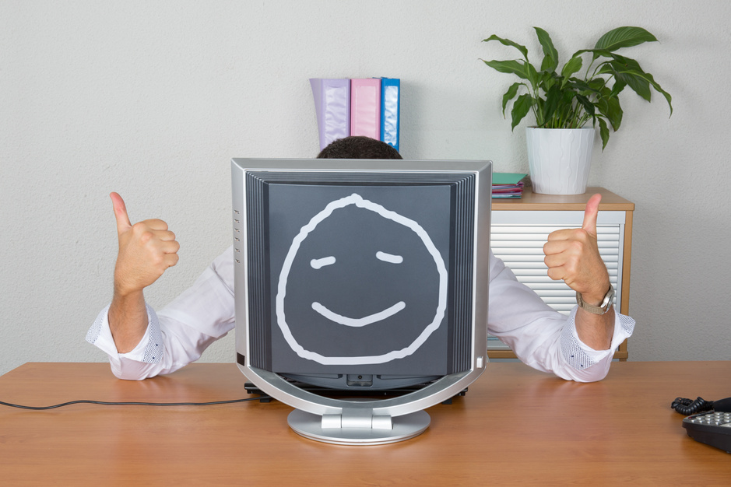
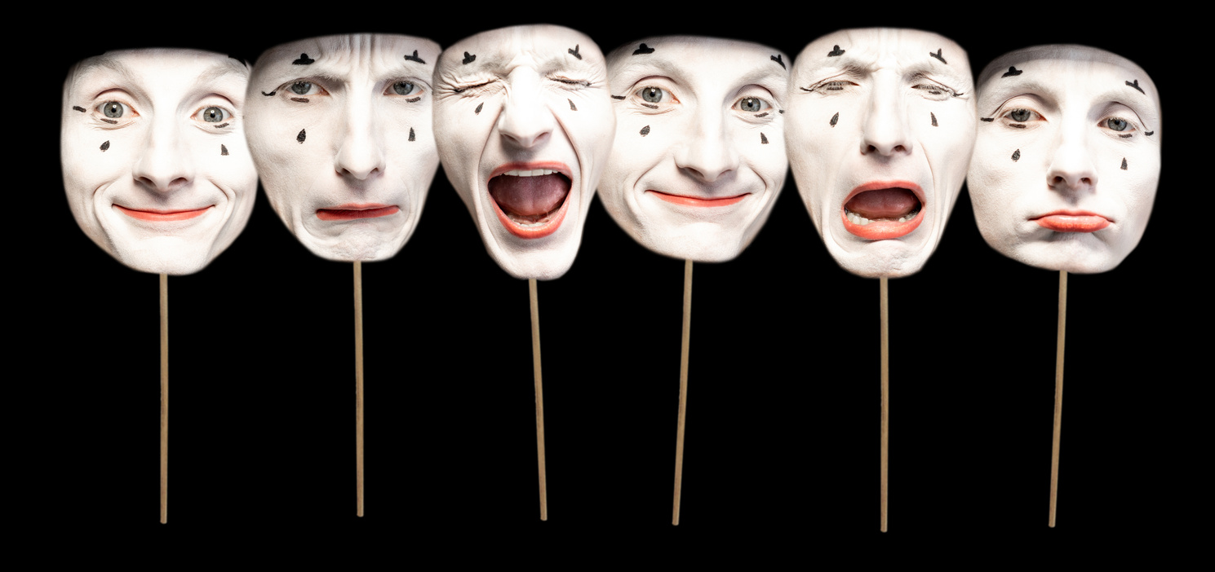

Which of these is NOT an affordance?
In apps like WhatsApp or Zoom, users see real-time messages or live video calls where responses happen immediately.
In forums like Reddit or email apps, users post or send messages, and others can reply hours or even days later.
In apps like WhatsApp or SMS, messages appear in a simple, linear order, regardless of topic.
In platforms like Slack or Discord, messages can be grouped into threads, allowing users to follow specific conversations within broader discussions.
Where would you be more likely to
confide sensitive information?
Notes:
Real-time vs delayed replies = asynchronicity (an affordance)
Threaded conversations = association / visibility (an affordance)
But “messages appear in a simple, linear order” is just a design feature / interface layout, not an affordance in the theoretical sense.
Affordances are about what actions are enabled or constrained (e.g., reply later, follow threads, persist over time), not about how the interface is arranged visually.
So the NOT-an-affordance option is the linear order one (third statement).

Slide 36
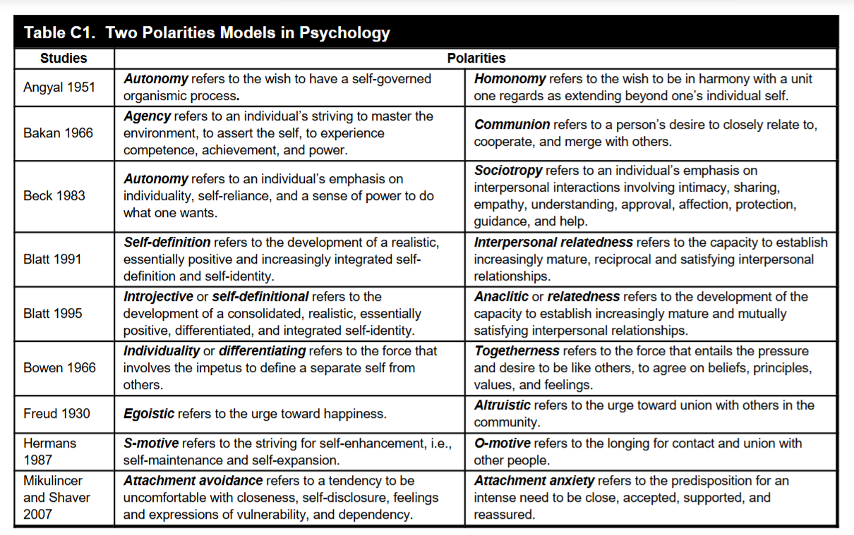
Psychology & perceived affordances
Karahanna, E., Xu, S. X., Xu, Y., & Zhang, N. (2018). The needs–affordances–features perspective for the use of social media. Mis Quarterly, 42(3), 737-A23.
Notes:
Psychological needs and actions can often be understood through polarities, or dual motivations, that guide behavior and self-perception. Understanding these polarities helps in analyzing user behavior on social media, where individuals balance needs for autonomy (e.g., creating unique content) with community belonging (e.g., engaging in shared discussions).
Action possibilities for achieving these polarities to different extents

Slide 37
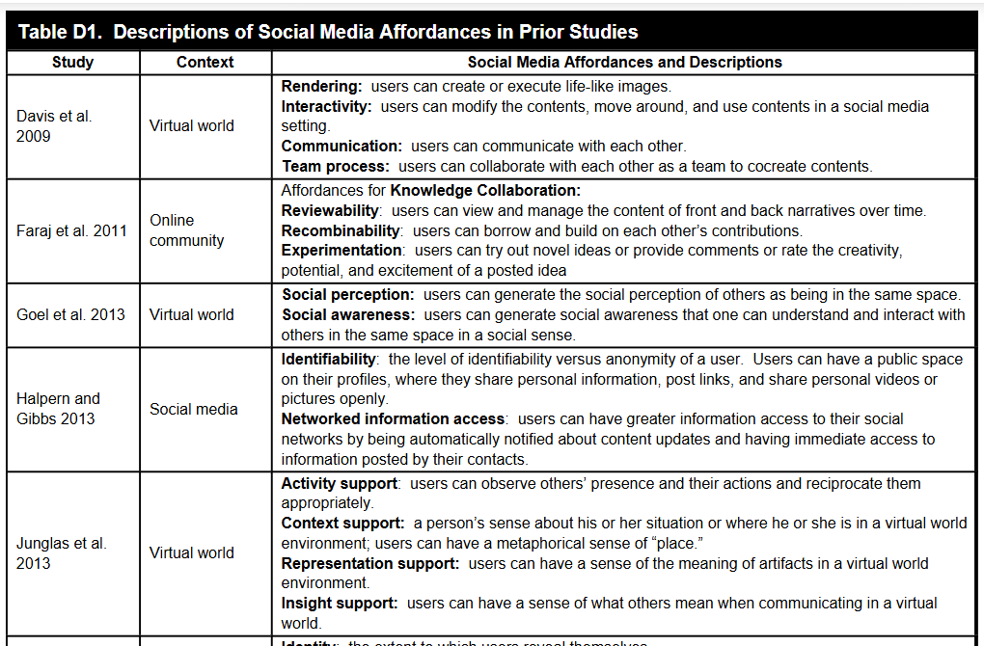
Use this as a lookup table
Karahanna, E., Xu, S. X., Xu, Y., & Zhang, N. (2018). The needs–affordances–features perspective for the use of social media. Mis Quarterly, 42(3), 737-A23.
Notes:
Table D1 categorizes different affordances based on their social media context, highlighting their purpose and role in enabling user interaction and engagement.
Interactivity: Allows modification and movement within the digital space.
Social perception
Identifiability: Balances anonymity and public identity.

Slide 38
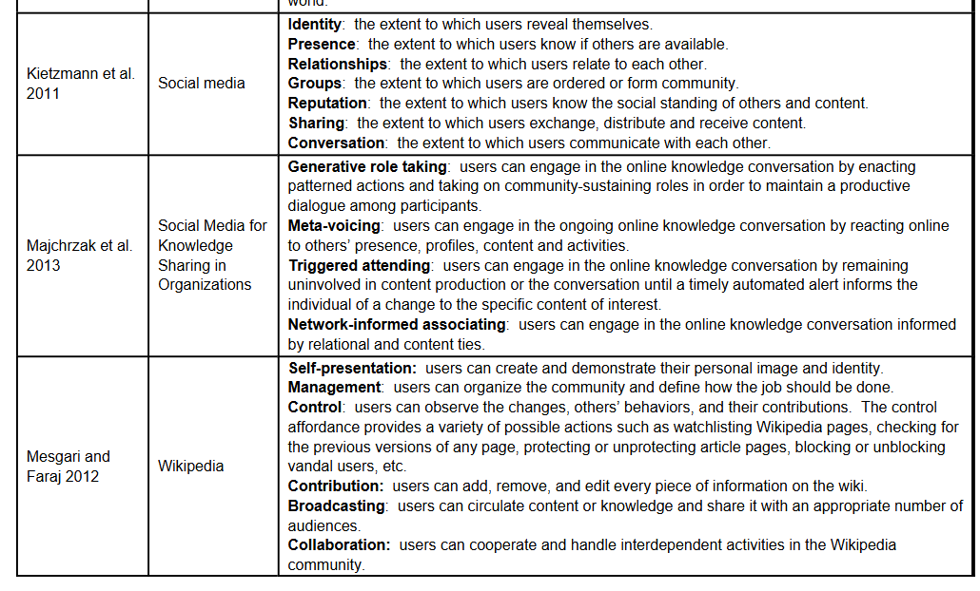
Use this as a lookup table
Karahanna, E., Xu, S. X., Xu, Y., & Zhang, N. (2018). The needs–affordances–features perspective for the use of social media. Mis Quarterly, 42(3), 737-A23.
Notes:
Presence
Triggered attending: Alerts users to specific changes or updates in conversations.
Network-informed associating: Simplifies connectivity through automatic notifications and updates.
Platforms like Wikipedia offer affordances like collaboration, self-presentation, and broadcasting, while social media like Facebook emphasize identity formation, group management, and content sharing.

Slide 39
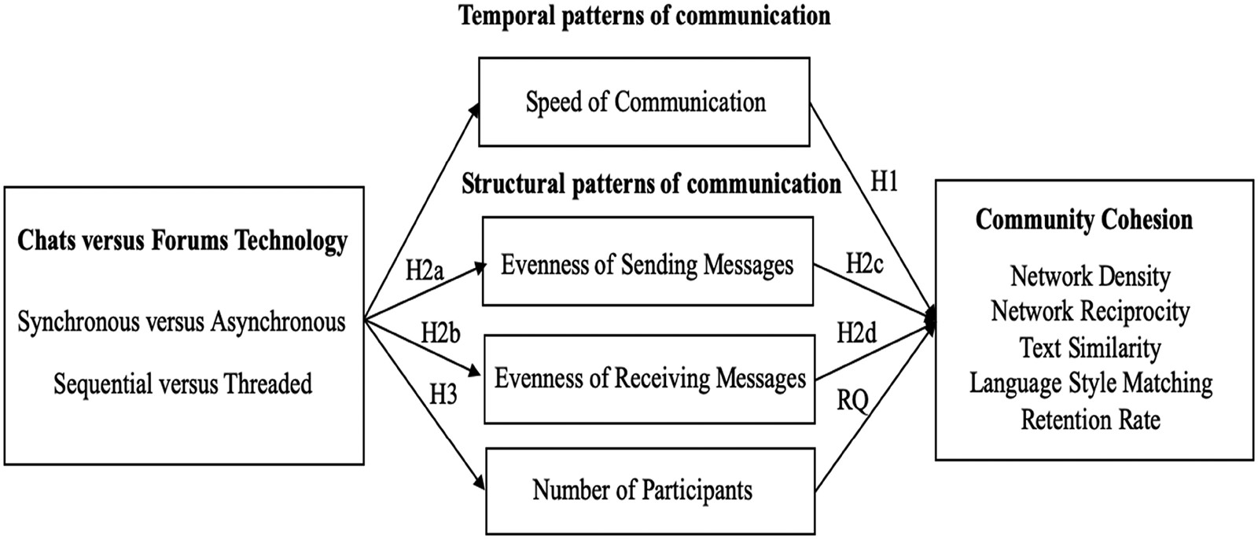
Conceptual model
https://academic.oup.com/jcmc/article/26/6/403/6375170
Li, Kraut, & Zhu, 2021
Notes:
Key Idea: The model illustrates how technical features of communication platforms (Chats vs. Forums) influence community cohesion via their impact on temporal and structural communication patterns.Technical Distinction:Chat Technology: Synchronous, sequential communication.
Forum Technology: Asynchronous, threaded communication.
Community Cohesion Indicators: Measured through network density, network reciprocity, text similarity, language style matching, and retention rate.
Temporal Patterns of Communication
Speed of Communication (H1):
Chat-based platforms afford faster, real-time responses, creating higher immediacy and intimacy among users.
Hypothesis: Faster communication fosters stronger bonds, enhancing community cohesion.
3. Structural Patterns of Communication
Evenness of Sending and Receiving Messages (H2a, H2b, H2c, H2d):
Forums: Centralized communication focuses on thread initiators, reducing evenness.
Chats: Sequential structure spreads attention more evenly among participants, especially in message reception.
Hypotheses:
Chat platforms increase the evenness of receiving messages, promoting cohesion.
Forums may show higher evenness in sending messages due to lower active participation.
Number of Participants (H3):
Forums, with their asynchronous design, allow easier participation for larger numbers.
Research Question: Does the number of participants positively or negatively influence cohesion?
4. Pathways to Community Cohesion
Findings from the Study:
Chat-based communities outperform forums in fostering cohesion through:
Faster response speeds.
Greater evenness in receiving messages.
Surprisingly, evenness in sending messages and participant numbers did not significantly impact cohesion.
5. Practical Implications
Design Recommendations:
For Forums: Introduce features to enhance responsiveness and visibility for non-initiators to improve cohesion.
For Chats: Maintain design simplicity to encourage message flow and equal interaction opportunities.

Slide 40
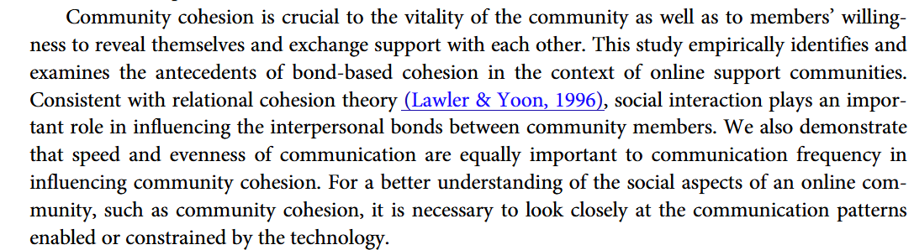
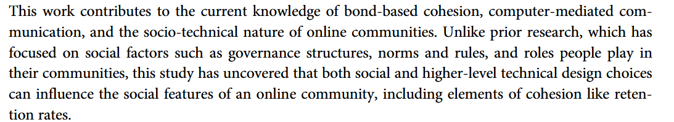
Implications
https://academic.oup.com/jcmc/article/26/6/403/6375170
Li, Kraut, & Zhu, 2021

Slide 41

Case study: Finstas
“Fake Instas”
‘Finsta’ is a slang term referring to a secondary private account that some Instagram users create for publishing personal content to a small carefully-chosen list of followers.
This is in line with presenting different identities on multiple social media platforms for different audiences and intentions.

Slide 42

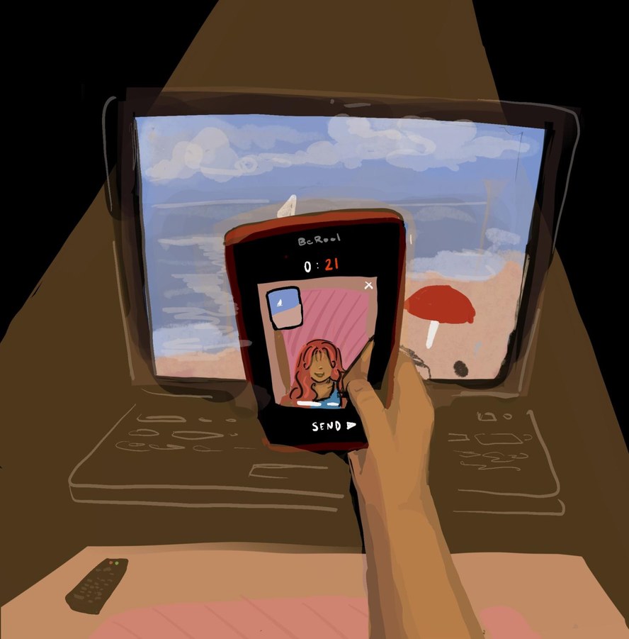


Finstas
“Fake Instas”
Post-Authenticity Age
(Xiao et al., 2020; Huang & Vitak, 2022; Balanji et al., 2023)
(Vanhoffelen et al., 2023; Holtermann, 2023)
Since this within-platform difference of self-representation cannot be explained by social media affordances, it lies in the difference in audience and intention:
New platforms such as BeReal encourage users to engage in authentic self-representation. However, to what extent do the platform affordances effectively result in healthy self-representation and alleviate self-esteem issues?
Deep Engagements
  Safe space with close friends, rather than public audience of strangers
in place of superficial interactions
Messy Self-Image
  Less impression management strategies (e.g., photo selection or manipulation)
in place of presenting idealized self
Emotional Vulnerability
  More authentic and raw emotional expressions (e.g., vents and rants)
Kang, J., & Wei, L. (2020). Let me be at my funniest: Instagram users’ motivations for using Finsta (aka, fake Instagram). The Social Science Journal, 57(1), 58-71.
in place of expectations for constant positivity
(Johnson & Sumi, 2022)
Notes:
Study abstract: We conducted an online survey with college Instagram users who used both Rinsta and Finsta (N = 149) to empirically uncover how user motivations and self-presentation behaviors were different between these two accounts. We found that Instagram users rated five user motivations (i.e., social interaction, self-expression, escapism, peeking, and archiving) higher for the Rinsta than for the Finsta, and they mainly created the Finsta to provide fun daily update and to socially bond with close friends. In addition, we observed that Instagram users presented their actual-self, ideal-self, deceptive-self, and impressive-self to a greater degree on the Rinsta than on the Finsta. Implications, limitations, and future directions are discussed.

Slide 43
Some Instagram users maintain two accounts:
a main account (Rinsta) followed by a wide audience (family, classmates, employers), and
a secondary private account (Finsta) followed only by close friends.
Studies show that on Finsta, users are more willing to post embarrassing photos, emotional updates, and unfiltered content. One possible explanation is that users feel safer when fewer people can see their posts.
Which affordance BEST explains this pattern?
A. Lower persistence on Finsta, because posts disappear automatically and cannot be saved.
B. Lower visibility on Finsta, because posts are seen only by a small, known audience.
C. Higher editability on Finsta, because users can revise captions after posting.
D. Higher association on Finsta, because users can follow celebrities and strangers.

Slide 44
Importance of Self Presentation
Social Psychological Perspective
Online social identity is built on the basic human need for relatedness and belonging.
∴ Self-presentation often involves some degree of strategy and selective honesty to portray one’s best self so as to seek acceptance from others.
(Thagard & Wood, 2015; Schlosser, 2020)
A note on Self-Presentation vs Self-Disclosure:
Self-disclosure focuses on communicating a factual representation of oneself, while self-presentation prioritises influencing how others perceive oneself.
Hence, they are not necessarily mutually exclusive -> self-presentation often involves truthfulness to reflect a desirable self-image.
(Schlosser, 2020)
Notes:
Self-presentation online satisfies our need for connection and acceptance (Thagard & Wood, 2015; Schlosser, 2020).
It combines strategy and selective honesty to gain approval (Thagard & Wood, 2015; Schlosser, 2020).
Self-presentation differs from self-disclosure by focusing on perception rather than fact, aiming for a favorable image (Schlosser, 2020).
In today's digital world, the importance of self-presentation is rooted in social psychological perspectives, emphasizing our innate need for relatedness and belonging. This drive compels us to carefully curate how we present ourselves online, often employing strategic and selective honesty to portray a version of ourselves that we believe will garner acceptance from others, as noted by Thagard & Wood and Schlosser.
It's crucial to differentiate between self-presentation and self-disclosure. While self-disclosure is about conveying factual information about oneself, self-presentation is more concerned with how others perceive us. It's not just about being truthful; it's about molding that truth into an image that we deem desirable. Schlosser in 2020 points out that these concepts, while distinct, are not mutually exclusive — our self-presentation often embodies truthful elements that serve to enhance our desired self-image.
Understanding these nuances is key in navigating our online interactions and the identities we construct in virtual spaces."

Slide 45
What social media affordances shape self-presentation?
“This impression management may involve outright deception, total honesty, or, most often, a strategic balance of sharing, withholding, and distorting information. Our ability to construct an online identity, whether authentic, fanciful, or manipulative is limited and enabled by the communicative tools, or affordances, a platform makes available and our skill at strategically managing them.”
(Baym, 2010)
Visibility
Association
Persistence
Editability

Slide 46
Importance of Self Presentation
Social Psychological Perspective - Findings
Social Information Processing Theory
Social cues that express one’s desire to communicate and interact (e.g., posting real personal characteristics such as appearance and mood) can increase audience interest and approval.
(Hong et al., 2020)
Social cues in selfies
Positive audience evaluation
Notes:
So the first thing we need to remember is that self-presentation is not necessarily bad. In fact, one reason we disclose things about ourselves online is that other people need those cues to figure out who we are.
This comes from Social Information Processing Theory. In face-to-face interaction, I have lots of information about you automatically — how you look, how you speak, your mood, what you're wearing, the setting we're in. Online, a lot of that disappears. So people compensate by using whatever social cues the platform allows them to provide.
Hong and colleagues give us a nice Instagram example. They looked at 1,873 actual selfies, rather than asking people how they think they behave. They coded whether the image contained additional social information — for example, something suggesting the person's profession, fitness, or status.
And what happened? Selfies containing social cues received substantially more likes: about 64.6 versus 49.4 on their normalized measure.
The SIP explanation is that these little pieces of information reduce the informational poverty of online interaction. They give me something more to understand you by, and they can signal, 'I'm giving you something about myself; I'm open to interaction.' Hong et al. interpret those additional cues as a willingness to engage, which then produces more positive evaluations.
So the first takeaway is: self-presentation can facilitate connection. More information about the self can make an online person more socially legible.”
Nice transition:
“But that immediately raises another question: why am I giving you that information? Am I expressing myself, or am I trying very hard to get you to approve of me?”

Slide 47
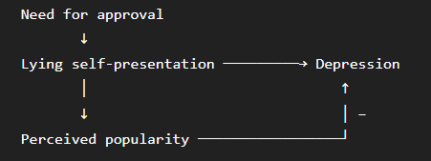
Importance of Self Presentation
Social Psychological Perspective - Findings
Association with Need for Approval & Low Self Esteem
The need for approval from others is linked to higher propensity for lying self-presentation, while low self-esteem is linked to higher relevance of feedback from other users (e.g., likes) as a means of seeking positive social validation, which further triggers self-esteem issues.
(Mun & Kim, 2021)
Mun, I. B., & Kim, H. (2021). Influence of false self-presentation on mental health and deleting behavior on Instagram: The mediating role of perceived popularity. Frontiers in Psychology, 12, 660484.
Notes:
Association with Need for Approval & Low Self Esteem. Mun & Kim in 2021, along with Ballara in 2023, highlighted a fascinating link between the need for approval and the use of lying in self-presentation tactics. Those who have a high need for approval are more likely to present themselves in untruthful ways. Additionally, individuals with low self-esteem tend to place more importance on feedback from others, such as likes on social media. This pursuit of social validation can become a vicious cycle that exacerbates self-esteem issues.
In essence, these findings shed light on the complex dynamics of self-presentation in the digital age. They underscore the delicate balance between expressing oneself authentically and the potential psychological pitfalls of seeking approval in virtual spaces."

Slide 48
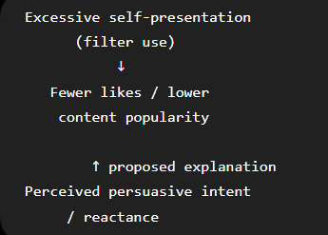
Importance of Self Presentation
Social Psychological Perspective - Findings
Intentional Persuasive Effort
Excessive self-presentation (e.g., use of filters) may backfire and negatively impact popularity (e.g., likes), especially if audiences perceive persuasive intention and evaluate it negatively.
(Hong et al., 2020)
Hong, S., Jahng, M. R., Lee, N., & Wise, K. R. (2020). Do you filter who you are?: Excessive self-presentation, social cues, and user evaluations of Instagram selfies. Computers in Human Behavior, 104, 106159.
Notes:
Next, we look at what's termed 'Intentional Persuasive Effort.' Hong et al. that when self-presentation is perceived as excessive or not genuine—such as the use of filters to alter one's appearance—it can actually have a counterproductive effect. It may lead to a decline in popularity because the audience may perceive the individual's intentions as insincere and consequently view them negatively.

Slide 49
Choices made in
self-presentation online
(Baym, 2010)
[When are people honest?]
Exaggeration:
One may exaggerate social appealing qualities or conceal embarrassing true favourites in order to be consistent with the image one wishes to portray.
Truthfulness:
While reduced social cues make it easier for one to lie, factors of separation, time lag and sparse cues remove social pressures that incentivise lying, hence most people are generally honest online.
Privacy
Women, young children and vulnerable demographics generally lie about private information for safety reasons, while some people lie in order to avoid being filtered out by social media algorithms.
Self-Deception:
One may present an ideal self based on goal-setting, or a misrepresentative self based on limited self-awareness (foggy mirror).
Conformity:
One is more likely to conform to group norms in anonymous settings than differentiate themselves
(Social Identity Theory of Deindividuation Effects).
Notes:
"In this segment, we explore the interplay between online and offline identities, drawing from Baym's insights from 2010.
We begin by questioning when people are most honest in their online interactions. Interestingly, despite the anonymity that the internet provides, which you might think would lead to more dishonesty, Baym's research suggests that most people remain truthful. The separation, time lag, and lack of nonverbal cues actually reduce the social pressures that often incentivize lying in face-to-face interactions.
However, this online space also opens the door to various forms of dishonesty:
Exaggeration is a common tactic. Individuals may amplify socially desirable attributes or downplay aspects of themselves that they feel may be judged negatively, all to maintain a certain desired image.
Self-Deception can also occur, where a person presents an 'ideal' self that aligns with their aspirations, or conversely, they may have a distorted view of themselves, akin to looking into a 'foggy mirror'.
Conformity has its own digital twist. In the pursuit to fit in with online communities, individuals are more likely to align with group norms, which can mean a suppression of one's unique traits, as described by the Social Identity Theory of Deindividuation Effects.
Lastly, the issue of Privacy is paramount. Vulnerable groups, such as women, young children, and other at-risk demographics, may lie about personal details to protect themselves. Moreover, some people adjust the truth to navigate the complex algorithms of social media that determine visibility and engagement.
In conclusion, the interplay between our online and offline selves is nuanced. The digital space allows for a reimagining of self but also presents challenges that prompt individuals to balance authenticity with the desire for privacy and social acceptance.

Slide 50
Interplay between online and offline identities
(Baym, 2010)
Disembodied Identities:
Separation of the self from the offline body means one’s online identity is governed only by one’s words and behaviour in the virtual world.
Multiple Identities:
Similar to various offline environments, one can have many distinct online identities in segmented spaces to play different roles in different contexts.
Mediated Identities:
Sense of confidence, mastery and control which are practised in online identities may be transferred to offline communication.
Testing out honest self-disclosure and expressing one’s real self online can be empowering and liberating.
Notes:
"In today's digital age, the lines between our online and offline selves are increasingly blurred. As Baym's work from 2010 articulates, this interplay involves several key facets.
Firstly, we have the concept of 'Disembodied Identities.' Online, we're not constrained by physical presence; our identities are crafted through words and actions within virtual spaces. This separation from the physical self allows a form of expression that's solely governed by the content we choose to share, free from the immediate judgments based on physical appearance or real-world limitations.
Moving to 'Multiple Identities,' it’s fascinating to see the parallels between online and offline worlds. Just as we might present ourselves differently in varied offline settings – say, at work versus with friends – we also navigate through multiple online identities. Each digital platform or community we engage with can see a different facet of our identity, tailored to the norms and expectations of that space.
Then we have 'Mediated Identities.' Online interactions often provide a sense of control that can be difficult to achieve in real-time, face-to-face conversations. This control can foster a confidence that, intriguingly, might transfer back into offline situations. The skills and self-assurance we gain in digital dialogues can enhance our communication in the physical world.
The quote highlighted here underscores the potential power of online self-expression: 'Testing out honest self-disclosure and expressing one's real self online can be empowering and liberating.' It suggests that the digital realm offers a unique space for individuals to explore and affirm aspects of their identity that may feel risky or vulnerable to present in person.
In conclusion, as we navigate through online and offline worlds, we continuously construct and reconstruct our identities. The interplay between these realms offers opportunities for self-discovery and expression that are as complex as they are impactful.
I'll now open the floor to any questions or comments you might have on this intriguing intersection of our digital and physical lives."

Slide 51
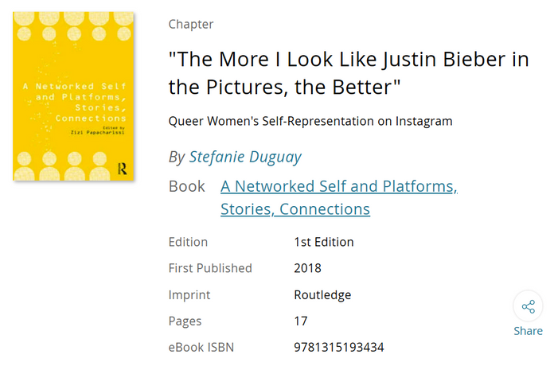
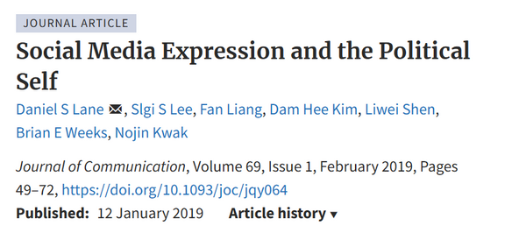
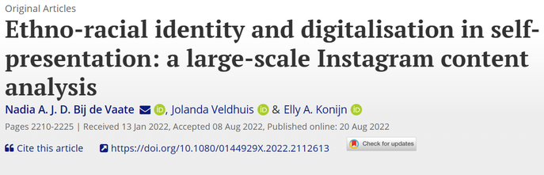
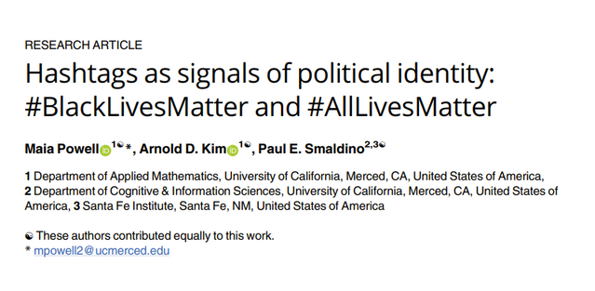
Importance of Self Presentation
Sociocultural Perspective
Online social identity is richly contextualised in offline group membership.
∴ Self-presentation is often used to claim and promote one’s sociocultural identity. -> e.g., Race, Nationality, Gender, Sexuality, Occupation, Political Preferences etc.
https://www.taylorfrancis.com/chapters/edit/10.4324/9781315193434-7/look-like-justin-bieber-pictures-better-stefanie-duguay
http://dx.doi.org/10.1093/joc/jqy064
https://doi.org/10.1080/0144929X.2022.2112613
https://doi.org/10.1371/journal.pone.0286524
Notes:
Main Concept:
Online self-presentation is a tool for claiming and promoting sociocultural identity. Examples include race, nationality, gender, sexuality, occupation, and political preferences. This aligns with the idea that online identities are often deeply tied to offline group memberships.
Key Points from Reading (Duguay, 2018):
Platform Affordances and Visual Aesthetics: Instagram emphasizes visuals, enabling users to craft curated self-representations. These visual affordances allow queer women to creatively showcase their sexual identity through photos, hashtags, and cultural references.
Cultural Stereotypes: Fashion items and styles, such as backward hats or tattoos, are often adopted to signify queerness. For example, one participant stated, "The more I look like Justin Bieber in the pictures, the better," referencing gender-fluid celebrity styles.
Hashtags as a Cultural Connector: Queer women use hashtags like #lesbian, #dykesofinstagram, or #translesbian not only to reflect personal identity but also to link with broader cultural representations and communities.
Microcelebrity Practices: Instagram users often adopt strategies like sharing stylized selfies, emulating celebrity aesthetics, and referencing popular culture to gain visibility and connect with audiences.

Slide 52
Importance of Self Presentation
Sociocultural Perspective - Findings
Online social identity is richly contextualised in offline group membership.
∴ Self-presentation is often used to claim and promote one’s sociocultural identity. -> e.g., Race, Nationality, Gender, Sexuality, Occupation, Political Preferences etc.
Tool for queer women:
  #hashtags enable both a declaration of one’s personal sexual identity and a connection to a collective lifestyle.
  Posts of relationships and fashion styles reflected personal choices while tying into broader cultural references.
Paradox for persons with disabilities:
  While social media has helped many PWDs to connect with society and overcome discrimination (e.g., mobility impairment), it has also limited access to other PWDs who are disabled by online affordances (e.g., dyslexia)
(Duguay, 2018)
(Ellis & Goggin, 2013)
Notes:
Duguay, S. (2018). " The More I Look Like Justin Bieber in the Pictures, the Better. A networked self and platforms, stories, connections.
Ellis, K., & Goggin, G. (2013). Disability and social media. In The social media handbook (pp. 126-143). Routledge.
Main Concept:
Self-presentation on social media is a vital sociocultural practice that bridges personal identity with collective group dynamics. However, it comes with both opportunities and limitations.
Findings from Reading (Duguay, 2018):
Tool for Queer Women:
Queer women use Instagram to navigate visibility and societal norms. For instance, participants blend personal identity with broader LGBTQ culture using symbolic hashtags, fashion, and partnerships.
Platform affordances like filters and third-party apps allow queer women to create visually appealing content, enhancing their ability to connect with similar audiences and promote self-expression.
Cultural References and Stereotypes:
The adoption of culturally recognizable fashion and imagery (e.g., My Little Pony references or Ruby Rose’s style) helps queer women to signify identity in ways that challenge traditional norms.
Many participants draw on pop culture, luxury imagery, and aspirational aesthetics, bridging personal self-expression and mainstream trends.
Paradox for Marginalized Groups:
While platforms like Instagram foster connectivity, they also impose constraints:
Content Moderation: LGBTQ content is often flagged as inappropriate, reflecting underlying platform biases.
Harassment and Misrepresentation: Queer women face challenges from unsolicited messages and the heterosexualization of lesbian identities.
Many participants use alternative platforms (e.g., Tumblr) for content Instagram deems inappropriate.

Slide 53
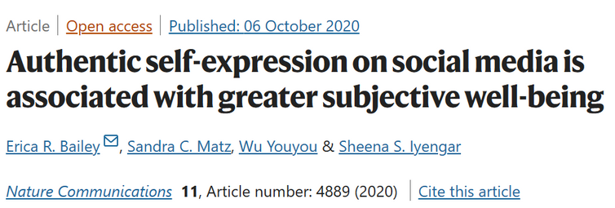
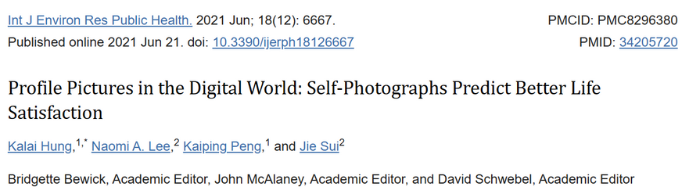

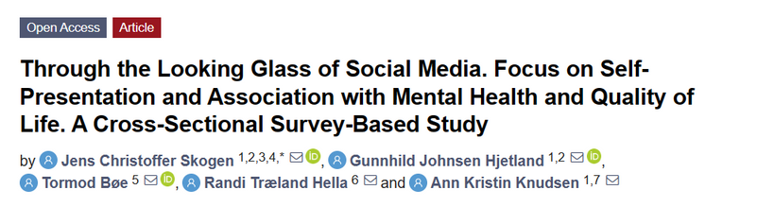
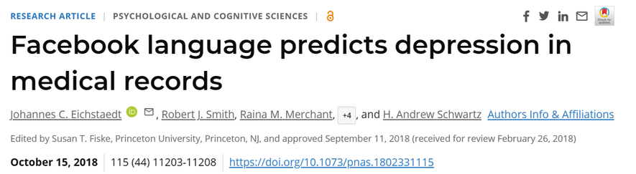
Importance of Self Presentation
Clinical Perspective
Online social identity is deeply intertwined with offline psychological health.
∴ Authentic self-presentation is linked to self-esteem, mental wellness and life satisfaction.
https://doi.org/10.1038/s41467-020-18539-w
https://doi.org/10.3390/ijerph18126667
∴ Conversely, social media may help to identify/understand potential mental health issues.
https://doi.org/10.3390/ijerph18063319
https://doi.org/10.1073/pnas.1802331115

Slide 54
References
Balanji, S., White, C., & Zaitsoff, S. (2023). ‘Fake’ Instagram use is associated with real differences in users’ self-photo activities: An exploratory investigation considering body satisfaction. Eating Behaviors, 50, 101777. https://doi.org/10.1016/j.eatbeh.2023.101777
Holtermann, C. (2023, April 13). They’re over being real. The New York Times. https://www.nytimes.com/2023/04/13/style/bereal-app.html
Huang, X., & Vitak, J. (2022). ‘Finsta gets all my bad pictures’: Instagram users’ self-presentation across finsta and rinsta accounts. Proceedings of the ACM on Human-Computer Interaction, 6(CSCW1), 69:1-69:25. https://doi.org/10.1145/3512916
Johnson, L., & Sumi, K. (2022, November 10). Opinion | Curating authenticity in the age of Be(Ing)Real. The Evanstonian. https://www.evanstonian.net/opinion/2022/11/10/opinion-its-time-to-be-real/
Vanhoffelen, G., Schreurs, L., Meeus, A., Janssens, N., Beullens, K., & Vandenbosch, L. (2023). BeReal, Be Happy? Examining the relationships between authentic self-presentations on BeReal and adolescents’ self-esteem. New Media & Society, 14614448231207783. https://doi.org/10.1177/14614448231207783
Weaver, C., & Issawi, D. (2021, September 30). ‘Finsta,’ explained. The New York Times. https://www.nytimes.com/2021/09/30/style/finsta-instagram-accounts-senate.html
Xiao, S., Metaxa, D., Park, J. S., Karahalios, K., & Salehi, N. (2020). Random, messy, funny, raw: Finstas as intimate reconfigurations of social media. Proceedings of the 2020 CHI Conference on Human Factors in Computing Systems, 1–13. https://doi.org/10.1145/3313831.3376424

