Slide 1
BIOMARKERS & MACHINE LEARNING
For Major Depressive Disorder
Dr. Cyrus Ho
MBBS, MSc, PhD, FRCPsych, FRCP, FAMS
Senior Consultant and Assistant Professor
Department of Psychological Medicine
National University of Singapore

Slide 2
CONTENTS
1. Introduction
Why depression & current challenges
2. Biomarkers & Machine Learning
3. Genome-wide Association Studies
About biomarkers in psychology
Transcriptomics, metabolomics, neuroimaging
4. Functional near-infrared spectroscopy (fNIRS)
About fNIRS
5. Questions
Questions & clarifications

Slide 3
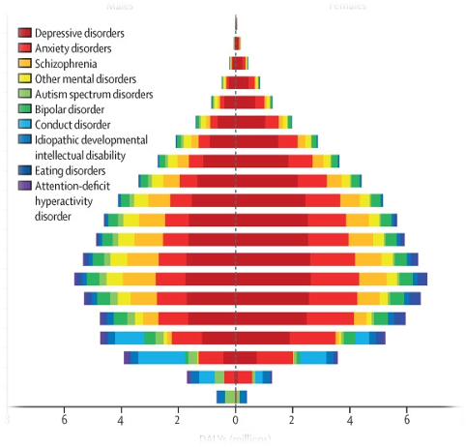
WHY FOCUS ON DEPRESSION?
Commonest psychiatric condition in the world and 2nd in global disease burden
Global prevalence 5-13%
300 million people suffer from depression
Introduction
WHO. (2017). Depression and Other Common Mental Disorders: Global Health Estimates.
Complications: productivity loss, suicide, disability
≈ 10-15% Singaporeans suffer from depression
Mathers, C. D., & Loncar, D. (2006). PLoS Medicine, 3(11), e442.
GBD 2019 Mental Disorders Collaborators (2022). Lancet Psychiatry, 9(2):137-150.
Lim, G. Y., et al (2018). Scientific Reports, 8(1), 2861.

Slide 4
CURRENT CHALLENGES FACED IN DEPRESSION
Complexity of psychiatric diagnosis
  Psychiatric diagnosis based on patients’ self-reported symptoms and longitudinal review of disease course
  Heterogeneity of symptoms and great extent of symptom overlap among disorders
    Misdiagnosis in unipolar depression, bipolar and schizoaffective disorders: 54.72%, 17.78% and 75%
  Low inter-rater reliability of MDD in DSM-5 (intraclass kappa 0.28); different psychiatrists concurred with same diagnosis for a patient only 4-15% of the time
Introduction
Regier, D. A., et al. (2013). American Journal of Psychiatry, 170(1), 59–70.
Allsopp, K. et al. (2019). Psychiatry Research, 279, 15–22.

Slide 5
CURRENT CHALLENGES FACED IN DEPRESSION
Exact etiology of depression not well understood
  Current psychiatric diagnoses are syndrome-based
    DSM categorise psychiatric disorders into distinct entities characterised by specific signs, symptoms, and natural histories
    DSM does not elucidate fundamental neurobiological and behavioural systems
  Current diagnoses do not inform the clinician about the individual patient and guide what treatment is needed.
  Trial-and-error and watch-and see approaches (untargeted treatment)
Introduction
Drysdale AT et al. (2017). Nat Med. Jan;23(1):28-38.
Francisco, G. E. et al. (2007). Brain Injury, 21(10), 1007–1014.

Slide 6
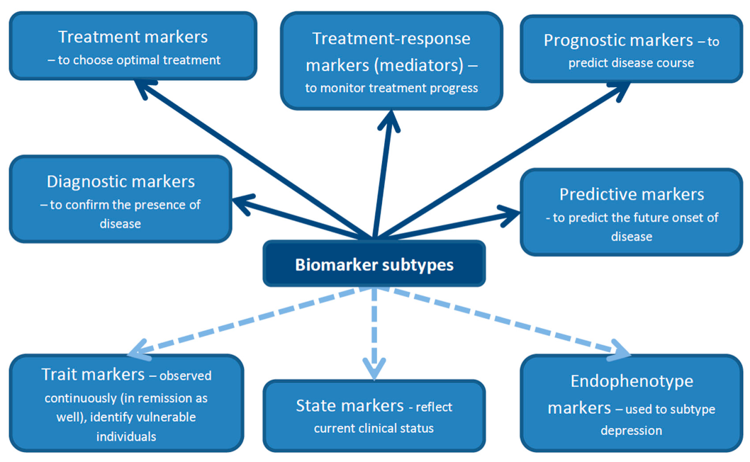
THE NEED FOR BIOMARKERS IN PSYCHIATRY
Biomarkers & Machine LEarning
Nobis et al (2020). Journal of Clinical Medicine, 9(12), 3793

Slide 7

Notes:
Two people both report feeling tired, unable to concentrate, and in low spirits. However, their underlying biological processes and response to treatment may be quite different. What does this example best illustrate?
https://www.polleverywhere.com/multiple_choice_polls/K251duHs0SCbqpvNCb7Fm

Slide 8
BIOMARKER CONSIDERATIONS
IN PSYCHIATRY
  Highly reproducible with acceptable sensitivity and specificity (>80% in disease diagnostic classification)
  Altered dynamically and consistently with disease progression
  Readily available
  Affordable*
  Pain-free and Non-invasive*
  Fast and hassle-free*
* Especially important for depressed/psychiatric patients
Biomarkers & Machine LEarning
Hacimusalar, Y., & Esel, E. (2017). Noro Psikiyatri Arsivi. 2017.19482.
Safran, M. A. et al. (2009). American Journal of Public Health, 99(11), 1962–1966.
Hermesdorf, M. et al. (2016). The Journal of Pain, 17(5), 606–616.

Slide 9
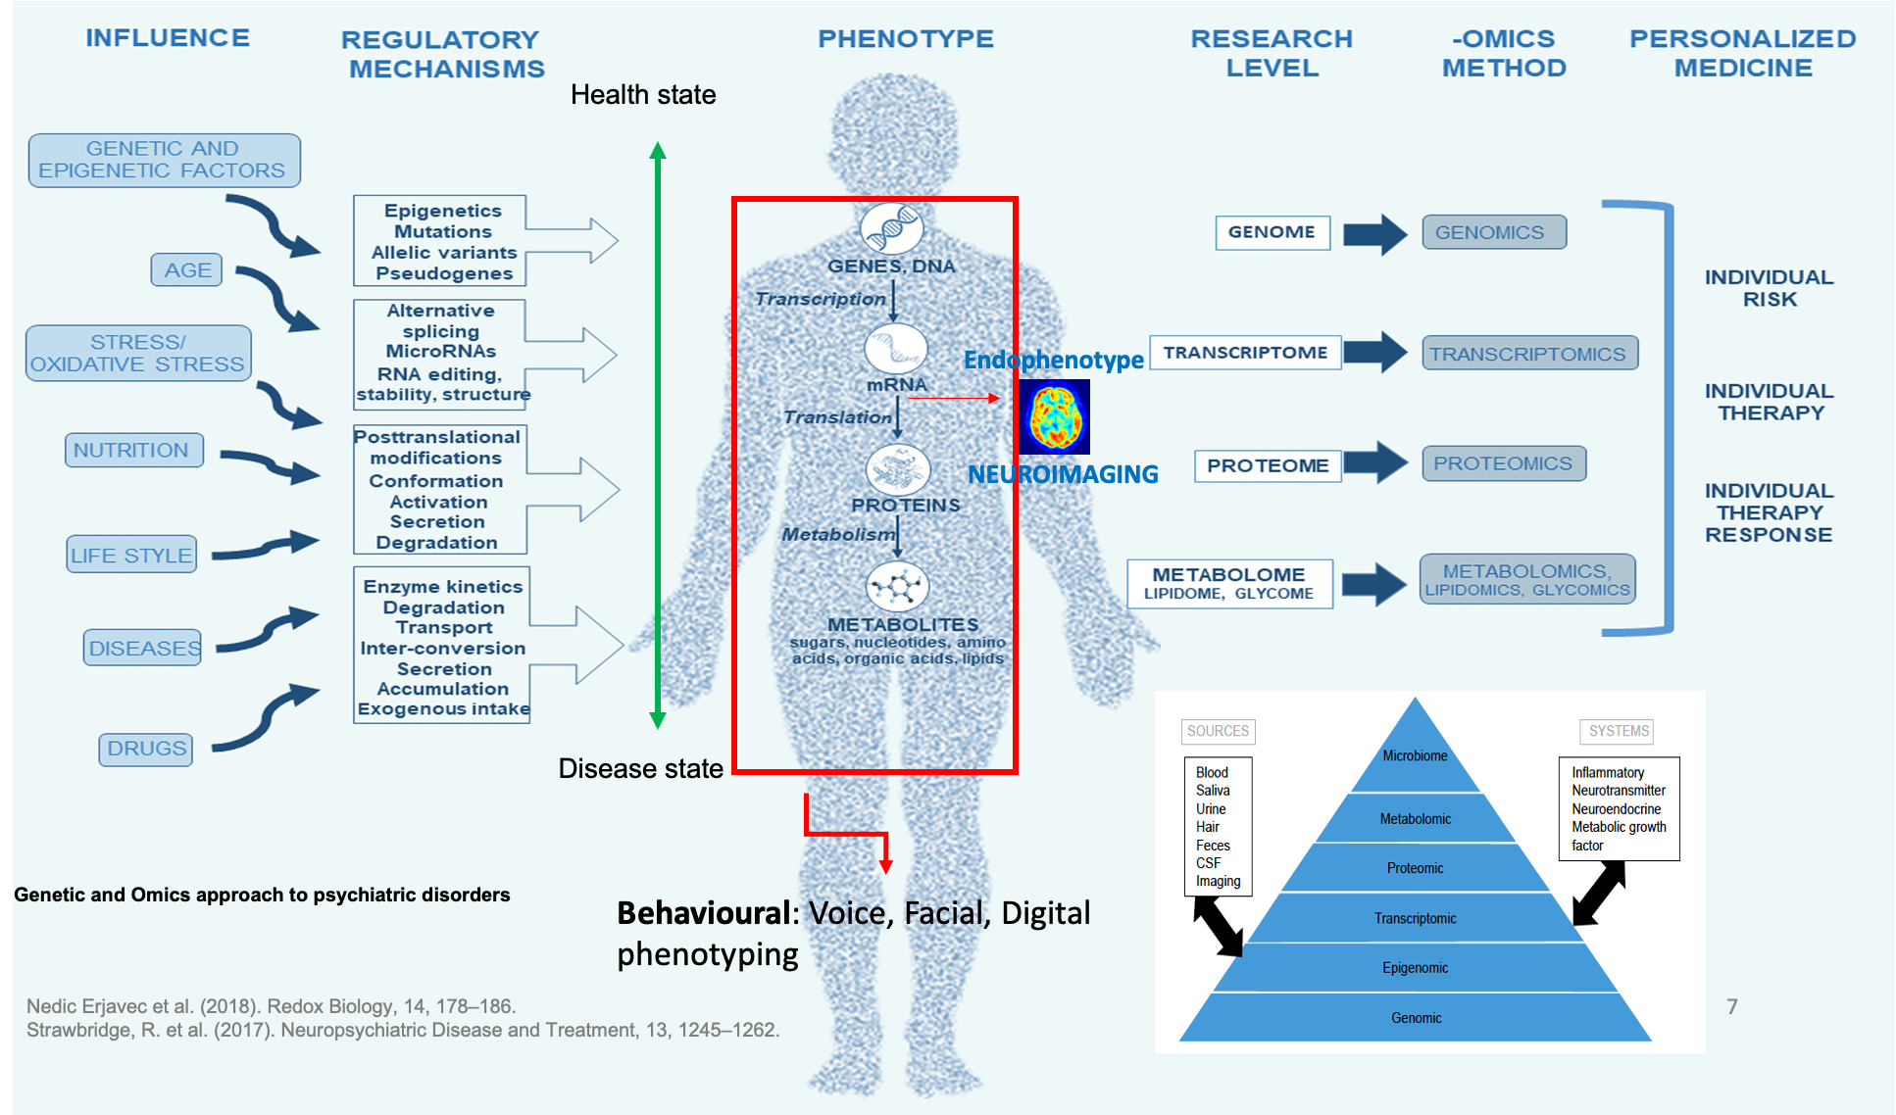

Slide 10
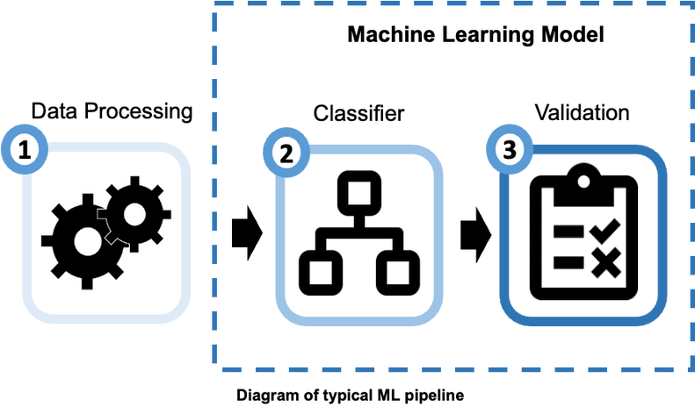
MACHINE LEARNING (ML)
  ML can bridge multiple data types into a single analysis to unravel patterns that are less intuitive but fundamental to a series of observations without needing to provide explicit instructions
  It applies individual-level analysis and can potentially uncover clinically relevant phenotypes that may aid clinical diagnoses, identify more precise targets for new treatments and anticipate therapeutic responses
  These models can evaluate enormous amounts of data to generate effective prediction tools that are personalised to an individual's characteristics and may enhance diagnostic accuracy
  Altered dynamically and consistently with disease progression
Biomarkers & Machine LEarning
Richter, T. et al. (2021). Journal of Personalized Medicine, 11(10), 957.
Zhu, Y. et al. (2019). Frontiers in Psychiatry, 10, 371.
Librenza-Garcia, D. et al. (2021). Psychological Medicine, 51(16), 2895–2903.

Slide 11
Notes:
Researchers develop a machine-learning model that combines sleep patterns, activity levels, demographic information and brain-imaging measurements to estimate whether someone may have depression. What is the main potential advantage of this approach?
https://www.polleverywhere.com/multiple_choice_polls/pcl9I0wePMQAzvFWEHK1H

Slide 12
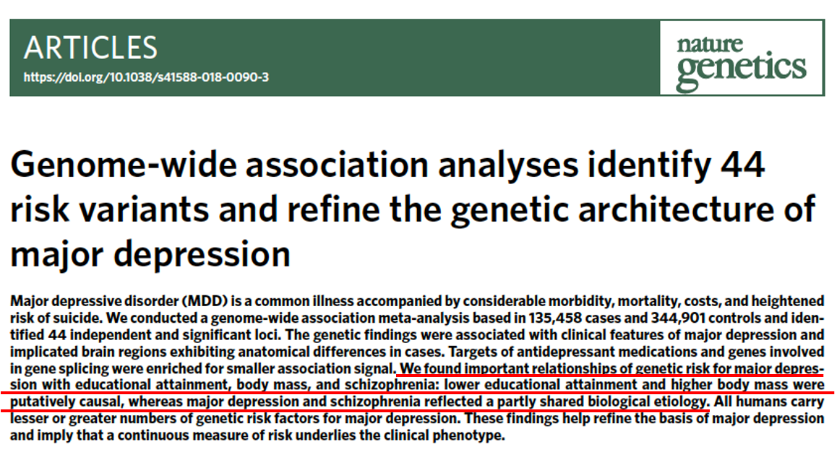
GENOME-WIDE ASSOCIATION STUDIES (GWAS)
Challenges in genetic studies
Genome-wide association studies
  Insufficient power and thus need larger sample sizes
  Insignificant results from heterogeneity of depression cases selected

Slide 13
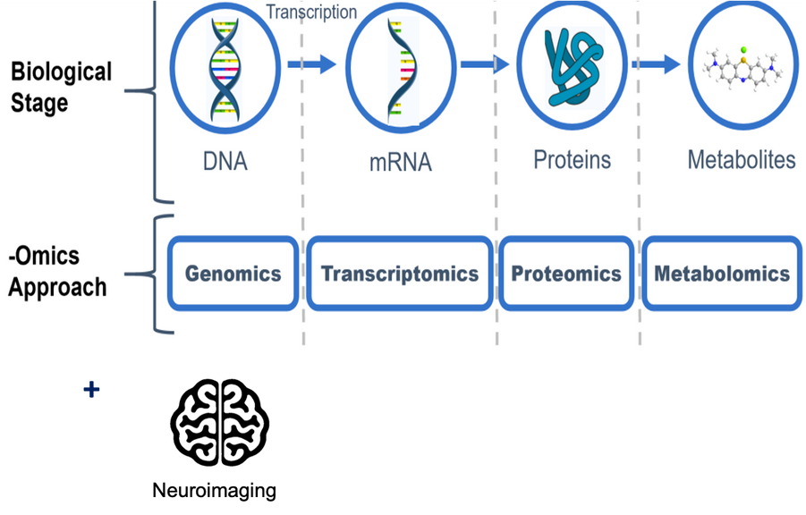
TRANSCRIPTOMICS, METABOLOMICS, NEUROIMAGING
  miRNA regulates gene expression, whereas metabolites are the final products of intricate metabolic pathways.
  Neuroimaging is the only viable means of directly assessing the neuroanatomy and neuronal function
  Need to integrate markers of various modalities to elucidate a holistic understanding of disease pathophysiology.
Genome-wide association studies

Slide 14
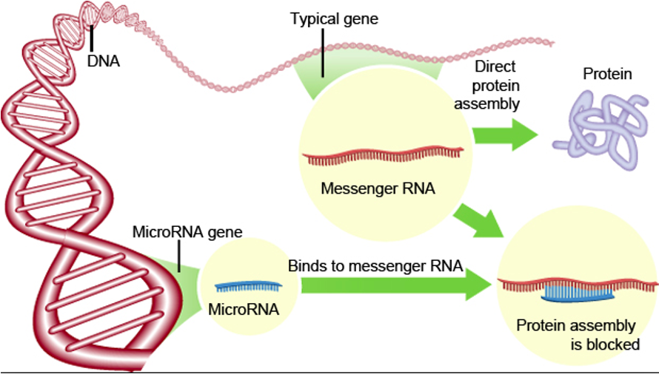
MICRORNA (MIRNA)
  Interaction of multiple genes of modest effect interplayed with environmental events increases vulnerability to depression
  Multiple small but dynamic alterations in biological pathways mediated by epigenetic mechanisms may have a higher yield in elucidating the underlying etiopathology and neurobiology
  A single miRNA could regulate hundreds of mRNAs while one mRNA may be targeted by multiple miRNAs
    Can modulate expression of up to 60% of mammalian genes that code for protein.
Genome-wide association studies
https://www.geneticistinc.com/blog/microrna
Lesch, K. P. (2004). Journal of Psychiatry & Neuroscience: JPN, 29(3), 174–184.
Żurawek, D., & Turecki, G. (2021). International Journal of Molecular Sciences, 22(21), 11312.
Friedman, R. C. et al. (2009). Genome Research, 19(1), 92–105.

Slide 15
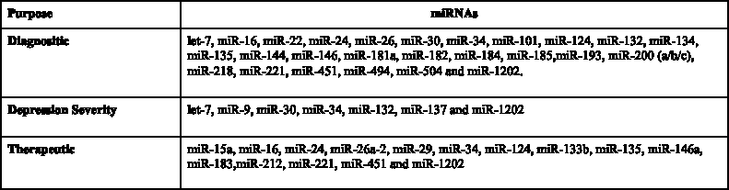
MICRORNA (MIRNA)
Genome-wide association studies
List of miRNAs implicated in the depression pathophysiology
  Existing studies are mainly from western and other Asian countries.
  The impact of miRNA on synaptic plasticity and depression is inconsistent1.
  There are still debates on whether miRNA can be reliable biomarkers for depression with viable clinical translation applications.
Ortega, M. A. et al. (2021). Biomedicines, 9(11), 1659.

Slide 16
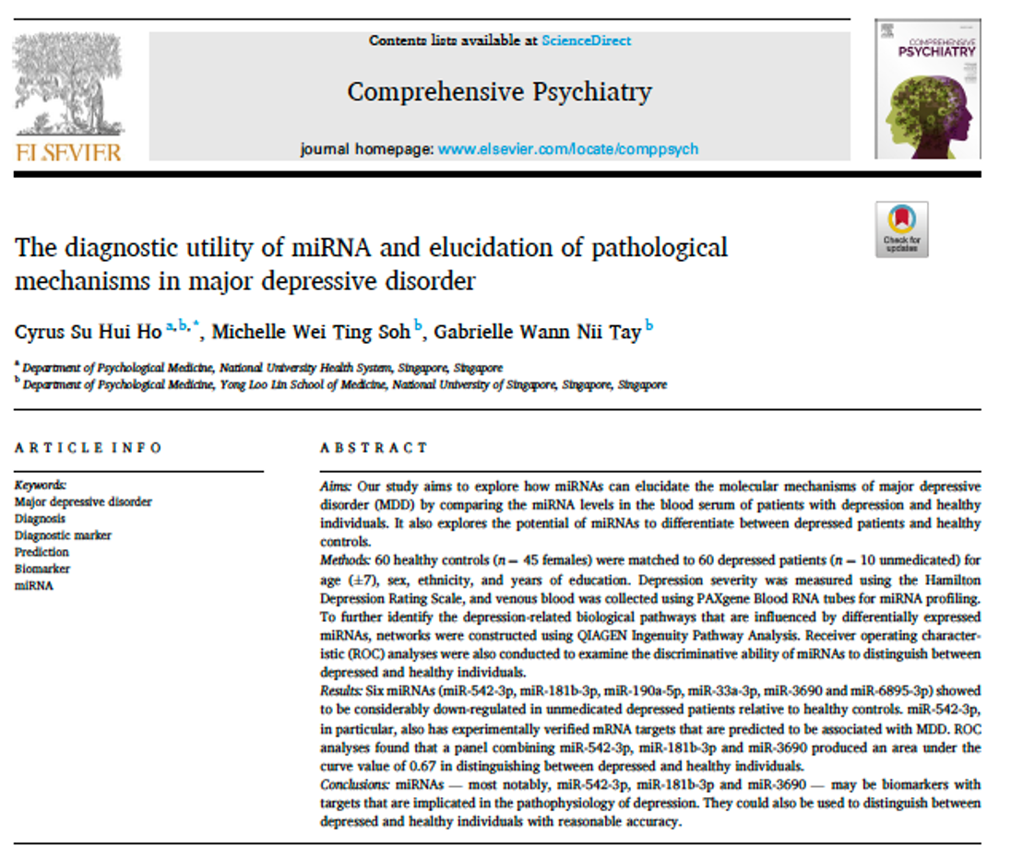
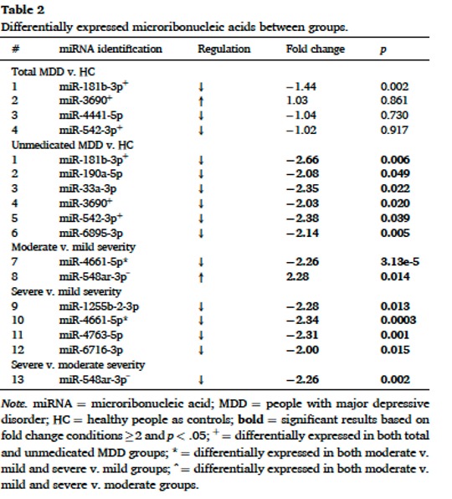
Genome-wide association studies

Slide 17
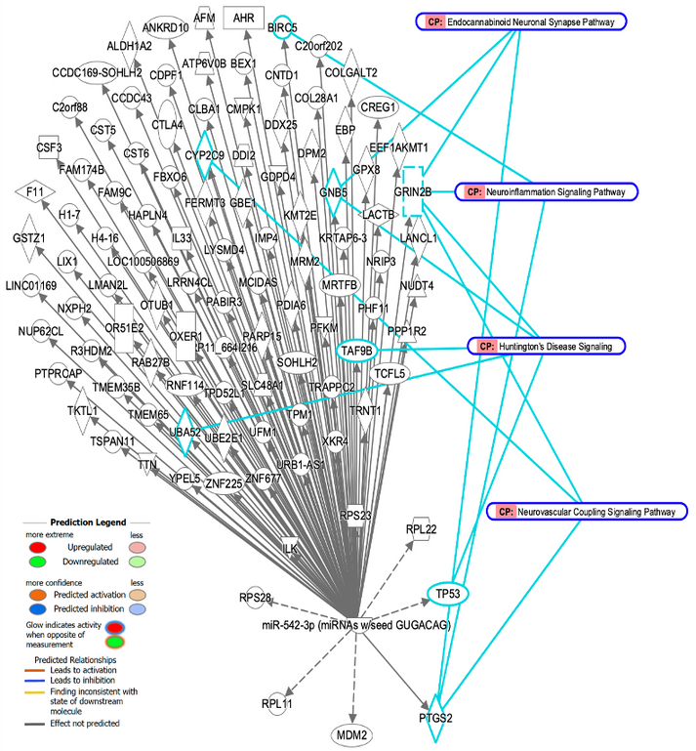
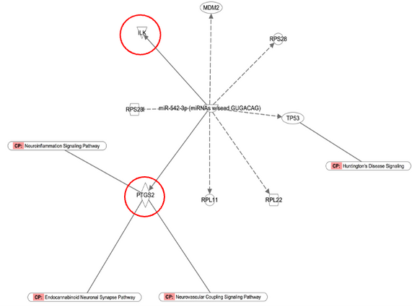
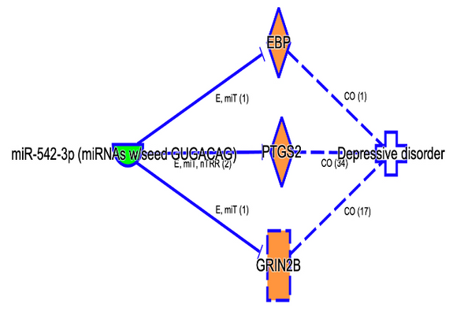
MIRNA TARGET PREDICTION AND PATHWAY ANALYSIS
miR-542-3p
Genome-wide association studies
miR-542-3p targets and molecular paths to depression. (a) miR-542-3p experimentally observed and highly predicted targets; (b) molecular paths to depression - high confidence prediction. E: Expression (includes metabolism/ synthesis for chemicals); miT: microRNA Targeting; nTRR: Non-Targeting RNA-RNA Interaction; Co: Correlation; The number in the brackets indicate the number of literature evidence. Based on IPA QIAGEN knowledgebase.

Slide 18
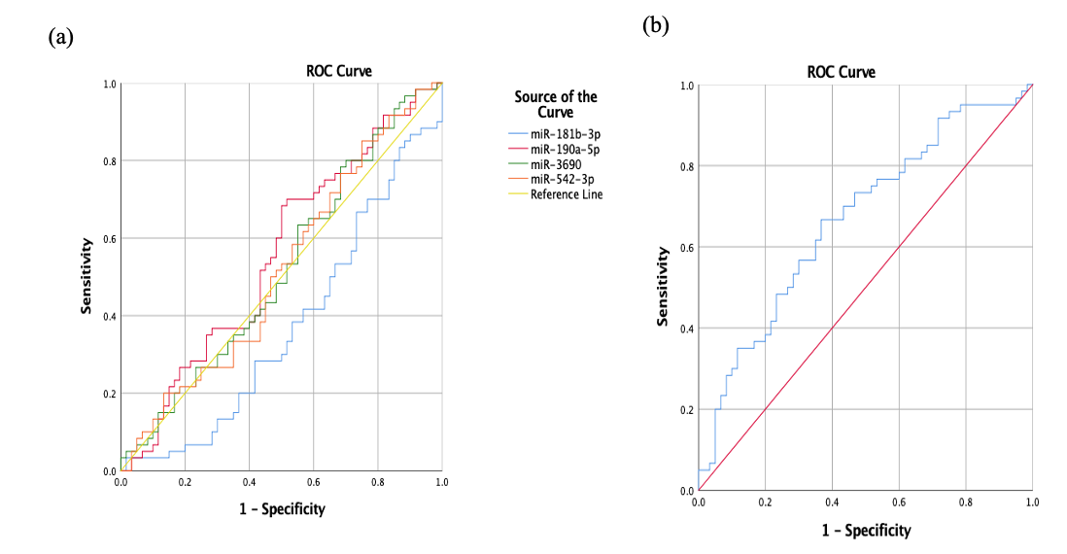
USING MIRNAS TO DISCERN MDD FROM HC
AUC was 0.67 [95% CI, (0.57, 0.77)], and an optimal threshold value of 0.51 correctly classified 66.7% of depressed patients and 63.3% of healthy controls
AUC 0.37, 0.55, 0.52, 0.52 for miR-181b-3p, miR-190a-5p, miR-3690, and miR-542-3p
Genome-wide association studies
(a) The receiver operating curve (ROC) analysis of individual miRNA in whole blood samples between MDD patients (n = 60) and HCs (n = 60); (b) The receiver operating curve (ROC) analysis of a combination of miR-181b-3p, miR‑3690 and miR-542b-3p in whole blood samples between MDD patients (n = 60) and HCs (n = 60).

Slide 19
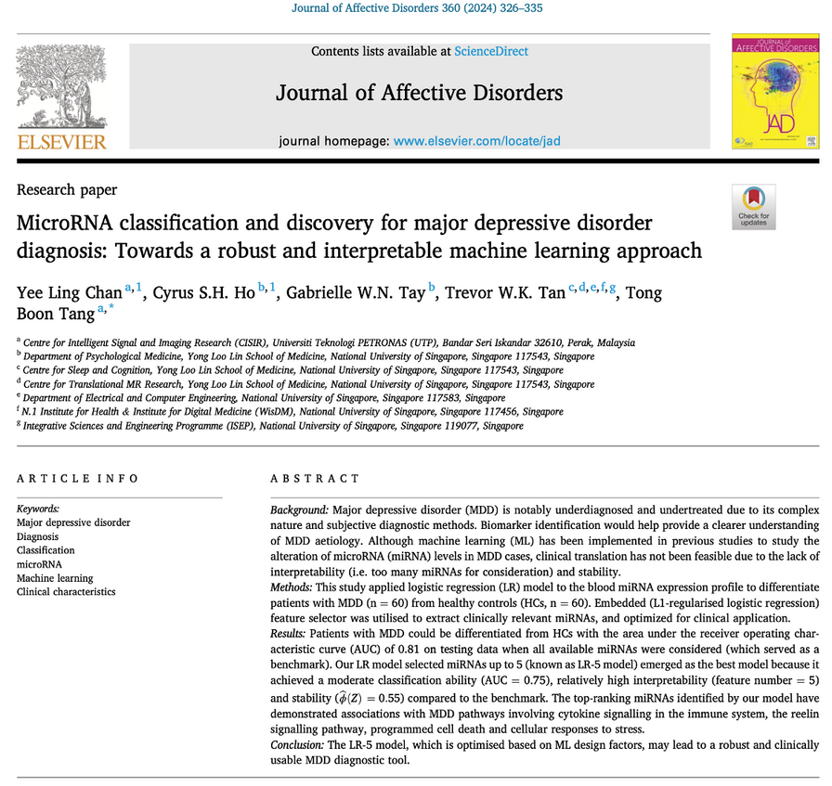
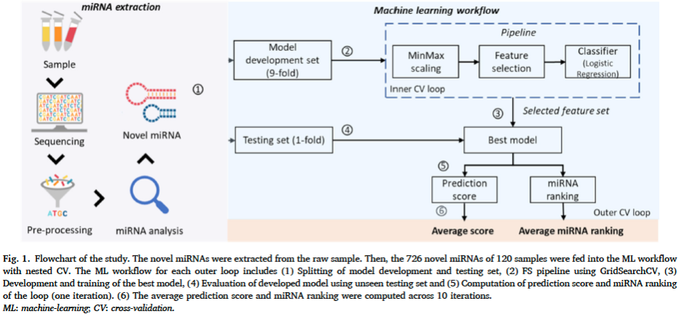

Slide 20
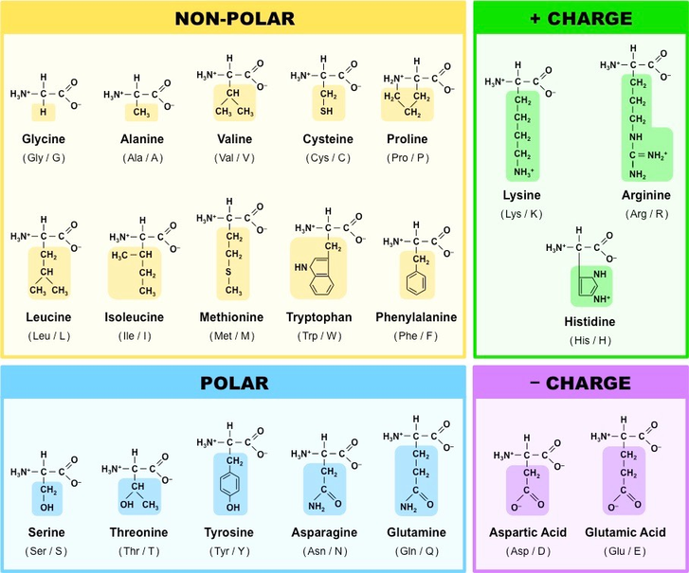
METABOLITES – AMINO ACIDS
Metabolites are the end- and by-products of complex biosynthetic and catabolism pathways.
  Most closely correlate with the observed phenotype as compared to genes and proteins
  May hold higher potential than other omics methods for discovering biological signatures particular to the illness
Amino acids are regarded as potential biomarkers for depression
  Involved in homeostatic responses and downstream signalling pathways
    Glutamate pathway
    Tryptophan-kynurenine pathway
    Phenylalanine pathway
Genome-wide association studies
The 20 Universal Amino Acids
https://ib.bioninja.com.au/standard-level/topic-2-molecular-biology/24-proteins/amino-acids.html
Nedic Erjavec et al. (2018). Redox Biology, 14, 178–186.
Guijas, C et al. (2018). Nature Biotechnology, 36(4), 316–320.
Anthony, T. G. (2015). Animal Nutrition, 1(3), 135–137.

Slide 21
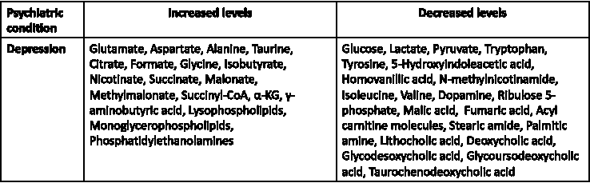
METABOLITES – AMINO ACIDS
Genome-wide association studies
Metabolites altered in depression
Nedic Erjavec, G. et al. (2018). Redox Biology, 14, 178–186.

Slide 22
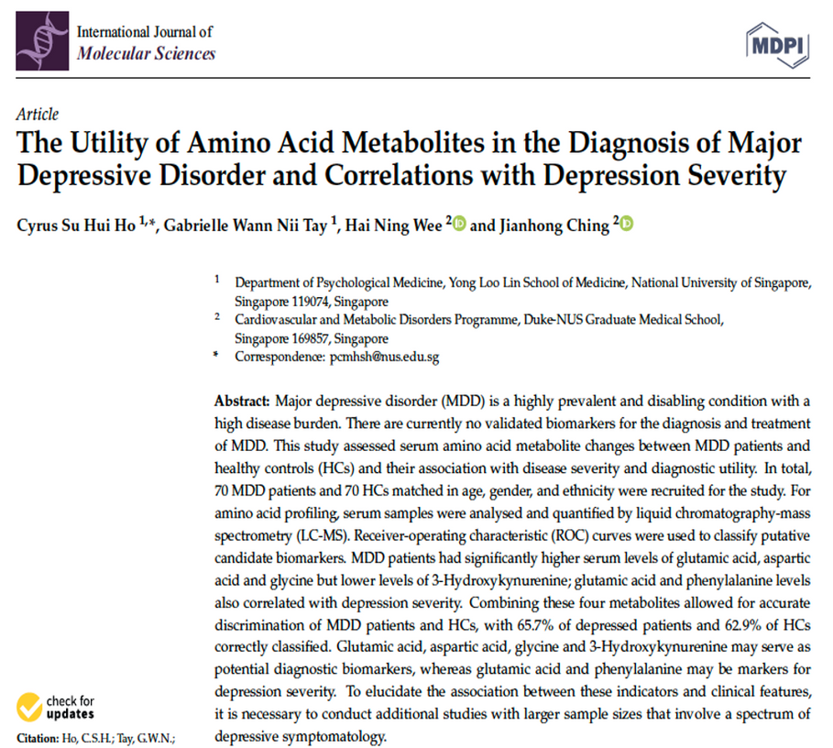
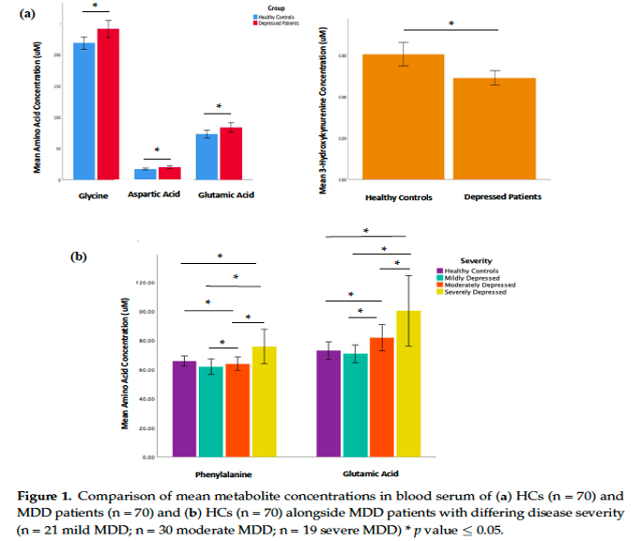

Slide 23
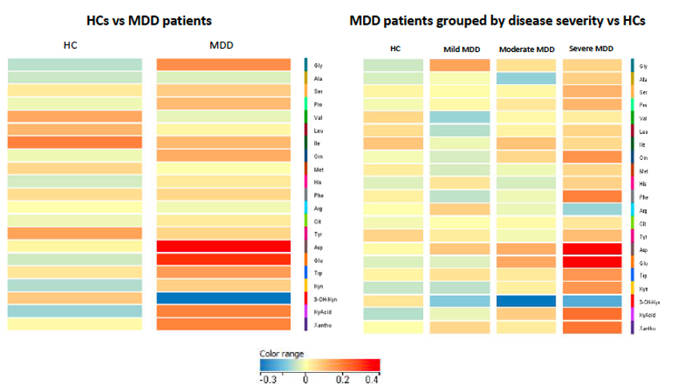

Slide 24
Notes:
A smartphone passively records a person's sleep timing, physical activity and daily movement patterns. Researchers use these data together with other information to study depression. Which term best describes this approach?
https://www.polleverywhere.com/multiple_choice_polls/HJvpWZAlczmePWgMkSPxq

Slide 25
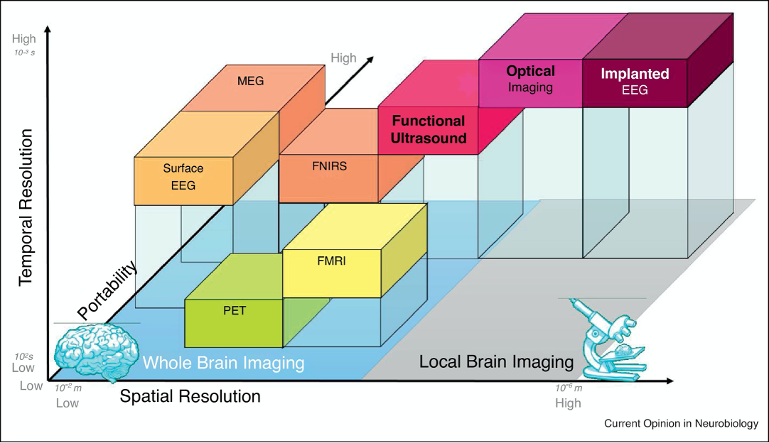
NEUROIMAGING APPROACHES
Genome-wide association studies
Figure: Comparative resolution and portability of various brain imaging techniques (Deffieux et al., 2018)

Slide 26
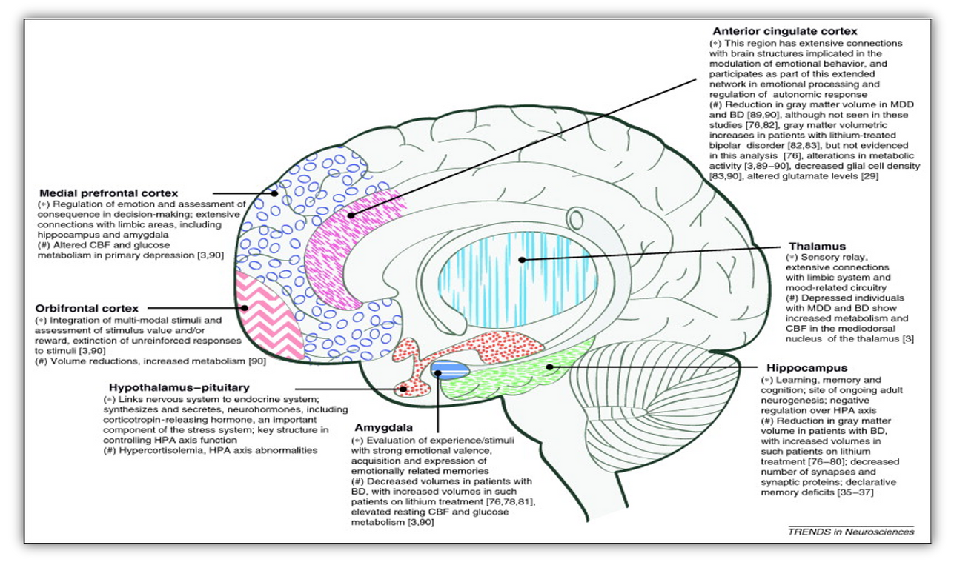
AREAS OF BRAIN
IMPLICATED IN MOOD DISORDER
Genome-wide association studies

Slide 27
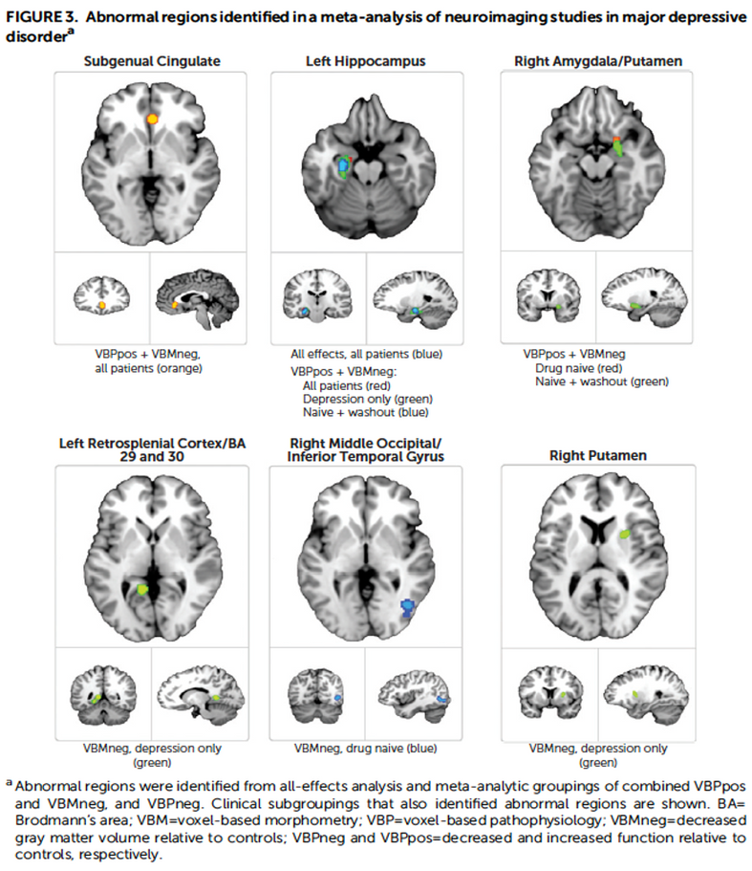
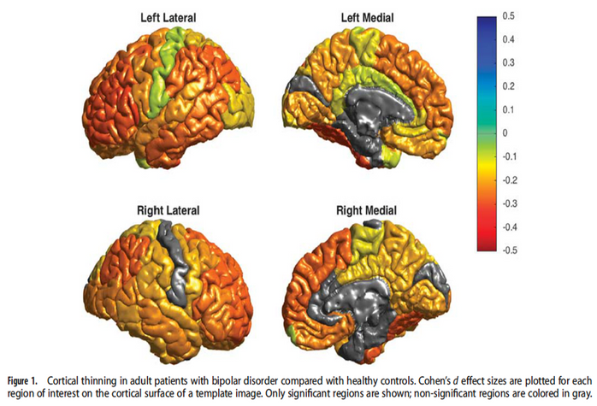
AREAS OF BRAIN
IMPLICATED IN MOOD DISORDER
Genome-wide association studies
Hibar et al (2018)
Gray et al (2019)
In BD, cortical gray matter was thinner in frontal, temporal and parietal regions of both brain hemispheres. BD had the strongest effects on left pars opercularis (Cohen’s d = − 0.293; P = 1.71 × 10 − 21), left fusiform gyrus (d = − 0.288; P = 8.25 × 10 − 21) and left rostral middle frontal cortex (d = − 0.276; P = 2.99 × 10 − 19). Longer duration of illness (after accounting for age at the time of scanning) was associated with reduced cortical thickness in frontal, medial parietal and occipital regions.

Slide 28
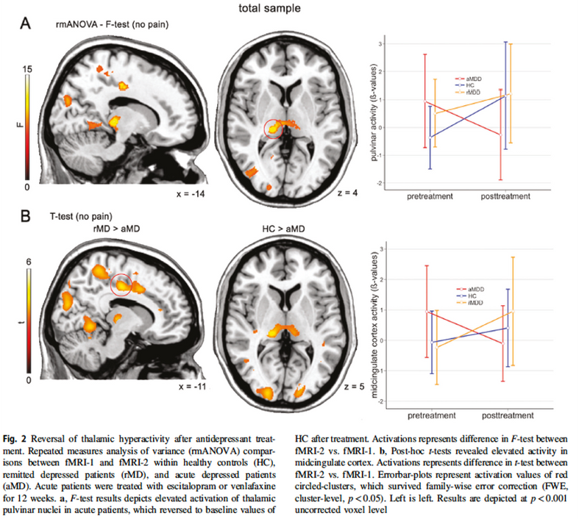
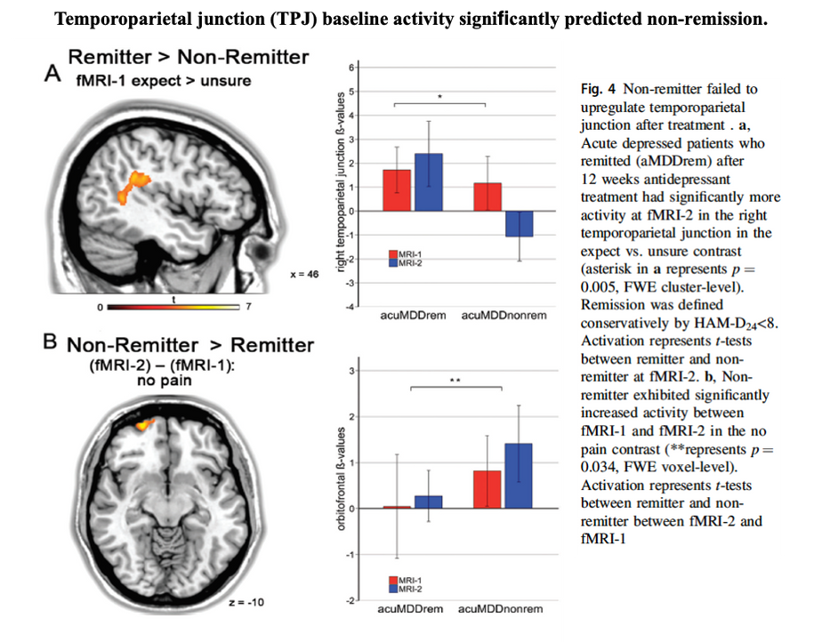
NEUROIMAGING
IN EVALUATING TREATMENT RESPONSE
Pulvinar nucleus and antidepressant treatment response
Genome-wide association studies
Kraus et al (2019)

Slide 29
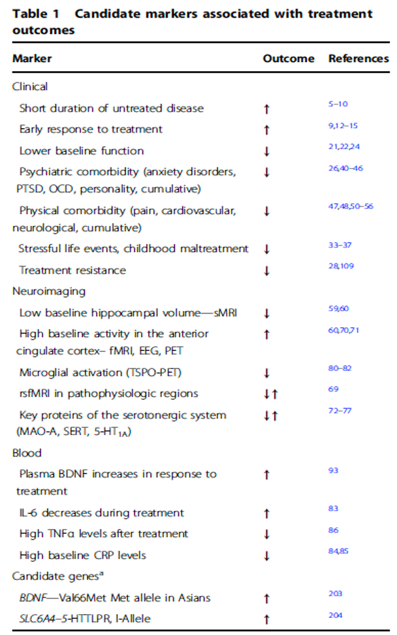
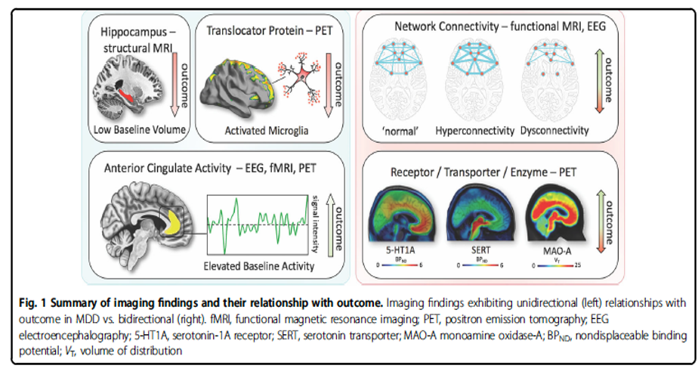
PREDICTORS
OF MDD TREATMENT RESPONSE
Genome-wide association studies
BDNF brain-derived neurotrophic factor, CRP c-reactive protein, EEG electro-encephalography, L-6 interleukin-6, OCD obsessive-compulsive disorder, PET positron emission tomography, PTSD post-traumatic stress disorder, rsMRI resting-state functional MRI, SLC6A4 solute carrier family 6 member 4, SMRI structural MRI, NFa tumor necrosis factor alpha, TSPO translocator protein, S-HT 1A serotonin-1A receptor, MAO-A monoamine oxidase A, SERT serotonin transporter
*Representative examples with meta-analytic evidence
Kraus et al (2019)

Slide 30
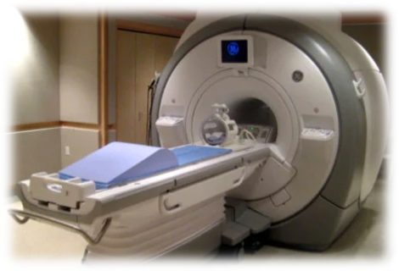
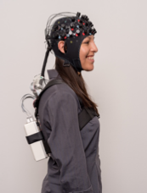
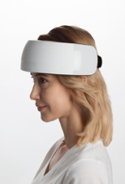
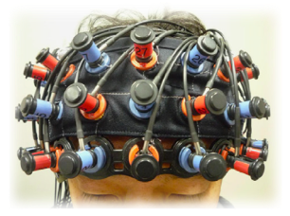
FUNCTIONAL NEAR-INFRARED SPECTROSCOPY (FNIRS)
fNIRS: comparable to fMRI
  The origin of the NIRS deoxy-Hb signal is assumed to be the same as the blood oxygenation level-dependent (BOLD) signal in fMRI
  NIRS-Hb signals are significantly correlated with BOLD signals in the gray matter2.
    Stronger NIRS-Hb response showed a stronger BOLD response.
Functional near-infrared spectroscopy
fMRI vs fNIRS
Ogawa, S., et al (1990). Proceedings of the National Academy of Sciences, 87(24), 9868–9872.
Sato, H.,et al. (2013). NeuroImage, 83, 158–173.

Slide 31
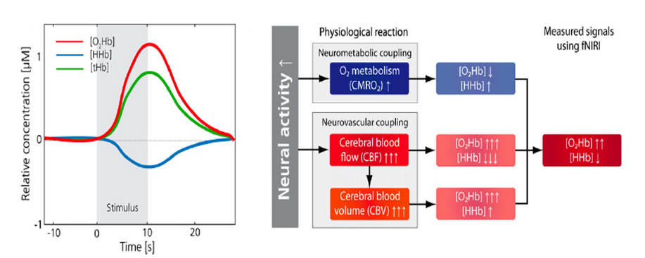
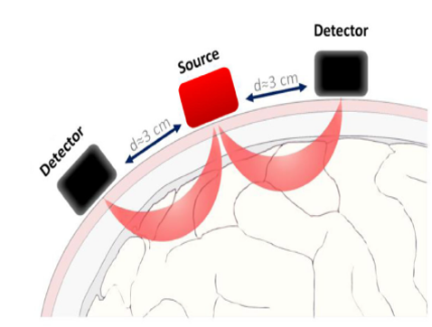
FNIRS: MEASURE OF CEREBRAL BLOOD FLOW
  Indirectly ascertains regional cerebral blood flow by measuring the relative oxygenated (HbO) and deoxygenated haemoglobin (HbR) concentration changes.
    Utilizes the different absorption spectra of oxygenated and deoxygenated Hb in the near-infrared region (695 and 830mm)
Functional near-infrared spectroscopy
Overview of the cerebral haemodynamic changes and effect on the NIRI-derived signals in event of an increased neural activity
Scholkmann F et al (2014). Neuroimage. Jan 15;85 Pt 1:6-27.
Csipo T et al (2019). Geroscience. Oct;41(5):495-509.

Slide 32
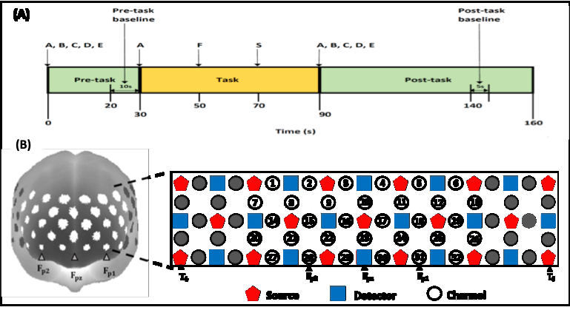
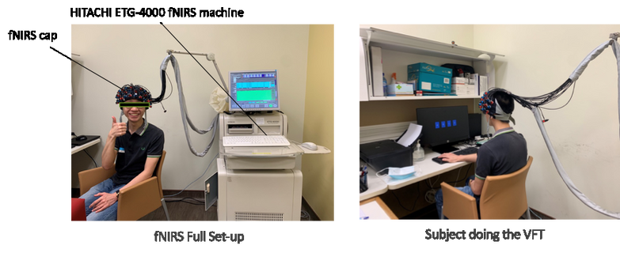
FNIRS PARADIGM
Functional near-infrared spectroscopy
  Verbal fluency task (VFT) is commonly used in neuropsychiatric disorders including depression
  Assess executive control and emotional processes, and has shown high validity and reliability in the cognitive domains assessed
VFT paradigm used in the study is shown in (A). fNIRS channels were illustrated using a spatial topographical template (left) and configured on the 10-20 system (right) in (B). The prefrontal cortical region studied is denoted by the white spots (32 channels).
Henry, J. D., & Crawford, J. R. (2005). Journal of Clinical and Experimental Neuropsychology, 27(1), 78–101.
Sass, K. et al. (2013). Behavioral Sciences, 3(3), 372–387.
Ettenhofer, M. L. et al (2006). Neuropsychology, 20(5), 607–613.

Slide 33
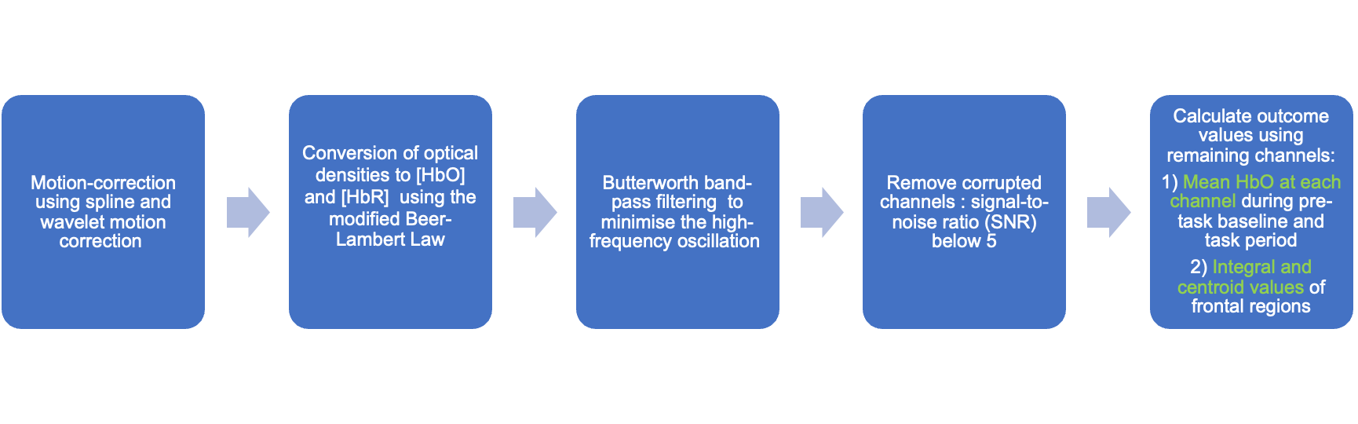
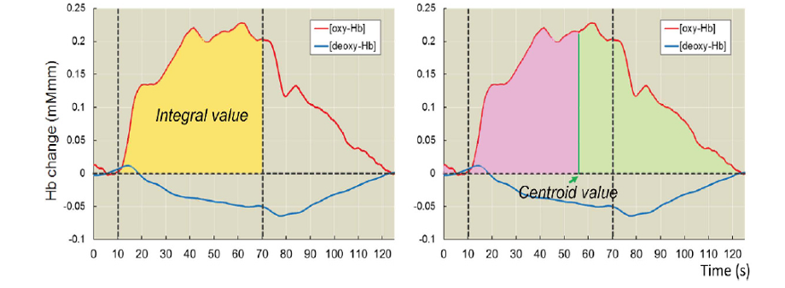
FNIRS PROCESSING
Functional near-infrared spectroscopy
Indices of HbO quantification
Takizawa, R. et al. (2014). NeuroImage, 85, 498–507.

Slide 34
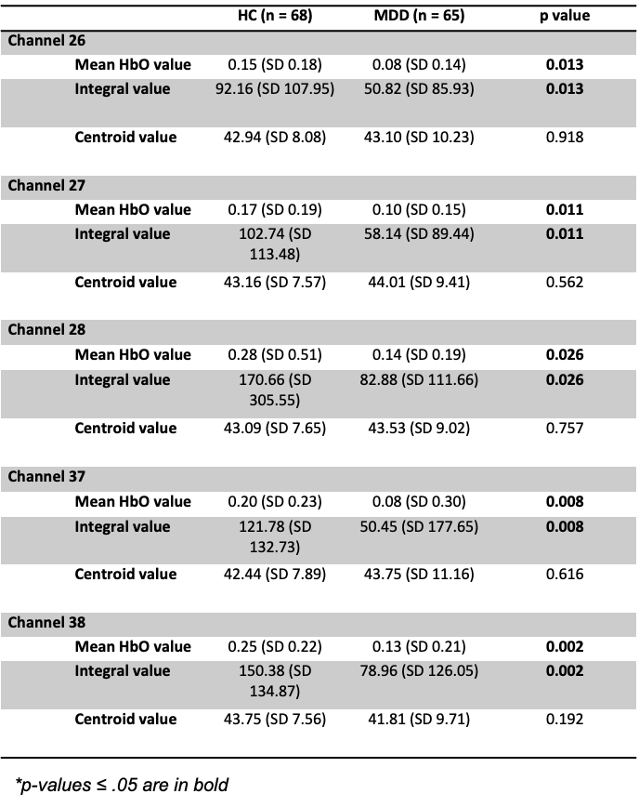
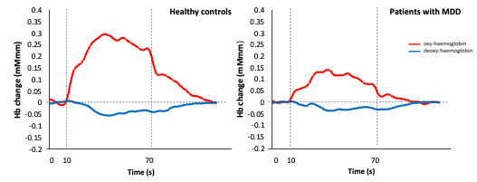
NIRS DIFFERENCES BETWEEN HC AND MDD PATIENTS
Functional near-infrared spectroscopy
Average HbO and HbR waveforms of the frontal region for HCs and MDD patients

Slide 35
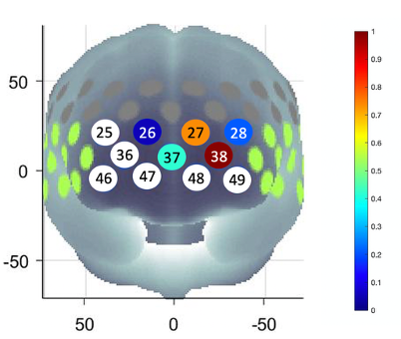
NIRS DIFFERENCES BETWEEN HC AND MDD PATIENTS
Channel 38:
  Mean HbO (r= .24, p< .05) and Integral value (r= .24, p< .05) significantly correlated with previous suicide attempts.
  Centroid value significantly correlated with the type of depression episode (single or recurrent) (r= .28, p< .05).
These 5 channels correspond to Brodmann’s Area 11, which is the orbitofrontal cortex (OFC)
  Plays crucial roles in emotion-, impulse- and reward-mediated behaviours
  Associated with suicidal ideations
Has implications in the use of fewer channels and suicide risk assessment.
Functional near-infrared spectroscopy
Wang, J. et al. (2017). Psychiatry Research: Neuroimaging, 264, 68–75.
Rolls, E. T. (2019). Neuropsychologia, 128, 14–43.
Bajaj, S. et al. (2019). Frontiers in Psychiatry, 10, 445.
Mean HbO differences measured by channels in the frontal brain region between HCs and MDD patients.

Slide 36
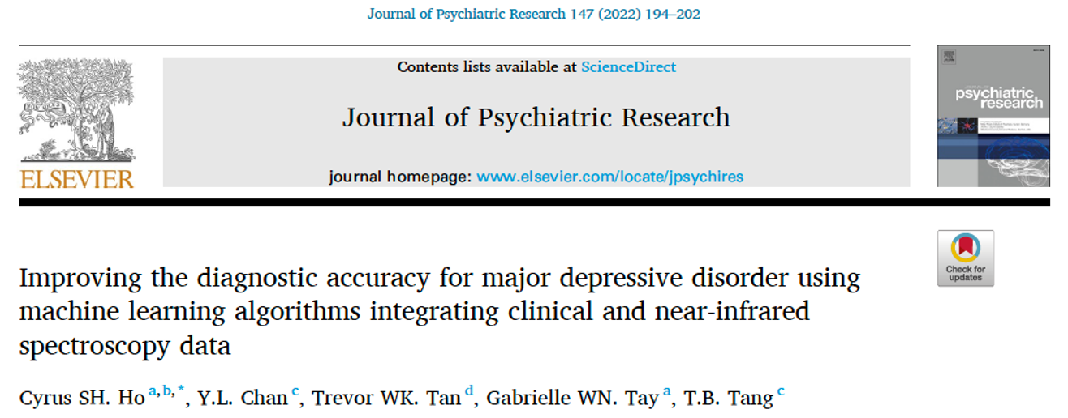
INTEGRATION OF CLINICAL AND FNIRS DATA
Functional near-infrared spectroscopy

Slide 37
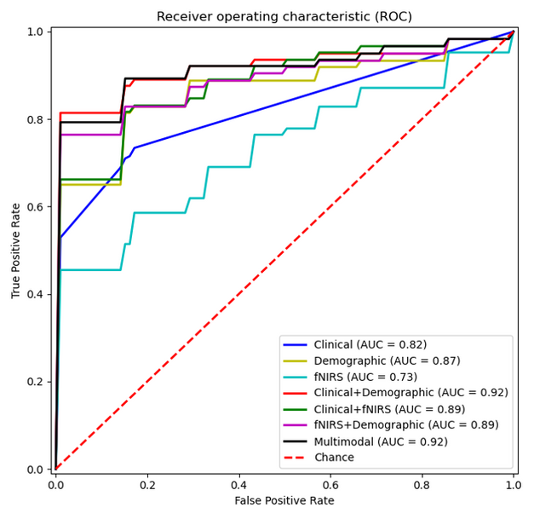
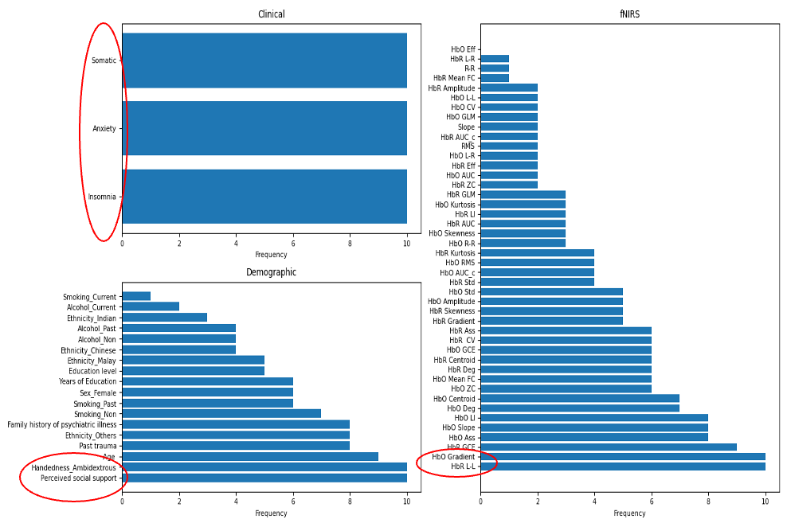
CLASSIFICATION PERFORMANCE
UNIMODAL, BIMODAL, AND MULTIMODAL MODELS
Functional near-infrared spectroscopy
Receiver operating characteristic (ROC) curves across ten folds for all seven classification models
Frequency of selected features across ten folds using sequential backward selection

Slide 38
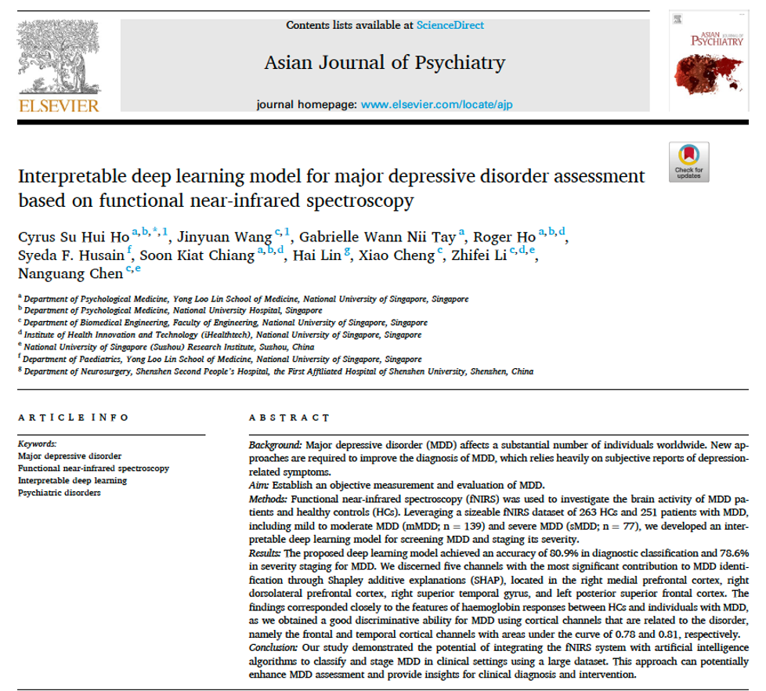
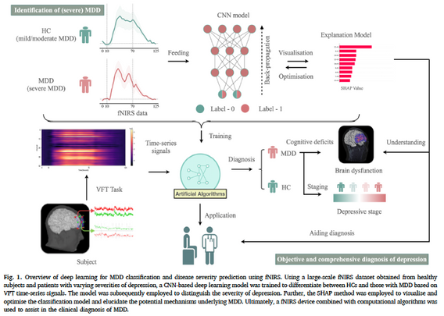
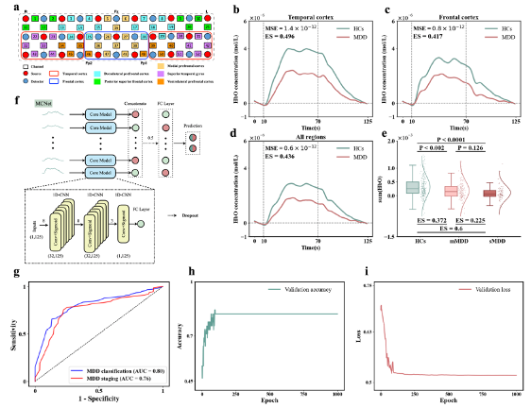
DEEP LEARNING IN NEUROIMAGING
Functional near-infrared spectroscopy

Slide 39
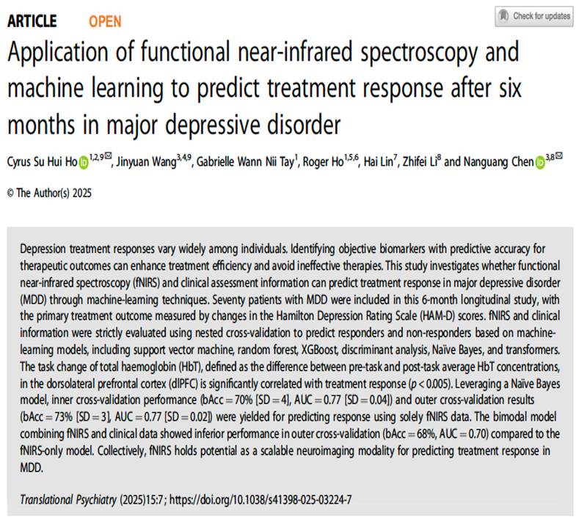
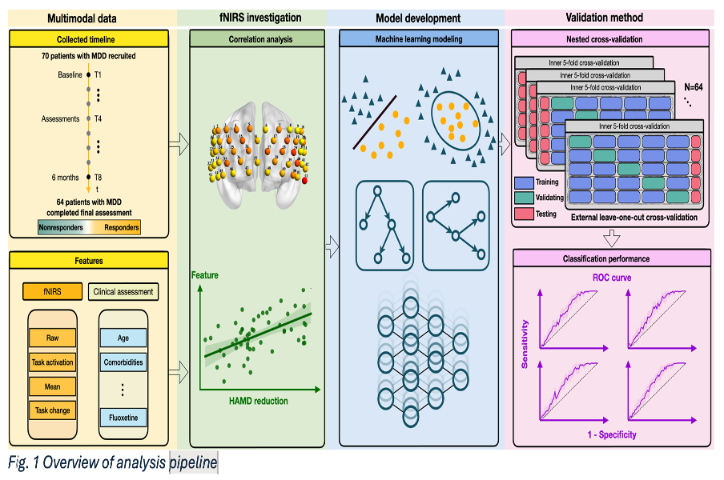
PREDICTION OF TREATMENT RESPONSE
Functional near-infrared spectroscopy

Slide 40


Functional near-infrared spectroscopy

Slide 41



Voice-based recognition model

Slide 42


Facial-based recognition model

Slide 43

The dataset was subset for the present analyses to 20 features consisting of a combination of 8 baseline biodemographics (i.e., Sex, Race, BMI, Pregnancy Status, Money Assistance, Comorbid Diabetes Type I, Comorbid Diabetes Type II, Comorbid Migraines), and 12 derived passively collected movement and sleep data (i.e., Average Awake Activity, Low Physical Activity Duration, Moderate-to-Vigorous Activity Duration, Active Day Count, Sedentary Day Count, Nighttime Sleep Variability, Average Weekday Sleep, Average Weekend Sleep, Sleep Start Time, Variability In Sleep Start Time, Weekly Hypersomnia Count, Weekly Hyposomnia Count). These features were chosen based on known direct or indirect associations with depression.
Digital Phenotyping

Slide 44
Notes:
Researchers propose four potential biomarkers for identifying depression. Which would be the most useful candidate for real-world application, based on the principles discussed in the lecture?
https://www.polleverywhere.com/multiple_choice_polls/1nvwvj8EqyTRyoSVyskwt

Slide 45
QUESTIONS?
Dr. Cyrus Ho
pcmhsh@nus.edu.sg

