Slide 1

Emotion and Social Cues in Online Communication
Week 06
HS2911 Social Media and Mental Health

Slide 2
Brief regression tutorial

Slide 3
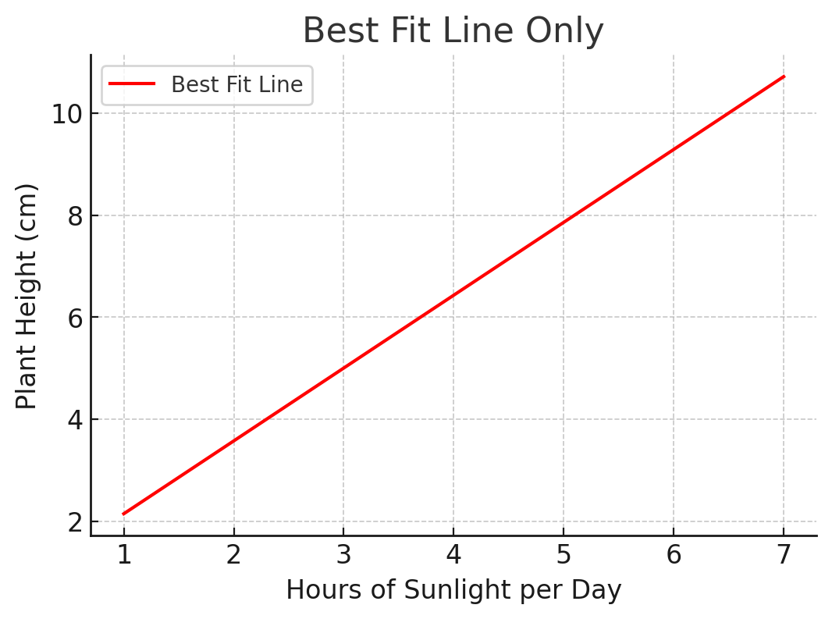
Reading a regression: the line of best fit
METHODS INTERLUDE · REVISION FROM WEEK 3

Slide 4
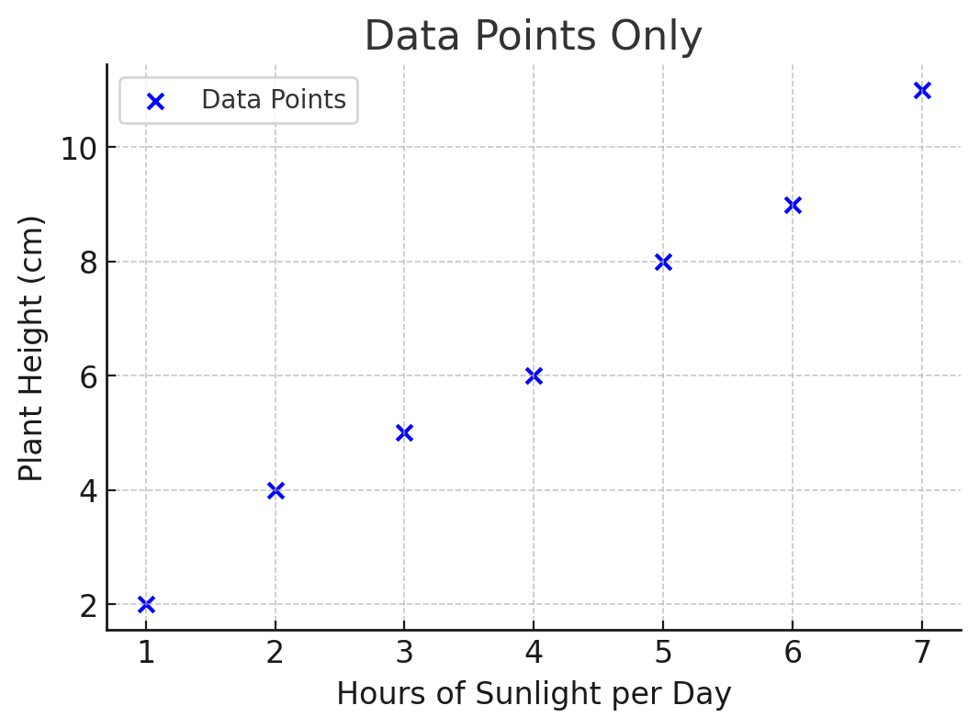
Reading a regression: the data behind the line
METHODS INTERLUDE · REVISION FROM WEEK 3

Slide 5
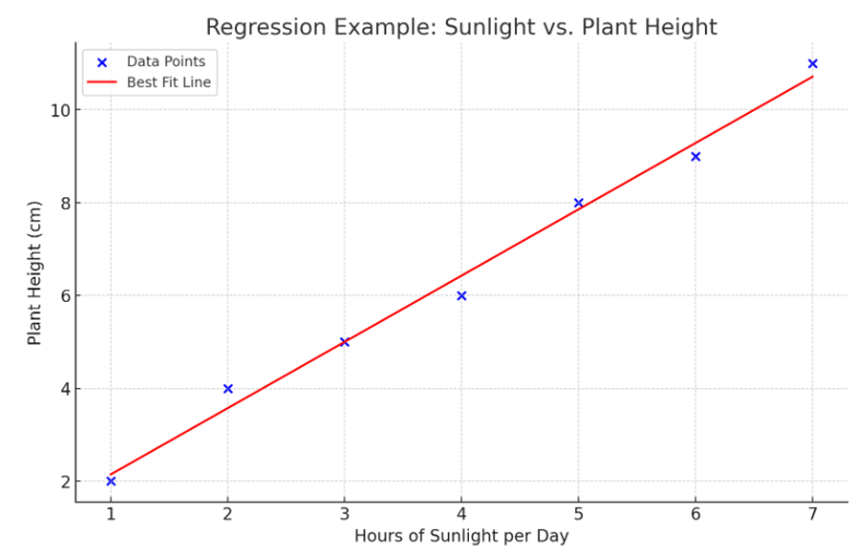
What a regression estimates
METHODS INTERLUDE · REVISION FROM WEEK 3
Notes:
Regression is a way to find out the relationship between two things. Imagine you want to predict how tall a plant will grow based on how much sunlight it gets.
Regression helps us understand if more sunlight means a taller plant and, if so, how much taller the plant will grow with more sunlight.
The blue dots represent the data points, showing the relationship between the amount of sunlight (in hours) and the height of the plant (in cm).
The red line is the "best fit line," which shows the general trend of the data.
This line suggests that, generally, as the amount of sunlight increases, the plant's height also increases.
Regression helps us find this line, which can then be used to make predictions. For example, if you want to predict the height of a plant that gets 8 hours of sunlight, you can look at where 8 hours meets the red line on the graph

Slide 6
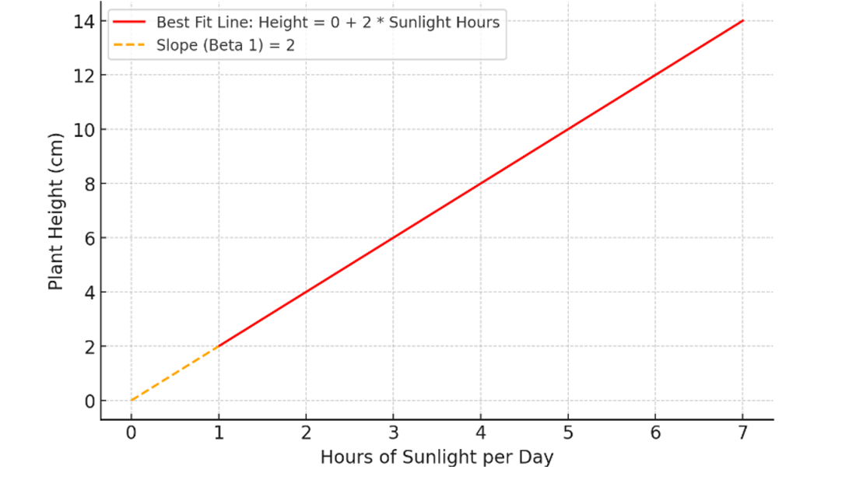
What a coefficient means
METHODS INTERLUDE · REVISION FROM WEEK 3
Notes:
Now lets say if the coefficient was 2 between X and Y.

Slide 7
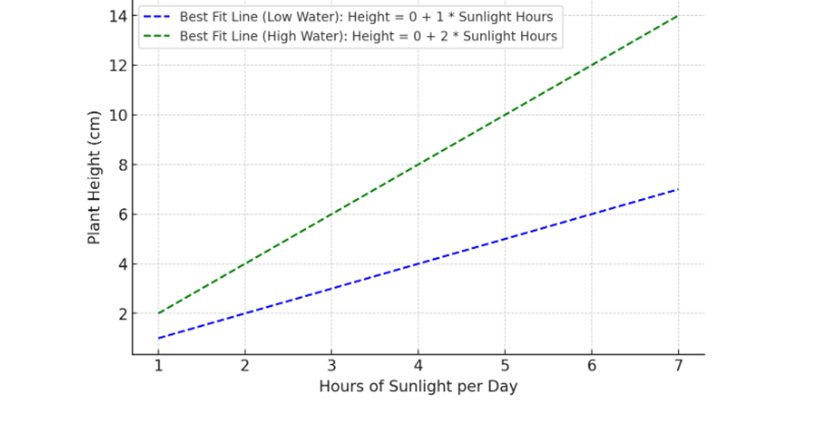
Moderation: when the effect depends on something else
METHODS INTERLUDE · REVISION FROM WEEK 3
Notes:
Moderation relationship in regression refers to a situation where the effect of one independent variable (predictor) on the dependent variable (outcome) changes depending on the level of another variable, called the moderator.
A moderator is a variable that influences the strength or direction of the relationship between the independent variable and the dependent variable. For example, let's say we still want to predict plant height based on sunlight, but we now consider a new factor: water supply.
The water supply could be a moderator in the relationship between sunlight and plant height. In other words, the effect of sunlight on plant growth might differ depending on whether the plant gets a little water or a lot.

Slide 8
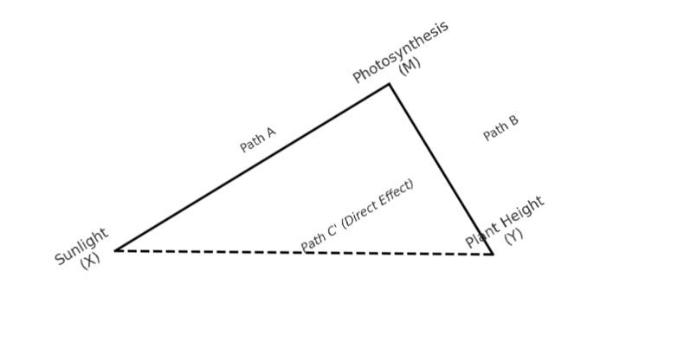
Mediation: the pathway between cause and outcome
METHODS INTERLUDE · REVISION FROM WEEK 3
Notes:
A mediation relationship in regression is when an independent variable (predictor) affects a dependent variable (outcome) indirectly through one or more mediator variables.
A mediator is a variable that explains the pathway through which the independent variable influences the dependent variable.
A mediator helps us understand how or why there is a relationship between the independent and dependent variables. For example, let's say we want to understand the relationship between sunlight and plant height. We might hypothesize that the effect of sunlight on plant height is actually mediated by another variable, such as the rate of photosynthesis. In this case:
Independent Variable (X): Sunlight (hours per day)
Mediator (M): Rate of Photosynthesis
Dependent Variable (Y): Plant Height

Slide 9
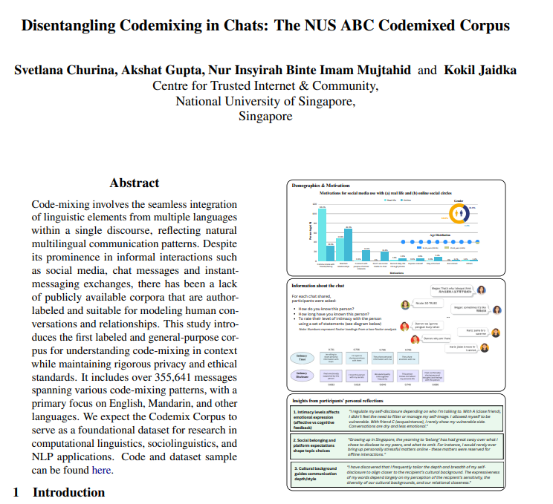
Svetlana Churina, Akshat Gupta, Nur Insyirah Binte Imam Mujtahid, and Kokil Jaidka. 2026. Disentangling Codemixing in Chats: The NUS ABC Codemixed Corpus. In Findings of the Association for Computational Linguistics: ACL 2026, pages 1602–1624, San Diego, California, United States. Association for Computational Linguistics.

Slide 10
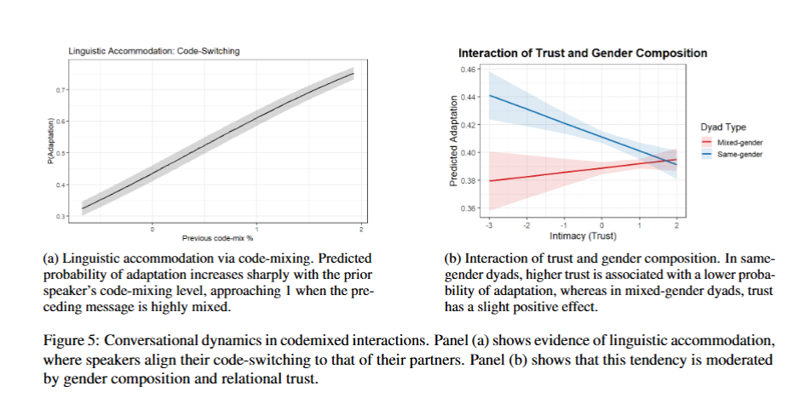
Svetlana Churina, Akshat Gupta, Nur Insyirah Binte Imam Mujtahid, and Kokil Jaidka. 2026. Disentangling Codemixing in Chats: The NUS ABC Codemixed Corpus. In Findings of the Association for Computational Linguistics: ACL 2026, pages 1602–1624, San Diego, California, United States. Association for Computational Linguistics.

Slide 11
Example submissions for
Individual reflection
Week 7

Slide 12


Feedback surveys
HS2911 feedback
Other courses by
Department of
Communication and New Media

Slide 13
Emotion and Social Cues in Online Communication
Week 06
HS2911 Social Media and Mental Health

Slide 14
What Replaces the Fire?
Humans have always had a special evening/leisure mode for emotional bonding and imagination
Today: what fills that role when communication becomes text?

Slide 15
Wiessner (2014): Firelight Talk Among the Ju/’hoansi
174 day and night conversations, supplemented by 68 translated texts
Ju/’hoansi (!Kung) Bushmen of the Kalahari, southern Africa
Question: what did firelight make possible that daylight didn’t?
Wiessner, P. W. (2014). Embers of society: Firelight talk among the Ju/’hoansi Bushmen. Proceedings of the National Academy of Sciences, 111(39), 14027-14035.

Slide 16
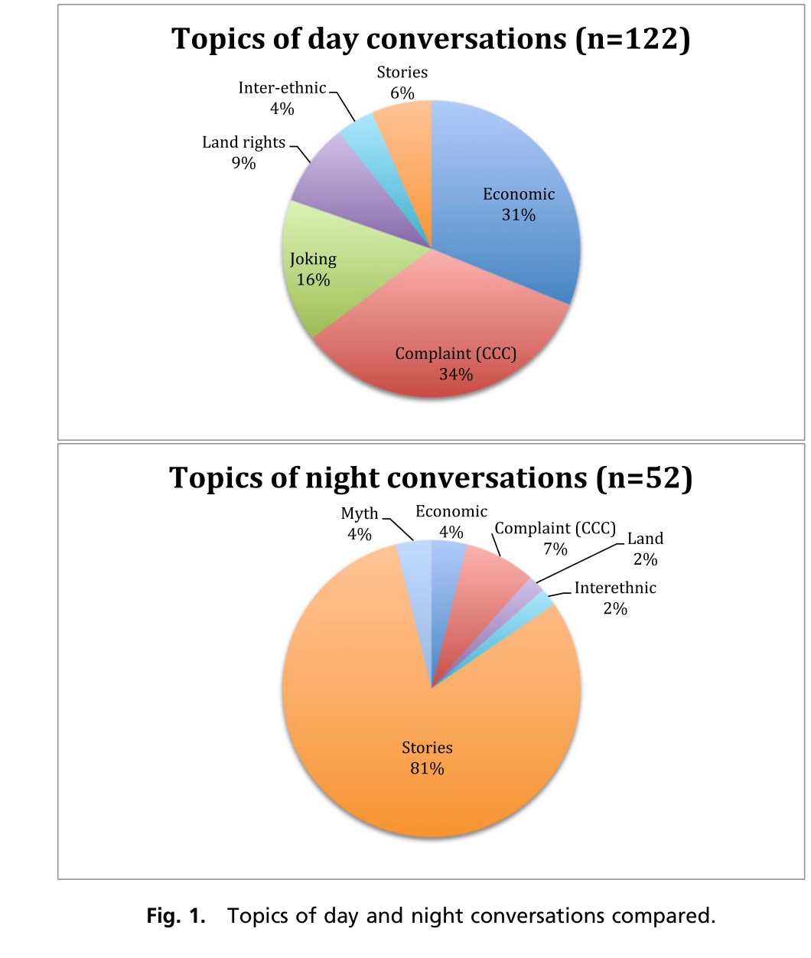
Day Talk
Centers on economic matters
Gossip that regulates social relations
Practical, often tense
Wiessner, P. W. (2014). Embers of society: Firelight talk among the Ju/’hoansi Bushmen. Proceedings of the National Academy of Sciences, 111(39), 14027-14035.

Slide 17
Night Talk
Singing, dancing, religious ceremony
Above all: enthralling stories, often about people known to the group
Steers away from the tensions of the day
Wiessner, P. W. (2014). Embers of society: Firelight talk among the Ju/’hoansi Bushmen. Proceedings of the National Academy of Sciences, 111(39), 14027-14035.

Slide 18
Why Night Talk Matters
Evokes higher orders of theory of mind, through imagination
Conveys the attributes of people across broad networks — Wiessner’s own term: ‘virtual communities’
Transmits the ‘big picture’ of cultural institutions that generate cooperation and trust at a regional level
Wiessner, P. W. (2014). Embers of society: Firelight talk among the Ju/’hoansi Bushmen. Proceedings of the National Academy of Sciences, 111(39), 14027-14035.

Slide 19
Wiessner’s Question
“What happens when economically unproductive firelit time is turned to productive time by artificial lighting?”
Her question, 2014 — before smartphones were the fire
Wiessner, P. W. (2014). Embers of society: Firelight talk among the Ju/’hoansi Bushmen. Proceedings of the National Academy of Sciences, 111(39), 14027-14035.

Slide 20
Replacing the Embodied Cues:
TPC
Firelight gave you tone, face, touch, presence — for free
Text gives you none of that automatically
Textual paralanguage cues (TPC) are how people build it back in

Slide 21
What Is a TPC?
“Written manifestations of nonverbal audible, tactile, and visual elements that supplement or replace written language” (Luangrath et al., 2016)
Emoji, character repetition (‘yeeei’), nonstandard punctuation (‘!!!’)
Two functions: disambiguation and intensity
Rodríguez-Hidalgo, C., Tan, E. S., & Verlegh, P. W. (2017). Expressing emotions in blogs: The role of textual paralinguistic cues in online venting and social sharing posts. Computers in Human Behavior, 73, 638-649.

Slide 22
How Much Do We Actually Use Them?
0.47% of words in a five-corpus study (Riordan & Kreuz)
Up to 0.95% per word in German chat data (Vandergriff)
Low frequency, outsized effect: a single emoticon changed how hostile a message was perceived (Thompson & Foulger)
Rodríguez-Hidalgo, C., Tan, E. S., & Verlegh, P. W. (2017). Expressing emotions in blogs: The role of textual paralinguistic cues in online venting and social sharing posts. Computers in Human Behavior, 73, 638-649.

Slide 23
Studying TPC: Design
LiveJournal blogposts, chosen for anonymity and SNS-like friend structure
Three phases of online Social Sharing of Emotion (SSE): initiation, feedback, repost
Compared against emotional venting posts
Framed by Social Information Processing theory (SIP) and Emotional Mimicry in Context (EMC)
Rodríguez-Hidalgo, C., Tan, E. S., & Verlegh, P. W. (2017). Expressing emotions in blogs: The role of textual paralinguistic cues in online venting and social sharing posts. Computers in Human Behavior, 73, 638-649.

Slide 24
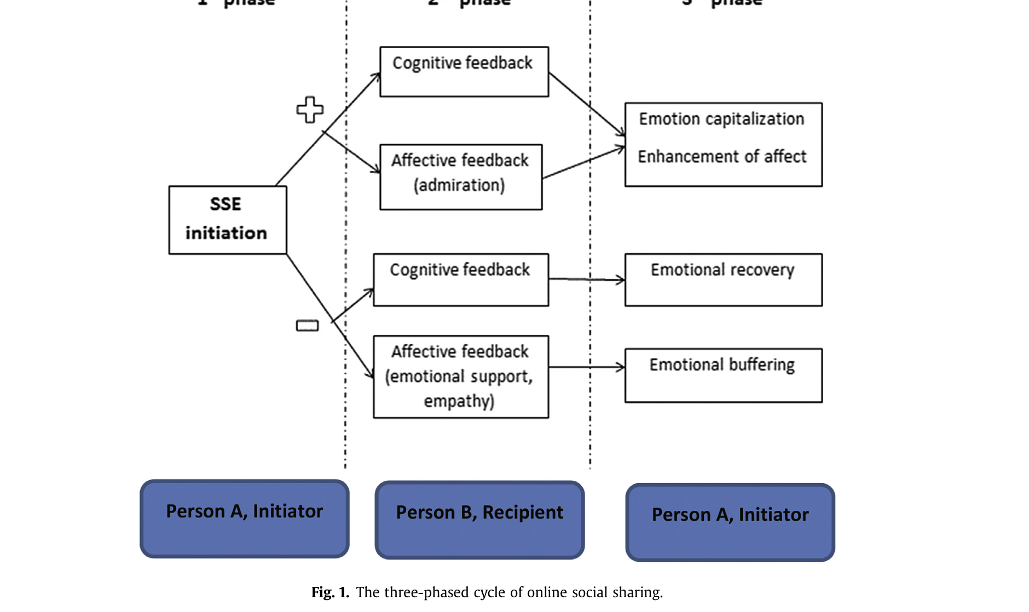
Rodríguez-Hidalgo et al. (2017), Fig. 1 — The Three-Phased Cycle of Online Social Sharing

Slide 25
What They Found
TPC dominated in venting posts, and prevailed in SSE
More common in affective feedback than cognitive feedback
Tactile affective cues (hugs, kisses) in the initiation post predicted their presence in the feedback
Rodríguez-Hidalgo, C., Tan, E. S., & Verlegh, P. W. (2017). Expressing emotions in blogs: The role of textual paralinguistic cues in online venting and social sharing posts. Computers in Human Behavior, 73, 638-649.

Slide 26
‘(((hugs)))’
Real example from the data: ‘(((hugs))) I’m sorry you’ve had a hard time!’
Tactile cues were the one type that reliably carried from initiation into feedback — genuine online mimicry
Design implication the authors raise: platforms still lack a ‘virtual hug’ button
Rodríguez-Hidalgo, C., Tan, E. S., & Verlegh, P. W. (2017). Expressing emotions in blogs: The role of textual paralinguistic cues in online venting and social sharing posts. Computers in Human Behavior, 73, 638-649.

Slide 27
One Thread to Hold Onto
TPC are interpreted differently by friends than by strangers (Riordan & Trichtinger)
We’ll come back to this when the whole audience is strangers
Rodríguez-Hidalgo, C., Tan, E. S., & Verlegh, P. W. (2017). Expressing emotions in blogs: The role of textual paralinguistic cues in online venting and social sharing posts. Computers in Human Behavior, 73, 638-649.

Slide 28
A Second, Unconscious Layer
TPC are the visible, deliberate cue layer
Word and pronoun choice is a second layer — mostly unconscious
Function words (I, we, articles) predict personality even with zero emoji or punctuation
Pennebaker, J. W. (2011, December). Your use of pronouns reveals your personality. Harvard Business Review.

Slide 29
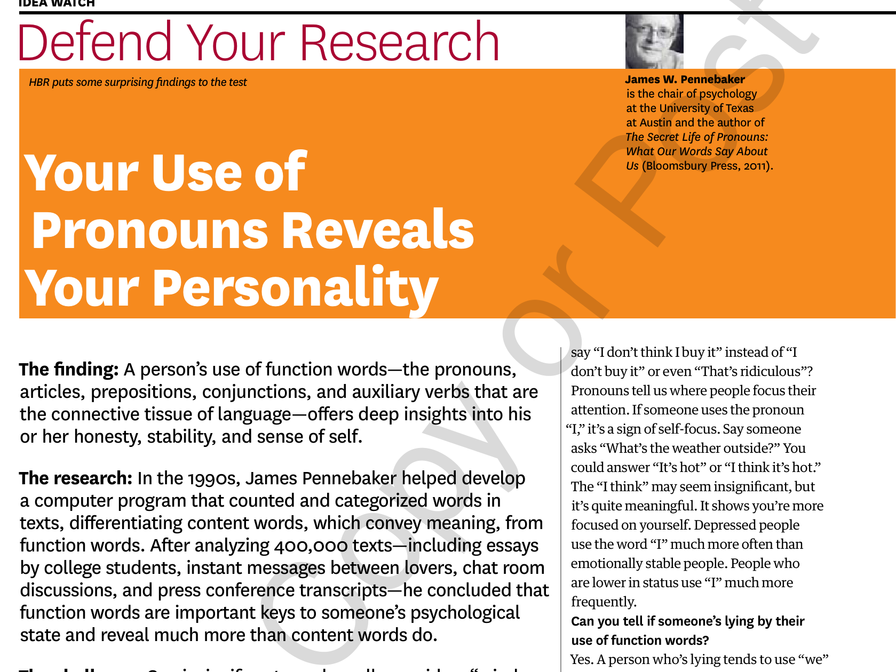
Pennebaker (2011) — Your Use of Pronouns Reveals Your Personality

Slide 30
Why Share At All?
Writing about emotional experience produces measurable physical and mental health benefits
The effect holds even when nobody reads it
Disclosure’s therapeutic function and its social function are separable mechanisms
Pennebaker, J. W. (1997). Writing about emotional experiences as a therapeutic process. Psychological Science, 8(3), 162-166.

Slide 31
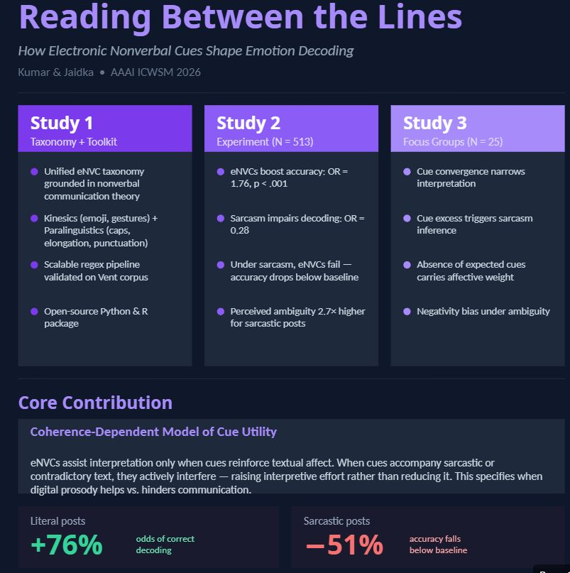
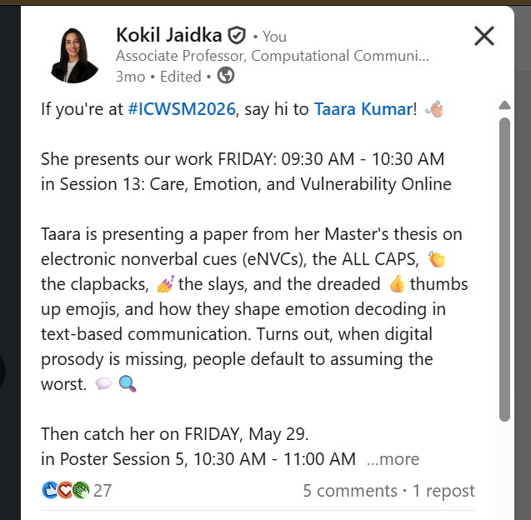

Slide 32
Cues Beyond Emotion: Identity and Culture
Cues don’t just carry feeling — they carry who you are, and who you’re talking to
Two more readings, two different kinds of identity cue

Slide 33
Reading Beneath the Cues: Strangers, at Scale
So far: cues signal emotion (TPC) and identity (code-mixing, culture)
Now: a framework for reading the deeper pattern underneath a disclosure — across thousands of strangers at once

Slide 34
The Same Emoticon, Read Differently
78 countries, Twitter big data, merged with Hofstede’s national culture scores
Individualistic cultures favor horizontal, mouth-oriented emoticons: :)
Collectivistic cultures favor vertical, eye-oriented emoticons: ^_^
Park, J., Baek, Y. M., & Cha, M. (2014). Cross-cultural comparison of nonverbal cues in emoticons on Twitter: Evidence from big data analysis. Journal of Communication, 64(2), 333-354.

Slide 35
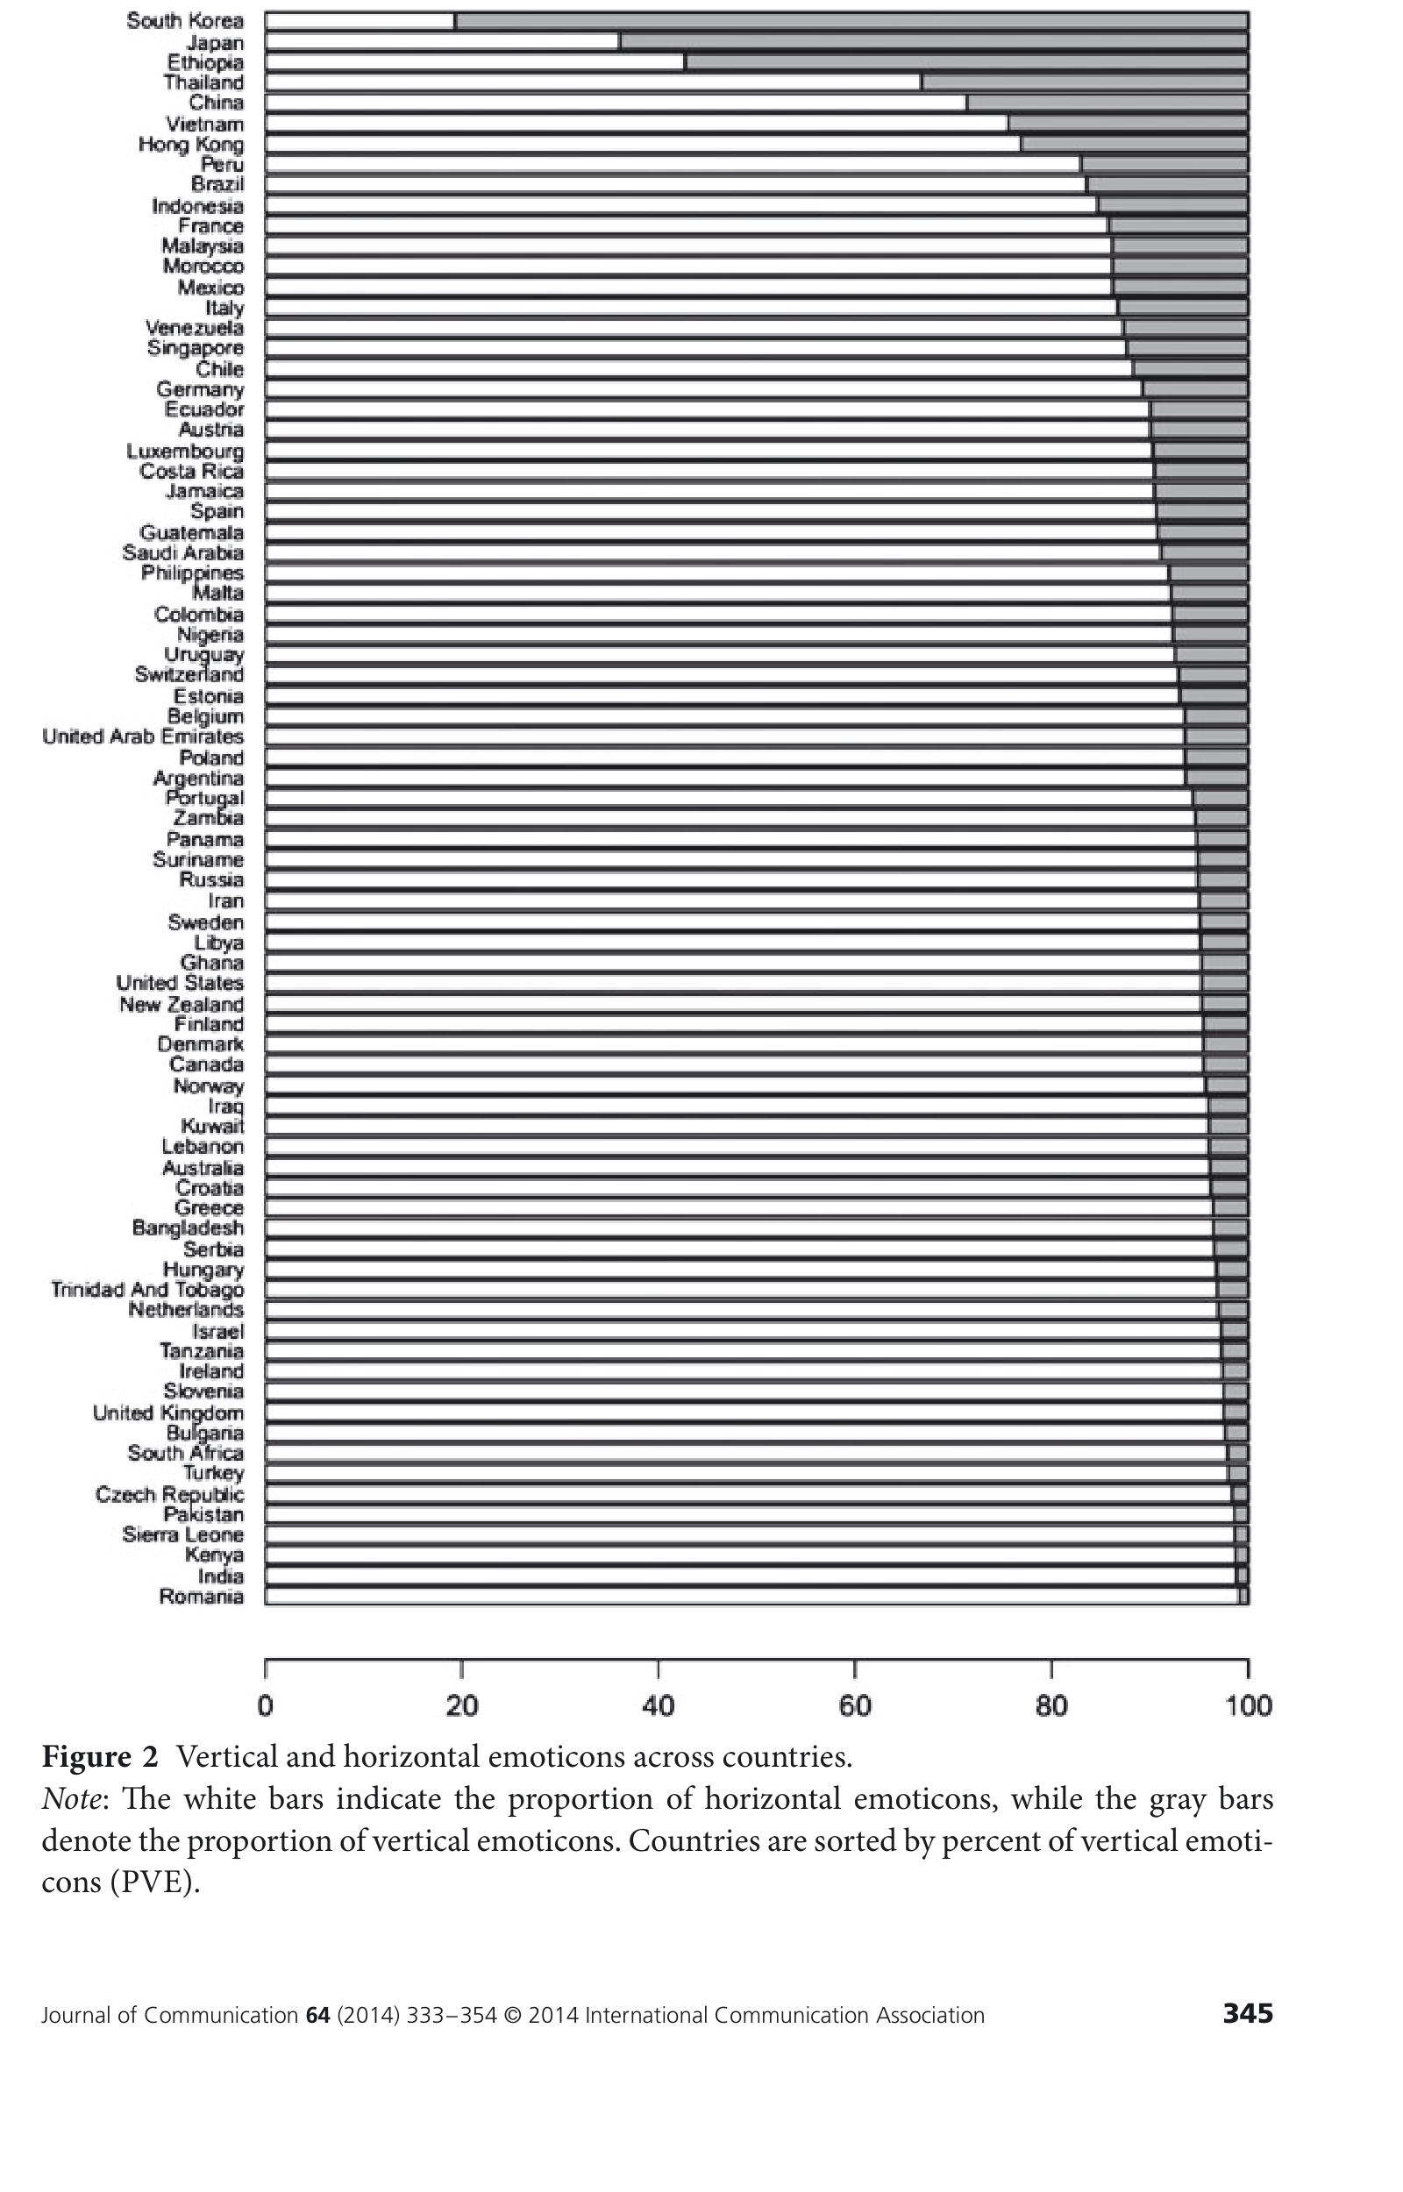
Park et al. (2014), Figure 2 — Vertical and Horizontal Emoticons Across 78 Countries

Slide 36
Why the Eyes vs. the Mouth?
Grounded in Gudykunst’s cultural variability in communication framework
Individualist cultures train explicit emotional display; collectivist cultures train subtler, indirect cues
Matches face-to-face research on how East Asian and Western observers actually read emotion (Jack et al.)
Park, J., Baek, Y. M., & Cha, M. (2014). Cross-cultural comparison of nonverbal cues in emoticons on Twitter: Evidence from big data analysis. Journal of Communication, 64(2), 333-354.

Slide 37
Emoji as Gestures
Writing strips the body out of language
Emblems: gestures with a direct verbal translation — a thumbs-up means ‘okay’
Emoji let us gesture in text — the substitute for the fire’s actual facial expression and hand movement
Concept note on emoji as internet gestures (corpus-linguistics analysis) — informal reading notes, no formal citation available.

Slide 38
‘Lepaking’
227 Facebook posts using ‘lepaking’ (Malay lepak + English -ing), Jan–Aug 2020
A genuinely new phenomenon: inserting a grammatical morpheme, not a whole word
Analyzed via Muysken’s (2000) insertion typology
Anuar, A. F., Paramasivam, S., & Ismail, M. J. (2020). Malay-English code-mixing insertion: why ‘lepaking’ in preference to ‘hanging out’? Quantum Journal of Social Sciences and Humanities, 1(5), 69-84.

Slide 39
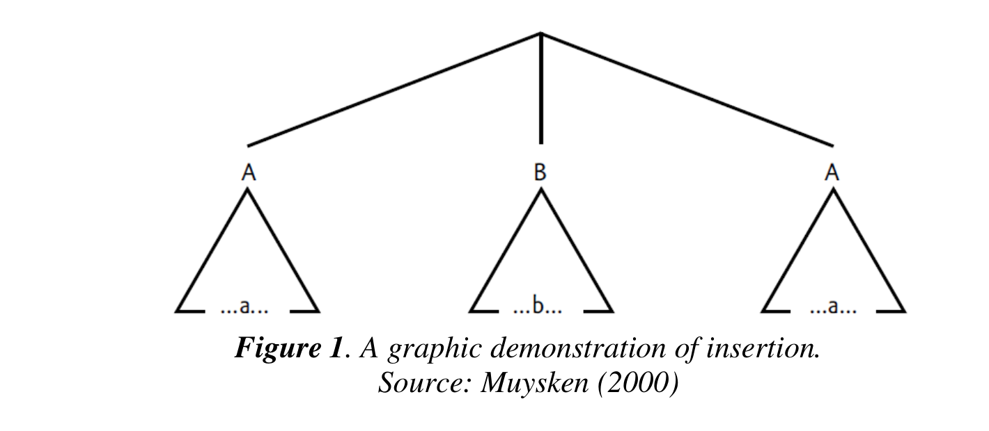
Anuar et al. (2020), Figure 1 (Muysken, 2000) — A Graphic Demonstration of Insertion

Slide 40
In Their Own Words
‘Lepaking with my roomate until late at night.’
‘Jom lepaking dekat gurukul petang ni.’ — ‘Let’s hang out at gurukul this evening.’
‘Lepaking, dah lama tak bertemu.’ — ‘Hanging out, haven’t met for quite some time.’
Anuar, A. F., Paramasivam, S., & Ismail, M. J. (2020). Malay-English code-mixing insertion: why ‘lepaking’ in preference to ‘hanging out’? Quantum Journal of Social Sciences and Humanities, 1(5), 69-84.

Slide 41
Why ‘Lepaking’ Over ‘Hanging Out’?
Role identification: social, registral, educational context
Style identification: following a language trend
The yearning to clarify: signaling attitude and relationship to the listener
Anuar, A. F., Paramasivam, S., & Ismail, M. J. (2020). Malay-English code-mixing insertion: why ‘lepaking’ in preference to ‘hanging out’? Quantum Journal of Social Sciences and Humanities, 1(5), 69-84.

Slide 42
What are the gaps/differences in online self-disclosure that the Tutorial 1 survey didn’t catch?

Slide 43


Tiktok study participation
Tiktok survey
Anonymous
No need to complete
Do knowledge questions
Polleverywhere
after Tiktok survey
knowledge questions

Slide 44
What Is an Early Maladaptive Schema?
A broad, pervasive pattern rooted early in life, about oneself and one’s relationship to others
Examples: abandonment/instability, mistrust/abuse, defectiveness/shame, emotional deprivation
Clinically measured via the Young Schema Questionnaire
Young, J., & Brown, G. Young Schema Questionnaire (YSQ-L3).

Slide 45
What the Questionnaire Actually Asks
Self-report items rated on a 1–6 scale of how true a statement feels
e.g., items probing fear of abandonment, feeling fundamentally flawed, mistrust of others’ intentions
The clinical instrument behind the computational method that follows
Young, J., & Brown, G. Young Schema Questionnaire (YSQ-L3).

Slide 46
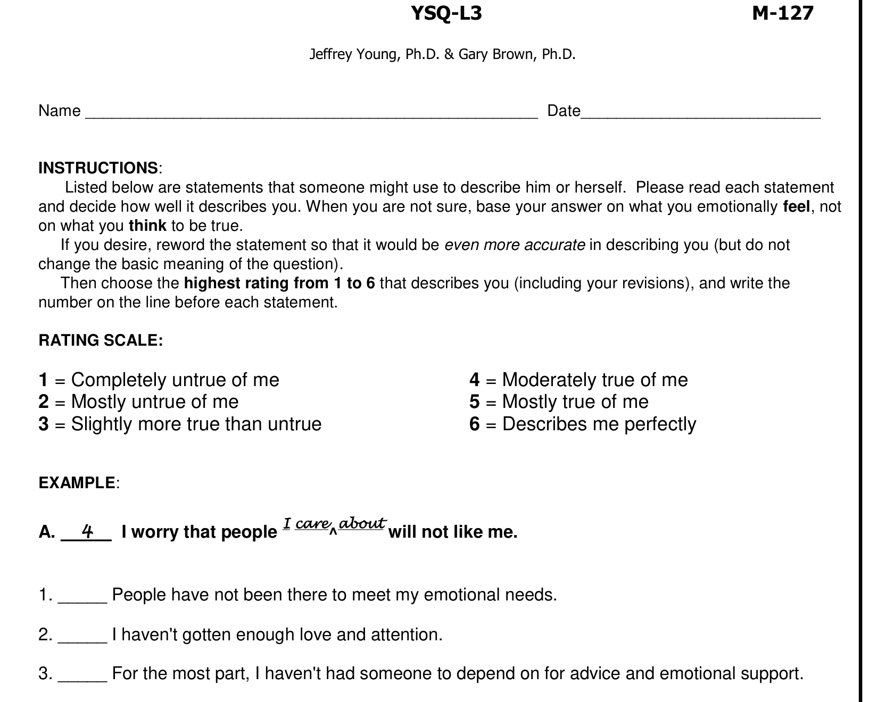
Young & Brown — Young Schema Questionnaire (YSQ-L3), Sample Items

Slide 47
From Clinic to Community
29,329 posts from widely-used online mental health communities, each labeled for schema and mental-health problem
Chi-square tests + odds ratios linking specific schemas to specific problems
Strangers, text-only, no relational history — cues are doing more interpretive work than anywhere else in this lecture
Ang, B. H., Gollapalli, S. D., Du, M., & Ng, S. K. (2025). Unraveling online mental health through the lens of early maladaptive schemas: AI-enabled content analysis of online mental health communities. Journal of Medical Internet Research, 27, e59524.

Slide 48
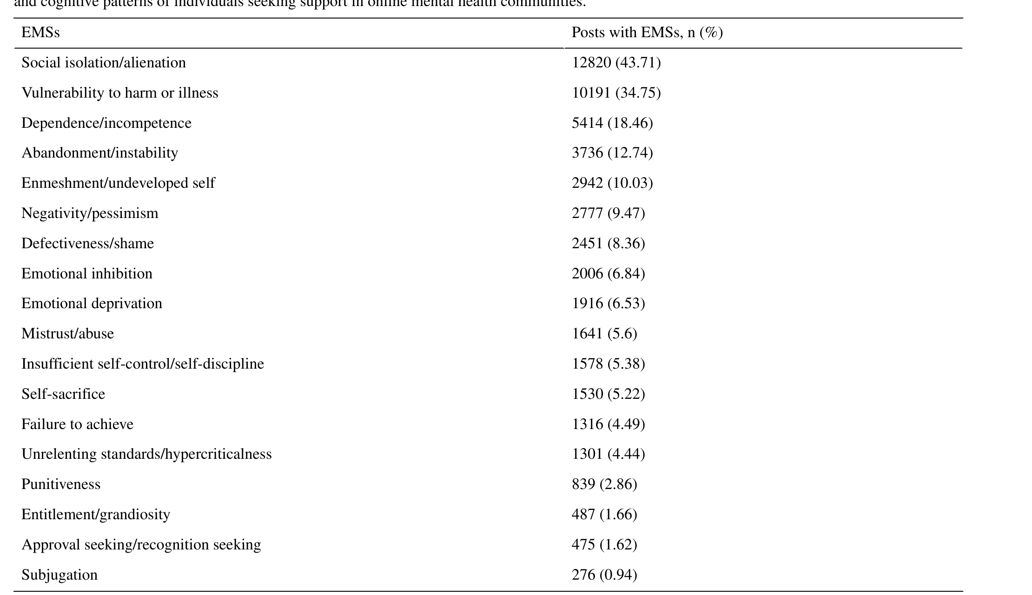
Ang et al. (2025), Table 2 — Distribution of EMSs Across 29,329 Posts (7 Cups, Beyond Blue, Patient)

Slide 49
Which Schema, Which Problem
Anxiety ↔ vulnerability to harm/illness (OR 5.64)
Depression ↔ unmet interpersonal needs, social isolation (OR 3.18)
PTSD ↔ distressing experiences and mistrust (OR 5.04)
Eating disorders ↔ negative self-perception, emotional inhibition (OR 1.89)
Ang, B. H., Gollapalli, S. D., Du, M., & Ng, S. K. (2025). Unraveling online mental health through the lens of early maladaptive schemas: AI-enabled content analysis of online mental health communities. Journal of Medical Internet Research, 27, e59524.

Slide 50
Complex vs. Targeted Problems
Depression, personality disorders, and PTSD were each linked to 7–12 distinct schemas — complex, needing comprehensive intervention
Anxiety, eating disorders, and substance use were linked to only 2–3 schemas each — narrower, more targeted intervention may suffice
GPT-4 was used to extract schema features (triggers, coping responses) at group level across the dataset
Ang, B. H., Gollapalli, S. D., Du, M., & Ng, S. K. (2025). Unraveling online mental health through the lens of early maladaptive schemas: AI-enabled content analysis of online mental health communities. Journal of Medical Internet Research, 27, e59524.

Slide 51
How the Detection Actually Works
Identifying EMS from mental health question texts, using NLP classification
Findings of ACL: EMNLP 2023
The method underlying the community-scale analysis
Gollapalli, S., Ang, B., & Ng, S. K. (2023, December). Identifying early maladaptive schemas from mental health question texts. Findings of the Association for Computational Linguistics: EMNLP 2023, 11832-11843.

Slide 52
When an AI Writes the Response
What’s next? Generating counseling responses conditioned on predicted schema?
A system that doesn’t just detect the pattern, it responds to it
Preview: you just watched a human community do this. Next week, and the week after, what happens when an AI does it instead?
Gollapalli, S. D., Ang, B. H., Du, M., & Ng, S. K. (2024). Counseling responses for mental health forum questions with early maladaptive schema prediction. ECAI 2024, 2556-2563.

Slide 53
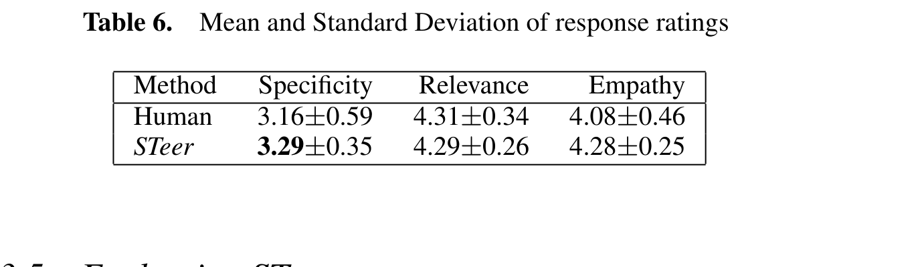
Gollapalli et al. (2024), Table 6 — Human vs. STeer (Confusia) Response Ratings

Slide 54
Back to the Fire
Wiessner’s question again: what happens when firelit time becomes productive time?
Late-night texting and scrolling — same function as firelight talk, or a different one?

Slide 55
Week 7
The voice on the other end of that late-night conversation might not be human at all
Week 7: Human-AI Communication

