Slide 1
Social Media & Addiction
HS2911 Social Media and Mental Health

Slide 2

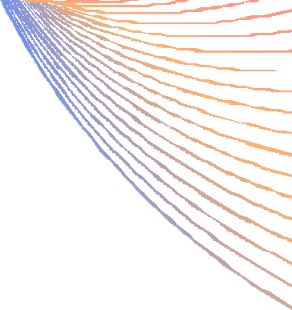



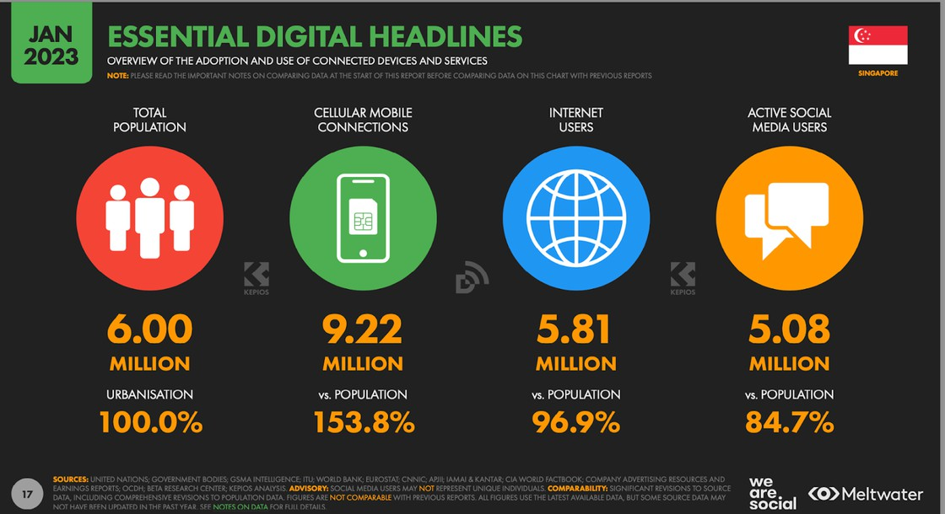

What is Internet & Social Media Addiction?
*also known as PIU: Problematic Internet Use
Internet addiction is an impulse control disorder described as a “dependence on the internet for psychological wellbeing”, whereby deprivation of the internet will result in heightened
unpleasant feelings.
Social media addiction is a subset that focuses on the habitual problematic use of social media platforms.
(Longstreet & Brooks, 2017)
Prevalence in Singapore:
84.7% of the population uses social media actively.
(We Are Social, 2023)
29.5% of surveyed college students were addicted to social media in 2017.
(Tang & Koh, 2017)
https://wearesocial.com/sg/blog/2023/02/understanding- singapores-digital-footprint/

Slide 3


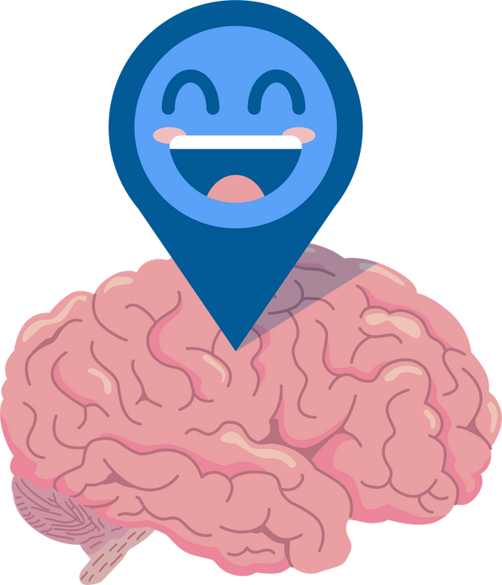
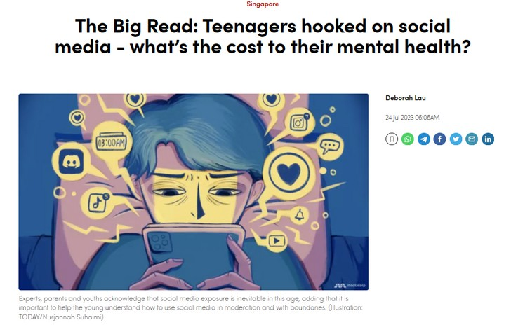

Quantifying & Qualifying Addiction
Diagnostic criteria
DSM-5 criteria for
Internet Gaming Disorder:
Biological comparison
Social media usage results in a dopamine-driven feedback loop
Behavioural symptoms
... driven by an uncontrollable motivation to log on to or use social media and devoting so much time and effort to social media that it impairs other important life areas.
(Pellegrino et al., 2022)
Preoccupation - Withdrawal
Tolerance - Deception
Unsuccessful attempts to stop/reduce
Loss of interest in other hobbies
Excessive use despite problems
Escape from negative mood
Jeopardized relationships/opportunities
Internet addiction is associated with impairments in brain regions that are involved in reward, motivation and control processes, with both similarities and differences compared to the effects of addictive drugs.
(Park et al., 2016)
*IGD is the only form of internet addiction currently included in the fifth revision of the Diagnostic and Statistical Manual of Mental Disorders.
(Besser et al., 2019)
Intense VS Problematic use
distinct but
Intense
Problematic
= Duration and frequency
correlated concepts
(Boer et al., 2020)
= Preoccupation and lack of control
https://www.channelnewsasia.com/singapore/big-read- teenagers-social-media-addiction-cost-mental-health-3647121

Slide 4
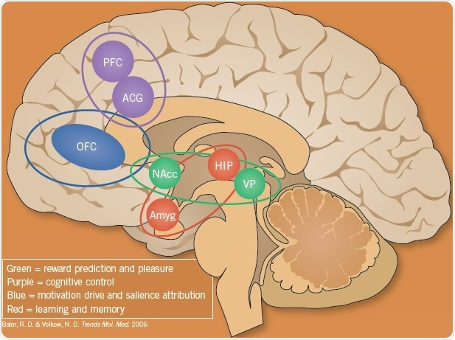
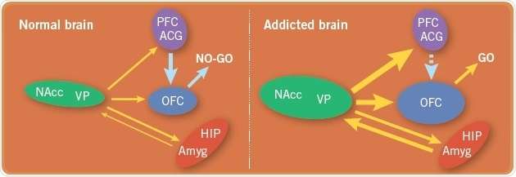
Neurobiology of Addiction
The balance is disrupted in addiction, and the motivation to use drugs become stronger, drug memories become more dominant, and the "top-down" mechanisms become weaker such that drug use cannot be controlled, leading to a "GO" take drugs state.
https://www.news-medical.net/whitepaper/20190311/The-Biological-Mechanisms-Behind-Addiction.aspx
The reward circuit (indicated in green) is a dopamine pathway from the ventral tegmental area to the nucleus accumbens (NAcc, also known as ventral striatum), which subsequently outflows through the ventral pallidum (VP). This pathway plays a role in responding to rewards and guiding behaviour towards them. The hippocampus (HIP) is involved in placing memories of drug use, and the amygdala (Amyg) is involved in the emotional aspects. The purple areas of the anterior cingulate gyrus (ACG) and prefrontal cortex (PFC) are responsible for cognitive control and depend on a suitable balance of glutamate and GABA interactions, allowing this region to exert "top-down" control on the pleasure and motivation areas. The orbitofrontal cortex (OFC) evaluates the value of rewards or salience and the decision to use. Generally, these areas are in a balanced condition, with the OFC having the final "say" in behavioural control, that is, "NO-GO" for drug use.

Slide 5





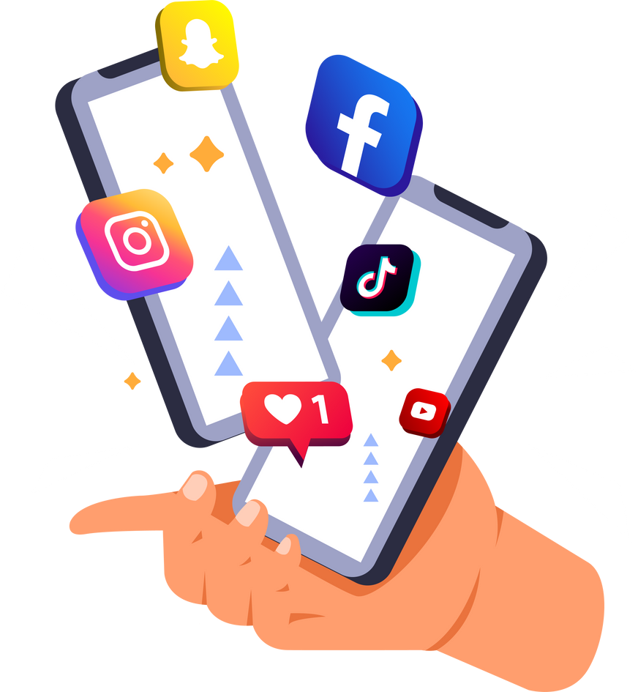

Why Do We Use Social Media?
Three functions of social media:
Two motivations for social media:
1 Social interactions
Globalised interconnectedness
Post-pandemic significance
Community inputs
Freedom to voice opinions
Networking and collaborating
Content sharing
Form of entertainment
Belongingness
Seeking acceptance
Communicating to care
Self-presentation
Seeking attention
Self-disclosure to express
1
2
2
3
(Seidman, 2013)
b. Form of education
(Pellegrino et al., 2022)
NOTE: Different social media platforms have different purposes and user behaviours.

Slide 6
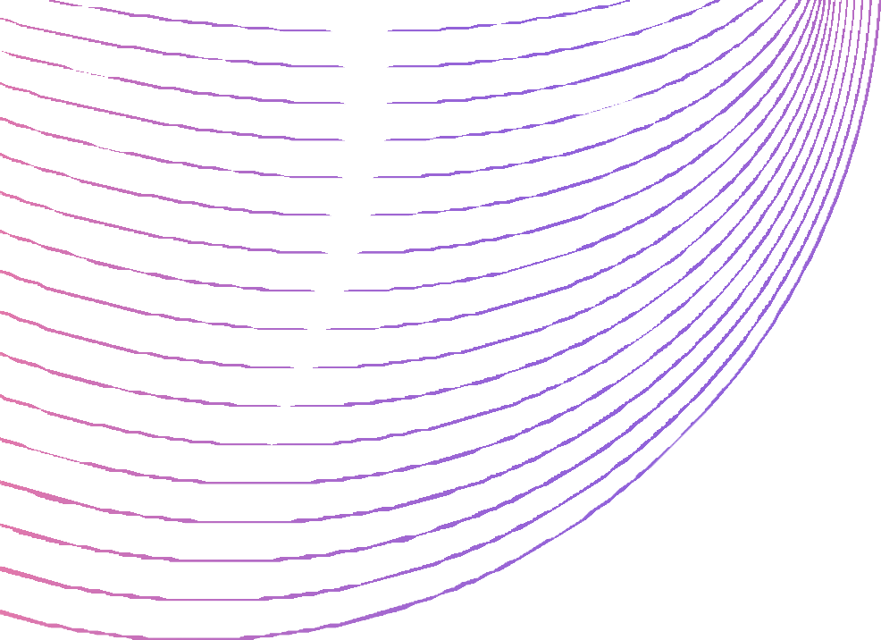

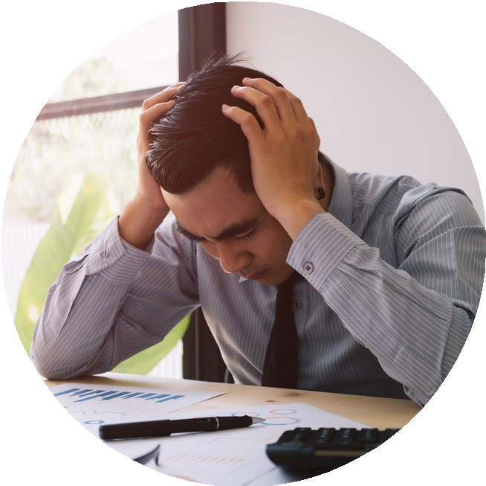






Social media acts as a sense of relief from psychosocial issues.
Cognitive-Behavioural Model Focus on maladaptation in cognitive processes
Social Skill Model Focus on deficits in social interaction
Social media acts as a substitute for offline communication.
Social media acts as a mindless habit of consumption.
Models of
Social Media Addiction
(Ho et al., 2017)
Social Cognitive Model Focus on deficiency in self-regulation
Theory of Planned Behaviour Focus on inclination in subjective attitude and norms
Social media acts as a behaviour aligned with self-interest and societal approval.

Slide 7

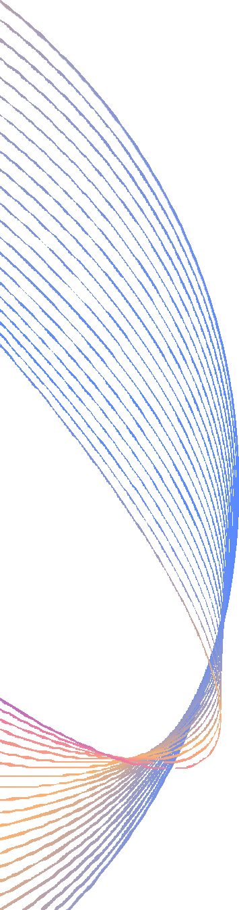
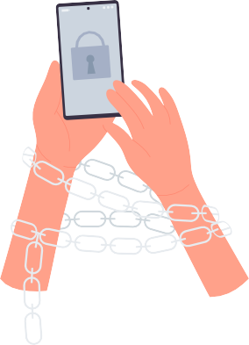










Emotional States & Life Satisfaction
More happiness -> Increase in life satisfaction -> Decrease in addiction More stress -> Decrease in life satisfaction -> Increase in addiction
∴ Associated with depression, loneliness and trauma
(Longstreet & Brooks, 2017)
Reasons for Social Media
Addiction
<user perspective>
Personality Traits
Extraversion: Easier communication and relationship-building online. Introversion: Easier communication and relationship-building online. Narcissism: Desire to be ‘seen’ and ‘liked’.
Neuroticism: Desire to express self, feel belonging and be in control.
(Pellegrino et al., 2022)
Other Demographic Associations
Female > Male Single > Attached Older (Adolescence) > Younger (Childhood)
(Pellegrino et al., 2022)
Motivations: Models:
1
Belongingness
Cognitive- Behavioural Model
Social Skill Model
Social Cognitive Model
Theory of Planned Behaviour
2
Self-presentation

Slide 8









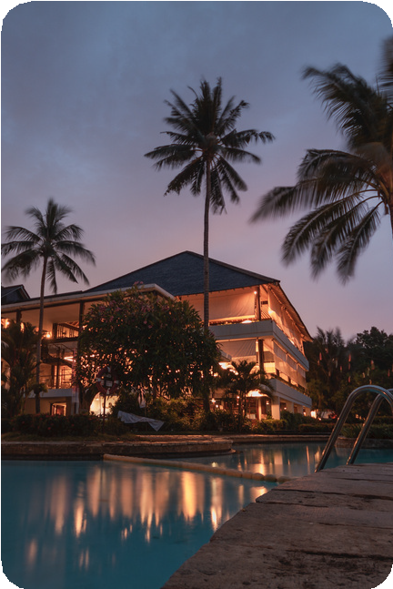
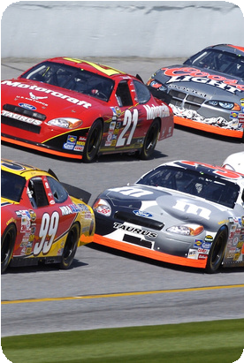




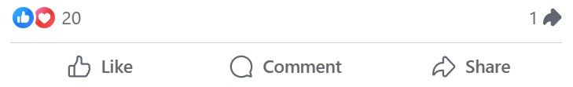

Functions:
Models:
1
Social interactions
3
Content sharing
Cognitive- Behavioural Model
Social Skill Model
Social Cognitive Model
Theory of Planned Behaviour
2
Community inputs
Asynchronous communication: Take time to craft messages and present best self
What’s on your mind?
Reasons for Social Media
Addiction
<platform perspective>
Algorithm of recommendations: Catered to personalised user engagement
Normalisation of surveillance: Ability to see what others are
doing online
Travel
Cars
Shopping
Food
Potential for anonymity: Safe space to comment
Friend
This is my life! What are your opinions?
Never-ending content: Automaticity of scrolling
Interesting Content
(Pellegrino et al., 2022; Ho et al., 2017)

Slide 9
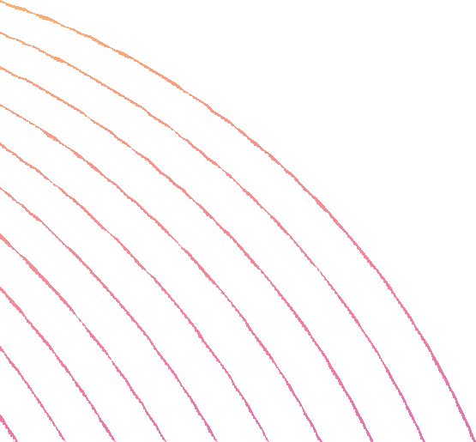
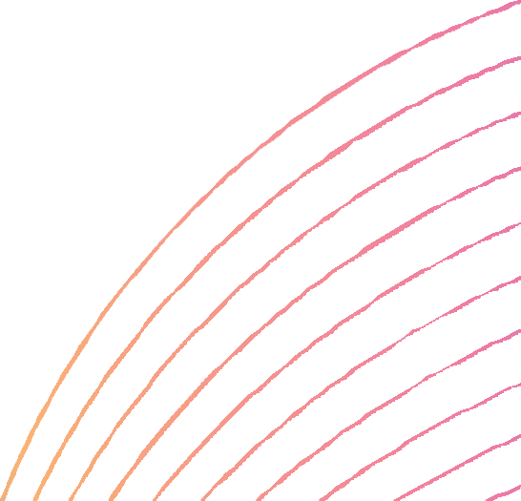
Convenience of online connectivity
Temporary surrogate for happiness
VICIOUS CYCLE
Long-lasting addiction of stress
What is the root cause of addiction?
Where is the appropriate place for intervention?
Disruption of offline relationships

Slide 10
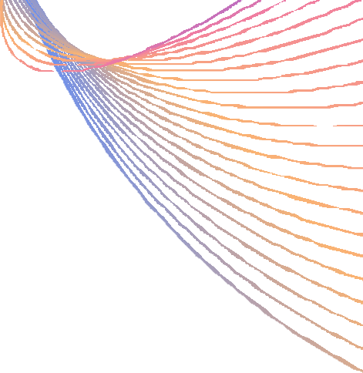
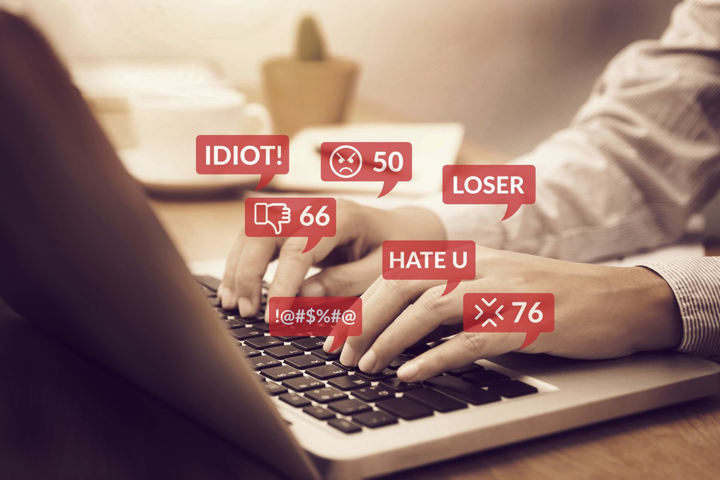

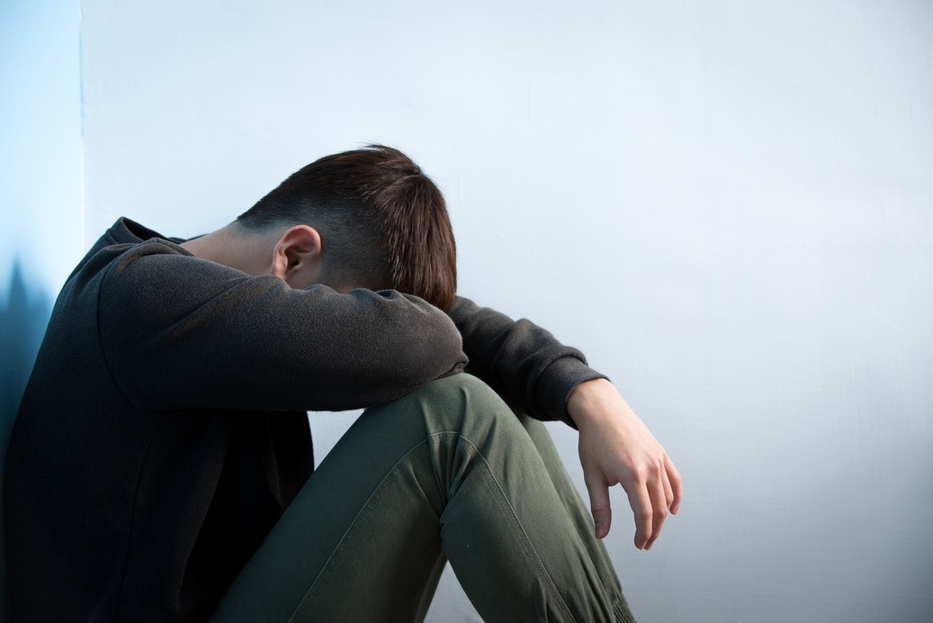
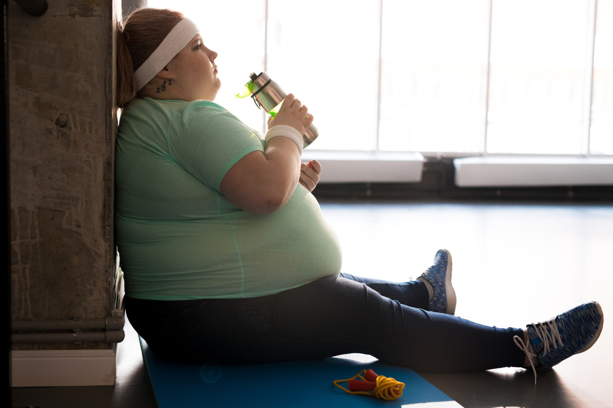


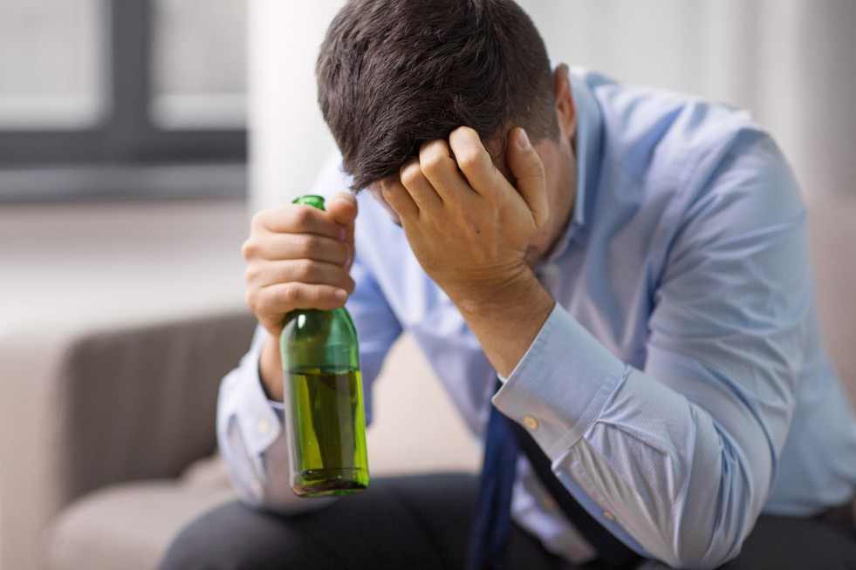
Effects of Social Media Addiction
Greater potential for general risks of improper internet use: E.g., sexting, stalking, cyber-bullying, privacy breaches
(Pellegrino et al., 2022;
Hussain & Griffiths, 2018; Ho et al., 2016;
Vannucci et al., 2020)
Reduced performance on cognitive tasks and mental effort: Academic outcomes and school wellbeing affected
Constant bombardment of virtual updates (fear of missing out) Comorbidity of mental health conditions such as depression, anxiety, stress
Displacement of routine lifestyle patterns: Disrupted exercise routines, eating habits and sleep schedules may cause physical health problems (obesity, carpal tunnel syndrome, etc)
Excessive exposure to unrealistic portrayals:
Upward social comparison exacerbates low self-esteem and body image dissatisfaction
Enhanced tendencies for sensation seeking: Risky behaviours such as drugs, alcoholism and unsafe sex

Slide 11
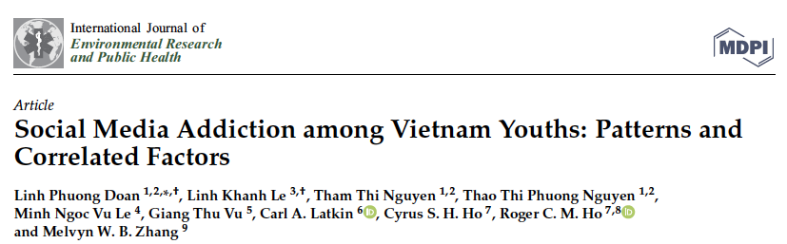
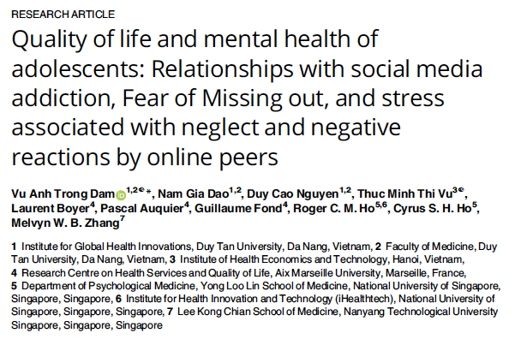
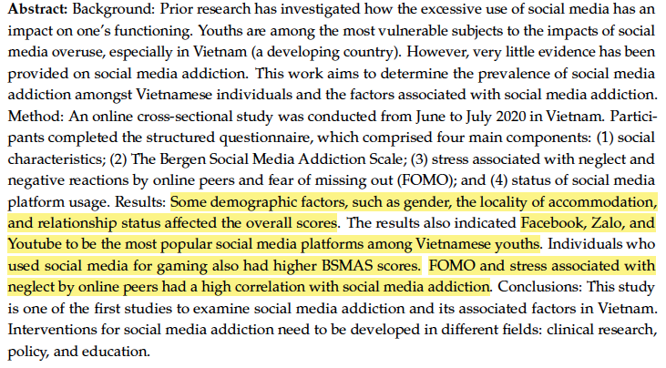
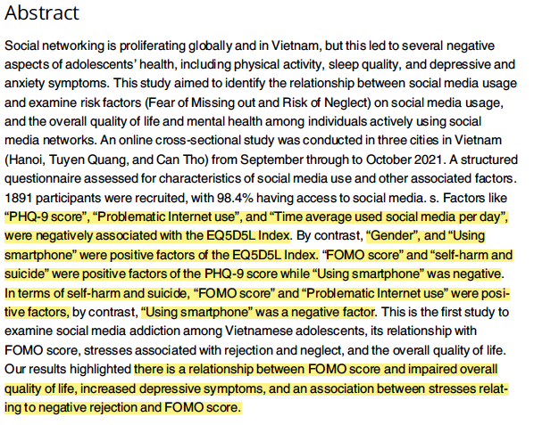

Slide 12
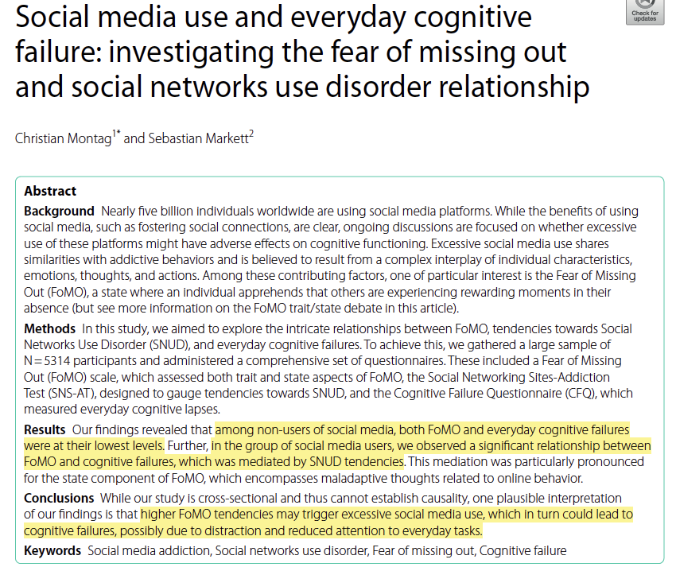
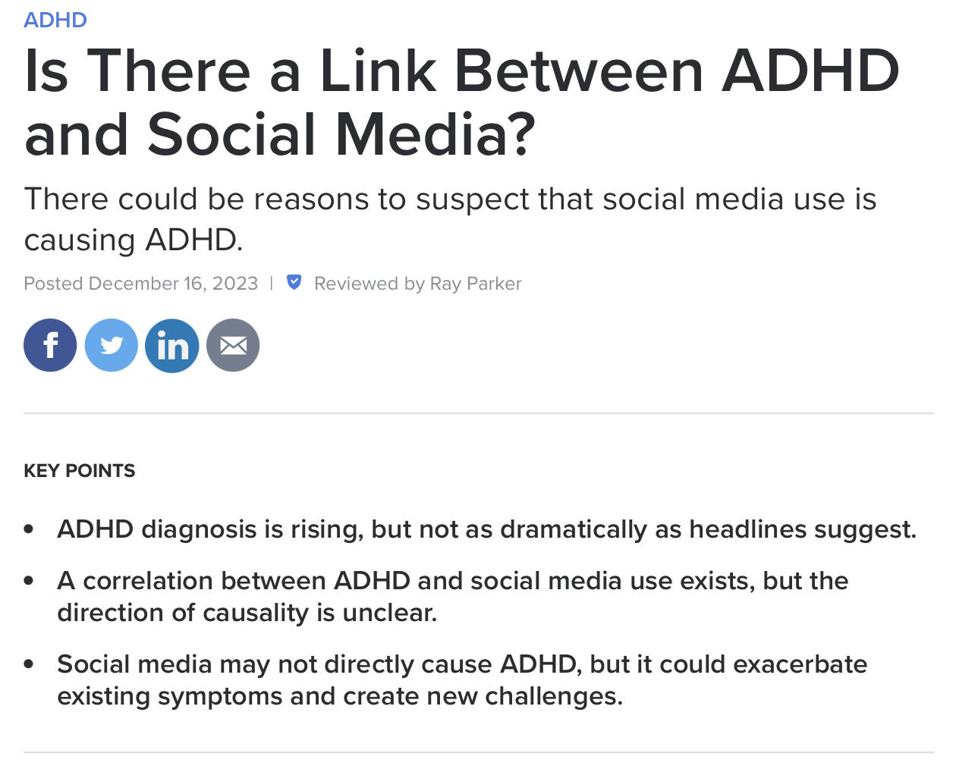

Slide 13
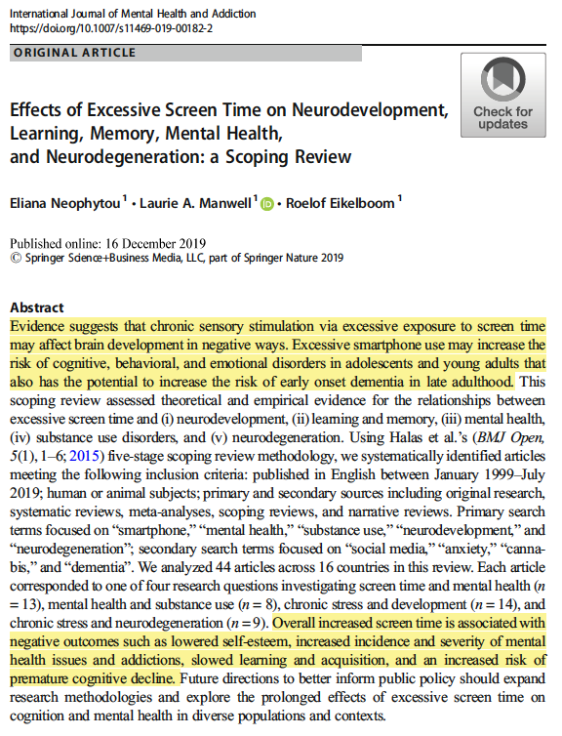
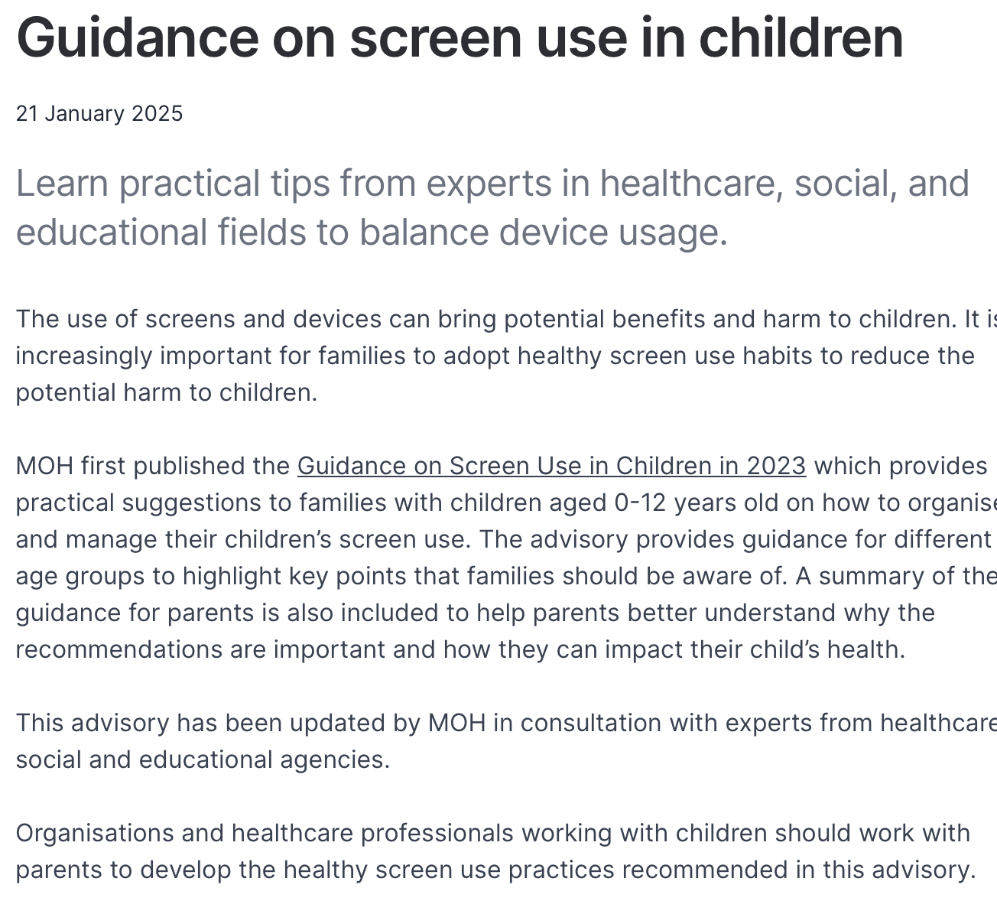

Slide 14
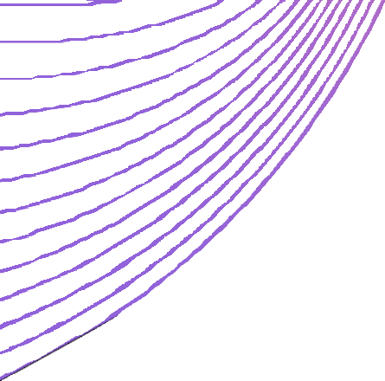

Solutions & Challenges
Treatment for individual Self-intervention methods Behavioural therapies
(Ji et al., 2023)
Responsibility of society: Systemic regulation of platform access
Public education Reduced reliance on internet usage to improve public welfare
(Pellegrino et al., 2022; Longstreet & Brooks, 2017)
Directions for further research: Current research mainly focuses on students between 19-25, further studies should be conducted exploring different age groups Different social media platforms have different user purpose and user behaviours, hence there may be different reasons for addiction

Slide 15
References
Besser, B., Loerbroks, L., Bischof, G., Bischof, A., & Rumpf, H.-J. (2019). Performance of the DSM-5-based criteria for Internet addiction: A factor analytical examination of three samples.
Journal of Behavioral Addictions, 8(2), 288–294. https://doi.org/10.1556/2006.8.2019.19
Boer, M., Van Den Eijnden, R. J. J. M., Boniel-Nissim, M., Wong, S.-L., Inchley, J. C., Badura, P., Craig, W. M., Gobina, I., Kleszczewska, D., Klanšček, H. J., & Stevens, G. W. J. M. (2020). Adolescents’ intense and problematic social media use and their well-being in 29 countries. Journal of Adolescent Health, 66(6), S89–S99. https://doi.org/10.1016/j.jadohealth.2020.02.014
Digital 2023. (2023, January 26). We Are Social Singapore. https://wearesocial.com/sg/blog/2023/01/digital-2023/
Ho, S. S., Lee, E. W. J., & Liao, Y. (2016). Social network sites, friends, and celebrities: The roles of social comparison and celebrity involvement in adolescents’ body image dissatisfaction.
Social Media + Society, 2(3), 205630511666421. https://doi.org/10.1177/2056305116664216
Ho, S. S., Lwin, M. O., & Lee, E. W. J. (2017). Till logout do us part? Comparison of factors predicting excessive social network sites use and addiction between Singaporean adolescents and adults. Computers in Human Behavior, 75, 632–642. https://doi.org/10.1016/j.chb.2017.06.002
Hussain, Z., & Griffiths, M. D. (2018). Problematic social networking site use and comorbid psychiatric disorders: A systematic review of recent large-scale studies. Frontiers in Psychiatry, 9, 686. https://doi.org/10.3389/fpsyt.2018.00686
Ji, Y., Liu, S., Xu, H., & Zhang, B. (2023). The causes, effects, and interventions of social media addiction. Journal of Education, Humanities and Social Sciences, 8, 897–903. https://doi.org/10.54097/ehss.v8i.4378
Lau, D. (2023, July 24). The Big Read: Teenagers hooked on social media - what’s the cost to their mental health? CNA. https://www.channelnewsasia.com/singapore/big-read- teenagers-social-media-addiction-cost-mental-health-3647121
Longstreet, P., & Brooks, S. (2017). Life satisfaction: A key to managing internet & social media addiction. Technology in Society, 50, 73–77. https://doi.org/10.1016/j.techsoc.2017.05.003 Park, B., Han, D. H., & Roh, S. (2017). Neurobiological findings related to Internet use disorders. Psychiatry and Clinical Neurosciences, 71(7), 467–478. https://doi.org/10.1111/pcn.12422 Pellegrino, A., Stasi, A., & Bhatiasevi, V. (2022). Research trends in social media addiction and problematic social media use: A bibliometric analysis. Frontiers in Psychiatry, 13, 1017506. https://doi.org/10.3389/fpsyt.2022.1017506
Seidman, G. (2013). Self-presentation and belonging on Facebook: How personality influences social media use and motivations. Personality and Individual Differences, 54(3), 402–407. https://doi.org/10.1016/j.paid.2012.10.009
Tang, C. S., & Koh, Y. Y. W. (2017). Online social networking addiction among college students in Singapore: Comorbidity with behavioral addiction and affective disorder. Asian Journal of Psychiatry, 25, 175–178. https://doi.org/10.1016/j.ajp.2016.10.027
Vannucci, A., Simpson, E. G., Gagnon, S., & Ohannessian, C. M. (2020). Social media use and risky behaviors in adolescents: A meta‐analysis. Journal of Adolescence, 79(1), 258–274. https://doi.org/10.1016/j.adolescence.2020.01.014

