Slide 1
Social Media and Mental Health in Young People
Michelle Neo, M. Psych (Clinical)
Principal Clinical Psychologist, Department of Psychological Medicine, NUH
Honorary Adjunct Lecturer, Department of Psychology, FASS, NUS
21-Oct-2026

Slide 2
Outline
Background
International Literature
Local Literature
Impacts on Clinical Practice
Discussion

Slide 3
1. Background

Slide 4
Definitions
Psychological Well-being
  The extent to which an individual can live meaningfully according to their deeply held values (Waterman et al., 2010)
Mental Health
  A state of well-being in which an individual can flourish, through realization of one’s potential, positive social interaction, and contribution to society (WHO; 2018)

Slide 5
The Evolving Social Media Landscape
Young people are no longer actively searching for content;
Content increasingly finds them
Algorithm-driven feeds
Infinite scrolling
Notifications
Short-form videos
Recommendation systems

Slide 6
Emerging Trends?
Artificial Intelligence
AI-generated influencers
Deepfakes
Chatbots
Appearance filters
Unrealistic beauty standards
Cosmetic procedure interest
Influencer culture
Parasocial relationships
Consumerism
Financial aspirations
Mental health content
Pros
Increased awareness
Cons
Self-diagnosis
Misinformation
Romanticising illness

Slide 7
Case Example 1
“Everyone else is happier than me”
Amy (pseudonym), 16yo, spends around 4–5 hours a day on Instagram and TikTok. She frequently compares herself with influencers and classmates who post photos of holidays, friendships, achievements, and their appearance.
Recently, Amy has become increasingly dissatisfied with her appearance and says, “Everyone looks better than me.” She has started deleting photos that do not receive many likes and repeatedly checks how many people have viewed her posts.
Her parents notice that she seems more withdrawn and irritable, although Amy says, “I’m just scrolling. It’s not a big deal.”

Slide 8
Case Example 2
“I can't put my phone down”
Brian (pseudonym), 19, uses TikTok and Instagram throughout the day. He checks his phone immediately after waking up and often stays up until 2–3 a.m. scrolling.
He tells his psychologist that he is constantly tired and has difficulty concentrating at university. He has stopped exercising and spends less time with friends in person.
Brian says, “I know I should stop, but every time I put my phone down, I feel like I’m missing something.”
He has tried deleting the apps several times but reinstalls them within a few days.

Slide 9
Case Example 3
“It isn’t really me”
Celine (pseudonym), 27yo, discovers that someone has used her publicly available photographs to create a realistic AI-generated nude image of her. The image is circulated in a private messaging group and eventually reaches several people she knows.
Although Celine knows the image is fake, she feels deeply violated and ashamed. She becomes worried that colleagues or family members may see it and starts repeatedly searching online to find out where the image has been shared.
Over the next few weeks, Celine develops difficulty sleeping, avoids social situations, and becomes increasingly anxious whenever she receives a notification on her phone.
“I know it's not actually me, but it still feels like my body and my identity have been taken from me.”

Slide 10
Why the Relevance?
 | Bio | Psycho | Social
Predisposing
Precipitating
Perpetuating
Protective

Slide 11
Questions
How do social media affect mental health?
Is social media always harmful? Could there be some benefits?
What are some risk and protective factors?
How do we promote healthy digital well-being?

Slide 12
2. International Literature
Journal of Clinical Child Psychology and Psychiatry 2023, Vol 28 (1), Special Issue on Social Media and Mental Health

Slide 13
The Clinical Implications of Digital Technology
(Idelji-Tehrani et al., 2023)
Domains of Digital Use Assessment
  Suicide and self-harm
  Substance misuse
  Aggression, hate, and radicalization
  Sexual risks
  Gaming and gambling
  Health and functioning
  Cyber-crime
  Digital exclusion

Slide 14
The Clinical Implications of Digital Technology (cont’d)
(Idelji-Tehrani et al., 2023)
Digital Resilience
  Resilience- A person’s ability to adapt to and manage challenging and stressful events
  Key factors
    Ability to self-regulate Internet use
    Parental guidance and encouragement of safe internet use, rather than restriction
Incorporate digital use into safety and care plans

Slide 15
Unpacking the Relation between Children’s Use of Digital Technologies and Children’s Well-being: A Scoping Review
(Messena & Everri, 2023)
Scoping review
129 studies
Two conceptualization of Digital Technology Negative Use (DTNU):
  Excessive use and addiction
  Negative online experiences or behaviours
Well-being
  Psychological
  Social
  Physical

Slide 16
Adolescents’ Perspectives on Social Media and Mental Health and Well-Being
(Popat & Tarrant, 2023)
Narrative literature review
24 research papers
Five main themes
  Self-expression and validation
  Appearance comparison and body ideals
  Pressure to stay connected
  Social engagement and peer support
  Exposure to bullying and harmful content
Notes:
Five themes were identified, describing the mechanisms through which social media impacts on mental health and wellbeing

Slide 17
Adolescents’ Perspectives on Social Media and Mental Health and Well-Being (cont’d)
(Popat & Tarrant, 2023)
No. | Theme | Positive or Negative? | Corresponding Well-being Concepts
1 | Self-expression and validation | Both | Self-esteem Social support Identity experimentation Social comparison Anxiety and fear of judgement Risky behaviour Self-acceptance Personal development
2 | Appearance comparison and body ideals | Negative | Self-esteem Body image Social comparison Eating disorder relapse
3 | Pressure to stay connected | Negative | Social pressure Social exclusion Emotional detachment Disconnection anxiety Sleep disruption Physical health issues

Slide 18
Adolescents’ Perspectives on Social Media and Mental Health and Well-Being (cont’d)
(Popat & Tarrant, 2023)
No. | Theme | Positive or Negative? | Corresponding Well-being Concepts
4 | Social engagement and peer support | Positive | Social support Social participation Connection Mental health recovery
5 | Exposure to bullying and harmful content | Negative | Emotional distress Anxiety Suicidal thoughts Self-esteem Lack of control Injustice Social exclusion and threats to belonging Loneliness and isolation

Slide 19
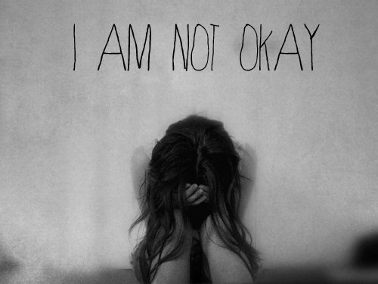
The Tic in TikTok and (where) All Systems Go: Mass Social Media Induced Illness and Munchausen’s by Internet as Explanatory Models for Social Media Associated Abnormal Illness Behaviour
(Giedinghage, 2023)
Recent phenomenon of adolescents presenting en masse (both online and in
clinical settings) with symptoms seemingly acquired from viewing illness-related content posted by social media influencers
Social Media Associated Abnormal Illness Behaviour (SMAAIB)

Slide 20
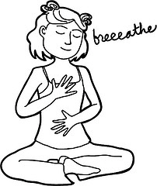
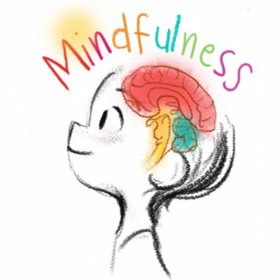
A Mindful Alternative to Screen Time
(Feldman et al., 2023)
Mindfulness was superior to unstructured screen time at increasing physiological and subjective markers of relaxation. Results suggest that repurposing smartphones to facilitate mindfulness practice though guided meditation apps may be a more effective method of promoting physiological and emotional wellbeing than more ubiquitous unstructured smartphone use

Slide 21
3. Local Literature

Slide 22
National Youth Mental Health Study (NYMHS)
Excessive Social Media Use
Refers to spending more than three hours on social media platforms daily
About 27.0%, or approximately 1 in 4 youths, reported engaging in excessive social media use
Young people below 30 years of age (vs. 30 – 35 years age) and females (vs. males) were more likely to engage in excessive social media usage
Young people with excessive social media usage were 1.5, 1.3 and 1.6 times more likely to have had severe or extremely severe symptoms of depression, anxiety and stress, respectively

Slide 23
NYMHS (cont’d)
Cyberbullying
About 21.0% or 1 in 5 youths reported having been cyberbullied, i.e., encountering threats, harassment, or mean, aggressive or rude messages online
The prevalence was similar across the different age groups and gender
Young people who had experienced cyberbullying were approximately twice as likely to have had severe or extremely severe symptoms of depression, anxiety or stress, compared with those who had not

Slide 24
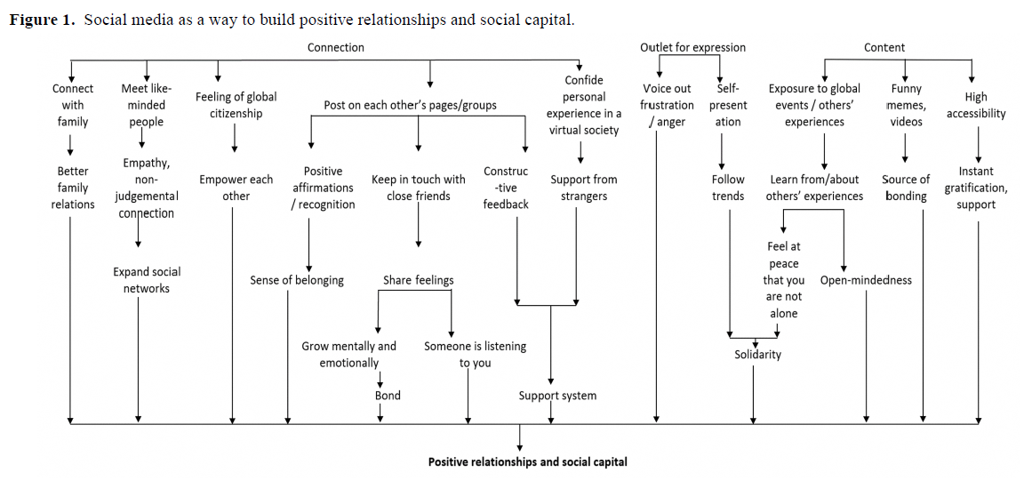
Social Media–Driven Routes to Positive Mental Health Among Youth: Qualitative Enquiry and Concept Mapping Study
Vaingankar et. al (2022)

Slide 25
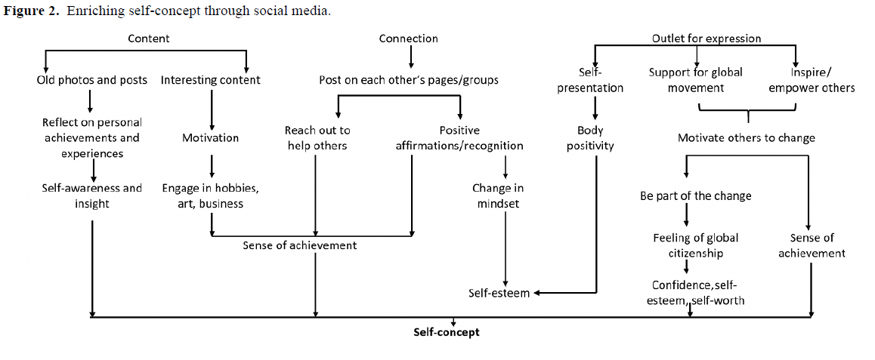
Social Media–Driven Routes to Positive Mental Health Among Youth: Qualitative Enquiry and Concept Mapping Study (cont’d)
Vaingankar et. al (2022)

Slide 26
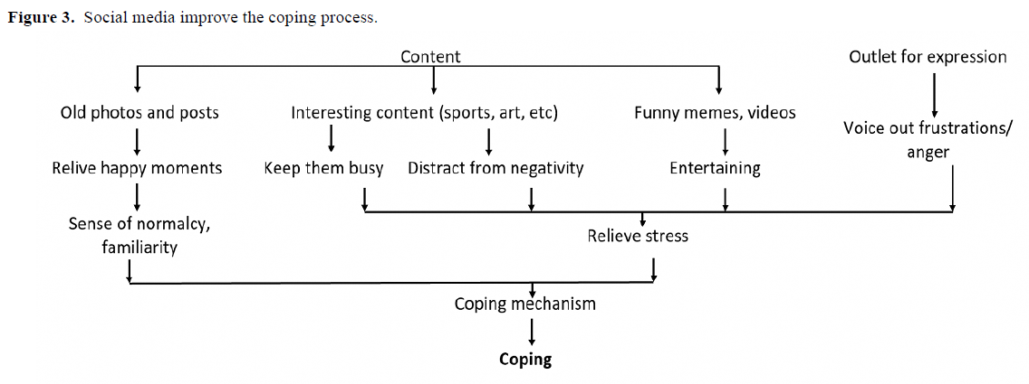
Social Media–Driven Routes to Positive Mental Health Among Youth: Qualitative Enquiry and Concept Mapping Study (cont’d)
Vaingankar et. al (2022)

Slide 27
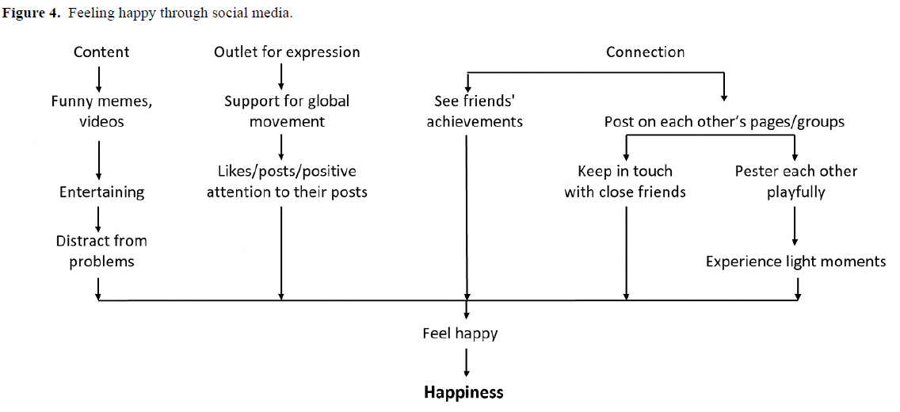
Social Media–Driven Routes to Positive Mental Health Among Youth: Qualitative Enquiry and Concept Mapping Study (cont’d)
Vaingankar et. al (2022)

Slide 28
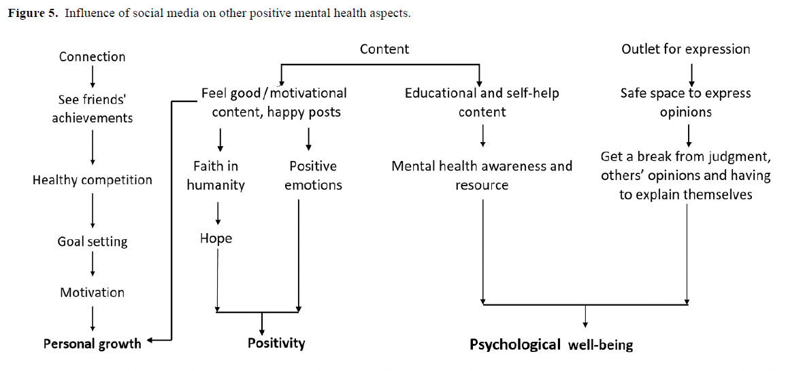
Social Media–Driven Routes to Positive Mental Health Among Youth: Qualitative Enquiry and Concept Mapping Study (cont’d)
Vaingankar et. al (2022)

Slide 29
4. Impacts on Clinical Practice
Notes:
No slides

Slide 30
Recap: Why the Relevance?
 | Bio | Psycho | Social
Predisposing
Precipitating
Perpetuating
Protective

Slide 31
Recap: Questions
How do social media affect mental health?
Is social media always harmful? Could there be some benefits?
What are some risk and protective factors?
How to promote healthy digital well-being?

Slide 32
How Social Media Affects Mental Health
A. Social Comparison
Unrealistic standards
Body image
Self-esteem
B. Fear of Missing Out (FoMO)
Constant checking
Anxiety
Sleep disruption
C. Validation Seeking
Likes and followers
Dopamine and reward
Self-worth
D. Cyberbullying
Online harassment
Psychological consequences
E. Problematic Social Media Use
Loss of control
Excessive use
Functional impairment

Slide 33
Is Social Media Always Harmful?
Benefits
Social connectedness
Peer support
Mental health literacy/awareness
Identity exploration
Creativity and self-expression
Key message
The impact depends on:
Who is using it
Why they are using it
How they engage with it

Slide 34
Risk and Protective Factors
Higher-risk groups
Adolescents with anxiety or depression
Low self-esteem
Loneliness
Perfectionism
Previous trauma
Protective factors
Digital literacy
Strong family relationships
Offline friendships
Healthy coping skills
Balanced online habits

Slide 35
Promote Healthy Digital Well-Being
Individual
Curate your feed
Reduce passive scrolling
Set screen-time boundaries
Prioritise sleep
Parents
Open conversations
Role modelling
Collaborative rule-setting

Slide 36
Promote Healthy Digital Well-Being (cont’d)
Schools
Digital citizenship
Cyberbullying prevention
Mental health education
Healthcare professionals
Ask about online habits during assessments
Screen for cyberbullying, sleep problems, and problematic use

Slide 37
Digital Use Assessment Tool (Idelji-Tehrani et al., 2023)
Opening Questions
Tell me a bit about your online life
What do you enjoy doing online?
Do you use social media?
What other online platforms do you like using?
What apps do you use?
Do you enjoy gaming?
How much time do you spend online per day?

Slide 38
Digital Use Assessment Tool (cont’d)
Impact on Health and Well-being
Do you feel that your use of technology has ever impacted your mood?
Does your use of technology ever impact your self-esteem?
Do you ever get FOMO (Fear of Missing out) from your online activity? How does this affect you?
Have you ever lied online in order to improve your social appearance?
Has your technology use stopped you from doing other activities?
Does your technology use impact your sleep?

Slide 39
Digital Use Assessment Tool (cont’d)
Further Probes to Consider
Has anyone ever commented on your technology use?
Do you know anyone who has made any money online?
Do you make money online?
How do you spend money online?
Have you ever lost money online? If so, how and how much?
Has anyone ever shared anything online about you that you would consider to be ‘private’ without your consent?
Have you ever used the dark web?

Slide 40
Digital Use Assessment Tool (cont’d)
Aggression, Hate, and Radicalization
Do you ever see stressful or hateful things happening online?
Have you ever been bullied online?
Have you ever thought you might have bullied someone online?
Have you ever agreed with, or expressed/shared, views online that others have thought are extreme or dangerous?
Has anyone ever knowingly shared any content with you online that is possibly harmful to others?

Slide 41
Digital Use Assessment Tool (cont’d)
Misinformation
What online information sources do you trust?
Do you ever fact check things you read on the internet?
How do you work out what is fact or fake online?

Slide 42
Digital Use Assessment Tool (cont’d)
Digital Skills and Resilience
What offline activities do you enjoy? Would you like to do them more often?
What do you do when you see something hateful or stressful online?
What helps you recover if you see something hateful or stressful online?
How do you avoid upsetting content?
Have you thought about how you could get support if something uncomfortable was happening?
Do you ever go online to get support when you are upset?

Slide 43
Digital Use Assessment Tool (cont’d)
Suicide and Self-Harm
Do you ever see any content where people harm themselves? Did you purposefully search for this or was it ‘suggested for you’ by a website/app?
Do you ever read blogs/posts or watch videos from people who are experiencing difficulties with self-harm or suicidal thoughts?
Do you look for materials to help you manage any thoughts of self-harm or suicide?
Have you ever used the internet to look for pro-suicide materials?
Have you researched what methods of suicide are lethal? Have you tried to find/buy any products to harm yourself?

Slide 44
Digital Use Assessment Tool (cont’d)
Substance Misuse
Have you ever bought illegal drugs online?
Have you ever sold illegal drugs online?
What platforms did you use to buy or sell illegal drugs? (e.g. social media, dark web)

Slide 45
Digital Use Assessment Tool (cont’d)
Gaming and Gambling
How long do you game for?
Does gaming ever get in the way of normal daily activities?
Do you ever spend money in game, on skins or loot boxes? How much do you spend?
Do you ever watch others gamble online?
Do you use online casinos? How much do you spend?

Slide 46
Digital Use Assessment Tool (cont’d)
Sexual Risks
What apps do you use for relationships?
Have you ever met anyone face to face that you met on the internet?
Do you message people generally your own age?
Have you ever had to deal with an adult who was interested in you?
Have you ever sent any sexual texts (‘sexts’)? Have you ever received any unwanted sexual texts?
Have you ever sent ‘nudes’ to anyone? Have you ever received any unwanted nudes from anyone? Has anyone sent nudes of you?
Have you ever been exposed to any sexual content that you did not want to see?
Have you ever been asked to engage in a sexual activity by anyone online?

Slide 47
Digital Use Assessment Tool (cont’d)
Cyber-crime
Have you ever been the victim of hacking?
Have you ever been asked to pay a ransom online?
Have you ever been the victim of fraud or identity theft online?
Have you ever been in trouble with the police for any of your online activity?
Have you ever been uncertain about the legality of your online activities?

Slide 48
Digital Use Assessment Tool (cont’d)
Body Image
Have images or influencers made you feel less good about your body?
Have you ever seen any pro-anorexia content online?
Have you ever purposefully searched for pro-anorexia content online?

Slide 49

Integration into Clinical Practice
Incorporate Digital Use into Safety and Care Plans
Psychoeducation
Rating scales
Self help mobile apps
Self-Help Mobile Apps for Anxiety
My Life (Stop, Breathe and Think)
Pacifica-Anxiety, Stress, & Depression relief based on CBT
Mindshift
Self-help for Anxiety Management
Ilovepanic
Beyondblue Breathe
Breathe2Relax
CBT Thought Record Diary
Clear Fear
Relax Melodies
Self-Help Mobile Apps for Depression
Mood Tools
CBT Thought Diary
Optimism
Pacifica-Anxiety, Stress, & Depression relief based on CBT
Calm Harm

Slide 50
Integration into Clinical Practice
Incorporate Digital Use into Safety and Care Plans
Self-Help Mobile Apps for Mindfulness Practice
Smiling Mind
Headspace
Mindfulness Coach
Insight
Calm
Self help mobile apps
Self-Help Mobile Apps for Insomnia
CBT-I Coach
Recharge- Move Well, Sleep Well, Be Well
Relax Melodies
SnoreLab
CBT Thought Record Diary

Slide 51
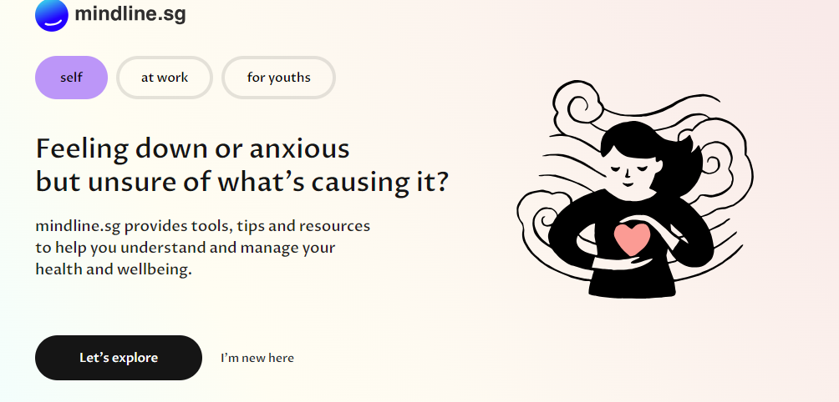
Integration into Clinical Practice
Incorporate Digital Use into Safety and Care Plans
Government initiatives

Slide 52
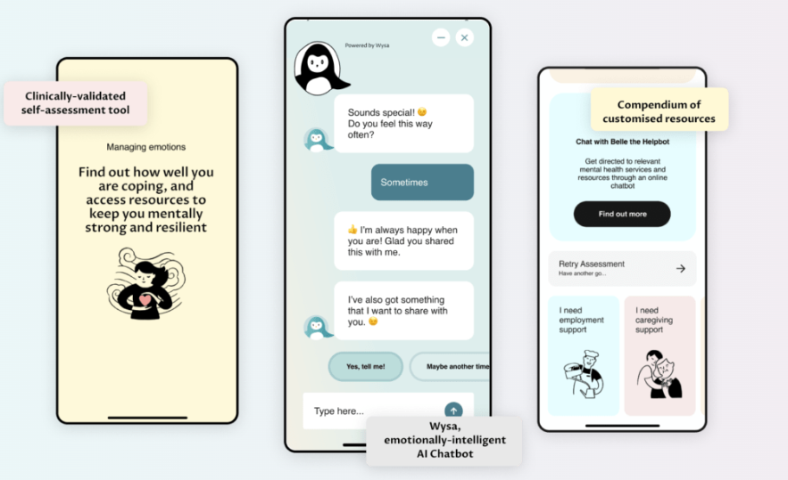
Integration into Clinical Practice
Incorporate Digital Use into Safety and Care Plans
Government initiatives

Slide 53
Emerging Trends to Watch?
Artificial Intelligence
AI-generated influencers
Deepfakes
Chatbots
Appearance filters
Unrealistic beauty standards
Cosmetic procedure interest
Influencer culture
Parasocial relationships
Consumerism
Financial aspirations
Mental health content
Pros
Increased awareness
Cons
Self-diagnosis
Misinformation
Romanticising illness

Slide 54
5. Discussion

Slide 55
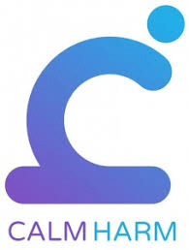
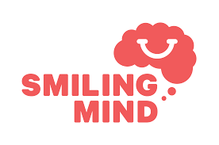
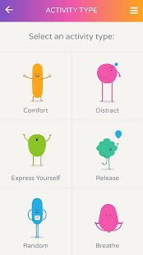
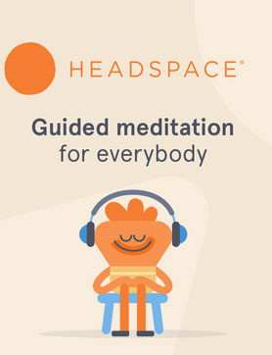
Discussion: The Value of Self Help Mobile Apps
How are your experiences with self-help mobile apps?

Slide 56
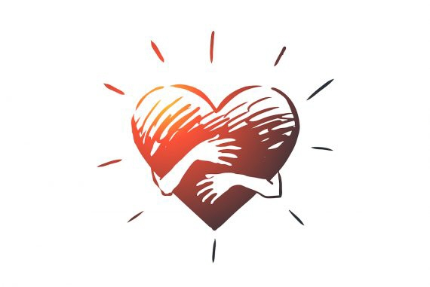
Discussion: Online Communities/Support Groups
How are your experiences with online communities/support groups?

Slide 57


Discussion: Building Digital Resilience
How can we build digital resilience in young people?

Slide 58
References
Feldman, G., Westine, M., Edelman, A., & Higgs, M. (2023). A mindful alternative to screen time: The short-term effects of a breath-focused mindfulness exercise vs. unstructured smartphone screen time on heart rate variability and relaxation. Journal of Social and Clinical Psychology, 42(6), 581–607. https://doi.org/10.1521/jscp.2023.42.6.581
Giedinghagen, A. (2022). The tic in TikTok and (where) all systems go: Mass social media induced illness and Munchausen’s by internet as explanatory models for social media associated abnormal illness behavior. Clinical Child Psychology and Psychiatry, 28, 270–278. https://doi.org/10.1177/13591045221098522
Idelji-Tehrani, S., Dubicka, B., & Graham, R. (2023). The clinical implications of digital technology. Clinical Child Psychology and Psychiatry, 28(1), 338–353. https://doi.org/10.1177/13591045221145400
Messena, M., & Everri, M. (2023). Unpacking the relation between children's use of digital technologies and children's well-being: A scoping review. Clinical Child Psychology and Psychiatry, 28(1), 161–198. https://doi.org/10.1177/13591045221127886
Naidu, K. N. C., Ng, W. Z., Ong, H. E. J., Tee, M., Cheng, J. Y. R., Ho, M. K. W., Ow Yong, F. Z. L., Tang, I. J. H., Sekar, S. H., Chong, E. X. M., Chee, T. T., Ho, D. W. S., Kundadak, G. K., Neo, H. L. M., Soo, S. C., Shorey, S., Gan, D. Z. Q., Subramaniam, M., Zainal, N. H., Ho, C. S., & Tan, R. K. J. (in press). Youth mental health in the age of artificial intelligence: Innovation without governance? Journal of Adolescent Health.
Popat, A., & Tarrant, C. (2023). Exploring adolescents’ perspectives on social media and mental health and well-being: A qualitative literature review. Clinical Child Psychology and Psychiatry, 28(1), 323–337. https://doi.org/10.1177/13591045221092884
Vaingankar, J. A., van Dam, R. M., Samari, E., Chang, S., Seow, E., Chua, Y. C., Luo, N., Verma, S., & Subramaniam, M. (2022). Social media-driven routes to positive mental health among youth: Qualitative enquiry and concept mapping study. JMIR Pediatrics and Parenting, 5(1), Article e32758. https://doi.org/10.2196/32758

