Slide 1
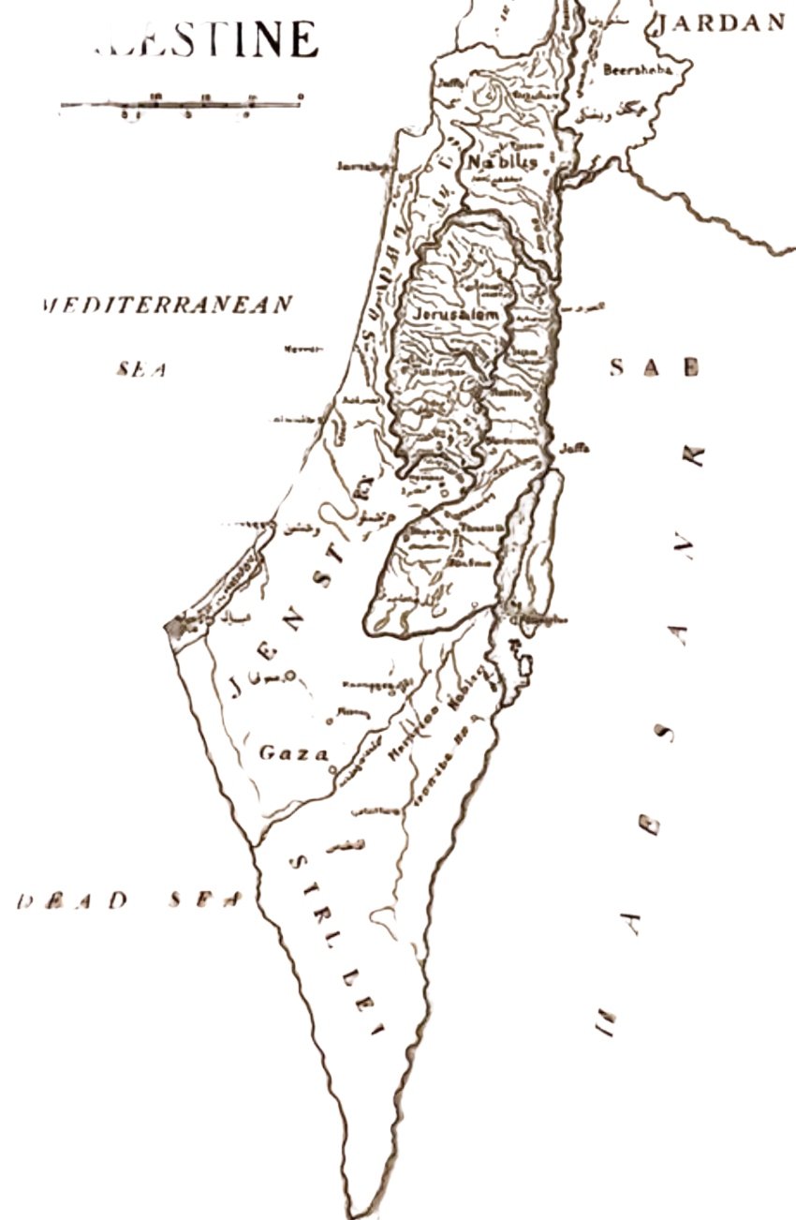
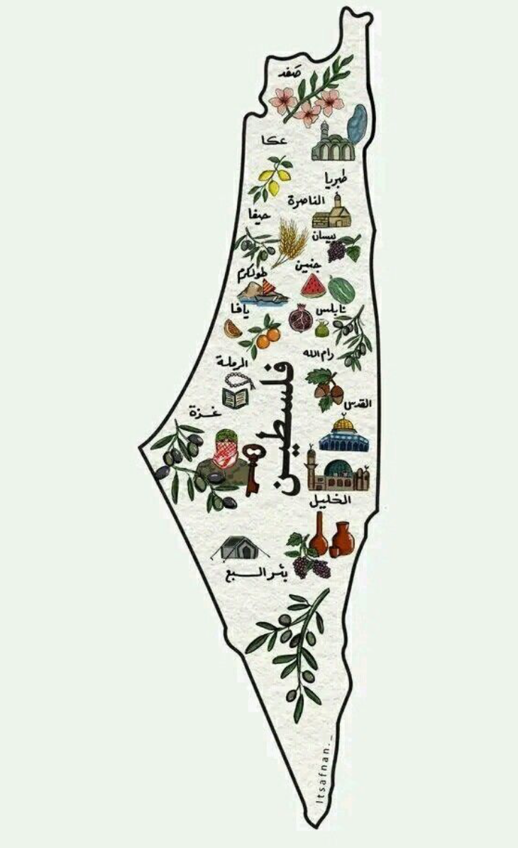
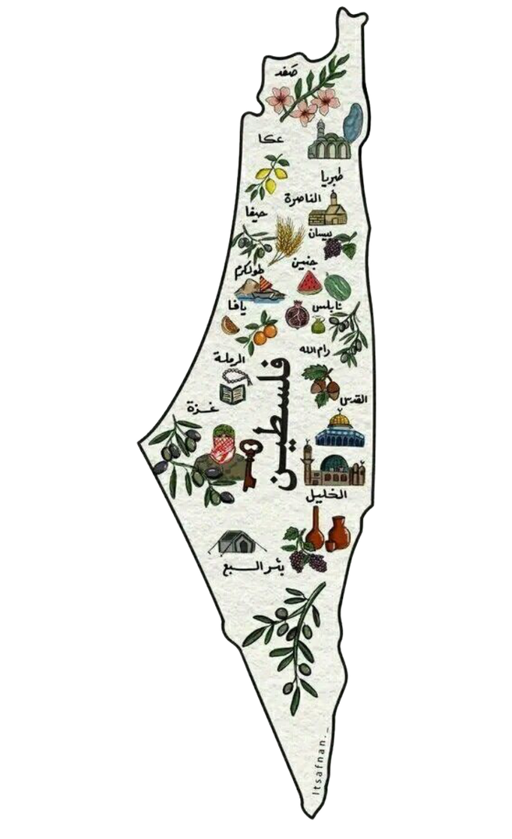
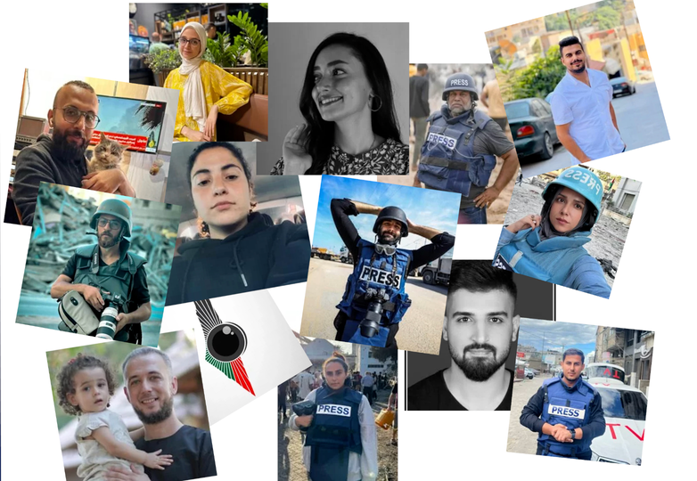
Reclaiming Place Through Symbolic Geographies: Visual Resistance on Palestinian Instagram
INSYIRAH MUJTAHID, NURUL HUDA RASHID & KOKIL JAIDKA
NATIONAL UNIVERSITY OF SINGAPORE, SINGAPORE
LEIDEN UNIVERSITY, THE NETHERLANDS

Slide 2
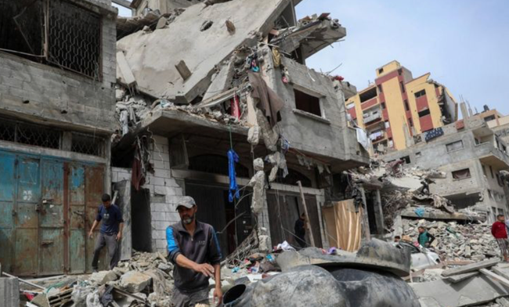
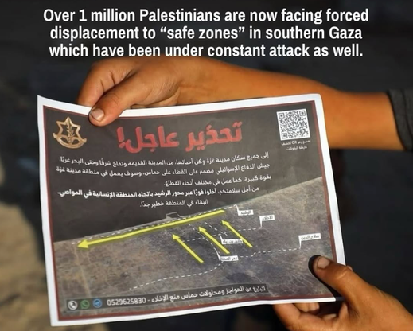
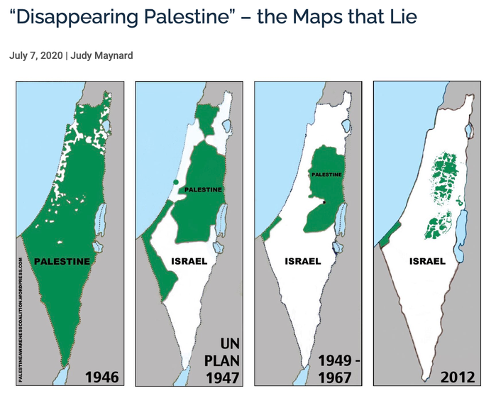

A SHOT OF INSPIRATION
Settler-Colonial Occupation (The Logic of ‘Elimination’)
1
Physical Reality - Material Erasure
Digital Reality - Symbolic Erasure
Physical removal through:
Symbolic removal through:
  Material Destruction
  Land confiscation & Displacement
  Settlement expansion
  Administrative fragmentation
  Restriction & Surveillance
  Control of visibility, memory, and narrative
  Social media censorship
  News Framing
  Territorial Erasure: Arabic place names were replaced, maps redrawn, and depopulated villages overwritten by new national narratives

Slide 3
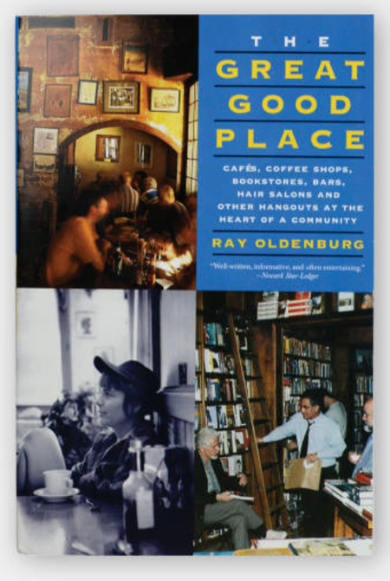
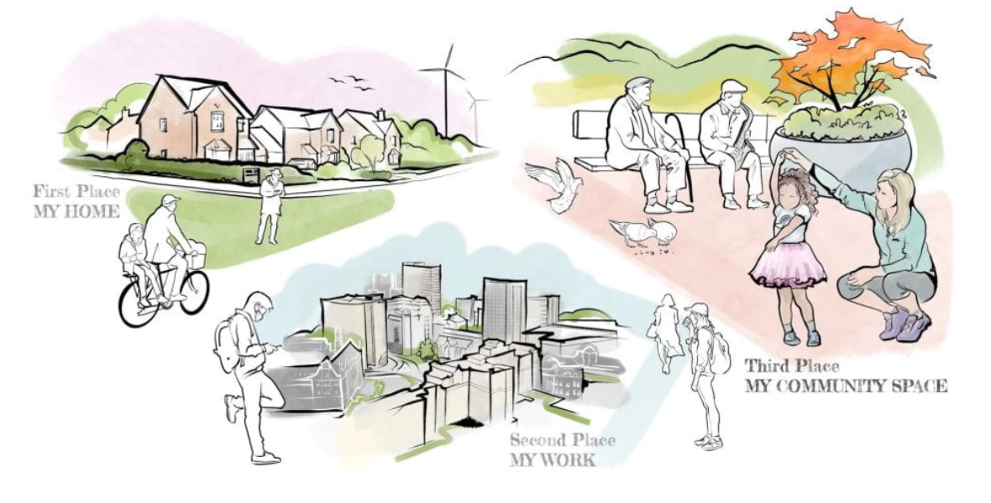
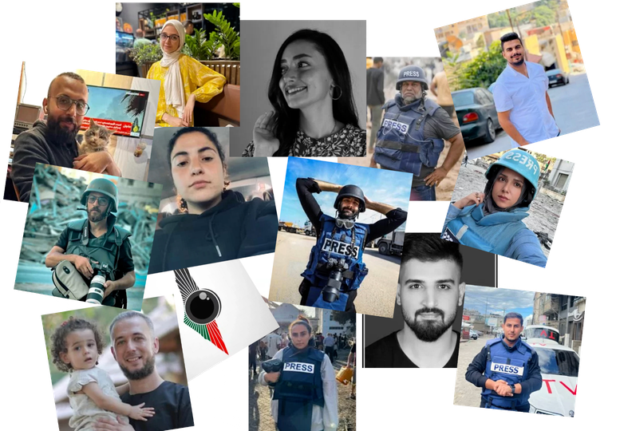
A SHOT OF INSPIRATION
The Third Place - true citizen, community spaces
2
“The digital can erase—but the very same mechanisms can also be reversed, reengineered, and reclaimed.”
In his book The Great Good Place (1989), Ray Oldenburg argues that third places are important for democracy, civic engagement, and a sense of place.

Slide 4


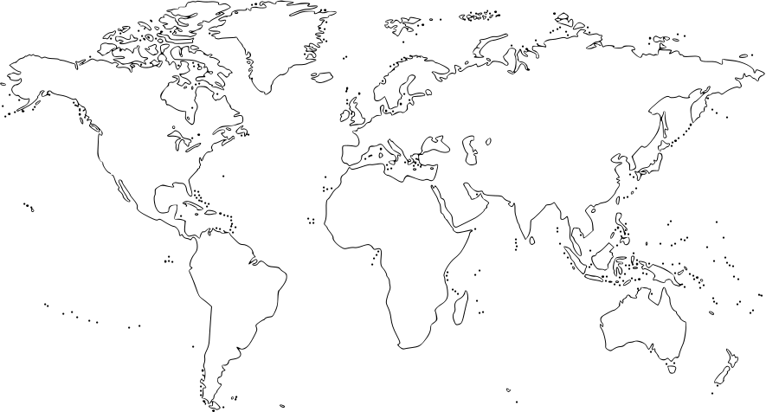
3
A SHOT OF INSPIRATION
A SHOT OF INSPIRATION
A SHOT OF INSPIRATION
Context
Concept
Implication
Digital
Placemaking
Symbolic Geographies
Countervisuality

Slide 5
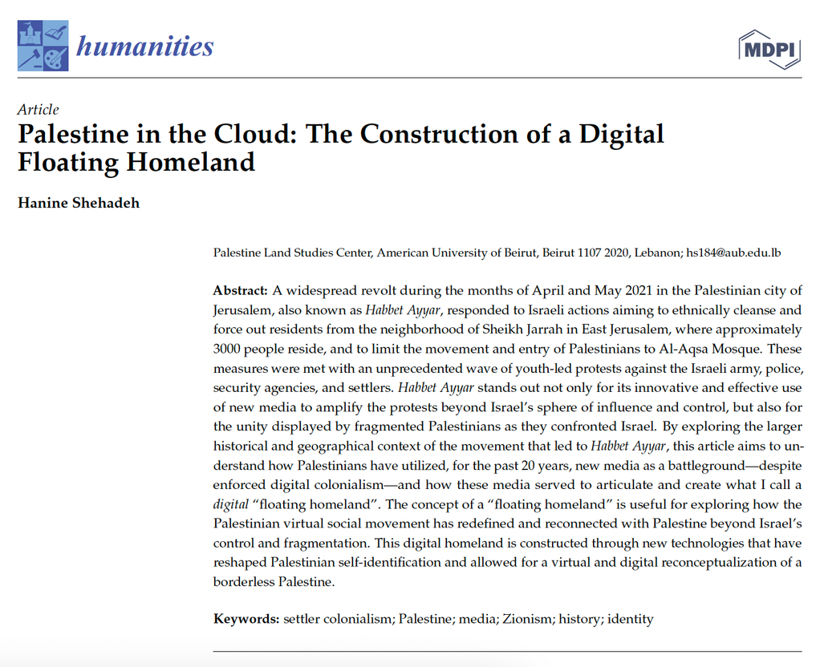
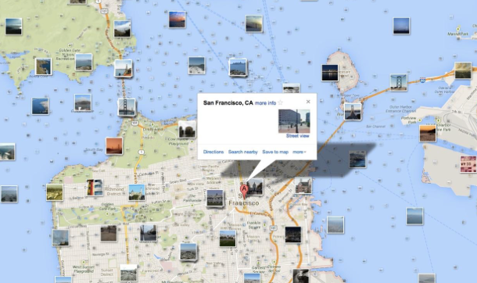
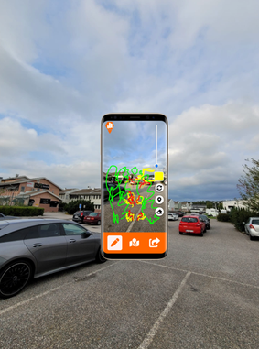
A SHOT OF INSPIRATION
4
Context: Digital Placemaking
What is digital placemaking?
  The use of digital tools (e.g., maps, geotags, posts) to represent and organise space online
  Platforms allow users to tag, locate, and share places across digital environments
  These practices shape how places are seen, remembered, and understood
The creation of the “floating homeland” is accomplished by
utilizing imagery and memory construction.

Slide 6


5
Concept: Symbolic Geographies
What are symbolic geographies?
  The idea that places are not just physical
  Mental construction of spaces created through images, narratives, and representations
  Media and discourse shape how we imagine places and assign meaning to them
  These representations influence who is seen as belonging to(or not belonging) in a space

Slide 7

6
Implication: Countervisuality
NICHOLAS MIRZOEFF - THE RIGHT TO LOOK (2011)
A decolonial visual framework that challenges dominant systems of seeing and knowing
What is countervisuality?
  Resistance that emerges from below
  The right to see, be seen on one’s own terms, and to refuse the imposed gaze of power
  Countervisuality gives visibility to alternative narratives and maintain historical continuity through image-based communication
  Digital placemaking emerges as a non-confrontational yet potent response to algorithmic erasure and hate
User-generated content on Instagram operates as a form of countervisuality that reorients how Palestinian space and life are seen

Slide 8
7
Research Gaps
  Most scholarship on Palestinian media focuses on textual analysis of mainstream press coverage and political discourse, with less attention to the role of citizen-led visual journalism.
  There is limited theorization of how repeated digital imagery functions as a form of spatial and symbolic reconstruction to preserve memory and resist disappearance, in contexts of colonial occupation and networked censorship.
How do Palestinian Instagram users deploy visual symbols to construct symbolic geographies?

Slide 9
8
A SHOT OF INSPIRATION
Research Questions
RQ1: Which are the themes in Palestinians’ Instagram posts that contribute to the countervisual representation of Palestine?
RQ2: In what ways do Palestinians’ Instagram posts about key cities function as acts of countervisuality when compared to press coverage?
RQ3: How does the repetition of countervisual themes in Palestinian Instagram posts relate to patterns of user engagement (e.g., likes and comments)?

Slide 10

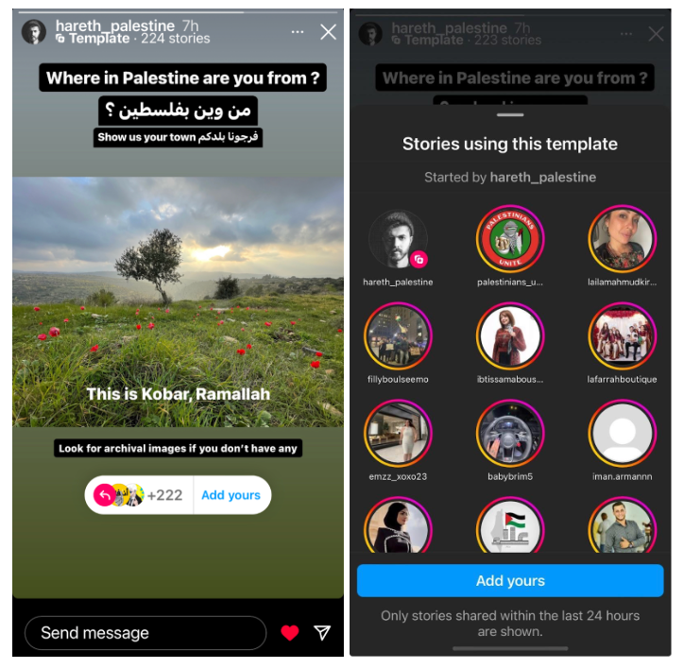
A SHOT OF INSPIRATION
9
Kindly do not photograph this slide
Methodology
Data Collection
Identifying Users
Compiled a list of 834 unique Palestinian Instagram users who responded publicly to story template with names of their hometown
hareth_palestine

Slide 11

A SHOT OF INSPIRATION
10
Methodology
Data Collection
Identifying Users
Data Download
Compiled a list of 834 unique Palestinian Instagram users who responded publicly to story template with names of their hometown
Downloaded public posts published during the first six months of the Israeli offensive, beginning in October 2023

Slide 12
A SHOT OF INSPIRATION
11
Methodology
Data Collection
Identifying Users
Data Download
Location-based
Filtering
Compiled a list of 834 unique Palestinian Instagram users who responded publicly to story template with names of their hometown
Downloaded public posts published during the first six months of the Israeli offensive, beginning in October 2023
Filtered dataset to keep only posts that referenced place names within Palestine in the hashtags or captions

Slide 13
A SHOT OF INSPIRATION
12
Methodology
Data Collection
Identifying Users
Data Download
Location-based
Filtering
Final Dataset
Compiled a list of 834 unique Palestinian Instagram users who responded publicly to story template with names of their hometown
Downloaded public posts published during the first six months of the Israeli offensive, beginning in October 2023
Filtered dataset to keep only posts that referenced place names within Palestine in the hashtags or captions
9,126 posts from individual users

Slide 14
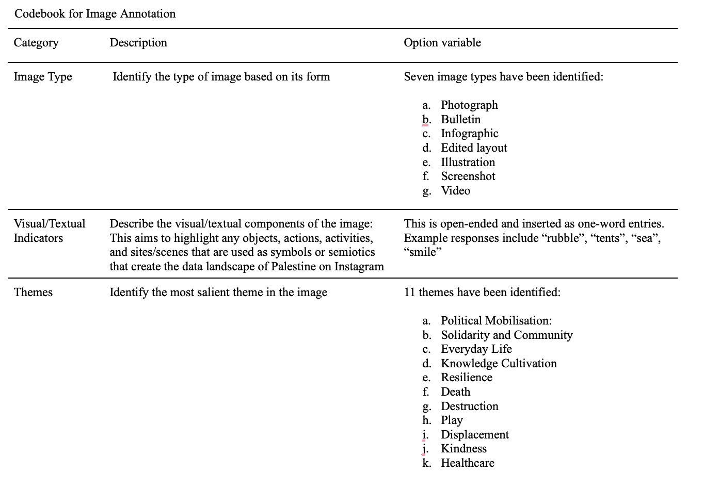
13
Methodology
Pilot annotation
Preliminary review of 50 randomly selected posts to develop an initial codebook

Slide 15
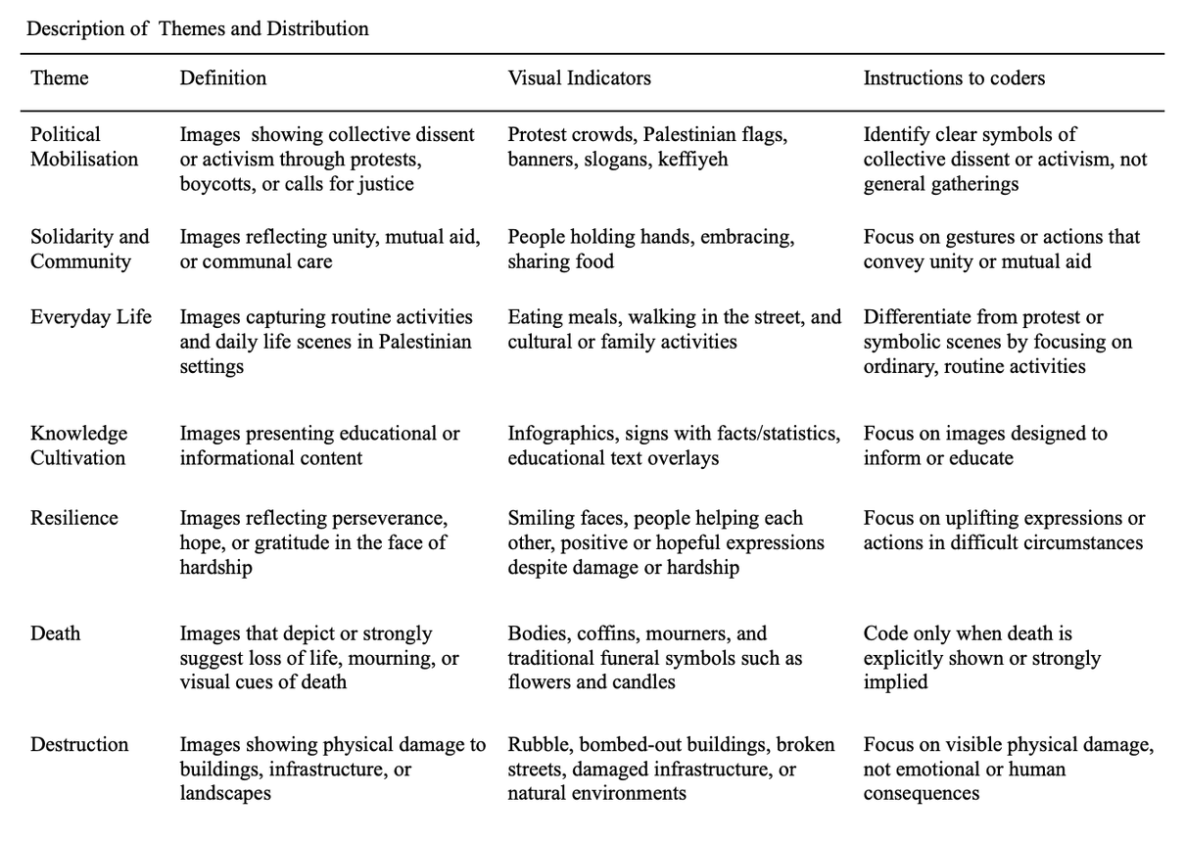
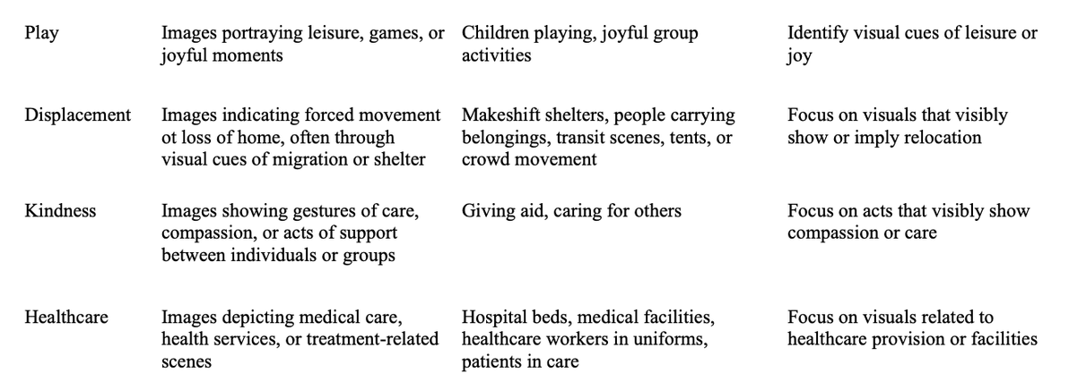
14
Methodology
Pilot annotation
Preliminary review of 50 randomly selected posts to develop an initial codebook

Slide 16
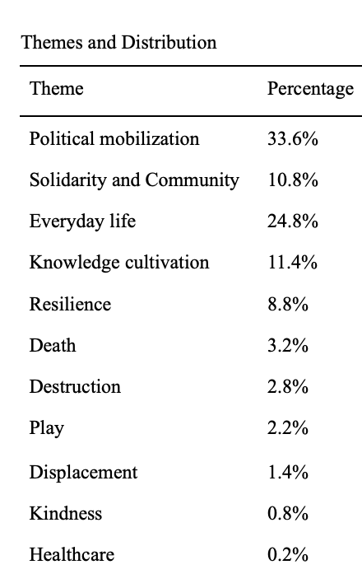
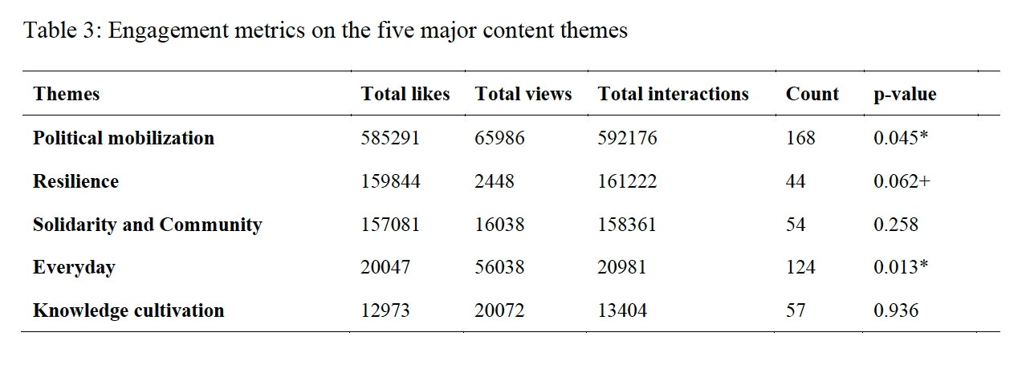
15
Results
What themes are present, and which gain visibility and engagement?
Content characteristics
User engagement
  Protest mobilization and everyday life themes showed significant associations with user engagement. These themes are more likely to resonate emotionally and gain algorithmic visibility.
  Themes like resilience and solidarity did not show strong engagement patterns. Repetition alone does not drive reach.

Slide 17
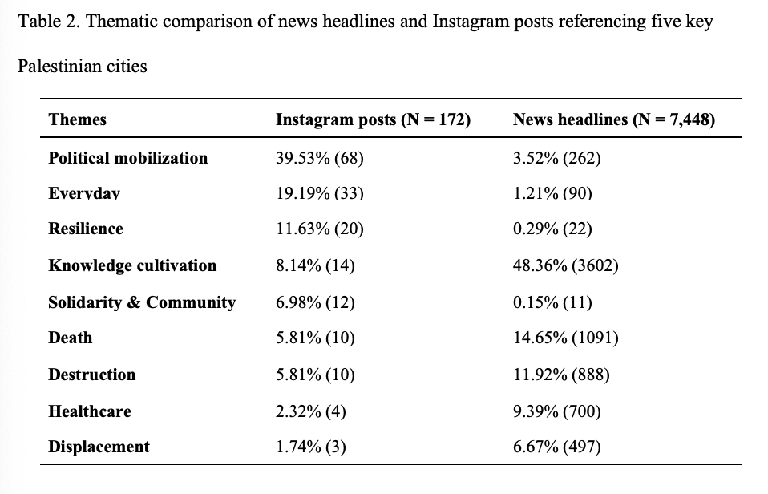
16
Results
How do Instagram representations differ from mainstream news coverage?
  Instagram posts emphasise everyday life, mobilisation, and resilience
  News coverage is dominated by knowledge framing, death, and destruction
  Lived experiences are more visible on Instagram but marginal in news media

Slide 18
17
How is countervisuality expressed?
3 Key Visual Themes
Resilience through motif of joy, family, and faith
Everyday Routines and familiar spaces to assert belonging
Cultivating knowledge through displaying places and traditions

Slide 19
18
How is countervisuality communicated?
3 High-Level Communicative Goals
Coding resistance
Claiming Space
Collective remembering

Slide 20
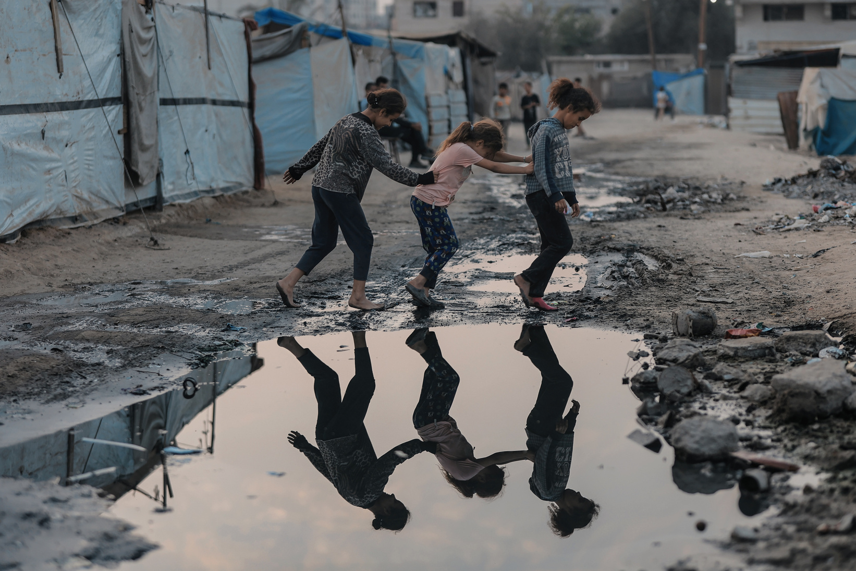
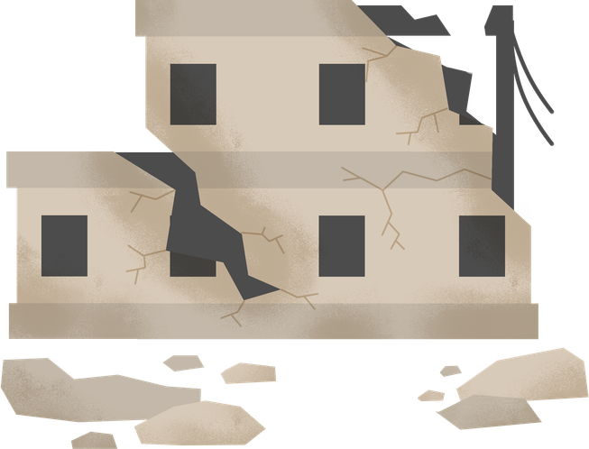

19
Visual Storytelling
3 High-Level Communicative Goals
Claiming contested spaces through visual–textual pairings that assert spatial belonging
  Affirming life within these spaces through everyday acts (e.g. play, care, routine)
  Possessive naming & geotagging
Claiming Space

Slide 21
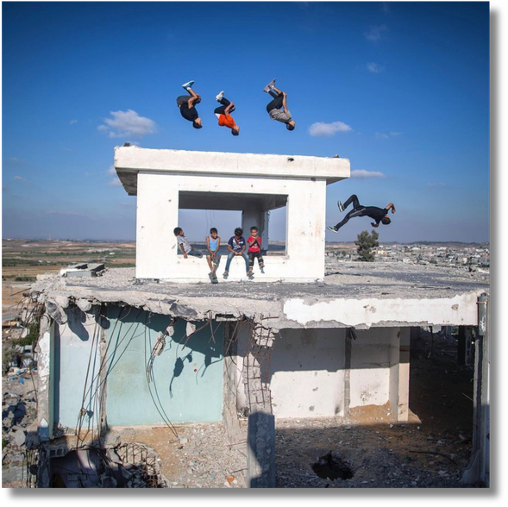
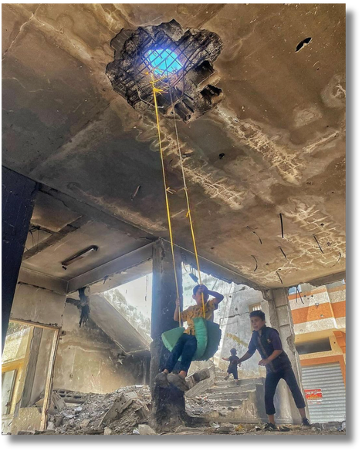
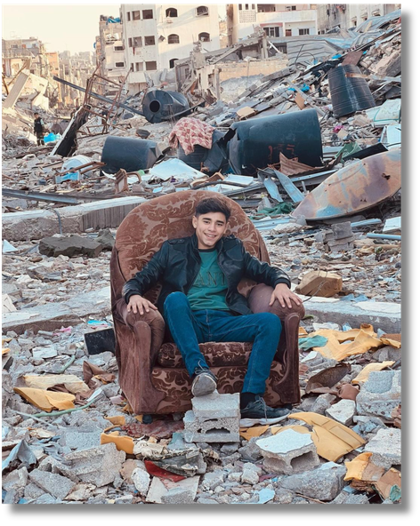
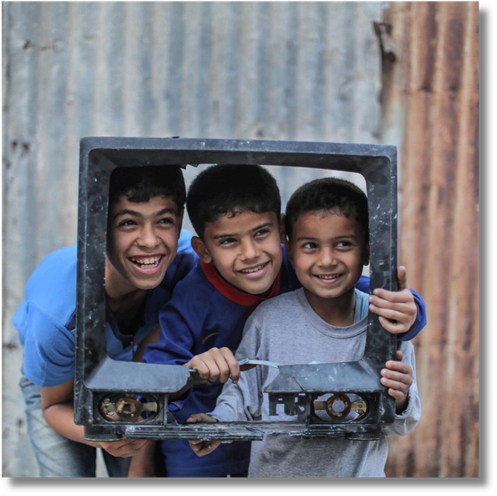
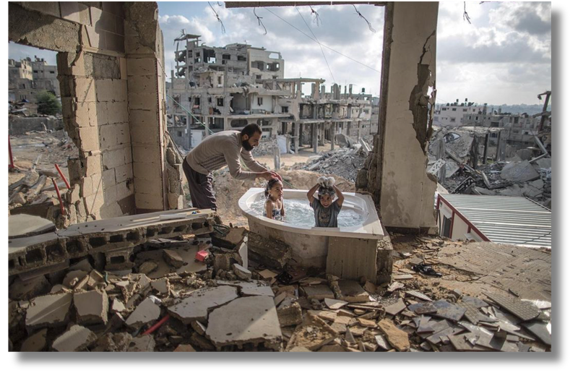
Kindly do not photograph this slide
20
Visual Storytelling
Claiming space through symbolic imagery
  Reclaiming destroyed spaces by turning rubble into symbols of life, presence, resilience and resistance
Rubble
is transformed into a site of play, art, and memory

Slide 22
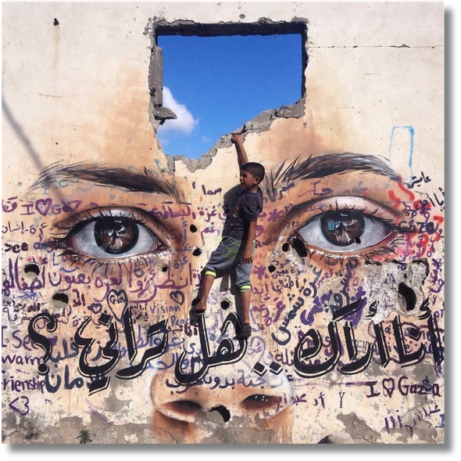
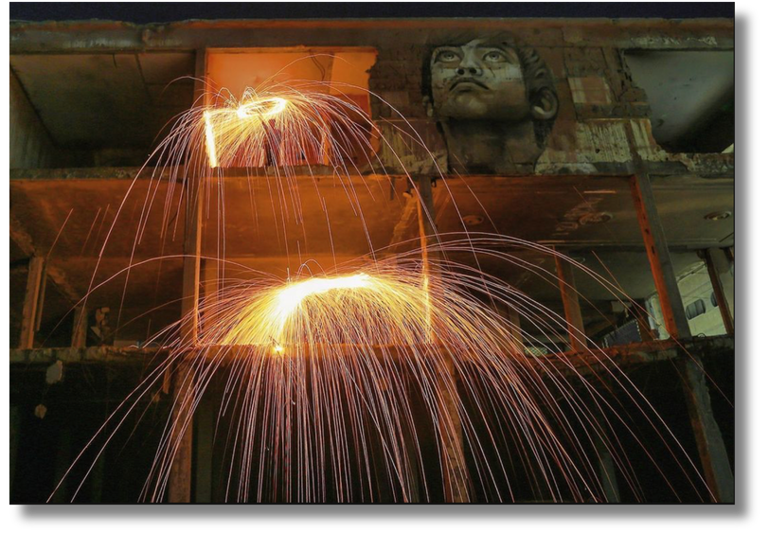
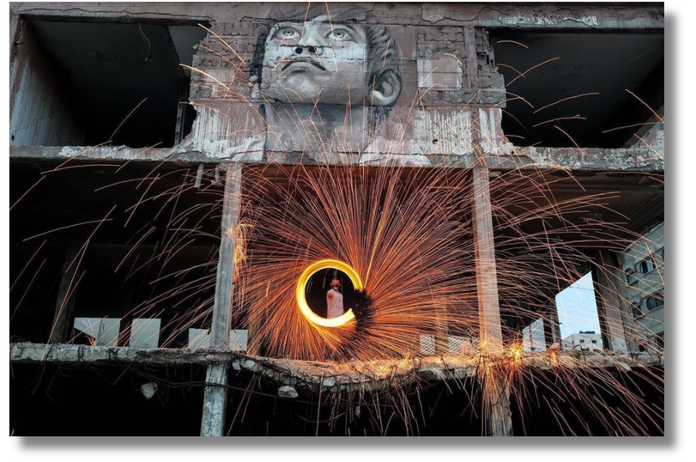
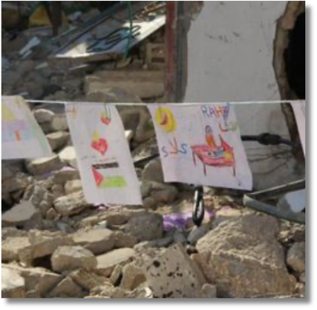
Kindly do not photograph this slide
21
Visual Storytelling
Claiming space through symbolic imagery
  Reclaiming destroyed spaces by turning rubble into symbols of life, presence, resilience and resistance
Rubble
is transformed into a site of play, art, and memory

Slide 23
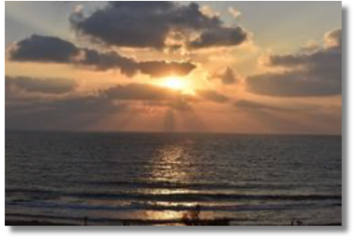
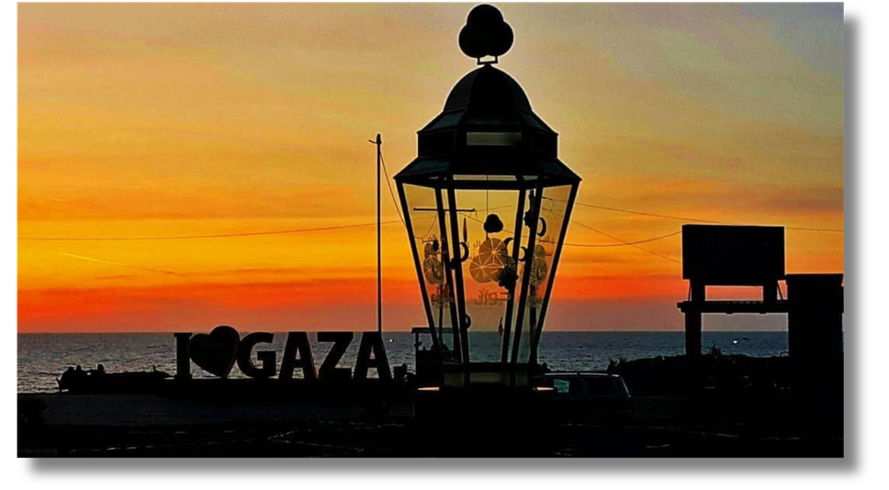
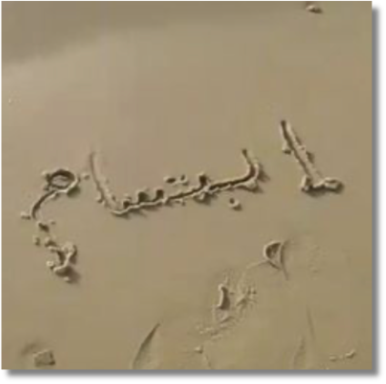
Kindly do not photograph this slide
22
Visual Storytelling
Claiming space through symbolic imagery
  The sea is reclaimed as a space of resilience and imagination, resisting narratives of confinement and control
The Sea
as symbol of hope, longing and freedom

Slide 24
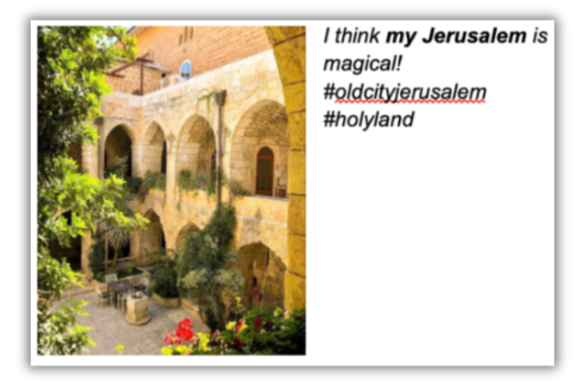
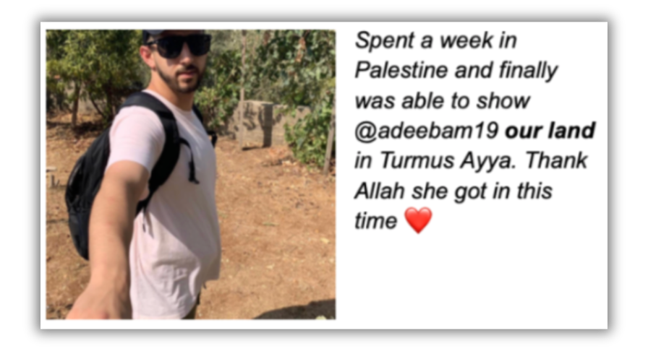
Kindly do not photograph this slide
23
Textual Strategies
Claiming space through possessive naming & geotagging
  Used to assert belonging against cartographic erasure (e.g. #pieceofpalestine, #humansofjerusalem)

Slide 25

24
Visual Storytelling
3 High-Level Communicative Goals
Coding resistance through strategic ambiguity
  Using ambiguity and symbolism to communicate meaning
  Circumventing platform moderation through indirect or coded language
  Creating meanings that require cultural or contextual knowledge to interpret
Coding resistance

Slide 26
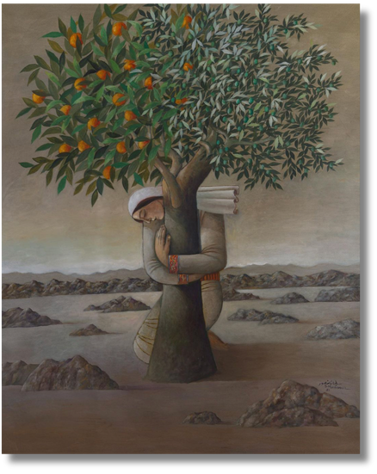
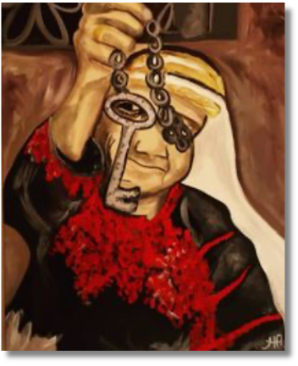
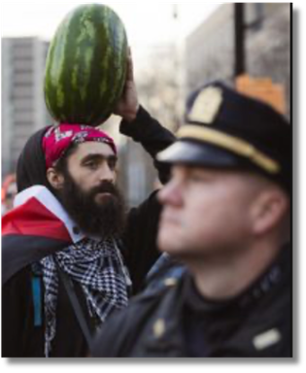
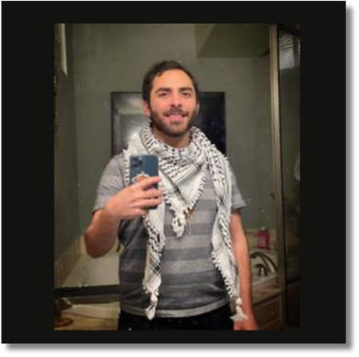
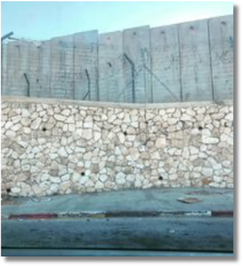
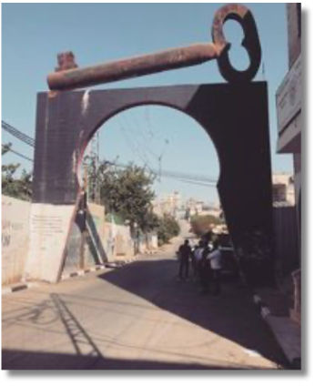
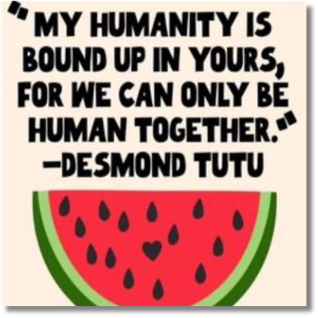
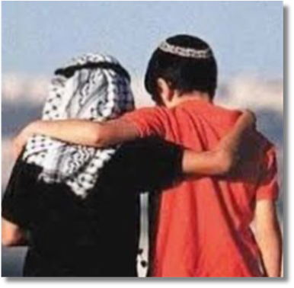
Kindly do not photograph this slide
25
Visual Storytelling
Coding resistance through recurring motifs
  Collective visual shorthand for broader narratives used to circumvent platform moderation, where explicit political reference is censored

Slide 27

26
Visual Storytelling
3 High-Level Communicative Goals
Collective remembering through temporal anchoring and visual repetition
  Anchoring events in time through dates, anniversaries, and recurring references
  Repeating visual motifs to reinforce shared memory
  Accumulating posts into a collective visual archive
Collective Remembering

Slide 28
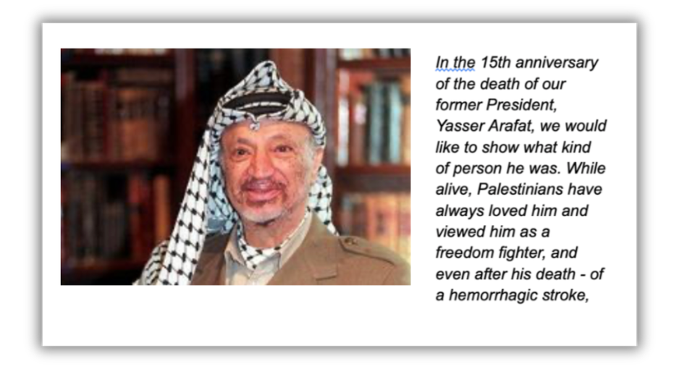
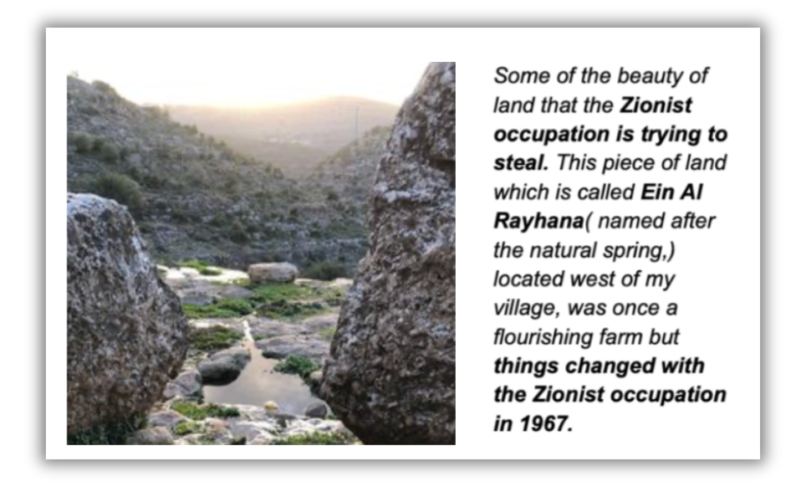
Textual Strategies
Kindly do not photograph this slide
27
Collective remembering through temporal anchoring
  Referencing historical figures, events, and place names as evidence of Palestinian presence, anchoring memory in time to counter narratives of erasure

Slide 29
A SHOT OF INSPIRATION
28
Conclusion
A SHOT OF INSPIRATION
Platforms are not neutral
    They govern visibility, shaping what is seen and circulated
Visual storytelling becomes strategy
    Using symbolism, ambiguity, and coded forms to navigate and circumvent moderation
Representation is not passive
    It operates as a practice of claiming space, resisting erasure, and asserting presence
    Social media posts function as a networked archive, enabling collective remembering, preserving presence and memory against erasure

Slide 30
Extended Methods
  Mixed-method design: Combined qualitative thematic analysis with quantitative metrics (engagement + statistical tests)
Comparative analysis
  Compared Instagram content to press coverage of 5 cities (Gaza, Jerusalem, Bethlehem, Nablus, and Ramallah) published in March 2024 compiled using NewsAPI.org
  Coded 7,449 news headlines using ChatGPT-4o, validated against manual subset
  Chi-square tests used to assess differences in theme distributions
Engagement metrics
  Created composite engagement score (likes + comments)
  Used Instagram's “Overperforming Score” for normalized comparison
  Tested associations between themes and engagement levels (low/med/high)

