Slide 1
90 minutes
HS2911
Cyberbullying
Problem · Antecedents · Consequences · Protective Measures
PROBLEM
ANTECEDENTS
CONSEQUENCES
PROTECTIVE
20 min
25 min
25 min
20 min
Core readings: Tokunaga (2010) · Runions (2013) · Kramer et al. (2014) · Kowalski & Limber (2013) · Billington et al. (2026) · Gillett (2023) · Machackova & Pfetsch (2016)

Slide 2
OPENING: CLOSER TO HOME THAN YOU THINK
Before we begin — reflect if…
Have you have ever changed your online behavior because someone was targeting or harassing you?
Tell us about a time when you witnessed cyberbullying... and chose to say nothing
If you reported cyberbullying to the platform, what happened next?
We will return to each of these moments — as data points — by the end of this lecture.
MDDI Perceptions of Digitalisation Survey (2025); OSRA Bill; Lexology (2025)
Slide 2

Slide 3
OPENING: CLOSER TO HOME THAN YOU THINK
Singapore, November 2025
Before we begin — reflect if…
Parliament passes the Online Safety (Relief & Accountability) Act
You have ever changed your online behaviour because someone was targeting or harassing you
Singapore's new Online Safety Commission — due June 2026 — will have power to force platforms to remove cyberbullying content and restrict perpetrators' accounts.
You witnessed cyberbullying and chose to say nothing
You reported it to the platform — and the platform actually helped
84%
of Singaporeans encountered harmful online content last year
~50%
cyberbullying rate — among Asia's highest
You or someone you know dealt with it alone rather than reporting
5+ days
typical platform response time to valid reports
Why now? Why here? Because this is not only an adolescent problem — or a UK problem.
We will return to each of these moments — as data points — by the end of this lecture.
MDDI Perceptions of Digitalisation Survey (2025); OSRA Bill; Lexology (2025)
Slide 2

Slide 4
FROM CULTURAL MOMENT TO ACADEMIC QUESTION
Netflix — Adolescence (2025)
Billington et al. (2026)
120 million viewers. Netflix's third-most watched show ever.
"All that from two symbols?!"
An Adolescence Roundtable
Jamie, 13, is arrested for murdering a classmate. The investigation traces a pathway:
cyberbullying on Instagram → humiliation → incel radicalisation → lethal violence.
Continuum: Journal of Media & Cultural Studies (2026)
Five scholars analyse the show's viral moment through recognition theory — asking who gets to be seen as a victim of harm, and whose suffering counts.
"Every generation has its own slang. But the adults in Adolescence don't even know what the emojis mean -- let alone the harm they're carrying."
⟶
Key contribution:
The show became a Rorschach test for moral panic. Scholars use it to trace how cyberbullying's consequences connect to broader structures of recognition, misogyny, and platform design.
⚠ Content note: incel ideology, patriarchy, violence — we return to this in Consequences (Billington et al.).
But note — Adolescence is a dramatisation.
What does the research literature actually tell us?
We revisit Billington in Consequences — the radicalization pathway slide.

Slide 5
01
PROBLEM
What are we actually talking about?
Definition, scope, and why it matters here.
20 minutes
Reading: Tokunaga (2010)
Computers in Human Behavior 26(2): 277–287

Slide 6
PROBLEM · WHAT IS CYBERBULLYING? (Tokunaga, 2010)
PROBLEM
Synthesised definition
"Any behaviour performed through electronic or digital media by individuals or groups that repeatedly communicates hostile or aggressive messages intended to inflict harm or discomfort on others."
Intentionality
Repetition
Power imbalance
The aggressor intends to harm. Accidental acts do not count — this matters for Runions' typology later.
Single incidents may not qualify. The structural permanence of digital data complicates this: one post, seen 1000 times.
Technical skill, anonymity, and audience scale all create asymmetries that differ from offline bullying.
🔑 Key distinction: cyberbullying can follow victims into any space, at any hour. 'No safe place' is not rhetoric — it is a structural feature of the medium.
Tokunaga, R.S. (2010). Computers in Human Behavior, 26(2), 277–287
Slide 5

Slide 7
PROBLEM · SCOPE & PREVALENCE
PROBLEM
~40%
~50%
84%
49%
adults globally have experienced
cyberbullying (Nature Human Behaviour, 2024)
adolescents in Singapore, China,
Malaysia, South Korea — among highest
Singaporeans encountered harmful
online content in the past year
of Singapore parents name
cyberbullying their #1 online concern
Who is most affected?
The dark figure problem
Ages 13–17 at highest risk — but university students are increasingly visible in data
Singapore MOE says cases are "low and stable" — but research consistently shows under-reporting.
43% of Singaporeans who experienced online harm said they "wouldn't take action because they don't believe it will help."
What does that tell us about protective measures?
Girls disproportionately targeted for sexual/appearance-based harassment
Bully-victim overlap: 4.8% of SG adolescents — we will return to this
Nature Human Behaviour (2024); Microsoft Digital Civility Index; MDDI Survey (2025); MOE Singapore
Slide 6

Slide 8
02
ANTECEDENTS
Why does it happen? Individual motives meet platform architecture.
25 minutes
Readings: Runions (2013) · Kramer, Guillory & Hancock (2014)
+ SIDE model callback from wk 2/3

Slide 9
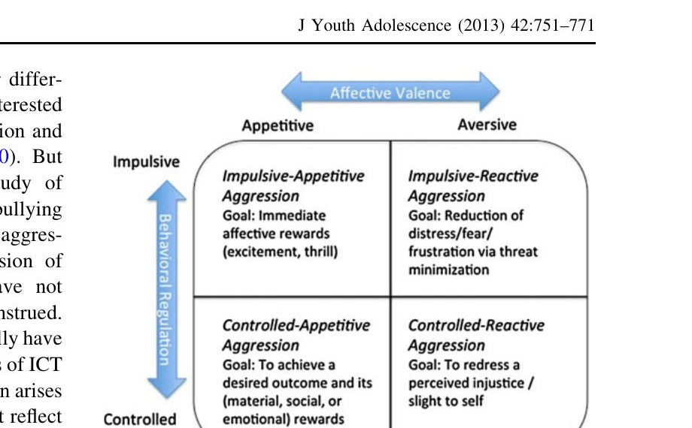
ANTECEDENTS · WHY DO PEOPLE CYBERBULLY? (Runions, 2013)
ANTECEDENTS
RAGE
Provocation → anger → immediate lashing out. Fatigue & sleep deprivation amplify this. The internet never sleeps.
Impulsive-Reactive
REVENGE
Perceived injustice + self-control = planned retaliation. Digital permanence of insults fuels rumination.
Controlled-Reactive
REWARD
Instrumental aggression for social status or material gain. Anonymity lowers perceived cost.
Controlled-Appetitive
Fig. 1 from Runions (2013) — Howard's Quadripartite Violence Typology
RECREATION
Aggression as entertainment — thrill-seeking with reduced empathy online. 'It was just a joke.'
Impulsive-Appetitive
Why this matters: interventions targeting 'cyberbullies' as a single group will fail — Rage needs de-escalation, Recreation needs empathy training, Reward needs structural change.
Runions, K.C. (2013). J Youth Adolescence, 42, 751–771
Slide 8

Slide 10
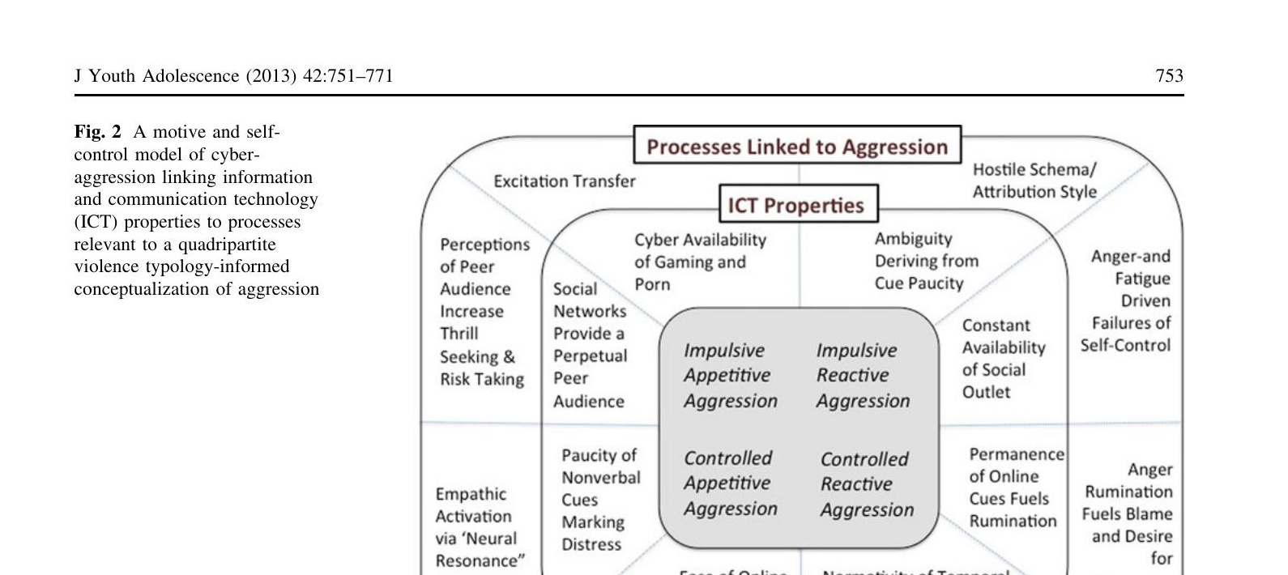
ANTECEDENTS · ICT AFFORDANCES & AGGRESSION (Runions, 2013)
ANTECEDENTS
Anonymity
Lowers perceived cost of aggression; decouples identity from act
Cue paucity
Text-only = no nonverbal feedback; hostile attribution bias amplified
Permanence
Screenshots live forever; rumination on injury prolonged
Fig. 2 from Runions (2013) — how ICT properties map onto aggression types
Perpetual audience
Social networks create sense of peers always watching — thrill amplified
Temporal lag
Time gap enables planned revenge ('dish best served cold')
Runions, K.C. (2013). J Youth Adolescence, 42, 751–771
Slide 9

Slide 11
ANTECEDENTS · PLATFORM DESIGN + GROUP NORMS (Kramer et al., 2014; SIDE model)
ANTECEDENTS
Kramer, Guillory & Hancock (2014)
SIDE Model — week 2/3 callback
Experimental evidence of massive-scale emotional contagion
PNAS, 111(24): 8788–8790
Social Identity model of Deindividuation Effects (Reicher, Spears & Postmes)
Facebook manipulated 689,000 users' news feeds without consent — reducing positive or negative content — to measure emotional spillover.
Result: Platform architecture shapes emotional state. A feed curated toward negative content produces more negative expression.
Anonymity doesn't simply disinhibit individuals — it makes group identity more salient. Online, if the visible identity is the ingroup, anonymous actors hyper-conform to ingroup norms.
Linking SIDE + Runions:
Moral disengagement tells us HOW individuals justify crossing lines
Implication for cyberbullying:
Platforms are not neutral pipes. Engagement-maximising algorithms can amplify the emotional conditions that precede aggression — without any individual choosing aggression.
SIDE tells us WHERE those justifications come from — and why they feel collectively sanctioned
Together: the platform renders ingroup aggression normative before any individual decision is made
Kramer et al. (2014). PNAS, 111(24). Reicher, Spears & Postmes (1995) — SIDE model
Slide 10

Slide 12
03
CONSEQUENCES
Psychological harm, the bully-victim paradox,
and the radicalization pathway.
25 minutes
Readings: Kowalski & Limber (2013) · Billington et al. (2026)
⚠ Trigger warning: mental health outcomes, self-harm risk, incel ideology, violence.

Slide 13
CONSEQUENCES · PSYCHOLOGICAL PATHWAY (Kowalski & Limber, 2013)
CONSEQUENCES
Mental health
Physical
Academic
Depression, anxiety, loneliness
Headaches, sleep disturbance
Disengagement from school
Lower self-esteem
Psychosomatic symptoms
Lower grades
Suicidal ideation (more strongly linked than offline bullying)
Increased absenteeism
Avoidance of online learning tools
The bully-victim paradox — the most significant finding
Kowalski & Limber find that bully-victims (those who both perpetrate and experience cyberbullying) report WORSE outcomes than either pure victims or pure perpetrators — more depression, more anxiety, more physical symptoms.
In Singapore: 4.8% fall into this category. Morally disengaged enough to bully, but also targeted. Standard victim-support or perpetrator-discipline frameworks miss them entirely.
Kowalski, R.M. & Limber, S.P. (2013). J Adolescent Health, 53(1 Suppl), S13–S20
Slide 12

Slide 14
"I think I would be a lot more liberal. I think I'd agree with the majority and try to silence the red pill and all them people."— 16-year-old male, NZ
What is this person describing?
Readings: · Billington (2026) Chapter 4
⚠ Trigger warning: mental health outcomes, self-harm risk, incel ideology, violence.

Slide 15
"Kind of just being a man, and being able to say what you want… I just liked that they were able to be themselves… that they were able to kind of just say how they feel about something without being scared of persecution."— Jacob, 16, South Africa
What is Jacob looking for in these online communities — and what does it tell us that he found it there?
Readings: · Billington (2026) Chapter 4
⚠ Trigger warning: mental health outcomes, self-harm risk, incel ideology, violence.

Slide 16
"I sometimes do wonder, like, if I would have turned out like any other angsty white teenage boy, if it wasn't due to my own, like, queerness and stuff."— Tui, 17, Pākehā/Māori transwoman
Tui and Jacob were in the same online spaces at the same time. Why did the pathway go differently for her?
Readings: · Billington (2026) Chapter 4
⚠ Trigger warning: mental health outcomes, self-harm risk, incel ideology, violence.

Slide 17
CONSEQUENCES · RECOGNITION, HARM & RADICALIZATION (Billington et al., 2026)
CONSEQUENCES
Recognition theory & cyberbullying
The radicalization pathway
Drawing on Honneth's recognition theory, Billington et al. ask: whose suffering from cyberbullying gets recognised as legitimate harm?
Jamie's victimisation (being called an incel, publicly mocked) becomes invisible to the adults around him — and toxic online communities offer recognition instead.
Recognition from harmful communities is still recognition.
1
Cyberbullying victimisation
Repeated, public humiliation → shame & identity threat
↓
2
Misrecognition
Adults/institutions fail to acknowledge or respond
↓
3
Platform algorithm
Grievance + absence of recognition → recommended extremist content
↓
4
Harmful recognition
Key tension:
Incel/manosphere community provides belonging & validation
↓
Cyberbullying as a consequence pathway to radicalisation is real — but the show's framing risks obscuring the gendered harm done to the victim Katie, whose death is rendered almost incidental.
5
Escalation
Ideology normalises violence as legitimate response
⚠ Billington et al. stress: this pathway is real but not inevitable — and it never excuses the harm perpetrated.
Billington et al. (2026). Continuum: Journal of Media & Cultural Studies | ⚠ Trigger: incel ideology, gendered violence
Slide 13

Slide 18
04
PROTECTIVE
MEASURES
Individual safety work, community response,
and the limits of platform governance.
20 minutes
Readings: Gillett (2023) · Machackova & Pfetsch (2016) · Gillespie (2018, passing mention)

Slide 19

"I report every single one of these. I've done that for like, almost an entire year, but it still kept coming up even to this day."— 17-year-old male, NZ
What would you do next?
Readings: · Billington (2026) Chapter 4
⚠ Trigger warning: mental health outcomes, self-harm risk, incel ideology, violence.

Slide 20
"I just listen to what they're on about and just smile and nod and go, 'Oh yeah.'"— Emily, 17, NZ European
Is this a coping strategy, a survival strategy, or something else?
Readings: · Billington (2026) Chapter 4
⚠ Trigger warning: mental health outcomes, self-harm risk, incel ideology, violence.

Slide 21
PROTECTIVE MEASURES · INDIVIDUAL SAFETY WORK (Gillett, 2023)
PROTECTIVE
Gillett (2023) — Feminist Media Studies
What does this look like for cyberbullying?
"This is not a nice safe space: investigating women's safety work on Tinder"
Self-censorship
Deleting posts, avoiding topics, maintaining vague profiles to reduce targeting
Gillett studies the extensive, ongoing, invisible labour women perform to stay safe on dating platforms — profile curation, meeting protocols, information management, identity verification.
Platform navigation
Blocking, muting, reporting — even when users know reports are unlikely to work
Network management
Core insight:
Restricting audiences, curating followers, maintaining alt accounts
Safety work is not exceptional — it is constant and gendered. Users adapt around platform failures rather than platforms designing out harm.
The burden of protection falls on potential victims, not perpetrators.
Emotional labour
Processing harassment, managing distress, deciding what to disclose to whom
Anticipatory safety
⚠ Content note: sexual harassment and assault are discussed in this reading.
Preemptively avoiding spaces where harassment is expected
Recall the poll: 'dealt with it alone.' Gillett names the work behind that answer.
Gillett, R. (2023). Feminist Media Studies, 23(1), 199–215 | ⚠ Trigger: sexual harassment/assault
Slide 15

Slide 22
"When you're, like, in real life, and you've got a supportive friend group, and you forget that people on the internet are really mean, and then you just go in and you're like… well, just, shock, disgust… and mostly just — it's just, people shouldn't be thinking that, and it's crazy. Like, what leads to that?"— Riley, 17, non-binary
Riley was surprised. Should they have been?
Readings: · Billington (2026) Chapter 4
⚠ Trigger warning: mental health outcomes, self-harm risk, incel ideology, violence.

Slide 23
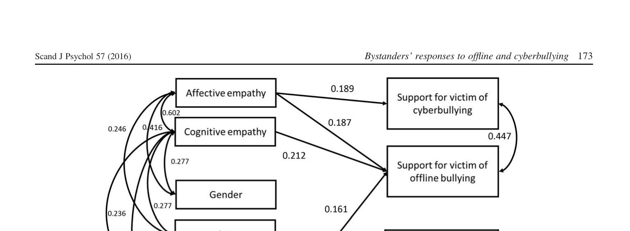
PROTECTIVE MEASURES · BYSTANDERS (Machackova & Pfetsch, 2016)
PROTECTIVE
Key findings
Affective empathy
Predicts victim support in BOTH offline and cyberbullying
Cognitive empathy
Only helps offline — cyber context disrupts severity assessment
Normative beliefs
Pro-aggression norms predict bully reinforcement — not victim support
Age & gender
No significant effect once cognition/affect controlled
Fig. 1 from Machackova & Pfetsch (2016) — path model, N=321 German adolescents
Implications for protective interventions
Empathy-building is necessary but not sufficient — high-empathy bystanders still reinforce bullies when they normalise aggression
Online context impairs severity assessment even for empathic students: 'I didn't realise it was that bad' is a structural problem, not a character flaw
Anti-bullying norms must target bystander reinforcement specifically — cheering, liking, sharing, silence are all forms of participation
Machackova, H. & Pfetsch, J. (2016). Scandinavian J Psychology, 57, 169–176
Slide 16

Slide 24
PROTECTIVE MEASURES · PLATFORM GOVERNANCE (Gillespie, 2018; Singapore OSRA)
PROTECTIVE
INDIVIDUAL
COMMUNITY
PLATFORM
Safety work (Gillett)
Bystander intervention (Machackova)
Content moderation (Gillespie)
Continuous, gendered, mostly invisible. Effective for the individual — does not reduce the problem. Shifts burden onto victims.
Affective empathy + anti-aggression norms drive support. Peer norm-change programs (school classes, teams) most promising. Cognitive empathy alone insufficient online.
Custodians of the Internet: platforms make consequential editorial choices while denying they are editors. Moderation is always value-laden. Singapore OSRA (2025) — OSC can order takedowns; but 5+ day response time reveals structural gaps.
Necessary but unjust
Promising, scalable
Powerful but captured
Gillespie, T. (2018). Custodians of the Internet. Yale UP | Singapore OSRA (Nov 2025)
Slide 17

Slide 25
SYNTHESIS: BRINGING IT BACK TO THE HANDS IN THE ROOM
PROBLEM
ANTECEDENTS
CONSEQUENCES
MEASURES
Not all online aggression is cyberbullying
(Tokunaga's criteria)
4 motives × platform affordances
(Runions + SIDE + Kramer)
Psychological harm, bully-victim paradox,
radicalization pathway (Kowalski; Billington)
Individual burden → community norms
→ platform accountability (Gillett; Machackova; Gillespie)
The recurring thread
Every level of protective measure works — but only for the people who already have capacity to use it. Safety work rewards the vigilant; bystander intervention rewards the empathic; platform moderation rewards those who know how to report. Cyberbullying, like offline bullying, reproduces existing inequalities. The bully-victims — the group in the paradox — fall through every net. That is the problem that remains unresolved in the literature.
Closing discussion: Return to the hand you raised. Which of the three levels — individual safety work, bystander response, or platform governance — was available to you in that moment? Which wasn't? Why not?
All readings, frameworks and empirical data as cited on slides. Lecture developed using PACM framework.

Slide 26
References
Main readings:
· Tokunaga, R. S. (2010). Following you home from school: A critical review and synthesis of research on cyberbullying victimization. Computers in Human Behavior, 26(2), 277–287.
· Runions, K. C. (2013). Toward a conceptual model of motive and self-control in cyber-aggression: Rage, revenge, reward, and recreation. Child Development Perspectives, 7(4), 245–251.
· Kowalski, R. M., & Limber, S. P. (2013). Psychological, physical, and academic correlates of cyberbullying and traditional bullying. Journal of Adolescent Health, 53(1 Suppl), S13–S20.
Supplementary readings:
· Kramer, A. D. I., Guillory, J. E., & Hancock, J. T. (2014). Experimental evidence of massive-scale emotional contagion through social networks. Proceedings of the National Academy of Sciences, 111(24), 8788–8790.
· Billington, J. et al. (2026). All that from two symbols?!: An Adolescence roundtable. Continuum: Journal of Media & Cultural Studies.
· Gillett, R. (2023). This is not a nice safe space: Investigating women’s safety work on Tinder. Feminist Media Studies, 23(1), 199–215.
· Machackova, H., & Pfetsch, J. (2016). Bystanders’ responses to offline bullying and cyberbullying: The role of empathy and normative beliefs about aggression. Scandinavian Journal of Psychology, 57, 169–176.
· Gillespie, T. (2018). Custodians of the Internet: Platforms, content moderation, and the hidden decisions that shape social media. Yale University Press.

Slide 27
References
Cited in slides only — not assigned to students
Theoretical foundations
Howard, R. C. (2011). The quest for excitement: A missing link between personality disorder and violence? Journal of Forensic Psychiatry & Psychology, 22(5), 692–705. https://doi.org/10.1080/14789949.2011.617540
[The QVT matrix in Runions Fig. 1 is Howard’s typology. Students reading Runions will encounter it, but this is the primary source.]
Reicher, S., Spears, R., & Postmes, T. (1995). A social identity model of deindividuation phenomena. European Review of Social Psychology, 6(1), 161–198. https://doi.org/10.1080/14792779443000049
[SIDE model, slides 10 and 13. Students will have encountered this in weeks 2–3.]
Honneth, A. (1995). The struggle for recognition: The moral grammar of social conflicts. Polity Press.
[Recognition theory underpinning Billington et al.’s analysis, slide 13.]
Empirical data and policy sources
Ministry of Digital Development and Information, Singapore. (2025). Perceptions of Digitalisation Survey. Government of Singapore.
[84% encountering harmful online content; 33% experiencing harmful online behaviour. Slides 2 and 6.]
Ministry of Digital Development and Information & Ministry of Law, Singapore. (2025, October 15). Online Safety (Relief and Accountability) Bill: Proposed new law to empower victims of online harms to seek timely relief and obtain redress. Government of Singapore. https://www.mlaw.gov.sg/proposed-new-law-to-empower-victims-of-online-harms-to-seek-timely-relief-and-obtain-redress/
[OSRA Bill; Online Safety Commission details; 5+ day platform response time. Slides 2, 15, 17.]
Lee, J., Ang, R. P., & Cheung, H. S. (2024). School bullying and cyberbullying in Singapore: Prevalence, predictors, and outcomes. In J. S. Hong, H. C. Chan, A. L. C. Fung, & J. Lee (Eds.), Handbook of school violence, bullying and safety (pp. 348–362). Edward Elgar Publishing. https://doi.org/10.4337/9781035301362.00037
[Singapore prevalence figures including the 7.3% / 1.8% / 4.8% breakdown. Slide 6.]
Gao, Y., Houghton, S., Carroll, A., & Wood, L. (2024). Umbrella review of meta-analyses on the risk factors, protective factors, consequences and interventions of cyberbullying victimization. Nature Human Behaviour, 8, 2087–2101. https://doi.org/10.1038/s41562-024-02011-6
[~40% global adult cyberbullying rate; ~50% Asia prevalence figures. Slide 6.]
Microsoft. (2021). Digital Civility Index: A four-year look at the evolution of online civility. Microsoft Corporation.
[Singapore 49% parental concern statistic; international comparison figures. Slide 6.]
Ministry of Education, Singapore. (n.d.). Cyber wellness education. Government of Singapore. https://www.moe.gov.sg
[“Low and stable” official reported cases figure. Slide 6.]

