Slide 1
DEEP LEARNING · MEDICAL IMAGE CLASSIFICATION
Brain Tumor Detection
from MRI Scans
A deep learning model that classifies a brain MRI scan into one of four categories.
Dhwani Agarwal RA2311027010021
Akshay Jha RA2311027010059
Notes:
This project builds a deep learning model that classifies a brain MRI slice into one of four categories: glioma, meningioma, pituitary macroadenoma, or healthy.

Slide 2
WHAT WE BUILT
Project Overview
1
2
3
Labelled MRI dataset
Transfer learning model
Prediction with confidence
1,137 brain MRI images across four classes, split 80/20 into training and testing sets.
A MobileNetV2 network pre-trained on ImageNet, fine-tuned on the MRI data in two phases with a four-class head.
The model returns the predicted tumor class along with how confident it is, reaching 86.9% accuracy on unseen test images.
Notes:
Three parts: a labelled dataset, a transfer learning model, and a prediction that comes with a confidence score.

Slide 3
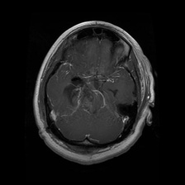
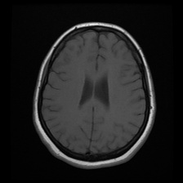
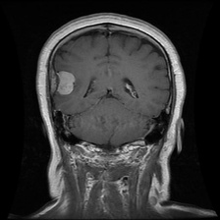
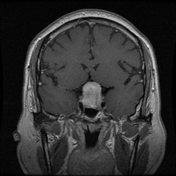
THE PROBLEM
What the Model Separates
Brain tumors differ in type, and the type determines the treatment pathway. Telling them apart on an MRI requires specialist training — this is what the model learns to do.
Glioma
Healthy
Meningioma
Pituitary Macroadenoma
Real samples from the training set · 224 × 224 MRI slices
Notes:
Four classes: three tumor types and a healthy brain. Telling them apart on an MRI needs specialist training, which is what the model learns.

Slide 4
WHERE THE DATA COMES FROM
The Dataset
1,137
4
908
229
MRI images
classes
training images
testing images
Source
Multi-Class Brain Tumor MRI Dataset
Jamil and Khan, Mendeley Data, V2 (2025)
doi: 10.17632/82mtzd8x72.2
Licence: CC BY 4.0
Notes:
The dataset is the Mendeley multi-class brain tumor MRI dataset, balanced across classes, split 80/20.

Slide 5
OUR CONTRIBUTION
What Makes This Project Different
TYPICAL STUDENT PROJECT
THIS PROJECT
Kaggle repost with no attribution
Mendeley dataset with a DOI and CC BY 4.0 licence
3 tumor types, or just tumor / no tumor
4 classes — three tumor types plus Healthy
Notebook only; the split can't be reproduced
Seeded split script committed to the repository
Class order from os.listdir — shifts between runs
Sorted class mapping — stable on every rerun
Accuracy only
Confusion matrix, per-class F1 and AUC, confidence score
The architecture is standard transfer learning. The contribution is the rigour around it — a traceable dataset, a reproducible split, and evaluation that cannot flatter the model.
Notes:
The architecture is standard transfer learning. The contribution is the rigour around it: traceable data, a reproducible split, and evaluation that cannot flatter the model.

Slide 6
THE STACK
Technologies Used
Language & environment
Deep learning
Image & data handling
Python 3
TensorFlow / Keras
Pillow (PIL)
Google Colab (GPU runtime)
MobileNetV2 pre-trained on ImageNet
NumPy
Evaluation & plotting
Web & deployment
Reproducibility
scikit-learn
Flask (local predictor)
Seeded split scripts
Matplotlib & Seaborn
Vercel (project website)
Fixed random seed (42)
Notes:
The stack: Python and TensorFlow/Keras for the model, scikit-learn and Matplotlib for evaluation, and Flask plus Vercel for the demo and website.

Slide 7
System Architecture
Brain MRI Dataset
1,137 labelled images · 4 classes
stratified 80 / 20
Training set
908 images
Testing set
229 images
Preprocessing
resize 224×224 · augment
Preprocessing
resize 224×224
MobileNetV2 Transfer Learning Model
two-phase fine-tune + 4-class head
Predicted tumor class + confidence score
Notes:
The dataset is split 80/20 with stratification. Both sets are resized to 224 by 224, training images are augmented, and the MobileNetV2 model outputs a class and a confidence score.

Slide 8
STEP BY STEP
Methodology
1
2
3
4
5
Data preparation
Preprocessing
Augmentation
Model training
Evaluation
Split the dataset 80/20 into Training and Testing folders, class by class.
Resize every image to 224×224; the model rescales pixel values internally.
Vary brightness, contrast, flip, rotation and zoom on training images only.
Train a new head on a frozen MobileNetV2, then fine-tune its top layers at a low learning rate.
Measure accuracy, F1, confusion matrix and ROC/AUC on the unseen test set.
Notes:
Five steps: prepare the data, preprocess, augment, train in two phases, then evaluate on the held-out test set.

Slide 9
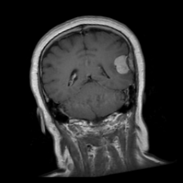
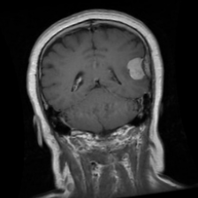
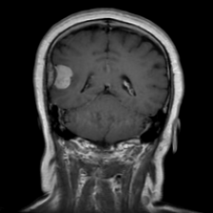
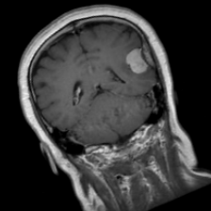
STEP 3, SEEN
Augmentation in Practice
One training image becomes many. Brightness, contrast, flip, rotation and zoom are applied at random, so the model sees a different version of each scan on every pass.
Original
Augmented 1
Augmented 2
Augmented 3
Augmented 4
Applied to training images only — the 229 test images are never augmented, so the reported score reflects unseen data.
Notes:
One training image becomes many. Augmentation is applied only to training images, never to the 229 test images.

Slide 10
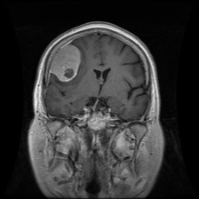
How a Prediction Is Made
MRI scan image
Model output
Resize to 224 × 224 · rescale pixels inside the model
Glioma
1.5%
MobileNetV2 model — forward pass
Healthy
1.6%
Probability for each of the 4 classes
Meningioma
95.1%
A real test image (Meningioma)
Pituitary
1.8%
Result: “Tumor: Meningioma (Confidence: 95.1%)”
Classes: Glioma · Healthy · Meningioma · Pituitary Macroadenoma
Notes:
A real example from the test set: the model reads the scan, outputs a probability for each class, and reports the top class with its confidence.

Slide 11
THE OUTCOME
Results on Unseen Images
86.9%
Test accuracy
0.868
Macro F1 score
0.974
Baseline vs final model
Mean AUC, one vs rest
VGG16 (128 px)
80.4%
MobileNetV2 (224 px)
86.9%
Notes:
On the held-out test set the model reaches 86.9 percent accuracy, up from 80.4 percent for the VGG16 baseline. Pituitary tumors are easiest to detect and meningiomas hardest.

Slide 12
WHERE IT GOES WRONG
Confusion Matrix
True \ Predicted | Glioma | Healthy | Meningioma | Pituitary
Glioma | 54 | 0 | 5 | 0
Healthy | 7 | 48 | 1 | 3
Meningioma | 6 | 2 | 43 | 5
Pituitary | 0 | 0 | 1 | 54
Reading the matrix
Rows are the true class, columns the prediction. The diagonal is correct.
11 glioma / meningioma swaps are the main error
Pituitary recall 98.2%
Healthy precision 96.0%
Notes:
Most mistakes are glioma versus meningioma, which look alike on some slices. Pituitary recall is 98.2 percent and healthy precision is 96 percent.

Slide 13
WHY IT MATTERS
Value Delivered
1
Speed
2
Triage
A four-way classification in about a second per scan, against minutes of manual review.
The confidence score separates the clear cases from the ones that need a human to look again.
3
Reproducibility
4
Extensibility
Anyone can regenerate the exact split and retrain — the result can be verified, not just claimed.
The pipeline is class-agnostic: adding a fifth tumor type needs a new folder, not a rewrite.
Notes:
Four benefits: speed, triage using the confidence score, reproducibility, and the ability to extend the model to more tumor types.

Slide 14
BEING HONEST
Limitations and Next Steps
Limitations
Next steps
Only 1,137 images in total
Split training and validation by patient or scan
Slices, not patients: near-identical slices can sit in both training and validation, so validation reads ~100% while the test set gives 86.9%
Try a stronger backbone such as EfficientNetV2 and ensemble several models
Educational model — no clinical validation, not a medical device
Export to TensorFlow.js so the website can predict in the browser
Notes:
Limits: a small dataset, slices rather than patients, and no clinical validation. Next steps: a patient-level split, a stronger backbone, an ensemble and in-browser inference.

Slide 15
CONCLUSION
A working four-class MRI classifier
The project takes a citable brain MRI dataset, preprocesses every image through one pipeline, and fine-tunes a MobileNetV2 network to separate glioma, meningioma, pituitary macroadenoma and healthy scans. The model returns a predicted class with a confidence score, and reaches 86.9% accuracy (macro F1 0.868) on test images it never saw during training — up from 80.4% for the VGG16 baseline.
Thank You
Dhwani Agarwal · RA2311027010021
Akshay Jha · RA2311027010059
Notes:
To wrap up: a working four-class MRI classifier built with a reproducible pipeline, reaching 86.9 percent accuracy on unseen test images.

