Slide 1
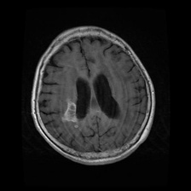
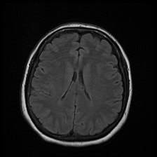
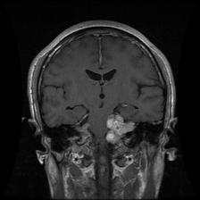
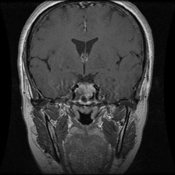
NeuroScan
Brain tumor MRI classification with transfer learning
Glioma | Meningioma | Pituitary Macroadenoma | Healthy
Dhwani Agarwal (RA2311027010021)
Akshay Jha (RA2311027010059)
Educational project, not a medical device
Notes:
Welcome. This project classifies brain MRI slices into four categories and improves on a baseline model by about six and a half points of accuracy.

Slide 2
Why classify brain MRI?
4
classes to tell apart
Glioma, Meningioma, Pituitary Macroadenoma and a healthy brain
1,137
MRI images
A public, citable academic dataset (Mendeley Data, CC BY 4.0)
86.9%
test accuracy
On 229 images the model never saw during training
Notes:
Brain tumors are diagnosed from MRI, and different types need different treatment. A model that sorts slices into types can support, not replace, a radiologist.

Slide 3
A balanced dataset
Glioma
Healthy
Meningioma
Pituitary
Notes:
The dataset is balanced across classes, split eighty twenty. Training has 908 images and testing 229, and the test set is never touched until final reporting.

Slide 4
From scan to prediction
1
2
3
4
5
Prepare
Augment
Train head
Fine-tune
Evaluate
Resize to 224 x 224, three channels
Flip, rotate, zoom, contrast, brightness
MobileNetV2 frozen, new classifier on top
Unfreeze top layers at a low learning rate
Held-out test set, F1, AUC, confusion matrix
Notes:
Training and prediction share exactly the same preprocessing. Rescaling is part of the model, so the website, the app and the notebook cannot drift apart.

Slide 5
Two models, one clear winner
 | VGG16 baseline | MobileNetV2 (final)
Input size | 128 x 128 | 224 x 224
Head | Flatten, dropout, 128 units | Average pooling, dropout 0.35
Training | One phase | Two phases: head, then fine-tune
Test accuracy | 80.4% | 86.9%
Macro F1 | 0.807 | 0.868
+6.5 points of accuracy from a lighter network
Notes:
The baseline was VGG16 at 128 pixels. The new model is MobileNetV2 at 224 pixels, which is smaller, faster and more accurate on this small dataset.

Slide 6
Training in two phases
What to know
33 epochs in total
Label smoothing 0.1 against overconfidence
Validation hit 100%, but is inflated by near-duplicate slices
Notes:
Phase one trains only the new head. At epoch nine we unfreeze the top of the base network and drop the learning rate. Validation accuracy reached one hundred percent, which is inflated by near duplicate slices, so we trust the test set instead.

Slide 7
Results on unseen images
86.9%
Test accuracy
0.868
Macro F1
0.974
Mean AUC
Notes:
On the held-out test set the model reaches eighty six point nine percent accuracy. Pituitary tumors are easiest to find, meningiomas hardest.

Slide 8
Where the model gets confused
True \ Predicted | Glioma | Healthy | Meningioma | Pituitary
Glioma | 54 | 0 | 5 | 0
Healthy | 7 | 48 | 1 | 3
Meningioma | 6 | 2 | 43 | 5
Pituitary | 0 | 0 | 1 | 54
Reading it
11 glioma / meningioma swaps
Pituitary recall 98.2%
Healthy precision 96.0%
Notes:
Most mistakes are glioma versus meningioma, which look alike on some slices. Healthy scans are rarely flagged wrongly, with precision of ninety six percent.

Slide 9
What was built
1
2
3
Colab notebook
Local predictor
Website
Full pipeline: data, training, evaluation, ROC and confusion matrix
Flask app. Images stay on your own computer
Nine pages on tumors, MRI, the model, results and FAQ, deployed on Vercel
Notes:
The project ships three things: a Colab notebook, a local Flask app for live prediction, and a public website with learning content.

Slide 10
Limits and next steps
Limits
Only 1,137 images
Slices, not patients: validation leaks
No clinical validation
Hosted site cannot run the model
Next
Split by patient or scan
EfficientNetV2 backbone
Ensemble several models
Export to TensorFlow.js
Notes:
Limits: small dataset, slices rather than patients, and no clinical validation. Next steps are patient level splits, a stronger backbone, an ensemble and in browser inference.

Slide 11
86.9%
test accuracy, up from 80.4%, using a fine-tuned MobileNetV2
Notebook, local app and website are complete. Thank you.
Dataset: Jamil and Khan (2025), Mendeley Data V2, doi:10.17632/82mtzd8x72.2, CC BY 4.0
Notes:
To wrap up: transfer learning with a careful two phase fine tune lifted test accuracy from eighty to eighty seven percent.

