Slide 1
Data Warehouse Project
FudgeMart Corporation
Group 2
1. Sheetal Chowdhary
2. Dhwani Gandhi
3. Rashika Singh
4. Karan Ashar
5. Sharvil Turbadkar

Slide 2
Business Case
Our Aim is to:
Analyze the needs of Data Warehouse.
Improve Sales Business Process for the Fudge Corporation.
Create an Integrated, Subject-Oriented, Non-Volatile, Time-Variant
Data Warehouse by integrating two sources Fudgeflix and Fudgemart.
Analyze the Sales of Fudge Corporation using a Business Intelligence Tool
Make Business Recommendations to higher authority for boosting Sales in the coming fiscal year.

Slide 3
What is FudgeMart and FudgeFlix?
Fudgemart is an e-commerce business which involves buying and selling of products.
It consists of information on products, categories, vendors, employees, orders placed by customers along with the customer details and their credit card details.
Fudgeflix is a movie rental space where users can subscribe to a plan to watch movies and tv shows.
The database consists of user accounts, the plans they subscribe, billing information. It also has various details of the movies and tv shows available.

Slide 4
Business Questions
Who are the top 10 customers for the company?
Which are the products that have generated least revenue for the company?
Which category of products are in high demand?
Which state is performing the best in terms of sales?
How is the company performance - Yearly, Quarterly, Monthly

Slide 5
How we achieved it?
ETL Tools Used -
SSIS, SSAS
BI Tools Used -
Microsoft Excel & Power BI
FudgeFlix
Staging
Sales Data Mart
ETL
FudgeMart

Slide 6
Mappings
Assumptions:
Quantity of each order of Fudgeflix plans is 1
Do not have Data for 2013 in the database so we are not projecting it
Cleves is assumed to be the city of cleveland in this scenario
SalesDataMart | FudgeMart | FudgeFlix
Product | Products | Plans
Customer | Customer | Accounts
Date | Order Date | Order Date
Sales | Orders | AccountBilling

Slide 7
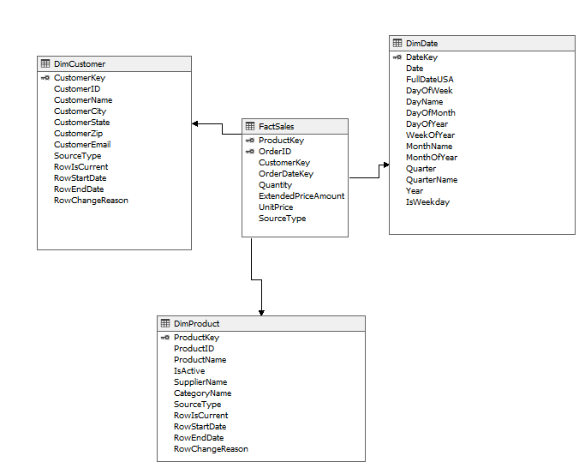
Star Schema

Slide 8
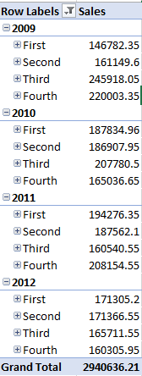
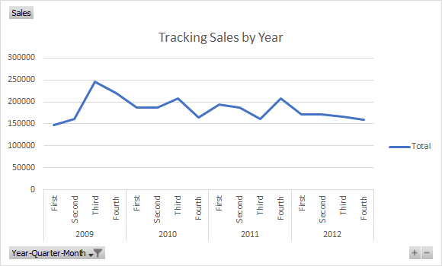
Revenue Generated
Notes:
3rd Quarter Sales are crucial
August and september are the best months for sales revenue.

Slide 9
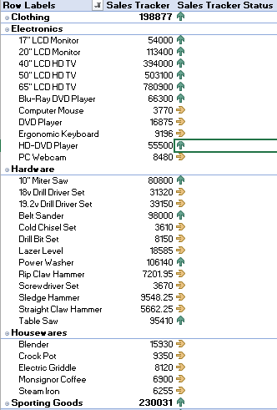
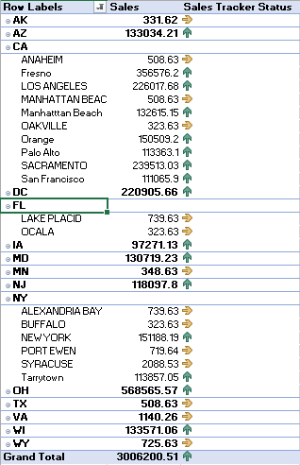
Sales Tracker
Notes:
All Electronics and clothings are the highAll Electronics and clothings are the highest sellers.
Housewares and Hardwares dont have high sales
New York,New Jersey and other NorthEastern States have high sales records
The same trend can be seen in southwestern states like California and Arizona
These Categories could have lead to Fudgemart Sale Attritionest sellers.All Electronics and clothings are the highest sellers.
Housewares and Hardwares dont have high sales
New York,New Jersey and other NorthEastern States have high sales records
The same trend can be seen in southwestern states like California and Arizona
These Categories could have lead to Fudgemart Sale Attrition
Housewares and Hardwares dont have high sales
New York,New Jersey and other NorthEastern States have high sales records
The same trend can be seen in southwestern states like California and Arizona
These Categories could have lead to Fudgemart Sale Attrition

Slide 10
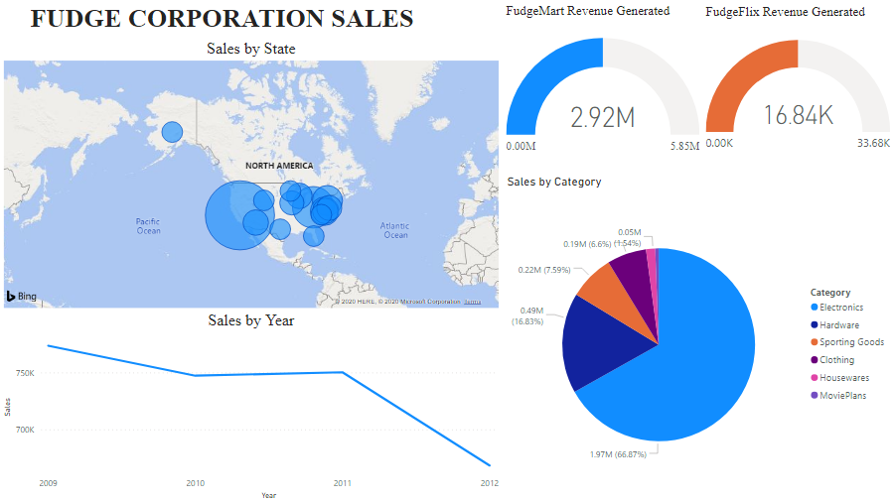
Fudge Sales
Notes:
CA, NY, NJ ,OH, AZ, TX higher sales. Clothing and sporting goods do not do well in 2012.

Slide 11
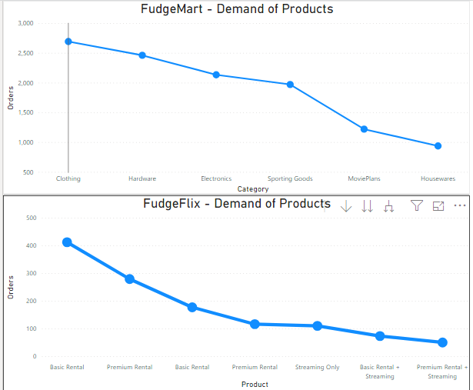
Demand of Products
Notes:
Cost is less so demand is high for basic rental.(students, younger people use basic plans)
Clothing - Basic necessities have greater demand. Electronics prices are going high so demand is decreasing.

Slide 12
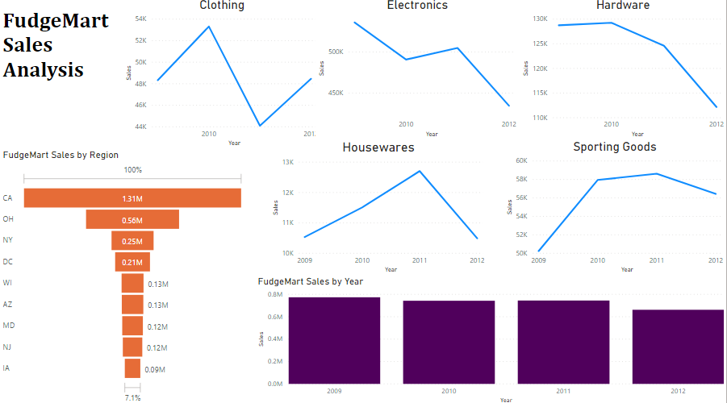
FudgeMart Sales Analysis
Notes:
Region wise California is generating the highest revenue as much marketing is done there. This needs to be followed by other states. Sales in 2012 is dropping as many competitors entered the market such as Target, Aldi.
Except clothing everything is dropping in 2012 as it is prioritized.

Slide 13
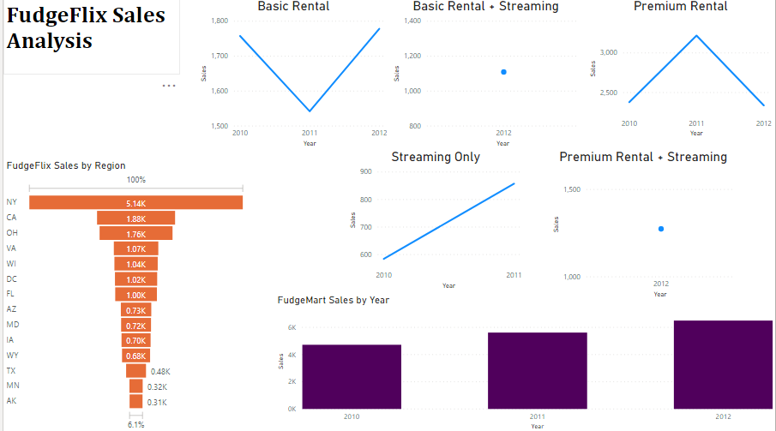
FudgeFlix Sales by Year
Notes:
FudgeFlix sales is highest in NY followed by California. Surprisingly, FudgeFlix market grew in 2012 due to digital streaming becoming a trend, internet becoming cheaper. The two plans just started so not much data. Densely populated. Streaming only got shut in 2011.

Slide 14
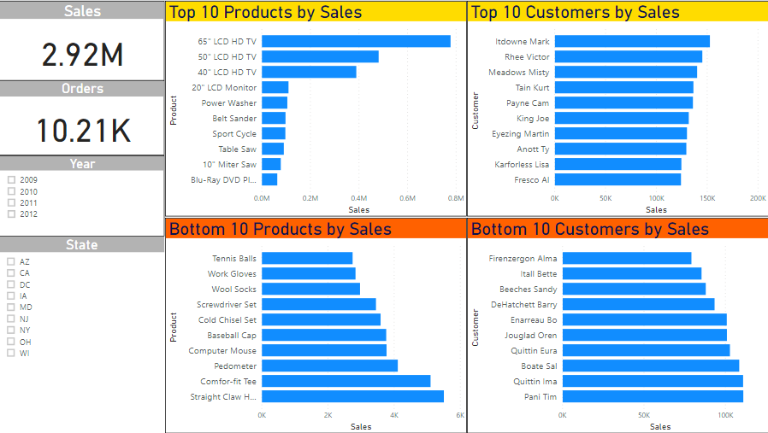
FudgeMart Top 10 Sales

Slide 15
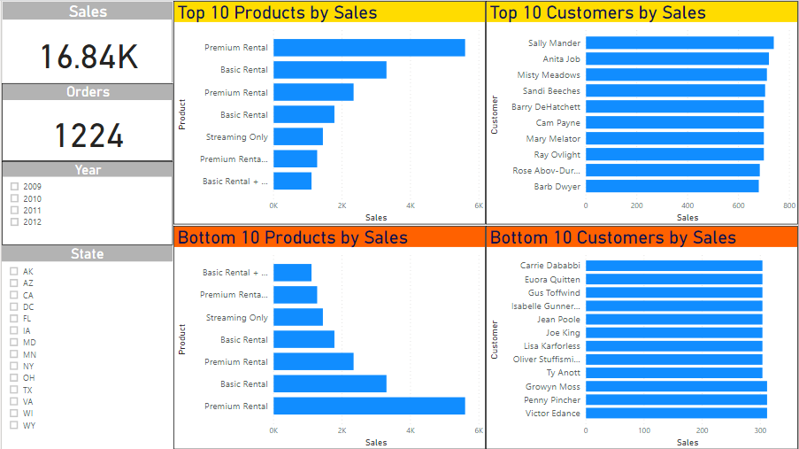
FudgeFlix Top 10 Sales

Slide 16
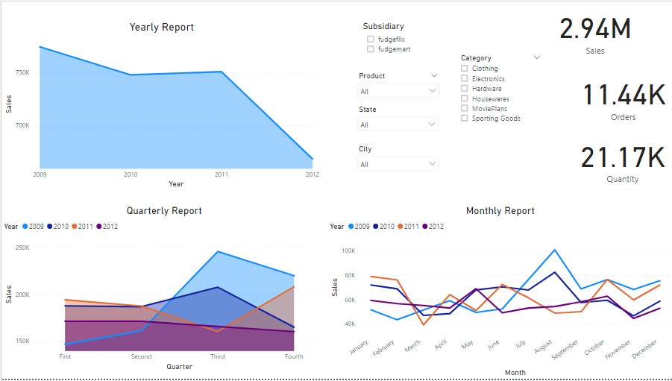
Time-Sales Report
Notes:
Sales drop in NY in november of 2012 due to hurricane sandy
Third Quarter always gives most sales due to summer months bringing most revenue from clothing and sporting goods
American taxpayer relief act of 2012 led to increase in taxes along with surcharges for the high class which are mostly concentrated in CA thus affecting clothing and sporting goods which are items of luxury in california
Also other players enter the market
Sales increase across all in 2010 as financial crisis of 2008 mitigates

Slide 17
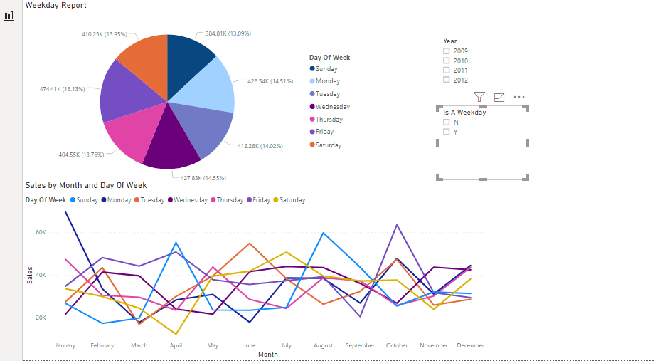
Weekday Report
Notes:
Weekends shows the highest sales across all the months
As customers tend to order and watch movies more frequently on weekends
December and January has equal sales across the week as it is the holiday season

Slide 18
Recommendations
Fudge Corporation need to increase sales as the forecast is showing a downward trend.
Financial easing on products
Extensive PR Campaigns in midwestern and southeastern states like Texas,Arkansas,Iowa
Make Premium Rentals and Rentals more affordable to boost sales
Market Clothing only in areas where it is a luxury like California
Notes:
Electronics have the highest unit price .Since there is a dip in 2012 we can infer that customers are price sensitive.We can cut costs across all domains

Slide 19
Thank You

