Slide 1
Hospital Readmissions Reduction Prediction Case Study
-Dhwani Nijhawan

Slide 2
Problem Statement
An acute care hospital is trying to avoid fines from the government by ensuring that their 30-day
readmission rate is not excessively high. As a data scientist, your task is to develop a predictive
model to identify patients who are likely to be readmitted within 30 days of discharge so that the
hospital can take proactive measures to reduce the risk.

Slide 3
Datasets Used
Admissions
Patients
DRG Codes
Patients

Slide 4
Tasks
Derive binary label for prediction
Exploratory Data Exploration
Data Preprocessing
Feature Engineering and Visualization
Model Development
Evaluation Metrics
Fine tuning
Model deployment Recommendations
Results
Conclusion

Slide 5
Derive Binary Label ‘READMITIN30’
The query combines information from admission table and assigns a rank to each record based on admission time within each patient and then joins the results with maximum admission time rank for each patient. The final result included all records from initial table along with maximum readmission rank for each patient.
Performed an operation to calculate the target variable. For each patient, computed the intervals between the two subsequent admissions.
If the interval is shorter than 30 days, the readmission label for the encounter is 1; otherwise the readmission label is 0.

Slide 6
2. Data Exploration
Performed descriptive statistics on each of the tables to find out what each of the columns mean, their counts, minimum or maximum values, unique values. Also got an information about its data types.
Cleaned the data types which were object for datetime data types.
Having a close look at the data, added a few features which I assume would be important factors for prediction.
Admissions table contains information about admission times of patients, each patient can be admitted multiple times and hence they have many hospital admit IDs.They also have information about the diagnosis.
Patient table contains patient demographics
DRG codes is important from codes and types perspective.
Labevents is another important table, from here I have made a feature extraction.

Slide 7
Feature Extraction
Added the following features:
Duration of a patients stay.
Age, calculated it based on the date of birth and current date (ideally), in our case the data seems imputed.
Count of abnormal readings per patient

Slide 8
Missing Value Analysis
Looked into each column and if they were null, either replaced them with an unknown label already existing for the column or imputed with a numerical value
For example if the age was missing I added a mean value to the missing ones.
Ethnicity missing values replaced with unknown

Slide 9
Assumptions
Removed deceased patients because they would most likely not get readmitted
Age calculation is also based on the assumption that the datetime values are real.
Flag variable in the lab event table has been replaced with normal for NaNs.

Slide 10
3. Data Preprocessing
The query combines information from admission table and assigns a rank to each record based on admission time within each patient and then joins the results with maximum admission time rank for each patient. The final result included all records from initial table along with maximum readmission rank for each patient.
Performed an operation to calculate the target variable. For each patient, computed the intervals between the two subsequent admissions.
If the interval is shorter than 30 days, the readmission label for the encounter is 1; otherwise the readmission label is 0.

Slide 11
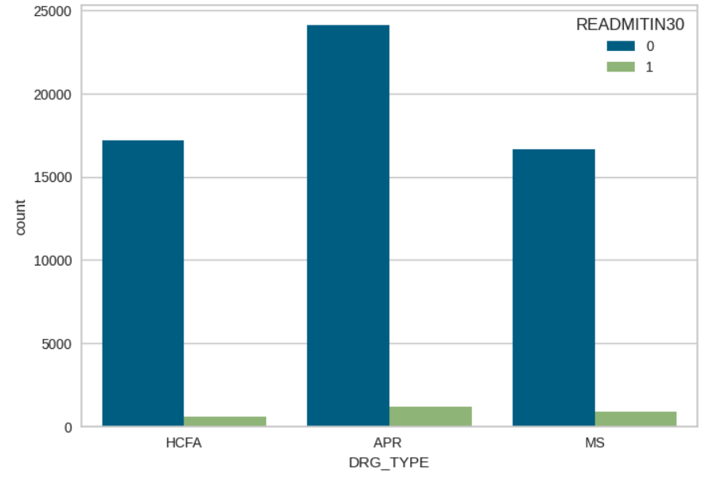
4. Feature Engineering
After filtering out the important predictors from all the four tables, came up with a clean dataframe of predictors and performed some feature engineering on them along with bivariate analysis.
Also handled duplicate rows by eliminating them.

Slide 12
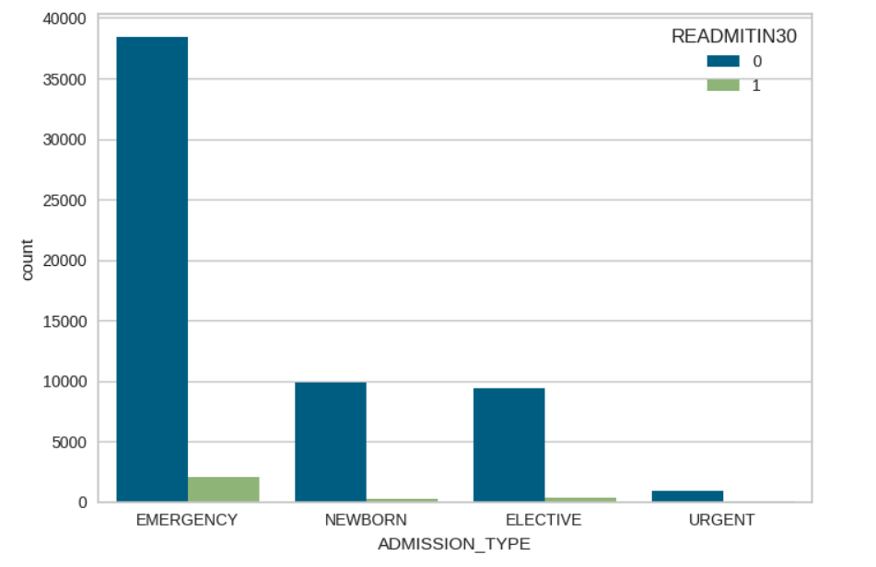
4. Feature Engineering admission type

Slide 13
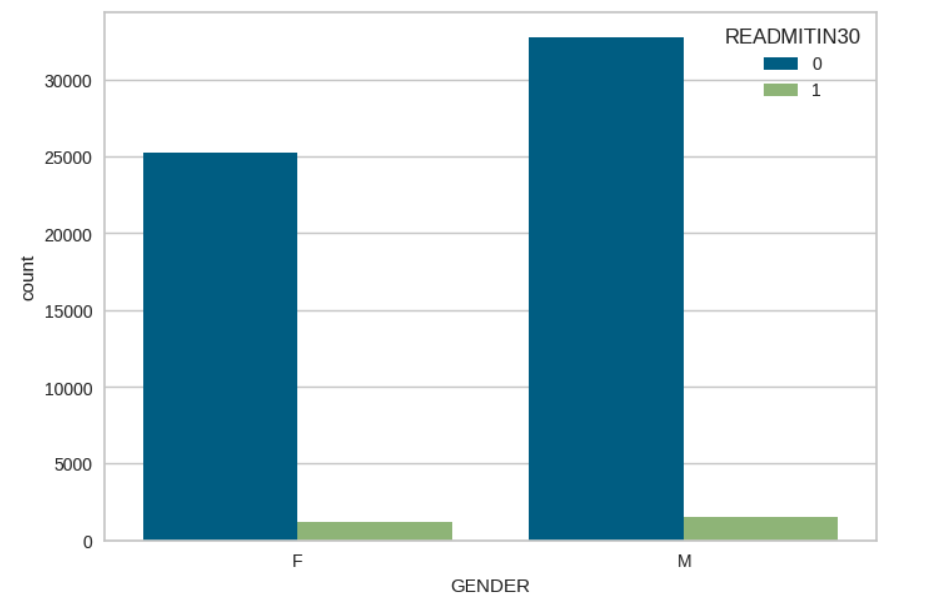
4. Feature Engineering gender

Slide 14
5. Model Development
Once the predictors and target variables are ready. Apply the following methods:
Data standardization before adding to the model
Splitting data into train and test sets (80-20)
Used the following algorithms for prediction:
Logistic Regression
Decision Trees
Random Forest
XGBoost

Slide 15
6. Evaluation Metrics
For evaluation metrics used the following metrics:
F1 Score
Recall
Precision
Confusion Matrix
Feature Importance
AUC/ROC
Accuracy

Slide 16
7. Fine-Tuning
Performed fine tuning on Logistic Regression model by adding threshold and reducing the probabilities to as less as 0.05.
There are many many hyperparameters that can be tuned for further improvement of algorithm, but die to the scope of this project I have kept it simple.

Slide 17
8. Model Deployment Recommendations
Containerization : We can containerize the model using Docker to create portable and isolated environment for deployment. This can simplify process of scaling and managing the model created.
Orchestration framework: We can choose between Kubernetes or Apache Airflow to manage deployment, scaling, workflow management and scheduling our model
CI/CD Continuous Integration/ Deployment: We can automate the deployment pipeline using C!/CD practices. Tools such as GitLab.

Slide 18
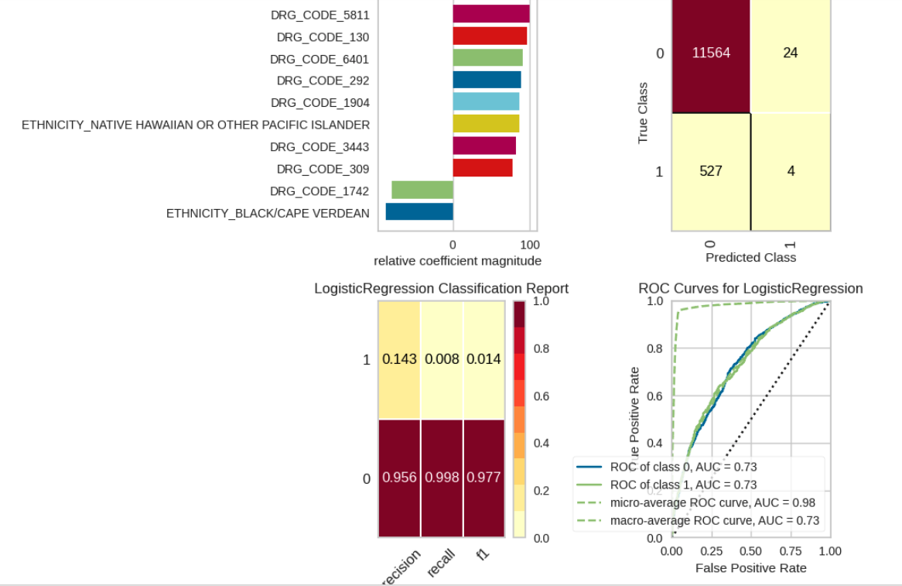
9. Results Logistic Regression
Logistic Regression:
Notes:
The accuracy of the model is pretty good, indicating 95% of instances were correctly classified.
However, its is important to note that the model’s performance in identifying instances of class1 is very poor with low recall and F1-score. This suggests that the model may be biased towards class 0 and struggles to correctly identify instances of class 1
Feature Importance is a good feature to understand when we are aware of the domain.

Slide 19
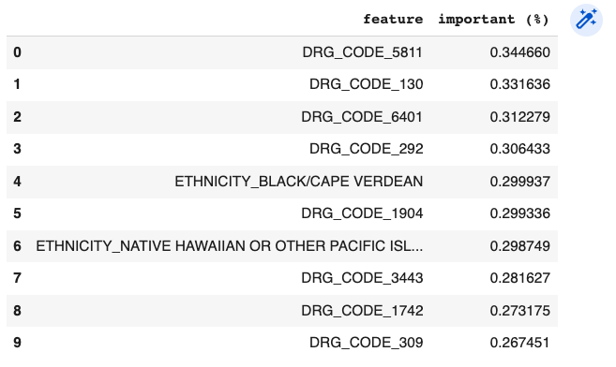

Slide 20
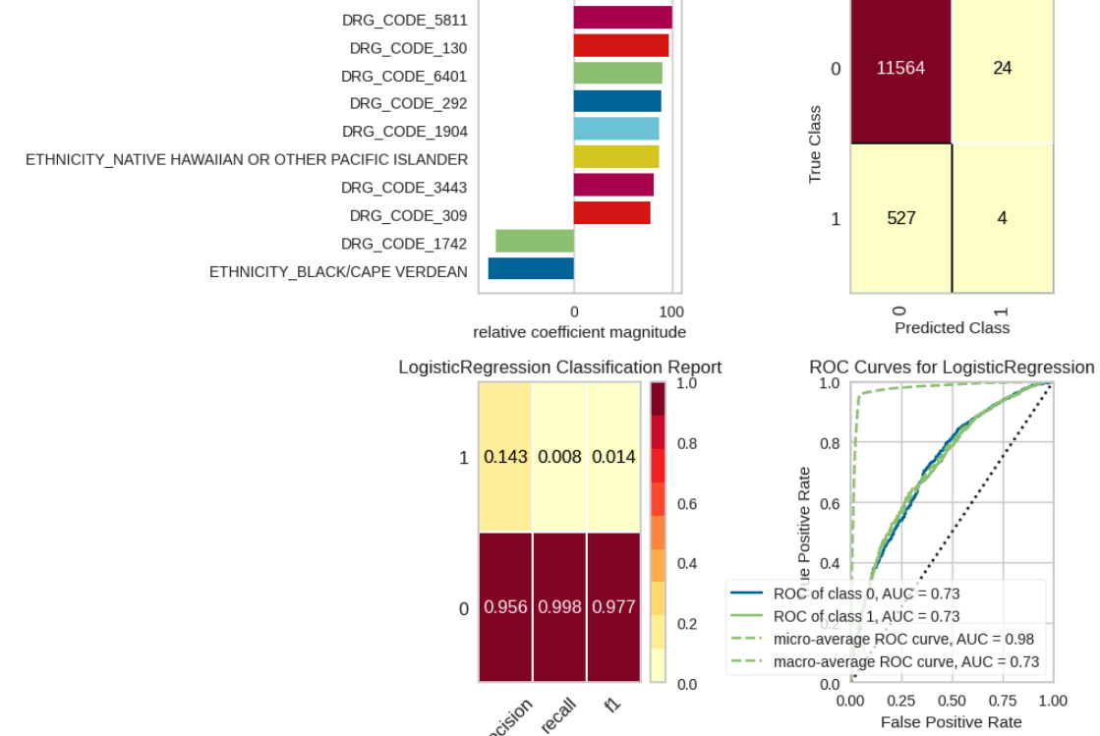
9. Results
Fine tuned
Notes:
The F1-score is 0.97, suggesting that the model performs better in predicting the majority class (not readmitted)
The precision measures how well the model correctly identifies the positive class, while recall measures the proportion of actual positives correctly identified by the model. In this case, the model has higher precision for class 0 (not readmitted) but higher recall for class 1 (readmitted), indicating a trade-off between precision and recall depending on the class.

Slide 21
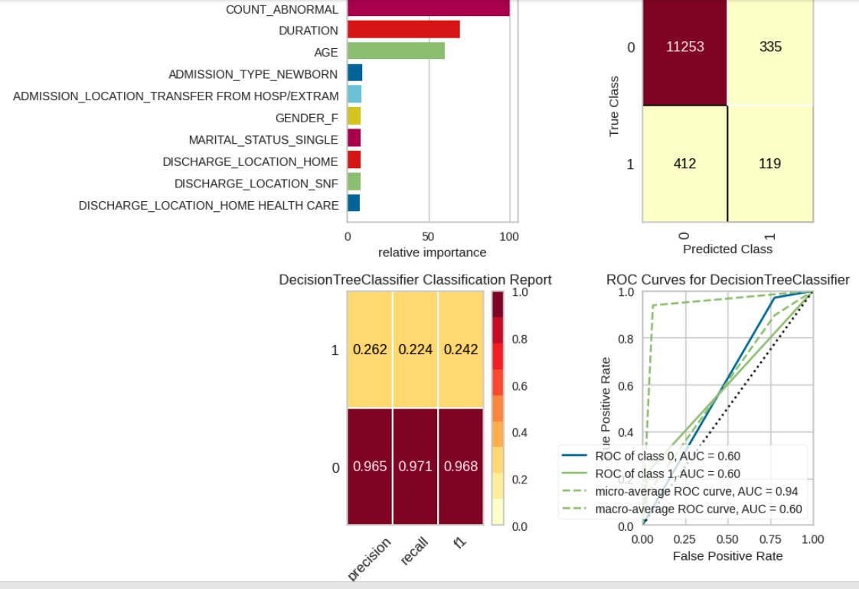
9. Results Decision Trees
Notes:
Interesting results since the feature importance of the features I extracted seem to be the best!
The weighted average F1-score is 0.94, suggesting that the model performs well in predicting both classes.

Slide 22
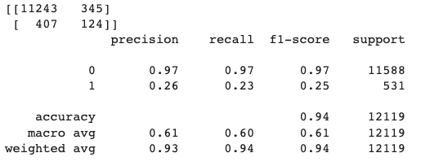
9. Results Decision Trees Fine Tuned
Notes:
Significant improvement

Slide 23
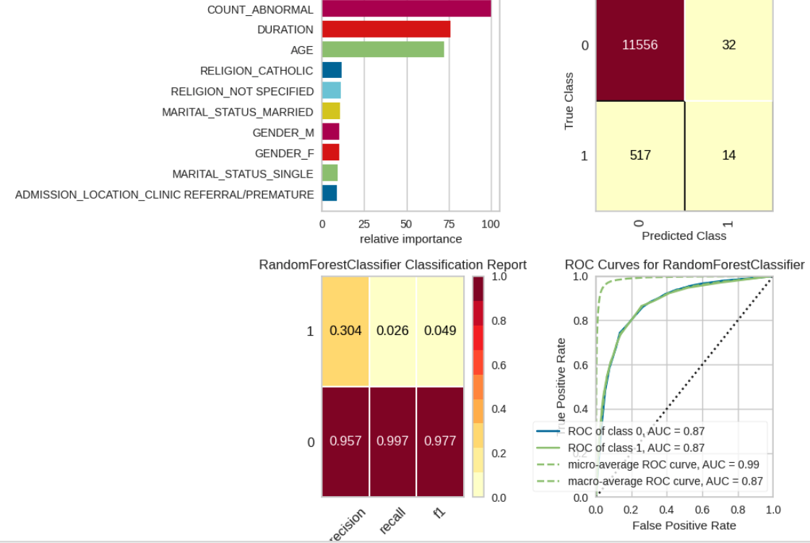
9. Results Random Forest
Notes:
Interesting take on feature importance

Slide 24
9. Conclusion
My classifiers perform fairly. One of the challenges in this project is that readmission data is inherently imbalanced. This gives rise to issues regarding designing the model as well as evaluating the model. Class weights can be modified in certain classifiers like random forest.
When it comes to logistic regression, I applied fine tuning based on probabilities.
Accuracy is an inappropriate here metric. Therefore I also digged into model's precision and confusion matrix.
Ensemble methods such as random forest after fine tuning would turn out to provide better performance than a single classifier.

