Slide 1
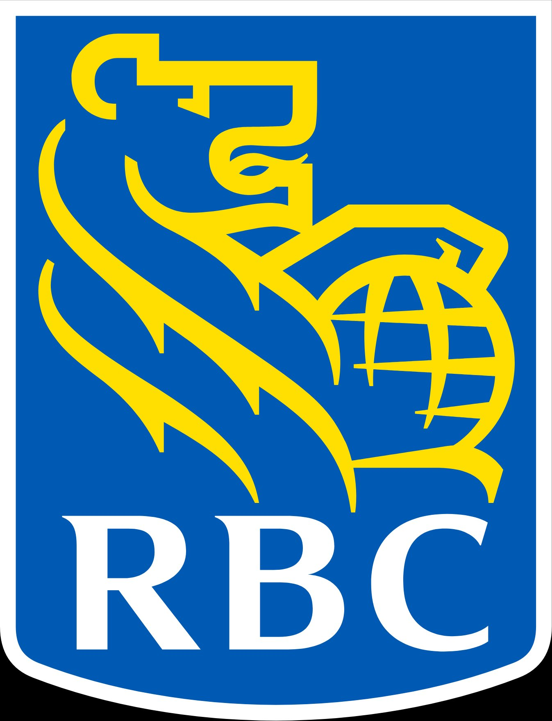
OPERATING MODEL TRANSFORMATION
From Vertical Silos
to Horizontal Flow
A Proposed Horizontal Operating Model for a 2,500-Person Infrastructure Organization
Prepared for: Executive Stakeholders | Discussion Document

Slide 2




EXECUTIVE SUMMARY
The Case for a Horizontal Operating Model
Today's vertical structure — Architecture, Engineering, Operations, AI/IM as separate towers — creates handoffs, queues, and conflicting priorities. A horizontal, platform-as-a-product model embeds these capabilities into outcome-owning teams.
15–25%
30–50%
2–5×
18–24
FTE capacity reclaimed
MTTR reduction
Faster provisioning
Months to scale
from automated toil & self-service
via embedded SRE + AIOps
self-service paved roads
phased: pilot → expand → scale
WHAT CHANGES
WHAT WE KEEP
Architecture, Operations & AI become embedded capabilities, not departments
Persistent stream-aligned squads own platforms end-to-end (build + run)
Funding shifts from project-by-project to persistent platform teams
Functional depth, via Communities of Practice & Guilds (Architecture, SRE, AI/ML, Security)
Senior IC ladder — Principal Engineers, Distinguished Architects retain career path
Regulatory rigor — strengthened via Assurance-as-Code
Operating Model Transformation | Technology Infrastructure

Slide 3
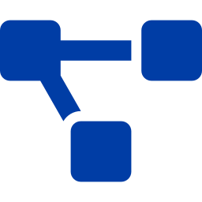




THE CHALLENGE
Where Today's Vertical Model Creates Friction
TODAY
Where this model leaks time and capacity
Approval & ticket queues
4–6 handoffs between idea and production. "Ticket ops" is the canonical anti-pattern.
Architecture
Engineering
Operations
AI / IM
Conflicting priorities
Each tower optimizes its own KPI — uptime vs. velocity vs. compliance vs. cost — with no joint owner.
Wait time dominates
Value-stream maps in regulated IaC environments routinely show 70%+ of lead time is queueing, not work.
Knowledge silos
Operators learn things developers never see; architects design without operational feedback.
Reverse Conway
Four towers produce a four-layer monolith with brittle interfaces — code, runbooks, ML models drift apart.
Four functional towers — dotted lines = ticket queues, RFC handoffs, knowledge silos
Operating Model Transformation | Technology Infrastructure

Slide 4

THE SHIFT
Vertical vs. Horizontal — At a Glance
DIMENSION
TODAY · VERTICAL
TARGET · HORIZONTAL
Primary unit
Function (Arch / Eng / Ops / AI)
Persistent team owning a platform end-to-end
Architecture
Standalone group, design approval queue
Embedded principals + part-time Architecture Guild
Operations
Separate run team taking handoffs
Embedded SRE pods · "You build it, you run it"
AI / Incident Mgmt
Standalone vertical
ML platform + embedded MLEs + AIOps as paved-road feature
Funding model
Project budgets, per function
Persistent platform funding tied to OKRs
Handoffs (idea → prod)
4–6 queue stops
0–1 (self-service via the platform)
Lead time for infra
Days to weeks (ticket ops)
Minutes to hours (golden paths)
Accountability
Diffuse across functions
Single team, single delivery lead, clear SLOs
Knowledge sharing
Trapped in functional managers
Communities of Practice / Guilds (horizontal)
The horizontal model doesn't remove specialists — it removes the queues between them.
Operating Model Transformation | Technology Infrastructure

Slide 5
OPERATING MODEL EVOLUTION
Where Does the Ownership Line Fall?
As organizations evolve, more of the lifecycle moves into single teams. The legend below mirrors the well-known “Pizza-as-a-Service” model — but applied to who owns what across infrastructure delivery.
EVOLUTION → more ownership in one team
Traditional
DevOps
Platform Teams
Full-Lifecycle Squads
Functional Silos
Dev + Ops Merged
Stream + Platform
One Team Owns It All
(Pre-Cloud Era)
(2010s)
(2020s)
(TARGET)
Strategy
Strategy
Strategy
Strategy
Architecture
Architecture
Architecture
Architecture
Engineering
Engineering
Engineering
Engineering
IaC / Modules
IaC / Modules
IaC / Modules
IaC / Modules
Deployment
Deployment
Deployment
Deployment
Operations
Operations
Operations
Operations
Incident Response
Incident Response
Incident Response
Incident Response
AI / Automation
AI / Automation
AI / Automation
AI / Automation
Multi-week ticket queues
Faster app dev, slow infra
Self-service for some
Self-service for everything
Owned by ONE team (end-to-end)
Siloed / handed off across teams
Operating Model Transformation | Technology Infrastructure

Slide 6
TARGET OPERATING MODEL
One Squad, Full Lifecycle · Peer Squads
Every infrastructure capability is owned by ONE persistent squad that does everything for it. No towers, no tiers — capabilities are peers, consuming each other as services through the Zephyr Control Plane.
GUILDS
COMMON PLATFORM CAPABILITIES
ENABLING
(craft)
Each is itself a squad doing the same five activities for its capability.
(coaching)
Architecture
SRE
AI/ML
Security
IaC
DevEx
Incident
Commander
Zephyr Control Plane
CI/CD & Release
Observability
Secrets & Identity
Policy / Sec Plane
Cloud-Native
AI/ML
DevEx
Security
Platform-as-
Product
used by every squad
SQL
Server
Postgres /
Mongo
Kubernetes
Compute
(VM/BM/GPU)
Storage
Network
Linux /
Windows
Edge /
Messaging
DB engine
DB engines
Container
Hosts
Block / object
SDN / DNS / LB
OS fleet
+ many more
8–12 ENG
8–12 ENG
8–12 ENG
8–12 ENG
8–12 ENG
8–12 ENG
8–12 ENG
8–12 ENG
EVERY SQUAD DOES:
Build IaC modules
·
Engineer the platform
·
Operate (SLO + on-call)
·
AI agents for incidents
·
Automate everything
Each engineer belongs to ONE squad (delivery accountability) and 1–2 Guilds (craft mastery). Cross-capability incidents handled by a rotational Incident Commander.
Operating Model Transformation | Technology Infrastructure

Slide 7
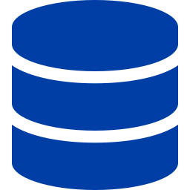
WORKED EXAMPLE
Where Does SQL Server Live?
SQL Server is owned by ONE squad — they build the IaC modules, engineer it, operate it, build the AI agents that prevent its incidents, and automate everything. They consume other squads as peer services through the Zephyr Control Plane.
COMMON PLATFORM CAPABILITIES — used by every squad
Zephyr Control Plane
CI/CD & Release
Observability
Secrets / Identity
Policy / Sec Plane
Compute Squad
Identity Squad
VMs / hosts
Service accounts
PEER SQUAD
PEER SQUAD
SQL Server Squad
Storage Squad
Observability Squad
Block / replication
8–12 engineers · single team
Metrics / logs
PEER SQUAD
✓ Build IaC modules
✓ Engineer (HA, DR, performance)
✓ Operate (SLOs, on-call, runbooks)
✓ AI agents for incident prevention
✓ Automate everything that can be
PEER SQUAD
Network Squad
Security Squad
ACLs / DNS / LB
Policy / scans
← consumes peer squads as services →
PEER SQUAD
PEER SQUAD
Same pattern for every capability — Kubernetes, Compute, Network, Storage. Each is a peer squad doing the full lifecycle. No towers. No handoffs.
Operating Model Transformation | Technology Infrastructure

Slide 8


FOUNDATIONAL FRAMEWORK
Four Team Types · Three Interaction Modes
We adopt the Team Topologies framework (Skelton & Pais) — the canonical model behind ING, Capital One, Netflix, JPMC's platform org, and Google SRE.
Stream-Aligned
Platform
Enabling
Complicated-Subsystem
60–80%
10–20%
5–15%
Few
of teams
of teams
of teams
where load justifies
Persistent squads owning a value stream end-to-end. Build it, run it, improve it.
Internal services consumed by stream-aligned teams. Treated as products, with PMs and roadmaps.
Time-boxed coaching teams that uplift capability, then move on. Architecture sits here as part-time enablers.
Deep specialist teams for niches like crypto/HSM, kernel, specialized AI model serving.
Three Interaction Modes
Collaboration
X-as-a-Service
Facilitating
Short-lived discovery & joint problem-solving
Steady-state self-service consumption (default)
Enabling team coaches another for a fixed period
Operating Model Transformation | Technology Infrastructure

Slide 9

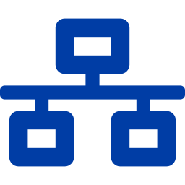
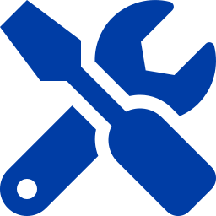
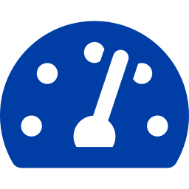

STRUCTURE
Seven Tribes Aligned to Value Streams
Each tribe groups 5–10 squads around a coherent infrastructure value stream. Led by a Tribe Lead + Tribe Product Lead + Tribe Engineering Lead triad.
Compute & Container Platforms
Network, Edge & Connectivity
Data, Storage & Database
Zephyr IaC & Lifecycle
VM, Kubernetes, bare-metal, GPU runtime
SDN, LB, DNS, edge, service mesh
Block / object / file, DBaaS, data fabric
34 platforms · Private Cloud Lifecycle
~350 FTE
~280 FTE
~320 FTE
~400 FTE
Developer Experience & Delivery
Reliability, Observability & AIOps
Security, Compliance & Assurance
Backstage portal · CI/CD · golden paths · FinOps
SLO platform · incident intel · AI agents
IAM, secrets, policy-as-code, regulatory
~320 FTE
~340 FTE
~290 FTE
~2,300 FTE allocated to tribes · 5–10% slack reserved for enabling, transformation & innovation
Operating Model Transformation | Technology Infrastructure

Slide 10
TRANSFORMATION
Where the Four Verticals Land in the New Model
ARCHITECTURE
ENGINEERING
OPERATIONS
AI / IM
→ Embedded enabler
→ The core, reframed
→ Embedded SRE + AIOps
→ Horizontal capability
BEFORE
BEFORE
BEFORE
BEFORE
Standalone group, design-approval queue
Functional vertical owning delivery
Separate run team taking handoffs
Standalone AI for IM/prediction tower
AFTER
AFTER
AFTER
AFTER
Senior/Principal architects embedded in Tier-1 & Tier-2 platform teams
Part-time Architecture Guild owns standards, ADRs, reference architectures
Office of the Chief Architect (5–10) supports the Guild
Engineers distributed across Tier-1, Tier-2, and Tier-3 teams
Accountable for product outcomes (adoption, SLOs, NPS), not just features
Excellence preserved through Engineering Chapters & senior IC ladder
30–40 SRE pods embedded inside Tier-2 and Tier-3 teams
AIOps & Incident Intel as a Tier-2 product everyone consumes
Lightweight rotational Incident Command, drawn from a Chapter
Tier-2 ML Platform team (~25–40)
~80 ML engineers embedded in Observability, IaC, DevEx, Lifecycle
AIOps as paved-road feature; AI agents shipped inside Zephyr
~40–60 FTE total
Bulk of org
~150–220 FTE in pods
~120–180 FTE
No vertical disappears as a capability — only as a reporting silo. Headcount migrates into the new model with deliberate role conversions.
Operating Model Transformation | Technology Infrastructure

Slide 11



GOVERNANCE BY DESIGN
What Stays Vertical — Cross-Cutting Functions
Not everything embeds. Four cross-cutting functions remain vertical to preserve enterprise-wide perspective, independent governance, and end-to-end orchestration across the new horizontal structure.
Strategy
Solution / Delivery Architecture
Change Advisory
Program Management Office
VERTICAL
VERTICAL
VERTICAL
VERTICAL
Enterprise direction & planning
Cross-platform design authority
Independent change governance
Enterprise portfolio orchestration
WHY IT STAYS VERTICAL
WHY IT STAYS VERTICAL
WHY IT STAYS VERTICAL
WHY IT STAYS VERTICAL
Multi-year strategy and target-state setting need enterprise-wide perspective beyond any tribe's quarterly delivery horizon.
Major programs span multiple tribes. A unified function ensures coherence and prevents accidental complexity at scale.
Regulated environment requires change governance independent of delivery, especially for high-risk multi-platform changes.
Multi-tribe initiatives, executive reporting, and dependency orchestration need a single function with org-wide visibility.
HOW IT INTERFACES
HOW IT INTERFACES
HOW IT INTERFACES
HOW IT INTERFACES
Owns multi-year tech strategy & North Star
Sets investment thesis & priorities
Partners with Enterprise Architecture
Tracks strategic OKRs org-wide
Owns multi-tribe solution designs
Partners with embedded Principals
Chairs cross-tribe design forums
Arbitrates platform-spanning calls
Reviews high-risk changes only
Receives automated records from CI/CD
Maintains change taxonomy
Aligned with OSFI E-21 posture
Coordinates with Tribe Leads at QBRs
Owns enterprise dependency board
Investment governance & reporting
Cross-tribe milestone tracking
Reports to: CTO / Head of Strategy
Reports to: Chief Architect
Reports to: Risk / Operations VP
Reports to: COO / VP Portfolio
Rule of thumb: a function stays vertical if it must speak truth across the entire org, or orchestrate work that no single tribe owns end-to-end.
Operating Model Transformation | Technology Infrastructure

Slide 12

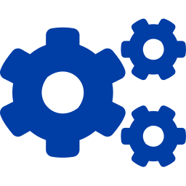

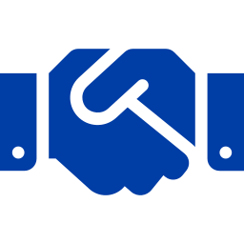
PRESERVING CRAFT EXCELLENCE
Communities of Practice — the Horizontal Weave
Why Guilds matter
Architecture Guild
SRE / Reliability Chapter
Removing functional silos doesn't mean removing functional depth. Communities of Practice carry craft mastery across teams — what a chapter or guild does well that a reporting line can't.
Chaired by Chief Architect · ADRs · reference architectures
SLO standards · postmortems · error-budget policy
AI / ML Engineering Guild
IaC / Zephyr Guild
Model lifecycle · MLOps · AIOps patterns · responsible AI
Module catalog · contribution model · version policy
Set standards (ADRs, SLO policy, MLOps patterns)
Calibrate skills across teams; own technical career ladder
Run brown-bags, drills, hackathons, tech-radar refreshes
Survive reorgs — fractal & resilient by design
Replace expensive design-authority approval boards with peer review
Security & Compliance
DevEx & Productivity
Control catalog · policy-as-code library
Developer NPS · golden-path adoption metrics
Incident Commander
IM playbooks · GameDay drills · cross-tribe rotation
Every engineer belongs to one team and 1–2 Guilds. Guilds are influence-based, not authority-based.
Operating Model Transformation | Technology Infrastructure

Slide 13

PROVEN AT SCALE
Who Is Already Running This Model
The flat peer-squad model isn't theoretical. The largest engineering organizations in the world have operated this way for over a decade — at scale, in regulated environments, and through massive growth.
Amazon / AWS
Netflix
Google SRE
Since 2002
Since 2011
Since 2003
“Two-pizza teams”
“Full-cycle developers”
“Embedded SRE pods”
Each service owned by 6–10 people who build it, run it, on-call it. The original "you build it, you run it."
Every team owns design, build, deploy, operate, support. Paved-road platform makes it possible at scale.
Site Reliability Engineers embedded with product teams; 50% engineering, 50% reliability. Toil is capped, not centralized.
Capital One
JPMorgan Chase
DBS Bank (ADA)
Since 2015
Since 2019
Since 2017
“Cross-functional pods”
“Platform-as-product”
“Federated platform”
14,000+ technologists organized as product teams. Distinguished Engineers federated across squads. Heavily regulated — like RBC.
55,000 technologists under a CIO of Infrastructure Platforms. Flat infra cost despite +50% compute growth.
Asian banking giant running an enterprise platform team with federated business-aligned squads. Most directly comparable to RBC.
Next three slides take a closer look at AWS, Netflix, and JPMorgan Chase — the most directly relevant patterns for RBC's scale and regulatory posture.
Operating Model Transformation | Technology Infrastructure

Slide 14
CASE STUDY · 1 OF 3
Amazon / AWS — Two-Pizza Teams
“You build it, you run it.”
— Werner Vogels, CTO Amazon · ACM Queue, 2006
HOW THEY OPERATE
RESULTS
Two-pizza teams
Teams sized so two pizzas can feed them — typically 6–10 engineers. Each team owns one service end-to-end.
Full ownership of the lifecycle
Build, deploy, monitor, on-call, customer support. No separate ops team to throw work over to.
Service-oriented architecture as the wedge
Every team exposes its capability as a service consumed by other teams via API. Teams are peers — no hierarchy.
API-first contracts between teams
Jeff Bezos’ famous 2002 mandate: “All teams will expose their data and functionality through service interfaces.”
200+
AWS services, each owned by a two-pizza team
1000s
of deploys per day across AWS
20+ yrs
operating this model continuously
RELEVANCE TO RBC
AWS is the canonical reference. SQL Server Squad, Compute Squad, Storage Squad — every name in our model maps directly to a two-pizza team pattern. Their API-first contracts between teams are exactly what the Zephyr Control Plane formalizes for us.
Operating Model Transformation | Technology Infrastructure

Slide 15
CASE STUDY · 2 OF 3
Netflix — Full-Cycle Developers + Paved Road
“Operate what you build.”
— Netflix Engineering Blog, 2018 · Full-cycle developers + paved-road platform
HOW THEY OPERATE
RESULTS
Full-cycle developers
Every engineer owns design, build, test, deploy, operate, support, retire. “Developers feel the pain when their code breaks at 2 AM.”
Centralized paved-road tooling
Spinnaker (CD), Titus (containers), Atlas (telemetry), chaos engineering — built and maintained by a small platform team for everyone else.
Freedom + responsibility culture
Teams are autonomous within paved-road guardrails. Step off the paved road, you own the consequences.
Resilience engineered in, not added on
Chaos Monkey embedded in production. Each team is expected to make its service resilient — not pass that work to a separate SRE org.
1000s
of microservices, each owned by one team
270M
subscribers served — global scale
<1 hr
median deploy time from commit to prod
RELEVANCE TO RBC
Netflix is the blueprint for the “paved road + autonomy” pattern. Zephyr Control Plane plays the role of Spinnaker + Atlas combined — the central thing teams build on, while keeping squad-level ownership of the service.
Operating Model Transformation | Technology Infrastructure

Slide 16
CASE STUDY · 3 OF 3
JPMorgan Chase — Platform-as-Product
“We run infrastructure as a product, not as projects.”
— Darrin Alves, CIO of Infrastructure Platforms, JPMorgan Chase
HOW THEY OPERATE
RESULTS
Infrastructure organized as platforms, not as ops silos
Dedicated CIO of Infrastructure Platforms reporting line. Each platform (compute, network, storage, data) is a product with a PM, roadmap, internal customers.
AI embedded across the infra estate
“20–30 use cases where AI augments anomaly detection.” AI is a horizontal capability shipped inside every platform — not a separate AI team.
Regulated environment, same model
Fed-supervised, OCC-supervised, global G-SIB. Compliance built into the platforms as paved-road controls — same Assurance-as-Code pattern we propose.
Persistent funding, not project budgets
Platform teams funded continuously against OKRs. No annual project recompetition that breaks team continuity.
55,000+
technologists working in platform/product orgs
Flat
infrastructure cost despite +50% compute growth since 2019
~20%
year-over-year improvement in feature delivery speed
RELEVANCE TO RBC
Most directly comparable to RBC: regulated G-SIB, similar scale, same constraints (OSFI / Fed). They proved the model works in a heavily-supervised environment — without compromising regulatory posture.
Operating Model Transformation | Technology Infrastructure

Slide 17
QUANTIFIED BENEFITS
What the Data Says — Realistic Targets
Aggregated from DORA 2024, McKinsey ING transformation, Bain product-operating-model research, Forrester IDP studies, and named case studies (Capital One, JPMC, Netflix, USAA, Booking.com).
Evidence from peer organizations
ING (McKinsey)
Release cadence 5–6×/yr → every 2–3 weeks
Bain (product OM)
Up to 60% dev-time reduction · 36% cost reduction
Booking.com
+16% throughput across 3,500 engineers
USAA
25% faster delivery, higher predictability & quality
JPMC Infra Plat.
Flat infra cost despite +50% compute/storage growth
Forrester IDP
77% report measurable time-to-market gains
DORA 2024
IDPs lift productivity, team & org performance
⚠ Expect a J-curve dip in months 4–9 before recovery. Communicate this to executive sponsors before kickoff.
Operating Model Transformation | Technology Infrastructure

Slide 18


PROGRAM ACCELERATION
Powering Programs Already in Flight
Zephyr On-Prem IaC
Private Cloud Lifecycle
34 platforms today span all four verticals
Canonical "you build it, you run it" candidate
Group into 6–10 stream-aligned squads inside the Zephyr & Lifecycle Tribe. A central Zephyr IaC Platform team owns module registry, contribution model, and golden paths. Embedded MLEs ship AI agents for module generation and drift remediation.
Sits as a Tier-2 capability platform consumed by Foundation platforms. Embedded SRE pod, embedded FinOps engineer, AIOps integrated for predictive lifecycle (capacity, EOL, patch).
Faster module velocity · single roadmap · fewer integration bottlenecks
Predictive lifecycle · reduced ops overhead · clear consumer SLOs
AI Agents for Infra Automation
Regulatory & Assurance Workflows
Risk: agents trapped in a single vertical
Process-by-process attestation today
Distribute the work — ML Platform team provides agent runtime, eval harness & guardrails. Embedded MLEs ship agents into Zephyr & Observability. AI/ML Guild governs cross-org standards (mirrors USAA AI-pod model & JPMC's distributed pattern).
Implement as Assurance-as-Code — a Tier-2 platform shipping compliance controls as paved-road features of IaC and CI/CD. Security & Compliance Chapter governs control taxonomy. Single control plane vs. siloed processes.
Pervasive AI capability · shared platform · governed responsibly
Single regulator-facing control plane · audit-ready by default
Operating Model Transformation | Technology Infrastructure

Slide 19
TRANSITION ROADMAP
Three Waves Over 18–24 Months
WAVE 1 · Months 0–6 · Foundation
WAVE 2 · Months 6–12 · Expand
WAVE 3 · Months 12–18+ · Scale & Optimize
Foundation & Pilot
Expand
Scale & Optimize
Stand up Transformation Office (~20 FTE, time-boxed)
Publish Operating Model Charter & decision rights
Baseline DORA / DevEx / CNCF maturity
Choose 2–3 lighthouse pilots — Zephyr IaC + 1 Foundation platform + 1 stream squad
Stand up Architecture, SRE, AI/ML Guilds (week-one signal)
First Quarterly Business Review
Roll model to 3–4 of the 5–7 Tribes (Compute, Zephyr, DevEx, Reliability)
Dissolve legacy Architecture & AI/IM verticals; redirect headcount
Stand up AIOps / Incident Intel platform as Tier-2 product
Internal tech-radar refresh for golden-path tools
Pivot funding: persistent platforms; project funding only for enabling work
Update career ladders — portable Principal track
Remaining Tribes converted; Transformation Office shrinks to 3–5 FTE
80%+ of teams cleanly classified by Team Topologies type
Target outcomes realised: 15–25% FTE reclaimed · 30–50% MTTR reduction
DevEx NPS visibly trending up across all tribes
≥60% of teams using ≥1 AI agent / AIOps feature daily
Annual operating-model health check becomes a permanent ritual
Pilots in steady state · J-curve managed
DORA top-quartile in pilot tribes
Steady state · compounding gains
Operating Model Transformation | Technology Infrastructure

Slide 20

RISK MANAGEMENT
Top Risks & How We Mitigate Each
RISK
LIKELIHOOD
MITIGATION
J-curve dip in delivery during platform rollout
High
Communicate explicitly to leadership · ring-fence pilots · publish recovery curves
Cargo-culting Spotify (rename without changing decisions)
High
Pair every name change with decision-rights change · single Engineering Lead per team
Reverse Conway producing wrong architecture
Medium
Draw target architecture FIRST, reorg to match (Inverse Conway Maneuver)
Matrix burnout (engineers serving two masters)
Medium
Single solid-line Engineering Lead · Guilds influence-based, not authority-based
Loss of functional depth in Architecture / AI
Medium
Strong Guilds + senior IC ladder + protected guild time (~10%)
Regulatory / assurance gaps during reorg
High
Make Assurance-as-Code platform a Wave-1 priority · keep current attestations live
Operating-model leakage (gains don't materialize)
Medium
Track FTE redirection · tie OKRs to business outcomes · cost-to-serve metric
Autonomy without alignment (decisions drift)
High
Quarterly Business Reviews · explicit OKR cascade · transparent dependency board
McKinsey: only 24% of operating-model transformations are highly successful — winners change structure, funding, technical practices, and metrics SIMULTANEOUSLY.
Operating Model Transformation | Technology Infrastructure

Slide 21
HOW WE MEASURE SUCCESS
Leading & Lagging Indicators
LEADING INDICATORS
LAGGING INDICATORS
Platform adoption %
Active teams using each Tier-2 platform
DORA 4 metrics
Lead time · deploy freq · CFR · MTTR
DevEx NPS
Developer satisfaction (SPACE / DX Core 4)
FTE % on toil
Target ≤ 50% (Google SRE cap)
Team Topologies fit %
Teams cleanly classifiable by type
Cost per deployment
FinOps unit-economics view
Inner-loop / outer-loop %
Time on coding vs. coordination
Provisioning lead time
Request → live infra
ADR throughput
Architecture Guild output cadence
High-sev incident rate
Volume + severity distribution
Reference-arch reuse
Adoption of golden-path patterns
Audit exception rate
Regulatory compliance posture
Guild participation
% engineers active in 1+ Guild
Voluntary attrition
Target: ING-style 80+ engagement
Operating Model Transformation | Technology Infrastructure

Slide 22
DECISIONS REQUESTED
Recommended Next Steps
To move from proposal to mobilization, we recommend the following four decisions over the next 30 days.
01
02
03
04
Endorse the target operating model
Stand up the Transformation Office
Select Wave-1 lighthouse pilots
Approve baseline measurement
Approve the team-of-teams lattice (4 Team-Topologies types · 5–7 Tribes · embedded SRE/Architecture/AI · Guilds for craft).
Time-boxed for 18 months. ~20 FTE. Sponsor + steering committee + change leads + OKR steward + comms.
Recommend Zephyr IaC as Tier-2 lead product + one Foundation platform (Compute/Container) + one stream-aligned squad.
Run DORA, DevEx, and CNCF Platform Engineering Maturity baselines in next 60 days. Publish openly to set the bar.
Decision: Yes / No / Refine
Decision: Approve charter & seats
Decision: Confirm pilot scope
Decision: Approve survey & tooling spend
Operating Model Transformation | Technology Infrastructure

Slide 23
From four towers
to flow.
A horizontal operating model that reduces friction, reclaims FTE capacity, and accelerates Zephyr, Private Cloud Lifecycle, AI agents, and regulatory programs — without losing the depth that today's verticals provide.
Discussion welcomed.

