Slide 1
JEEVIKA (जीविका)
Empowering Rural Women Entrepreneurs via Lived Experience
Team Name: Jeevika NFCE Team Leader Name: Dhwanit Patel Problem Statement: Financial literacy programs suffer from the 'intention-action gap'. Current modules are pedantic, urban-centric, and heavily text-based, alienating low-literacy demographics. Research shows standard financial education has a negligible 0.09 SD effect on actual behavior. Specifically, 93% of women micro-entrepreneurs mix personal and business funds, and 35% of accounts lie dormant. They don't need quizzes; they need a safe simulation to experience the visceral consequences of financial mismanagement (the debt trap) before making real-world mistakes.

Slide 2
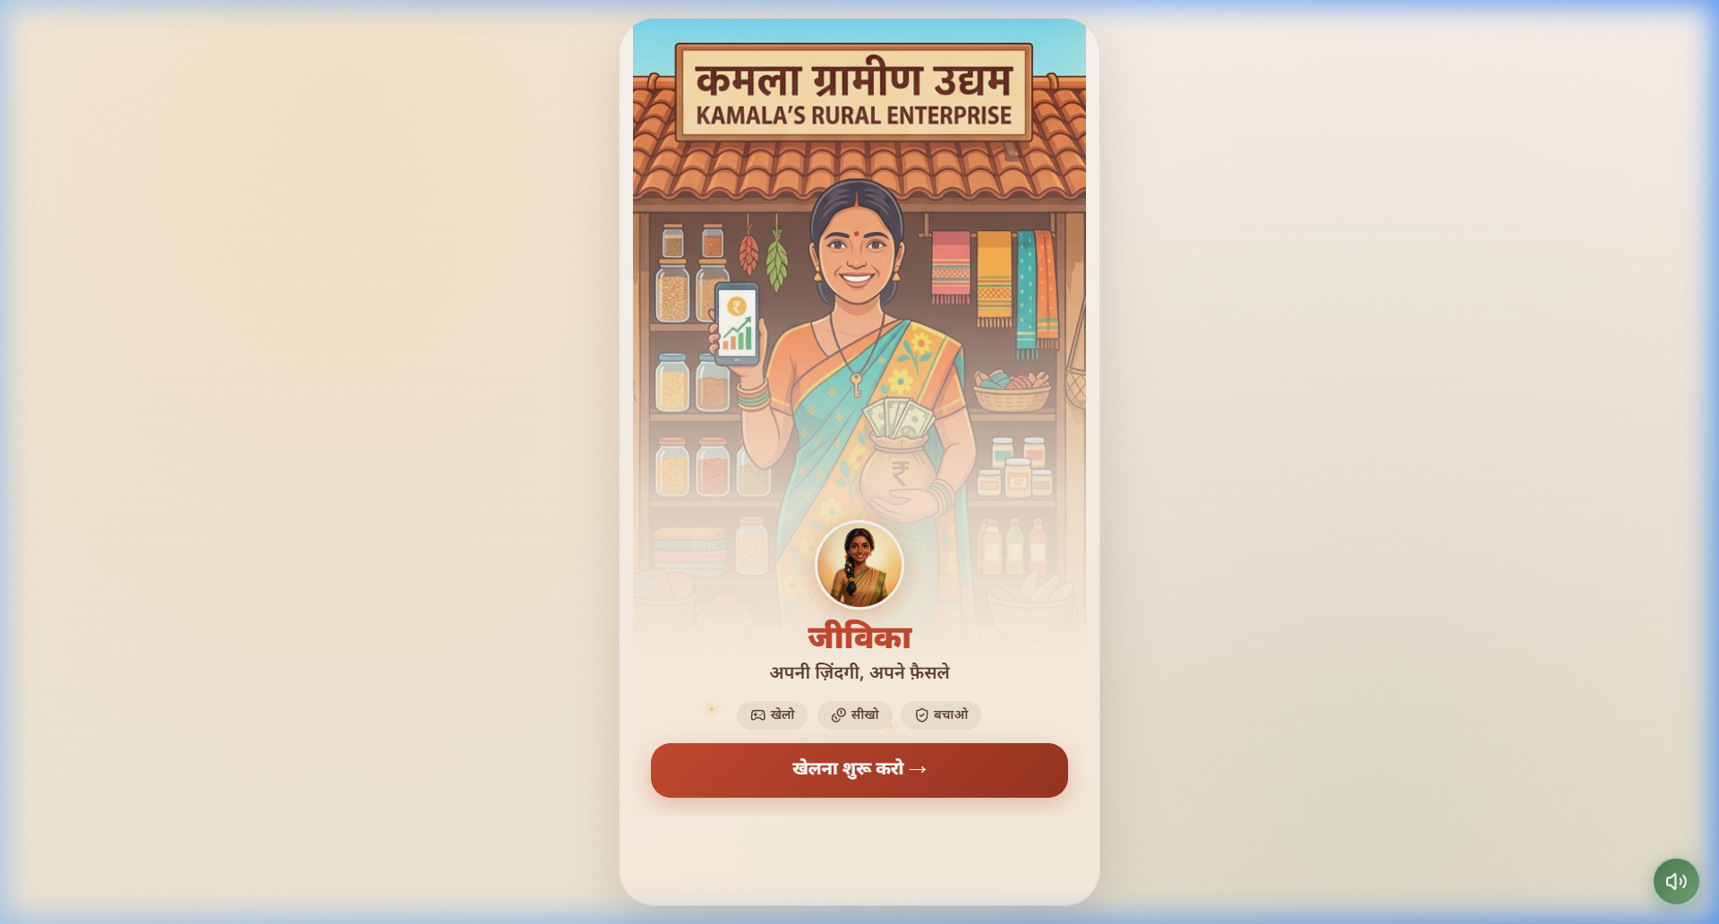
Prototype Brief
Core Product Vision:
A voice-first, offline-capable Progressive Web App (PWA) life simulator. The player embodies 'Kavita', making tactile financial decisions across 4 farming seasons. Consequences manifest visually (No text needed).
Target Demographic:
Rural Indian women (25-50), low literacy, shared entry-level Android devices.
The 6 Core Behavioral Mechanics:
1. The Split Wallet: Force physical separation of 'Home' and 'Work' funds.
2. Consequence Engine: Split-screen forecasting of immediate vs future pain.
3. Goal Photo Frame: Emotional anchoring; daughter's photo blurs if savings drop.
4. Debt Snake vs Savings Tree: Visualizing compound interest (Prospect Theory).
5. SHG Accountability: Multiplayer peer-pressure mechanics.
6. Scheme Power-Ups: Bima Vistaar and APY appear as discoverable game abilities.

Slide 3
Technical Architecture
A. Tech Stack & Environment Architecture
Frontend
Next.js 14 / React
Tailwind & Framer
State Management
Zustand Store
(Client-side JSON)
Audio Delivery
Howler.js
(Pre-cached MP3)
Local Storage DB
(IndexedDB)
Offline Save State
B. Offline Capabilities for Rural Environments (Low-Bandwidth)
PWA Service Worker | Utilizes Vite/Next PWA plugins to install the app directly to the Android Home screen. After a single initial 5MB fetch, the entire application, including the React component tree, runs entirely offline.
Audio Caching Strategy | Hindi voice narratives are compressed MP3s pre-cached via CacheStorage API. There is zero latency for voice playback in remote areas without internet.
Zero-Backend Schema | To eliminate API timeout errors caused by 2G networks, user progress, session telemetry, and the 'Life Score' are stored via IndexedDB/localStorage. Syncs only when connectivity returns.

Slide 4
GitHub Public Repository
A) Repository Link: https://github.com/Dhwanit-Patel/Jeevika-NFCE
Email 'ncfe.hackathon@ncfe.org.in' has been granted Read access as per checklist policy.
B) Mandatory README.md Checklist Data
Dependencies & Versions (Stack):
• React 18.2 / Next.js 14 / Vite
• TailwindCSS 3.4 (Styling)
• Framer Motion 11.2 (UI Interactions)
• Zustand 4.5.2 (State Management)
Step-by-Step Local Deployment:
1. git clone https://github.com/Dhwanit-Patel/Jeevika-NFCE.git
2. cd web (Navigate to root UI folder)
3. npm install (Install dependencies via package.json)
4. npm run dev (Starts local VITE server at localhost:5173)
Testing Credentials:
• No login required for user evaluation. Gamification relies on persistent local device storage designed for a frictionless start.

Slide 5
Demo Video & Gamification
Video Link: [INSERT UNLISTED YOUTUBE/G-DRIVE LINK HERE] - Functional unedited playthrough.
Gamification Strategy & The 'Rule of Three'
The Submersive Scenario Arc
1. SEPARATE: The physical 'Split Wallet' swipe mechanic forces the differentiation of Household vs Business income. 2. PROTECT: Scheme power-ups (Bima Vistaar) must be activated BEFORE the random 'Crisis Engine' event occurs (e.g., Husband's injury). 3. GROW: Good decisions map directly to the visual 'Savings Tree' size.
Character: Kavita, a rural tailor in Bihar. Antagonist: Seth Ji (High-interest Informal Moneylender). Gameplay Gameplay:
• Kavita receives ₹12,000 Kharif harvest income. Player physically allocates it. • A cyber-scam OTP trap rings the phone—answering incorrectly drains funds immediately. • The 'Crisis Event' strikes mid-season. If she skipped Bima Vistaar, she falls into Seth Ji's 60% APR loan, birthing the Debt Snake.
Rewards vs Penality Incentives
Reward: Financial growth is represented by the 'Photo Frame' — Kavita sets a savings goal for her daughter's education. Smart savings = A crystal-clear photo. Beautiful UI milestones ('Samajhdar' badges) validate behavior. Penalty: Mixing expenses or relying on the antagonist moneylender spawns a 'Debt Snake' that coils around the house, visually increasing psychological dread.

Slide 6
Limitations of Prototype
While technically complete as a PWA, the prototype has defined Hackathon scope constraints:
Static Narrative Arrays (Hardcoded Dummies):
The story variables and JSON mapping for 'Episode 1: Kharif Season' are hardcoded. In production, these narrative branches will be fetched dynamically via a Sanity/Supabase CMS so educators can add new vernacular dialects without writing React code.
TTS Voice Narration:
The prototype utilizes static, mock API endpoints corresponding to Voice audio strings to simulate narrative dictation. The ultimate production system will utilize real-time ElevenLabs TTS to instantly support 8 Indian dialects (Bhojpuri, Maithili, etc).
Episode Scope:
Currently, only 'Episode 1: The Harvest & The Crisis' is fully mapped and playable. The logic engine supports it, but Episodes 2-4 (School Fees, The Festival, Business Expansion) remain in wireframe status.

Slide 7
Feasibility & Market Alignment
How this scales into a National Core Infrastructure for Mass Adoption:
Self Help Group (SHG) B2B2C Vector
The India Stack Bridge (API)
White-Label Policy Scaling
Deployment will target the 12 Million active SHG groups in India. The game includes 'Multiplayer Leaderboards' designed specifically to be projected from one phone during weekly SHG meetings, simulating peer-pressure accountability and rapid network-effect spread.
Jeevika is not just a game; it's a lead generator for financial inclusion. The 'Power-Up' mechanics (Bima Vistaar, Jan Dhan) are designed to bridge the intent-action gap by concluding with deep-links directly into partner banking portals or generating pre-filled WhatsApp Bots connecting the user to their local Bank Mitra.
By defining scenarios via JSON metadata without recompiling the app, the engine can be white-labeled immediately by RBI, IRDAI, or Private Banks to teach their specific products in distinct regional dialects at zero marginal cost.

Slide 8
Additional Information: The Behavioral Evidence Base
Every mechanic in Jeevika is anchored in rigorous econometric and behavioral science RCTs:
Mechanic 1: The Split Wallet
Citation: Study: Drexler, Fischer, Schoar (2014) RCT in Dominican Republic.
Result: Standard accounting training failed. But teaching micro-business owners to physically separate home and business money increased revenues by 19%.
Mechanic 2: Visualizing The Consequence Engine
Citation: Study: Hershfield et al., 'Future Self Visualization'.
Result: Forcing individuals to visually simulate interactions with their 'future selves' resulted in a 41% higher allocation to savings compared to control groups.
Mechanic 3: The Daughter's Photo Goal
Citation: Study: Soman and Cheema (2011) Savings Earmarking RCT.
Result: Participants whose savings envelopes had photos of their children printed on them saved 15% more than those with standard envelopes. Abstraction fails; emotional stakes win.

Slide 9
APNI ZINDAGI, APNE FAISLE.
Thank You | Innovate4FinLit Submission

