Slide 1
SOEN 6011 : SOFTWARE ENGINEERING PROCESSES (SUMMER 2024)
Presentation By:
NAME: Dhyey Nilesh Doshi
ID: 40244534
Wednesday
10th July 2024

Slide 2
Agenda
Task is to express requirements of ‘tan(x)’ function based on the styles and guidelines given in the ISO/IEC/IEEE 29148 Standard.
Associating each requirement with a unique identifier.
Notifying if any assumptions are made

Slide 3

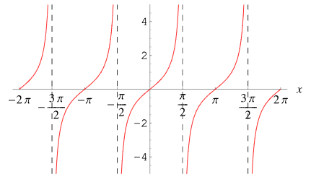
Tan(x)
Tan(x) is defined as:
The definition that is commonly used for the tangent of an angle theta in a right triangle is the ratio of the side lengths that are adjacent to and opposite from the angle. [2]

Slide 4

Initial Assumptions
Function implemented in a language that supports the required data type. As well as arithmetic operations and error handling.
Availability of library that provides trigonometric functions.
The input and output in radians.
The input is in domain of the tan function (ie. All values EXCEPT -> pi/2+pi*k (where k : integers)) [1]

Slide 5
Functional Requirements [4]
FR001 – Function is required to accept an input of type float or double (in radians)
Priority: High
FR002 – Function shall return tangent of the input
Rationale: Provides the primary functionality of the tangent function.
Priority: High
FR003 – Function should show an error if input is in odd multiples of pi/2
Rationale: Ensures the function handles undefined values appropriately.
Priority: High

Slide 6
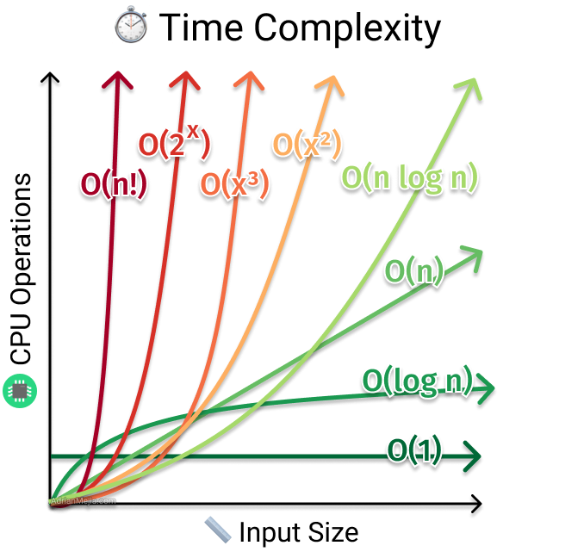
Performance Requirements (Non-functional)
PF001 – Function shall compute the result with a time complexity of O(1)
Priority: Medium
PF002 – Function should use a maximum of O(1) space complexity.
Priority: Medium
Assumption: No stack, queue is
Needed and only constant values
Are stored. [6]

Slide 7
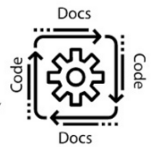
Interface/Usability Requirements
IR001 – Function should have a simple, textual user interface with a single input parameter x.
Priority: Medium
IR002 – Function should return a value of type double that can be easily used in further calculations (if needed).
Priority: High
IR003 – Function should be documented with examples
Priority: Medium

Slide 8
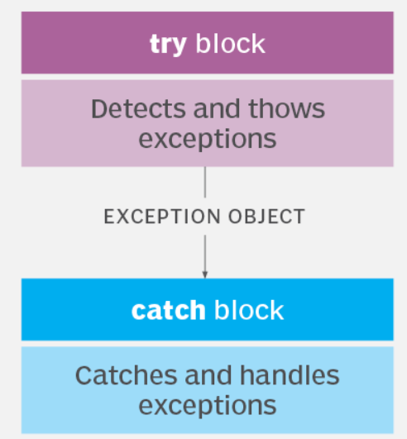
Error Handling Requirements
EH001 – Function should show an error if the input x is not a valid double value (e.g., NaN, infinity).
EH002 – Function should show an error if the result overflows or underflows.
Rationale: Ensures users understand why the function fails.
Priority: Medium
[7]

Slide 9

Reliability Requirements
RR001 – Function should pass a test suite that covers typical and boundary cases.
Priority: High

Slide 10
Success Criteria
The function calculates the tangent of the input angle with the specified accuracy
For valid inputs, the function executes successfully.
For invalid inputs, error message is shown

Slide 11
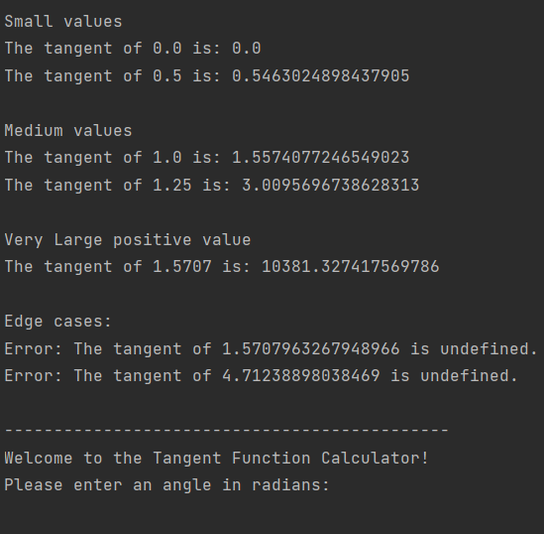
OUTPUT

Slide 12
Conclusion
Successfully outlined the requirements for the tan(x) function in accordance with the standard.
The functional, performance, interface, error handling etc… requirements were identified
Structured approach used to provide an accurate tan(x) function. Making it easy to integrate in larger tasks.
Overall, I learnt to adhere to the ISO/IEC/IEEE 29148 Standard which helped me to build a high-quality function and effective communication of requirements using the java code.

Slide 13
References
Weisstein, E. W. (n.d.). Tangent. Wolfram MathWorld. Retrieved from https://mathworld.wolfram.com/Tangent.html
Tan(x) graph -> https://sherpa-online.com/forum/thread/maths/gcse/plot-and-interpret-graphs/what-is-a-tan-x-graph
ISO/IEC/IEEE 29148:2018. (2018). Systems and software engineering — Life cycle processes — Requirements engineering. ISO/IEC/IEEE.
Atlassian. (n.d.). Jira Software Documentation. Retrieved from https://confluence.atlassian.com/jirasoftware
IEEE Xplore Digital Library. (n.d.). IEEE Xplore Digital Library. Retrieved from https://ieeexplore.ieee.org
Time complexity image: https://www.linkedin.com/pulse/time-complexity-vs-space-sumaiya-rimu
Try catch image: https://www.techtarget.com/searchsoftwarequality/definition/error-handling

