Slide 1
SOEN 6011 : SOFTWARE ENGINEERING PROCESSES (SUMMER 2024)
Presentation By:
NAME: Dhyey Nilesh Doshi
ID: 40244534
Wednesday
25th July 2024

Slide 2
Agenda
Task is to express requirements of ‘tan(x)’ function based on the styles and guidelines given in the ISO/IEC/IEEE 29148 Standard.
Associating each requirement with a unique identifier.
Notifying if any assumptions are made
Modifying the implementation of Tan(x) from scratch in Java.
GUI using Java Swing/JavaFX

Slide 3

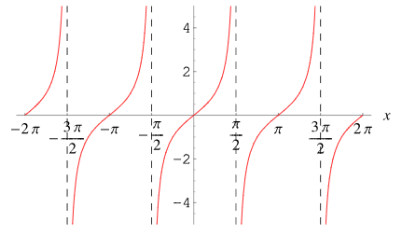
Tan(x)
Tan(x) is defined as:
The definition that is commonly used for the tangent of an angle theta in a right triangle is the ratio of the side lengths that are adjacent to and opposite from the angle. [2]
Tangent graph[1]

Slide 4


Series expansion for Sine and Cosine
Sin(x):
Cos(x):

Slide 5

Initial Assumptions
Function implemented in a language that supports the required data type. As well as arithmetic operations and error handling.
The input and output in radians.
The input is in domain of the tan function (ie. All values EXCEPT -> pi/2+pi*k (where k : integers)) [1]
pi/2 graph [2]

Slide 6
Functional Requirements [4]
FR001 – Function is required to accept an input of type float or double (in radians)
Priority: High
FR002 – Function shall return tangent of the input
Rationale: Provides the primary functionality of the tangent function.
Priority: High

Slide 7
Functional Requirements [4]
FR003 – Function should show an error if input is in odd multiples of pi/2
Rationale: Ensures the function handles undefined values appropriately.
Priority: High
FR004 – Function is required to calculate Tangent without using any inbuilt Java functions (Taylor or Maclaurin series should be used)
Priority: High

Slide 8
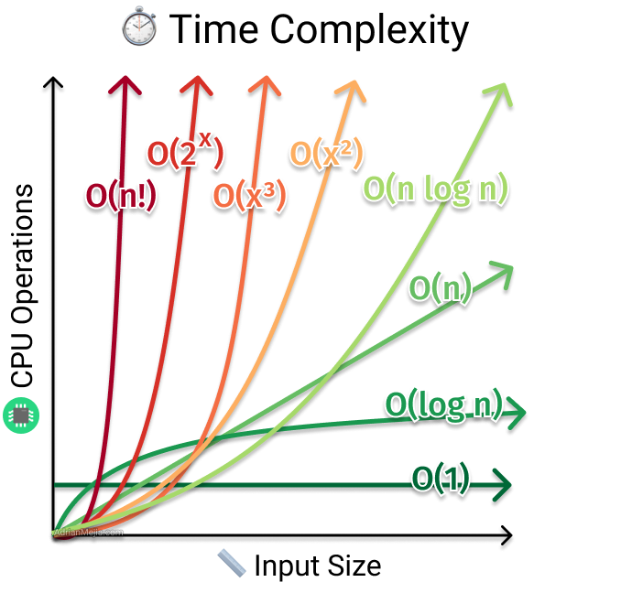
Performance Requirements (Non-functional)
PF001 – Function shall compute the result with a time complexity as less as possible
Priority: Medium
PF002 – Function should use the lease amount of space as possible.
Priority: Medium
Time complexity[6]

Slide 9
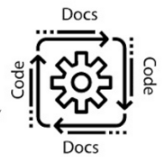
Interface/Usability Requirements
IR001 – Function should have a Graphical User Interface using JavaFX as well as buttons for calculating the tangent and clearing the input.
Priority: High
IR002 – Function should return a value of type double that can be easily used in further calculations (if needed).
Rationale: Ensures the function is not made for single use
Priority: Medium
IR003 – The code should be Platform Independent and
and IDE independent
Priority: High

Slide 10
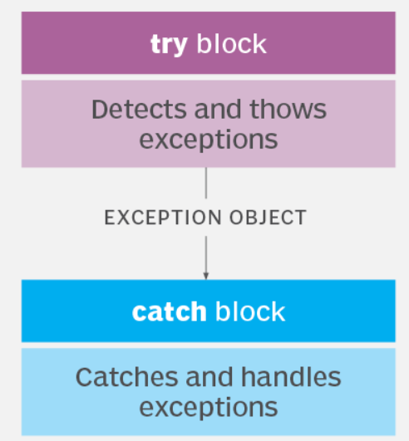
Error Handling Requirements
EH001 – Function should show an error if the input x is not a valid double value (e.g., NaN, infinity, String etc).
EH002 – Function should show an error if the result overflows or underflows.
Rationale: Ensures users understand why the function fails.
Priority: Medium
Try Catch block [7]

Slide 11

Reliability Requirements
RR001 – Function should be prepared pass a test suite that covers typical and boundary cases.
Priority: High

Slide 12
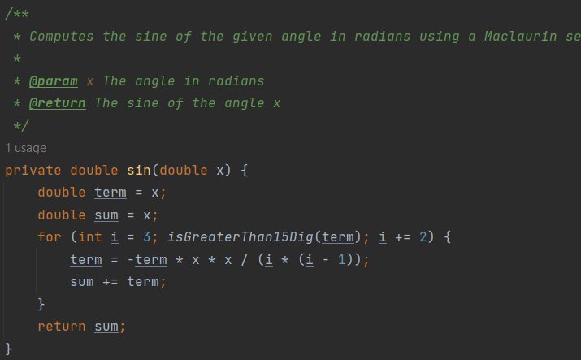
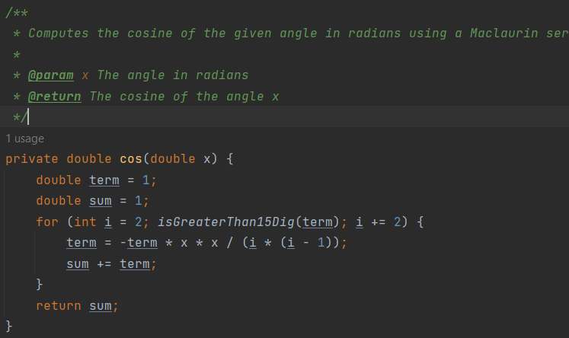
Sine and Cosine Calculations

Slide 13
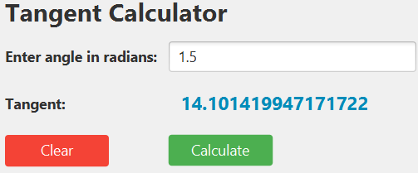
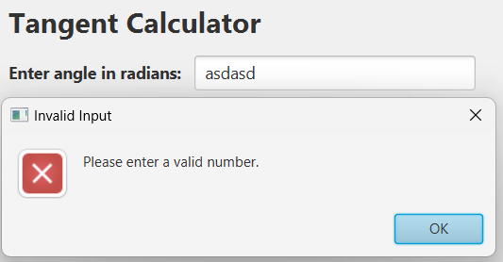
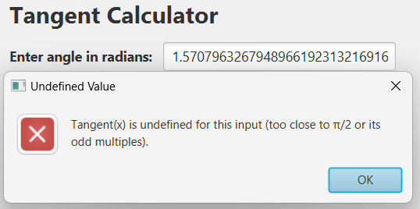
OUTPUT

Slide 14
Conclusion
Successfully outlined the requirements for the tan(x) function in accordance with the standard.
Structured approach used to provide an accurate tan(x) function. Making it easy to integrate in larger tasks.
Interactive GUI was made using JavaFX.
Overall, I learnt to adhere to the ISO/IEC/IEEE 29148 Standard which helped me to build a high-quality function and effective communication of requirements using the java code.

Slide 15
References
Weisstein, E. W. (n.d.). Tangent. Wolfram MathWorld. Retrieved from https://mathworld.wolfram.com/Tangent.html
Tan(x) graph -> https://sherpa-online.com/forum/thread/maths/gcse/plot-and-interpret-graphs/what-is-a-tan-x-graph
ISO/IEC/IEEE 29148:2018. (2018). Systems and software engineering — Life cycle processes — Requirements engineering. ISO/IEC/IEEE.
Atlassian. (n.d.). Jira Software Documentation. Retrieved from https://confluence.atlassian.com/jirasoftware
IEEE Xplore Digital Library. (n.d.). IEEE Xplore Digital Library. Retrieved from https://ieeexplore.ieee.org
Time complexity image: https://www.linkedin.com/pulse/time-complexity-vs-space-sumaiya-rimu
Try catch image: https://www.techtarget.com/searchsoftwarequality/definition/error-handling
GAI : Claude 3.5 https://www.anthropic.com/news/claude-3-5-sonnet

